Slide 1
2.1c Mechanics
Motion & Force
Breithaupt pages 132 to 145
March 15th, 2011

Slide 2
AQA AS Specification
Lessons | Topics
1 to 3 | Newton’s laws of motion Knowledge and application of the three laws of motion in appropriate situations. For constant mass, F = ma. Terminal speed.

Slide 3
Newton’s laws of motion
Newton’s laws of motion describe to a high degree of accuracy how the motion of a body depends on the resultant force acting on the body.
They define what is known as ‘classical mechanics’.
They cannot be used when dealing with:
speeds close to the speed of light
– requires relativistic mechanics.
(b) very small bodies (atoms and smaller)
– requires quantum mechanics

Slide 4
Newton’s first law of motion
A body will remain at rest or move with a constant velocity unless it is acted on by a net external resultant force.
Notes:
‘constant velocity’ means a constant speed along a straight line.
The reluctance of a body to having its velocity changed is known as its inertia.

Slide 5
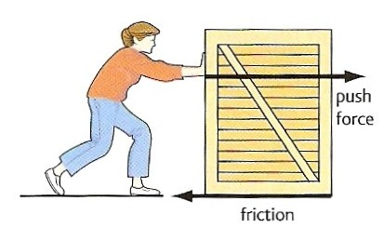
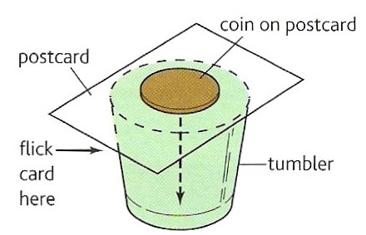
Examples of Newton’s first law of motion
Box stationary
The box will only move if the push force is greater than friction.
Box moving
If the push force equals friction there will be no net force on the box and it will move with a constant velocity.
Inertia Trick
When the card is flicked, the coin drops into the glass because the force of friction on it due to the moving card is too small to shift it sideways.

Slide 6
Newton’s second law of motion
The acceleration of a body of constant mass is related to the net external resultant force acting on the body by the equation:
resultant force = mass x acceleration
ΣF = m a

Slide 7
Question 1
Calculate the force required to cause a car of mass 1200 kg to accelerate at 6 ms ⁻².
ΣF = m a
ΣF = 1200 kg x 6 ms ⁻²
Force = 7200 N

Slide 8
Question 2
Calculate the acceleration produced by a force of 20 kN on a mass of 40 g.
ΣF = m a
20 000 N = 0.040 kg x a
a = 20 000 / 0.040
acceleration = 5.0 x 10⁵ ms ⁻²

Slide 9
Question 3
Calculate the mass of a body that accelerates from 2 ms ⁻¹ to 8 ms ⁻¹ when acted on by a force of 400N for 3 seconds.
acceleration = change in velocity / time
= (8 – 2) ms ⁻¹ / 3s
a = 2 ms ⁻²
ΣF = m a
400 N = m x 2 ms ⁻²
m = 400 / 2
mass = 200 kg

Slide 10
Answers
Complete:
Force | Mass | Acceleration
24 N | 4 kg | 6 ms ⁻²
200 N | 40 kg | 5 ms ⁻²
600 N | 30 kg | 20 ms ⁻²
2 N | 5 g | 400 ms ⁻²
5 μN | 10 mg | 50 cms ⁻²
24 N
40 kg
20
2 N
50

Slide 11
Types of force
1. Contact
Two bodies touch when their repulsive molecular forces (due to electrons) equal the force that is trying to bring them together. The thrust exerted by a rocket is a form of contact force.
2. Friction (also air resistance and drag forces)
When two bodies are in contact their attractive molecular forces (due to electrons and protons) try to prevent their common surfaces moving relative to each other.
3. Tension
The force exerted by a body when it is stretched. It is due to attractive molecular forces.
4. Compression
The force exerted by a body when it is compressed. It is due to repulsive molecular forces.
5. Fluid Upthrust
The force exerted by a fluid on a body because of the weight of the fluid that has been displaced by the body. Archimedes’ Principle states that the upthrust force is equal to the weight of fluid displaced.

Slide 12
6. Electrostatic
Attractive and repulsive forces due to bodies being charged.
7. Magnetic
Attractive and repulsive forces due to moving electric charges.
8. Electromagnetic
Attractive and repulsive forces due to bodies being charged. Contact, friction, tension, compression, fluid upthrust, electrostatic and magnetic forces are all forms of electromagnetic force.
9. Weak Nuclear
This is the force responsible for nuclear decay.
10. Electro-Weak
It is now thought that both the electromagnetic and weak nuclear forces are both forms of this FUNDAMENTAL force.
11. Strong Nuclear
This is the force responsible for holding protons and neutrons together within the nucleus. It is one of the FUNDAMENTAL forces.

Slide 13
12. Gravitational
The force exerted on a body due to its mass.
It is one of the FUNDAMENTAL forces.
The weight of a body is equal to the gravitational force acting on the body.
Near the Earth’s surface a body of mass 1kg in free fall (insignificant air resistance) accelerates downwards with an acceleration equal to g = 9.81 ms⁻²
From Newton’s 2nd law:
ΣF = m a
ΣF = 1 kg x 9.81 ms ⁻²
weight = 9.81 N
In general: weight = mg

Slide 14
Gravitational Field Strength, g
This is equal to the gravitational force acting on 1kg.
g = force / mass
= weight / mass
Near the Earth’s surface:
g = 9.81 Nkg⁻¹
Note: In most cases gravitational field strength is numerically equal to gravitational acceleration.

Slide 15
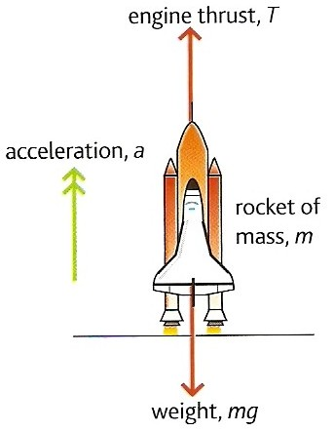
Rocket question
Calculate the engine thrust required to accelerate the space shuttle at 3.0 ms ⁻² from its launch pad.
mass of shuttle, m = 2.0 x 10 ⁶ kg
g = 9.8 ms ⁻²

Slide 16
Rocket question
ΣF = m a
where :
ΣF = (thrust – weight)
= T – mg
and so:
T – mg = ma
T = ma + mg

Slide 17
Rocket question
ma:
= 2.0 x 10⁶ kg x 3.0 ms ⁻²
= 6.0 x 10⁶ N
mg:
= 2.0 x 10⁶ kg x 9.8 ms ⁻²
= 19.6 x 10⁶ N
but: T = ma + mg
= (6.0 x 10⁶ N) + (19.6 x 10⁶ N)
Thrust = 25.6 x 10⁶ N

Slide 18
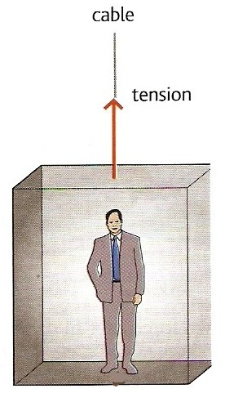
Lift question
A lift of mass 600 kg carries a passenger of mass 100 kg. Calculate the tension in the cable when the lift is:
(a) stationary
(b) accelerating upwards at 1.0 ms⁻²
(c) moving upwards but slowing down at 2.5 ms⁻²
(d) accelerating downwards at 2.0 ms⁻²
(e) moving downwards but slowing down at 3.0 ms⁻².
Take g = 9.8 ms⁻²

Slide 19
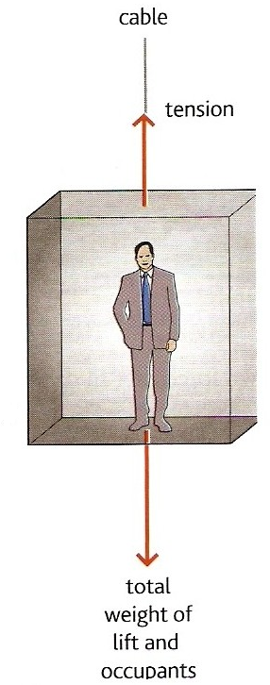
Let the cable tension = T
Mass of the lift = M
Mass of the passenger = m
(a) stationary lift
From Newton’s 1st law of motion:
A stationary lift means that resultant force acting on the lift is zero.
Hence:
Tension = Weight of lift and the passenger
T = Mg + mg
= (600kg x 9.8ms⁻²) + (100kg x 9.8ms⁻²)
= 5880 + 980
Cable tension for case (a) = 6 860 N

Slide 20
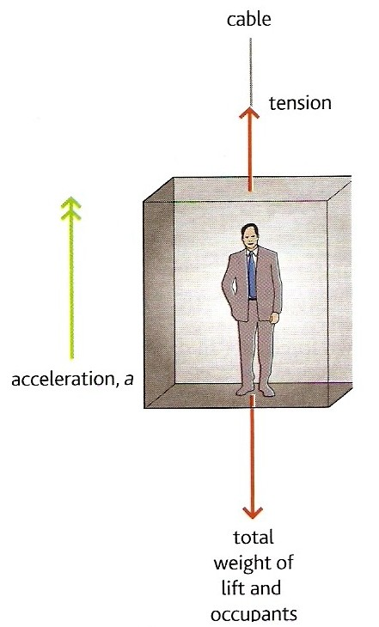
(b) accelerating upwards at 1.0 ms⁻²
Applying Newton’s 2nd law:
ƩF = (M + m) a
with
ƩF = Tension – Total weight
Therefore:
(M + m) a = T – (Mg + mg)
(600kg + 100kg) x 1.0 ms⁻²
= T – (5880N + 980N)
700 = T – 6860
T = 700 + 6860
Cable tension for case (b) = 7 560 N

Slide 21
(c) moving upwards but slowing down at 2.5 ms⁻²
Upward accelerations are positive in this question.
The acceleration, a is now
MINUS 2.5 ms⁻²
Therefore:
(M + m) a = T – (Mg + mg)
becomes:
(600kg + 100kg) x - 2.5 ms⁻²
= T – (5880N + 980N)
- 1750 = T – 6860
T = -1750 + 6860
Cable tension for case (c) = 5 110 N

Slide 22
(d) accelerating downwards
at 2.0 ms⁻²
Upward accelerations are positive in this question.
The acceleration, a is now
MINUS 2.0 ms⁻²
Therefore:
(M + m) a = T – (Mg + mg)
becomes:
(600kg + 100kg) x - 2.0 ms⁻²
= T – (5880N + 980N)
- 1400 = T – 6860
T = -1400 + 6860
Cable tension for case (d) = 5 460 N

Slide 23
(e) moving downwards but slowing down at 3.0 ms⁻²
This is an UPWARD acceleration
The acceleration, a is now
PLUS 3.0 ms⁻²
Therefore:
(M + m) a = T – (Mg + mg)
becomes:
(600kg + 100kg) x + 3.0 ms⁻²
= T – (5880N + 980N)
2100 = T – 6860
T = 2100 + 6860
Cable tension for case (e) = 8 960 N

Slide 24
Terminal speed
Consider a body falling through a fluid
(e.g. air or water)
When the body is initially released the only significant force acting on the body is due to its weight, the downward force of gravity.
The body will fall with an initial acceleration = g
Note: With dense fluids or with a low density body the upthrust force of the fluid due to it being displaced by the body will also be significant.
weight

Slide 25
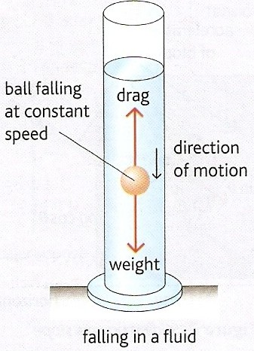
As the body accelerates downwards the drag force exerted by the fluid increases.
Therefore the resultant downward force on the body decreases causing the acceleration of the body to decrease.
ΣF = (weight – drag) = ma
Eventually the upward drag force equals the downward gravity force acting on the body.

Slide 26
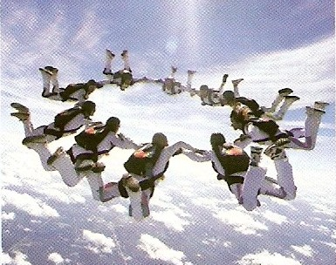
Therefore there is no longer any resultant force acting on the body.
ΣF = 0 = ma
and so: a = 0
The body now falls with a constant velocity.
This is also known as ‘terminal speed’
Skydivers falling at their terminal speed

Slide 27
resultant force & acceleration
speed
initial acceleration = g
terminal speed
time from release

Slide 28
Newton’s third law of motion
When a body exerts a force on another body then the second body exerts a force back on the first body that:
has the same magnitude
is of the same type
acts along the same straight line
acts in the opposite direction
as the force exerted by the first body.

Slide 29

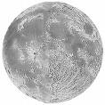
Examples of Newton’s third law of motion
1. Earth – Moon System
There are a pair of gravity forces:
A = GRAVITY pull of the EARTH to the LEFT on the MOON
B = GRAVITY pull of the MOON to the RIGHT on the EARTH
B
A
Notes:
Both forces act along the same straight line.
Force A is responsible for the Moon’s orbital motion
Force B causes the ocean tides.

Slide 30
2. Rocket in flight
There are a pair of contact (thrust) forces:
A = THRUST CONTACT push
of the ROCKET ENGINES
DOWN
on the EJECTED GASES
B = CONTACT push
of the EJECTED GASES
UP
on the ROCKET ENGINES
Note: Near the Earth there will also be a pair of gravity forces. If the rocket is accelerating upwards then the upward contact force B will be greater than the downward pull of gravity on the rocket.
A
B

Slide 31
3. Person standing on a floor
There are a pair of gravity forces:
A = GRAVITY pull of the EARTH
DOWN on the PERSON
B = GRAVITY pull of the PERSON
UP on the EARTH
And there are a pair of contact forces:
C = CONTACT push of the FLOOR
UP on the PERSON
D = CONTACT push of the PERSON
DOWN on the FLOOR
Note: Neither forces A & C nor forces D & B are Newton 3rd law force pairs as the are
NOT OF THE SAME TYPE
although all four forces will usually have the same magnitude.
A
D
C
B
EARTH

Slide 32
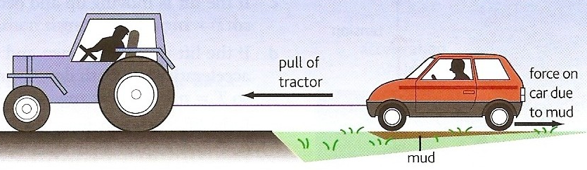
Tractor and car question
A tractor is pulling a car out of a patch of mud using a tow-rope as shown in the diagram opposite. Identify the Newton third law force pairs in this situation.
C₁
T₁ T₂
G₁
F₁ F₂
C₂
G₂
There are three pairs of GRAVITY forces between the tractor, rope, car and the Earth - for example forces G₁ & G₂.
There are two pairs of TENSION forces. The tractor exerts a TENSION force to the LEFT on the rope and the rope exerts an equal magnitude TENSION force to the RIGHT on the tractor. A similar but DIFFERENT magnitude pair exist between the rope and the car, T₁ & T₂.
There are eight pairs of CONTACT forces between the eight tyres and the ground - for example forces C₁ & C₂.
There are eight pairs of FRICTIONAL forces between the eight tyres of the tractor and car and the ground - for example forces F1 & F2.
For the tractor to succeed the tension force T₁ must be greater than the four frictional forces acting from the ground on the car’s four tyres.

Slide 33
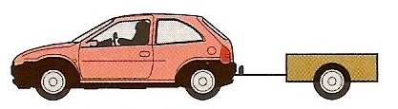
Trailer question
A car of mass 800 kg is towing a trailer of mass 200 kg. If the car is accelerating at 2 ms⁻² calculate:
(a) the tension force in the tow-bar
(b) the engine force required
Let the engine force = E
The tension force = T
Car mass = M
Trailer mass = m
Acceleration = a
The forces are as shown in the diagram.
The force acting on the trailer = T
= ma
= 200kg x 2 ms⁻²
Tension force in the tow-bar = 400 N
T
E
The resultant force acting on the car
ΣF = E – T
E – T = Ma
but: T = ma
Hence:
E – ma = Ma
E = Ma + ma
= (M + m) a
= (800kg + 200kg) x 2 ms⁻²
Engine force = 2000 N

Slide 34
Internet Links
Forces in 1 Dimension - PhET - Explore the forces at work when you try to push a filing cabinet. Create an applied force and see the resulting friction force and total force acting on the cabinet. Charts show the forces, position, velocity, and acceleration vs. time. View a Free Body Diagram of all the forces (including gravitational and normal forces).
Motion produced by a force - linear & circular cases - netfirms
Table Cloth & Other Newton 1st Law Demos - 'Whys Guy' Video Clip (3 mins) (1st of 2 clips)
Inertia of a lead brick & Circular motion of a water glass - 'Whys Guy' Video Clip (3 mins) (2nd of 2 clips)
Air Track - Explore Science
Force on a Wing - Explore Science
Space Cadet - Control a space ship using Newton's 1st law & turning forces - by eChalk
Newton's 2nd Law Experiment - Fendt
Pendulum in an accelerated car - NTNU
Acceleration meter - NTNU
Sailing a boat- NTNU
Free-fall Lab- Explore Science
Galileo Time of Fall Demonstration - 'Whys Guy' Video Clip (3 mins) - Time of fall independent of mass - Leads slug and feather with and without air resistance. (1st of 2 clips)
Distance Proportional to Time of Fall Squared Demonstration - 'Whys Guy' Video Clip (3:30 mins) - Falling distance proportional to the time of fall squared. (2nd of 2 clips some microphone problems)
Lunar Lander - PhET - Can you avoid the boulder field and land safely, just before your fuel runs out, as Neil Armstrong did in 1969? Our version of this classic video game accurately simulates the real motion of the lunar lander with the correct mass, thrust, fuel consumption rate, and lunar gravity. The real lunar lander is very hard to control.
Moonlander Use your thrusters to overcome the effects of gravity and bring the moonlander safely down to earth.
BBC KS3 Bitesize Revision: Mass and gravity Weight
The Ramp- PhET- Explore forces, energy and work as you push household objects up and down a ramp. Lower and raise the ramp to see how the angle of inclination affects the parallel forces acting on the file cabinet. Graphs show forces, energy and work. .

Slide 35
Core Notes from Breithaupt pages 132 to 145
State Newton’s first law of motion and give two examples of this law.
State the equation for Newton’s second law of motion.
Explain why a heavy object falls at the same rate as a heavy one.
Copy figure 1 on page 135 and explain how the tractor is able to pull the car out of the mud.
Copy figure 3 on page 136 and explain the forces involved in rocket propulsion.
What does the drag force acting on a body depend upon?
Describe and explain the motion of a body falling because of gravity through a fluid.
What is meant by terminal speed?

Slide 36
Notes from Breithaupt pages 132 to 134
Force & Acceleration
State Newton’s first law of motion and give two examples of this law.
State the equation for Newton’s second law of motion.
Explain why a heavy object falls at the same rate as a heavy one.
Repeat the worked example on page 133 this time for a vehicle of mass 800 kg reaching 16 ms⁻¹ in 30 s.
Try the summary questions on page 134

Slide 37
Notes from Breithaupt pages 135 to 137
Using F = ma
Copy figure 1 on page 135 and explain how the tractor is able to pull the car out of the mud.
Copy figure 3 on page 136 and explain the forces involved in rocket propulsion.
Repeat the worked example on page 136 but this time with a lift of total mass 800 kg decelerating at 2.0 ms⁻².
Try the summary questions on page 137

Slide 38
Notes from Breithaupt pages 138 & 139
Terminal Speed
What does the drag force acting on a body depend upon?
Describe and explain the motion of a body falling because of gravity through a fluid.
What is meant by terminal speed?
Repeat the worked example on page 139 but this time with a car of mass 900 kg and an engine force of 700 N.
Try the summary questions on page 139

Slide 39
Notes from Breithaupt pages 140 to 142
On the road
Repeat the worked example on page 142 but this time with a car of mass 1200 kg.
Try the summary questions on page 142

Slide 40
Notes from Breithaupt pages 143 to 145
Vehicle safety
Try the summary questions on page 145

