Slide 1
2.3b Waves
Optics
Breithaupt pages 188 to 207
December 20th, 2010

Slide 2
AQA AS Specification
Lessons | Topics
1 to 4 | Refraction at a plane surface Refractive index of a substance s; n = c / c_{s} Candidates are not expected to recall methods for determining refractive indices. Law of refraction for a boundary between two different substances of refractive indices n₁ and n₂ in the form n₁ sin θ₁ = n₂ sin θ₂ . Total internal reflection including calculations of the critical angle at a boundary between a substance of refractive index n₁ and a substance of lesser refractive index n₂ or air; sin θ_{c} = n₂ / n₁ Simple treatment of fibre optics including function of the cladding with lower refractive index around central core limited to step index only; application to communications.
5 to 7 | Interference The concept of path difference and coherence The laser as a source of coherent monochromatic light used to demonstrate interference and diffraction; comparison with non-laser light; awareness of safety issues Candidates will not be required to describe how a laser works. Requirements of two source and single source double-slit systems for the production of fringes. The appearance of the interference fringes produced by a double slit system, fringe spacing w = λ D / s where s is the slit separation.
8 to 10 | Diffraction Appearance of the diffraction pattern from a single slit. The plane transmission diffraction grating at normal incidence; optical details of the spectrometer will not be required. Derivation of d sin θ = nλ, where n is the order number. Applications; e.g. to spectral analysis of light from stars.

Slide 3
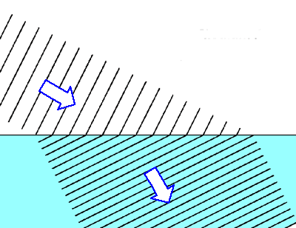
Refraction
Refraction occurs when a wave passes across a boundary at which the wave speed changes.
The change of speed usually, but not always, results in the direction of travel of the wave changing.
A wave slowing down on crossing a media boundary

Slide 4
Refraction of light
(a) Less to more optical dense transition (e.g. air to glass)
AIR GLASS
normal
angle of refraction
angle of incidence
Light bends TOWARDS the normal.
The angle of refraction is LESS than the angle of incidence

Slide 5
(b) More to less optical dense transition (e.g. water to air)
angle of refraction
normal
angle of incidence
WATER AIR
Light bends AWAY FROM the normal.
The angle of refraction is GREATER than the angle of incidence

Slide 6
Refractive index (n)
This is equal to the ratio of the wave speeds.
refractive index, n_{s} = c / c_{s}
n_{s} = refractive index of the second medium relative to the first
c = speed in the first region of medium
c_{s} = speed in the second region of medium

Slide 7
Question 1
When light passes from air to glass its speed falls from 3.0 x 10⁸ ms⁻¹ to 2.0 x 10⁸ ms⁻¹.
Calculate the refractive index of glass.
n_{s} = c / c_{s}
= 3.0 x 10⁸ ms⁻¹ / 2.0 x 10⁸ ms⁻¹
refractive index of glass = 1.5

Slide 8
Question 2
The refractive index of water is 1.33.
Calculate the speed of light in water.
n_{s} = c / c_{s}
→ c_{s} = c / n_{s}
= 3.0 x 10⁸ ms⁻¹ / 1.33
speed of light in water = 2.25 x 10⁸ ms⁻¹

Slide 9
Examples of refractive index
Examples of n_{s} for light (measured with respect to a vacuum as the first medium)
vacuum = 1.0 (by definition)
air = 1.000293 (air is usually taken to be = 1.0)
ice = 1.31
water = 1.33
alcohol = 1.36
glass = 1.5 (varies for different types of glass)
diamond = 2.4

Slide 10
The law of refraction
When a light ray passes from a medium of refractive index n₁ to another of refractive index n₂ then:
n₁ sin θ₁ = n₂ sin θ₂
where:
θ₁ is the angle of incidence in the first medium
θ₂ is the angle of refraction in the second medium
θ₁
Medium of refractive index, n₁
n₂
θ₂

Slide 11
Question
Calculate the angle of refraction when light passes from air to glass if the angle of incidence is 30°.
n₁ sin θ₁ = n₂ sin θ₂
→ 1.0 x sin 30° = 1.5 x sin θ₂
1.0 x 0.5 = 1.5 x sin θ₂
→ sin θ₂ = 0.5 / 1.5 = 0.333
→ angle of refraction, θ₂ = 19.5°

Slide 12
Complete:
Answers
medium 1 | n₁ | θ₁ | medium 2 | n₂ | θ₂
air | 1.00 | 50º | water | 1.33 | 35.2º
glass | 1.50 | 30º | air | 1.00 | 48.6º
water | 1.33 | 59.8º | glass | 1.50 | 50º
air | 1.00 | 50º | diamond | 2.4 | 18.6º
air | 1.00 | 50º | unknown | 1.53 | 30º

Slide 13
Total internal reflection
Total internal reflection (TIR) occurs when light is incident on a boundary where the refractive index DECREASES.
And the angle of incidence is greater than the critical angle, c for the interface.
θ₁ > c
θ₁
n₁
n₂ ( < n₁ )

Slide 14
Critical angle (c)
This is the angle of incidence, θ₁ that will result in an angle of refraction, θ₂ of 90 degrees.
n₁ sin θ₁ = n₂ sin θ₂
becomes in this case:
n₁ sin c = n₂ sin 90°
n₁ sin c = n₂ (sin 90° = 1)
Therefore: sin c = n₂ / n₁
θ₁ = c
θ₁
n₁
n₂ (<n₁)
θ ₂ = 90º

Slide 15
Question 1
Calculate the critical angle of glass to air.
(n_{glass} = 1.5; n_{air} =1)
sin c = n₂ / n₁
→ sin c = 1.0 / 1.5
= 0.667
→ critical angle, c = 41.8°

Slide 16
Question 2
Calculate the maximum refractive index of a medium if light is to escape from it into water (n_{water} = 1.33) at all angles below 30°.
sin c = n₂ / n₁
→ sin 30° = 1.33 / n₁
→ 0.5 = 1.33 / n₁
→ n₁ = 1.33 / 0.5
→ refractive index, n₁ = 2.66

Slide 17
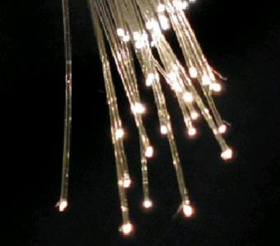
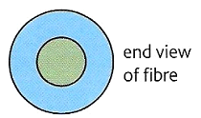
Optical fibres
Optical fibres are an application of total internal reflection.
Step-index optical fibre consists of two concentric layers of transparent material, core and cladding.
The core has a higher refractive index than the surrounding cladding layer.
core
cladding

Slide 18
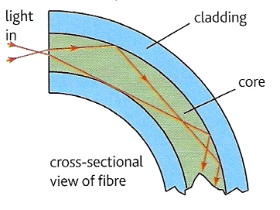
Total internal reflection takes place at the core - cladding boundary.
The cladding layer is used to prevent light crossing from one part of the fibre to another in situations where two fibres come into contact.
Such crossover would mean that signals would not be secure, as they would reach the wrong destination.

Slide 19
Question
A step-index fibre consists of a core of refractive index 1.55 surrounded by cladding of index 1.40. Calculate the critical angle for light in the core.
sin c = n₂ / n₁
→ sin c = 1.40 / 1.55
= 0.9032
→ critical angle, c = 64.6°

Slide 20
Optical fibres in communication
A communication optical fibre allows pulses of light to enter at one end, from a transmitter, to reach a receiver at the other end. The fastest broadband systems use optical fibre links.
The core must be very narrow to prevent multipath dispersion.
This occurs in a wide core because light travelling along the axis of the core travels a shorter distance per metre of fibre than light that repeatedly undergoes total internal reflection.
Such dispersion would cause an initial short pulse to lengthen as it travelled along the fibre.
Multipath dispersion causing pulse broadening
input pulse
output pulse

Slide 21
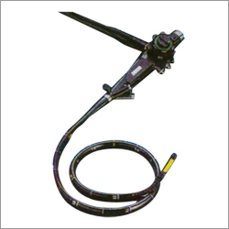
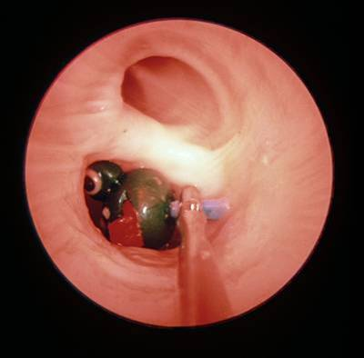
The Endoscope
The medical endoscope contains two bundles of fibres. One set of fibres transmits light into a body cavity and the other is used to return an image for observation.

Slide 22
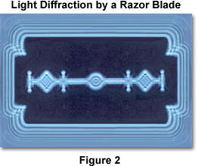
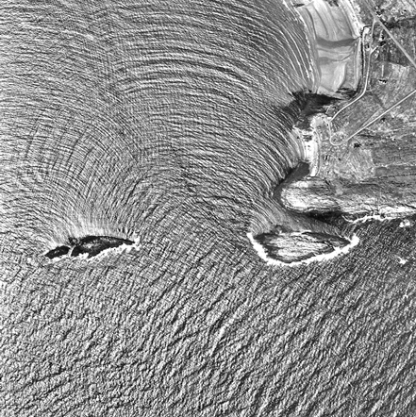
Diffraction
Diffraction occurs when waves spread out after passing through a gap or round an obstacle.
Sea wave diffraction

Slide 23
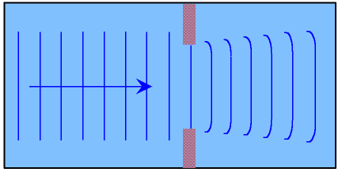
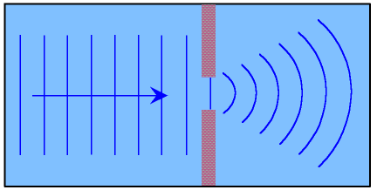
Diffraction becomes more significant when the size of the gap or obstacle is reduced compared with the wavelength of the wave.

Slide 24
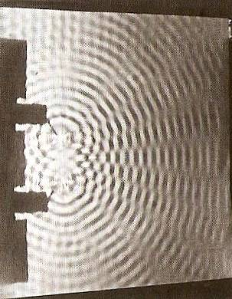
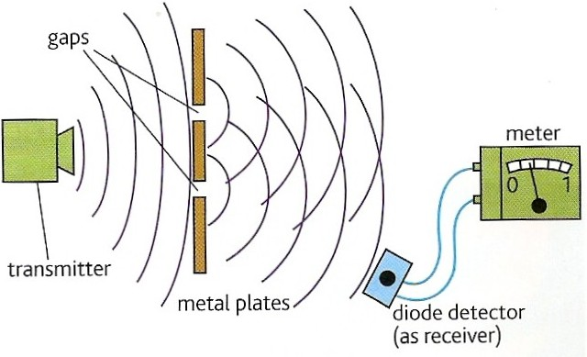
Interference
Interference occurs when two waves of the same type (e.g. both water, sound, light, microwaves etc.) occupy the same space.
Wave superposition results in the formation of an interference pattern made up of regions of reinforcement and cancellation.

Slide 25

Coherence
For an interference pattern to be observable the two overlapping waves must be coherent.
This means they will have:
1. the same frequency
2. a constant phase difference
If the two waves are incoherent the pattern will continually change usually too quickly for observations to be made.
Two coherent waves can be produced from a single wave by the use of a double slit.

Slide 26
Path difference
Path difference is the difference in distance travelled by two waves.
Path difference is often measured in ‘wavelengths’ rather than metres.
Example:
Two waves travel from A to B along different routes. If they both have a wavelength of 2m and the two routes differ in length by 8m then their path difference can be stated as ‘4 wavelengths’ or ‘4 λ’

Slide 27
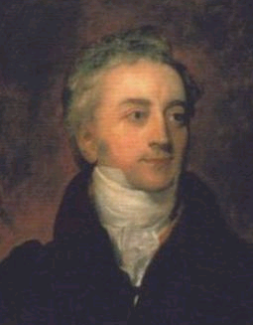
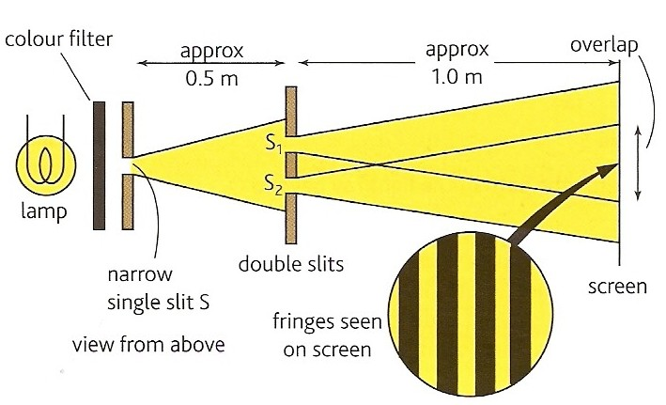
Double slit interference with light
This was first demonstrated by Thomas Young in 1801.
The fact that light showed interference effects supported the theory that light was a wave-like radiation.
Thomas Young 1773 - 1829

Slide 28
Experimental details
Light source:
This needs to be monochromatic (one colour or frequency).
This can be achieved by using a colour filter with a white light. Alternatives include using monochromatic light sources such as a sodium lamp or a laser.
Single slit:
Used to obtain a coherent light source. This is not needed if a laser is used.
Double slits:
Typical width 0.1mm; typical separation 0.5mm.
Double slit to fringe distance:
With a screen typically 1.0m.
The distance can be shorter if a microscope is used to observe the fringes.

Slide 29
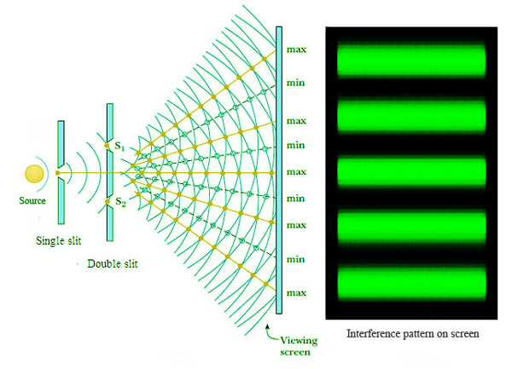

Slide 30
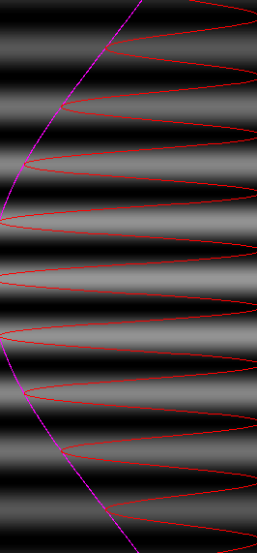
Interference fringes
Interference fringes are formed where the two diffracted light beams from the double slit overlap.
A bright fringe is formed where the light from one slit reinforces the light from the other slit.
At a bright fringe the light from both slits will be in phase.
They will have path differences equal to a whole number of wavelengths: 0, 1λ, 2λ, 3λ etc…
A dark fringe is formed due to cancelation where the light from the slits is 180° out of phase.
They will have path differences of: ¹/₂λ, ³/₂ λ , ⁵/₂ λ etc..

Slide 31
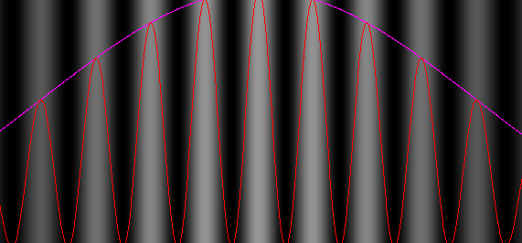
Young’s slits equation
fringe spacing, w = λ D / s
where:
s is the slit separation
D is the distance from the slits to the screen
λ is the wavelength of the light
w

Slide 32
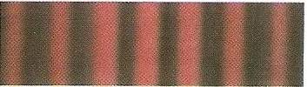

Question 1
Calculate the fringe spacing obtained from a double slit experiment if the double slits are separated by 0.50mm and the distance from the slits to a screen is 1.5m with (a) red light (wavelength 650nm and (b) blue light (wavelength 450nm).
fringe spacing w = λ D / s
(a) red light:
w = (650nm x 1.5m) / (0.50mm)
= (650 x 10⁻⁹m x 1.5m)
/ (5 x 10⁻⁴m)
= 0.00195m
= 2.0mm
(b) blue light:
w = 1.4mm

Slide 33
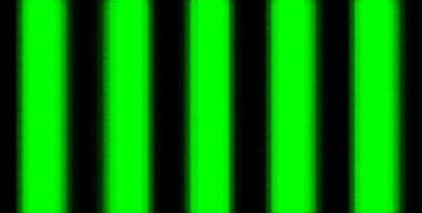
Question 2
Calculate the wavelength of the green light that produces 10 fringes over a distance of 1.0cm if the double slits are separated by 0.40mm and the distance from the slits to the screen is 80cm
fringe spacing w = 1.0cm / 10
= 0.10 cm
fringe spacing w = λ D / s
becomes:
λ = ws / D
= (0.10cm x 0.40mm) / (80cm)
= (0.001m x 0.0004m) / (0.80m)
= 0.000 000 5m
wavelength = 500nm
1.0 cm

Slide 34
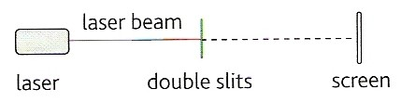

Demonstrating interference with a laser
A laser
(Light Amplification by Stimulated Emission of Radiation)
is a source of coherent monochromatic light.
0.5m to 2m

Slide 35

Using a laser safely
Laser light is very concentrated and can destroy retina cells in the eye.
Never look along a laser beam, even after it has been reflected.

Slide 36
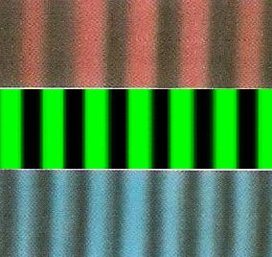
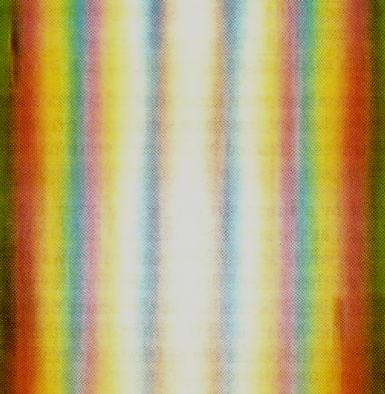
White light fringes
Every colour produces a bight central fringe.
Therefore with white light there is also a bright central white fringe.
The other fringes do not coincide resulting in fringes that are tinted blue on the inside and red on the outside.
The fringes become less distinct away from the centre.
central bright fringe

Slide 37

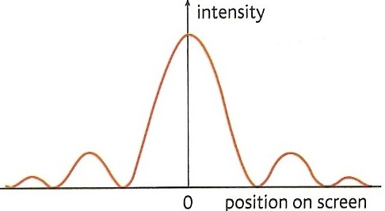
Diffraction from a single slit
A single slit also produces a fringe pattern.
The central fringe is much brighter than and twice the width of the others.
Diffraction fringe pattern produced by a red light laser

Slide 38
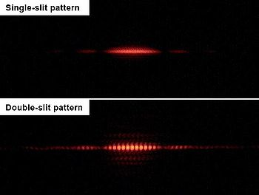
Double slit pattern with single slit diffraction

Slide 39
Transmission diffraction grating
A transmission diffraction grating consists of a glass or plastic slide with many closely spaced slits ruled onto it (typically 500 per mm).
500 lines per mm (magnified view)
100 lines per mm (magnified view)
Note: A CD or DVD disc acts as a reflection diffraction grating

Slide 40
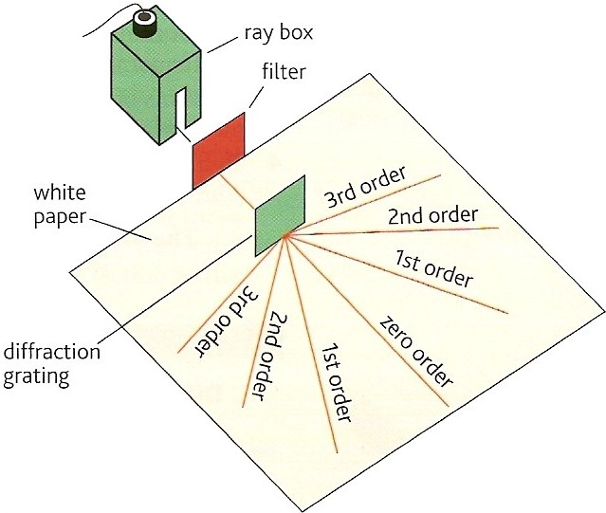
Grating and monochromatic light
When a parallel beam of monochromatic light is incident normally with the grating the light is transmitted in certain directions only.
This happens because:
the light is diffracted by each slit in the grating.
the diffracted light from adjacent slits reinforces only in a few directions. In all other directions cancellation occurs.

Slide 41
The central beam is referred as the ‘zero order beam’ and is in the same direction as the incident beam.
Other transmitted beams are numbered outwards from the zero order beam.
The pattern of beams is symmetric about the zero order beam.

Slide 42
The angle between the beams increases if:
the wavelength of the light is increased
the width of the slits in the grating is decreased (more lines per mm)

Slide 43
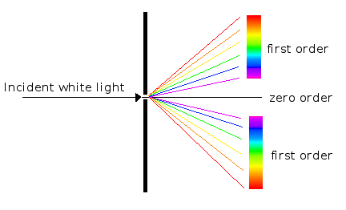
Grating and white light
Each wavelength produces its own set of lines.
The zero order beam is white.
The other beams are spectra with red showing the greatest angles

Slide 44
Diffraction grating equation
d sin θ = nλ
where:
d = the grating spacing (the distance
between the centres of adjacent slits
drawn on the grating)
n = the beam order number (0, 1, 2 etc..)
λ = the wavelength of the light
θ = the angle between the beam in
question and the zero order beam
Note: The number of slits per metre, N in
the grating is given by: N = 1 / n
d

Slide 45
Diffraction grating equation derivation
Let θ be the angle between the zero order maximum and the n^{th} order maximum.
For this to occur the path difference between the light from two adjacent slits must equal a nλ.
In the diagram opposite distance QY must equal nλ.
But: sin θ = QY / QP
sin θ = nλ / d
Hence: d sin θ = nλ
Q
Y
d
θ
P
θ

Slide 46
Question 1
Calculate the angle of the first order beam when red light, wavelength 650nm is incident on a diffracting grating that has 200 lines per mm.
d sin θ = nλ
becomes: sin θ = nλ / d
with grating spacing, d = ¹/₂₀₀ mm = 0.005 mm
sin θ = (1 x 650 nm) / (0.005 mm)
= (650 x 10⁻⁹ m) / (5 x 10⁻⁶ m)
sin θ = 0.13
First order angle, θ = 7.5°

Slide 47
Question 2
Calculate the wavelength of light the has a second order angle of 30° when used with a diffracting grating of 500 lines per mm.
d sin θ = nλ
becomes: λ = d sin θ / n
with grating spacing, d = ¹/₅₀₀ mm = 0.002 mm
λ = (0.002 mm x sin 30°) / (2)
= (2 x 10⁻⁶ m x 0.5) / (2)
wavelength = 5 x 10⁻⁷ m = 500 nm

Slide 48
Question 3
How many beams are formed when blue light, wavelength 450nm is used with a diffracting grating of 400 lines per mm.
d sin θ = nλ
becomes: n = d sin θ / λ
grating spacing, d = ¹/₄₀₀ mm = 0.0025 mm
sin θ cannot be greater than 1.0 (with θ = 90°)
n = (0.0025 mm x 1.0) / (450 nm)
= (2.5 x 10⁻⁶ m) / (4.5 x 10⁻⁷ m)
= 5.6
but n must be an integer
and so max n = 5
There will therefore be 11 beams

Slide 49
Answers:
Answers:
Complete:
d / μm | N / mm⁻¹ | θ / ° | n | λ / nm
2.00 |  |  | 1 | 400
2.00 |  |  | 2 | 400
2.00 |  |  | 4 | 400
 | 200 |  | 2 | 400
 | 400 | 30 | 5
500
11.5
500
23.6
500
53.1
5.00
9.21
2.50
250

Slide 50
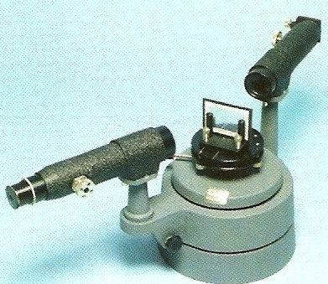
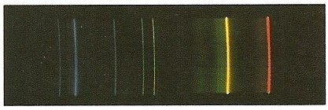
Applications of diffraction gratings
A diffraction grating can be used in a spectrometer to study the spectrum of light from any light source and to measure wavelengths very accurately.
For example the line spectrum given off by a gas can be used to identify its components.
diffraction grating
Spectrometer
A line spectrum

Slide 51
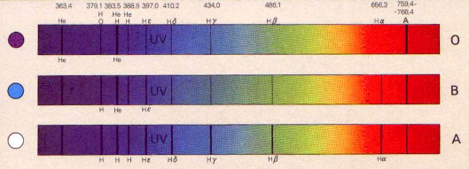
Star spectra
The spectra of stars can also be analysed and can be used to identify, amongst other things, their chemical composition, surface temperature and rotational speed.
star spectra

Slide 52
Internet Links
Refraction - Powerpoint presentation by KT
Light Refraction - Fendt
Reflection & Refraction at a boundary - NTNU
Refraction animation - NTNU - Does not show TIR effect
Prism - non dispersive reflections and refractions - NTNU
Light moving from water to air - NTNU
Fibre optic reflection - NTNU
Interference explained
Thin film interference
Interference Experiments - Atomic Lab
Interference - uses two sets of concentric circles - by eChalk
Interference patterns from two sets of moving concentric rings x- Explore Science
Interference of two circular waves - Explore Science
Interference from two sources showing path length difference- NTNU
Two source interference pattern
Interference in water waves I - with path difference indication - netfirms
Interference in water waves II- netfirms
Interference with two sources of sound - falstad
Interference from two sources in 3D - 7stones
Multiple source interference- netfirms
Diffraction / interference pattern from single / multiple slits - NTNU
Double Slit Interference - Slits distance & wavelength adjustable - NTNU
Young's Double Slit - flash demo
Interference pattern formed by a wedge - NTNU
Diffraction / interference pattern from single / multiple slits - NTNU
Single slit diffraction - wavelength adjustable - NTNU
Diffraction from a single slit- netfirms
Diffraction around an obstacle - netfirms
Diffraction past a barrier- netfirms .

Slide 53
Core Notes from Breithaupt pages 188 to 207
(plus 178 & 179)
What is meant by ‘coherence’? (see page 199). How is wave coherence achieved in the Young’s double slit experiment?
What are the advantages and disadvantages of using a laser as a light source in the double slits experiment? (see pages 197 & 200)
Explain with the aid of a diagram what is meant by ‘diffraction’ (see pages 179 & 202)
Copy the right hand diagrams of figure 1 on page 202 and state how the diffraction pattern produced depends on: (a) the light wavelength & (b) the slit width.
Explain how the diffraction pattern formed by a single slit affects the interference fringes formed by a set of double slits. (see pages 203 & 204)
What is a ‘plane transmission diffraction grating’? Describe the effect of such a grating on monochromatic light. (Draw figure 1 on page 205)
Draw figure 3 on page 206 and use it to derive the equation: d sin θ = nλ.
What is refraction (p178)? Draw figure 3 on page 178.
Define ‘refractive index’ (p188).
State the equation relating refractive index and the speed of a wave in the two regions involved. (p190). Draw figure 2 on page 191 and explain the derivation of the equation n₁ sin i₁ = n₂ sin i₂
Draw diagrams AND explain what is meant by ‘critical angle’ and ‘total internal reflection’.
Show how the equation sin i_{c} = n₂ / n₁ is derived from n₁ sin i₁ = n₂ sin i₂
What is an optical fibre? Outline how optical fibres are used in communication systems.
Draw figure 2 on page 194 and explain the function of the cladding
Draw figure 2 on page 196 and use it to explain how Thomas Young demonstrated light interference using a set of double slits.
Use the concept of ‘path difference’ to explain how interference fringes are formed. (see page 197)

Slide 54
Notes from Breithaupt pages 178, 179, & 188 to 192
Refraction
What is refraction (p178)? Draw figure 3 on page 178.
Define ‘refractive index’ (p188).
State the equation relating refractive index and the speed of a wave in the two regions involved. (p190). Draw figure 2 on page 191 and explain the derivation of the equation n₁ sin i₁ = n₂ sin i₂
Copy figure 3 on page 189 and calculate all of the angles if the first angle (i₁) is 60°.
Repeat the calculation at the bottom of page 190 but this time with diamond (refractive index = 2.4)
Copy figure 1 on page 190 and derive the equation: n_{s} = c / c_{s}
Explain the phenomena of ‘dispersion’. (p192)
Try Summary Question 3 on page 179 plus all questions on pages 189 & 192

Slide 55
Notes from Breithaupt pages 193 to 195
Total Internal Reflection
Draw diagrams AND explain what is meant by ‘critical angle’ and ‘total internal reflection’.
Show how the equation sin i_{c} = n₂ / n₁ is derived from n₁ sin i₁ = n₂ sin i₂
What is an optical fibre? Outline how optical fibres are used in communication systems.
Draw figure 2 on page 194 and explain the function of the cladding
Calculate the critical angle for (a) glass to air (n_{glass} = 1.5); (b) water to air (n_{water} = 1.33); (c) glass to water.
Describe how optical fibres are used in medical endoscopes. Draw a diagram to illustrate your answer.
Try the Summary Questions on page 195.

Slide 56
Notes from Breithaupt pages 196 to 201
Interference
Draw figure 2 on page 196 and use it to explain how Thomas Young demonstrated light interference using a set of double slits.
Use the concept of ‘path difference’ to explain how interference fringes are formed. (see page 197)
What is meant by ‘coherence’? (see page 199). How is wave coherence achieved in the Young’s double slit experiment?
What are the advantages and disadvantages of using a laser as a light source in the double slits experiment? (see pages 197 & 200)
Quote the equation for fringe spacing on page 197. Use this equation to explain the formation of coloured fringes shown on page 201.
Calculate the fringe spacing expected 2.5m away from a set of double slits 0.5mm apart when illuminated by light of wavelength 500nm.
Explain why the equation for fringe spacing should only be used near the centre of the fringe pattern. (see page 198)
Why are fringe patterns not normally observed with overlapping beams of light? (see pages 199 & 200)
Try the Summary Questions on pages 198 & 201.

Slide 57
Notes from Breithaupt pages 179 & 202 to 207
Diffraction
Explain with the aid of a diagram what is meant by ‘diffraction’ (see pages 179 & 202)
Copy the right hand diagrams of figure 1 on page 202 and state how the diffraction pattern produced depends on: (a) the light wavelength & (b) the slit width.
Explain how the diffraction pattern formed by a single slit affects the interference fringes formed by a set of double slits. (see pages 203 & 204)
What is a ‘plane transmission diffraction grating’? Describe the effect of such a grating on monochromatic light. (Draw figure 1 on page 205)
Draw figure 3 on page 206 and use it to derive the equation: d sin θ = nλ.
Explain how a diffraction grating can be used to identify the chemical composition of a star. (see page 207)
Calculate the angle between the first and second order maxima formed by a diffraction grating that has 200 lines per metre when it is illuminated by light of wavelength 550nm.
Try the Summary Questions on pages 204 & 207.

