Slide 1
Accelerating Chip Layout Design using ML
Predicting Area, Power, and Wire Length
Name Jayesh Parab

Slide 2
Contents:
Introduction
Problem Statement
Solution
Data Collection and cleaning
Data Visualization
Model Selection

Slide 3

Introduction
Designing microchips (like those from Intel or NVIDIA) begins as code, which must be painstakingly translated into a physical blueprint of billions of transistors and wires a stage known as physical design. Because engineers must constantly tweak this blueprint to prevent overheating and power drain, the process becomes a massive, time-consuming game of trial and error. To solve this bottleneck, I developed a Machine Learning model that instantly predicts critical performance parameters, eliminating weeks of guesswork and drastically speeding up the journey from code to silicon.

Slide 4
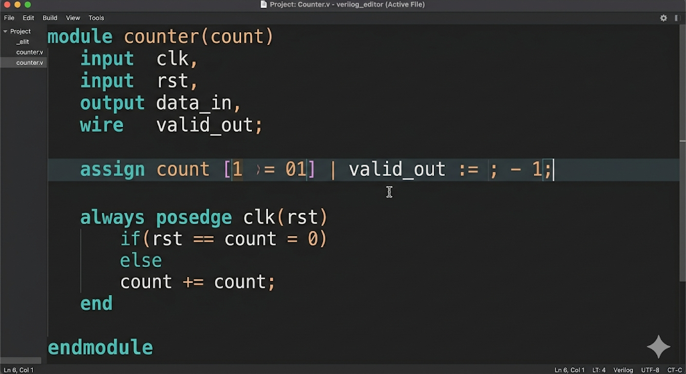
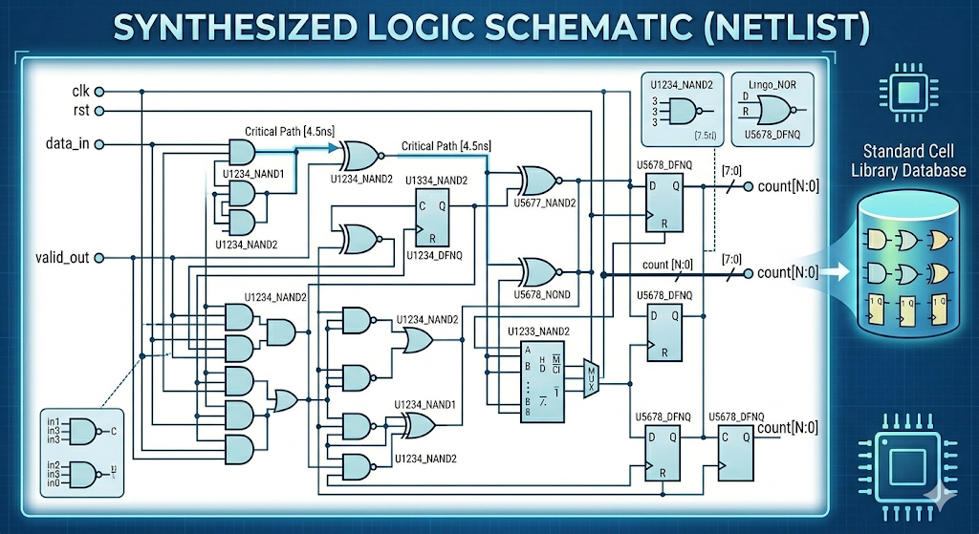
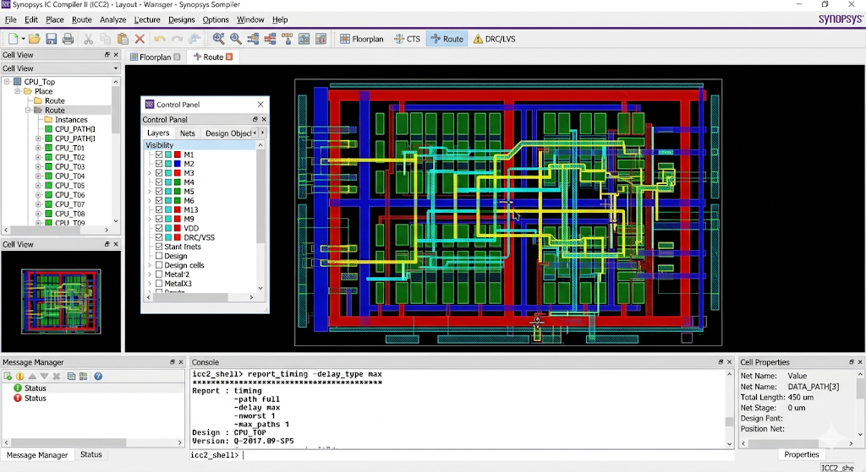
Problem:
Synthesis
Time: few hours
Change parameters and repeat this process
Issue with design
Physical Design
Time: few days

Slide 5
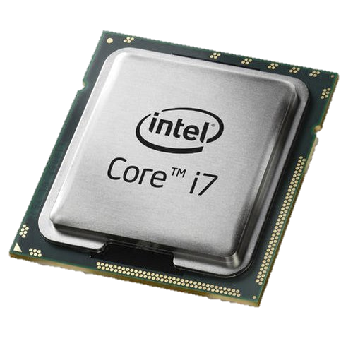
Solution:
Synthesis
Time: few hours
Predicting Results of Physical Design stage
Time: few minutes
Only if predicted values feels Right
Physical Design
Prediction and software values are same
Time: few days

Slide 6
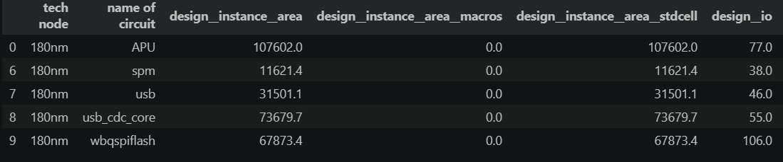
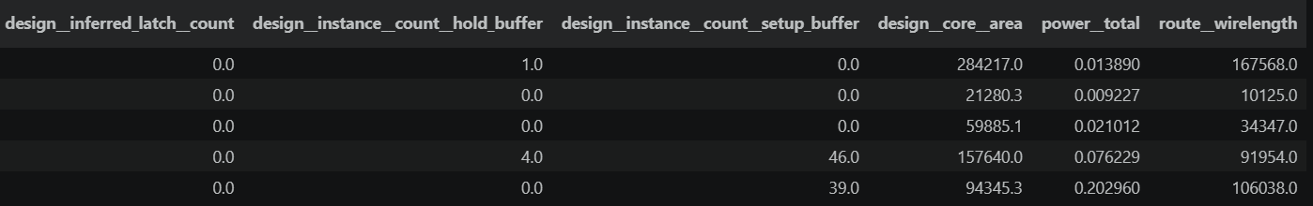
Data Collection and cleaning:
Got My data from GitHub in Individual JSON file, I combined all JSON file in one CSV.
Removed Unwanted Columns which are not needed for my targets.
Removed rows with NA or missing data, after that I came to 20729 Rows.
Removed Outlying data

Slide 7
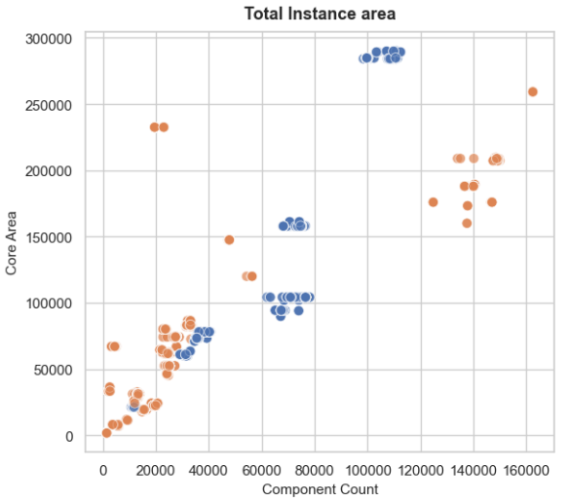
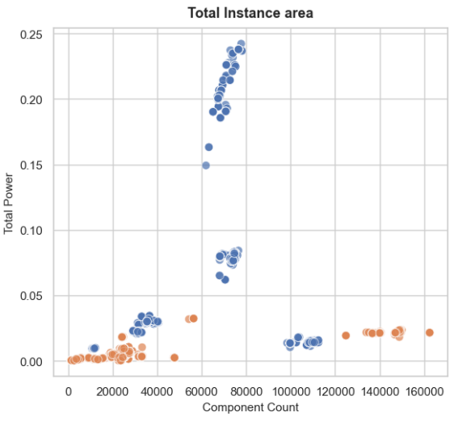
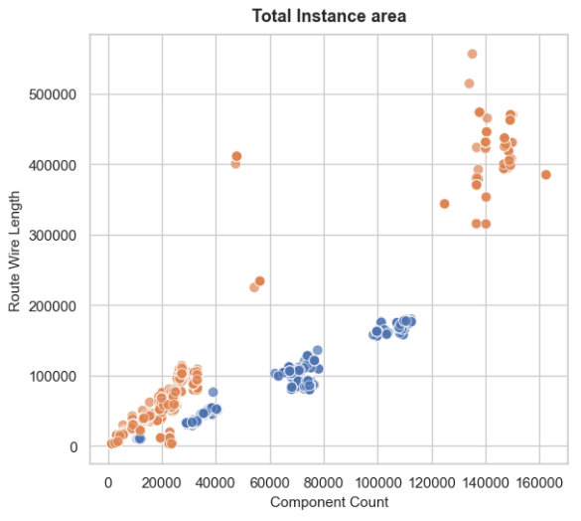
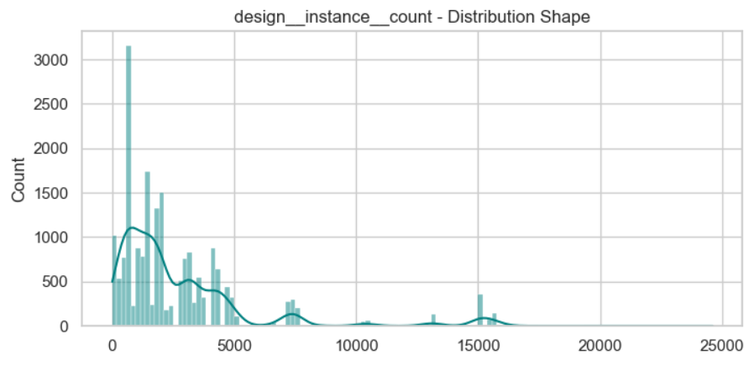
Data Visualization:
Blue dots are 180nm chips.
Orange dots are 130nm chips.
I also plotted distribution graph.

Slide 8
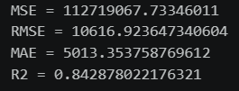
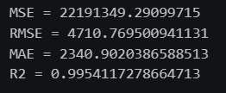
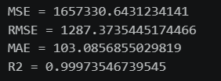
Model Selection:
Linear Regression:
Initially tried this model without much data processing, and got poor results with r2 score of 0.5. to Improve this I tried removing all NA rows, outlier data, and high corelated features.
Final Results:
Polynomial Regression:
I tried this model to imporve on the liner regression, with raw data It performed worst then the liner model I got r2 score of -11.51. After cleaning the data, r2 score impoved significatly.
Final Results:
Random Forest Regression:
I tried to use this model to improve on the polynomial regression. Even on the raw data this model performed well I got r2 score of 0.95, after cleaning the data, r2 score improved slightly.
Final Results:

Slide 9
Further Enhancement:
Try to predict more parameters like, chance of getting a compilation error during PD stage.
Try to predict the tuning parameters for the EDA software, which can accelerate pipeline further more.
Try to predict parasitic components inside the chip, which can cause problems in the design, but that can only be detected in final stage. Which can cause large delays in the chip production.

Slide 10
Use Of AI:
I used AI for the following reasons:
To merge each and every data in the JSON file and convert it to CSV, I merged around 30000 JSON files.
Specifically, to format the markdowns written in the notebook.
First, I roughly plotted graphs for the data, and then using AI added colors and formatted it in such a way that they looks good.

Slide 11
Thanks a lot!

