Slide 1
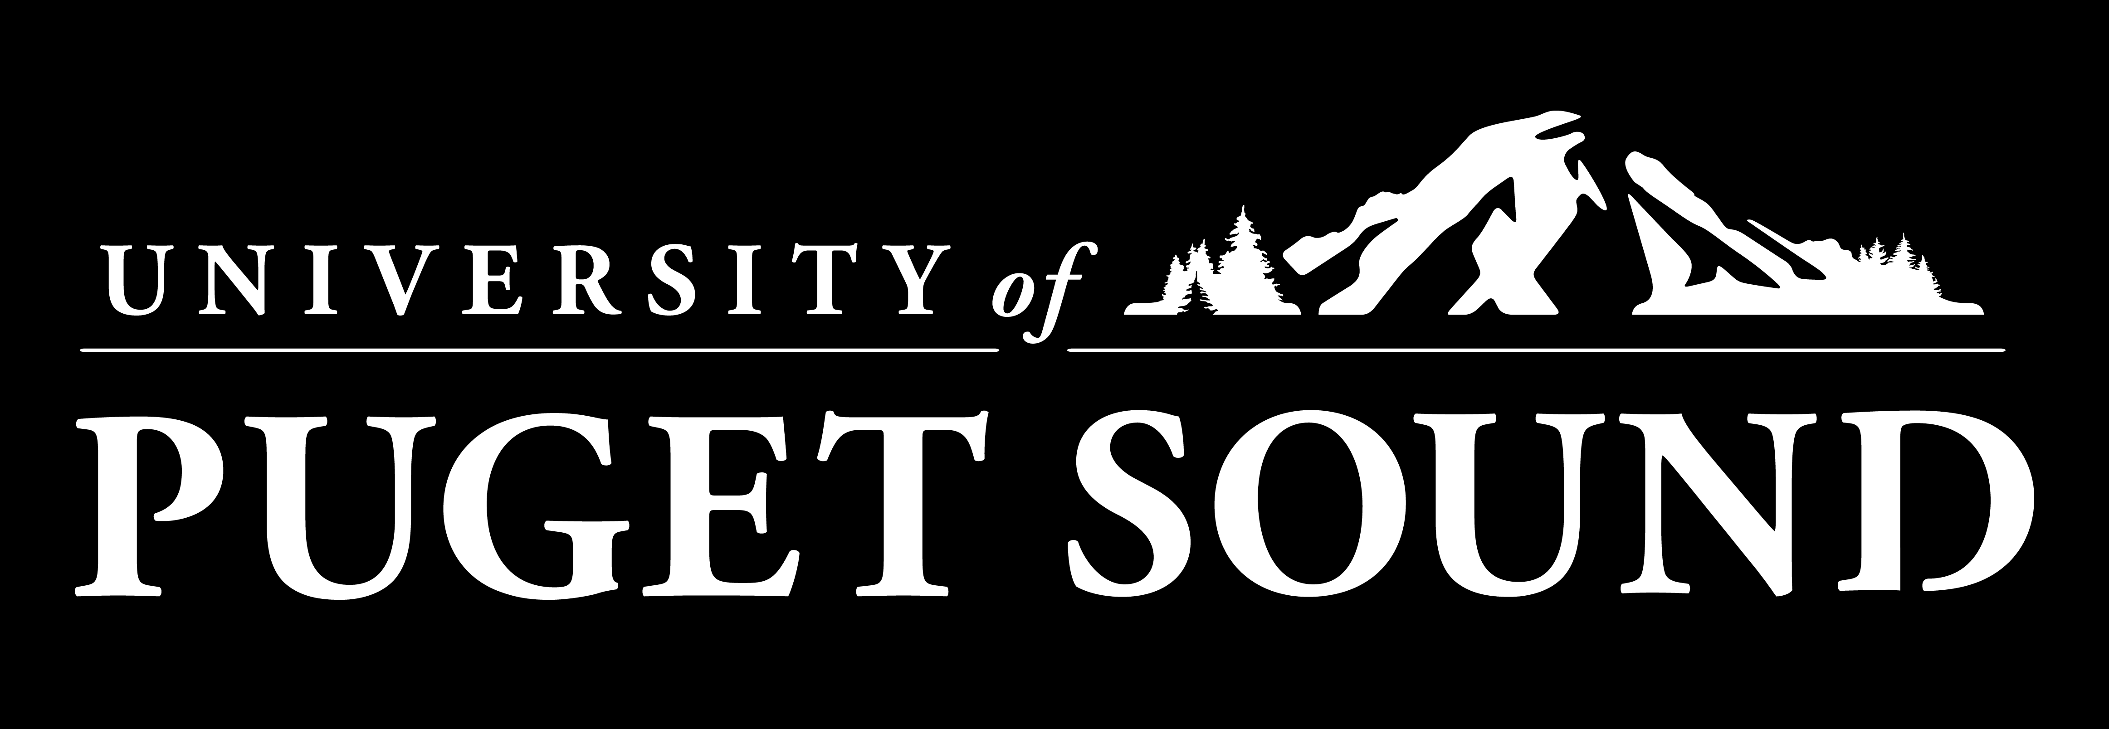
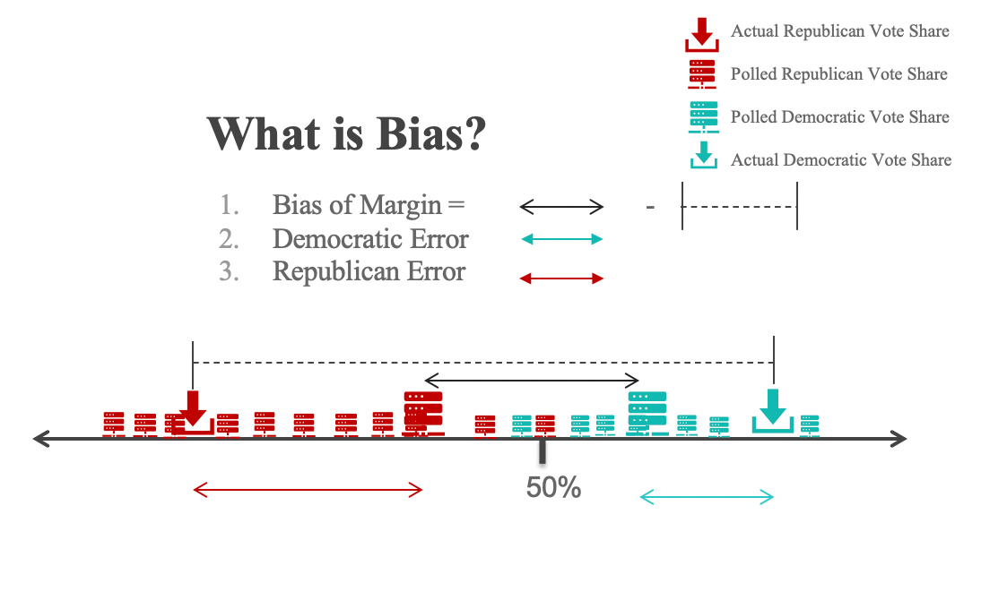
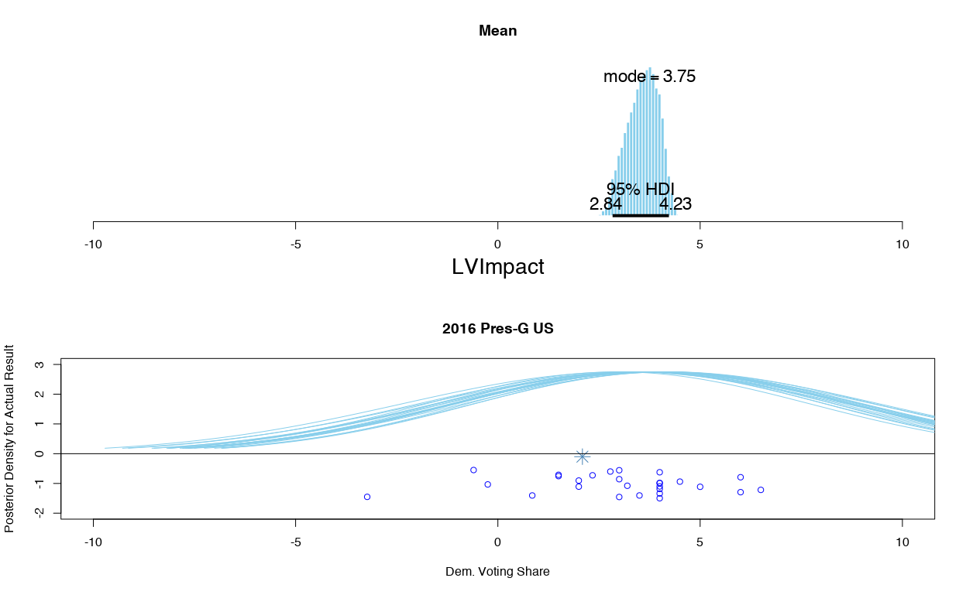
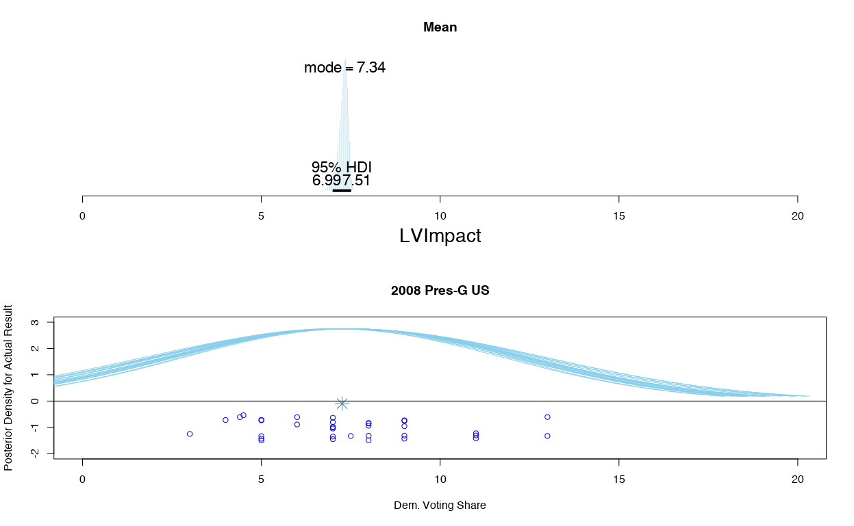
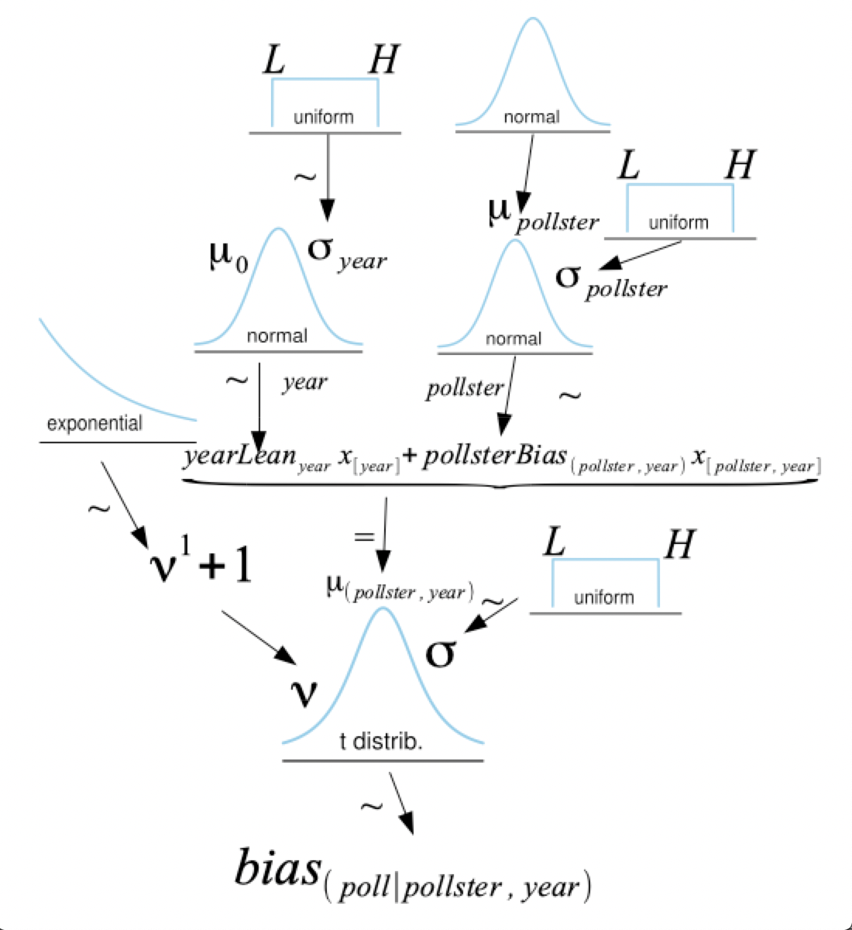
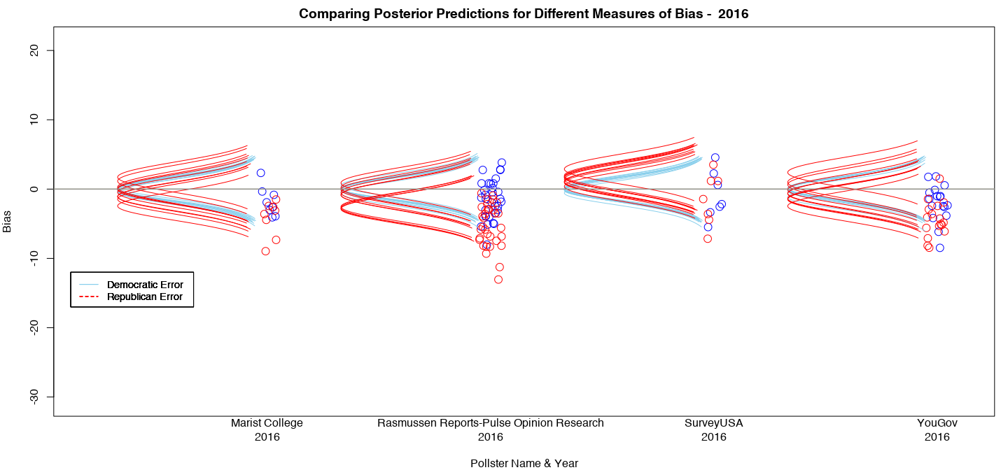
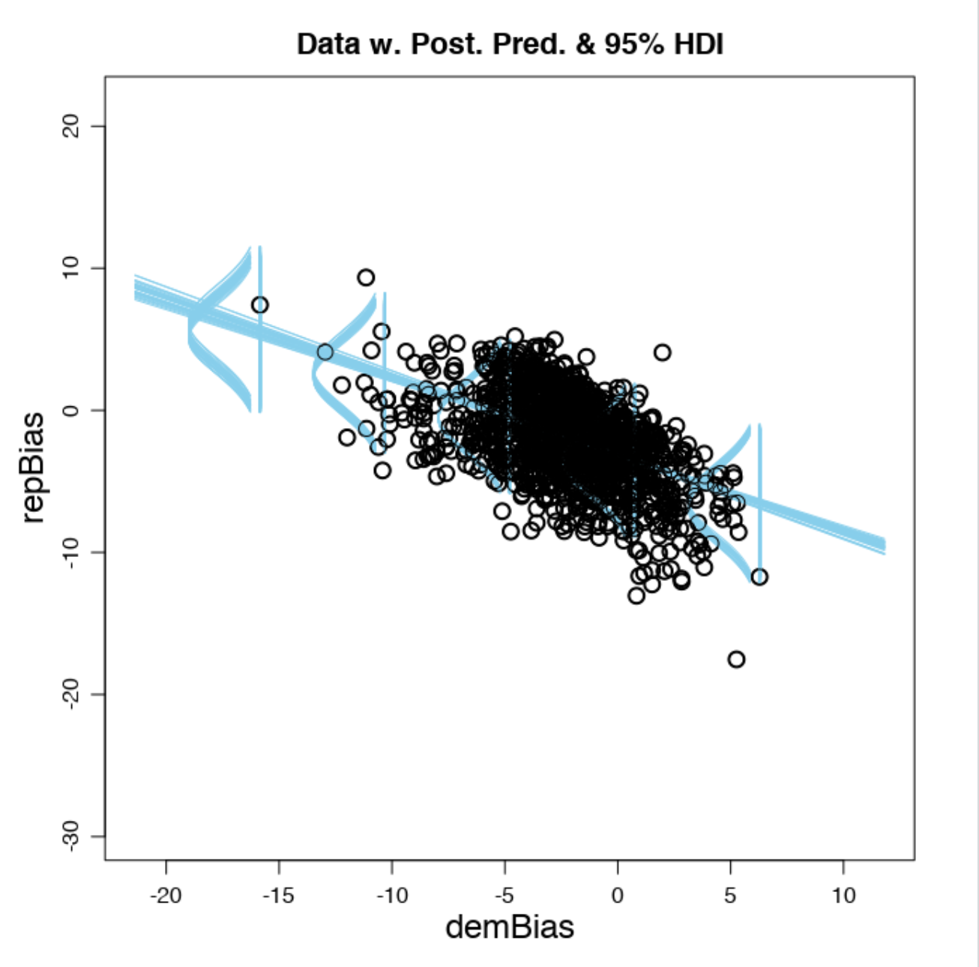
Bayesian Hierarchical Modeling to Understand Election Forecasting & Pollster Bias
Haley Reed, Professor Jake Price
University of Puget Sound
Introduction
What’s in a Model?
Conclusion
Given the closeness of recent elections, correct and accurate modeling is imperative to understanding and interpreting data from political pollsters, who often report contradictory results based on methodological differences. Even though there are many predictions available, there is still a demand for transparency in the field surrounding the mechanics and algorithms used in election forecasting.
This project employs Bayesian analysis, coupled with hierarchical modeling, to predict election outcomes, select variables, and estimate and correct pollster bias.
The hierarchical model was able to estimate distributions of true vote share with predictors including but not limited to, poll recency, pollster, delivery mode (i.e. telephone, online, etc.), sample size, and comparing registered voter versus likely voter models. Using this combination of nominal and numerical variables, a posterior model was created that states what percent of vote share is most credible to believe in for past and current elections at both state and national levels.
Variables that ended up in use in the final model:
Year
Delivery Mode: How the poll was conducted – Online? Over the phone? With a live operator? A robot caller?
Pollster: What company or institution is conducting the poll?
Transparency: A yes/no dummy variable measured by if the pollster participates in the American Association for Public Opinion Research’s Transparency Initiative and/or the Roper Center for Public Opinion Research (two organizations that promote transparency in polling)
Sample Size: the number of respondents to the poll
Likely Voter versus Registered Voter Model
Results
Bias and accuracy varies by pollster and polling methods, and to what extent can be understood with a Bayesian hierarchical modeling process.
When you see a poll, thinks that should effect how much credence you give it include the delivery mode, the pollster, the pollster’s commitment to transparency, the sample size, and the type of voting model used.
The pollster and the year themselves also produce systematic error in polls that you should be aware of.
Also, each of these variables' effects are different for the Bias of the Margin, Democratic Error, and Republican Error.
Methodology
This project utilized the statistical processing systems of R and RStudio. Additionally, JAGS (Just Another Gibbs Sampler) was used extensively to create Markov Monte Carlo simulations to produce posterior distributions for the hierarchal Bayesian models.
The final models, shown visually here as posterior predictive checks, weigh polls already corrected for bias. The distributions as a result of the hierarchal modeling can reconcile some of the differences between polled opinion and eventual vote share by using parameter values obtained from modeling a total of 953 independent general election races since 2000.
With the help of JAGS, model diagrams like those to the left, when converted to model statements, are used to predict the most credible parameter values for every parameter at every step in the model.
Further Research
The model described here could be improved with the inclusion of time series analysis. Additionally, better ways to measure transparency may offer more promising results.
Republican Bias
Acknowledgements
Democratic Bias
A special thanks goes to Jake Price for being a wonderful research advisor and to the Agricola fund donors for funding my research.
There is a relationship between democratic error and republican error, but it’s certainty not a perfect 1 to 1 relationship, and it varies by pollster and by year.
Data was retrieved from publicly available repositories. The final models summarized here used FiveThirtyEight’s collection of pollster’s reported results.

