Slide 1
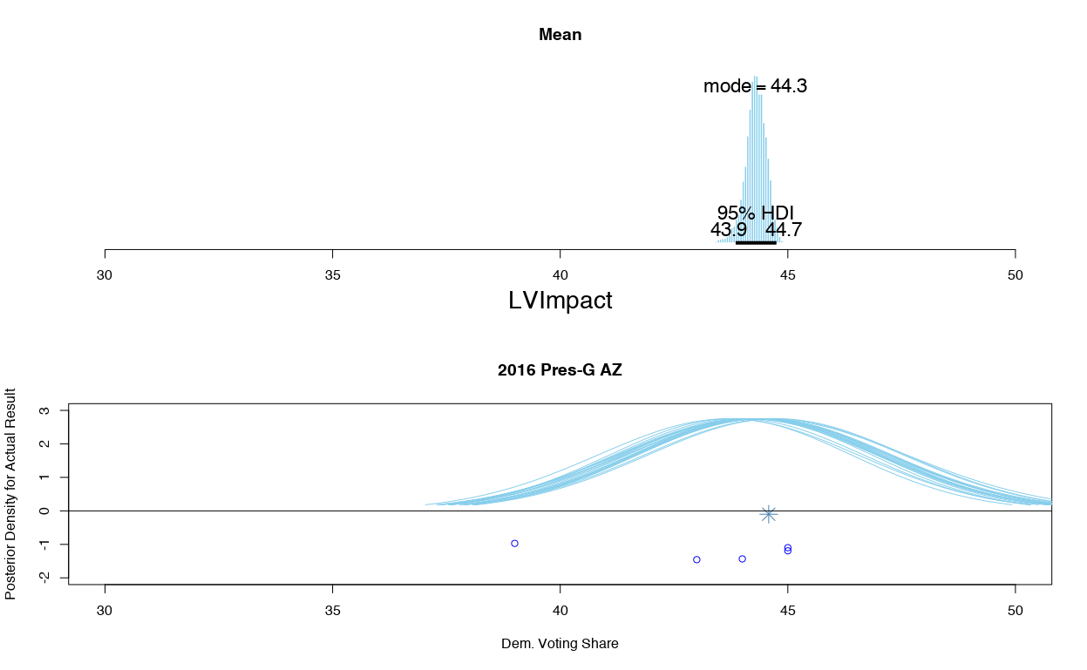
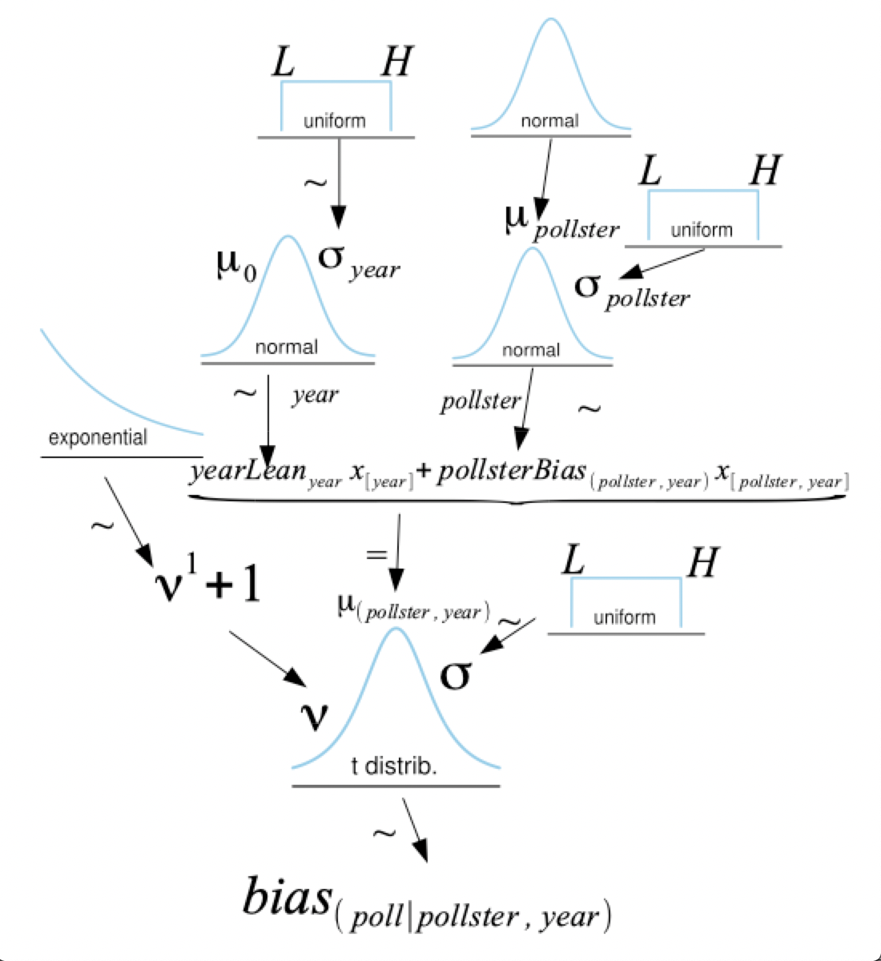
Bayesian Hierarchical Modeling to Understand Election Forecasting & Pollster Bias
Haley Reed, Professor Jake Price
University of Puget Sound
Introduction
Results
Conclusion
Given the closeness of recent elections, correct and accurate modeling is imperative to understanding and interpreting data from political pollsters, who often report contradictory results based on methodological differences. Even though there are many predictions available, but there is a demand for transparency in the field surrounding the mechanics and algorithms used in election forecasting.
This project employs Bayesian analysis, coupled with hierarchical modeling, to predict election outcomes, select variables, and estimate and correct pollster bias.
The hierarchical model was able to estimate distributions of true vote share with predictors including but not limited to, poll recency, pollster, delivery mode (i.e. telephone, online, etc.), sample size, and comparing registered voter versus likely voter models. Using this combination of nominal and numerical variables created a posterior model that states what percent of vote share is most credible to believe in for past and current elections at both the state and national levels.
What did the final models look like?
Add your information, graphs and images to this section.
Further Research
Methodology
Add your information, graphs and images to this section.
This project utilized the statistical processing systems of R and RStudio. Additionally, JAGS (Just Another Gibbs Sampler) was used extensively to create Markov Monte Carlo simulations to produce posterior distributions for the hierarchal Bayesian models.
With the help of JAGS, model diagrams like those to the left, when converted to model statements, are used to predict the most credible parameter values for every parameter at every step in the model.
Acknowledgements
Add your information, graphs and images to this section.
Data was retrieved from publicly available repositories. The final models summarized here used FiveThirtyEight’s collection of pollster’s reported results.

