Slide 1
What Noise May We Encounter?

Slide 2
Particle Gun (Borrowed from MuSun Code)
1.1% sigma around momentum mean
8.33 mm spread horizontally, 5.992 mm spread vertically
0.86 degree sigma from straight
43 MeV/c used with 2 mm target to get most stops in target

Slide 3

General Setup
Veto
Downstream Arm
Target
Germanium (Ge)
Upstream Arm
Triggers

Slide 4
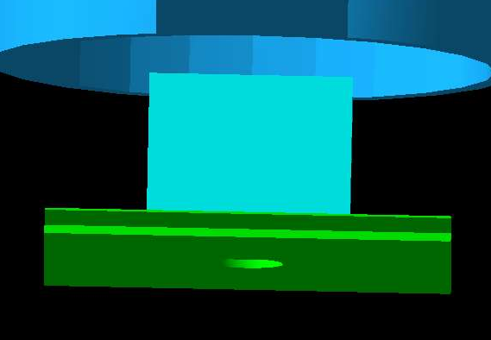
Upstream Detectors
MWPC (MuPC)
MuSC
MuSCA
(Anticoincidence with MuSC, must go through hole)

Slide 5

Arms
Veto
Thin counter (dE)
Thick counter (E)

Slide 6
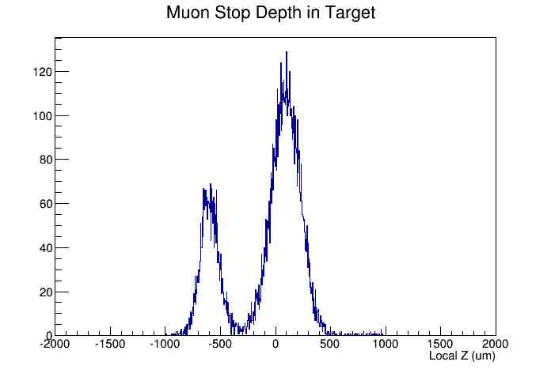
Muon Stops
Through Hole
Passing through MuSCA
After seeing this, adjusted particle gun to produce fewer muons not passing through MuSCA hole.

Slide 7
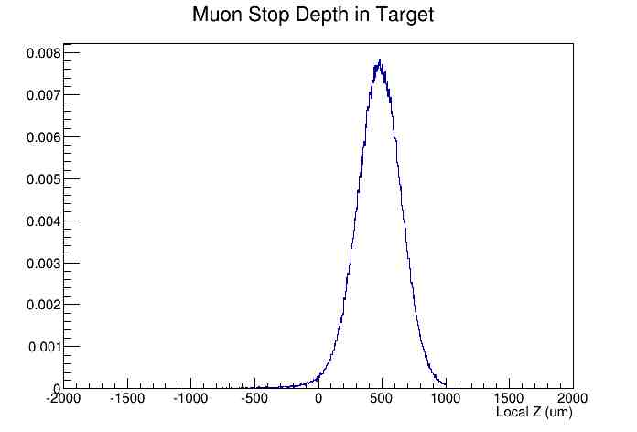
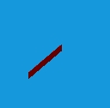
Muon Stops
82.7% of the muons are here.
+z
Upstream face
Downstream face

Slide 8
Signal (400,000 simulated muons)
56 protons from target to downstream thin detector (dE)
41 make it through to thick downstream detector (E)
38 do not make it through to downstream veto
For upstream, respective numbers are 24, 22, and 18
We would expect to 56 events under these circumstances

Slide 9
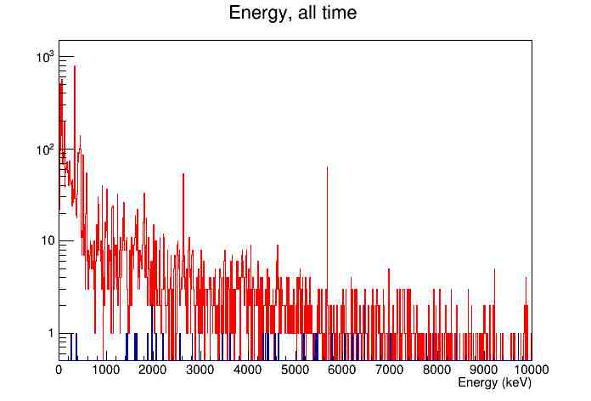
Noise
The red line represents the energy of entering muons, electrons, and photons in the downstream thin dE detector and the blue the protons with no time cut.

Slide 10
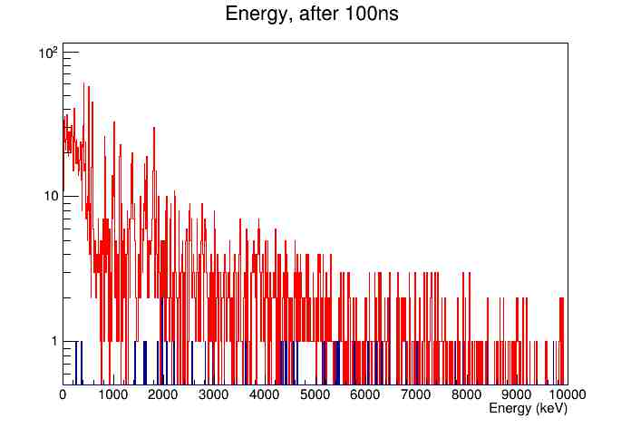
Noise
After 100ns...

Slide 11
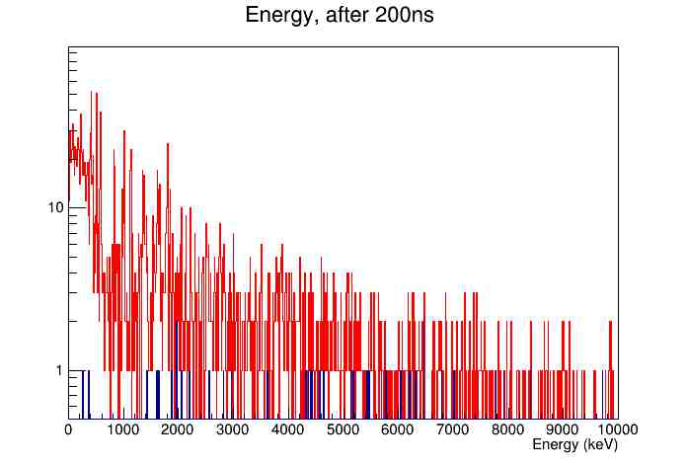
Noise

Slide 12
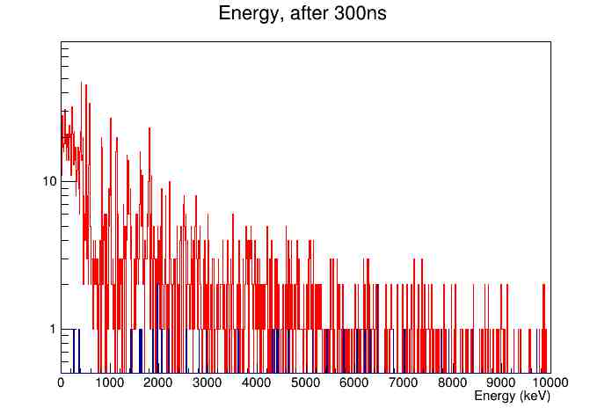
Noise

Slide 13
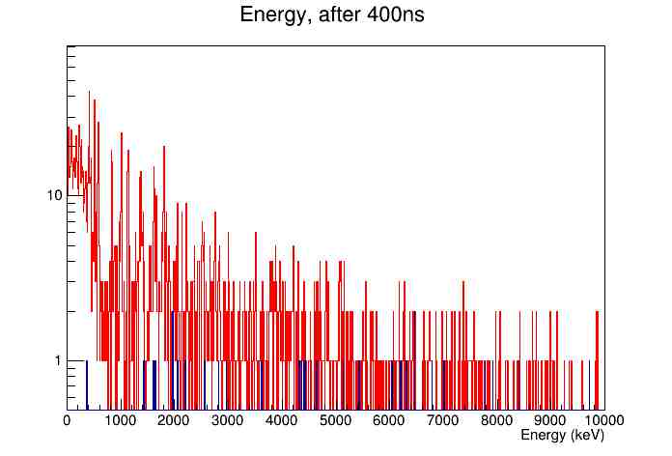
Noise

Slide 14
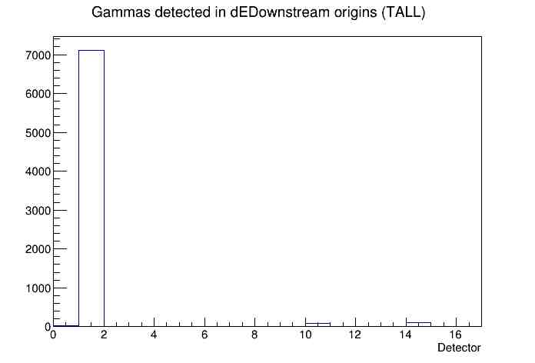
And where are they coming from?
X-axis:
0. MuSC
1. Target
2. Veto
3. Thin upstream
4. Thick upstream
5. Veto upstream
6. Thin downstream
7. Thick Downstream
8. Veto downstream
9. Ge
10. Chamber
11. MuSCA
12. MuPC
14. Collimator
13,15,16 are invalid
“Detected” here means “Entering.” As in the majority of the photons entering the downstream dE detector were produced in the target.
The horizontal axis indicates which detector the photons (detected in the downstream thin detector) came from. The majority is the target (bin 1), some also come from the MuSC (bin 0), many from the chamber (bin 10), and also from the collimator (14).

Slide 15
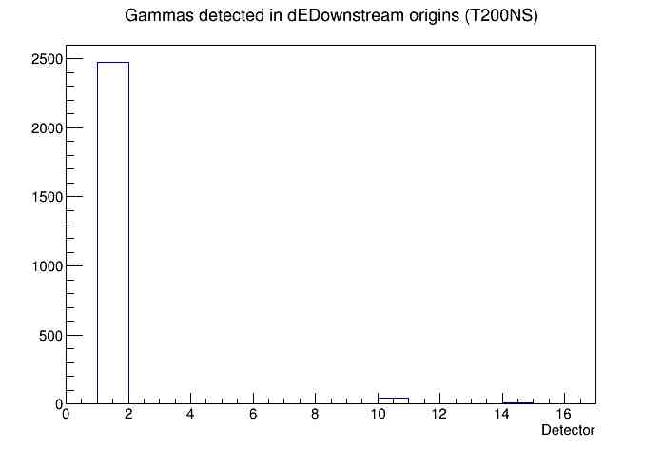
And where are they coming from?
X-axis:
0. MuSC
1. Target
2. Veto
3. Thin upstream
4. Thick upstream
5. Veto upstream
6. Thin downstream
7. Thick Downstream
8. Veto downstream
9. Ge
10. Chamber
11. MuSCA
12. MuPC
14. Collimator
13,15,16 are invalid
And after 200ns, the number from all sources has decreased. The chamber has increased in its contribution to gammas in the downstream thin detector, but we also have low statistics. The lead seems to have decreased in its relative contribution here.

Slide 16

And where are they coming from?
X-axis:
0. MuSC
1. Target
2. Veto
3. Thin upstream
4. Thick upstream
5. Veto upstream
6. Thin downstream
7. Thick Downstream
8. Veto downstream
9. Ge
10. Chamber
11. MuSCA
12. MuPC
14. Collimator
13,15,16 are invalid
There are electrons coming from pretty far upstream. But not many. Most, again, come from the target.

Slide 17
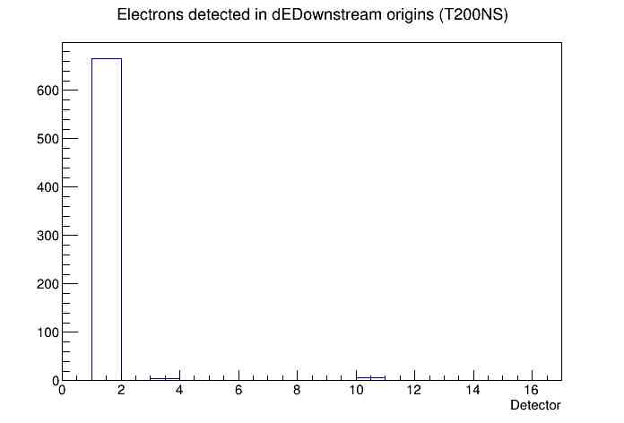
And where are they coming from?
X-axis:
0. MuSC
1. Target
2. Veto
3. Thin upstream
4. Thick upstream
5. Veto upstream
6. Thin downstream
7. Thick Downstream
8. Veto downstream
9. Ge
10. Chamber
11. MuSCA
12. MuPC
14. Collimator
13,15,16 are invalid
Killed the ones from upstream.

Slide 18
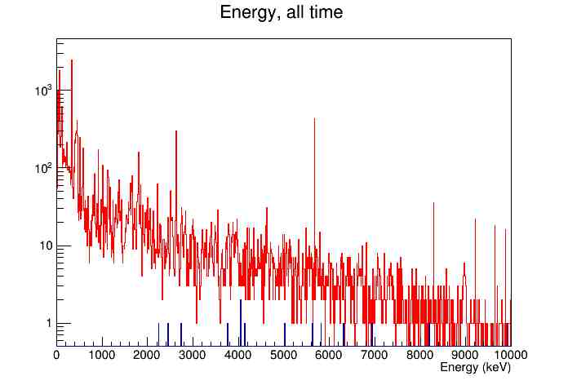
Upstream Thin Counter

Slide 19
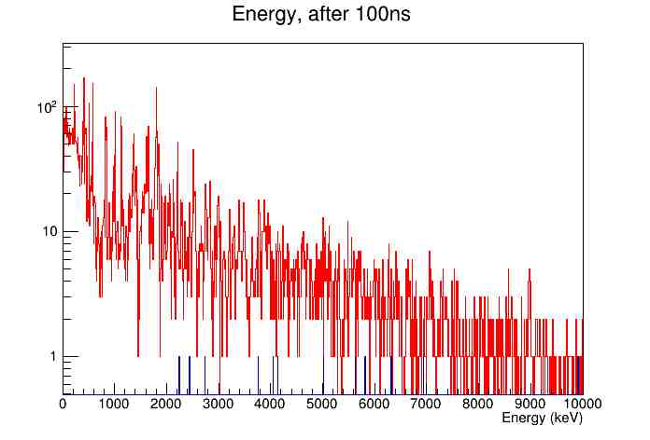
Upstream Thin Counter

Slide 20
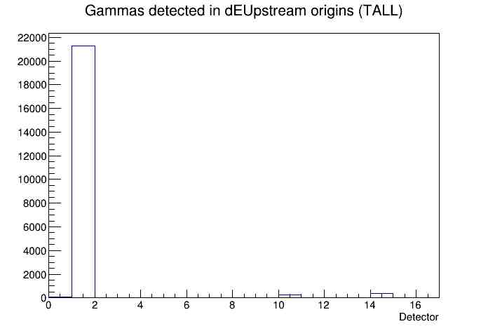
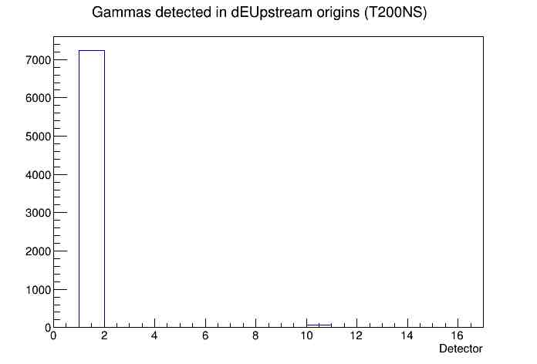
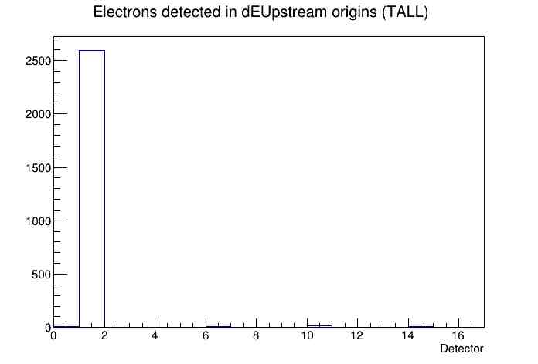
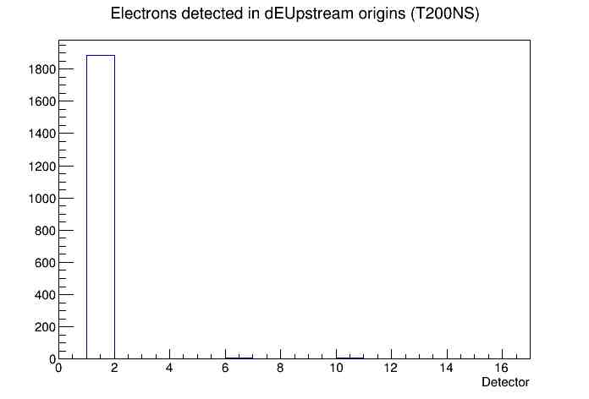
Upstream Thin Counter
X-axis:
0. MuSC
1. Target
2. Veto
3. Thin upstream
4. Thick upstream
5. Veto upstream
6. Thin downstream
7. Thick Downstream
8. Veto downstream
9. Ge
10. Chamber
11. MuSCA
12. MuPC
14. Collimator
13,15,16 are invalid
Notice there are a ton more hits here from just the target. In this setup, the target is much closer to the upstream arm.

Slide 21
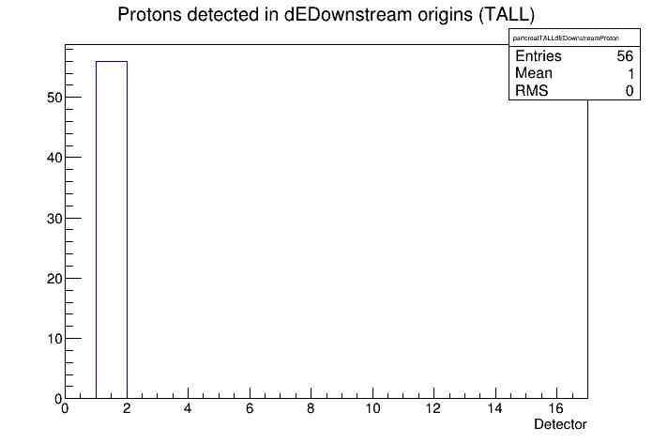
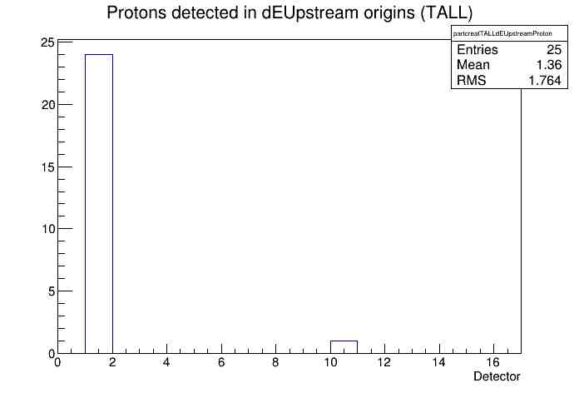
Difference between arms
Presumably because all the muons stopped at the far face of the target, the downstream arm saw a greater signal.
X-axis:
0. MuSC
1. Target
2. Veto
3. Thin upstream
4. Thick upstream
5. Veto upstream
6. Thin downstream
7. Thick Downstream
8. Veto downstream
9. Ge
10. Chamber
11. MuSCA
12. MuPC
14. Collimator
13,15,16 are invalid

Slide 22
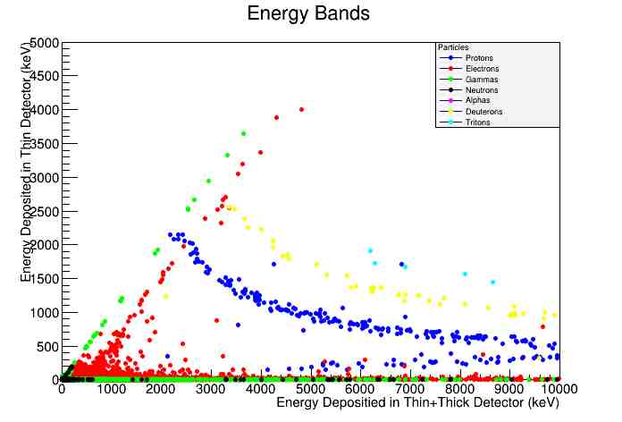
Can we tell the difference?

Slide 23
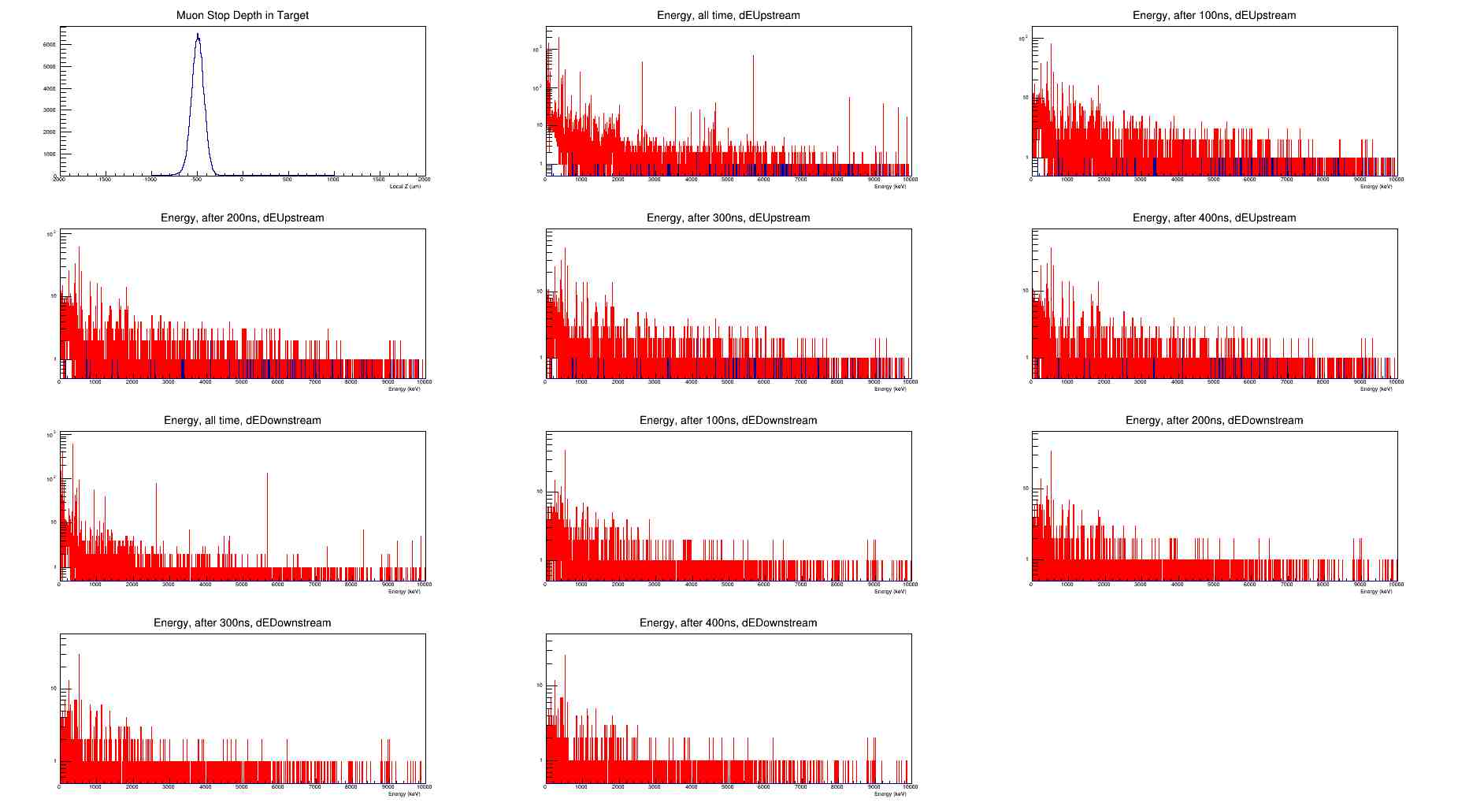
Difference between faces
If we lower the muons to stop nearer to the upstream face, we see what we'd expect
(Only 68% muons stop in target.)

Slide 24
Thin Target
More noise from other locations?
Combined with lower signal rate

Slide 25
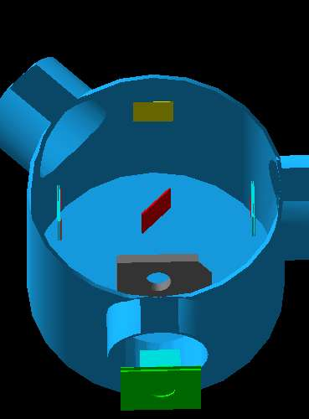
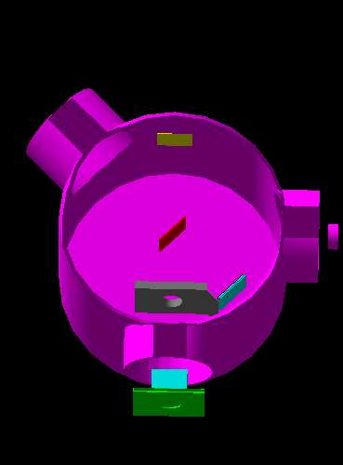
To do...

