Slide 1
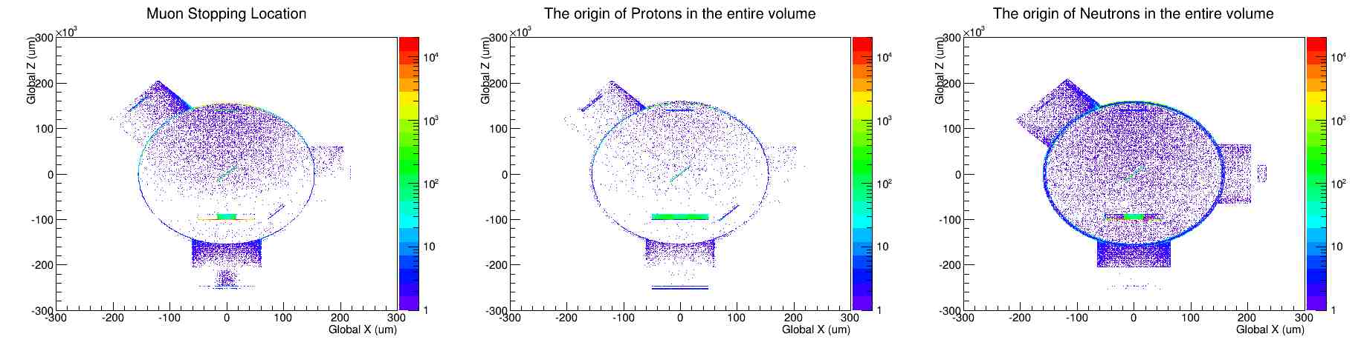
Brief Muon Stops

Slide 2
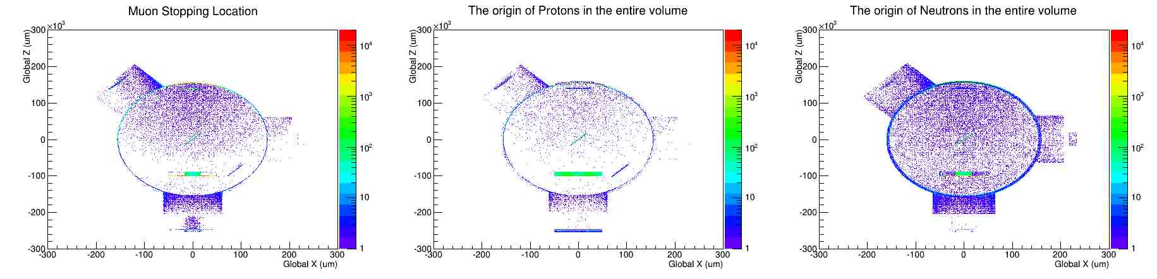
Brief Muon Stops
Cuts down muons here
Absorber

Slide 3
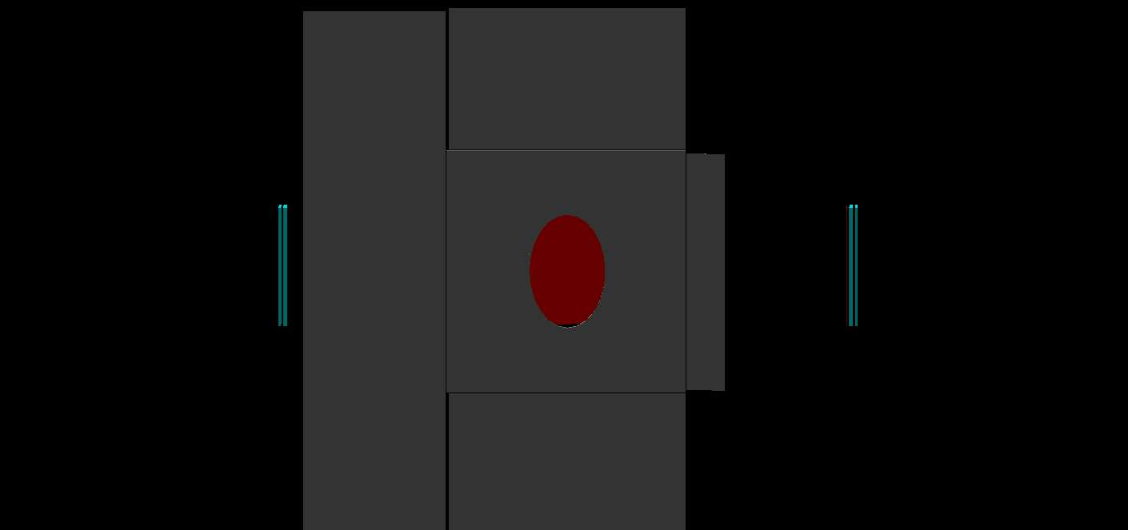
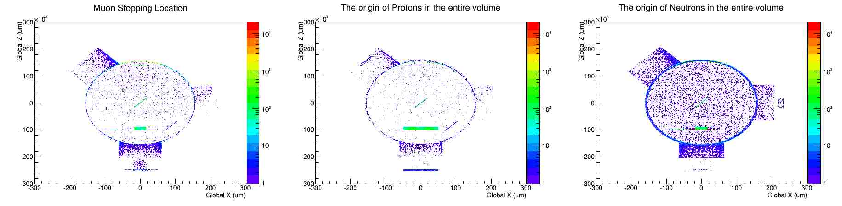
Brief Muon Stops
Shielding
Fewer stops in chamber

Slide 4
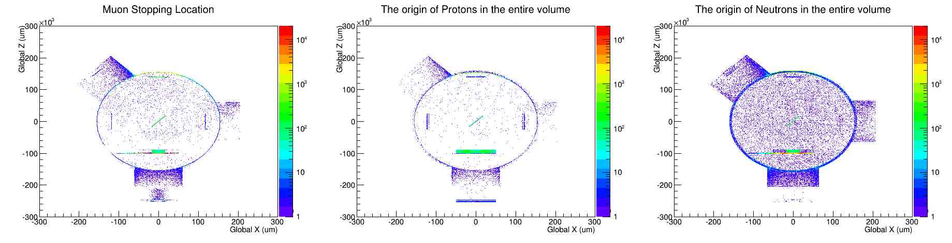
Brief Muon Stops
90 Degree Setup (with shielding)

