Slide 1
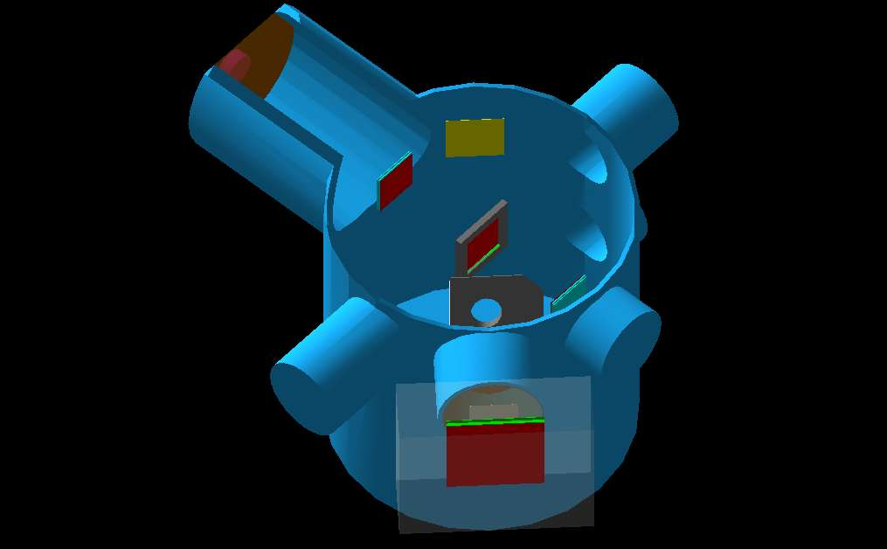
An Attempt to Reproduce the Old Energy Spectrum
Collimator in cruddy location: line of sight from beam window
6 cm x 6 cm beam veto
5 cm x 5 cm target

Slide 2
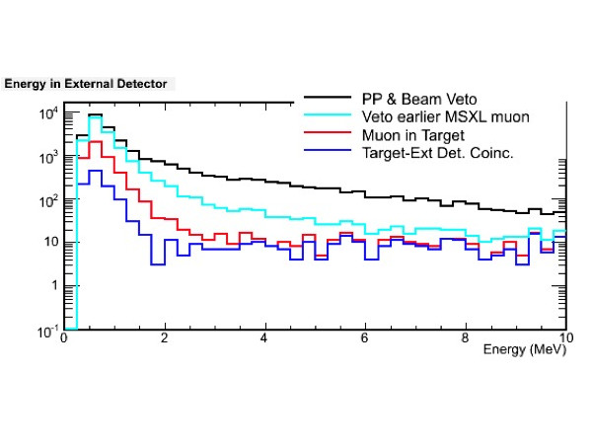
What are we trying to reproduce?

Slide 3
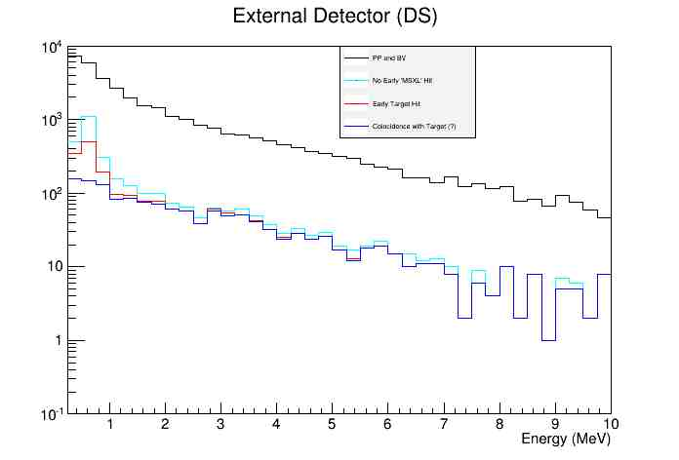
Our graphs....

Slide 4
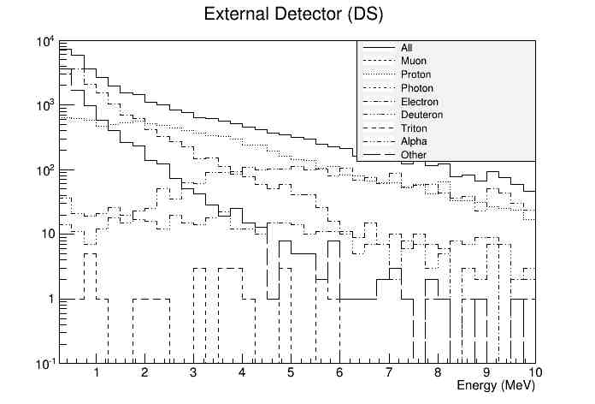
Particle Composition

Slide 5
Particle Composition
E800ns>250 keV
 | Muons | Protons | Electrons | Photons | Deuterons | Tritons | Alphas | Other
PP/BV | 0.0% | 26.1% | 42.3% | 0.0% | 1.4% | 0.1% | 6.4% | 23.8%
NoSi | 0.0% | 20.8% | 72.9% | 0.0% | 1.3% | 0.2% | 3.9% | 0.9%
MuStp | 0.0% | 30.3% | 61.7% | 0.0% | 1.5% | 0.2% | 5.3% | 1.0%
E800ns>2 MeV
 | Muons | Protons | Electrons | Photons | Deuterons | Tritons | Alphas | Other
PP/BV | 0.0% | 49.9% | 20.9% | 0.0% | 3.1% | 0.2% | 20.5% | 5.4%
NoSi | 0.0% | 63.3% | 17.8% | 0.0% | 4.3% | 0.6% | 13.0% | 1.0%
MuStp | 0.0% | 67.8% | 13.5% | 0.0% | 3.7% | 0.7% | 13.2% | 1.0%

Slide 6
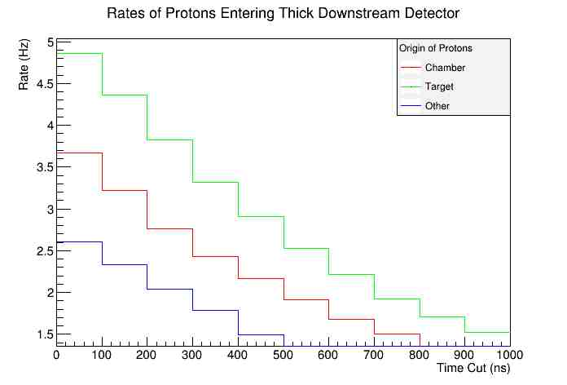
Rates
No cuts in these rates plots other than time

Slide 7
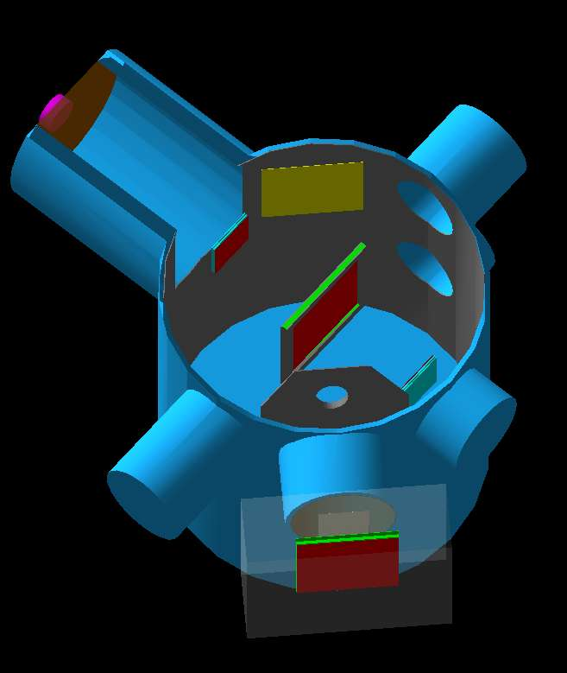
Possible Current Setup
10 cm veto
10 cm target
More shielding upstream
Lead lining downstream (180 degree coverage plus half the roof)
First we'll look at a chamber without the lining

Slide 8
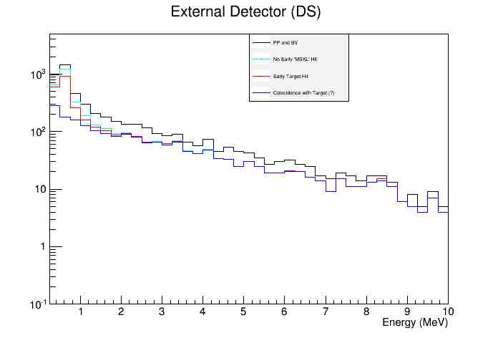
Spectrum

Slide 9
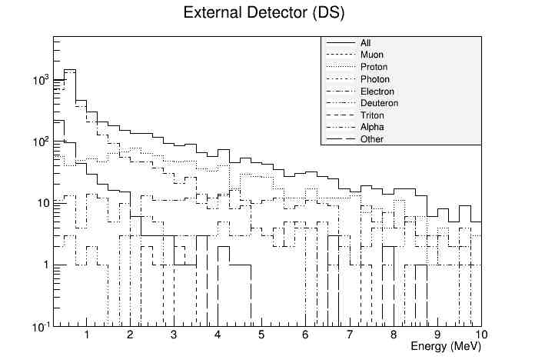
Particle Composition

Slide 10
Particle Composition
E800ns>250 keV
 | Muons | Protons | Electrons | Photons | Deuterons | Tritons | Alphas | Other
PP/BV | 0.0% | 18.8% | 73.7% | 0.0% | 1.9% | 0.2% | 4.4% | 1.0%
NoSi | 0.0% | 18.8% | 73.8% | 0.0% | 0.2% | 1.9% | 4.4% | 0.9%
MuStp | 0.0% | 23.0% | 68.6% | 0.0% | 2.3% | 0.2% | 5.3% | 0.5%
E800ns>2 MeV
 | Muons | Protons | Electrons | Photons | Deuterons | Tritons | Alphas | Other
PP/BV | 0.0% | 45.9% | 36.1% | 0.0% | 5.7% | 0.5% | 11.6% | 0.2%
NoSi | 0.0% | 45.9% | 36.2% | 0.0% | 0.5% | 5.7% | 11.6% | 0.2%
MuStp | 0.0% | 58.3% | 19.0% | 0.0% | 7.2% | 0.6% | 14.7% | 0.1%

Slide 11
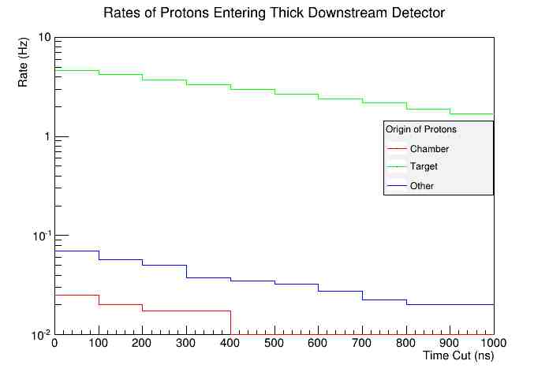
Rates (again, without the lining)

Slide 12
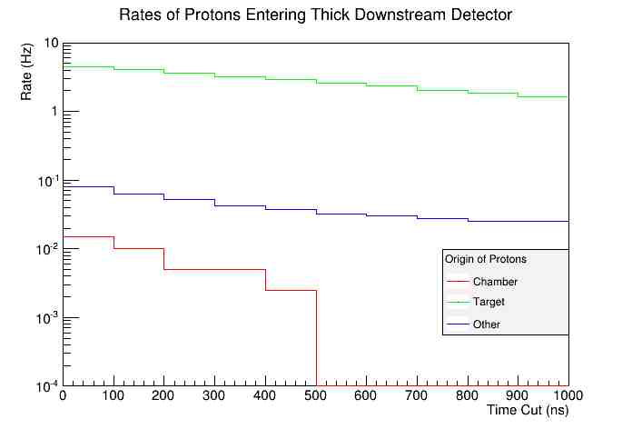
Rates (with lining)

Slide 13
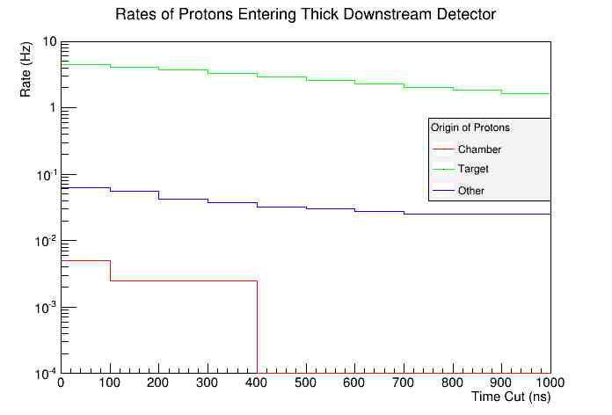
Rates (90 Degree setup)

Slide 14
Conclusions thus far
Further shielding upstream a necessity, though this is not news to anyone
Lead lining downstream may not be necessary even with thin target
90 degree setup seems a bit better for the proton rates, still have to check particle spectrum

