Slide 1
Thresholds

Slide 2
Time cut is 800 ns
Reolutions:
  Thick Si-- 303 keV
  Thin Si-- 33 keV
  Plastic-- 50 keV
Noise:
  Gaussian with mean 0 keV and sigma 20 keV added to every reading
  Legend:
    Blue-- Original
    Red-- Time cut
    Green-- Time Cut + Resolution + Noise

Slide 3
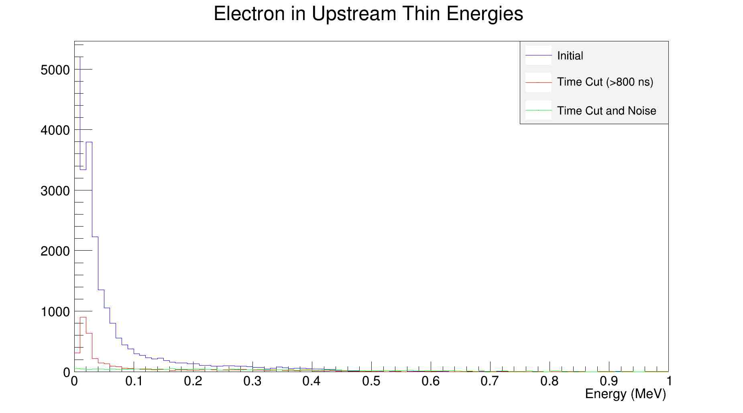
Electrons

Slide 4
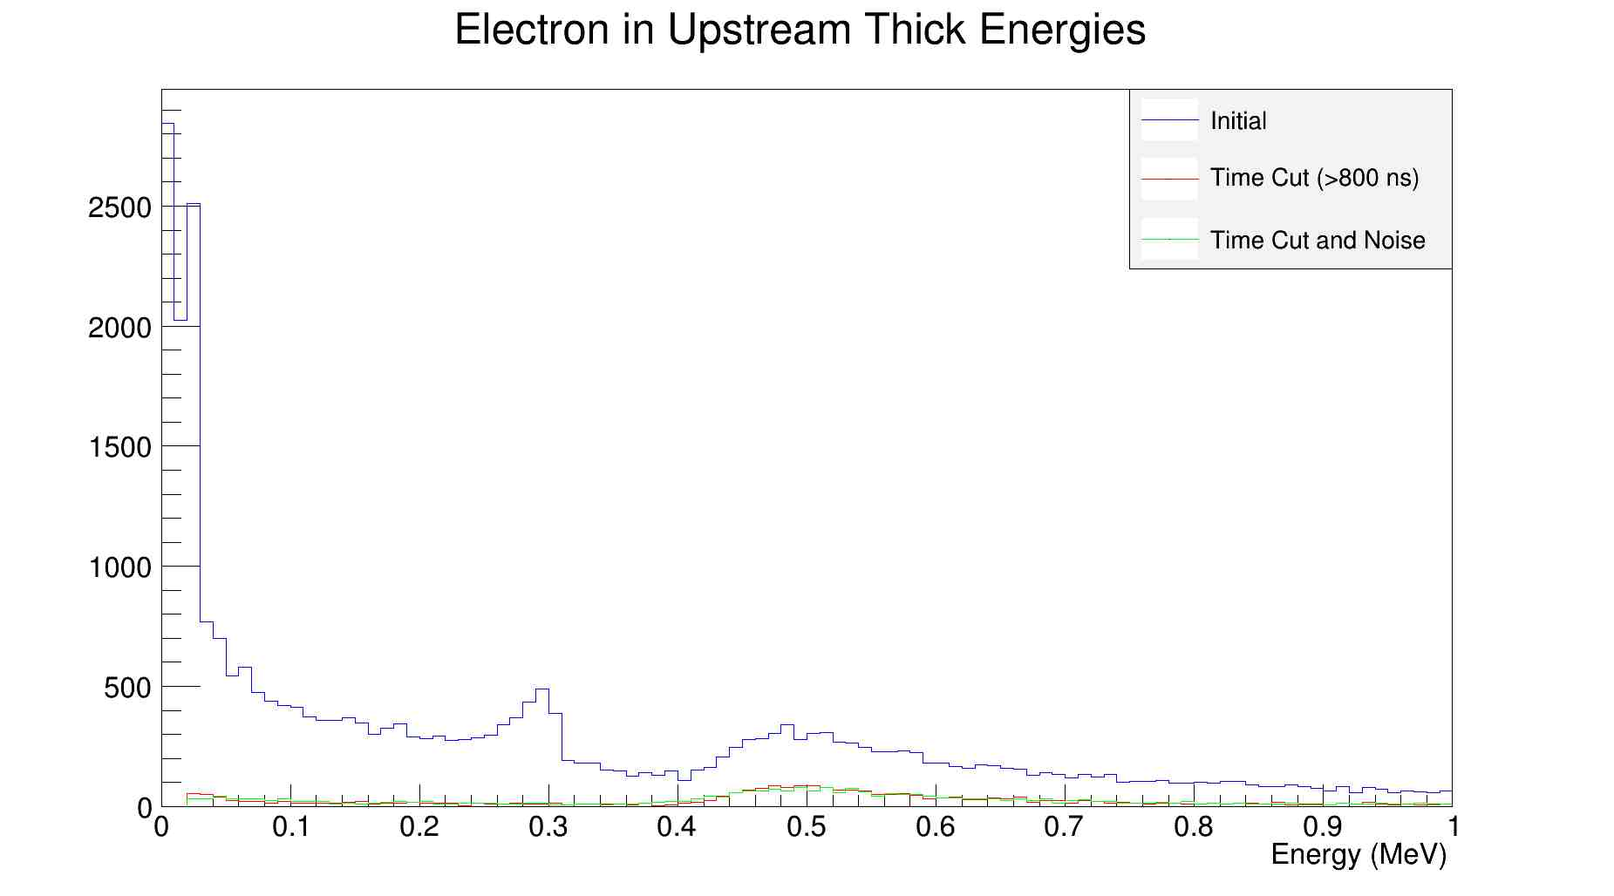
Electrons
?

Slide 5
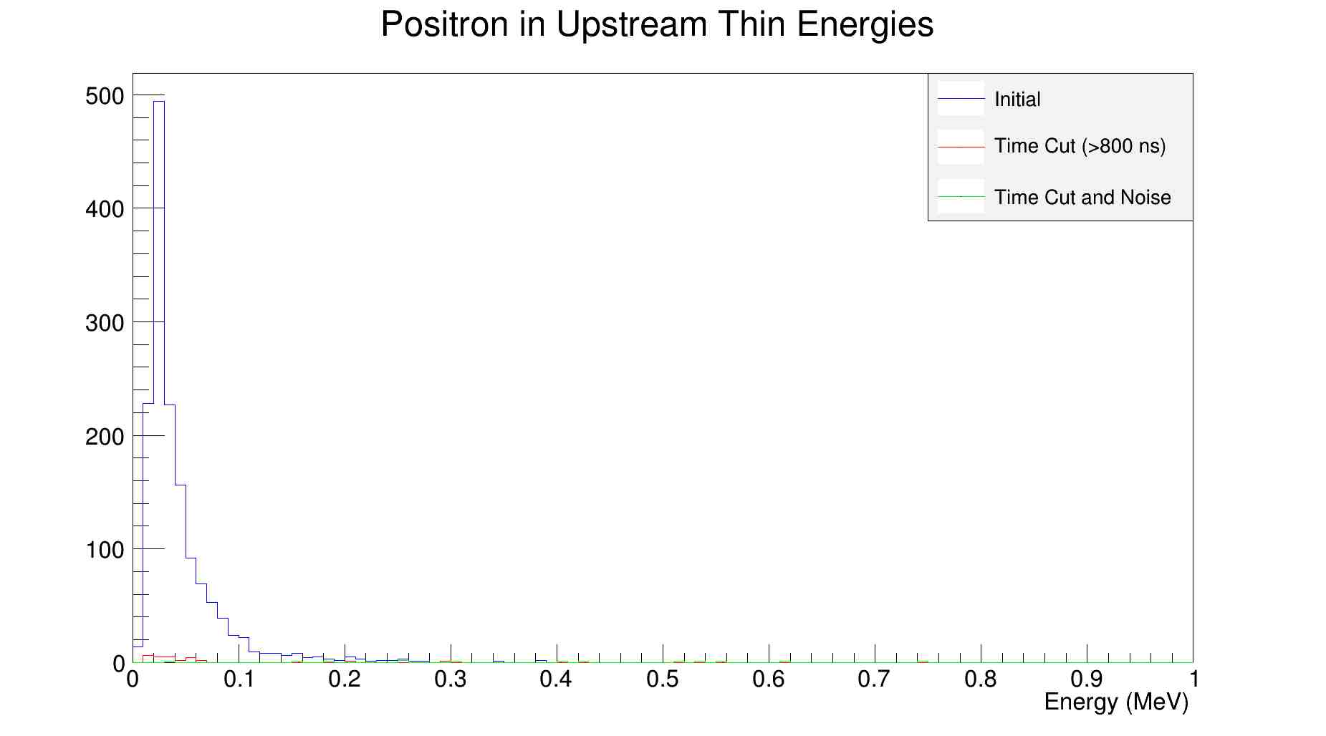
Positrons

Slide 6
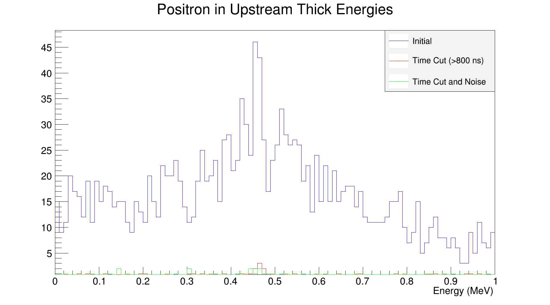
Positrons

Slide 7
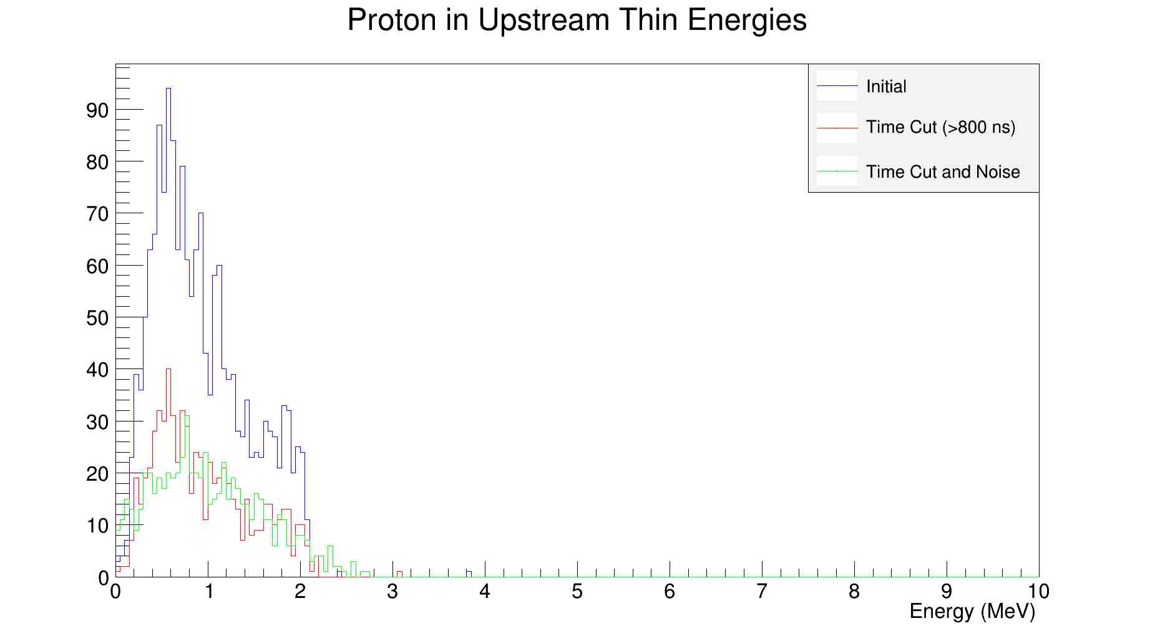
Protons

Slide 8
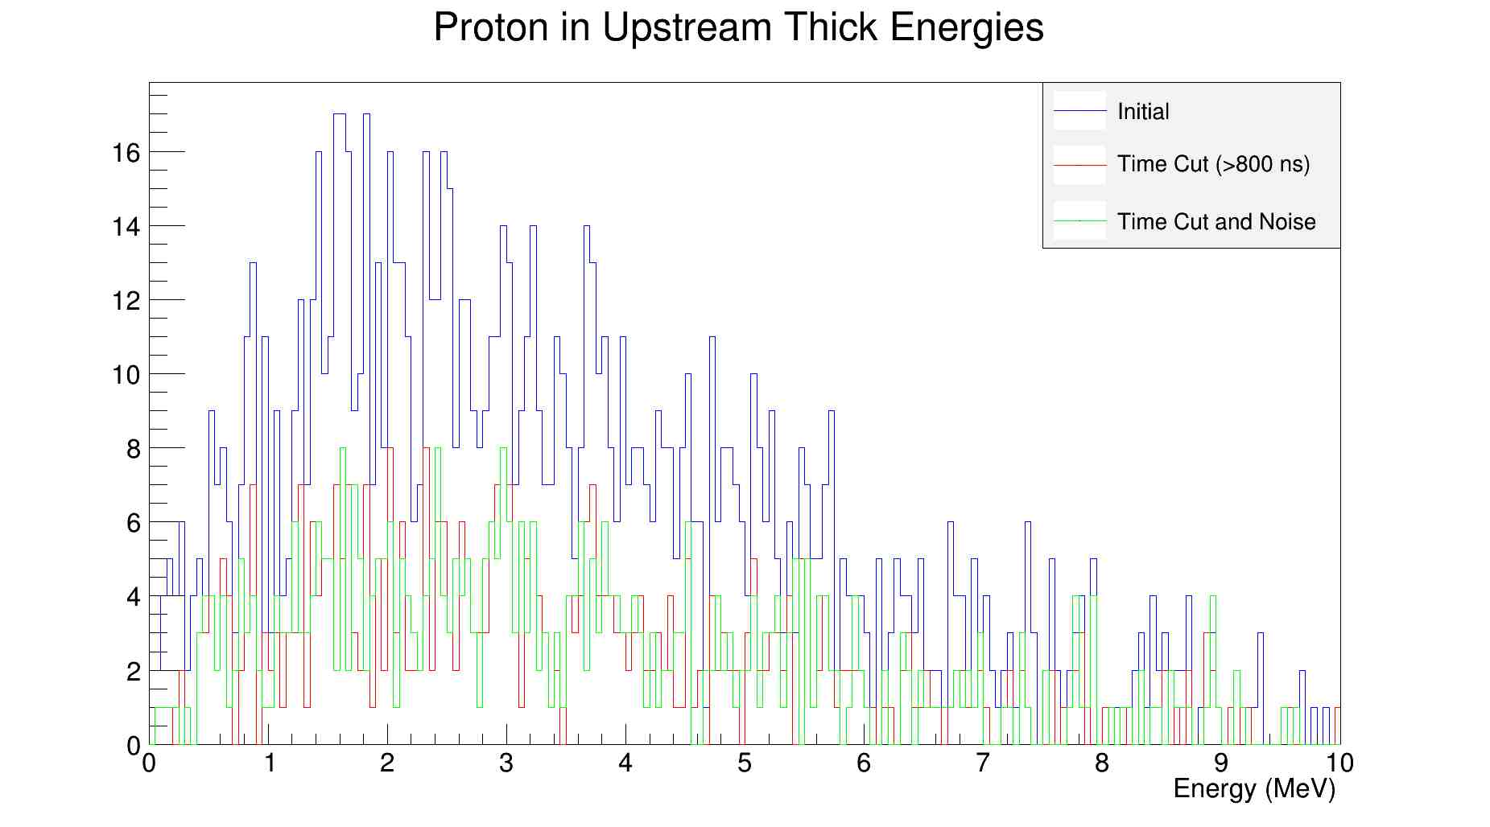
Protons
Energy cut ~ 1MeV

Slide 9
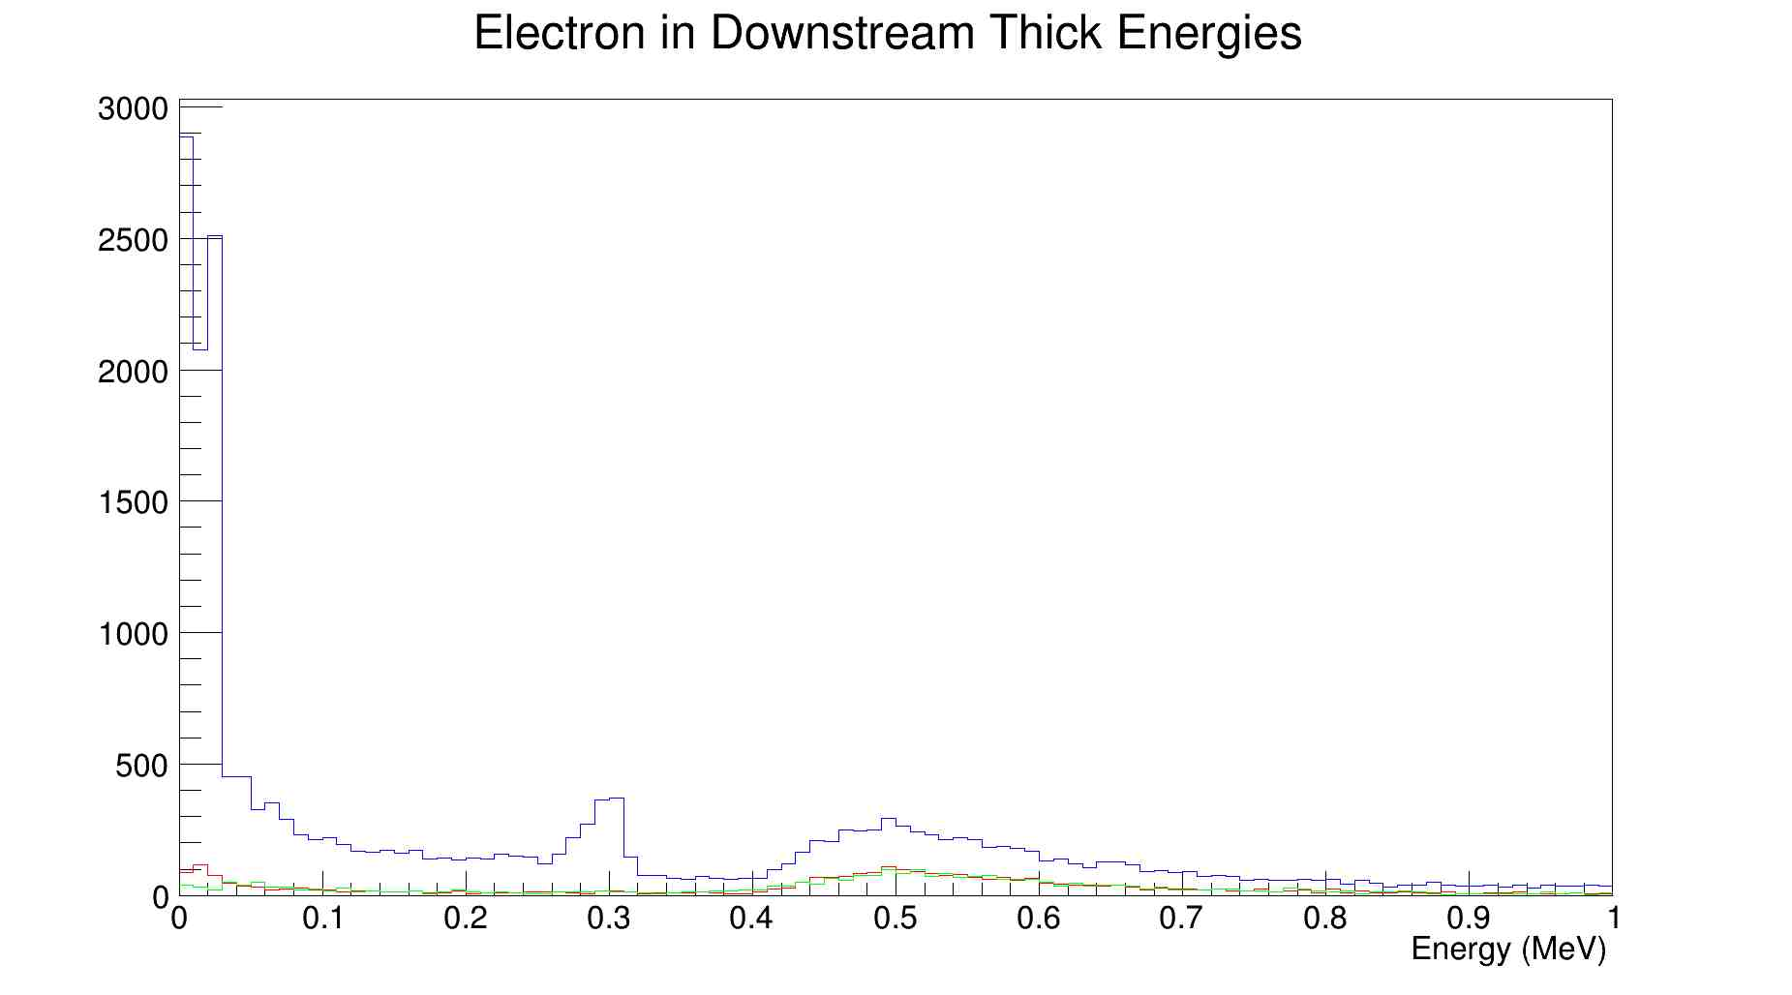
Downstream (same)

Slide 10
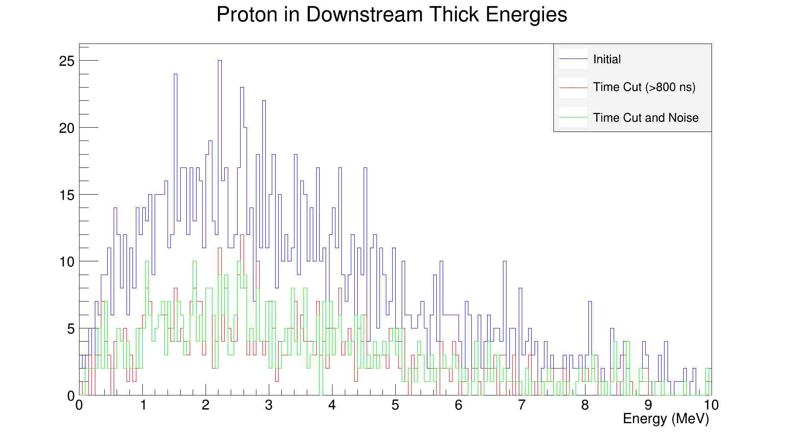
Downstream

