Slide 1
Pseudo-Data
MC
Event
TPulseIsland
Vector Map
Pseudo
Event

Slide 2
MC Event
= Energy Deposition Hit Information (Energy, Time, Particle ID, Detector ID)
(< 1 ns)
Time
Muon transport in MuSC
Muon atomic capture in Targ
Muon decay in Targ
Proton passing through SiL1 or SiR1 (Thin Silicon)
Proton stopping in SiL2 or SiR2 (Thick Silicon)

Slide 3
MC Event to TPulseIslands
Time
T = Time of first energy deposition hit
D = Detector
E = Total energy in energy deposition hits from first hit to 1 ns later

Slide 4
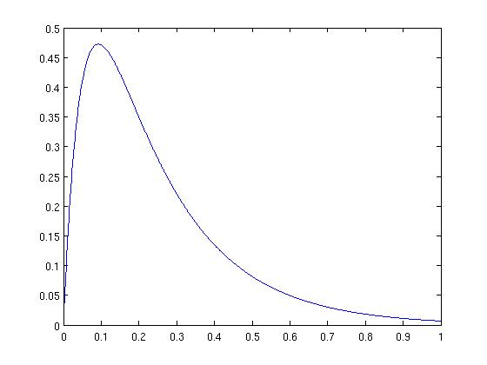
MC Event to TPulseIslands
Time
T = Time of first energy deposition hit
D = Detector
E = Total energy in energy deposition hits from first hit to 1 ns later
A = Amplitude
tD = Decay time
tR = Rise time

Slide 5
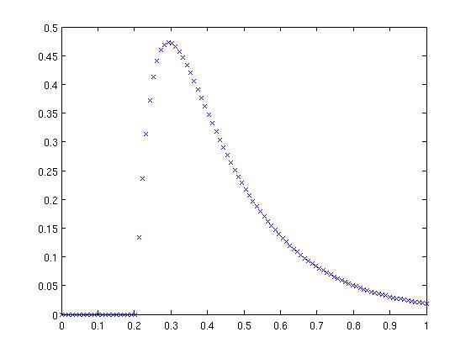
MC Event to TPulseIslands
Time
T = Time of first energy deposition hit since muon was generated
D = Detector
E = Total energy in energy deposition hits from first hit to 1 ns later
A = Amplitude
tD = Decay time
tR = Rise time

Slide 6
MC Event to TPulseIslands
T

Slide 7
MC Event to TPulseIslands
TPulseIsland:
Vector of samples
Time of first tick
Tick Length (1 / Dig. Freq.)
Bank name

Slide 8
MC Event to TPulseIslands
TPulseIsland:
Vector of samples
Time of first tick
Tick Length (1 / Dig. Freq.)
Bank name
Time of First Tick
For each new MC event, add a random time chosen from
to all energy deposition hit times in that MC event
Collect all TPulseIslands into vectors corresponding to detectors, which are not necessarily time ordered (different from Peter W.'s step)
Stop when cumulative time is greater than 10 ms, package it up, then restart

Slide 9
TPulseIsland Vector Map
Time
10 ms window is entry in tree of TGlobalData
TGlobalData = Map of bank names (detectors) to vectors of TPulseIslands
Bank List
MuSC
Targ
Targ_TFA
Veto
SiR1
SiR1_TFA
SiR2
SiR2_TFA
ScR
SiL1
SiL1_TFA
SiL2
SiL2_TFA
ScL
Input Parameters
Rise times
Decay times
Polarity
Threshold
Pedestal
Energy to ADC
  Maximum energy
  Bits

Slide 10
TPulseIsland Vector Map to Event
Just will follow current setup as laid out in Peter W's elog (86)
post of his, Michael's, and Volodya's slides

