Slide 1
90 Deg vs. 135 Deg
Number of Muons Scattered Into Downstream
Angle | Normalized to Pileup Protection and Beam Vetos | Normalized to Primary Stops in Target
135 deg | 86.9571E-5 | 56.2194E-3
90 deg | 3.7938E-5 | 02.4545E-3

Slide 2
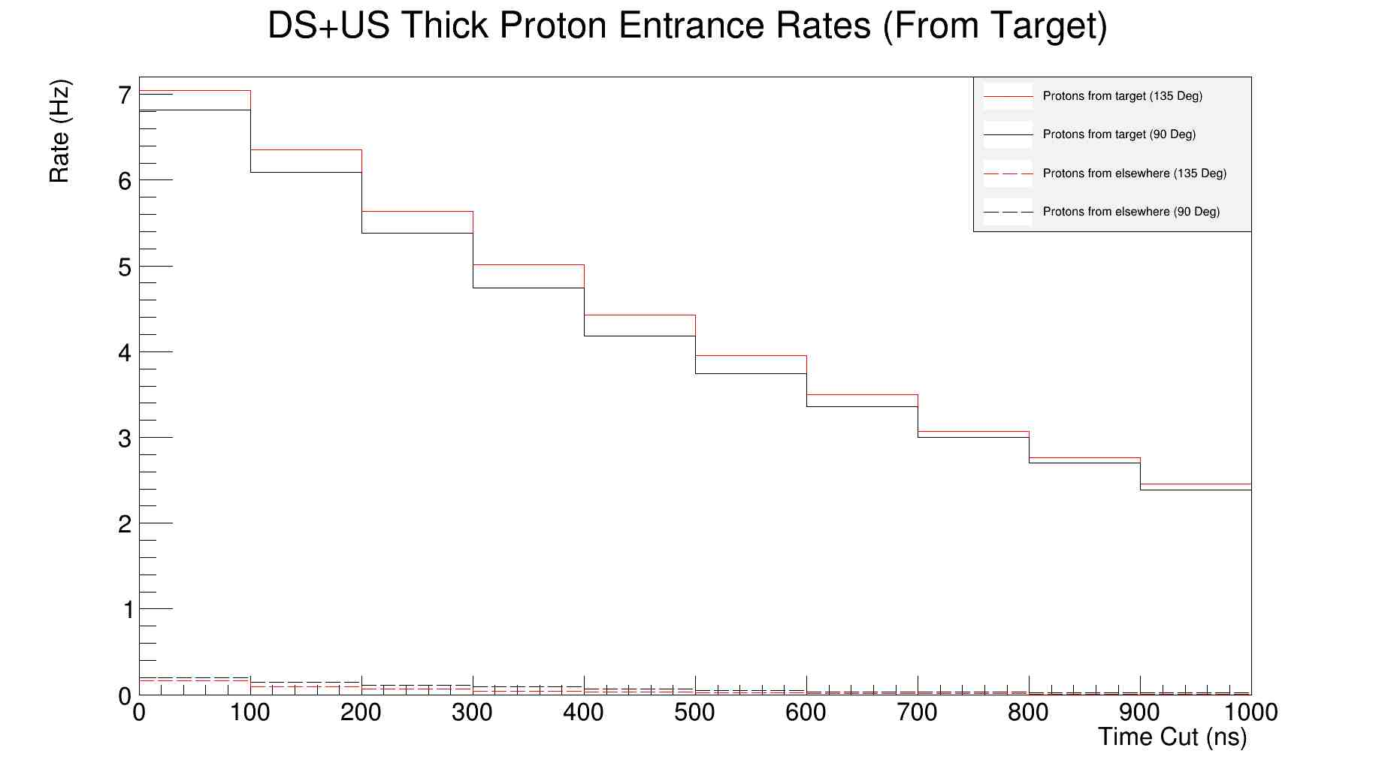
Proton Rates

Slide 3
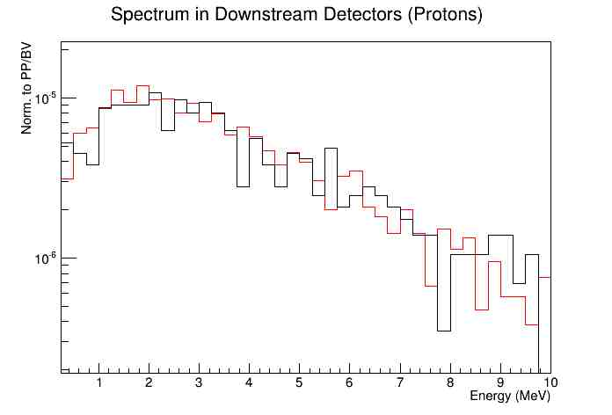
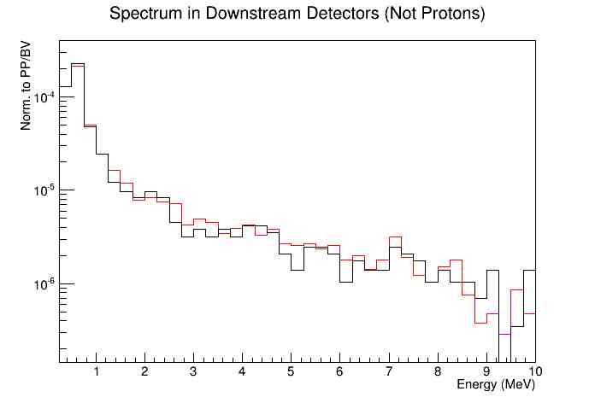
Energies
135 Deg
90 Deg

Slide 4
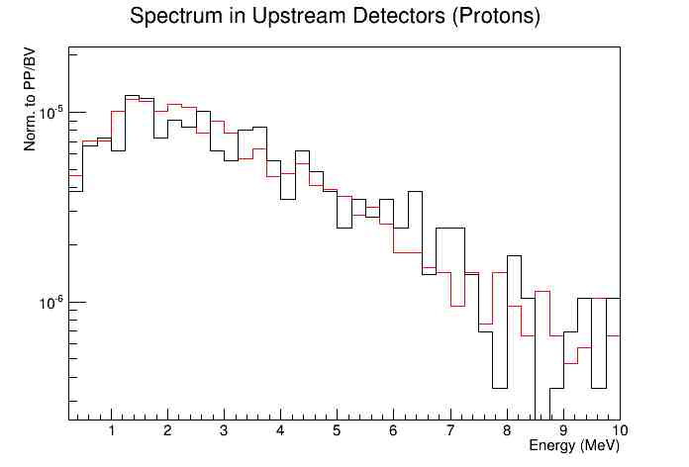
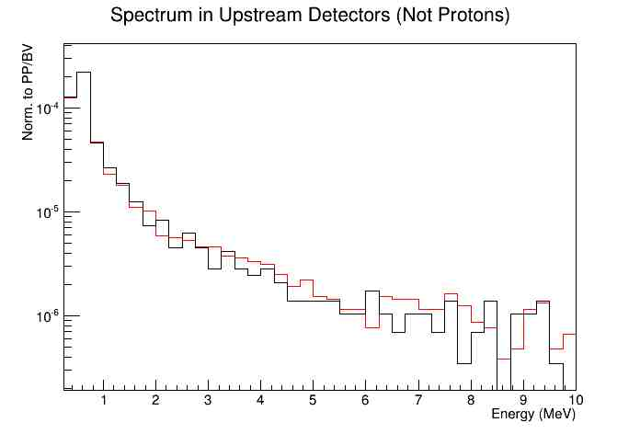
Energies
135 Deg
90 Deg

Slide 5
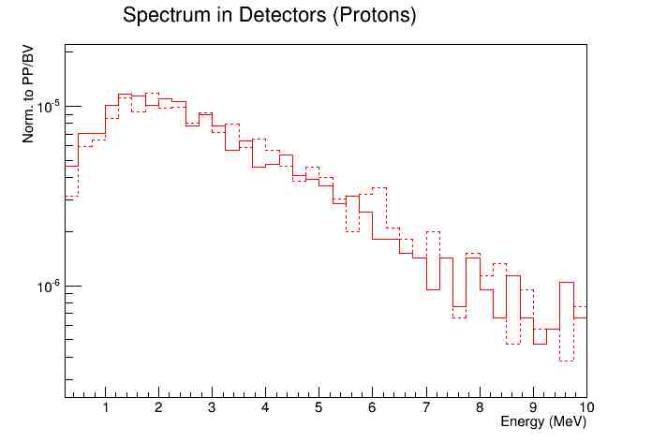
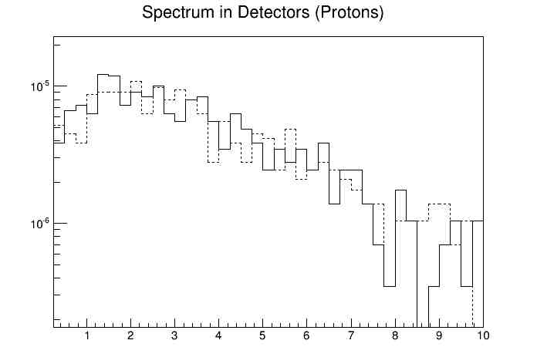
US/DS
Upstream (Beam Right): Solid Line
Downstream (Beam Left): Dotted Line

Slide 6
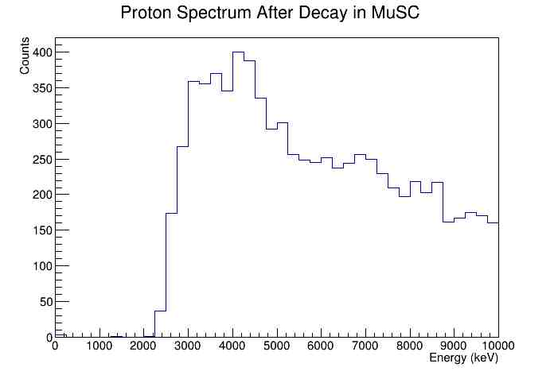
MuSc inside chamber?
~25% as many muons stop in MuSC as in Target (for beam momentum maximizing stops in thin target)
If valid event := !(muSCA | muVeto | ScL | ScR) & muSc
  15% primary stops in target per valid event when beam counter outside chamber
  75% primary stops in target per valid event when beam counter inside chamber

