Slide 1
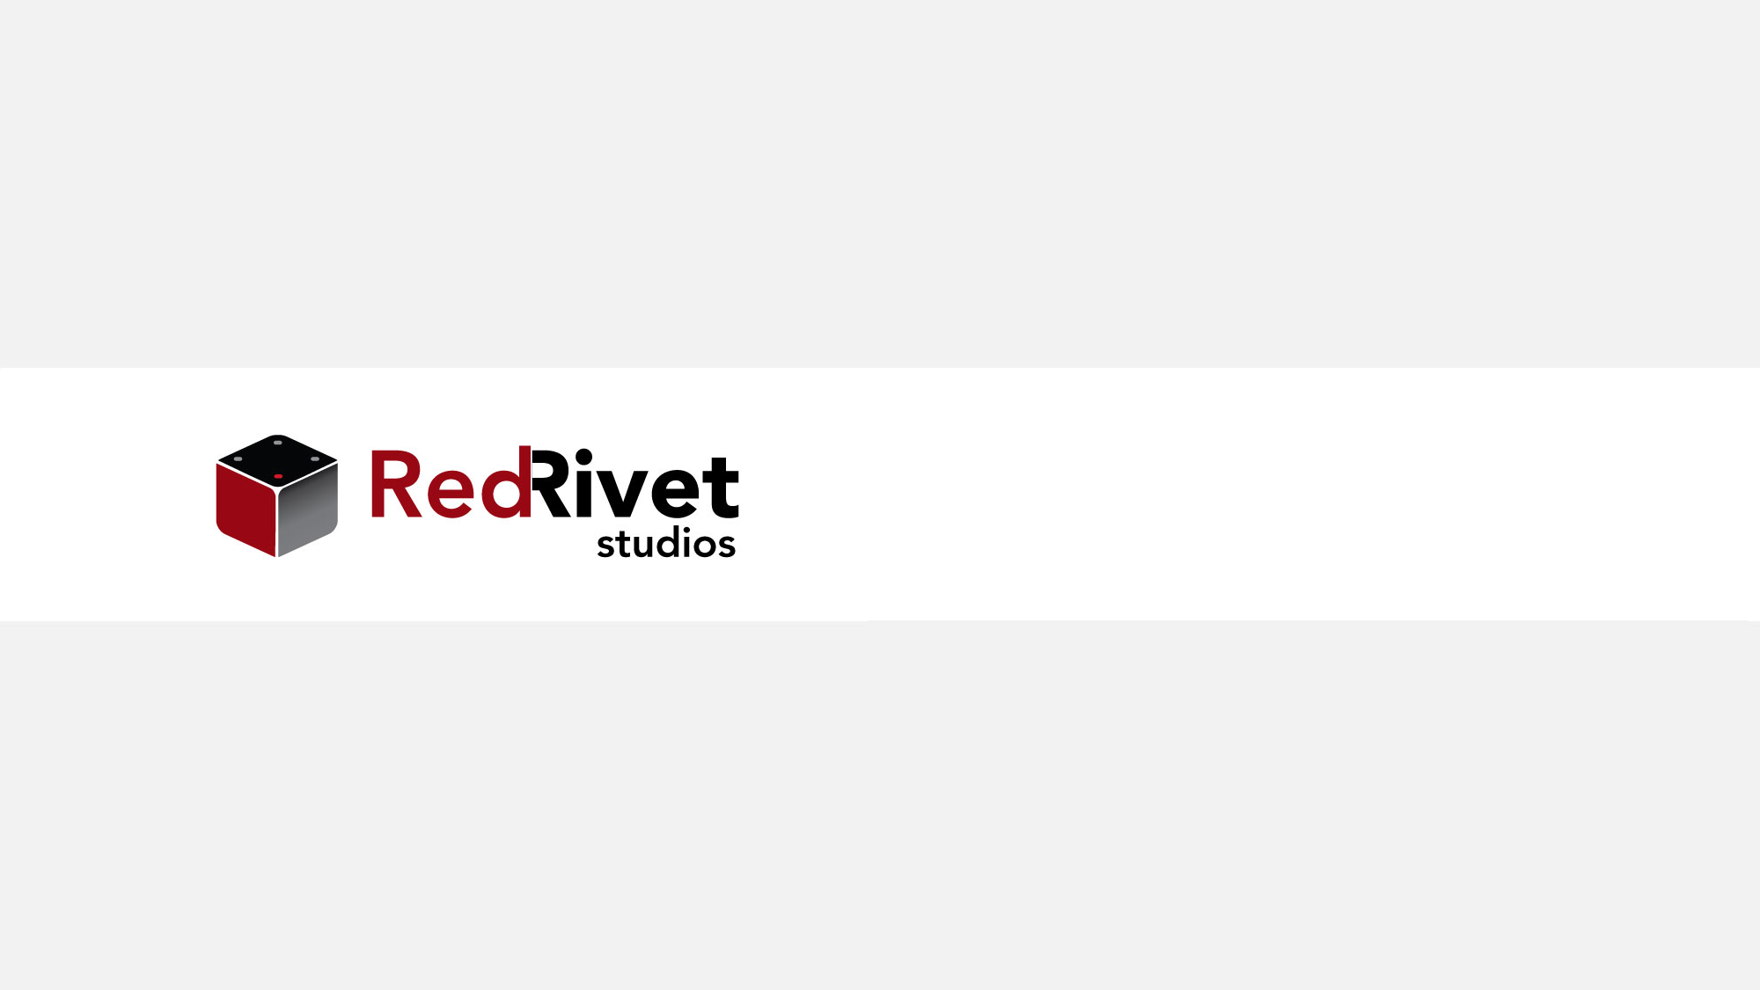
K8s Networking

Slide 2

Module Outline
Network Model Overview
Pod Network
Cluster Network
Services
Gateway API (Ingress)
Network Policy

Slide 3
Overview
K8s Networking consists of multiple layers
  Between containers
  Between Pods
  Between Nodes
Both lower level (Services) and higher level (Gateway)
Configurable and extensible

Slide 4
Pod Network
Within EACH Pod, all containers share a network interface
Containers can refer to “localhost” to communicate
Manged by software implementing the Container Runtime Interface (CRI) → the container engine

Slide 5
Cluster Network
By default, all Pods get IP addresses from a defined range
Pods can directly communicate (no NAT)
Implemented by Container Network Interface (CNI) plugins

Slide 6
CNI Plugins
Component add-ons to k8s
Implementations of a specific API:
https://github.com/containernetworking/cni/blob/spec-v1.0.0/SPEC.md
Many popular networking add-ons:
https://kubernetes.io/docs/concepts/cluster-administration/addons/#networking-and-network-policy

Slide 7
Example Network Plugins
Flannel: https://github.com/flannel-io/flannel#deploying-flannel-manually
Calico: https://www.tigera.io/project-calico/
Cilium: https://github.com/cilium/cilium
Weave: https://github.com/rajch/weave#using-weave-on-kubernetes

Slide 8
Service Networking
Created Services automatically managed by K8s
Service Proxy implements routing to individual pods
Service Types:
  ClusterIP
  NodePort
  LoadBalancer
  ExternalName

Slide 9
Gateway (previously Ingress)
K8s resources for handling ingress traffic
GatewayClass, Gateway, HTTPRoute, GRPCRoute
Replaces Ingress API (less flexible)
Mimics StorageClass / PV / PVC API

Slide 10
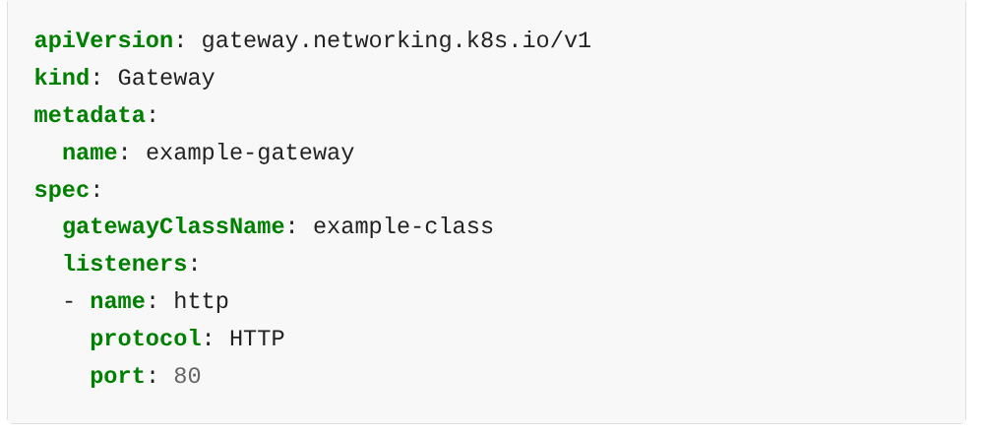
Gateway Example

Slide 11
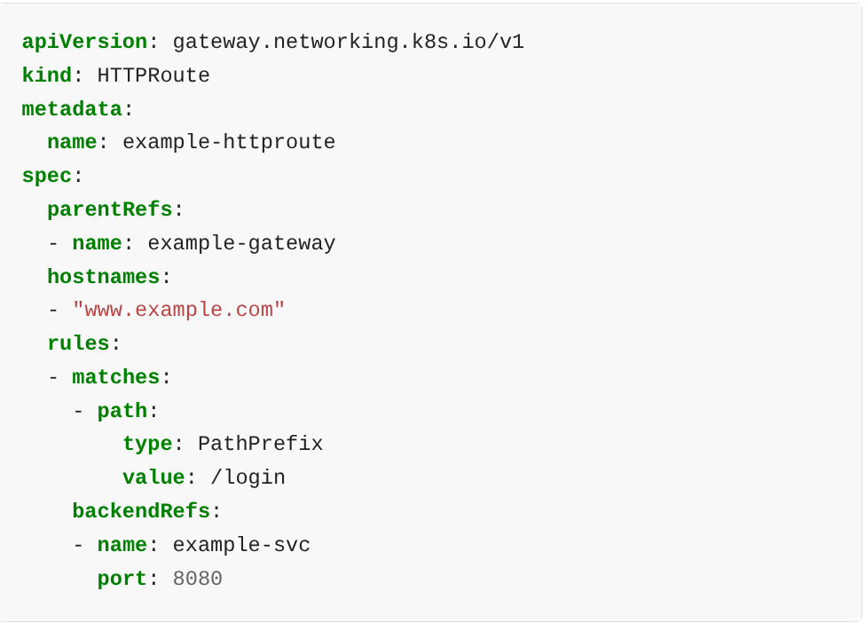
HTTPRoute Example

Slide 12
Network Policy
Defines policies that control how traffic between pods is handled
Must be implemented by CNI plugin
Default Policy: Pods have unrestricted egress, and unrestricted ingress from same namespace
Tons of options

Slide 13
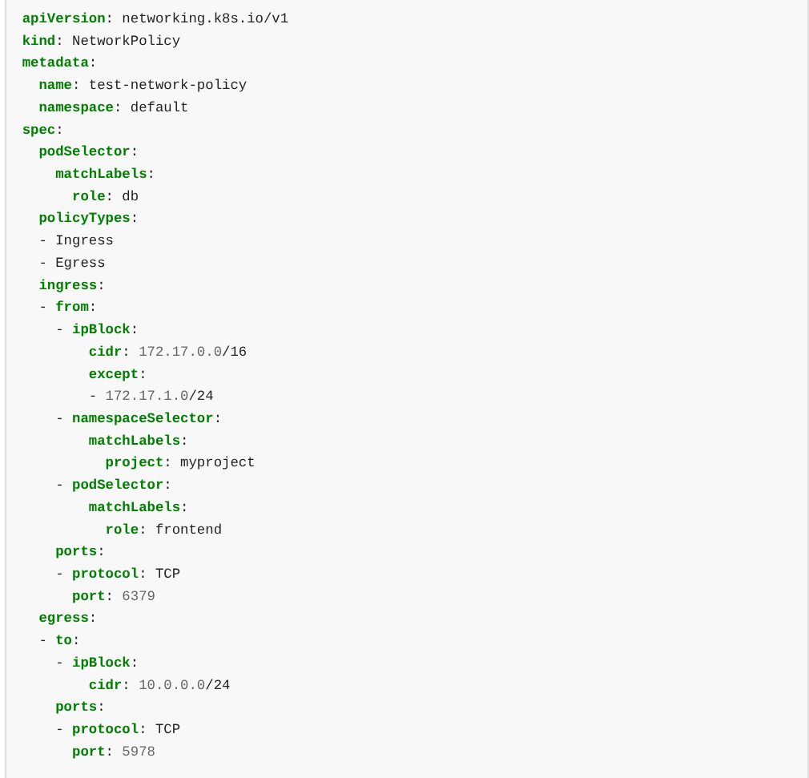
Network Policy Example

