Slide 1
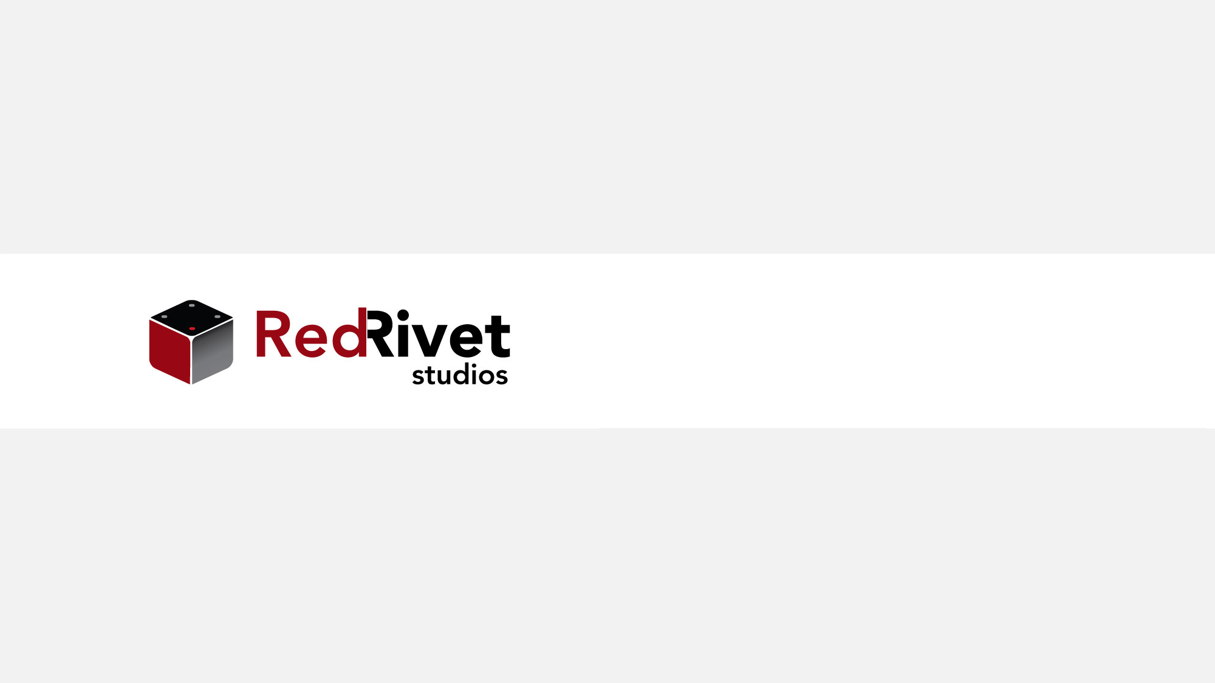
Extending k8s

Slide 2
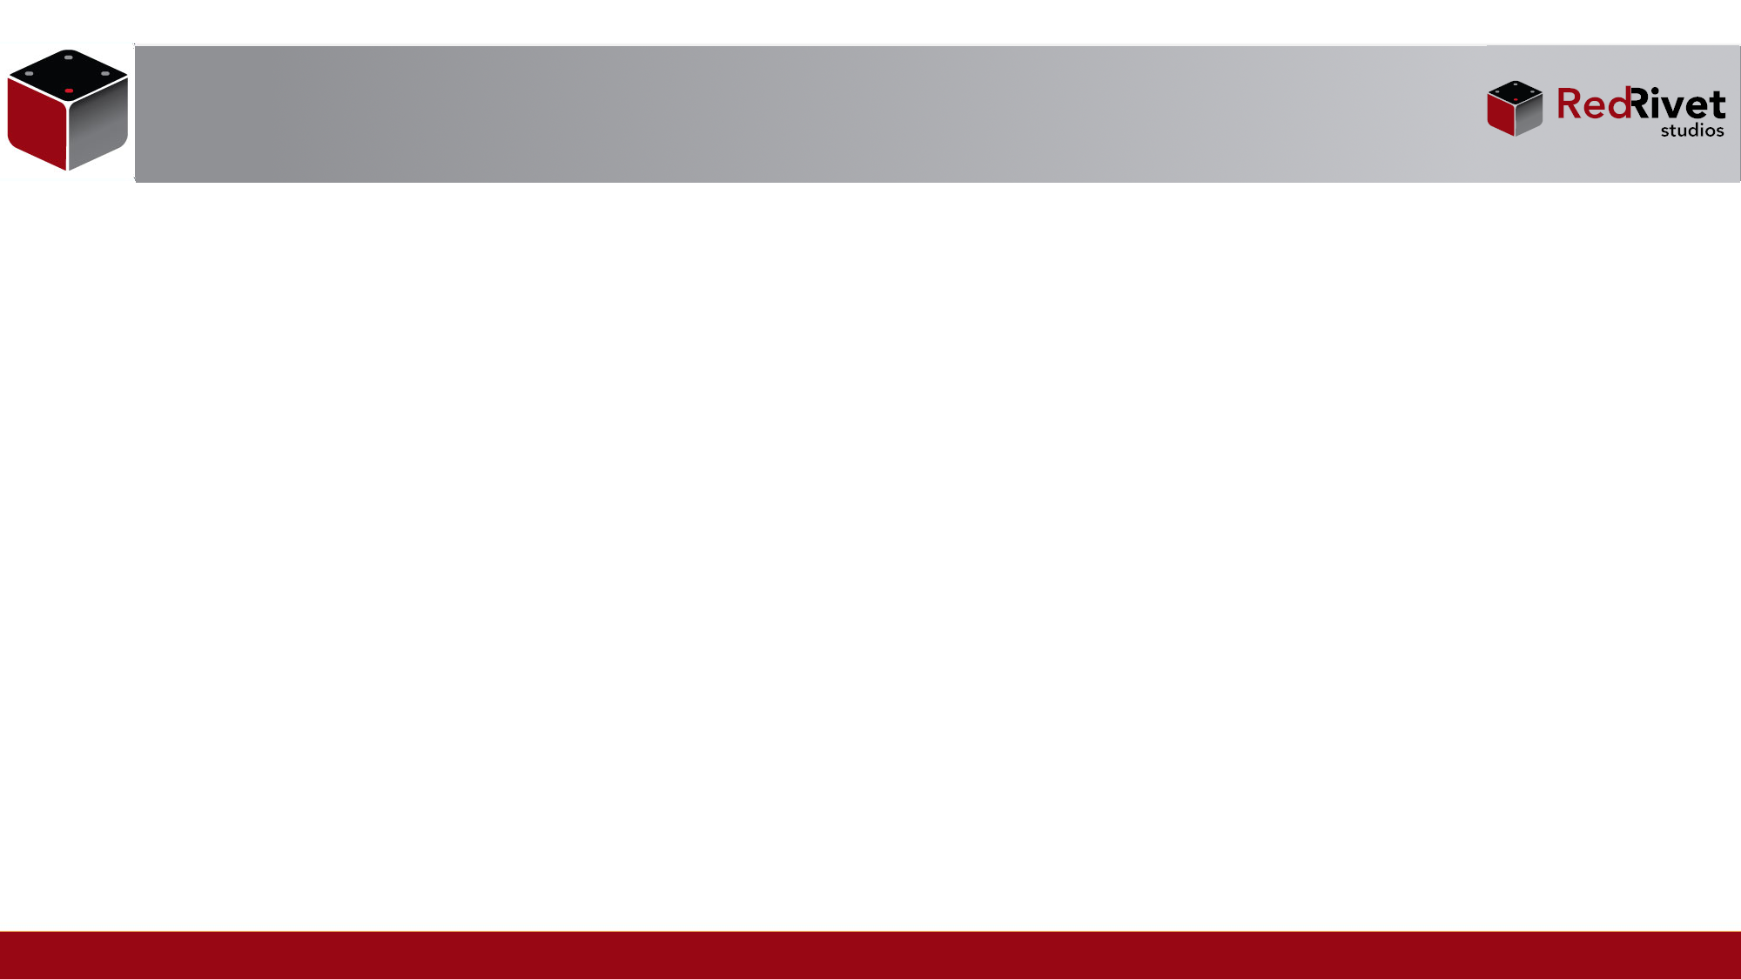
Module Outline
Helm
Container Network Interface (CNI)
Container Storage Interface (CSI)
CustomResource

Slide 3
Helm
Package manager for Kubernetes
Allows installation / management of software on Kubernetes
Can be either regular software or Kubernetes components

Slide 4
Helm Concepts
Helm Chart: set of templated k8s manifest files
Helm Repository: location where multiple charts are stored / updated
Release: Helm chart deployed running in K8s
Umbrella Chart: Chart that refers to sub-charts (think git submodules)

Slide 5
Container Network Interface
Defines an API spec to be implemented by plugins
Allows plugin components to manage k8s cluster networking
May optionally support resources such as NetworkPolicy
Managed by the CNCF

Slide 6
Container Storage Interface
Defines an API spec to be implemented by plugins
Allows plugin components to manage volumes for k8s
Configured via StorageClass resource
Managed by the CNCF
List of drivers: https://kubernetes-csi.github.io/docs/drivers.html

Slide 7
Custom Resources
Use the k8s API to define new resources for the k8s API
Generally includes custom namespace for resources
Implementation supported by a custom controller
Registered via a CustomResourceDefinition

Slide 8
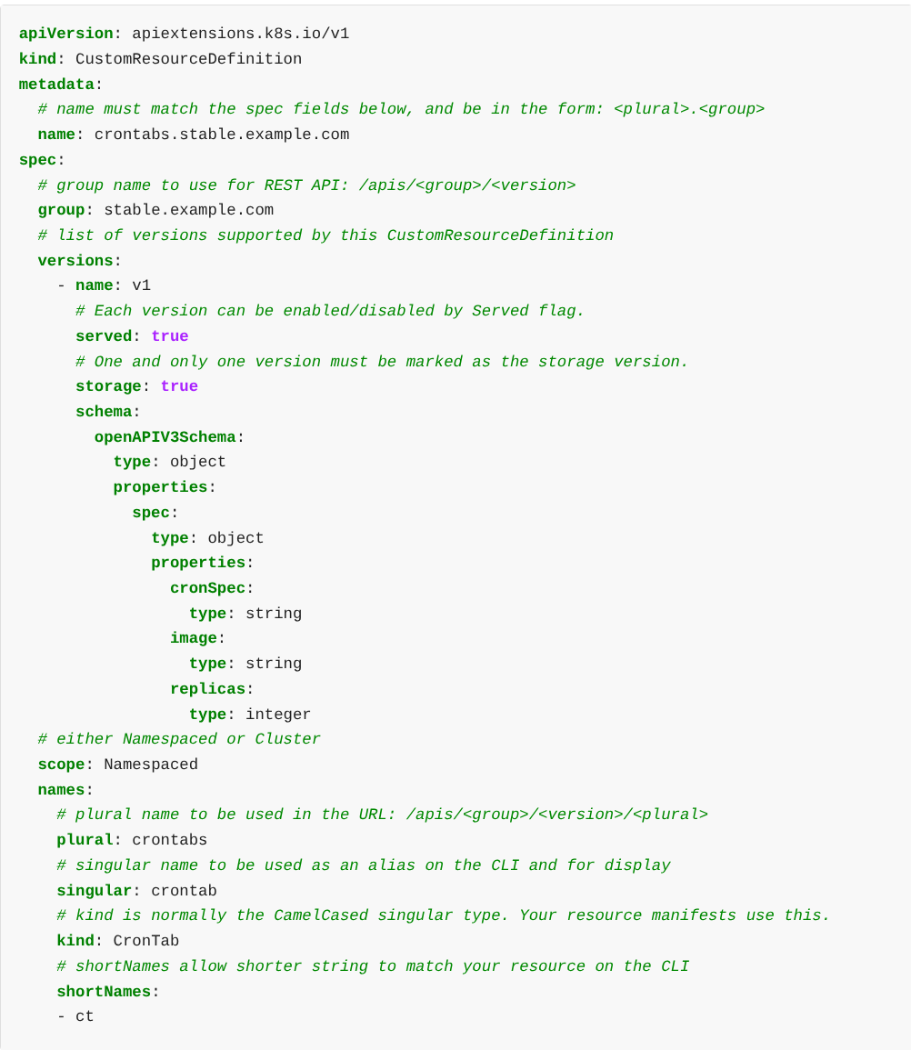
Custom Resource Example

