Slide 1
World Wide Importers Capstone
Justin Robinson
Maryville University
BDAT 650

Slide 2
WWI Data Team Tasks
Employee and Friends Recognition Program
WWI to The Future

Slide 3
Business Questions to Consider
From what company do we receive the highest amount of business from?
What area provides the company the most profit?
What insights can we gain from locations we serve based on the market size?
What are the products that generate the most profit from customers?
What product do we buy that is not worth it anymore?
Where should we be putting most of our resources?

Slide 4
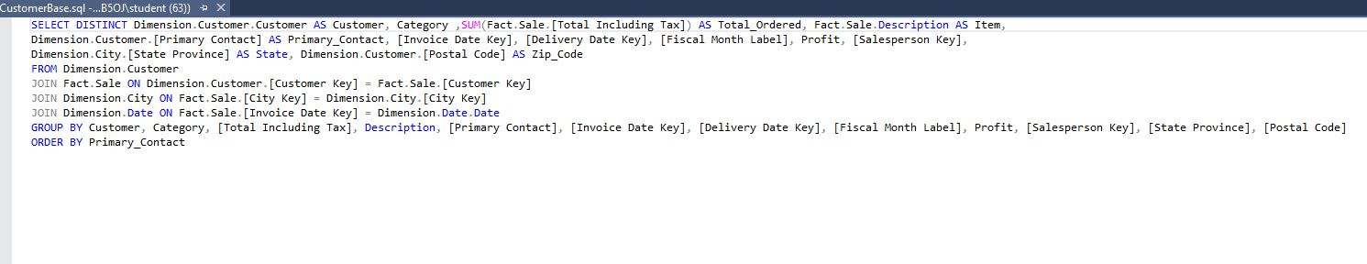
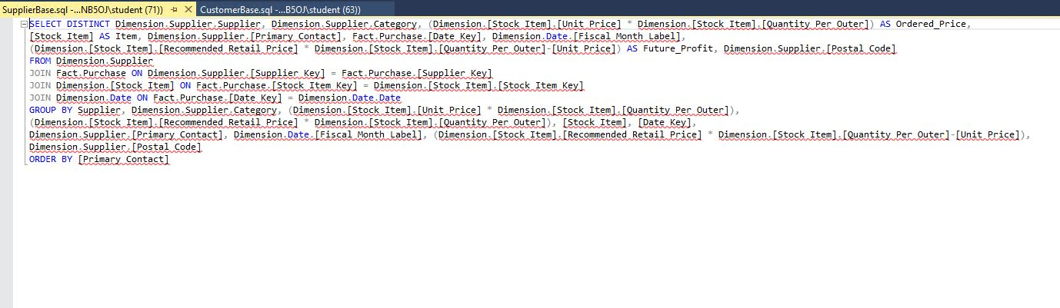
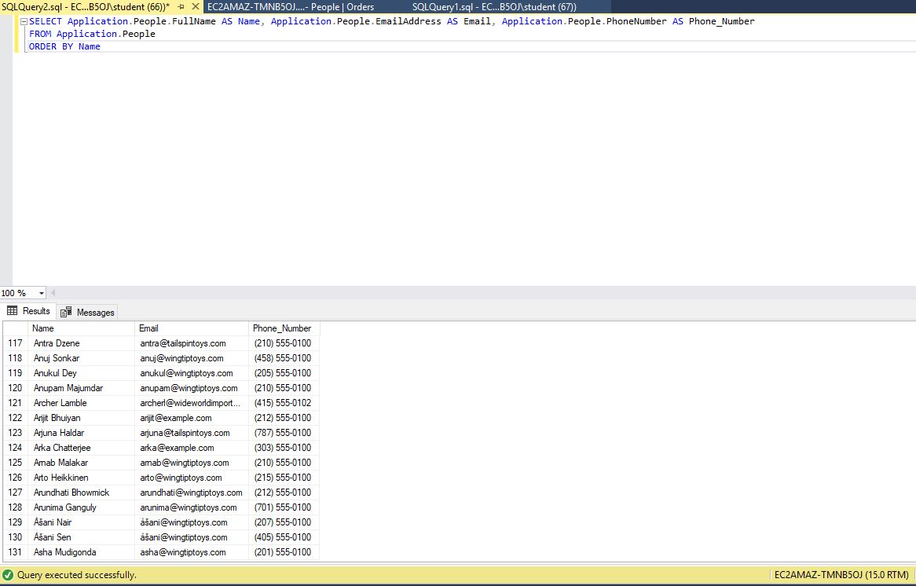
Loading & Preparing the Data

Slide 5
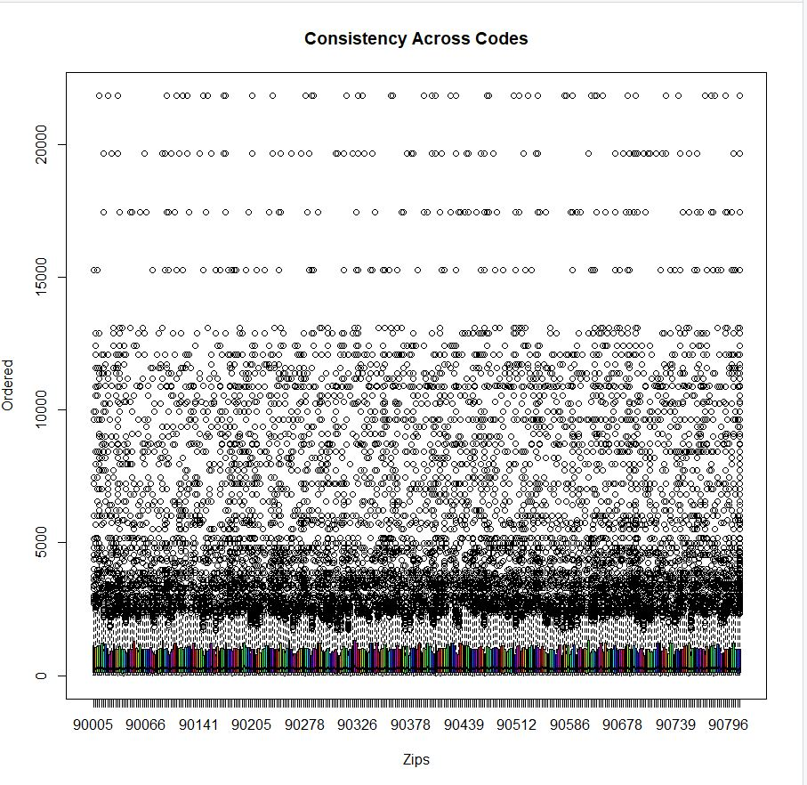
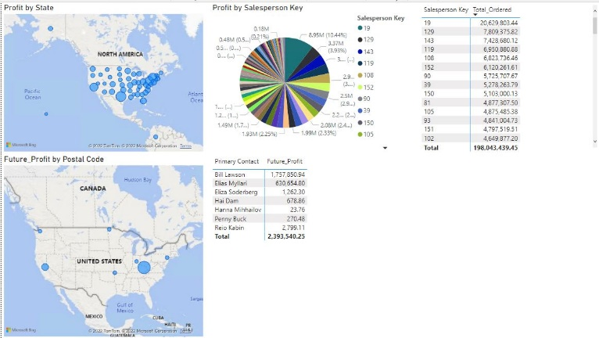
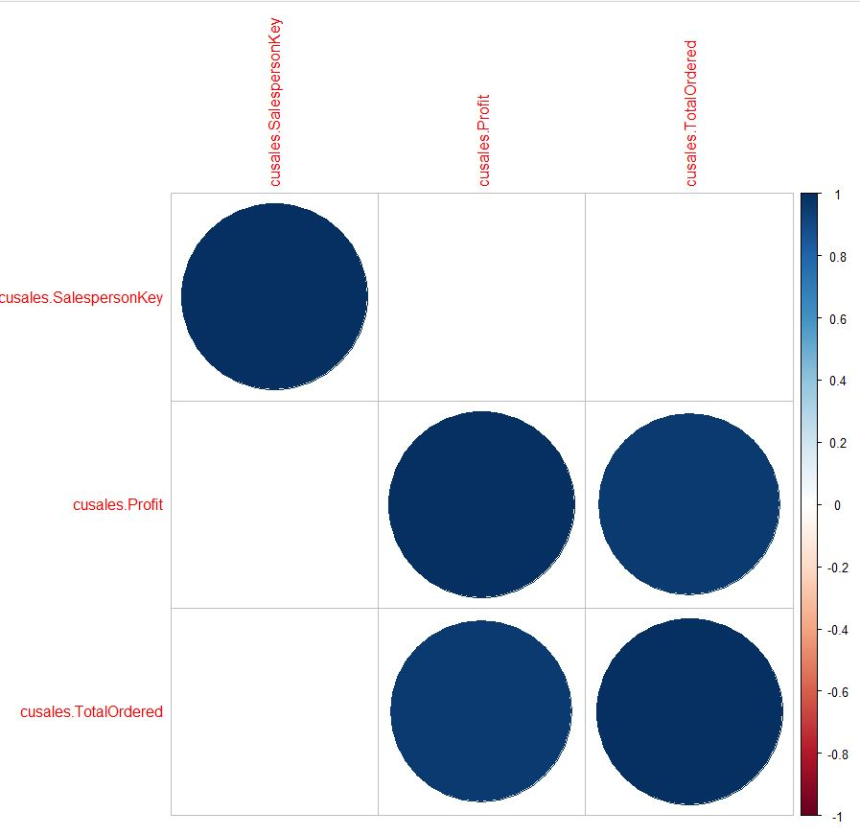
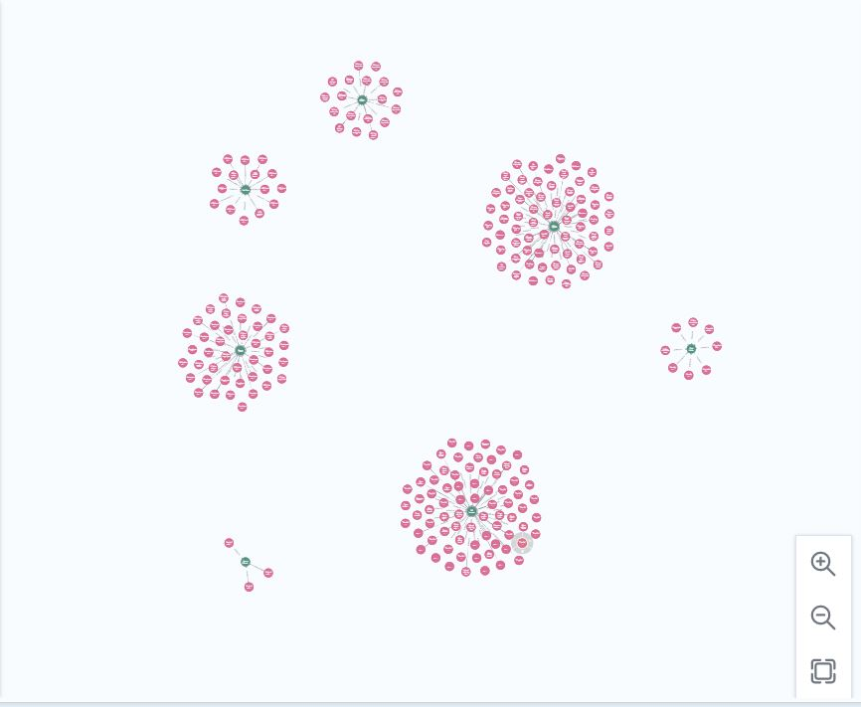
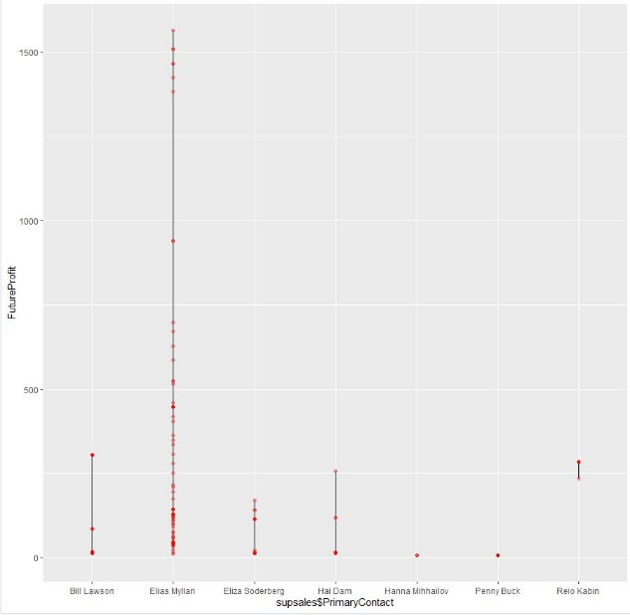
Visualizing the Data

Slide 6
Dashboards
Year
Contacts
Location
Salesperson
Customers
Suppliers

Slide 7
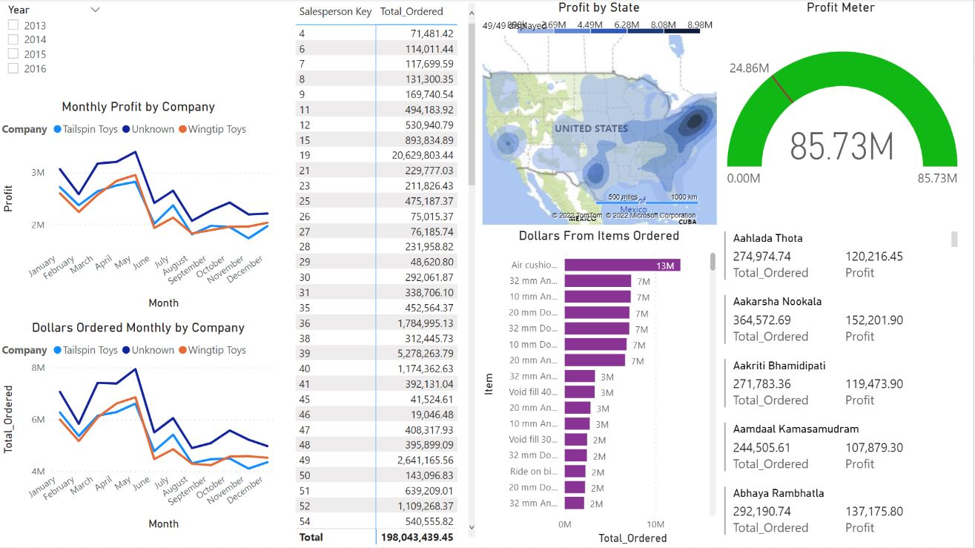
Year

Slide 8
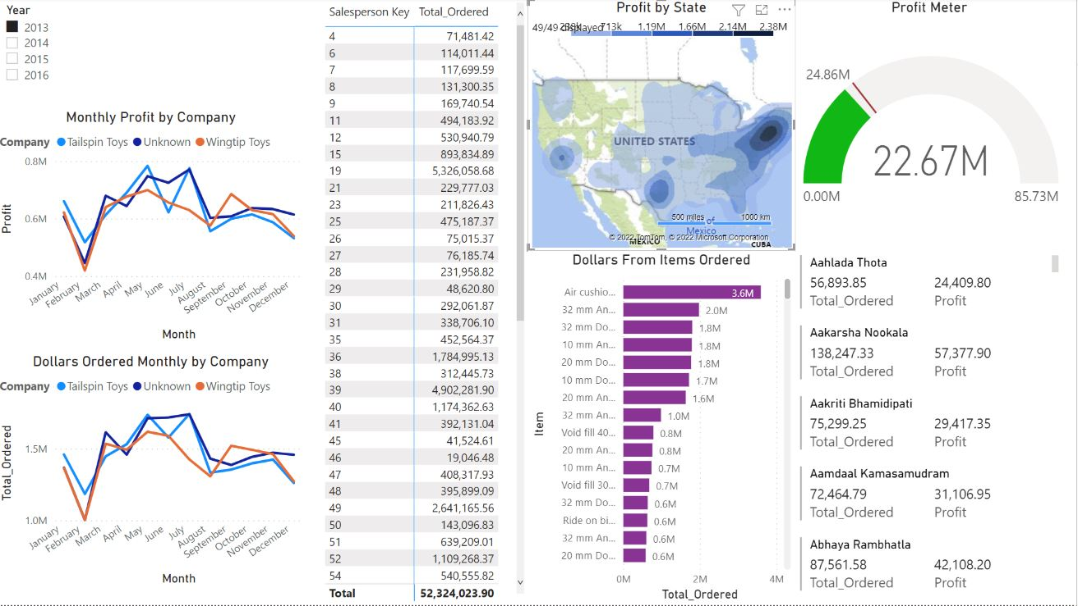
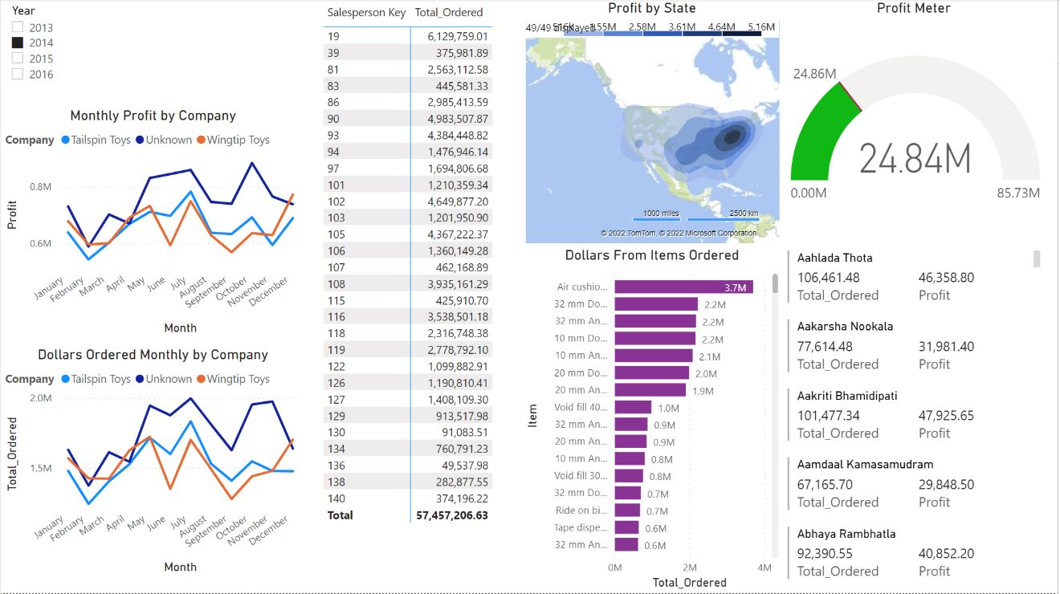
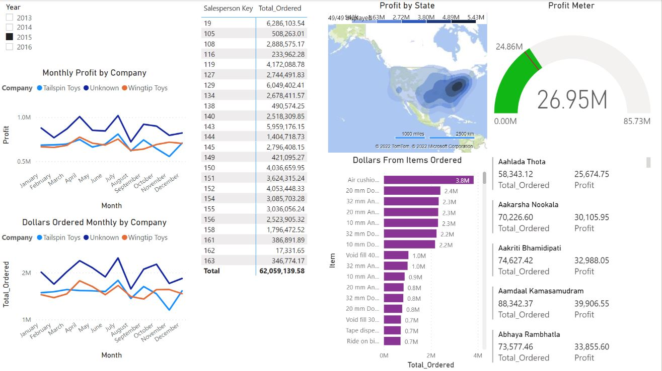
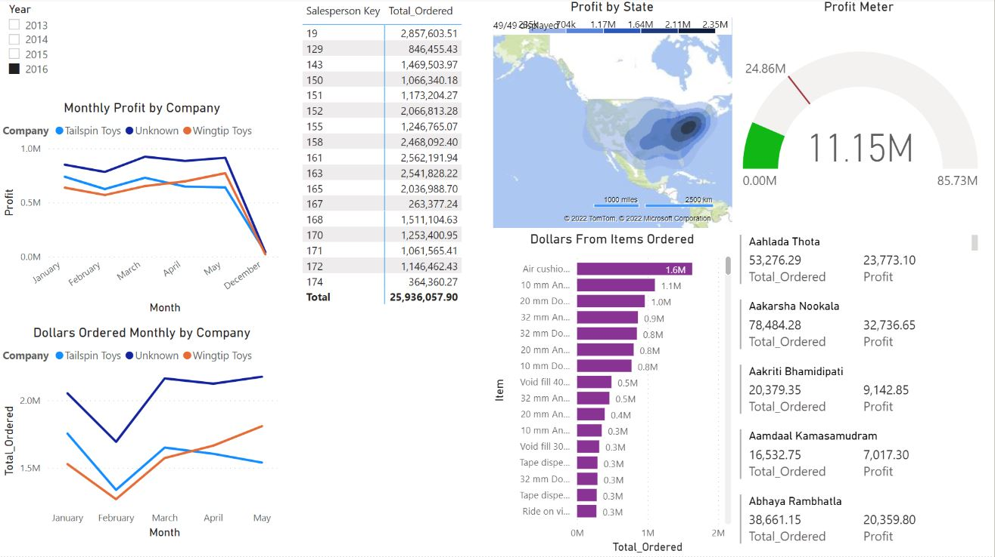
Per Year
2013
2014
2015
2016

Slide 9
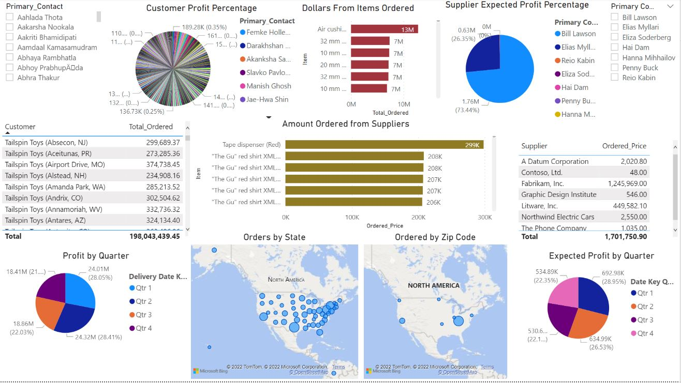
Contacts

Slide 10
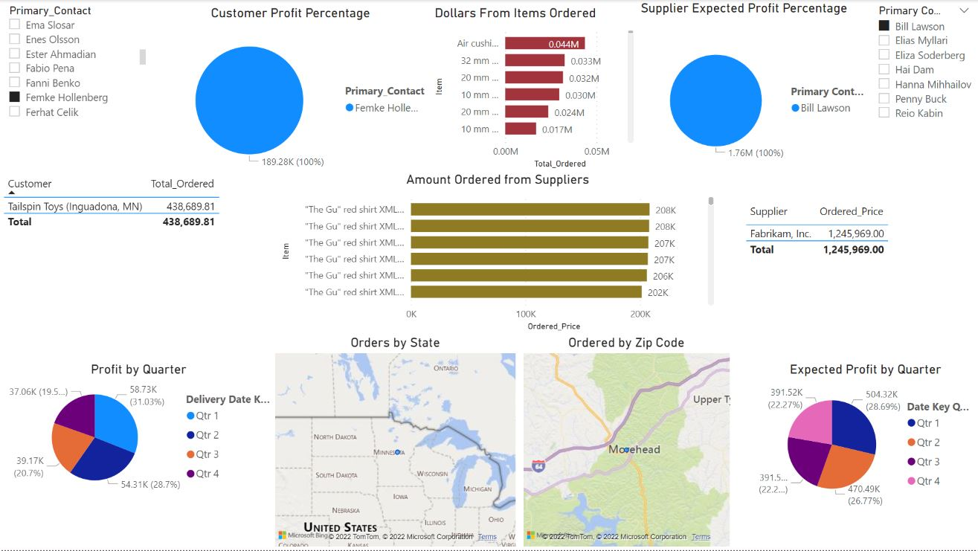
Top Contacts

Slide 11
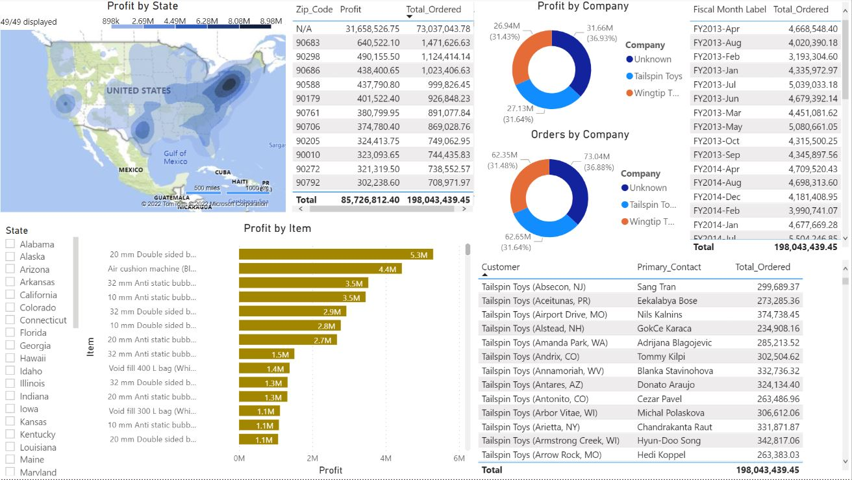
Location

Slide 12
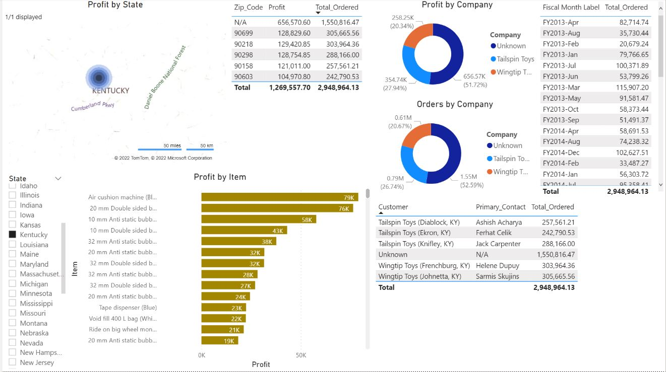
Kentucky Location

Slide 13
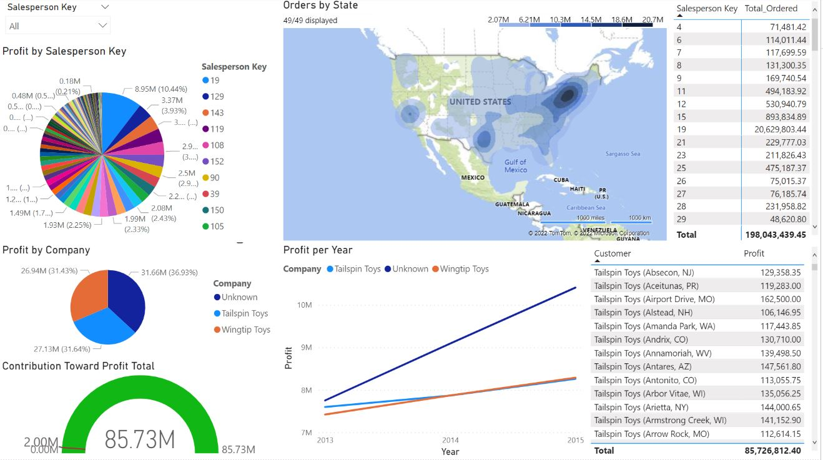
Salesperson

Slide 14
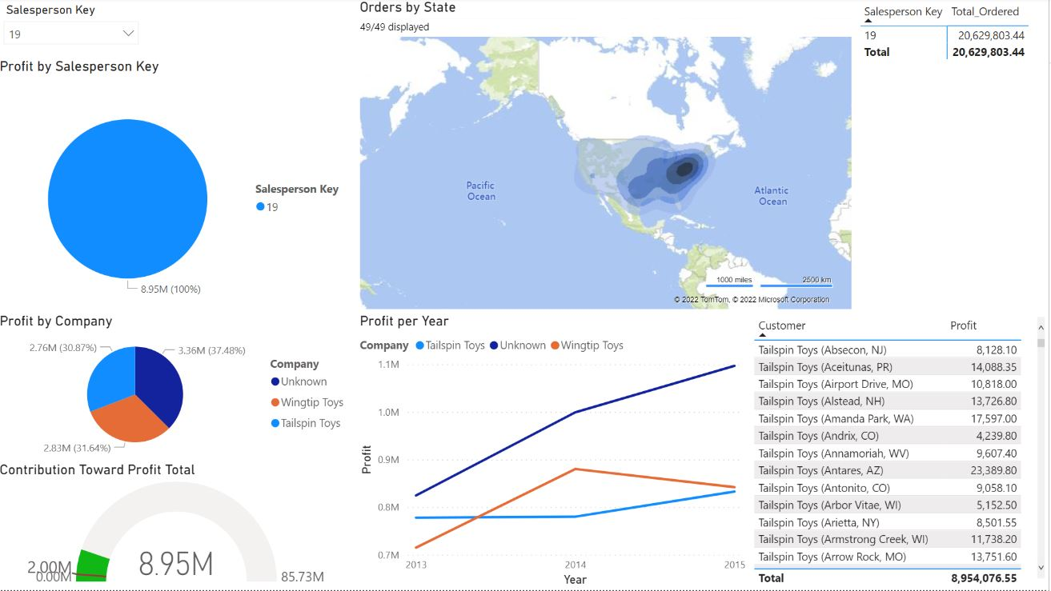
Top Salesperson

Slide 15
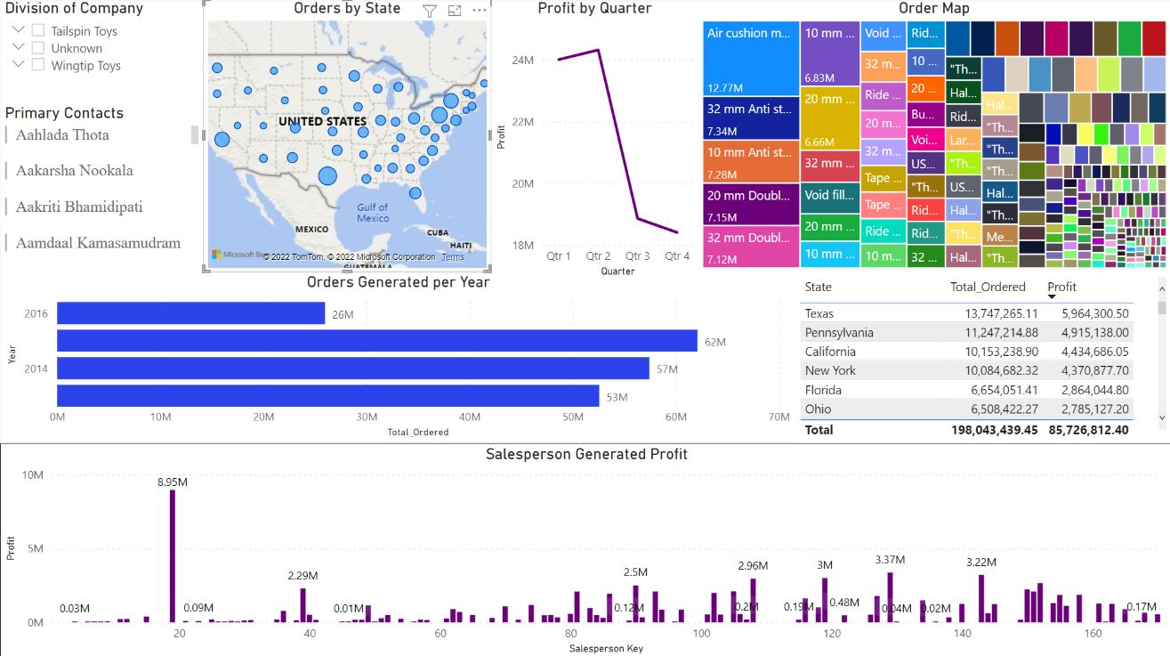
Customers

Slide 16
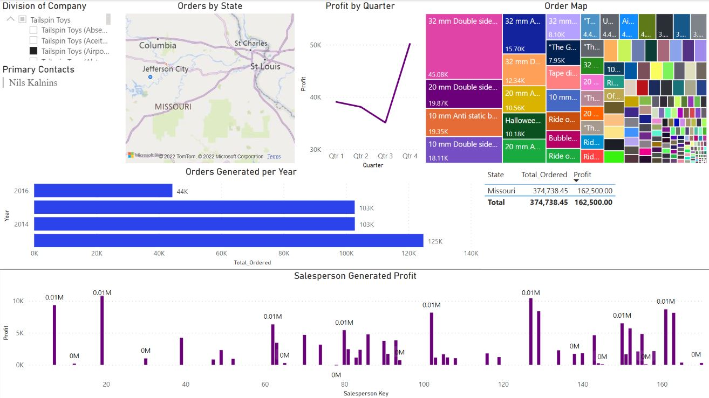
Tailspin Toys (Airport, MO)

Slide 17
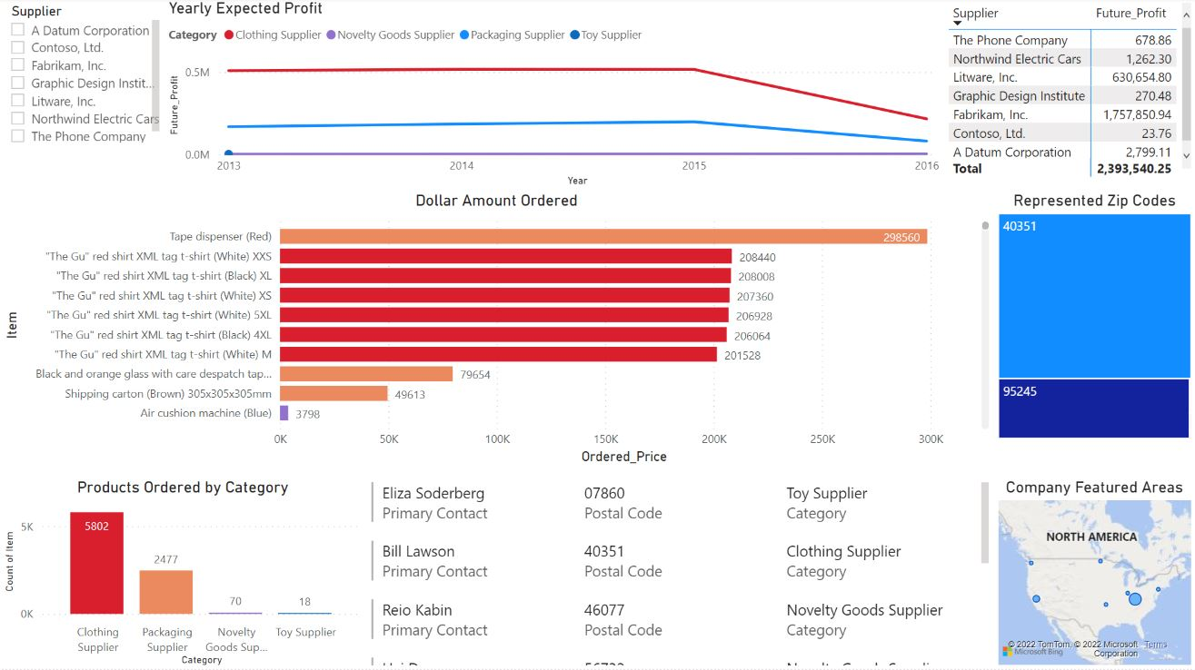
Suppliers

Slide 18
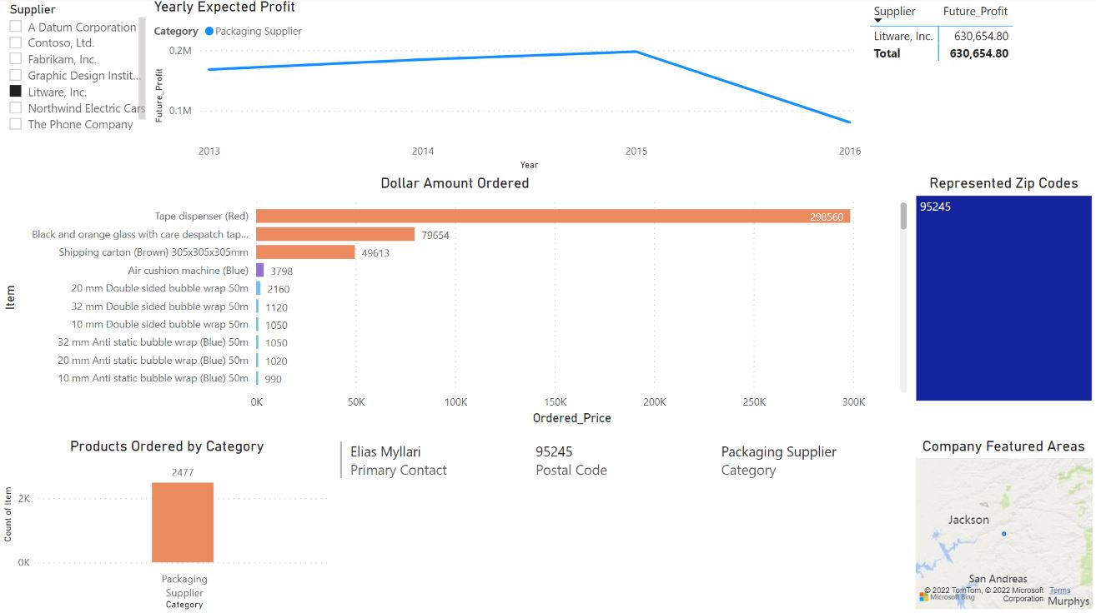
Litware, Inc.

Slide 19
Findings
From what customer do we receive the highest amount of business from?
  Close but Tailspin Toys
What area provides the company the most profit?
  Selling of novelty items
What insights can we gain from locations we serve based on the market size?
  Texas, California, East Coast

Slide 20
Findings cont.
What are the products that generate the most profit from customers?
  Sizes of Bubble Wrap
What product do we buy that is not worth it anymore?
  Packing Knifes
Where should we be putting most of our resources?
  Selling to Toy Stores

Slide 21
Employee and Friends Recognition Program
Sales
  Salesperson 19
Customer
  Femke Hollenberg (Inguadona, MN)
Suppliers –
  Bill Lawson at Fabrikam, Inc.

Slide 22
Thank you for your time!

