Slide 1
Incentives to cheat in economic announcements
John Reynolds
Jing Xia
Yash Goel
Sakada Lim

Slide 2
Hypothesis
There is a large incentive to “cheat” around financial announcements such as non-farm payrolls, fed minutes, central bank policy, natural resource data, etc. The individuals familiar with this information have an incentive to leak the information to “financial agents” who can then act on this data before it is publicly announced.

Slide 3
Some fun first …
Four speculators are in Chicago and its 7:00 am, Feb 1 ,2019.
Speculator 1 is “The Awesome one” Everything is great
Speculator 2 is “The Pissed-off one” Everything sucks
Speculator 3 is “The corrupt/cynical-one” F*** all of you
Speculator 4 is “The biased hedger”
Non-farm Payroll number are being released in 30 minutes (from BLS)
If it’s a blowout number
Equity Futures (ES) should take off
Bond Futures (UB) should sell off
If it’s a disappointing number (Mr. Pissed-off will be happy)
Equities should sell
Bond should take off
If its mixed the market will probably jigsaw then pick a direction

Slide 4
Before the Announcement ….
Each speculator has $1 million bucks to play with
Each is going to do 50/50 between Equities and Fixed Income
Each speculator must put up $3,500 in margin for each contract (ES or UB)
$3,500 margin/contract on $1 million = 1000000/3500 = 284 (rounding to even)
So each speculator can take exposure of :
142 ES contracts
Market Exposure = Price*50*N*Contracts
=2700*50*142 = $19,170,000
142 UB Contracts
Market Exposure = Price*1000*Contracts =
= 161.5 *1000* 142 = $22,862,000

Slide 5
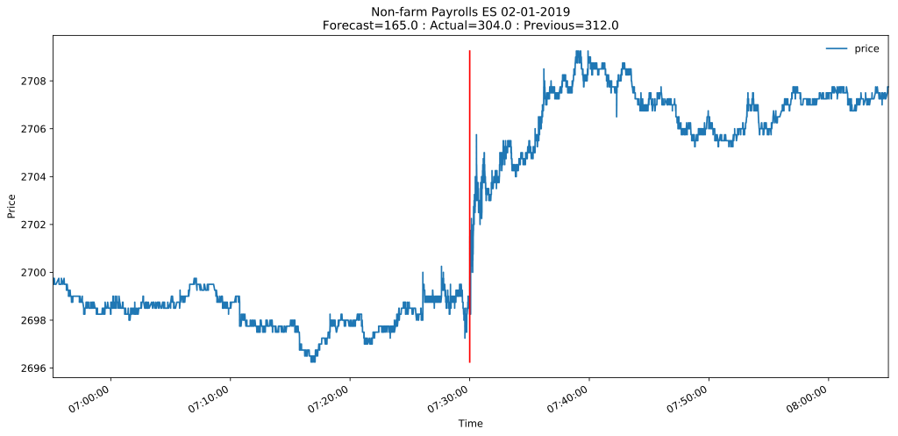
Market reaction to Non-farm Payrolls announcement
ES prices around 7:30 am CST (8:30am EST) 2/1/2019

Slide 6
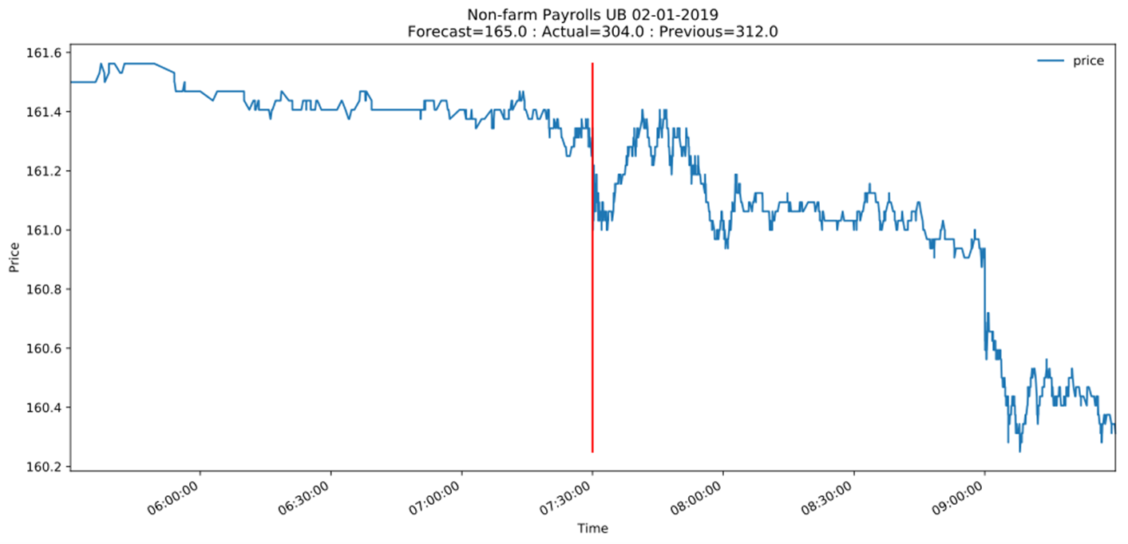
Market reaction to Non-farm Payrolls announcement
UB prices around 7:30 am CST (8:30am EST) 2/1/2019

Slide 7
Food for Thought
Economic Announcements can move markets
The information in the announcement is known to agents preparing the announcement before market participants know
Are the moves compelling enough in the announcements for market participants to attempt to seek the information before the announcement is made?

Slide 8
Types of Announcements
Non-farm Payrolls
Federal Reserve Open Market Committee
ISM (Institute for Supply Management) Survey (Manufacturing)
Durable Goods
CPI (Consumer Price Index)
Retail Sales
Consumer Confidence
Company Earnings / IPO’s/ Management Changes/ Dividends etc.

Slide 9
Approach
Measure the market opportunity for announcements and compare to non-announcement periods:
It may be the case that these moves aren’t large enough to even care.
Maybe the market volume is worse
Pick some time window before the announcement (start and duration) and see if pre-announcement returns offer any insight in to what happened ex-post.

Slide 10
Study focus on the Futures Markets
Equities (ES-mini),
Short Term Rates (2 Year TU) ,
Long Term Rates (Ultra-Bond UB)

Slide 11
Why Futures?
Most liquid of all markets
Leverage: Futures are leveraged products
Trade around the clock from Sunday Night
Easiest to express short position (just sell contract)
No special behavior to go short a market
Short = Betting price of contract will fall
Long = Betting price of contract will rise
Contracts across all markets
Equities, Bond Futures, F/X
Oil, Gasoline, Natural Gas, Agriculture, Metals

Slide 12
Data Source
Publicly available events calendar
Futures tick trade data from CME

Slide 13
Hypothesis Testing
Do announcements present opportunity?
Can pre market movements help in predicting the direction of an event?

Slide 14
Do announcements present opportunity?
We will start with the premise that there can be no crime without opportunity.
“Opportunity”: market movement pre-event compared to post-event ten minute window.

Slide 15
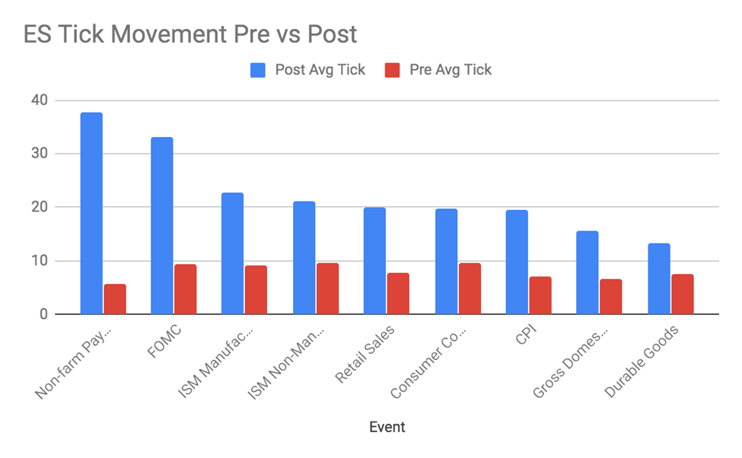
For 9 most important economic announcement

Slide 16
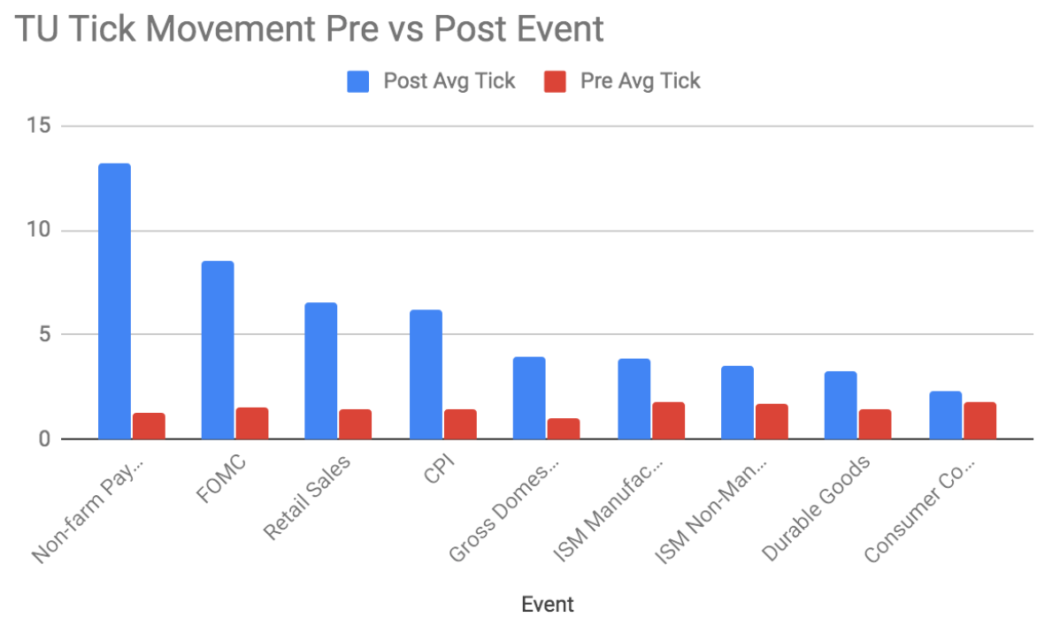
For 9 most important economic announcement

Slide 17
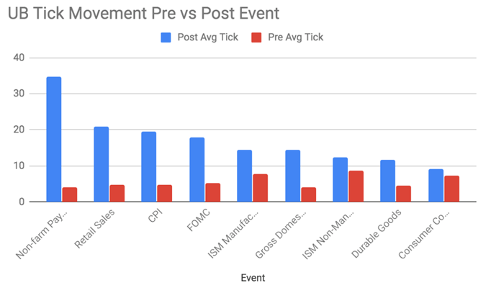
For 9 most important economic announcement

Slide 18
Do announcements present opportunity?
Events present extremely outsized opportunities.
It’s possible to make short term trades and gain outsized profits given the time period.
The average tick movement across all events is approximately 3.5x larger than the average tick movement in prices across a similar time window without an event while the trading volume is on average 6.5x larger and can be over 20x larger.

Slide 19
Can pre market movements help in predicting the direction of an event?
We examine two scenarios and compare their predictability.
All pre-event returns
All pre-event returns that were 1 standard deviation greater than the mean pre-event move
In absence of any information, there would no reason to believe that there would be any predictive difference between the 2 scenarios.

Slide 20
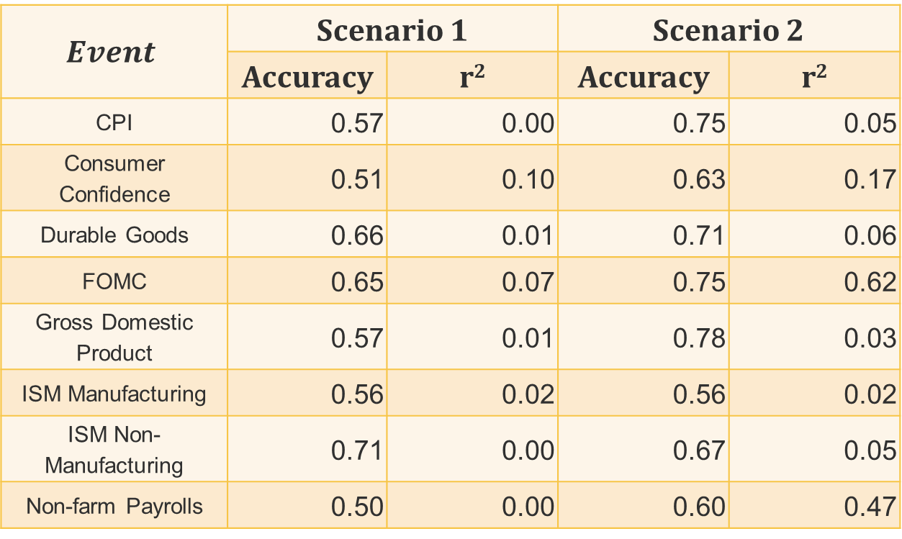
Predicting post return on ES
$$Event$$ | Scenario 1 |  | Scenario 2
 | Accuracy | r² | Accuracy | r²
CPI | 0.57 | 0.00 | 0.75 | 0.05
Consumer Confidence | 0.51 | 0.10 | 0.63 | 0.17
Durable Goods | 0.66 | 0.01 | 0.71 | 0.06
FOMC | 0.65 | 0.07 | 0.75 | 0.62
Gross Domestic Product | 0.57 | 0.01 | 0.78 | 0.03
ISM Manufacturing | 0.56 | 0.02 | 0.56 | 0.02
ISM Non-Manufacturing | 0.71 | 0.00 | 0.67 | 0.05
Non-farm Payrolls | 0.50 | 0.00 | 0.60 | 0.47

Slide 21
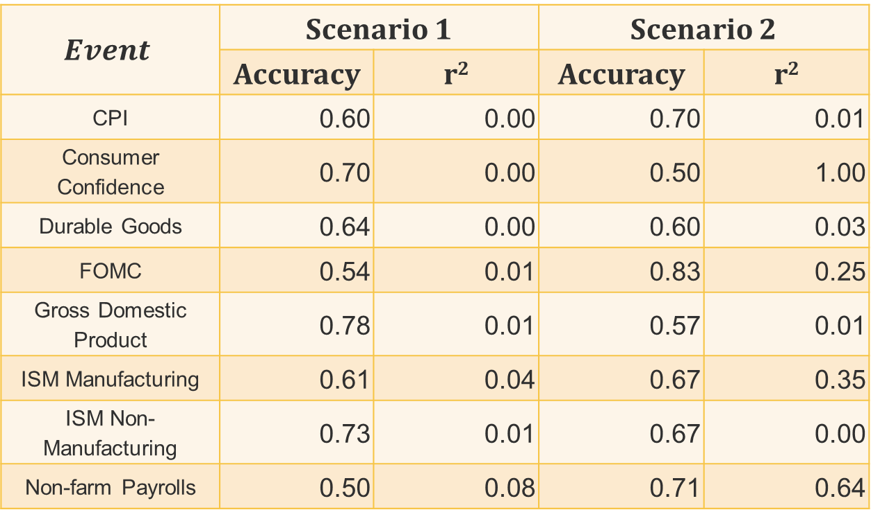
Predicting post return on TU
$$Event$$ | Scenario 1 |  | Scenario 2
 | Accuracy | r² | Accuracy | r²
CPI | 0.60 | 0.00 | 0.70 | 0.01
Consumer Confidence | 0.70 | 0.00 | 0.50 | 1.00
Durable Goods | 0.64 | 0.00 | 0.60 | 0.03
FOMC | 0.54 | 0.01 | 0.83 | 0.25
Gross Domestic Product | 0.78 | 0.01 | 0.57 | 0.01
ISM Manufacturing | 0.61 | 0.04 | 0.67 | 0.35
ISM Non-Manufacturing | 0.73 | 0.01 | 0.67 | 0.00
Non-farm Payrolls | 0.50 | 0.08 | 0.71 | 0.64

Slide 22

Predicting post return on UB
$$Event$$ | Scenario 1 |  | Scenario 2
 | Accuracy | r² | Accuracy | r²
CPI | 0.50 | 0.02 | 0.75 | 0.26
Consumer Confidence | 0.62 | 0.01 | 0.75 | 0.13
Durable Goods | 0.55 | 0.00 | 0.63 | 0.25
FOMC | 0.52 | 0.02 | 0.67 | 0.03
Gross Domestic Product | 0.52 | 0.00 | 0.57 | 0.03
ISM Manufacturing | 0.54 | 0.00 | 0.70 | 0.07
ISM Non-Manufacturing | 0.60 | 0.00 | 0.67 | 0.16
Non-farm Payrolls | 0.62 | 0.02 | 0.78 | 0.10

Slide 23
Can pre market movements help in predicting the direction of an event?
A speculator has much better odds of making a profit when the pre-event movement is larger than usual.

Slide 24
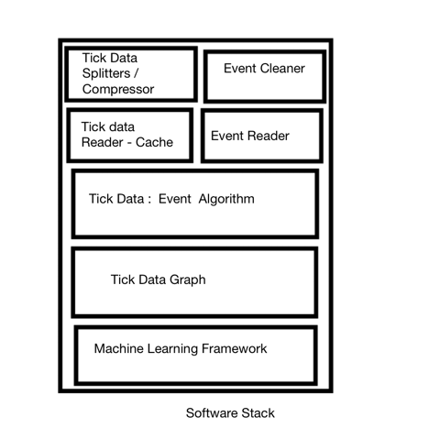
Minimum Viable Product

Slide 25
Product Features
Create compressed Tick Trade Archive from Raw Exchange Data
Take exchange tick trade data make it fast to load for any particular date across a range of contracts.
Create Events Repository with Event , Event Date, Market Expectation and Actual Number
Locate event based on a close date, map the market reaction and expectations and plot
Show the profit loss of speculators taking long/short positions in contracts
Compare Events based on Tick Movements
Apply Machine Learning
Assess pre-market moves of post event moves,
Assess market expectations vs actual on market moves

Slide 26
Scalability
To other markets:
Earnings announcements on US Equities
International central banks announcements on impacted currency markets
General foreign economic reporting on local equities and fixed income markets
To non-traditional economic events:
Twitter for President Trump’s communications

Slide 27
Conclusion
Economic announcements present outsized opportunity in terms of market volatility and trading volume.
“Someone knows something.”
A product that can be used to analyze historical events impact on the markets.

