Slide 1
Incentives to cheat in economic announcements
Social Networks
Spring 2019
John Reynolds
Jing Xia
Yash Goel
Sadaka Lim
https://github.com/jrrpanix/SocialNetworks

Slide 2
Hypothesis
There is a large incentive to “cheat” around financial announcements such as non-farm payrolls, fed minutes, central bank policy, natural resource data, etc. The individuals familiar with this information have an incentive to leak the information to “financial agents” who can then act on this data before before it is publicly announced.

Slide 3
Some fun first … showing corrupt incentives
Four speculators are in Chicago and its 7:00 am, Feb 1 ,2019.
Speculator 1 is “The Awesome one” Everything is great
Speculator 2 is “The Pissed-off one” Everything sucks
Speculator 3 is “The corrupt/cynical-one” F*** all of you
Speculator 4 is “The biased hedger”
Non-farm Payroll number are being released in 30 minutes (from BLS)
If it’s a blowout number
Equity Futures (ES) should take off
Bond Futures (UB) should sell off
If it’s a disappointing number (Mr. Pissed-off will be happy)
Equities should sell
Bond should take off
If its mixed the market will probably jigsaw then pick a direction

Slide 4
Some Futures Math and Leverage
Each speculator
$1 million bucks to play with
Will take long or short positions in ES and UB Futures
ES Margin - $6,300 per contract
At a price of 2,700, 1 ES Contract = 2700*50 = $135,000
Leverage Ratio = 135000/6300 = 21.4
UB Margin = $3,400 per contract
At a price of 161, 1 UB Contract = 161*1000 = $161,000
Leverage Ratio = 161000/3400 = 47.1
50/50 Margin Account Split between ES and UB
ES - 500,000/6,300 = 79 Contracts
UB – 500,000/3,400 = 147 Contracts
Exposure = 79*(135000) + 147*(161000) = $34,333,000
On $1 Million speculators can use futures to get $34,000,000 in exposure

Slide 5
Pre-Announcement Positioning For Feb 1, 2019 @ 7:20am CST
 | Symbol | Contracts | Margin | PrePrice
Optimist | ES | 79 | 497700 | 2698.000
 | UB | -147 | 499800 | 161.500
Pessimist | ES | -79 | 497700 | 2698.000
 | UB | 147 | 499800 | 161.500
Corrupt | ES | 79 | 497700 | 2698.000
 | UB | -147 | 499800 | 161.500
Hedger | ES | 79 | 497700 | 2698.000
 | UB | 147 | 499800 | 161.500
Our corrupt friend has information about the number rules of thumb
Big win – Buy Equities / Short Bonds
Bid miss – Short Equities Big Time/ Short Bonds

Slide 6
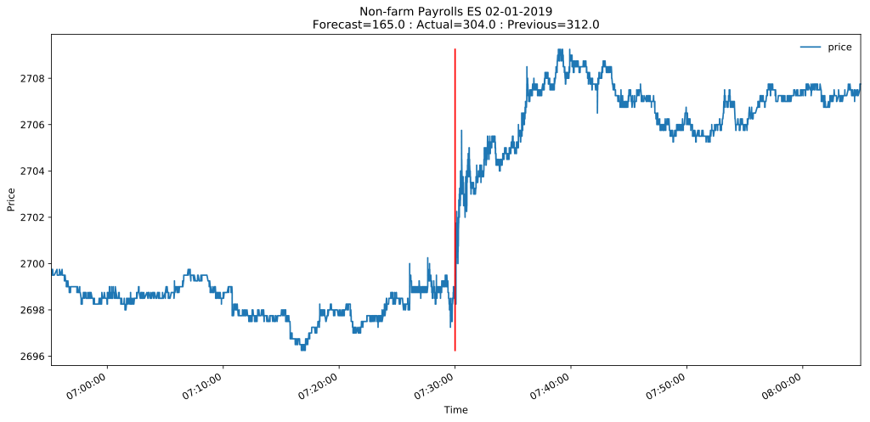
Market reaction to Non-farm Payrolls announcement announcement at 7:30 am CST (8:30am EST) 2/1/2019

Slide 7
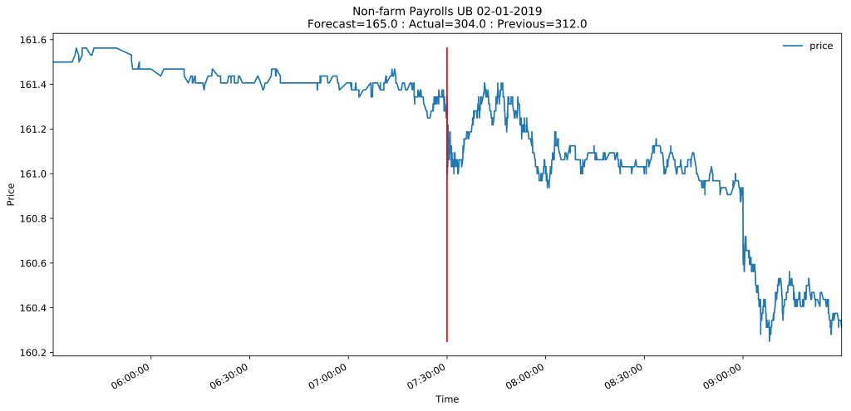
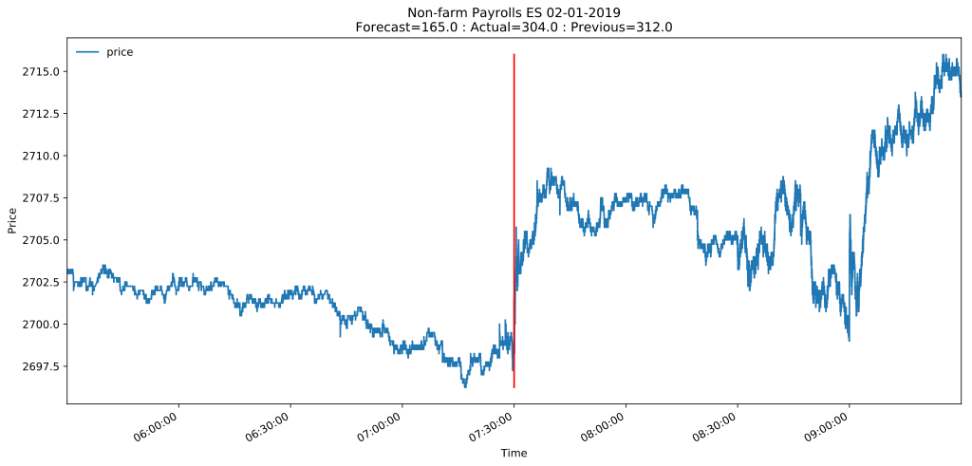

Slide 8
PNL for NFP Feb 2019

Slide 9
So what happened?
The Non-farm Payroll number for Feb 2019 massively exceeded expectations! Job creation was almost 2x expected (304 v 165).
What happened to our friends?
The optimist and corrupt both immediately saw approx. $60K gains on release of the number from their positions. Two hours later the gain was over $200k.
The pessimist was wrong and immediately lost -$60K

Slide 10
The next month … March 2019 NFP, Profit Loss our corrupt friend knows it will be bad ES will sell hard so its pure short on ES

Slide 11
NFP Mar 2019 – Massive miss, market sells off

Slide 12
Initial thoughts
Economic Announcements can move markets
The information in the announcement is known to agents preparing the announcement before market participants know
Are the moves compelling enough in the announcements for market participants to attempt to seek the information before the announcement is made?

Slide 13
Types of Announcements
Non-farm Payrolls
Federal Reserve Open Market Committee
ISM (Institute for Supply Management) Survey (Manufacturing)
Durable Goods
CPI
Retail Sales
Consumer Confidence
Company Earnings / IPO’s/ Management Changes/ Dividends etc.

Slide 14
Approach
Measure the market opportunity for announcements and compare to non-announcement periods
It may be the case that these moves aren’t large enough to even care.
Maybe the market volume is worse
Pick some time window before the announcement (start and duration) and see if pre-announcement returns offer any insight in to what happened ex-post.

Slide 15
Software developed
We developed software that would map market reactions to economic events with accurate timing of event to reaction.
For this project we have tied events to Equity and Fixed Income Futures.
The software ties in for pre-planned events the expectations of the event (forecast), the actual event and the tick plot of the futures contract price.
The software aligns time zones or prices and forecasts.
The software can also look at any window given the times.

Slide 16
Tariff Man … a non-planned event

Slide 17
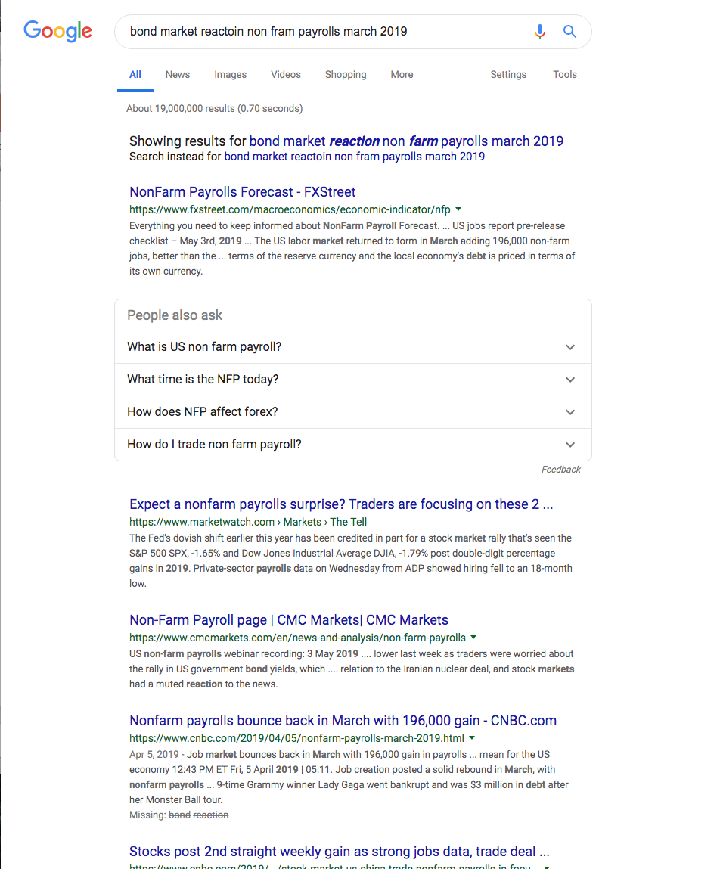
Aside – Its not easy to find the market reaction

Slide 18
Study will focus on the Futures Markets in particular Equities (ES-mini), Short Term Rates(2 Year TU) , long Term Rates (Ultra-Bond UB)
Why Futures
Most liquid of all markets
Leverage: Futures are leveraged products
Trade around the clock from Sunday Night
(6pm EST) to Friday Night (1 hour close at 5pm EST for switch over)
Easiest to express short position (just sell contract)
No special behavior to go short a market
Short = Sell contracts, betting price of contract will fall
Long = Buy contracts, betting price of contract will rise
Contracts across all markets
Equities (ES-S&P 500, NQ – Nasdaq 100, YM- Dow)
Bond Futures (TU, FV, TY, ZB, UB) (2, 5, 10, 15 30 yr)
Oil, Gasoline, Natural Gas( CL, RB, NG)
Agriculture (Wheat, Corn, Soybeans)
F/X (Euro, Yen, CAD, Swiss, Pound, ADU, NZD, Peso)
Metals (Gold, Sliver , Copper)

Slide 19
Data Source
Publicly available events calendar
Futures tick trade data from CME
Twitter for President Trump’s communications

Slide 20
Hypothesis Testing Questions that need to be examined
Do announcements present opportunity?
Can pre market movements help in predicting the direction of an event?

Slide 21
Do announcements present opportunity?
We will start with the premise that there can be no crime without opportunity. To determine “opportunity” we will compare the magnitude of the market movement pre-event compared to post-event ten minute window.
1

Slide 22
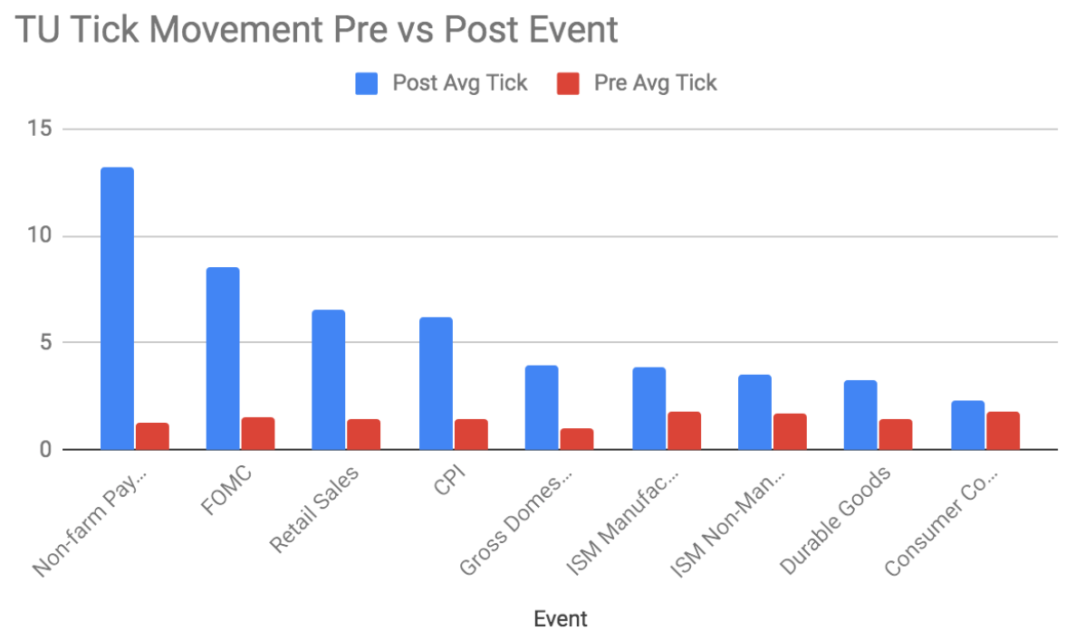
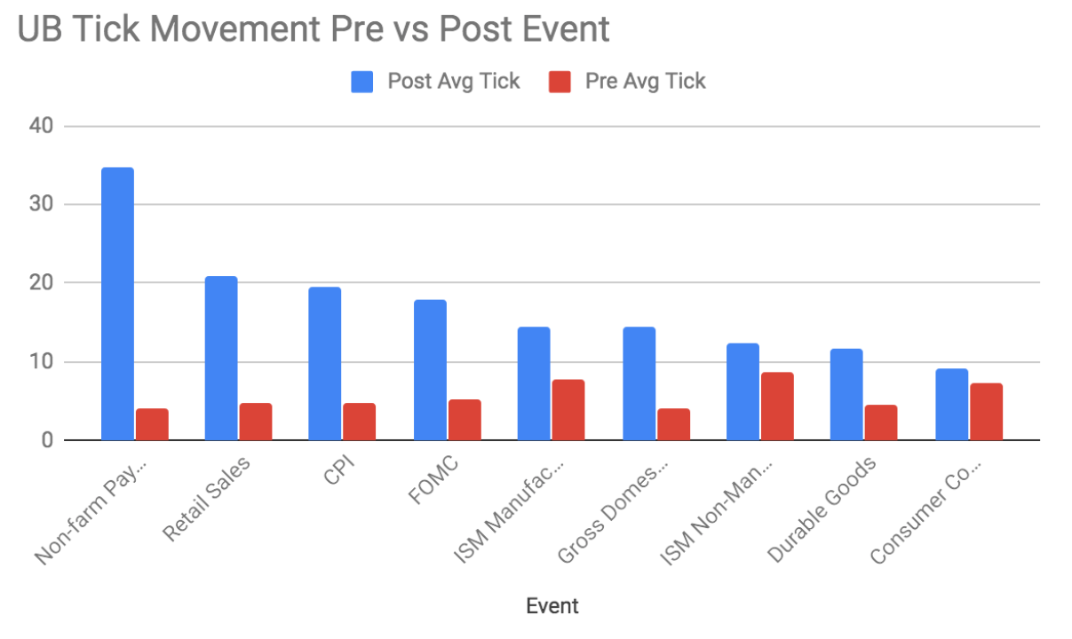
Charts comparing pre-event and post-event window for 9 most important economic announcement
1

Slide 23
Tables comparing pre-event and post-event window for 9 most important economic announcement
Symbol | Event | N | Event Max | Even Mean | No Event | Vol Ratio
UB | Non-farm Payrolls | 58 | 80 | 35 | 4 | 16.4
UB | Retail Sales | 58 | 46 | 21 | 5 | 8.5
UB | CPI | 58 | 44 | 20 | 5 | 8.0
UB | Gross Domestic Product | 46 | 29 | 14 | 4 | 5.9
UB | FOMC | 54 | 45 | 18 | 5 | 3.6
UB | Durable Goods | 56 | 29 | 12 | 5 | 4.2
UB | ISM Manufacturing | 57 | 31 | 14 | 8 | 2.1
UB | ISM Non-Manufacturing | 55 | 43 | 12 | 9 | 1.7
UB | Consumer Confidence | 53 | 32 | 9 | 7 | 1.4
Symbol | Event | N | Event Max | Mean | No Event | VolumeR
TU | Non-farm Payrolls | 58 | 35 | 13 | 1 | 17.1
TU | FOMC | 54 | 45 | 9 | 2 | 5.4
TU | Retail Sales | 58 | 14 | 7 | 1 | 9.0
TU | CPI | 58 | 13 | 6 | 1 | 8.5
TU | Gross Domestic Product | 46 | 10 | 4 | 1 | 6.7
TU | Durable Goods | 56 | 8 | 3 | 1 | 4.4
TU | ISM Manufacturing | 57 | 10 | 4 | 2 | 2.7
TU | ISM Non-Manufacturing | 55 | 12 | 3 | 2 | 2.1
TU | Consumer Confidence | 53 | 12 | 2 | 2 | 1.8
1

Slide 24
Result
Do announcements present opportunity?
Events present extremely outsized opportunities. It’s possible to make short term trades and gain outsized profits given the time period. The average tick movement across all events is approximately 3.5x larger than the average tick movement in prices across a similar time window without and event while the trading volume is on average 6.5x larger and can be over 20x larger.
1

Slide 25
Can pre market movements help in predicting the direction of an event?
To test this premise we examine a few different models to determine how much pre-event returns can help in predicting post event returns. We evaluated the prediction of post-event return using two models and condition on different criteria, all pre-event returns and pre-event returns that were 1 standard deviation greater than the mean pre-event move.
The first model predicts the post event return using a standard linear regression, the second model is a classification model to just predict the post move direction (up or down). We choose support vector machine because it has stricter criteria than a simple logistic regression.
2

Slide 26
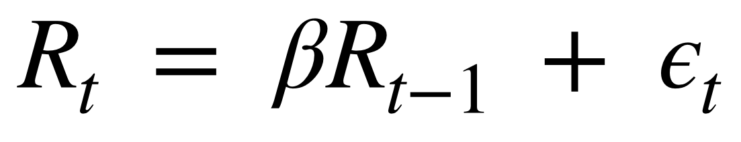
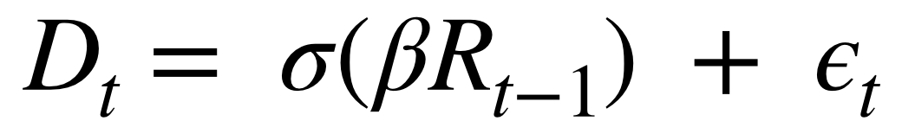
Models used for Analysis
Model 1: linear regression of post-event return on pre-event return
Model 2: support vector machine logistic regression of post-event direction using pre-event return
2

Slide 27
Tables comparing the two scenarios
Scenario 1:
What is the relation of post event market move based on the pre-market move.
Scenario 2:
What is the relation on larger pre-market moves?
 | E[R|dP] |  |  | E[D|dP]
 | TU | UB | ES | TU | UB | ES
Consumer Confidence | 0.00 | 0.01 | 0.10 | 0.51 | 0.62 | 0.51
CPI | 0.00 | 0.02 | 0.00 | 0.57 | 0.50 | 0.57
Durable Goods | 0.00 | 0.00 | 0.10 | 0.66 | 0.55 | 0.66
FOMC | 0.01 | 0.02 | 0.07 | 0.65 | 0.52 | 0.65
GDP | 0.01 | 0.00 | 0.01 | 0.57 | 0.52 | 0.57
ISM Manufacturing | 0.04 | 0.00 | 0.02 | 0.56 | 0.54 | 0.56
ISM Non-Manufacturing | 0.01 | 0.00 | 0.00 | 0.71 | 0.60 | 0.71
Non-farm Payrolls | 0.08 | 0.02 | 0.00 | 0.5 | 0.62 | 0.50
 | E[R|dP > s] |  |  | E[D|dp > s]
 | TU | UB | ES | TU | UB | ES
Consumer Confidence | 1.00 | 0.13 | 0.17 | 0.5 | 0.75 | 0.65
CPI | 0.01 | 0.26 | 0.05 | 0.7 | 0.75 | 0.75
Durable Goods | 0.03 | 0.25 | 0.06 | 0.6 | 0.63 | 0.71
FOMC | 0.25 | 0.03 | 0.62 | 0.83 | 0.67 | 0.75
GDP | 0.01 | 0.03 | 0.03 | 0.57 | 0.57 | 0.78
ISM Manufacturing | 0.35 | 0.07 | 0.02 | 0.67 | 0.70 | 0.56
ISM Non-Manufacturing | 0.00 | 0.16 | 0.05 | 0.67 | 0.67 | 0.67
Non-farm Payrolls | 0.64 | 0.10 | 0.47 | 0.71 | 0.78 | 0.6

Slide 28
Result
Do pre market movements help in predicting the direction of an event?
We were surprised to find that when the pre-event market move is greater than 1 standard deviation from the mean pre-event market move, the predictive power of the pre-market move is significantly better compared to all market moves. A speculator has much better odds of making a profit when the pre-event movement is larger than usual! This was actually surprising to find. Also the ability to predict post market returns from pre-market returns using all data for each event was close to zero, while the ability to predict post even direction fared better.
2

Slide 29
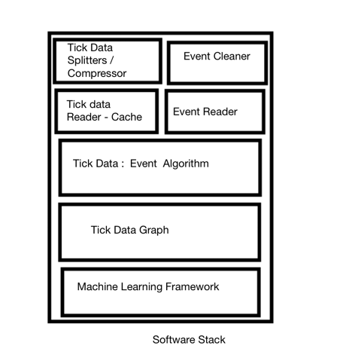
Product Tech Stack
The diagram represents the software stack developed for this analysis which could turn into a product to lease to middle-tier financial firms. Many firms we have encountered do not have any in house capability to split, compress, cache and then deliver tick data to a client program for analysis. The software takes in several GB of raw trade tick data from the CME, splits and compresses it so it can be quickly looked up via data time in a client analysis tool via the cache reader or used as input to simple machine learning framework developed for this project.

Slide 30
Product Features
The software developed has the following features:
Create compressed Tick Trade Archive from Raw Exchange Data
Take exchange tick trade data make it fast to load for any particular date across a range of contracts.
Create Events Repository with Event , Event Date, Market Expectation and Actual Number
Locate event based on a close date, map the market reaction and expectations and plot
Show the profit loss of speculators taking long/short positions in contracts
Compare Events based on Tick Movements
Apply Machine Learning
Assess pre-market moves of post event moves,
Assess market expectations vs actual on market moves

Slide 31
Applications to Other Markets
While we focused on US Futures Markets and Macroeconomic Events, the software stack developed can be applied to any exchange traded markets around the world. For instance we could use the methodology on earnings announcements on US Equities, international central banks announcements on their impact currency valuation and general foreign economic reporting and its impact on local equities and fixed income markets.

Slide 32
Conclusion
We have shown that economic announcements present outsized opportunity in terms of market volatility and trading volume compared to non-event market periods. We have shown that higher than average pre-event market moves are better predictors of the post event price direction and returns compared to the average pre-event return. This lends some credence to the adage that “someone knows something.” The software developed for this problem, stumbled on the problem of the difficulty in using search engines to answer things from an historical context.and starts to address the issue of its not really easy to use search engines to find things in a historical context. In addition we have created the genesis of a product that can be used to analyze historical events impact on the markets.
We also discovered in doing the course of this work there are no real good sources that map historical events to market reactions and they are not easy to find.

