Slide 1
NSAI FOR INSURANCE · PROPERTY & CASUALTY · SMALL COMMERCIAL DIRECT
Small commercial, fully reasoned.
The LLM is the customer-facing agent. NSAI is the underwriting brain.
A chatbot makes direct small commercial feel simple. The underwriting core makes sure simple doesn’t become misclassified, underpriced, or under-covered business.
Illustrative executive walkthrough · Delgado Home Services and BrightSure Direct are fictional · Figures hypothetical

Slide 2
THE SCENARIO · DIRECT-TO-CONSUMER QUOTE REQUEST
A small business owner describes their work in plain English.
CUSTOMER MESSAGE · VIA WEB FORM
ON FILE
“Hi, looking for a quote. I run a handyman business in the Phoenix metro — been at it about six years. It’s me and one helper, and we mostly do small jobs for landlords and property managers. Bathroom fixes, kitchen stuff, water heaters when they go out, drywall patching. Sometimes we’ll patch leaks or replace a few shingles when a tenant calls. We do maybe $180K a year. Need general liability and probably property coverage for my tools and truck stuff.”
BUSINESS
Delgado Home Services
OWNER
Marcos Delgado (sole proprietor)
COVERAGE REQUESTED
General Liability + Tools & Equipment
YEARS / EMPLOYEES
6 years · 2 (owner + 1 helper)
ANNUAL REVENUE
$180,000 (self-reported)
CHANNEL
Instant quote-and-bind, DTC web
“Handyman” is a self-classification. The words also describe plumbing and roof-surface work — different exposure classes with different appetite.

Slide 3
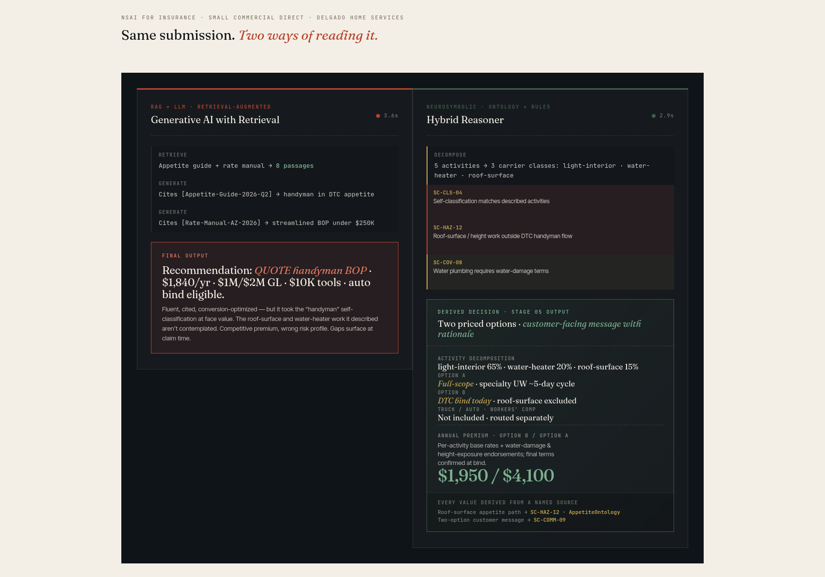
THE LIVE WALKTHROUGH · SAME SUBMISSION, RUN THROUGH BOTH SYSTEMS
One fluent answer vs. a decomposed, priced, explained decision.

Slide 4
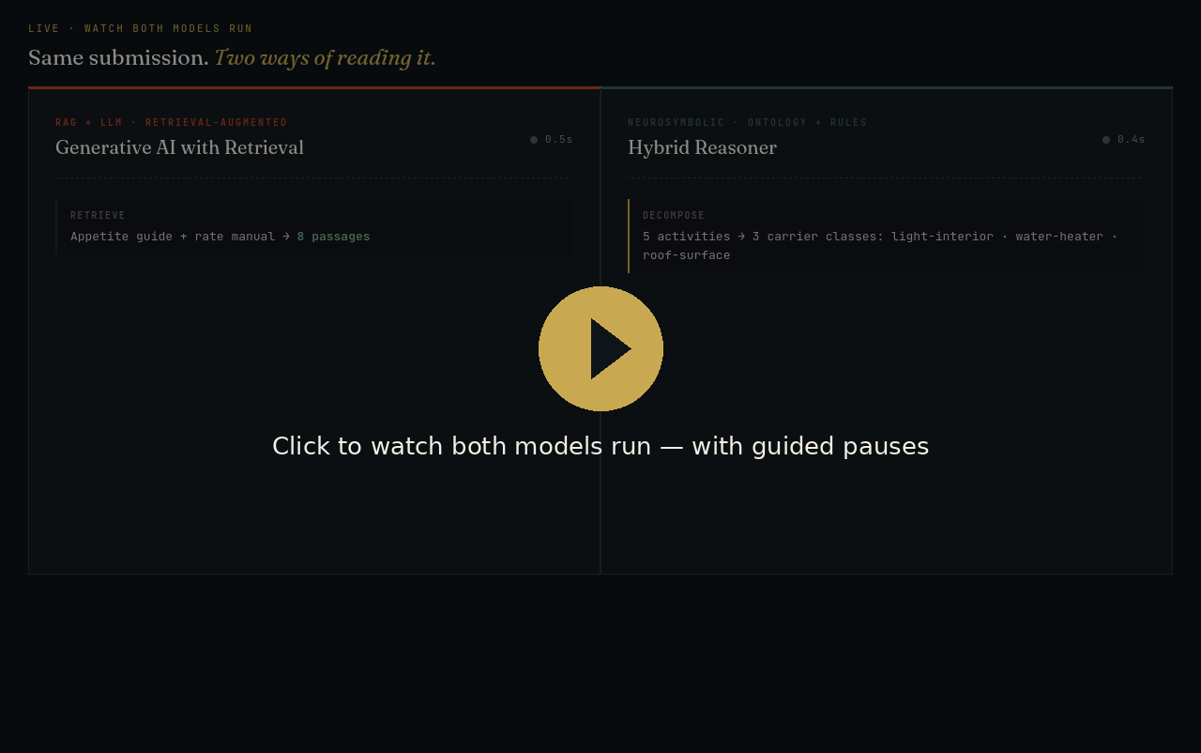
THE LIVE DEMO · TWO WAYS TO PRESENT IT — PICK ONE ONCE THE SITE IS PUBLISHED
Embedded video, or a live interactive view.
OPTION 1 · EMBEDDED VIDEO plays in-slide on click · works offline
OPTION 2 · LIVE WEB VIEWER fully interactive · needs internet
WEB VIEWER GOES HERE
Insert it once, in PowerPoint:
1. Insert ▸ Get Add-ins → search “Web Viewer” → Add
2. Paste this URL into the add-in:
https://nsai4insurance.com/pc-demo-widget.html
3. Resize the add-in to fill this box.
Live after the site is published to the main branch.
No internet or add-ins needed. The 13-second run is baked into this file — good for any room.
▶ Open the live demo in a browser
Notes:
Two ways to show the demo:
• OPTION 1 (left): the embedded video plays in-slide on click — no internet or add-ins. Safe default.
• OPTION 2 (right): a live, interactive view. After the site is published to the main branch, insert the Microsoft ‘Web Viewer’ add-in (Insert > Get Add-ins > search ‘Web Viewer’ > Add), paste https://nsai4insurance.com/pc-demo-widget.html, and resize it to fill the box. You can then click ‘Run Both Models’ inside the slide.
The ‘Open the live demo in a browser’ button works regardless — it just opens the page in your browser.
Before publishing, you can test the live view now via htmlpreview.github.io pointed at the branch copy of pc-demo-widget.html.
Once you decide, delete whichever option you don’t want.

Slide 5
METHOD B · RAG + LLM · COMPETENT, FLUENT — AND UNSAFE
What the retrieval-augmented LLM got right — and what it missed.
WHAT IT GOT RIGHT
WHAT IT MISSED
✓ Correctly identified a small handyman operation
✓ Found the relevant appetite and rate references
✓ Produced a professional, fluent quote — ready to bind
✓ Premium is competitive for the bound class
✕ Roof leak / shingle work is roof-surface work — height/fall exposure outside DTC handyman appetite
✕ Water-heater work carries water-damage exposure the standard handyman BOP doesn’t fully address
✕ Coverage has gaps that only surface at claim time
✕ Competitive — because it’s pricing the wrong risk profile
The failure is structural, not stupid: retrieval gives the model context — it does not force activity-level decomposition or bind the underwriting rules.

Slide 6
METHOD C · NEUROSYMBOLIC CORE · THE UNDERWRITING BRAIN
What the neurosymbolic core did differently.
1
Decomposed the activity set
Five described activities → three exposure classes (light-interior, water-heater, roof-surface) — not one bundled “handyman” label.
2
Caught the appetite breach
Roof-surface work inherits height-work exposure → flagged outside standard DTC handyman appetite (SC-HAZ-12).
3
Connected to claim patterns
Same shared underwriting + claims ontology: Delgado is compared to risks with the same activity mix, not all “handymen.”
4
Priced each exposure separately
Per-activity rating with water-damage and height-exposure endorsements — every value traces to a named source.
5
Produced two options, kept agency
Option A full-scope (~$4,100, specialty UW) · Option B bind today, roof excluded ($1,950) — customer chooses.
6
Wrote the explanation
A customer message that turns a higher quote into an informed choice — plus truck/auto and workers’-comp handoffs.

Slide 7
SIDE BY SIDE · WHAT EACH APPROACH DELIVERS
The scorecard.
RAG + LLM
Neurosymbolic
Business activities recognized
1 bundled label: handyman
3 activity classes
Exposure-class accuracy
Self-classified
Decomposed & rule-bound
Claims-history comparison
Generic class-level
Similar activity-mix pattern
Customer message
Price-only
Price with informed-choice rationale
Reproducibility across runs
Probabilistic
Deterministic
Auditable rationale
Retrieved citations
Proof tree
Bottom line. Verisk estimates small-commercial misclassification drives up to $6.5B in first-year premium leakage and more than $22B over four years in BOP premium alone. A DTC flow that takes the self-description at face value is the leakage. NSAI keeps the speed and adds the underwriting judgment.
Source: Verisk LightSpeed Small Commercial materials and Verisk analysis of small-commercial SIC/NAICS misclassification. Carrier, insured, rules, and figures are illustrative.

Slide 8
APPENDIX · RAG RETRIEVAL — WHAT IT PULLED VS. WHAT IT OVERLOOKED
The exclusions were in the guide the whole time.
WHAT VECTOR SEARCH RETRIEVED · 8 PASSAGES
IN THE SAME GUIDE — NEVER APPLIED
PASS 1 · APPETITE GUIDE (5)
§2.4 handyman, rev < $250K → in appetite, auto-bind
§2.4.1 eligible: drywall, fixtures, bath/kitchen, interior paint
§1.2 Arizona: admitted, streamlined, no surcharge
§3.1 sole prop / owner + ≤3 helpers eligible
§2.0 DTC: in-appetite classes get an instant bindable quote
PASS 2 · RATE MANUAL + COVERAGE DEFAULTS (3)
§AZ-4 rate band B2, streamlined BOP
§AZ-4.3 typical bound premium $1,700–$2,000
§DTC-1 defaults: $1M/$2M GL, $10K tools, $25K AOP
→ All eight reinforce one answer: “handyman, in appetite, bind today.”
§2.6 Water-heater / plumbing → water-damage exposure to landlord property. In appetite only with water-damage terms / sublimit.
§2.7 Roof-surface work — leak patching, shingle repair, work from a roof — carries height/fall exposure and is outside standard DTC handyman appetite → specialty UW.
→ The query was “handyman,” so §2.4 ranked first; §2.6 and §2.7 never surfaced.
Where it goes wrong: not a broken step — a missing one. Retrieval is steered by the bundled “handyman” query, and even if §2.6 / §2.7 were retrieved, generation isn’t bound to honor them. The neurosymbolic lane decomposes the customer’s words into the activities that trigger §2.6 and §2.7, then fires those rules deterministically.

