Slide 1
Healthcare Treatment Policy Learning Using Reinforcement Learning
Harshit Chhabra (23csu118)
Harsh Yadav (23su115)
Himanshu rao (23csu125)
Jatin Yadav (23csu139)

Slide 2
Problem Statement
Design and implement a reinforcement learning agent that learns optimal treatment strategies for patients suffering from chronic or critical illnesses such as diabetes, sepsis, or cancer. The goal is to maximize long-term health outcomes while minimizing treatment side effects, hospital stay duration, and overall healthcare costs.

Slide 3
Introduction & Project Goals
Purpose: Build an AI-driven healthcare dashboard
Integrates ML, RL, chatbot, analytics & simulation
Simple visualizations + real-time monitoring
Demonstrates AI for clinical decision-support
Predict patient risk using ML
Provide alerts for abnormal vitals
Enable PDF reporting & patient lookup
Add intelligent doctor chatbot
Deploy as a Streamlit web app

Slide 4
Input
The input consists of patient health data collected over time from electronic health records (EHR). Each record forms a state vector containing clinical variables such as:
Vital signs: heart rate, blood pressure, oxygen level
Lab results: WBC count, glucose, creatinine
Treatment history: insulin dose, antibiotics, vasopressor usage
Outcome indicators: recovery, ICU stay
This input helps the RL agent to understand the current health condition and make decisions (actions) like dosage adjustment or therapy change. Data preprocessing includes normalization, handling missing values, and time-series structuring.

Slide 5
Techniques – RL Algorithms
(a) Deep Q-Network (DQN)
Learns optimal action-value functions (Q-values) from patient state transitions.
Handles high-dimensional continuous inputs using neural networks.
Advantage: Simple and interpretable in healthcare decision systems.
(b) Deep Deterministic Policy Gradient (DDPG)
Used for continuous action spaces such as dosage control.
Combines actor–critic architecture for stable policy learning.
Advantage: Balances exploration vs exploitation and adapts personalized treatment intensities.
(c) Batch-Constrained Q-Learning (BCQ)
Works on offline datasets (no live interaction).
Prevents unsafe or unrealistic actions by learning only from existing medical data.
Ideal for healthcare where experiments on real patients are not feasible.
These three collectively ensure both safe offline learning and real-world policy optimization.

Slide 6
Simulation Environment
Since real-world medical trials are risky, we use a virtual patient simulator based on the MIMIC-III dataset. Simulation framework examples:
SepsisGym (OpenAI Gym-style environment for ICU patients)
Synthea synthetic patient generator
Each episode represents a simulated patient journey (admission → treatment → discharge/death).
The environment models Markov Decision Process (MDP) dynamics with:
State: Patient’s health indicators
Action: Treatment decision
Reward: Improvement, stability, or decline in health

Slide 7
System Architecture
User Interface (Streamlit)
Synthetic Data Generator (NumPy + Pandas)
ML Model (Logistic Regression)
RL Engine (Q-Learning)
Doctor Chatbot (Rule-based)
PDF Reports (ReportLab)
Authentication Layer

Slide 8
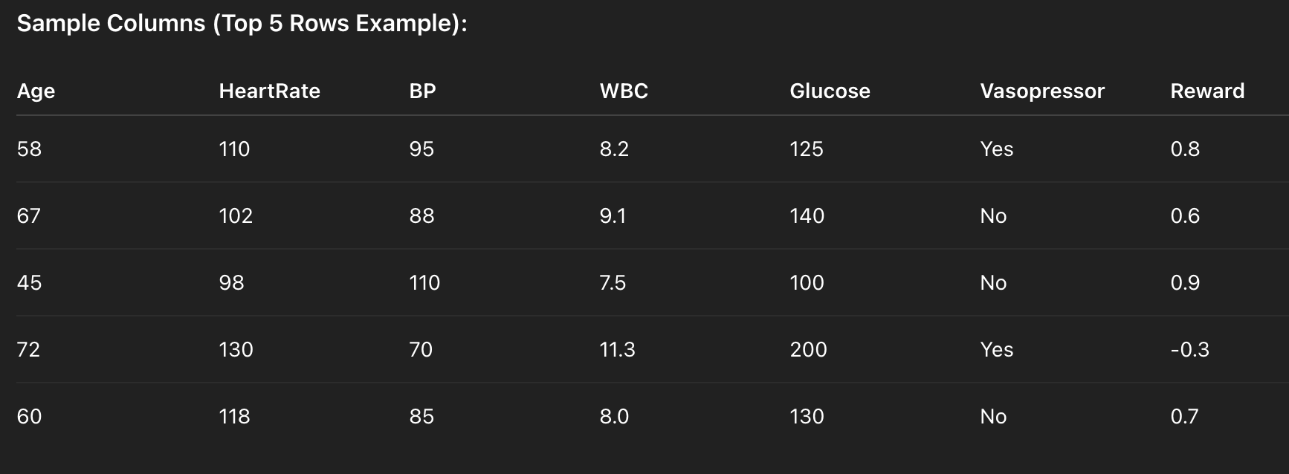
Dataset
Dataset Name: MIMIC-III (Medical Information Mart for Intensive Care) Source: https://physionet.org/content/mimiciii/1.4/
Each row represents a patient’s state and action at one time step with a corresponding reward.

Slide 9
Final Output
The trained RL model outputs an optimized treatment policy that:
Suggests personalized actions (e.g., “increase vasopressor by 5%” or “reduce insulin dose”)
Predicts expected long-term reward (patient recovery probability)
Can visualize treatment trajectories using policy heatmaps or patient improvement graphs
Expected outcome:
Reduced mortality rate (compared to standard treatment)
Shorter ICU stays
Safer drug dosage strategies

Slide 10
Machine Learning Model
Logistic Regression for Risk Prediction
Inputs: HR, SBP, Temp, RR
Output: High-risk (1) / Low-risk (0)
Provides probability score
Excellent for simple, interpretable decisions
Fast prediction
High interpretability
Useful for threshold-based risk assessment
Complements RL treatment engine

Slide 11
Reinforcement Learning Model
Q-Learning Treatment Engine
States: Low, Medium, High
Actions:
No Action
IV Fluids
Vasopressor
Call Doctor
Reward-driven clinical logic
Learns best action for each risk level
Q-Table Visualization
Heatmap of Q-values
Best action per risk state
Evidence of policy learning
Treatment pattern emerges clearly
Q-Learning: Reward Logic
High-risk → Vasopressor / Call Doctor (reward +12)
Medium-risk → IV Fluids (reward +8)
Low-risk → No Action (reward +5)
Penalties for harmful or unnecessary actions

Slide 12
Alert & Warning System
HR > 120 → High HR warning
SBP > 160 → Hypertension alert
Temp > 38.5°C → Fever alert
RR > 24 → High respiration alert
Real-time alerts during Live Simulation
Doctor Chatbot
Rule-based clinical assistant
Answers:
Fever symptoms
BP-related questions
Heart rate issues
Basic treatment advice
Enhances user interaction

Slide 13
Conclusion
Successfully integrated ML, RL, chatbot & analytics
Built an end-to-end clinical decision-support simulation
User-friendly interface for students & medical learners
Ready for future expansion:
Deep RL (DDPG / BCQ)
Real medical datasets
Advanced chatbot (LLM)
Cloud deployment

Slide 14
Reference
Komorowski, M., et al. “Artificial Intelligence for Treatment of Sepsis in Intensive Care: Reinforcement Learning Framework.” Nature Medicine, 2022.
Killian, J. A., et al. “Offline Reinforcement Learning for Personalized Treatment Strategies.” NeurIPS 2023.
Tang, X. et al. “Safe Reinforcement Learning in Healthcare: A Survey.” ACM Computing Surveys, 2021.
Gottesman, O., et al. “Evaluating Reinforcement Learning Algorithms in Healthcare.” Nature Machine Intelligence, 2020.
Fatemi, M. et al. “Deep Reinforcement Learning for Personalized Medicine.” IEEE Transactions on Neural Networks and Learning Systems, 2021.

Slide 15

HARSHIT HARSH HIMANSHU JATIN

