Slide 1

Angular OC
September 11 2014
John R Schmidt
Consume RESTful APIs
with
$resource
and
Restangular

Slide 2
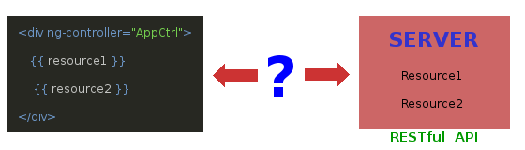
Angular OC
September 11 2014
John R Schmidt
Consume RESTful APIs with $resource and Restangular
How can we connect an Angular JS application with a back end RESTful application on the server?

Slide 3
Angular OC
September 11 2014
John R Schmidt
Consume RESTful APIs with $resource and Restangular
How can we connect an Angular JS application with a back end RESTful application on the server?
3 tools are available:

Slide 4
Angular OC
September 11 2014
John R Schmidt
Consume RESTful APIs with $resource and Restangular
How can we connect an Angular JS application with a back end RESTful application on the server?
3 tools are available:
$http
$resource
Restangular

Slide 5
Angular OC
September 11 2014
John R Schmidt
Consume RESTful APIs with $resource and Restangular
Next slide … (introduce the 3 options and announce the demo with $resource and Restangular)

Slide 6
Angular OC
September 11 2014
John R Schmidt
Consume RESTful APIs with $resource and Restangular
$resource
v
Restangular
Let's create a simple demo app to compare the two.

Slide 7
Angular OC
September 11 2014
John R Schmidt
Consume RESTful APIs with $resource and Restangular
$resource v Restangular DEMO:
(Since we thought this presentation was going to happen in July ...)

Slide 8
Angular OC
September 11 2014
John R Schmidt
Consume RESTful APIs with $resource and Restangular
$resource v Restangular DEMO:
(Since we thought this presentation was going to happen in July ...)
FIFA 2014 World Cup Schedule & Results

Slide 9
Angular OC
September 11 2014
John R Schmidt
Consume RESTful APIs with $resource and Restangular
The models for the demo app:
Match model
Team1_id:integer
Team2_id:integer
MatchDate:date
Score1:integer
Score2:integer
Team model
Name:string

Slide 10
Angular OC
September 11 2014
John R Schmidt
Consume RESTful APIs with $resource and Restangular
Building the Demo

Slide 11
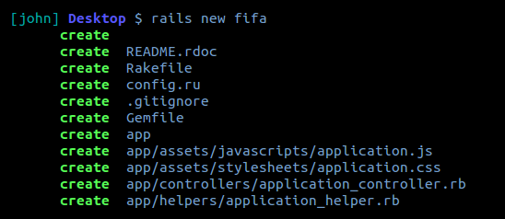
Angular OC
September 11 2014
John R Schmidt
Consume RESTful APIs with $resource and Restangular
First, let's create a RESTful backend with Rails.

Slide 12
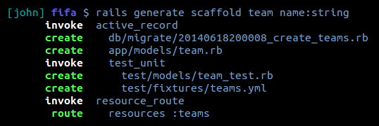
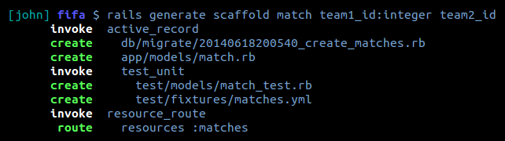
Angular OC
September 11 2014
John R Schmidt
Consume RESTful APIs with $resource and Restangular
And add our models, views and controllers.

Slide 13
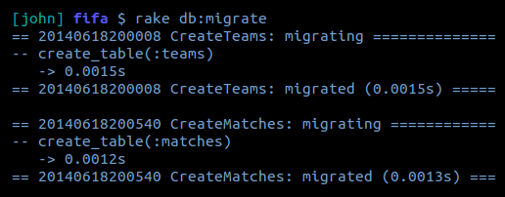
Angular OC
September 11 2014
John R Schmidt
Consume RESTful APIs with $resource and Restangular
Run the Rails migration to initialize the database with our models.

Slide 14
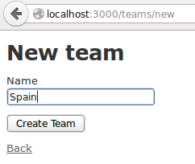
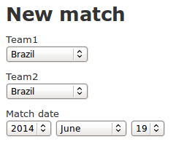
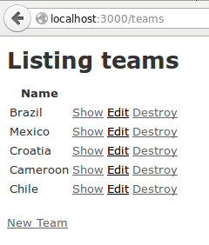
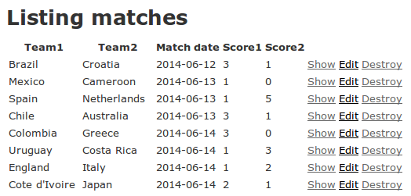
Angular OC
September 11 2014
John R Schmidt
Consume RESTful APIs with $resource and Restangular
And prepopulate the app with some data prior to running the demo.

Slide 15
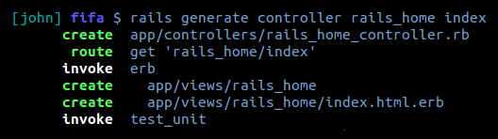
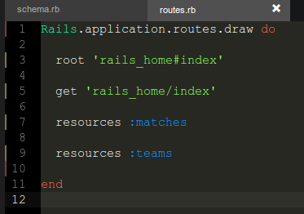
Angular OC
September 11 2014
John R Schmidt
Consume RESTful APIs with $resource and Restangular
Use the Rails controller generator to add a 'Rails Home' controller and view to act as the home/index
from the Rails perspective. Then route the Rails root to its index. We'll put the Angular view inside there.

Slide 16
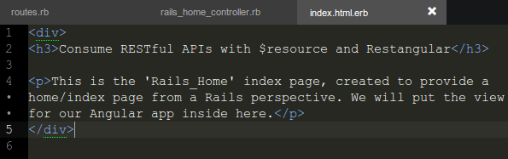
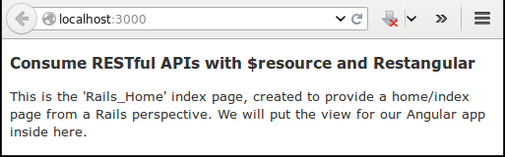
Angular OC
September 11 2014
John R Schmidt
Consume RESTful APIs with $resource and Restangular
After customizing the Rails_Home index.html.erb created by the Rails controller generator:

Slide 17
Angular OC
September 11 2014
John R Schmidt
Consume RESTful APIs with $resource and Restangular
Now we can add a simple Angular app, integrated into our Rails app.

Slide 18
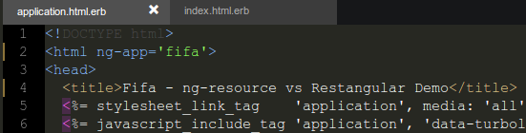
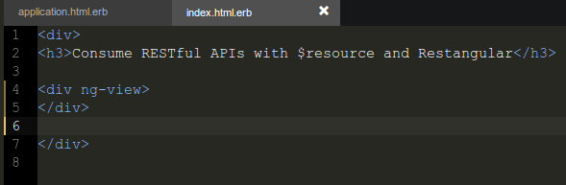
Angular OC
September 11 2014
John R Schmidt
Consume RESTful APIs with $resource and Restangular
Add our initial Angular directives to the HTML tags.

Slide 19
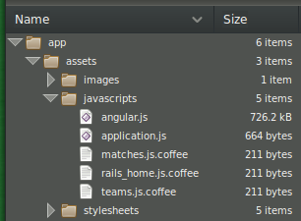
Angular OC
September 11 2014
John R Schmidt
Consume RESTful APIs with $resource and Restangular
Add the angular.js file.

Slide 20
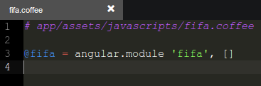
Angular OC
September 11 2014
John R Schmidt
Consume RESTful APIs with $resource and Restangular
Create the fifa.coffee file. (Rails will automatically compile to JS.)

Slide 21
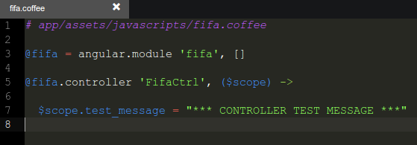
Angular OC
September 11 2014
John R Schmidt
Consume RESTful APIs with $resource and Restangular
Add an Angular controller.

Slide 22
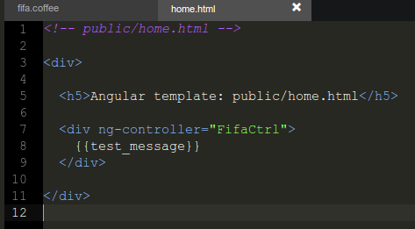
Angular OC
September 11 2014
John R Schmidt
Consume RESTful APIs with $resource and Restangular
Create an Angular homepage template.

Slide 23
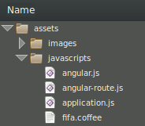
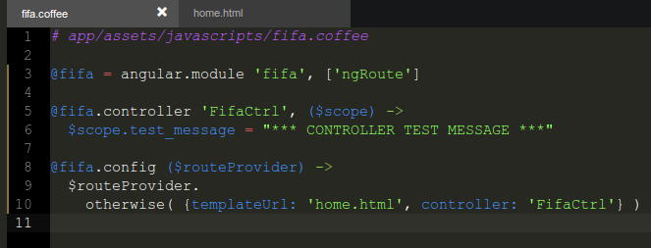
Angular OC
September 11 2014
John R Schmidt
Consume RESTful APIs with $resource and Restangular
Add angular-route.js and configure Angular routing to direct the app to the template.

Slide 24
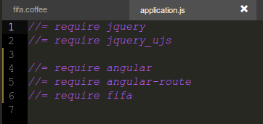
Angular OC
September 11 2014
John R Schmidt
Consume RESTful APIs with $resource and Restangular
One more item in order to successfully mix Rails with Angular: Edit the Rails manifest file for javascript assets (app/javascripts/application.js) to add fifa.js, angular.js and angular-route.js, and remove turbolinks.

Slide 25
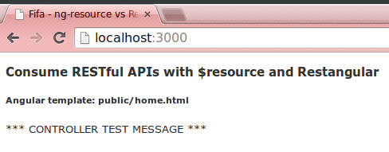
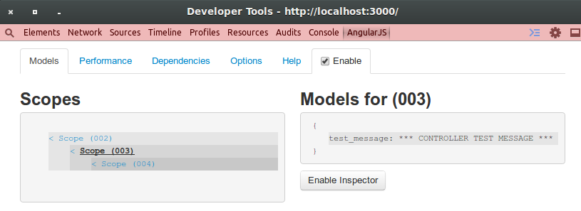
Angular OC
September 11 2014
John R Schmidt
Consume RESTful APIs with $resource and Restangular
Now we have a working Angular app running inside a Rails app.

Slide 26
Angular OC
September 11 2014
John R Schmidt
Consume RESTful APIs with $resource and Restangular
Now for the showdown! We'll start with $resource first.
Let's set this up to display a list of teams retrieved from the server with the Angular $resource service.
Several steps are needed to accomplish this:

Slide 27
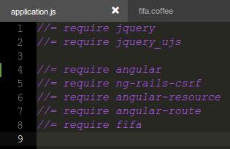
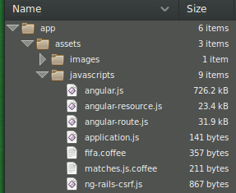
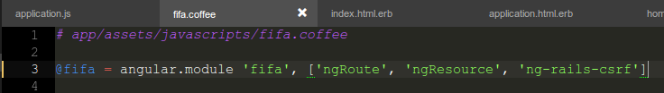
Angular OC
September 11 2014
John R Schmidt
Consume RESTful APIs with $resource and Restangular
Add the $resource service. We also need to add a third party service called ng-rails-csrf. This will allow Angular to send and receive RESTful data through the Rails cross service reference forgery protections.

Slide 28

Angular OC
September 11 2014
John R Schmidt
Consume RESTful APIs with $resource and Restangular
Add the necessary dependencies to the controller.
We need the $http and $resource services ($resource depends on $http), and a variable to hold the base URL for teams.

Slide 29
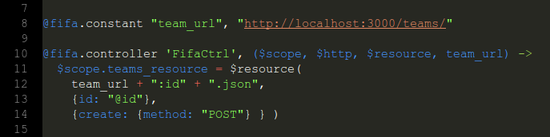
Angular OC
September 11 2014
John R Schmidt
Consume RESTful APIs with $resource and Restangular
After setting the value for the team_url constant, we can define a teams_resource object using the $resource service.

Slide 30
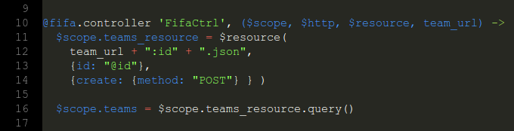
Angular OC
September 11 2014
John R Schmidt
Consume RESTful APIs with $resource and Restangular
If we define a $scope.teams model to be the result of applying the query() method to $scope.teams_resource, then $scope.teams will be bound to the Teams table in the database.

Slide 31
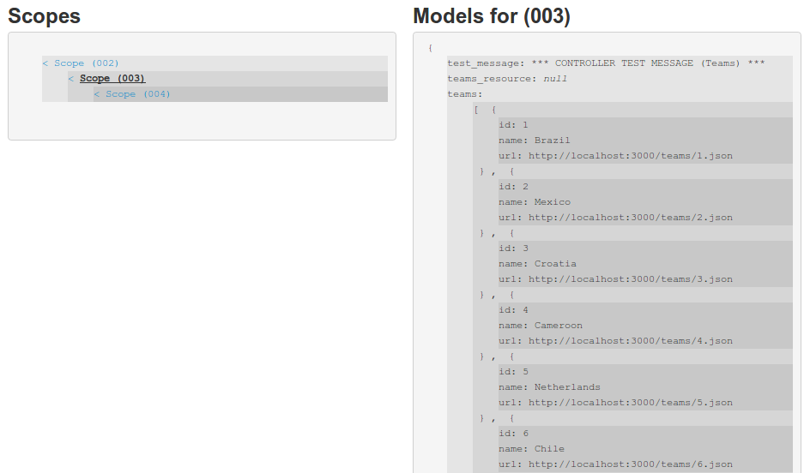
Angular OC
September 11 2014
John R Schmidt
Consume RESTful APIs with $resource and Restangular
The Batarang dev tool shows us that we now have the data available to the scope of the ng-view div.

Slide 32

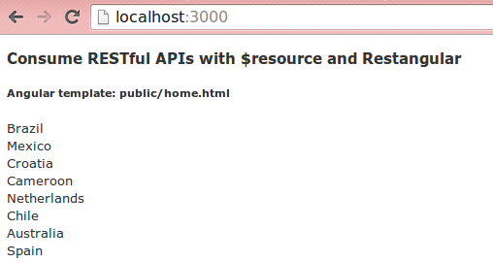
Angular OC
September 11 2014
John R Schmidt
Consume RESTful APIs with $resource and Restangular
Use ng-repeat to display the teams.

Slide 33
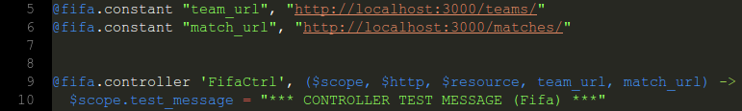
Angular OC
September 11 2014
John R Schmidt
Consume RESTful APIs with $resource and Restangular
Now let's add match data for each team.
Create a constant for the Matches base URL and add it as a dependency.

Slide 34
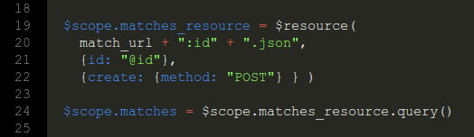
Angular OC
September 11 2014
John R Schmidt
Consume RESTful APIs with $resource and Restangular
Define a matches_resource object and a corresponding $scope.matches model.

Slide 35
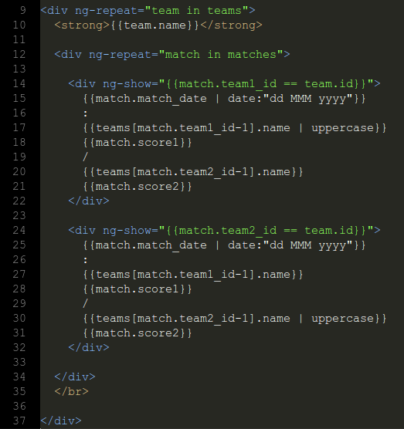
Angular OC
September 11 2014
John R Schmidt
Consume RESTful APIs with $resource and Restangular
Nest an ng-repeat directive for matches inside the ng-repeat for teams, configured to only show matches for the current team.
Format the output as desired.

Slide 36
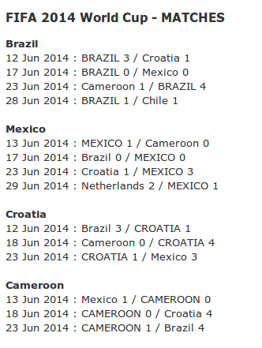
Angular OC
September 11 2014
John R Schmidt
Consume RESTful APIs with $resource and Restangular

Slide 37
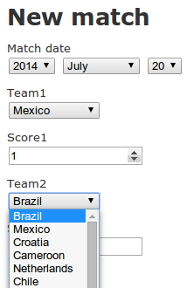
Angular OC
September 11 2014
John R Schmidt
Consume RESTful APIs with $resource and Restangular
Now let's try submitting data to the server with Angular and $resource. We already have a form which was created by Rails for adding new matches.
Let's substitute an Angular form.

Slide 38
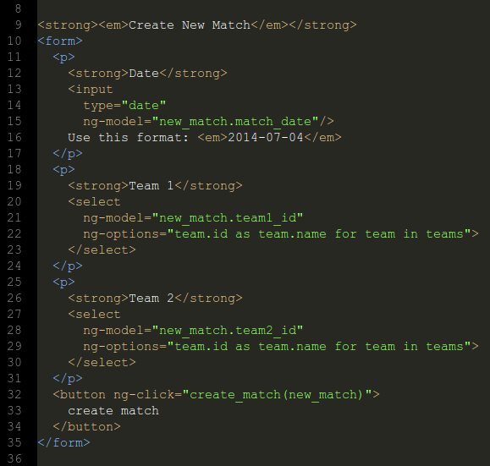
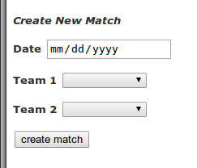
Angular OC
September 11 2014
John R Schmidt
Consume RESTful APIs with $resource and Restangular
This is our new Angular based form for adding new matches.

Slide 39
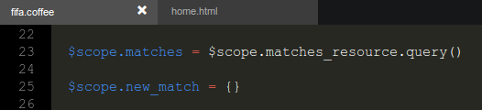
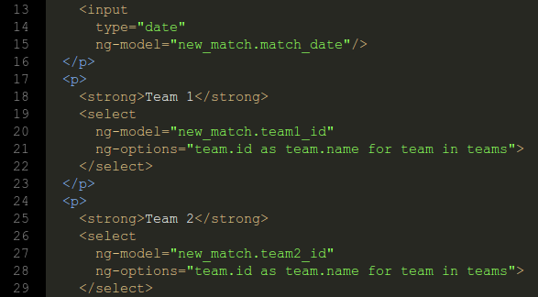
Angular OC
September 11 2014
John R Schmidt
Consume RESTful APIs with $resource and Restangular
We'll store our data from the form as attributes of a model called $scope.new_match.

Slide 40
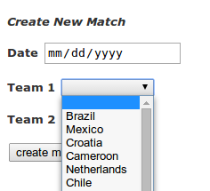
Angular OC
September 11 2014
John R Schmidt
Consume RESTful APIs with $resource and Restangular
By using the comprehensions syntax on the ng-options directive, we get a pull down list of team names on the select tag.

Slide 41
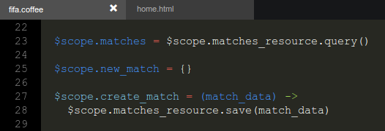
Angular OC
September 11 2014
John R Schmidt
Consume RESTful APIs with $resource and Restangular
The $resource service defines a number of RESTful mehods. We need to define a function which calls the save() function on the $scope.matches_resource object. We'll call that function $scope.create_match().

Slide 42
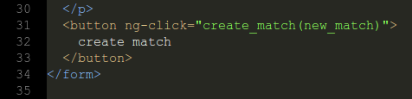
Angular OC
September 11 2014
John R Schmidt
Consume RESTful APIs with $resource and Restangular
By using the create_match() function which we've just defined as an attribute on an ng-click directive, we can create a button which, when clicked, will communicate with the server to create the new match. Note that a submit tag is not required.

Slide 43
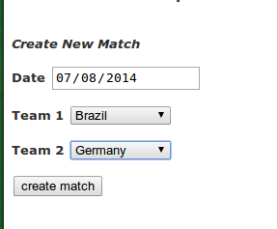
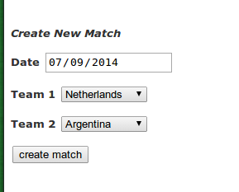
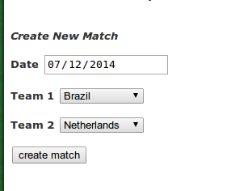
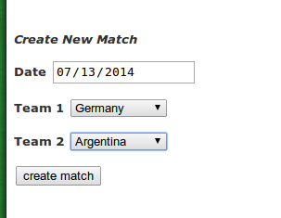
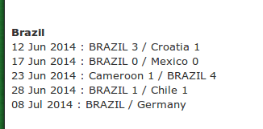
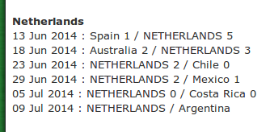
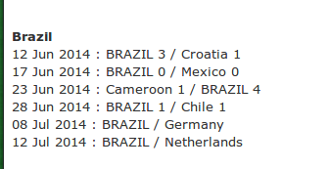

Angular OC
September 11 2014
John R Schmidt
Consume RESTful APIs with $resource and Restangular
Now we can add the final four games to our database.

Slide 44


Angular OC
September 11 2014
John R Schmidt
Consume RESTful APIs with $resource and Restangular
Now let's add a form to input the scores separately for games that don't have them yet.
First, we'll add logic to separate the matches with no scores yet and display them at the top of the list.

Slide 45

Angular OC
September 11 2014
John R Schmidt
Consume RESTful APIs with $resource and Restangular
And make a form for each scoreless match.

Slide 46

Angular OC
September 11 2014
John R Schmidt
Consume RESTful APIs with $resource and Restangular
Add a button to submit the form with a value of update_match(match) for the ng-click directive.

Slide 47

Angular OC
September 11 2014
John R Schmidt
Consume RESTful APIs with $resource and Restangular
Then we add the update_match() function to our controller.

Slide 48

Angular OC
September 11 2014
John R Schmidt
Consume RESTful APIs with $resource and Restangular
Now we can update matches by adding the scores.

Slide 49
Angular OC
September 11 2014
John R Schmidt
Consume RESTful APIs with $resource and Restangular
Next slide ...

Slide 50
Angular OC
September 11 2014
John R Schmidt
Consume RESTful APIs with $resource and Restangular
Next slide ...

Slide 51
Angular OC
September 11 2014
John R Schmidt
Consume RESTful APIs with $resource and Restangular
Next slide ...

Slide 52
Angular OC
September 11 2014
John R Schmidt
Consume RESTful APIs with $resource and Restangular
Next slide ...

Slide 53
Angular OC
September 11 2014
John R Schmidt
Consume RESTful APIs with $resource and Restangular
Next slide ...

Slide 54
Angular OC
September 11 2014
John R Schmidt
Consume RESTful APIs with $resource and Restangular
Next slide ...

