Slide 1
Database Management Systems - Project
Introduction

Slide 2
Project Outline
Overview
Checkpoints
Grading
Worksheets

Slide 3
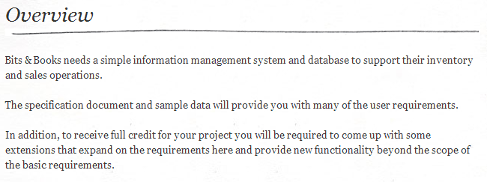
Project Assignment

Slide 4
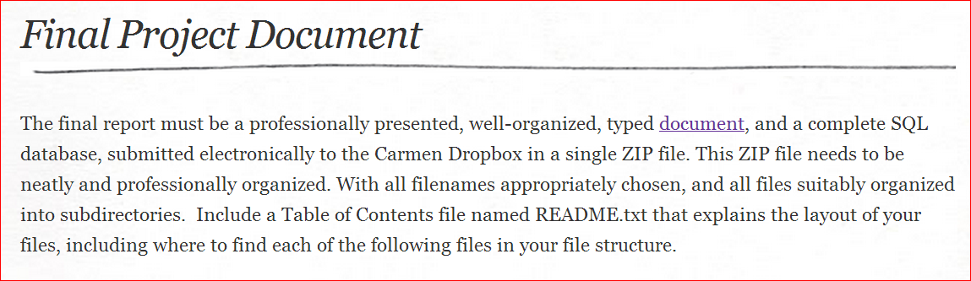
Project Deliverables

Slide 5
Project Deliverables
Part I – The Final Report
Your final document will include a relational database schema, entity relationship diagram, SQL queries, and reports, as indicated below.

Slide 6
Part I, Section 1 - Database Description
A database description document that contains
ER Model
Relational Schema
Normalization
Indexes
Views
Transactions

Slide 7
Part I, Section 2 - User Manual
Describe the usage of your database, for use by developers who are going to be writing code to use your database.
Tables
Sample SQL

Slide 8
Part I, Section 3 - Graded Checkpoint Documents
All of your original, graded checkpoint documents organized in a neat and professional manner.
For each checkpoint that required a revision you must indicate a revision for that checkpoint.

Slide 9
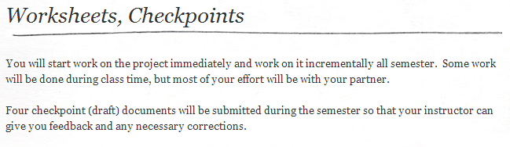
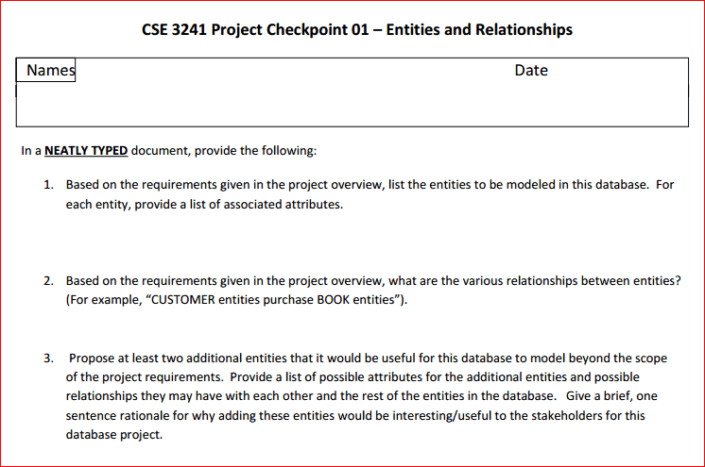
Project Assignment

Slide 10
Part II – The SQL Database
A binary version of your database, suitable for opening with SQLite.
Data Files
SQL
Create
Queries
Insert/Delete

Slide 11
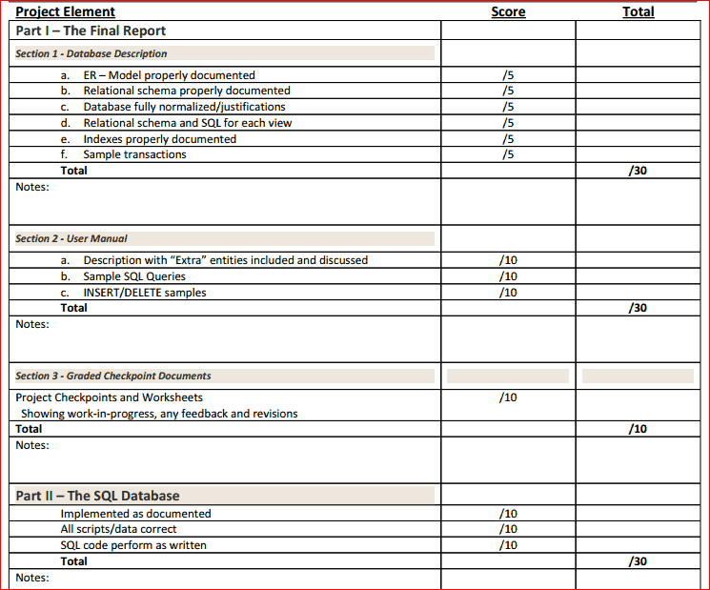
Grading
Project Element | Points
Part I, Section I Database Descriptions | 30
Part I, Section II User Manual | 30
Part I, Section III Checkpoints | 10
Part II SQL database | 30

Slide 12
Roadmap
Collect requirements (users, views, constraints, tasks)
Model requirements and validate (ERD and EERD)
Map ERD to relational model
Verify model with relational algebra
Build model using DBMS (SQL)
Optimize model (Normalization and Indexing)
Build transactions and other user tools

Slide 13
Validation vs Verification
Validation
“Are we building the right model?”
Verification
“Are we building the model right?”

Slide 14
What now
Start assembling requirements of course!
Who are the users?
What views / reports do they want?
What queries might be needed?
What data might need to be updated?
What constraints are on the data?

Slide 15
Fact Finding Methods
Distribute and collect stakeholder questionnaires
Review existing reports, forms, and procedure descriptions
Conduct interviews and discussion with users
Observe business processes and workflows

Slide 16
Questionnaires
Limited and specific information from a large number of stakeholders
Preliminary insight
Not well suited for gathering detailed information
Open-ended questions vs. closed-ended questions

Slide 17
Existing Documentation
Forms, reports, user manuals, job descriptions, etc.
Preliminary understanding of processes
Guidelines / visual cues to guide interviews
Identify business rules, discrepancies, and redundancies
Be cautious of outdated material

Slide 18
Interviews and Discussion
Most effective way to understand business functions and rules
Time-consuming and resource-expensive
May require multiple sessions

Slide 19
Observe Business Processes and Workflow
From office walkthrough to performing actual tasks
May make users nervous
Not necessary to observe all processes at same level of detail

Slide 20
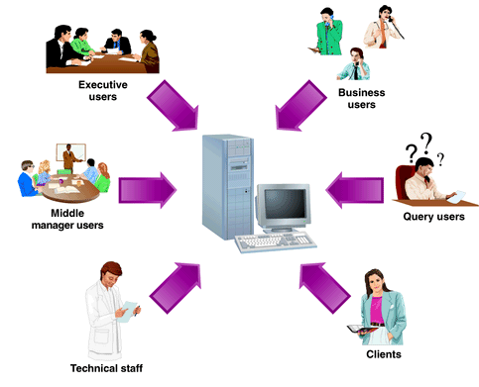
Who are the Users?
Internal
Horizontal - across departments
Vertical - clerical staff, middle management, and senior executives
Day-to-day operations vs Administrative support
External
Customers
Regulators
Suppliers
Systems

Slide 21
What Views, Queries, Updates are needed?
What are the business processes or operations?
Routine, ad hoc
What triggers the process?
What are the system inputs?
Input forms, data feeds, etc.
What are the steps in the process?
What changes as a result of the process?
What are the outputs?
Reports, data transmissions, etc.

Slide 22
What constraints on the database?
Key constraint
What data is unique or has an identifier?
Referential constraint
What relationships are important?
What should happen if one is updated or deleted?
Semantic constraint
Implied, from the meaning of the situation

