Slide 1
Aviation Accident Rate Comparison in Recent Events
CPT Moreland, CPT Rogers, CPT Seo
Excellence Through Knowledge
Notes:
Joseph

Slide 2

Agenda
Problem and Motivation
Data Sources and Preparation
Accident Trends
Phase of Flight Analysis
Engine Data Analysis
Conclusion
Notes:
Joseph

Slide 3


Problem Description
Recent headlines suggest aviation accidents are “on the rise”.
The FAA (Federal Aviation Administration) implements major regulatory changes to prevent future accidents from occurring based upon past trends and post-accident analysis.
Analyze yearly accident/incident counts.
Long-Term Trends
Phases of Flight Risk
Role of Engine Manufacturer
Notes:
Joseph

Slide 4


Data Sources and Preparation
The National Transportation Safety Board (NTSB)
All recorded aviation accidents since 1962
~ 200K
Each record contains:
Aircraft
Location
Weather
Crew Experience
Homebrew
Converts Microsoft Access files for Linux and Mac
“The Missing Package Manager for macOS (or Linux)”
Manipulation of Data
Total of 30 .CSV files
Comparing information across multiple .CSV files
Identifying discrepancies and incorrect information
Notes:
Joseph

Slide 5
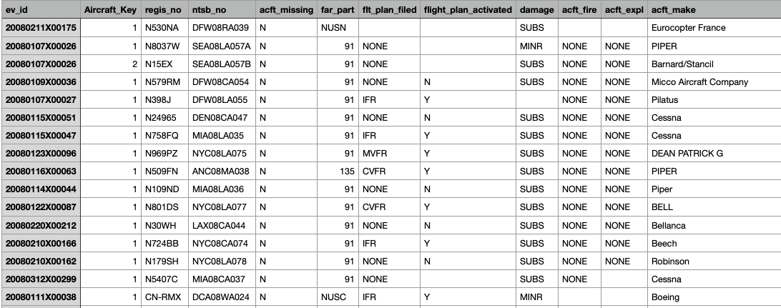
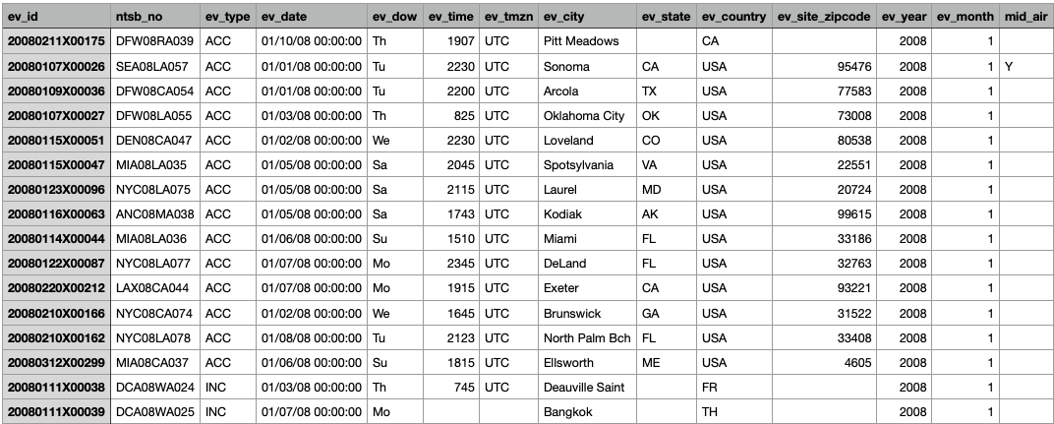
Cleaning the Data
aircraft.csv
aircraft.csv
engines.csv
events.csv
occurrences.csv
ct_seqevt.evt
events.csv

Slide 6
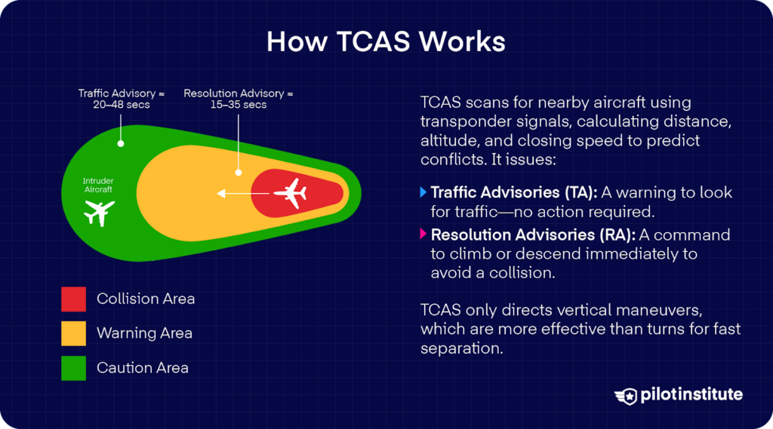
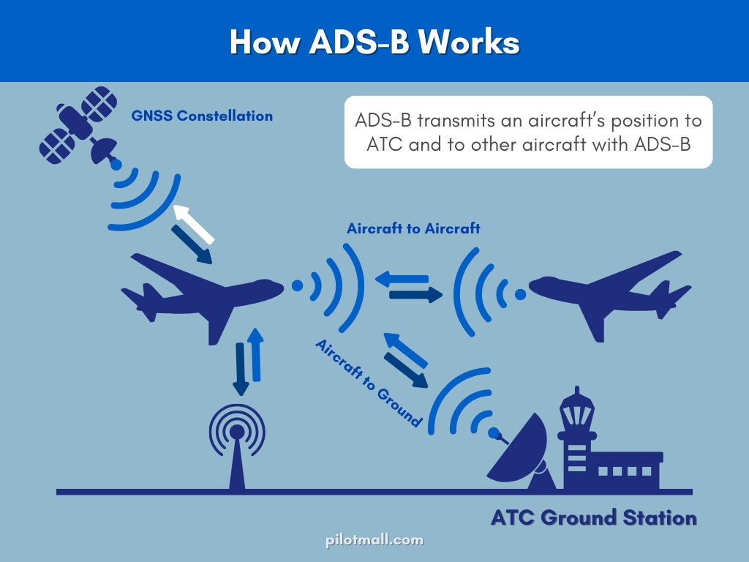

Terminology
Federal Aviation Regulations
Part 91 – General Aviation
Part 121 – Major Airlines and Cargo
Part 135 – Commuter and On-Demand Cargo Operators
Traffic Collision Avoidance System
Automatic Dependent Surveillance - Broadcast

Slide 7
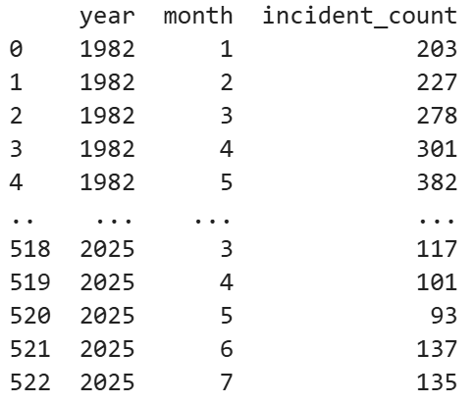
Cleaning the Data
Import the data : pd.read_csv()
Concatenating the two data(pre 2008 and after 2008) : pd.concat([df1,df2])
Making the datetime object : pd.to_datetime(df['ev_date'])
Grouping daily accidents : df.groupby('ev_date').size().reset_index(name='N')
Adding the column of year(month) : df_daily['ev_date'].dt.year(month)
Grouping monthly accidents : df_daily.groupby(['year', 'month'])['N'].sum().reset_index(name='incident_count')
Ex) df_monthly
Notes:
Min

Slide 8
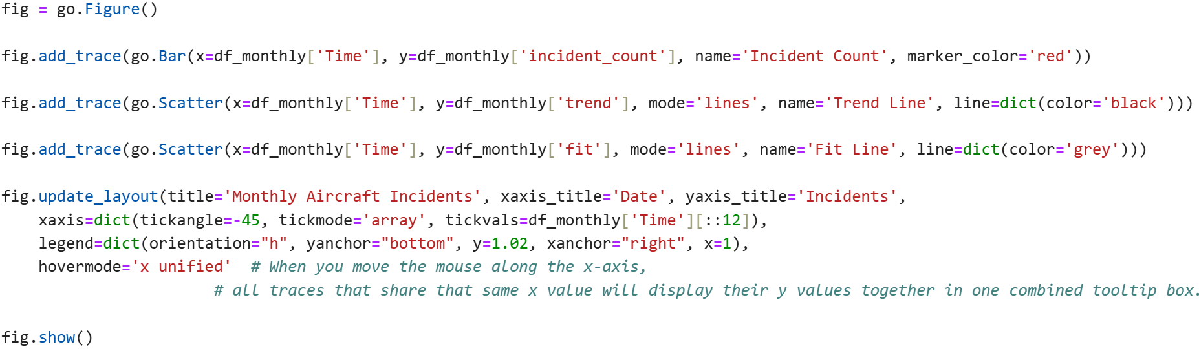
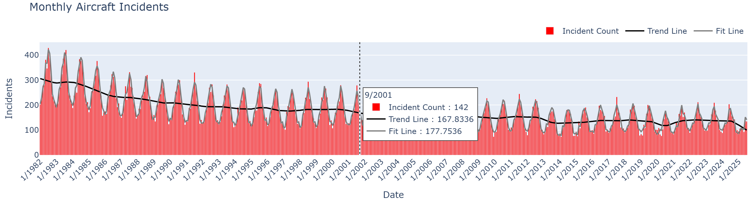
General Trend
Notes:
For the general trend analysis, the monthly aircraft-incidents plot reveals a clear decline over time.
by using some codes like mode and hovermode,
we can implement the function that When you move the mouse along the x-axis,
all traces that share that same x value will display their y values together in one combined tooltip box.

Slide 9
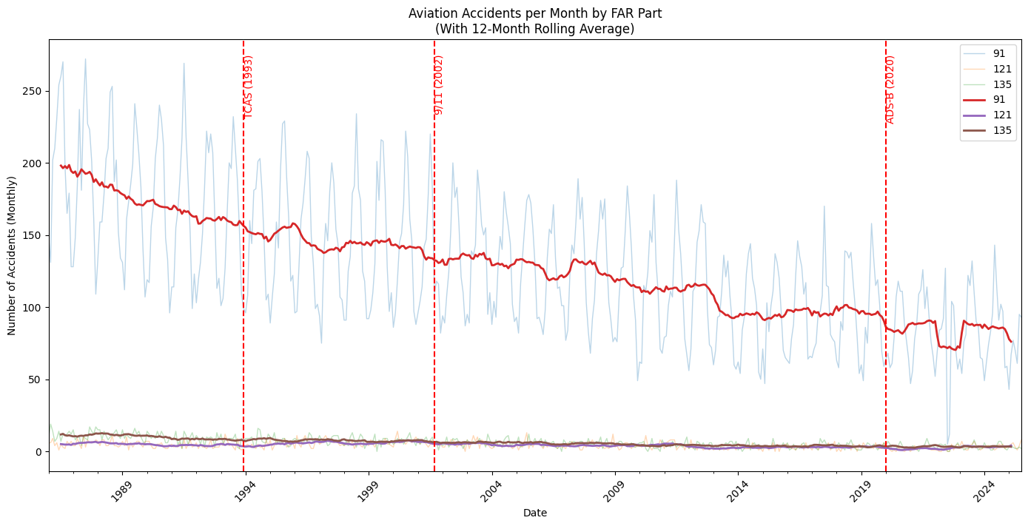
General Trend
Notes:
After splitting the data through the FAR part type, We can easily realize that 091 accidents are dominant.
In other words, the incidents trend is affected by mostly 091 which makes sense general aviation has a lot of flight events including private and training flights and usually less regulation effect

Slide 10
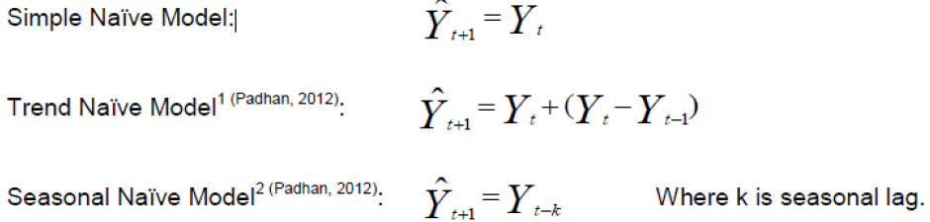
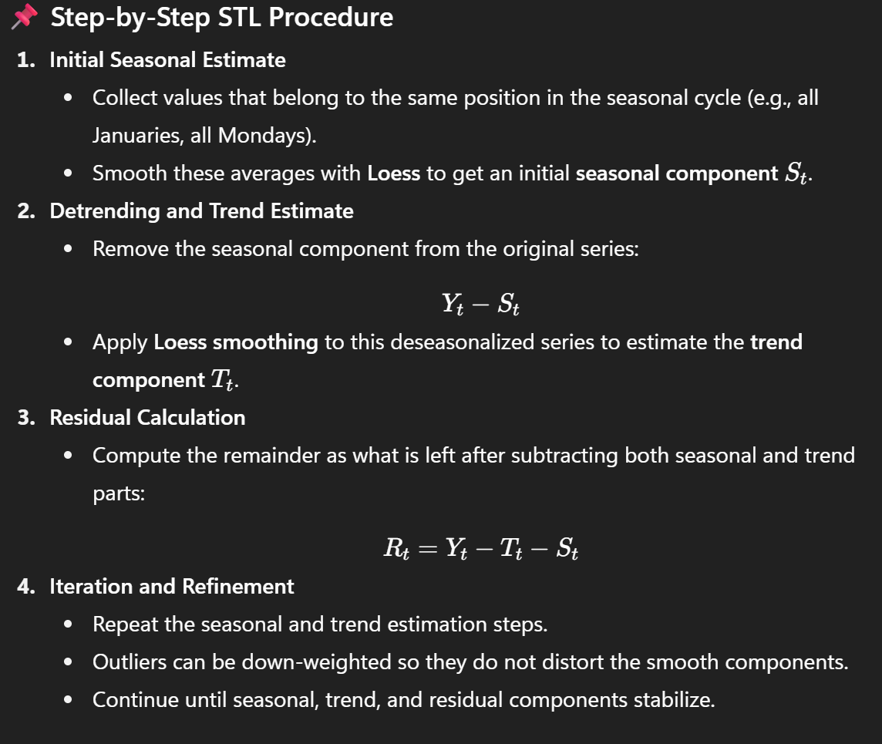
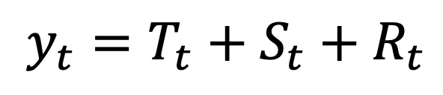
Seasonal-Trend Decomposition Using Loess
Notes:
For the better visualization and precise analysis, I did STL decomposition which is usually for the prediction.
When we handle the time series data without further considerations, like Naïve Forecasting model, assume the next value is simply copied from the past (previous value, previous trend, or seasonal cycle). In contrast, STL decomposition extracts trend and seasonal components statistically using Loess smoothing. Conceptually, the trend and seasonal parts in STL correspond to what Naïve models try to mimic in a simple formula, but with much more flexibility and accuracy.

Slide 11
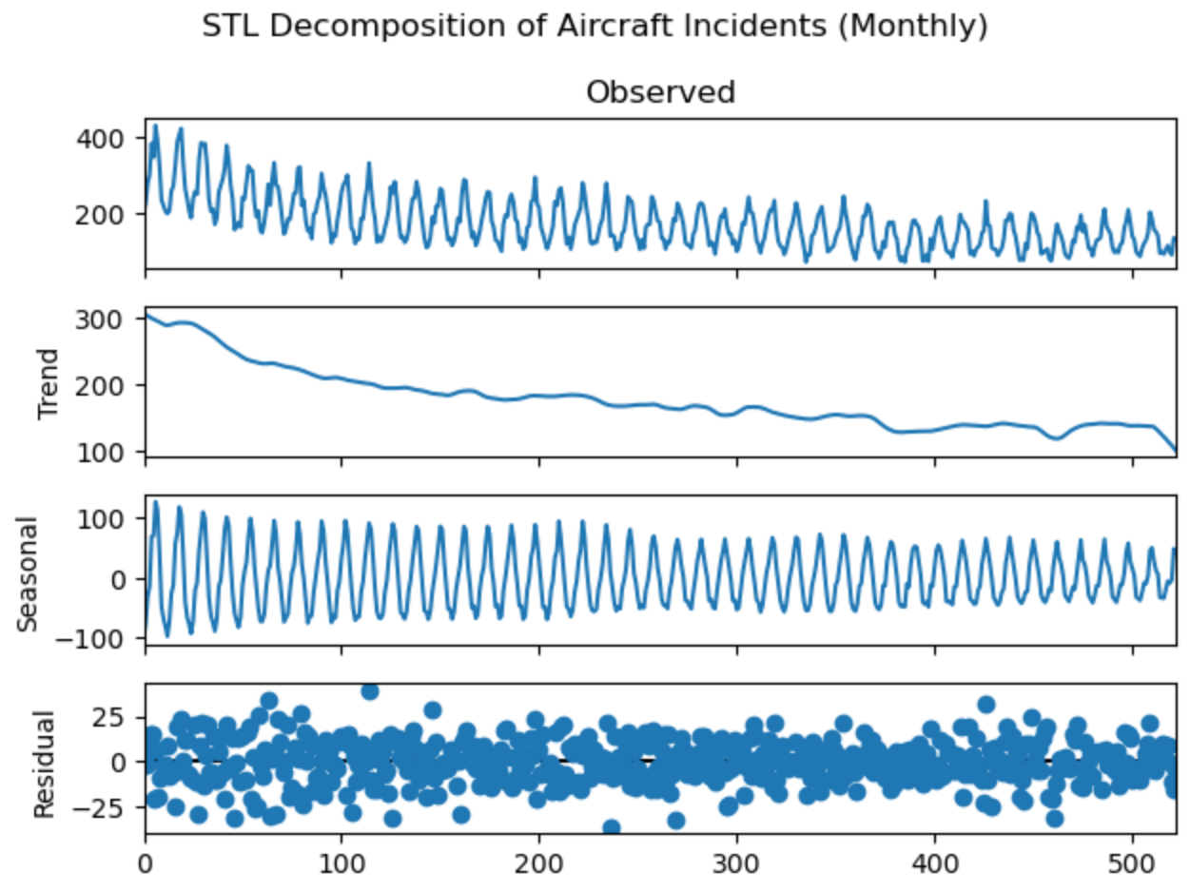
STL Decomposition
Notes:
By STL decomposition, we can get this plot(observed data, trend, seasonal, and residuals)
Seasonal decomposition allows us to isolate the trend-cycle so we can have a meaningful conversation.
And, we need to check for homoscedastic noise to make sure we’ve got a good fit. From that perspective, this decomposition model fits well and showing seasonal effect and decreasing trend.

Slide 12
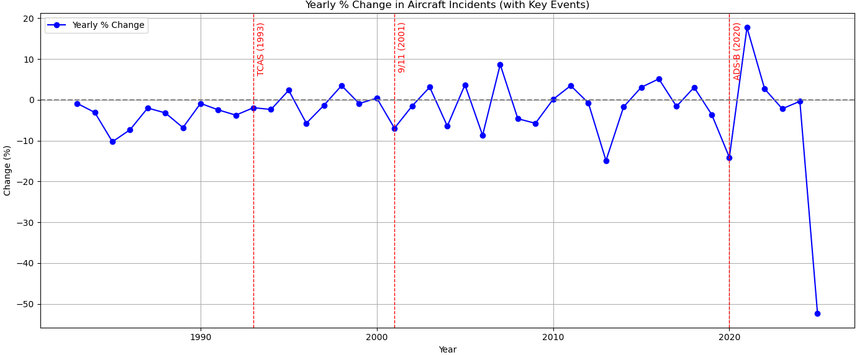
Yearly % Change
Current – Previous
Previous
Notes:
From this slide, I analyzed the % Change both Year and Month.
I used dataframe's diff() function and pct_change() function.
Diff() calculates the difference between the current row and the previous row, which gives the absolute year-over-year change in the number of incident.
Pc_change() calculates the percentage change between the current and the previous value like upper-right equation.
As we see the plot, all three years with key events has negative change of yearly % change.
As shown in the plot, the three years associated with key events show negative YoY percent changes, suggesting those events may have contributed to reductions in incidents over a one-year horizon.

Slide 13
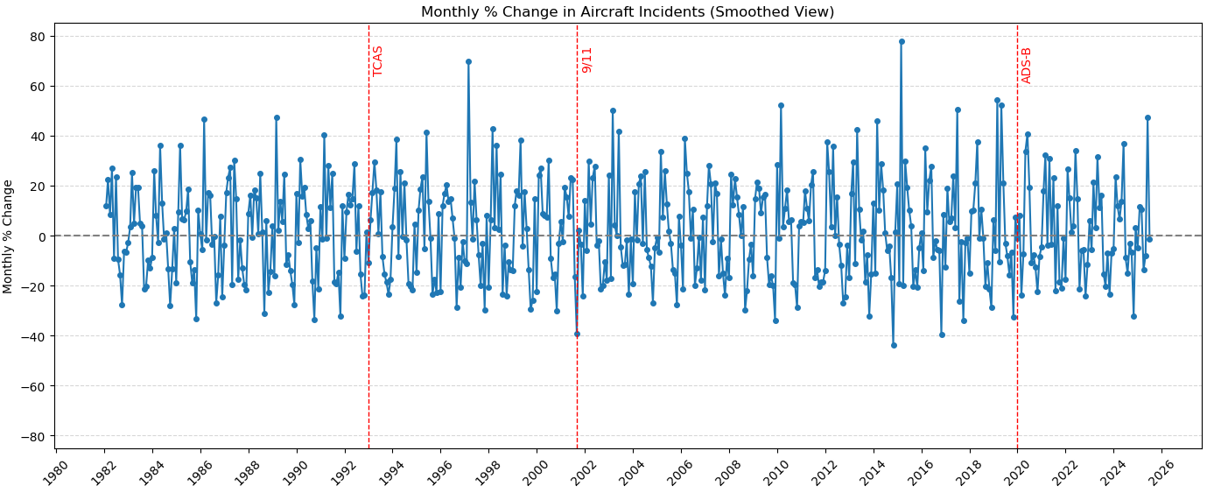
Monthly % Change
Notes:
Likewise, I performed the same analysis for monthly % changes.
Because there are many more monthly observations than yearly ones,
I split the timeline into several windows centered around each key event to improve readability.

Slide 14
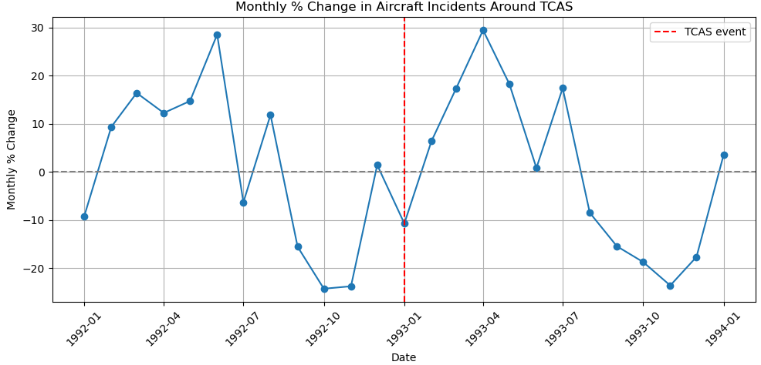
Monthly % Change (TCAS)
Notes:
First, in January 1993 when TCAS event happened, there was negative monthly % change.
However, we need to see this result carefully because we also need to consider right before the event month or right after the event month.

Slide 15
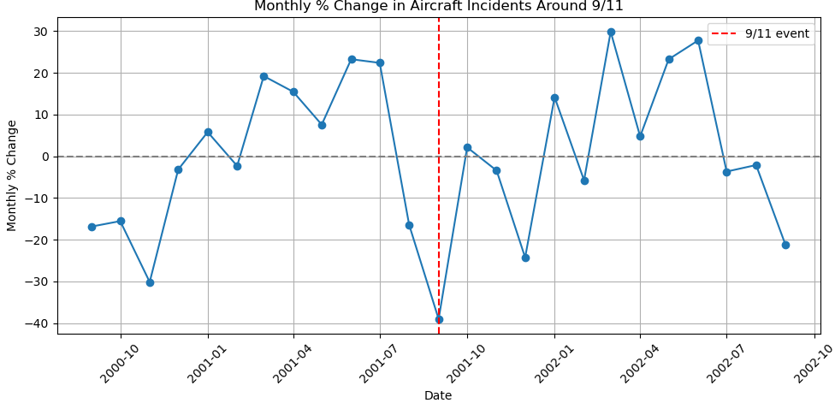
Monthly % Change(9/11)
Notes:
Second, in September 2001 when 9/11 happened, there was clear negative monthly % change.
Even if considering right before and right after months, it was affecting a lot.

Slide 16
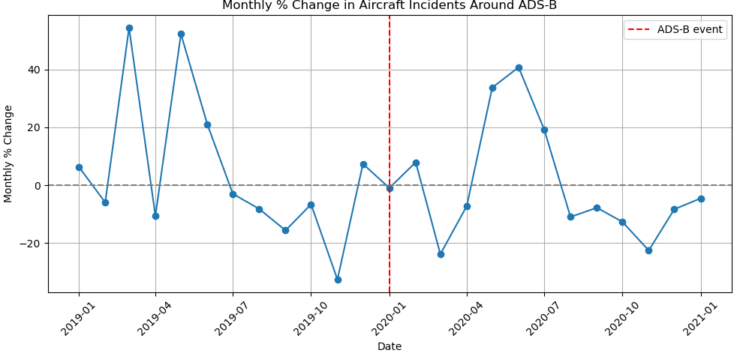
Monthly % Change(ADS-B)
Notes:
Lastly, in January 2020 when ADS-B event happened, there was zero monthly % change.
But, right before and right after the event month, there were negative % change which represented as yearly & change before.
At the same time, what we need to contemplate is the seasonal effect, as we saw before, in this flight accidents data has clear seasonal effects, so we need to analyze it with more details.

Slide 17
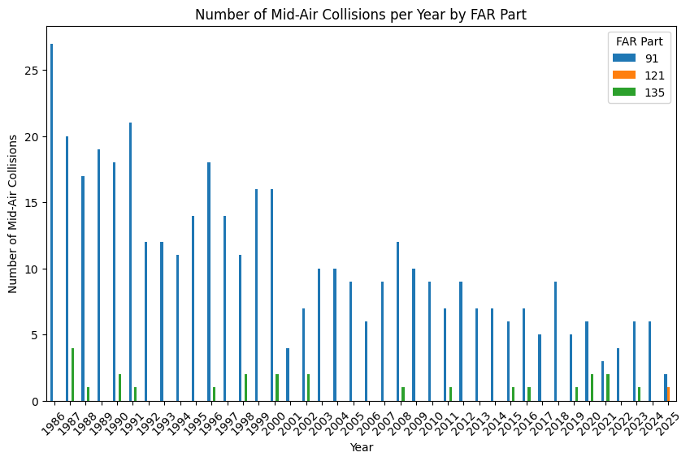
Mid-Air by FAR
TCAS
ADS-B
Notes:
Joseph

Slide 18
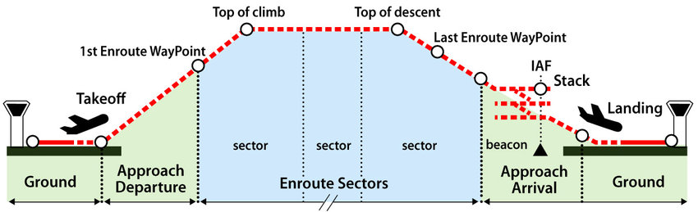
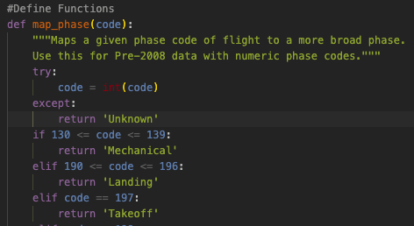

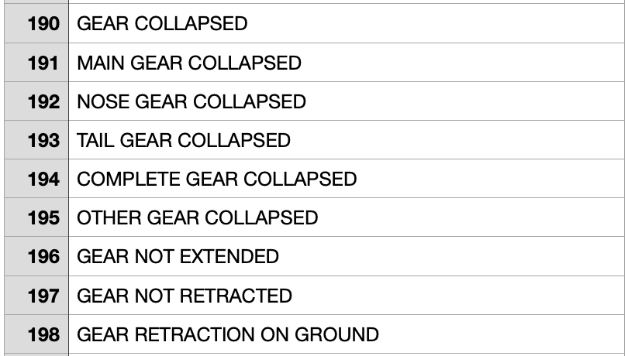
Phases of Flight
Phases of Flight: Taxi, Takeoff, Climb, Cruise, Descent, Approach, Landing
Notes:
Joseph

Slide 19
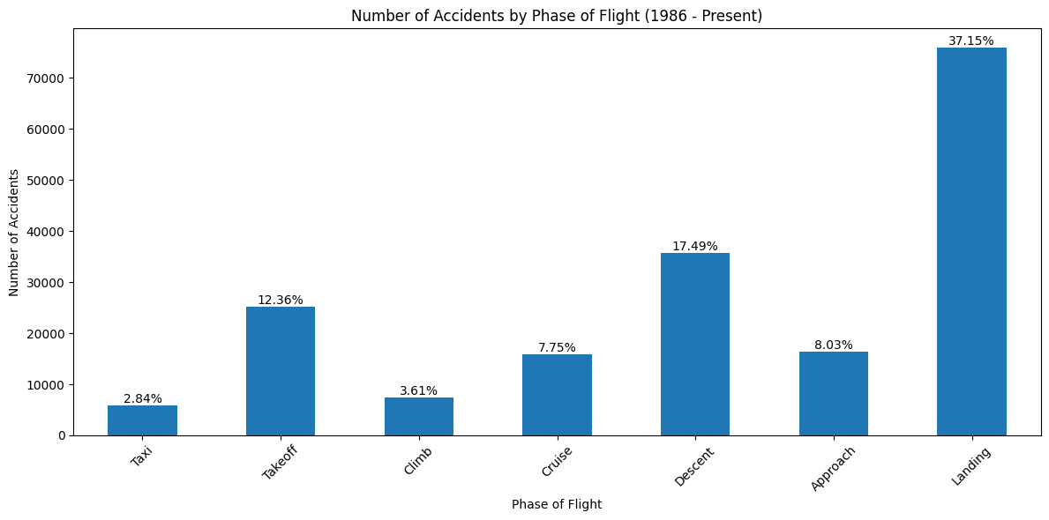
Accident Rates by Phase of Flight
“Nearly 50% of aviation accidents happen during a two-minute segment of the flight!” - Joseph Moreland
Percentage of Part 91 accidents relative: 78.15%
Percentage of Part 121 accidents relative: 2.22%
Percentage of Part 135 accidents relative: 3.69%
Notes:
Joseph

Slide 20
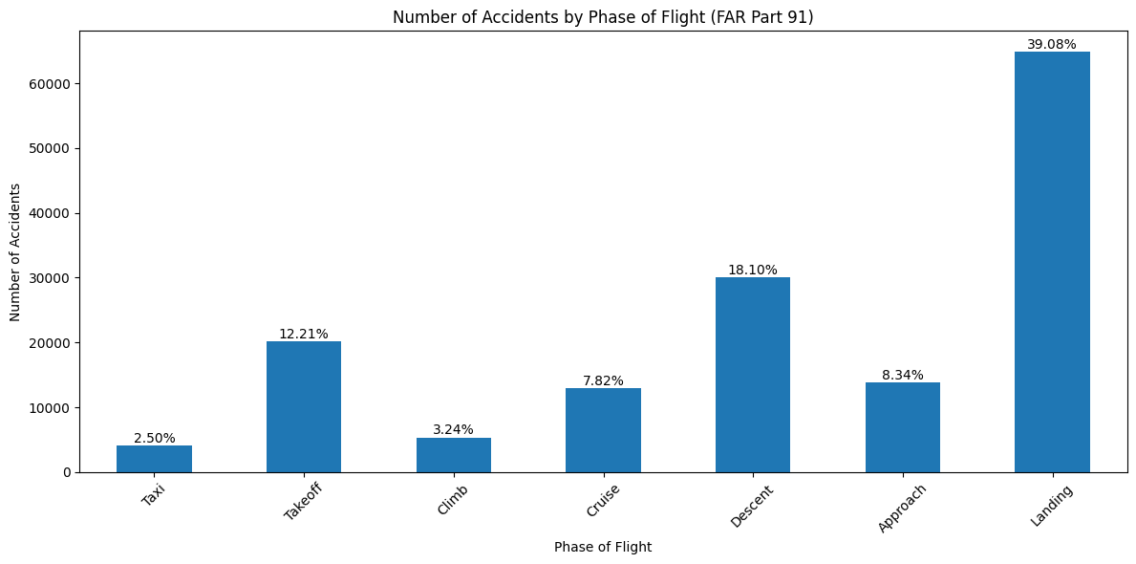
Phase of Flight Part 91

Slide 21
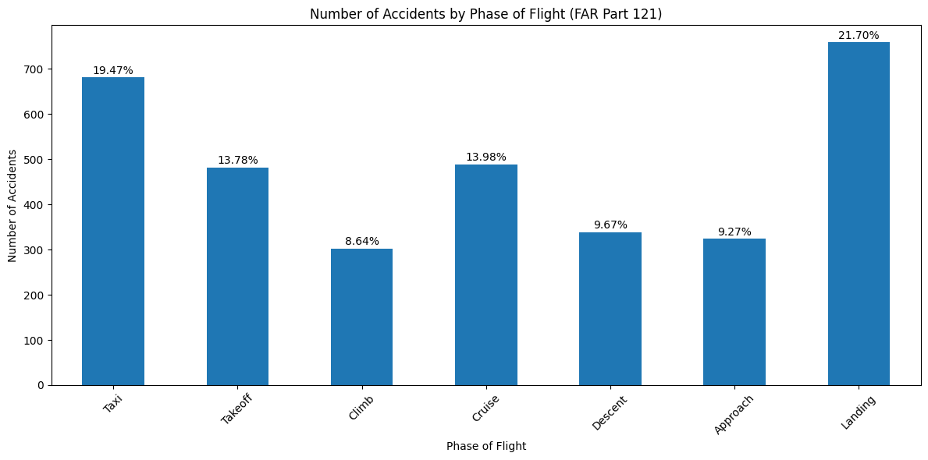
Phase of Flight Part 121

Slide 22
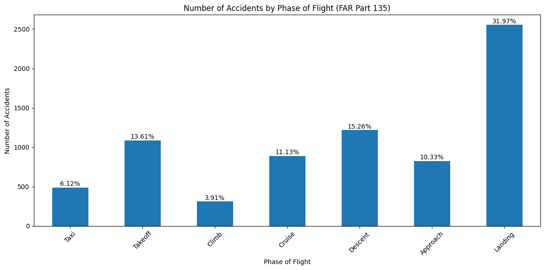
Phase of Flight Part 135

Slide 23


Engine Data Overview
Aimed to determine what role the engine manufacturers played in identified trends
NTSB maintains records of the engine type, manufacturer, model, and number of engines for each unique event id.
Built master CSV from event, engine, and sequence data files.
Primary focus on the manufacturer and sequence code.
Code 351 and 352 represent full and partial engine failure.
Notes:
John

Slide 24
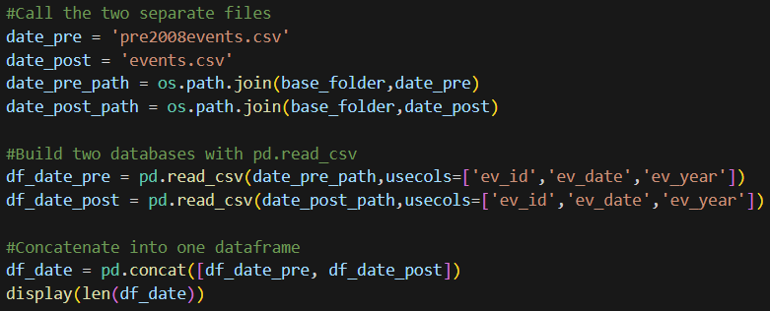
Engine Data Cleaning
Two main issues:
Data consolidation
Formatting (Name Matching)
Consolidation
Notes:
John

Slide 25
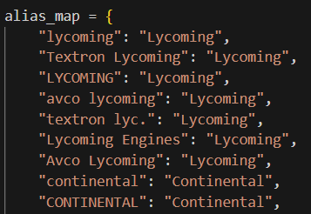

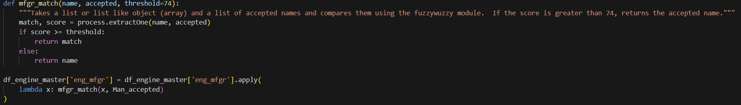
Engine Data Cleaning Cont.
Name Matching
Alias map
FuzzyWuzzy
Notes:
John

Slide 26
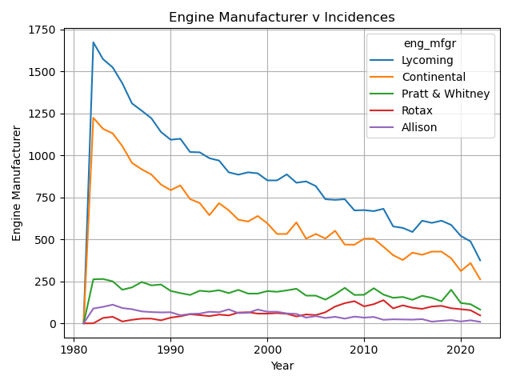
Engine Data Results
*Accounts for all events with recorded engine data

Slide 27
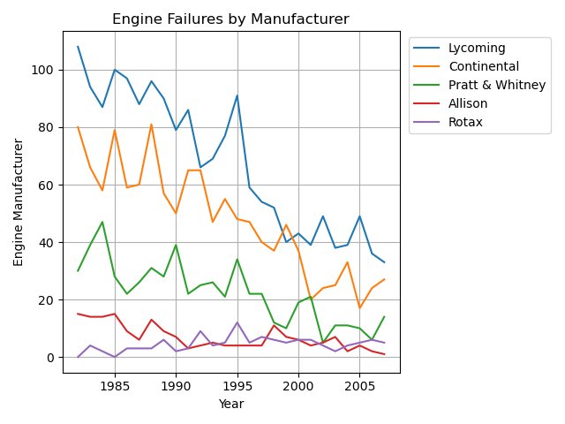
Engine Data Results cont.
*Accounts for events with sequence codes 351 or 352 (engine failure).

Slide 28
Conclusion
Long term accident/incident rates are decreasing
Regulations are effective
Peaks during summer months
High-risk phases of flight
Takeoff and landing
Engine Data
Engine failure accounts for 2.07% of recorded incidence since 1981
Largest incidence occur among manufacturers of smaller, rotary aircraft; Supports FAR 91 trends
Next steps:
Expand analysis with fatality data
Machine learning for predictive risk modeling
Apply seasonal analysis to engine data

Slide 29
References/Additional Resources
NTSB
https://www.ntsb.gov/safety/data/Pages/Data_Stats.aspx
Homebrew
https://brew.sh

Slide 30
Images
https://www.reddit.com/r/memes/comments/eoi4bb/hmmm_flying/
https://www.pilotmall.com/blogs/news/part-91-vs-135-vs-121-what-are-the-differences-complete-guide?srsltid=AfmBOoo9Dk0FoET8ZByA_hlU9qY9NJnNFI59FCarzBqfmBbgRhIHHFCu

