Slide 1
Statistical Inference
Diego Romero
September 8, 2023

Slide 2
Statistical Inference
Objective: we want to learn something about a population based on our analysis of a sample from that population.
We need to:
Define the question we want to ask.
E.g., what is the proportion of the population that pays bribes? What is the relation between wealth and bribery?
Define the population
Construct a sample

Slide 3
Estimation
Estimate = Estimand + Bias + Noise

Slide 4
Estimation
Estimate = Estimand + Bias + Noise
Estimand: the true quantity (parameter) of interest (e.g., the proportion of people who engage in bribery; the correlation between wealth and bribery)

Slide 5
Estimation
Estimate = Estimand + Bias + Noise
Estimand: the true quantity of interest (e.g., the proportion of people who engage in bribery; the correlation between wealth and bribery)
Estimate: the number we get from our analysis. Our approximation to the true value.

Slide 6
Estimation
Estimate = Estimand + Bias + Noise
Estimand: the true quantity of interest (e.g., the proportion of people who engage in bribery; the correlation between wealth and bribery)
Estimate: the number we get from our analysis. Our approximation to the true value.
Estimator: the procedure we use to generate the estimate.

Slide 7
Estimation
Estimate = Estimand + Bias + Noise
Estimand: the true quantity of interest (e.g., the proportion of people who engage in bribery; the correlation between wealth and bribery)
Estimate: the number we get from our analysis. Our approximation to the true value.
Estimator: the procedure we use to generate the estimate.
Bias: errors that occur systematically

Slide 8
Estimation
Estimate = Estimand + Bias + Noise
Estimand: the true quantity of interest (e.g., the proportion of people who engage in bribery; the correlation between wealth and bribery)
Estimate: the number we get from our analysis. Our approximation to the true value.
Estimator: the procedure we use to generate the estimate.
Bias: errors that occur systematically
Noise: idiosyncratic (unsystematic) errors

Slide 9
Estimation
Estimate = Estimand + Bias + Noise
Estimand: the true quantity of interest (e.g., the proportion of people who engage in bribery; the correlation between wealth and bribery)
Estimate: the number we get from our analysis. Our approximation to the true value.
Estimator: the procedure we use to generate the estimate.
Bias: errors that occur systematically
Noise: idiosyncratic (unsystematic) errors
In general, people refer to bias + noise as the error of the estimate.

Slide 10
Estimation
Estimate = Estimand + Bias + Noise
This equation applies to all parameters that we wish to estimate: regression coefficients, proportions, the incidence of a particular behavior…

Slide 11
Noise
Sampling noise: natural variability that comes from drawing samples from a population.
Relation between noise and sample size:
By the Law of Large Numbers: as the sample size increases, the expected value of the noise tends to zero.
In the extreme case (when our sample size = population size) we are essentially conducting a census.

Slide 12
Bias
Bias: errors that occur systematically.
An estimator is unbiased if the average value of the estimates it generates would equal the estimand if we were to apply the estimator to new and independent samples infinitely.
The expected value of an unbiased estimator is the estimand.
Sources of bias: a sample that is not drawn at random.

Slide 13
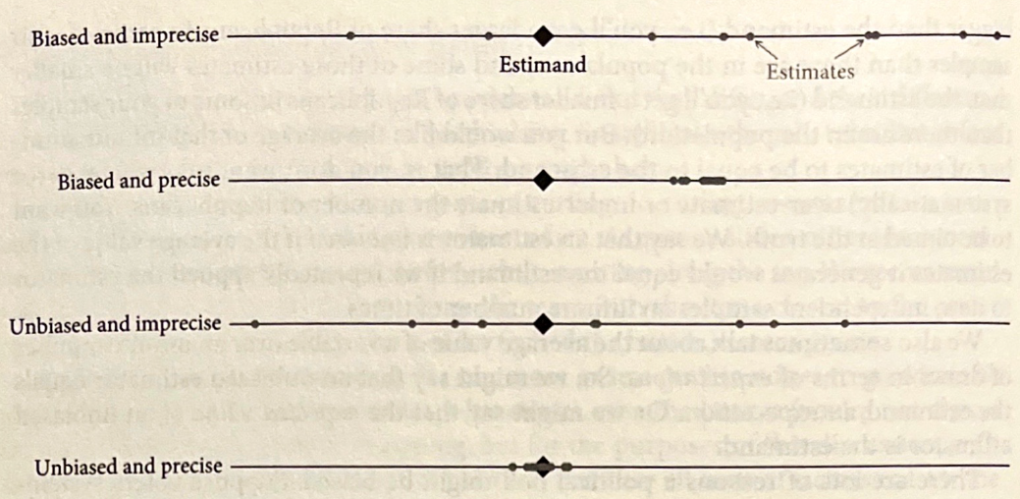
Bias and Noise

Slide 14
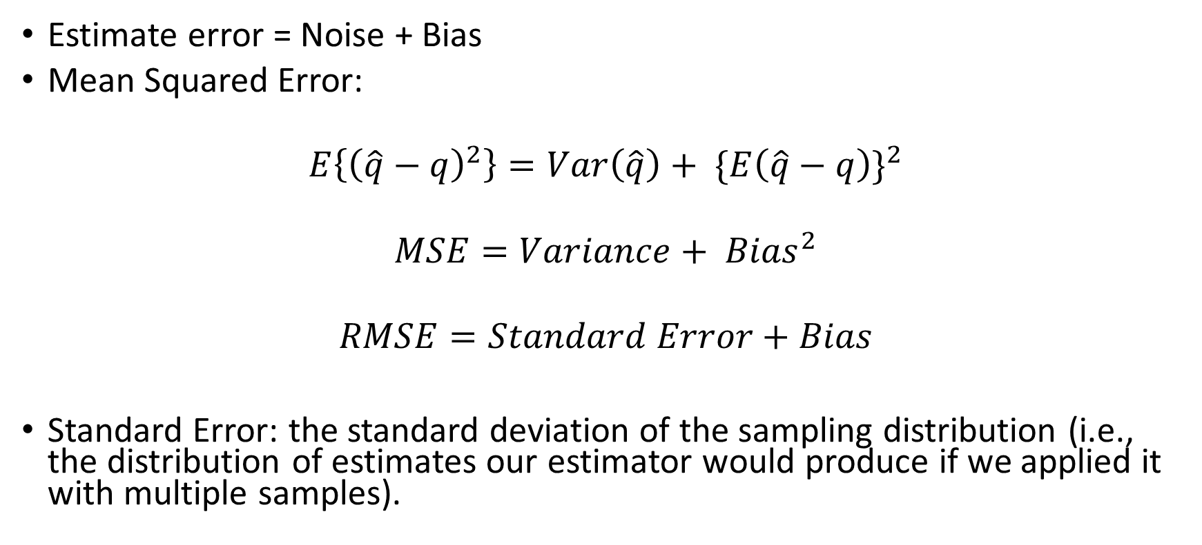
Quantifying the Error/Measuring Accuracy
Estimate error = Noise + Bias
Mean Squared Error:
$$E\left\{{\left(\hat{q}−q\right)}^{2}\right\}=Var\left(\hat{q}\right)+ {\{E\left(\hat{q}−q\right)\}}^{2}$$
$$MSE=Variance+ {Bias}^{2}$$
$$RMSE=Standard Error+Bias$$
Standard Error: the standard deviation of the sampling distribution (i.e., the distribution of estimates our estimator would produce if we applied it with multiple samples).

Slide 15
Standard Error and Variability
The Standard Error quantifies the variability of our estimate which comes from sampling noise.
What is the Standard Error?
Our estimate can be thought of as drawn from a distribution of estimates produced by our estimator with independent samples.
This distribution is called the sampling distribution.
If our estimator is unbiased, then the mean of the sampling distribution would correspond to the population mean.
The standard deviation of the sampling distribution is the standard error.

Slide 16
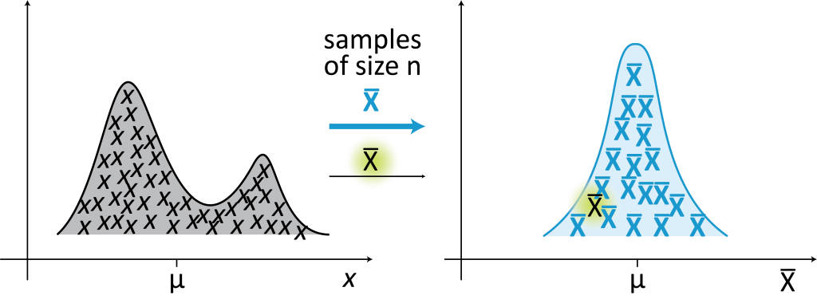
Data Distribution vs Sampling Distribution
Distribution of a Variable within the Sample
Sampling distribution of the parameter of interest

Slide 17
Confidence Intervals
A measure of uncertainty based on a more complete characterization of the sampling distribution.
Confidence intervals give a range of values that are likely to include the true value of the estimand:
“Over a hypothetically repeated data-generating process, confidence intervals contain the true value of the parameter with the probability specified by the confidence level.”
Confidence level is usually set to 95%

Slide 18
Confidence Intervals
A measure of uncertainty based on a more complete characterization of the sampling distribution.
Confidence intervals give a range of values that are likely to include the true value of the estimand:
“Over a hypothetically repeated data-generating process, confidence intervals contain the true value of the parameter with the probability specified by the confidence level.”
Confidence level is usually set to 95%
Interpretation: “If there is no bias and if we repeat our estimator an infinite number of times, the true estimand would be inside the 95% confidence interval 95% of the time.”

Slide 19
Confidence Intervals
Based on the assumption that the sampling distribution is normally distributed.
If our observations are independently and identically distributed according to the normal distribution, then the sampling distribution of the sample mean is also normally distributed. – Special case.
In general, if observations are iid, the Central Limit Theorem implies that the sampling distribution of the sample mean is approximately normally distributed.

Slide 20
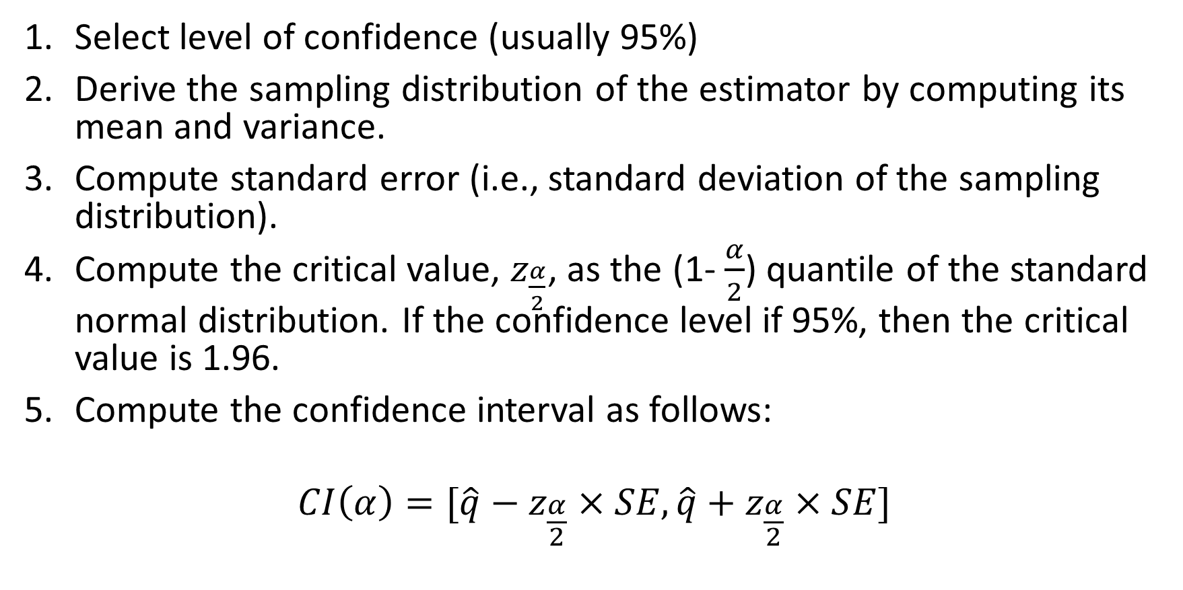
Steps to Compute Confidence Intervals
Select level of confidence (usually 95%)
Derive the sampling distribution of the estimator by computing its mean and variance.
Compute standard error (i.e., standard deviation of the sampling distribution).
Compute the critical value, $z_{\frac{α}{2}}$, as the (1- $\frac{α}{2}$) quantile of the standard normal distribution. If the confidence level if 95%, then the critical value is 1.96.
Compute the confidence interval as follows:
$$CI\left(α\right)=[\hat{q}−z_{\frac{α}{2}}×SE,\hat{q}+z_{\frac{α}{2}}×SE]$$

Slide 21
Hypothesis Testing
In statistics, hypothesis testing is based on probabilistic proof by contradiction:
Proof by contradiction: strategy of mathematical proof in which one demonstrates that, assuming the contrary of what we would like to prove leads to a logical contradiction.
In statistics we can never reject a hypothesis with certainty.

Slide 22
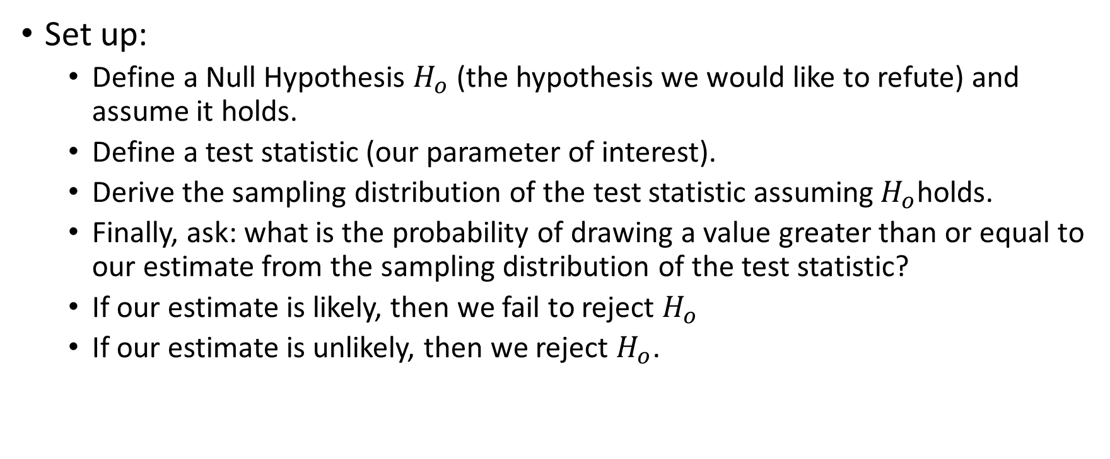
Hypothesis Testing
Set up:
Define a Null Hypothesis $H_{o}$ (the hypothesis we would like to refute) and assume it holds.
Define a test statistic (our parameter of interest).
Derive the sampling distribution of the test statistic assuming $H_{o}$holds.
Finally, ask: what is the probability of drawing a value greater than or equal to our estimate from the sampling distribution of the test statistic?
If our estimate is likely, then we fail to reject $H_{o}$
If our estimate is unlikely, then we reject $H_{o}$.
Notes:
how likely is it that we would observe the estimate we have obtained if $H_{o}$ were true?

Slide 23
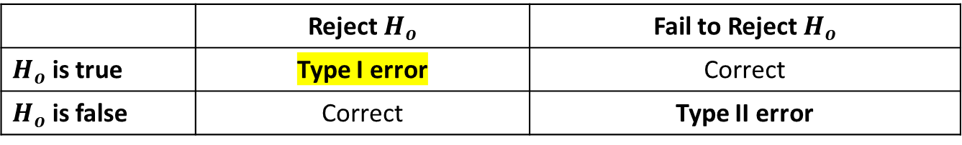
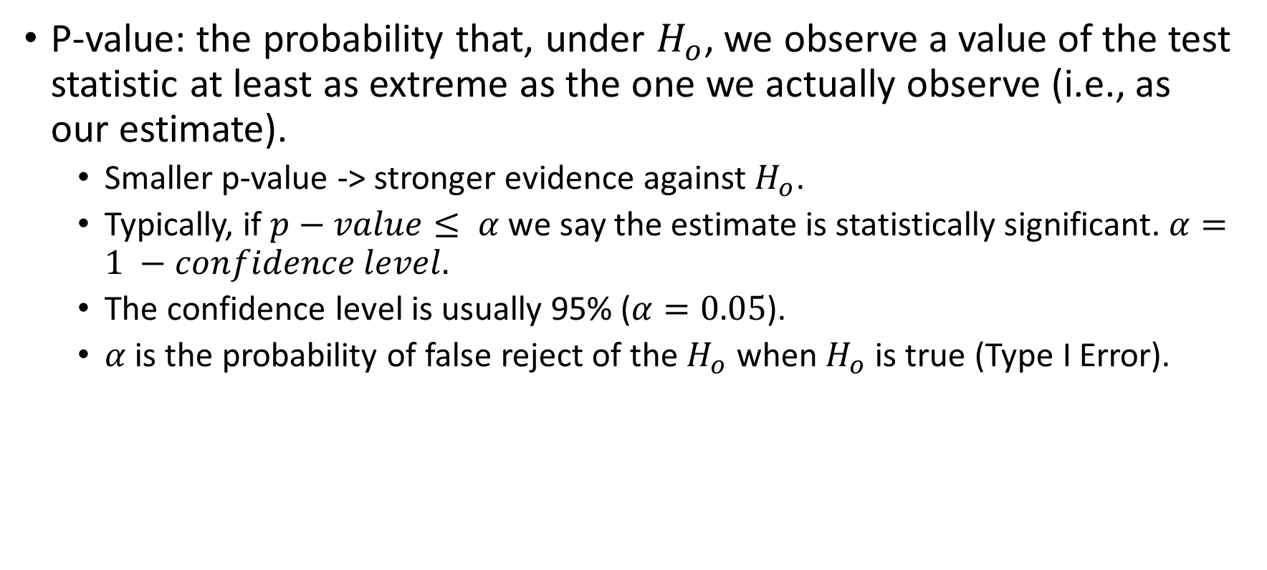
How likely is likely?
P-value: the probability that, under $H_{o}$, we observe a value of the test statistic at least as extreme as the one we actually observe (i.e., as our estimate).
Smaller p-value -> stronger evidence against $H_{o}$.
Typically, if $p−value≤ α$ we say the estimate is statistically significant. $α=1 −confidence level.$
The confidence level is usually 95% ($α=0.05$).
$α$ is the probability of false reject of the $H_{o}$ when $H_{o}$ is true (Type I Error).
 | Reject $H_{o}$ | Fail to Reject $H_{o}$
$H_{o}$ is true | Type I error | Correct
$H_{o}$ is false | Correct | Type II error

