Slide 1
R and RStudio

Slide 2
Resources
This activity draws on Chapter 1 in Statistical Inference via Data Science: A ModernDive into R and the Tidyverse

Slide 3
What are R and RStudio?
In the quantitative methods tutorial, we will use R and RStudio to illustrate basic statistical concepts
R is a programming language and free computing environment for statistical computing and graphics
RStudio is an integrated development environment (IDE) that provides an interface by adding many convenient features and tools
Think of R as a car’s engine and RStudio as the dashboard
Notes:
R is a programming language and free computing environment for statistical computing and graphics. It can be runs on a wide variety of operating systems, including Linux, Windows, and MacOS. RStudio is an integrated development environment (IDE) that provides an interface by adding many convenient features and tools.
You can think of R as a car’s engine and RStudio as the dashboard. In the same way that having access to a speedometer and a navigation system makes driving much easier, using RStudio’s interface makes using R much easier as well.
R and RStudio are entirely free and updated on a regular basis, making them much more accessible and widely used than paid alternatives. You can conduct nearly any analysis using R, ranging from calculating the average of a variable to creating maps and conducting spatial analysis to conducting the analysis for an impact evaluation.

Slide 4
Installing R
Download and install R by going to https://cloud.r-project.org/
Windows: Click on “Download R for Windows”, then click on “base”, then click on the Download link
macOS user: Click on “Download R for macOS”, then under “Latest release:” click on R-X.X.X.pkg, where R-X.X.X is the version number
Linux user: Click on “Download R for Linux” and choose your distribution for more information on installing R for your setup
Notes:
If you don’t have R and RStudio already installed, that will be the first step. You will first need to download and install both R and RStudio (Desktop version) on your computer. It is important that you install R first and then install RStudio.

Slide 5
Installing RStudio
Download and install RStudio at https://www.rstudio.com/products/rstudio/download/
Scroll down to “Installers for Supported Platforms” near the bottom of the page
Click on the download link corresponding to your computer’s operating system
Notes:
Once you have installed R, you can now install RStudio.

Slide 6
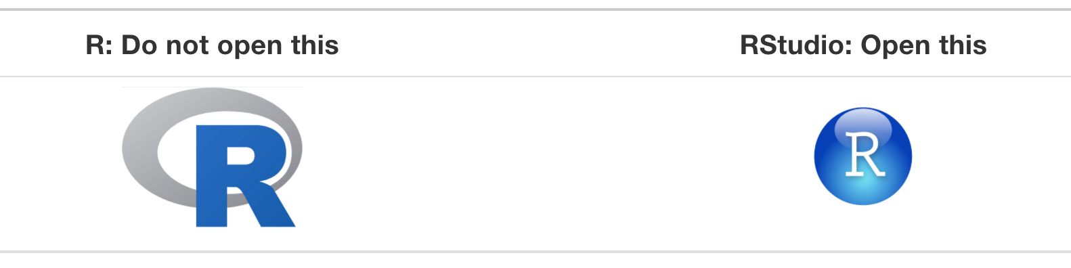
Using R via RStudio
Using R by opening RStudio

Slide 7
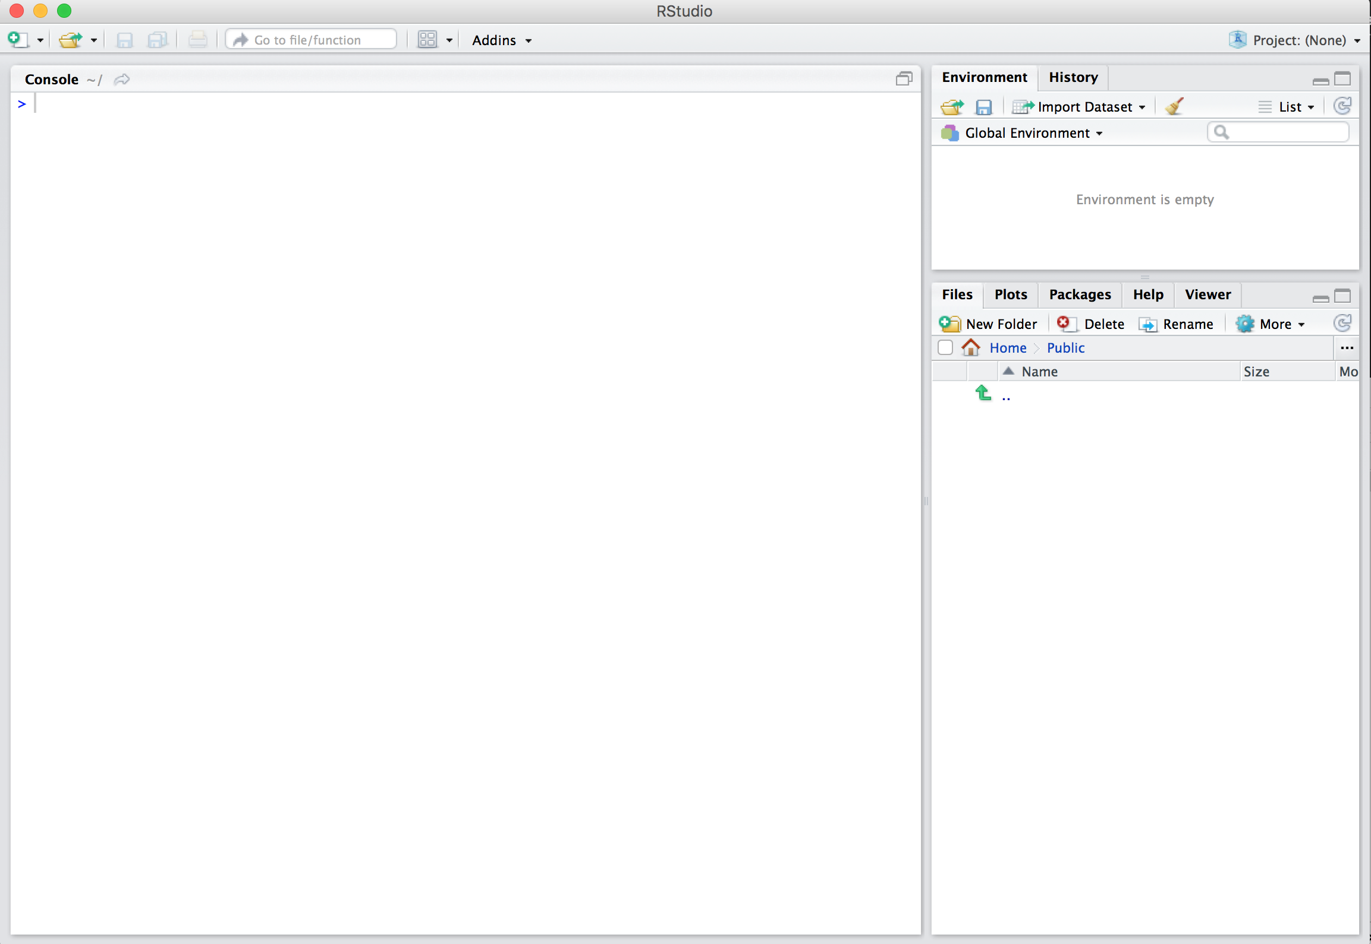
Using R via RStudio
After you open RStudio, you should see something like this
Notes:
Note the three panes which are three panels dividing the screen: the console pane, the files pane, and the environment pane. Over the course of this tutorial, you’ll come to learn what purpose each of these panes serves.

Slide 8
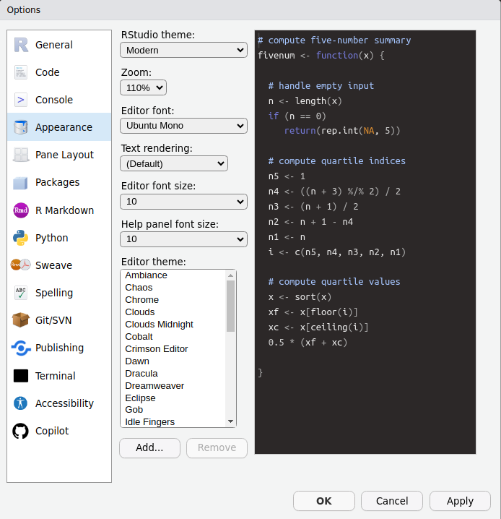
Peronalization
Customize the appearance of your R IDE by going to Tools -> Global Options -> Appearance

Slide 9
Layout
Rstudio contains 4 panes: source, console, environment, and viewer
The left pane is the source where you write code
Try typing 2 + 2 into the source panel and hitting ENTER
The console panel pop-up in the bottom-left and return a value of 4
[INSERT SCREEN RECORDING]

Slide 10
Layout
The top-right includes the Environment panel
This contains information about any objects that you load into your environment
Type sum = 2 + 2 into the source and hit ENTER
The object sum should appear in your environment
The bottom-right includes the Viewer panel, where you will be able to see graphics that you generate

Slide 11
Basic programming concepts
Running code: telling R to perform an act by giving it commands in the source or console
Objects: where values are saved in R. On the last slide, you created the object sum.
Data types:
Integers are whole numbers like -1, 0, 2, 4092
Doubles are integers with decimal values like -24.932 and 0.8
Logicals are either TRUE or FALSE
Characters are text or strings like "hello world" and "welcome to R"

Slide 12
Basic programming concepts
Vectors are a series of values. These are created using the c() function. For example, c(6, 11, 13, 31) creates a four element vector of integers.
Factors are a group of characters/strings with a fixed number of unique values
Data frames are objects where the rows correspond to observations and the columns correspond to variables that describe the observations

Slide 13
Basic programming concepts
Conditionals:
Testing for equality in R is done using ==. For example, 2 + 1 == 3 will return TRUE
Boolean algebra: Operators such as < (less than), <= (less than or equal), and !=(not equal to). For example, 3 + 5 <= 1 will return FALSE
Logical operators: & represent “and” while | represents “or.” For example, (2 + 1 == 3) & (2 + 1 == 4) returns FALSE since both clauses are not TRUE

Slide 14
Loading Packages
R gives you accesss to thousands of “packages” that are created by users
Packages contain datasets and bundles of code called “functions” that can execute specific tasks
Use install.packages() to install a package
Insert the name of the package contained in quotation marks
Start by installing the dplyr package

Slide 15
Loading Data
Load data into your environment by “reading-in” a spreadsheet
Spreadsheets should be saved as a .csv file
Use read.csv() to pull data from a spreadsheet on your harddrive into your R/RStudio environment
Within the parentheses, add the full file pathway where the .csv file is stored
[INSERT SCREEN RECORDING]

Slide 16
Errors, warnings, and messages
When you run code, R often provides feedback in the console
There are 3 main types of feedback that appear in RED
Errors: When the RED text is prefaced with “Error in…”, your code will not work. The error message will try to explain the problem.
Warnings: When the red text is prefaced with “Warning:”, your code will still work, but there still might be a problem. The warning message will try to explain the problem.
Messages: When the red text doesn’t start with “Error” or “Warning”, it’s just a friendly message

