Slide 1
Agenda
Correlation
What is it?
What is it composed of?
What is it good for?
Causation
What is it good for?
Why is it hard?
Potential outcomes and counterfactuals

Slide 2
Correlation

Slide 3
Which of the following statements describe a correlation?
Most professional data analysis took a statistics course in college.
The longer a person runs the more calories they burn.
People who live to be 100 years old typically take vitamins.
Older people vote more than younger people.

Slide 4
Correlations: Quantitative Comparison
Lots of bad analysis implies comparisons
Ex. 10 things that extremely successful people do to be productive
Ex. 60% of Americans now live paycheck-to-paycheck
Ex. 70% of participants reported an improvement
Avoid ‘selecting on the dependent variable’
Applies to qualitative comparisons as well

Slide 5
Correlations: Necessary Components
What do we need to calculate correlations?
Measures of central tendency
Mean
Measures of spread
Variance
Standard deviation

Slide 6
Central Tendency: Mean
$$μ_{X}=\frac{1}{n}\sum_{i}^{n}{X_{i}}$$
my_vector = rnorm(10, mean = 10, sd = 5) # Step 1: Sum the values sum_values <- sum(my_vector) # Step 2: Count the number of elements count_elements <- length(my_vector) # Step 3: Calculate the mean mean_value <- sum_values / count_elements print(mean_value)
[1] 10.62131
mean(my_vector)
[1] 10.62131

Slide 7
Spread: Variance
“^2_X = _{i}^{N} (X_i - _X)^2”
What does the square in $σ^{2}$ accomplish?
What are the implications for interpretation?
Units
Distribution
Even with these basic measures, we’re already thinking about the distribution!

Slide 8
Spread: Variance
## Create vector, sort by size, and store var set.seed(123) dat = rnorm(10, mean = 10, sd = 5) dat = sort(dat) o_var = var(dat) print(dat)
[1] 3.674694 6.565736 7.197622 7.771690 8.849113 10.352542 10.646439 [8] 12.304581 17.793542 18.575325
## Create new dataframe for big addition and store vector length b_dat = dat ind = length(b_dat) ## Add four to the largest number in the vector and calculate size of var increase b_dat[ind] = b_dat[ind] + 4 b_var = var(b_dat) val = b_var - o_var cat("Variance increases by", val )
Variance increases by 8.890842
## Create new dataframe for small addition s_dat = dat ## Add four to the smallest number in the vector and calculate size of var increase s_dat[ind-2] = s_dat[ind-2] + 4 s_var = var(s_dat) val = s_var - o_var cat("Variance increases by", val )
Variance increases by 3.316847

Slide 9
Spread: Standard Deviation
$$σ_{X}=\sqrt{\frac{1}{N}\sum_{i}^{N}{{\left(X_{i}−μ_{X}\right)}^{2}}}$$
What does the $\sqrt{​}$ accomplish?
What are the implications for interpretation?
Expressed in the same units as the observations
How far we expect each observation to be from the mean, on average
This means we can report effect sizes as SDs

Slide 10
Measures of Correlation
Covariance $\text{Cov}\left(X,Y\right)=\frac{1}{n}\sum_{i}^{N}{\left(X_{i}−\overset{‾}{X}\right)}\left(Y_{i}−\overset{‾}{Y}\right)$
Product of the deviations
Range: unbounded
Correlation coefficient $\text{Cor}\left(X,Y\right)=\frac{\text{Cov}\left(X,Y\right)}{σ_{X}σ_{Y}}$
Covariance normalized by product of SDs
Range: -1 to 1
Slope $β_{X}=\frac{\text{Cov}\left(X,Y\right)}{σ_{X}^{2}}$
Covariance normalized by variance
Expected change in $Y$ with 1-unit change in $X$

Slide 11
Measures of Correlation
What does the correlation coefficient tell you that slope doesn’t?
Consistency of the relationship on bounded scale (-1 to 1)
What does slope tell you that the correlation coefficient doesn’t?
Substantive importance (magnitude)
Give an example of when you’d prefer each
Correlation: When comparing relationships on different scales
Slope: When thinking about ROI

Slide 12
Correlation
What can with do with them?
Description: quantitative comparisons
Note
sample matters alot
sample matters less

Slide 13
Forecasting: sample population $→$ out-of-sample
Causal inference: correlation + research design
Simple, but powerful
Non-linearities, interactions, machine learning

Slide 14
Causation

Slide 15
Schools of Thought
Potential outcomes and counterfactuals (Econ)
DAGs and do-calculus (CS)
Manipulability (Philosophy)
“We think of a cause as something that makes a difference, and the difference it makes must be a difference from what would have happened without it.” (Lewis, 1973)

Slide 16
Causality: Why bother?
Understanding cause and effect is how we change things in the real world
Causal inference separates good evaluations from bad
Policy change
Development intervention
Causal identification is not binary
It’s harder for some policies and interventions than others
Variety of tools that can help us rule out different threats to inference

Slide 17
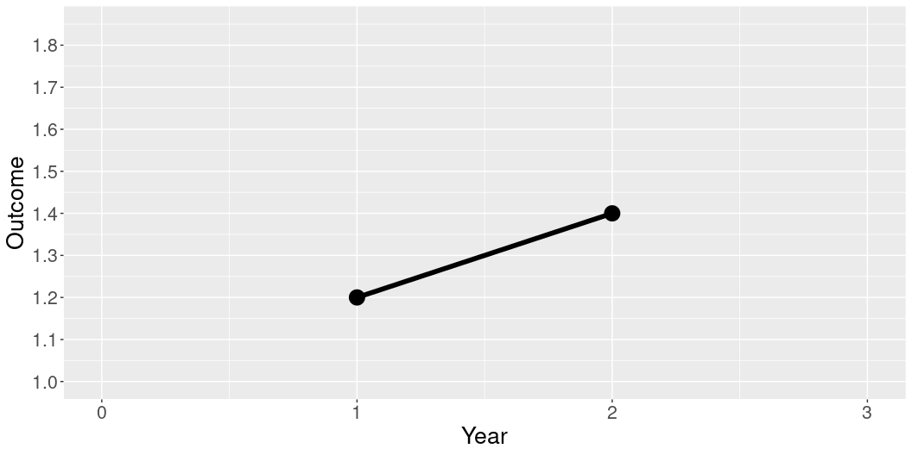
Causality: Why bother?
library(ggplot2) Year = c(0,1,2,3) Outcome = c(NA, 1.2, 1.4,NA) Treatment = c("Control", "Control","Control","Control") dat = data.frame(Year, Outcome, Treatment) ggplot(data = dat, aes(x = Year, y = Outcome, group = Treatment)) + geom_line(aes(linetype=Treatment),size=2) + geom_point(size = 6) + scale_linetype_manual(values=c("solid")) + xlim(0,3) + scale_y_continuous(limits = c(1,1.85), breaks = seq(1, 1.85, by = .1)) + theme(legend.position = "none", text = element_text(size=20))

Slide 18
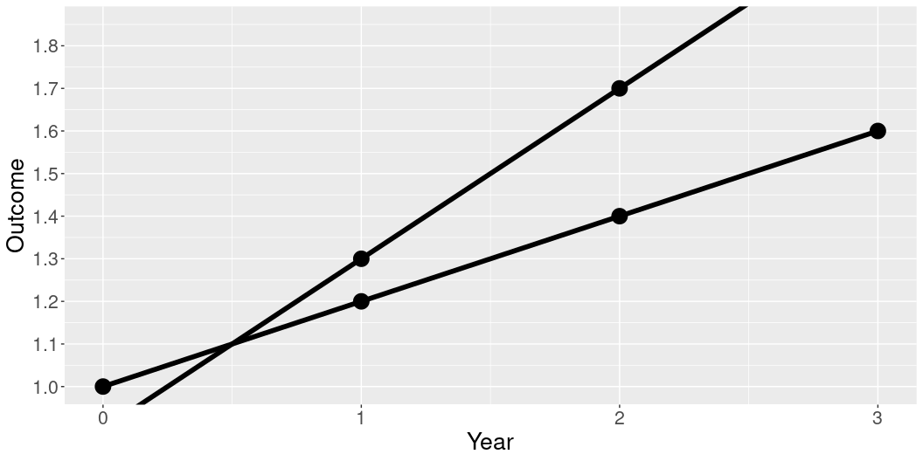
Causality: Why bother?
Year = c(0,1,2,3) Outcome = c(1, 1.2, 1.4, 1.6, 0.9, 1.3, 1.7, 2.1) Treatment = c("Control", "Control","Control","Control", "Treatment", "Treatment", "Treatment", "Treatment") dat = data.frame(Year, Outcome, Treatment) ggplot(data = dat, aes(x = Year, y = Outcome, group = Treatment)) + geom_line(aes(linetype=Treatment),size=2) + geom_point(size = 6) + xlim(0,3) + scale_y_continuous(breaks = seq(1, 1.85, by = .1)) + scale_linetype_manual(values=c("solid", "solid")) + coord_cartesian(ylim = c(1, 1.85), clip = "on") + theme(legend.position = "none", text = element_text(size=20))

Slide 19
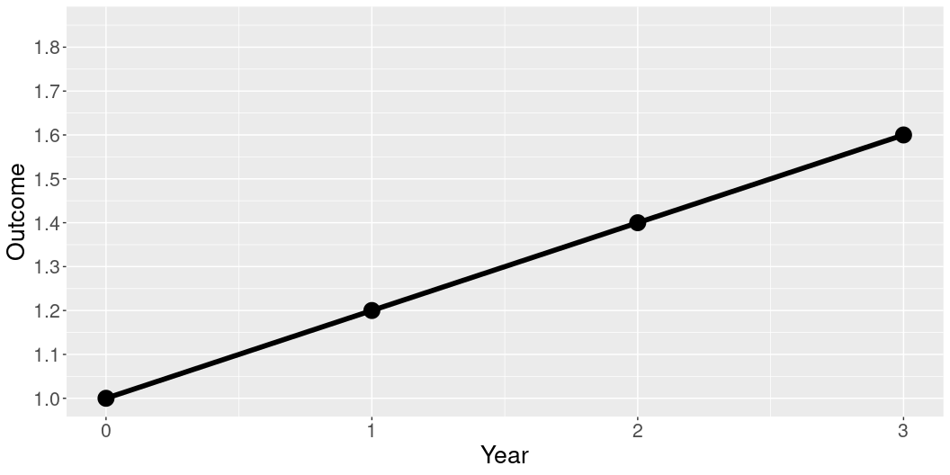
Causality: Why bother?
Year = c(0,1,2,3) Outcome = c(1, 1.2, 1.4,1.6) Treatment = c("Control", "Control","Control","Control") dat = data.frame(Year, Outcome, Treatment) ggplot(data = dat, aes(x = Year, y = Outcome, group = Treatment)) + geom_line(aes(linetype=Treatment),size=2) + geom_point(size = 6) + scale_linetype_manual(values=c("solid")) + xlim(0,3) + scale_y_continuous(limits = c(1,1.85), breaks = seq(1, 1.85, by = .1)) + theme(legend.position = "none", text = element_text(size=20))

Slide 20
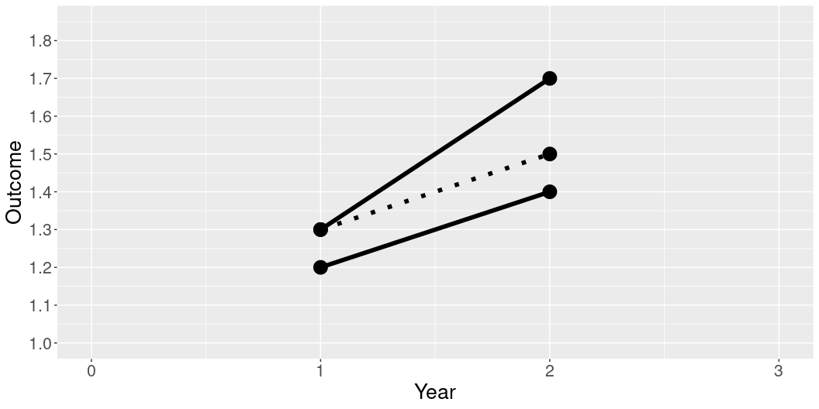
Causality: Why bother?
Year = c(0,1,2,3) Outcome = c(NA, 1.2, 1.4, NA, NA, 1.3, 1.7, NA, NA, 1.3, 1.5, NA) Treatment = c("Control", "Control","Control","Control", "Treatment", "Treatment", "Treatment", "Treatment", "Comparison","Comparison","Comparison","Comparison") dat = data.frame(Year, Outcome, Treatment) ggplot(data = dat, aes(x = Year, y = Outcome, group = Treatment)) + geom_line(aes(linetype=Treatment),size=2) + geom_point(size = 6) + xlim(0,3) + scale_y_continuous(limits = c(1,1.85), breaks = seq(1, 1.85, by = .1)) + scale_linetype_manual(values=c("dotted", "solid", "solid")) + theme(legend.position = "none", text = element_text(size=20))

Slide 21
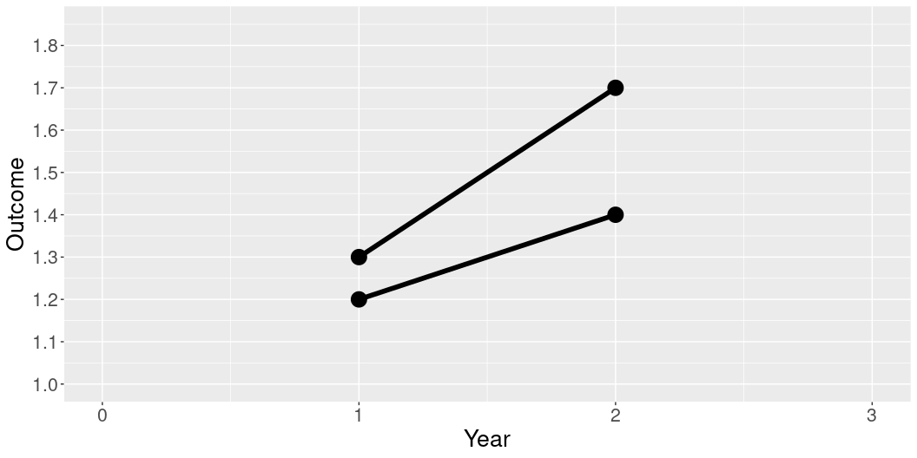
Causality: Why bother?
Year = c(0,1,2,3) Outcome = c(NA, 1.2, 1.4, NA, NA, 1.3, 1.7, NA) Treatment = c("Control", "Control","Control","Control", "Treatment", "Treatment", "Treatment", "Treatment") dat = data.frame(Year, Outcome, Treatment) ggplot(data = dat, aes(x = Year, y = Outcome, group = Treatment)) + geom_line(aes(linetype=Treatment),size=2) + geom_point(size = 6) + xlim(0,3) + scale_y_continuous(limits = c(1,1.85), breaks = seq(1, 1.85, by = .1)) + scale_linetype_manual(values=c("solid", "solid")) + theme(legend.position = "none", text = element_text(size=20))

Slide 22
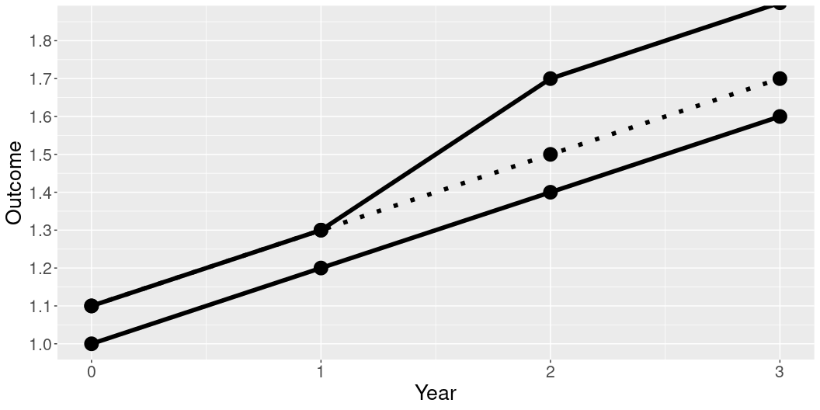
Causality: Why bother?
Year = c(0,1,2,3) Outcome = c(1, 1.2, 1.4,1.6, 1.1, 1.3, 1.7, 1.9, 1.1, 1.3, 1.5, 1.7) Treatment = c("Control", "Control","Control","Control", "Treatment", "Treatment", "Treatment", "Treatment", "Comparison","Comparison","Comparison","Comparison") dat = data.frame(Year, Outcome, Treatment) ggplot(data = dat, aes(x = Year, y = Outcome, group = Treatment)) + geom_line(aes(linetype=Treatment),size=2) + geom_point(size = 6) + scale_y_continuous(breaks = seq(1, 1.9, by = .1)) + scale_linetype_manual(values=c("dotted", "solid", "solid")) + coord_cartesian(ylim = c(1, 1.85), clip = "on") + theme(legend.position = "none", text = element_text(size=20))

Slide 23
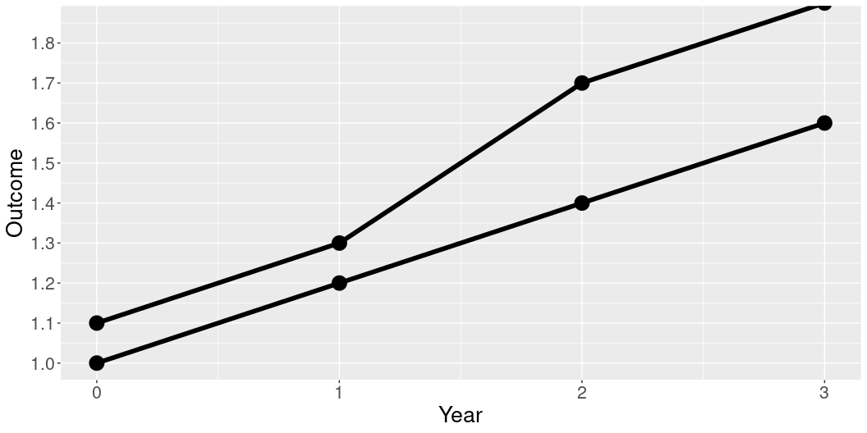
Causality: Why bother?
Year = c(0,1,2,3) Outcome = c(1, 1.2, 1.4,1.6, 1.1, 1.3, 1.7, 1.9) Treatment = c("Control", "Control","Control","Control", "Treatment", "Treatment", "Treatment", "Treatment") dat = data.frame(Year, Outcome, Treatment) ggplot(data = dat, aes(x = Year, y = Outcome, group = Treatment)) + geom_line(aes(linetype=Treatment),size=2) + geom_point(size = 6) + scale_y_continuous(breaks = seq(1, 1.9, by = .1)) + scale_linetype_manual(values=c("solid", "solid")) + coord_cartesian(ylim = c(1, 1.85), clip = "on") + theme(legend.position = "none", text = element_text(size=20))

Slide 24
Causality: What makes it hard?
Fundamental Problem of Causal Inference
$$Y_{i}=\left\{\begin{matrix}Y_{i}\left(1\right) & \text{if }D_{i}=1\text{ (treatment group)} \\ Y_{i}\left(0\right) & \text{if }D_{i}=0\text{ (control group)}\end{matrix}\right.$$
We only observe any given unit in one treatment status at any one time so we can never directly observe the causal effect of a treatment on a unit.

Slide 25
Potential Outcomes and Counterfactuals
Treatment Effect for individual $i$
$TE_{i}=Y_{i}\left(1\right)−Y_{i}\left(0\right)$
Average Treatment Effect (ATE)
$ATE=\frac{1}{N}\sum_{i=1}^{N}{T}E_{i}$

Slide 26
Many Different Tools
Randomized experiments
Gold-standard
Field and survey
Observational data
Natural experiments
Difference-in-Differences
Matching, Synthetic Control

Slide 27
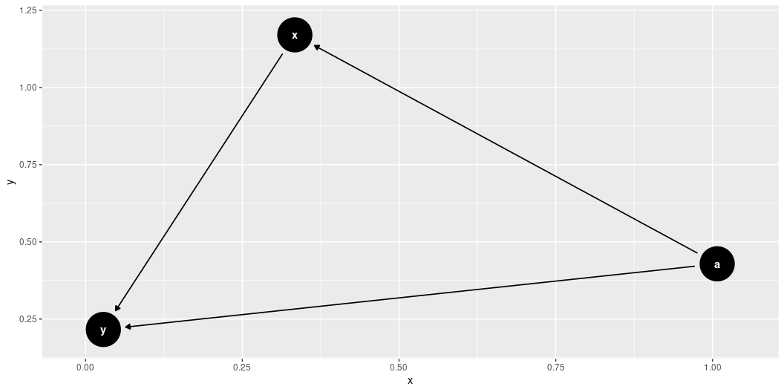
DAGs and Confounding

