Slide 1
Git and Github

Slide 2
Resources
To learn more about using git with R, visit happygitwithr.com
Notes:
This tutorial draws heavily on the website happygitwithr.com To learn more about using git with R, please visit the website, which covers introductory materials in greater details and guides new users through more advanced topics.

Slide 3
Git Basics
Git is a version control program, so you can avoid…
analysis.R analysis_v1.R analysis_v2.R analysis_v2_FINAL.R
Version control
Helps avoid devastating loss/failure
Tracks changes and allows users to view or restore older versions
Can be private or public
Notes:
Fundamentally, git is about “version control” - Data analysis tasks are often long-term efforts - They usually require input from multiple people - You must be able to go back and replicate results or tweak methods Version control creates a detailed, permanent record of this process - This helps to avoid devastating loss/failure - Tracks changes and allows users to easily view (or restore) older versions - Repos can be kept private or made public, allowing users to easily share their data and code publicly

Slide 4
Git Basics
Each project is a repository (repo)
Data and code for projects are stored in a repo folder
Repo is hosted remotely on github.com and locally as a folder on your harddrive
Make changes locally, record them as a commit, push them to the remote version
pull changes made by others from the remote version down to your local copy
Notes:
Git revolves around folders called repositories (or repos) - Data and code for individual projects are stored in a dedicated repo - The repo is hosted remotely on github.com - Repos exist on your harddrive as a normal folder (usually within a larger folder that includes all active git repositories you are working on) - Users make changes locally, record them as a “commit”, which is a record of any changes you have made, and “push” them to the remote version - Users can “pull” changes made by others from the remote version down to their local copy

Slide 5
Git Basics
Usage
Edit files using your preferred software (RStudio, Excel, text editors, etc.)
When you’re done, record the changes as a commit, push them to the remote version
Collaboration
Precise record of who makes changes
Simultaneous editing can cause challenges
Notes:
Git works mostly in the background - Before you start working, pull any changes that exist on the remote version but not on your local copy - Create/add/edit/delete files as you normally would if you were not using git - For example, you can edit files containing code by using RStudio or VSCode, or create or edit a spreadsheet using Excel - Once you’ve accomplished a task or want to walk away for the day, record the changes you’ve made (which we’ll cover below) and then push your changes to the remote version Collaboration - Git is great for collaboration because it keeps precise track of who has made changes - However, simultaneous editing of the same file can cause challenges, and beginners should avoid doing so

Slide 6
Git Basics
Essential commands
git pull origin main
git add .
git commit -m "describe your changes or vent frustration"
git push origin main
Notes:
Beginners only need to know a few commands; in this tutorial, we’ll use a software client that implements these commands for us using easy point-and-click software - Main refers to the man version of the repository (advanced users might create multiple versions, or branches, of a repo, but we don’t need to worry about that here) - Start a work session by using pull to get any updates (aka “commits”) that were pushed by a colleague (or by you on a different computer) - Use add to tell Git that you have made changes that you want to record - Use commit to record those changes and write a brief message explaining what you did - Push your commit(s) to the remove version on Github.com

Slide 7
Git Basics
Git can be complicated
Often used for sophisticated software development
Branches, conflicts, merges, rebase
Massive online community to guide new users
Notes:
While the basic functionality of git is important for data analysis projects, it is important to note that it is often used by large teams developing very sophisticated software, and has many features aimed toward more complicated use. Luckily, there is a massive online community that can help guide new users through the process of using and learning

Slide 8
Creating a Github account
Create an account for yourself or your organization
Go to github.com
Click “Sign-up” (top right)
Pick a username (ex. CloudburstGroup)
Follow the instructions
Notes:
Signing up for github is free, you just need to visit github.com and follow the instructions Make sure to pick a username for the account. This is like a social media handle that will allow others to find your data analysis projects online If you plan to use git as a team, you may want to create one account for your organization, while all colleagues that will interact with repos hosted on the organization account should create personal accounts

Slide 9
Installing git
Open the terminal/command prompt
Check if you have git installed
git --version
Notes:
Once you’ve signed-up for a Github account, you need to install git on your machine - Begin by checking to see if you have git installed - Open a terminal window (aka command prompt); you can search for “terminal” on Windows or Mac - Type git –version into the prompt and hit Enter - If you don’t have it installed, you’ll get an error that looks like this

Slide 10
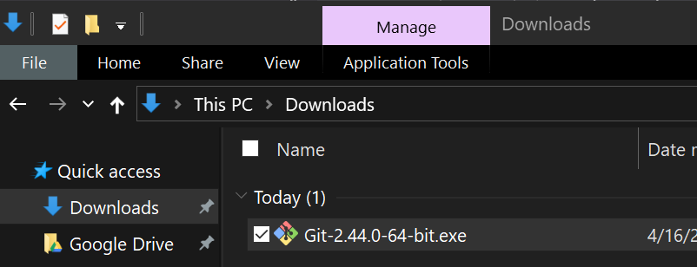
Installing git
If no, install git
Visit gitforwindows.org, click “Download”, then double-click the .exe
Notes:
If you don’t have Git installed, Mac will offer to install it for you. Just click Install - If you are on Windows, you will need to install yourself by visiting gitforwindows.org - Click “Download”, which will install an exe file on your harddrive. Double-click the exe file and follow the instructions

Slide 11
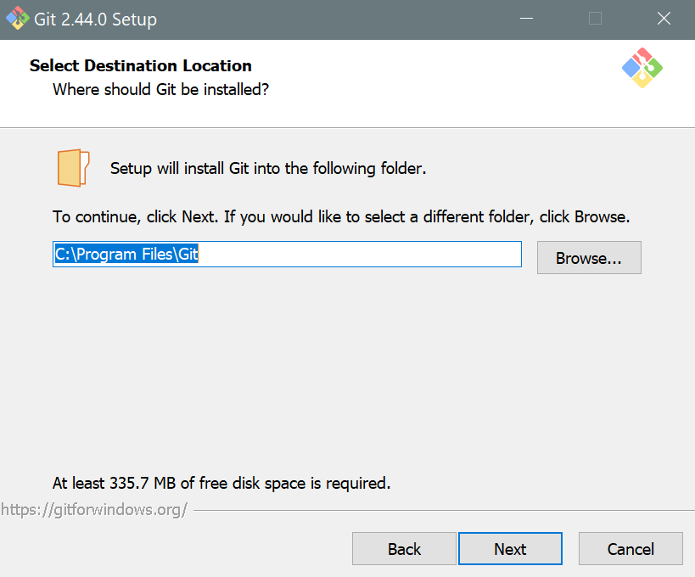
Installing git
Notes:
Once you double-click the exe, a prompt will open. Proceed through the next few steps

Slide 12
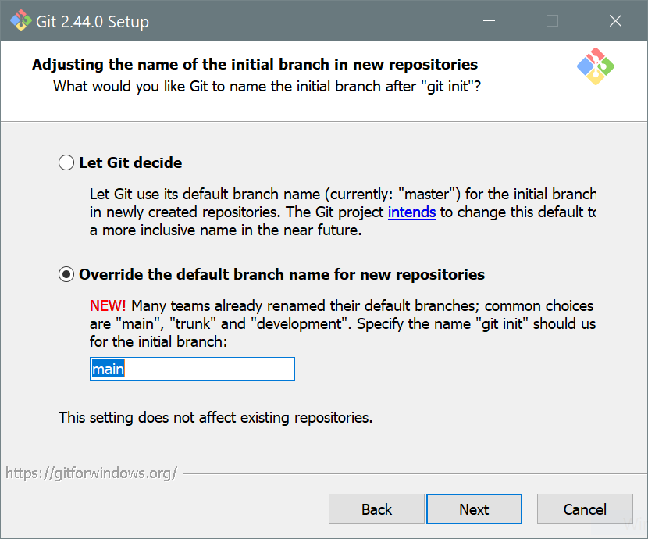
Installing git
Optional: Override the default branch name (select ‘main’)
Notes:
Although this is optional, most users prefer to call the primary branch main rather than master (default)

Slide 13
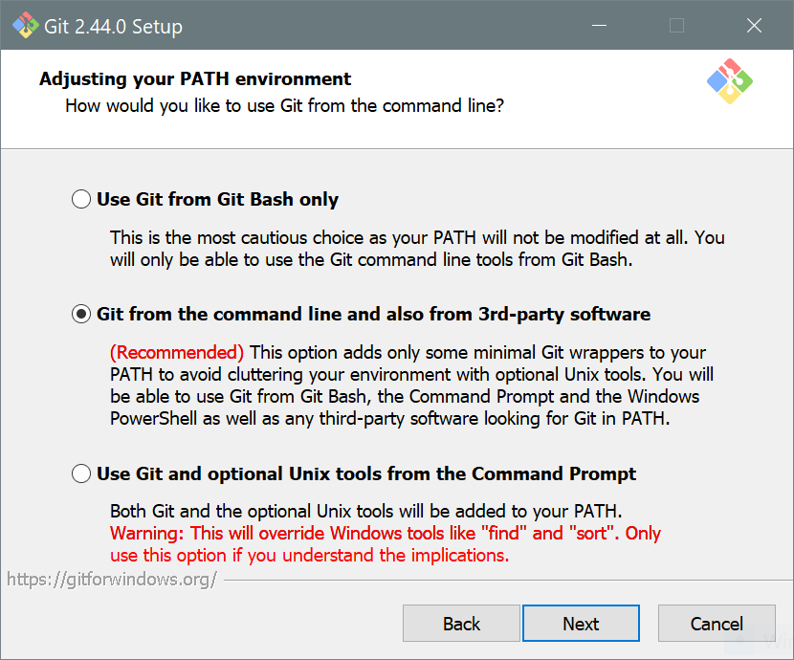
Installing git
Make sure that “Git from the command line and 3rd-party software” is selected

Slide 14
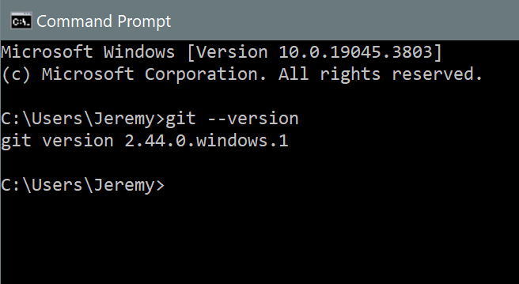
Installing git
Notes:
Now open a new command prompt and type git –version again - This time, you should get a response that indicates a version of git is installed on your computer

Slide 15
Connect your GitHub account
Open the terminal and enter the code below
Replace "Your Name"and "yourname@email.edu" with your name/email used to sign up for GitHub
Run the code
git config --global user.name "Your_user_name" git config --global user.email "youremail@email.edu"
Notes:
Now you need to connect your computer’s Git installation with your account on Github.com Type the following two commands into your terminal window, using the username and email address that you used to sign-up for a Github account

Slide 16
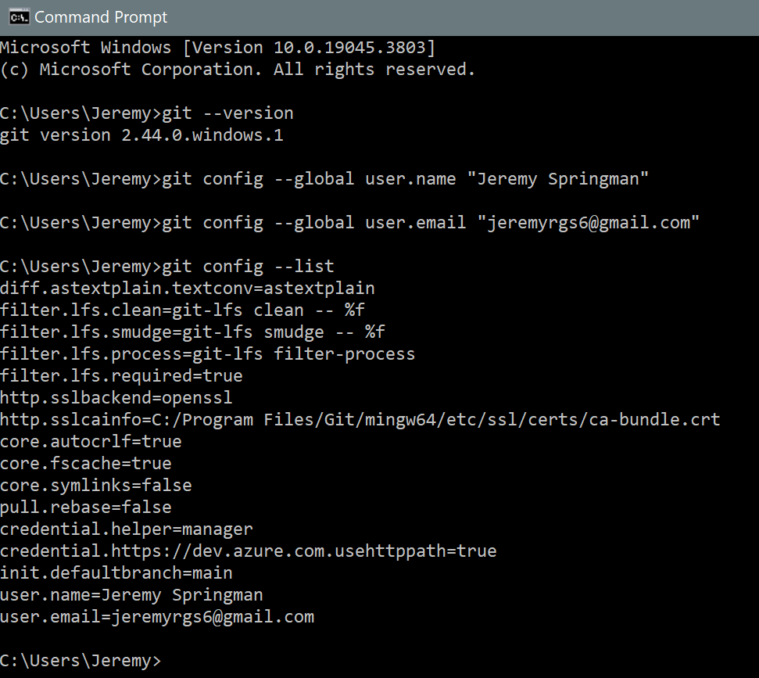
Connect your GitHub account
Check that the confirmation worked
git config --list
Notes:
Check to see that the configuration worked. Depending on your operating system, the message you see might look different. If the configuration was successful, your username and email address will show-up somewhere in the message The Git on your computer can now communicate with your account on Github.com

Slide 17
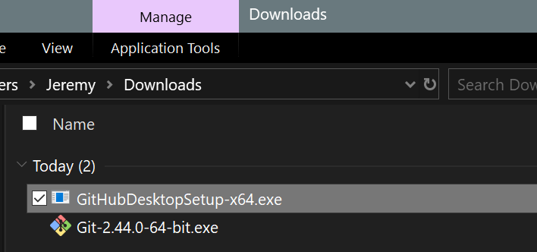
Install a git client
Visit desktop.github.com and click “Download”
Double click the .exe
Notes:
The next step is to install a Github client - The client allows you to more easily manage the process of pushing and pulling commits between your local copy of a repo and the remote version on Github.com - There are many clients you can use, but we recommend Github Desktop for most users because of its simplicity - Just visit desktop.github.com, click download, and then double-click the .exe file that gets downloaded to your computer

Slide 18
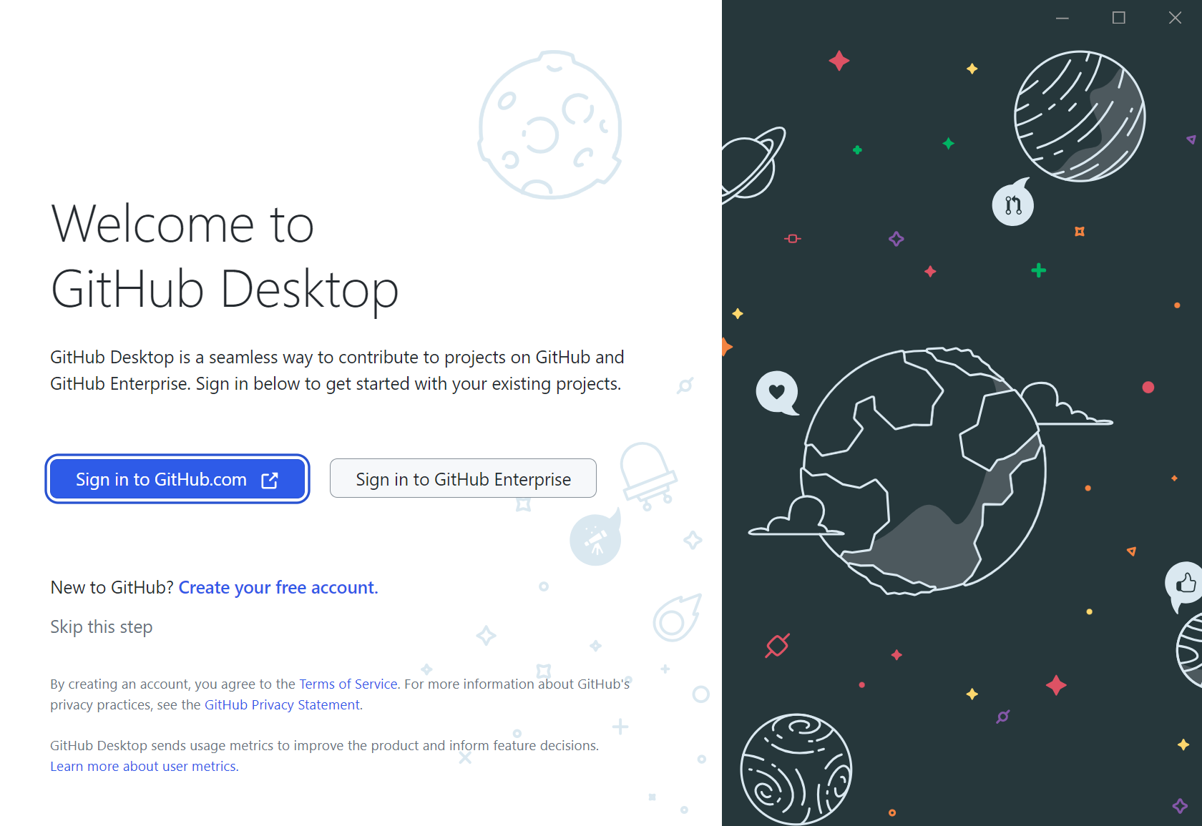
Install a git client
Notes:
You will receive a prompt asking you to sign-in to your account on Github.com. Follow these instructions

Slide 19
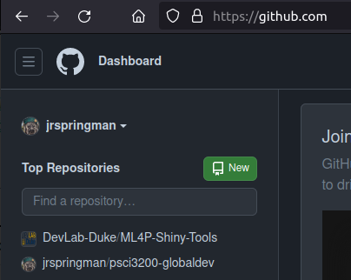
Create a new repo
Sign-in to your account on github.com and click “New” in the top right

Slide 20
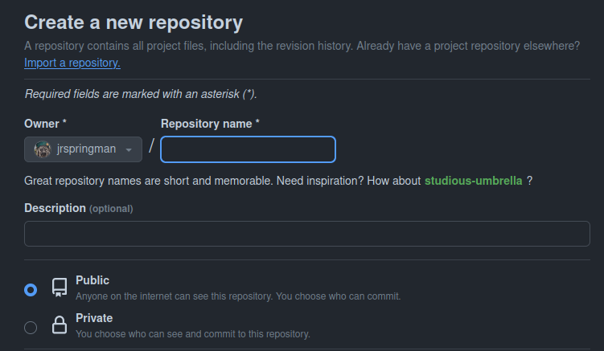
Create a new repo
Give your repository a name and decide whether to make it public or keep it private

Slide 21
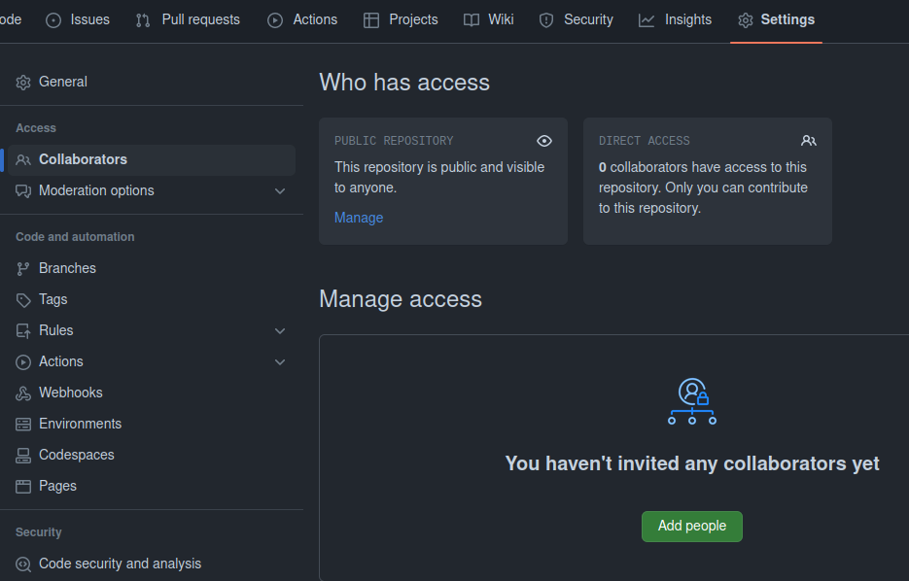
Share with colleagues
Navigate to: Settings -> Collaborators -> Add People - Add the email address associated with any personal Github accounts of colleagues that you want to make contributions to the repo

Slide 22
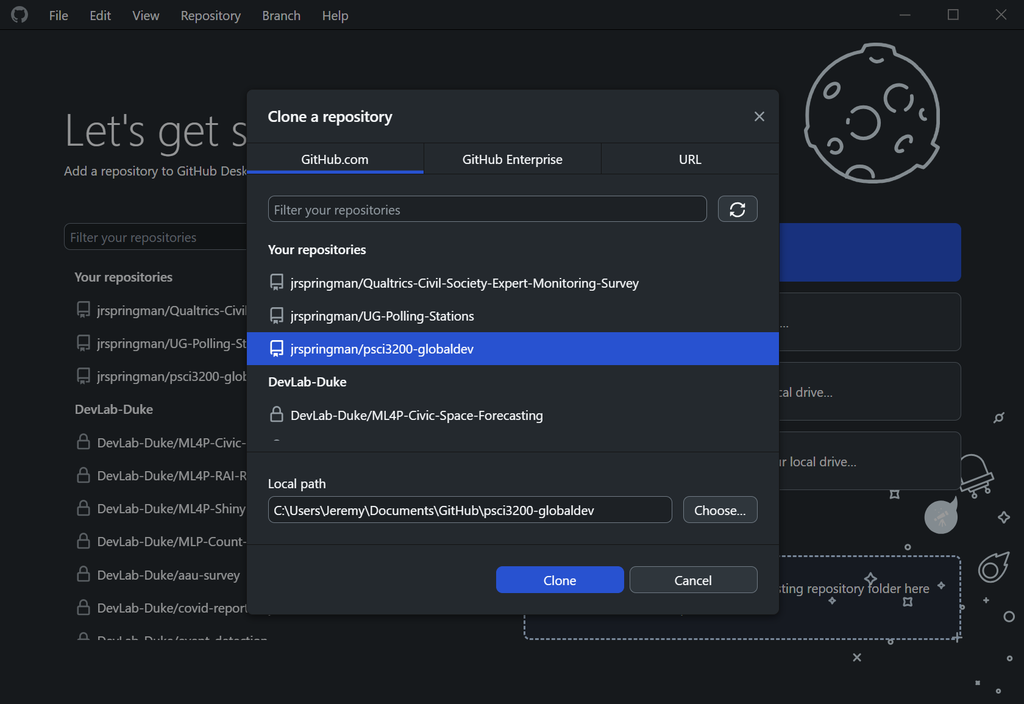
Clone your repo
Open the Github Desktop application and create a “clone” the remote repo to create a local copy
Notes:
Once you have created a git repo on your Github account, you need to “clone” the remote repo to create a local copy on your harddrive. This will allow you to add files and make changes to the repo before pushing them up to the remote version

Slide 23
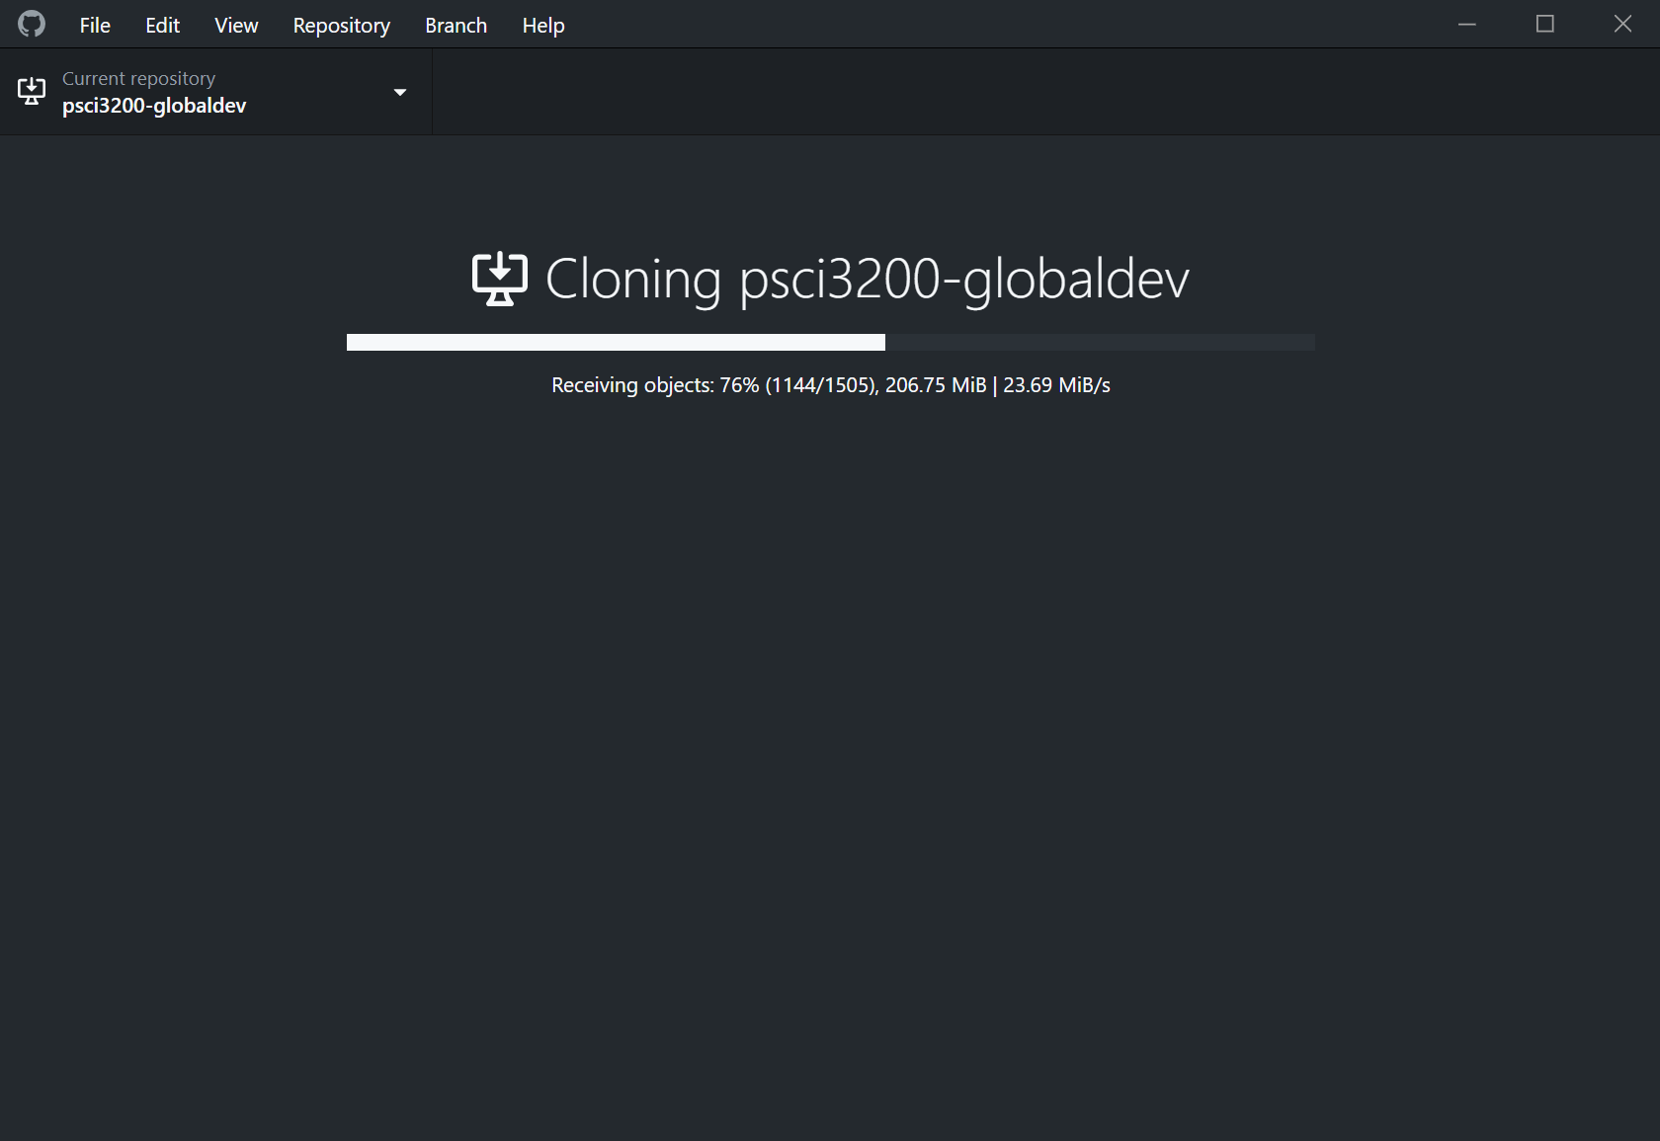
Clone your repo

Slide 24
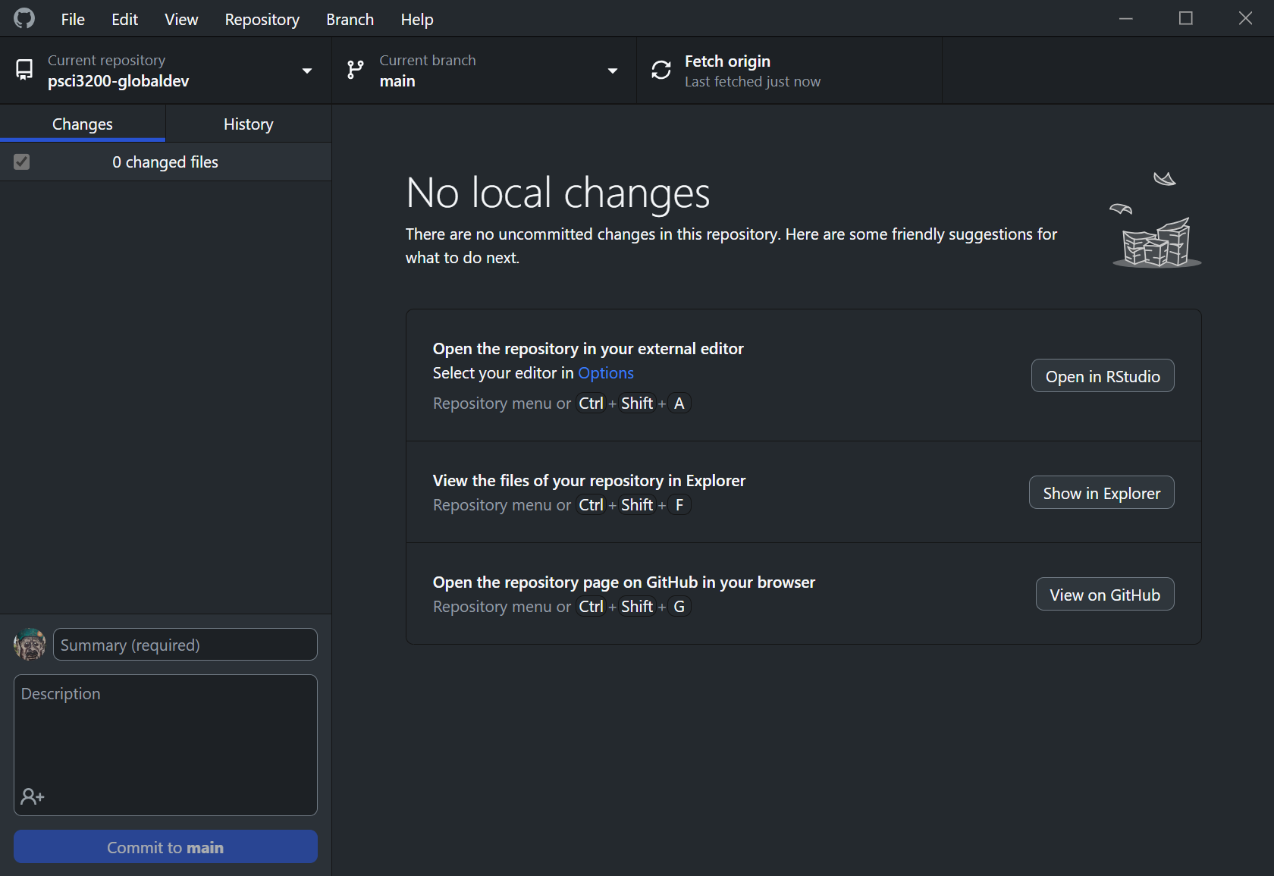
Clone your repo
Notes:
Once your repo has finished cloning, you should have a Github Desktop page for the repo that looks like this You can click the icons to open the project in RStudio, see the repo’s folder on your harddrive, or view the remote version on Github.com

Slide 25
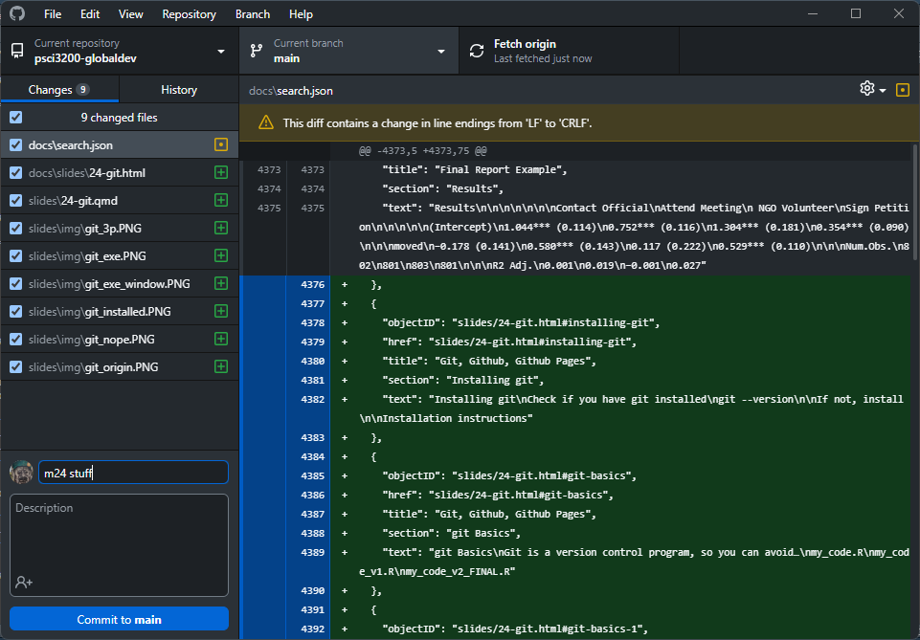
Commit changes
Now you can make changes to the repo, and those changes will appear as “diffs” in the application - Add a description and make a “commit” to record those changes in git
Notes:
Now you can make changes to the repo, and those changes will appear as “diffs” in the application Green will indicate additions, Red will indicate deletions, and yellow will indicate changes Try adding a .R file or an empty .txt file to the repo’s folder; you should see it show up immediately on the Github Desktop app In the bottom left, enter text to describe the changes that you made and then click “Commit to main”

Slide 26
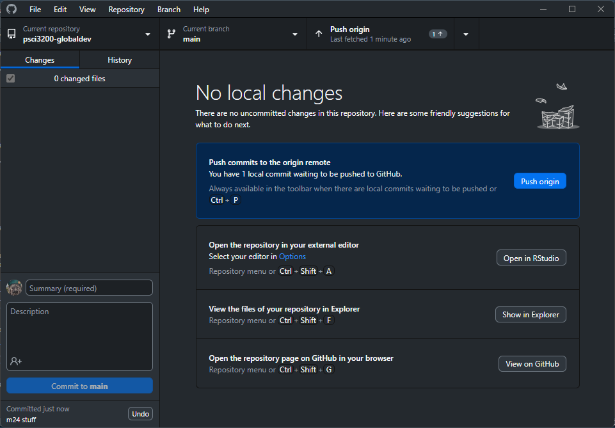
Push to your repo
Push those changes to the remote version of the repo on Github.com
Notes:
Now you have made your first commit, push it to the “origin”, which is the remote version of the repo on Github.com Those changes should now appear on the repo’s page on Github.com

Slide 27
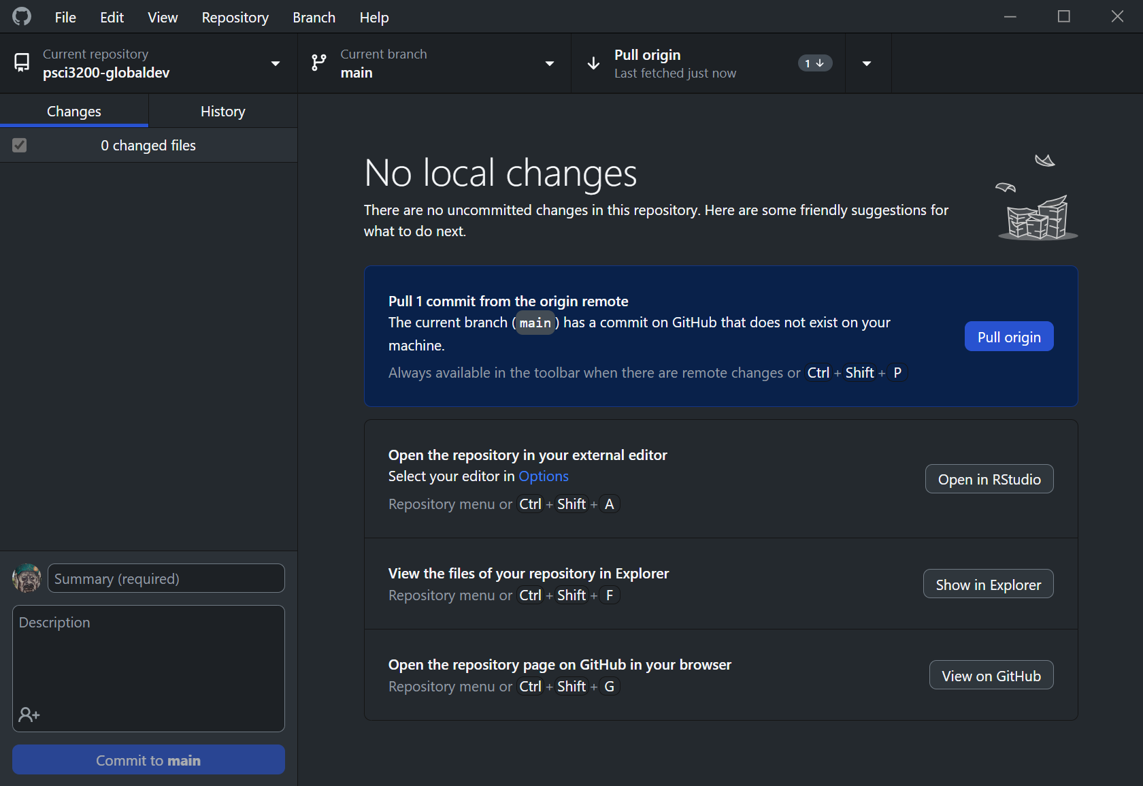
Pull from your repo
When colleagues push a commit to the repo, you can pull their commit by clicking “Pull origin”
Notes:
When colleagues push a commit to the repo, you can pull their commit by clicking “Pull origin” Make sure to pull any commits before you start working; this will make sure you are working on the most recent version of your project

