Slide 1
Git and Github

Slide 2
Creating a Github account
Notes:
does this work; prob not

Slide 3
Installing git
Open the terminal/command prompt
Check if you have git installed
git --version

Slide 4
Installing git
If yes, consider running an update
git update-git-for-windows

Slide 5
Installing git
If no, install git
Installation instructions
Download .exe and double-click
Two things to watch for:
Adjusting the name of the initial branch: Override the default branch name (select ‘main’)
Adjusting your PATH: make sure to select command line and 3rd-party

Slide 6
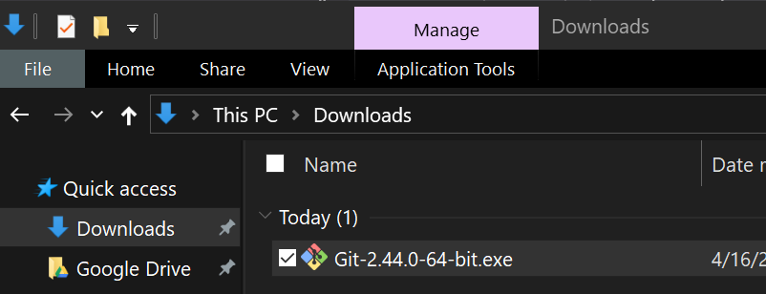
Installing git

Slide 7
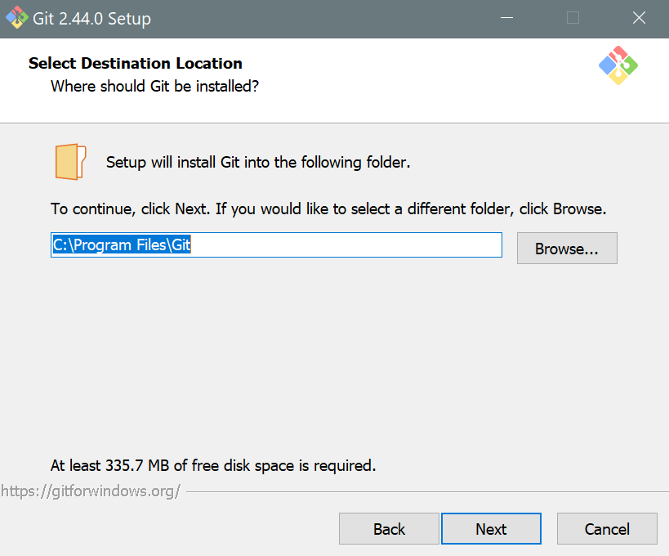
Installing git

Slide 8
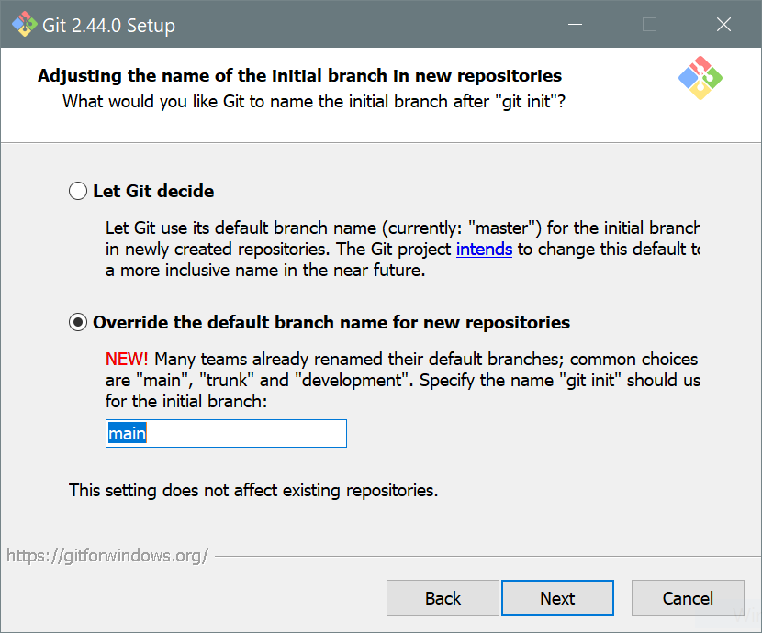
Installing git

Slide 9
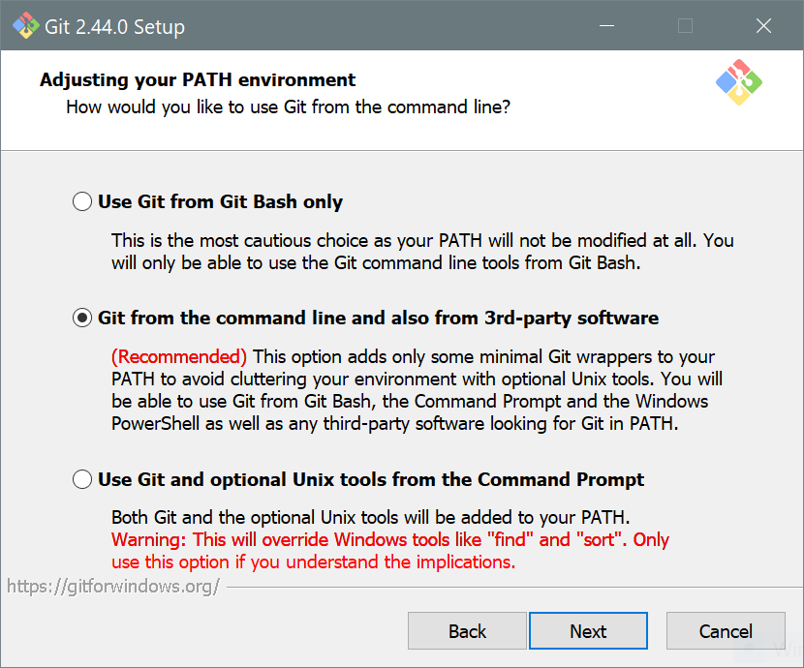
Installing git

Slide 10
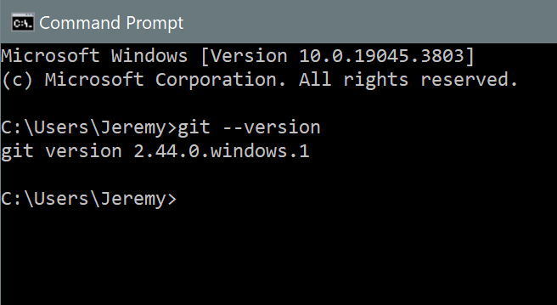
Installing git

Slide 11
git Basics
Git is a version control program, so you can avoid…
analysis.R analysis_v1.R analysis_v2.R analysis_v2_FINAL.R
Git hosts data and code
“Remote” (main) on github.com
“Local” on your harddrive(s) in a designated folder

Slide 12
git Basics
Version control
Helps avoid devastating loss/failure
Precisely tracks changes and can revert to old versions
Note: everything is public by default
Collaboration
When you collaborate, it’s clear who to blame
Simultaneous editing can cause challenges

Slide 13
git Basics
Basic commands
git pull origin main
git add .
git commit -m "describe your changes or vent frustration"
git push origin main
git pull origin main

Slide 14
git Basics
Git can be complicated
Often used for serious software development
Branches, conflicts, merges, rebase
Massive online community to help with more sophisticated use

Slide 15
Connect your GitHub account
Open the terminal and enter the code below
Replace "Your Name"and "yourname@email.edu" with your name/email used to sign up for GitHub
Run the code
git config --global user.name "Your Name" git config --global user.email "yourname@email.edu"

Slide 16
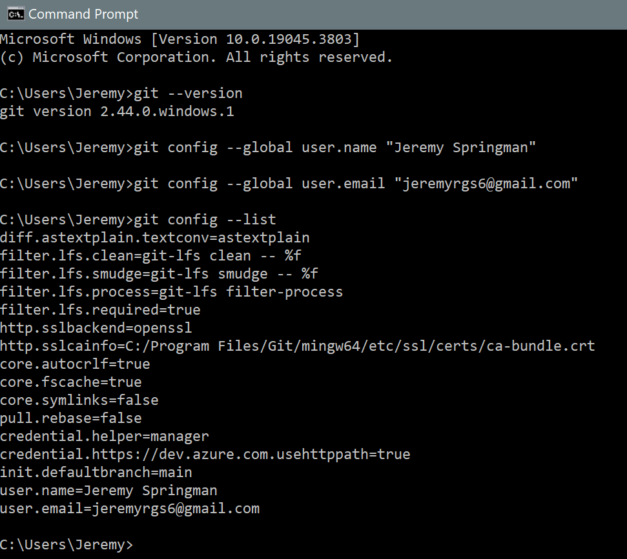
Connect your GitHub account
Check that the confirmation worked
git config --list

Slide 17
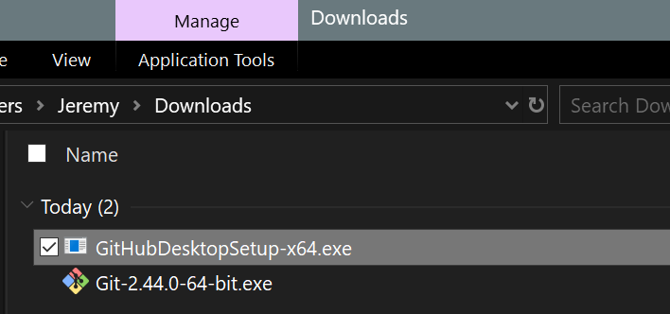
Install a git client
Download GitHub Desktop .exe
Double click the .exe

Slide 18
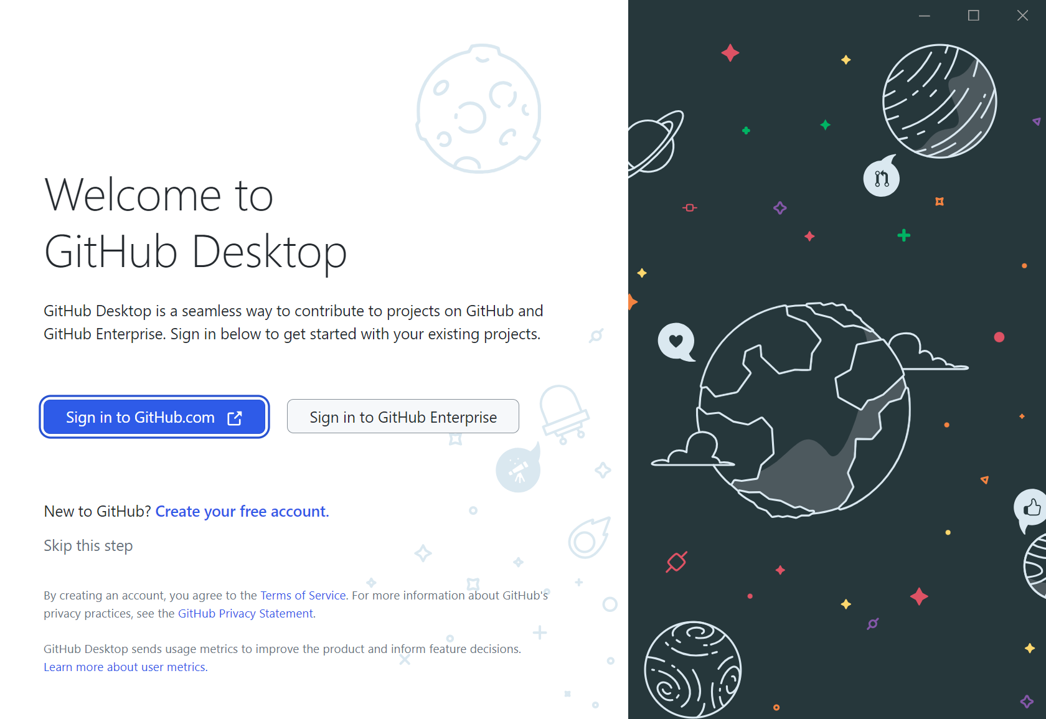
Install a git client

Slide 19
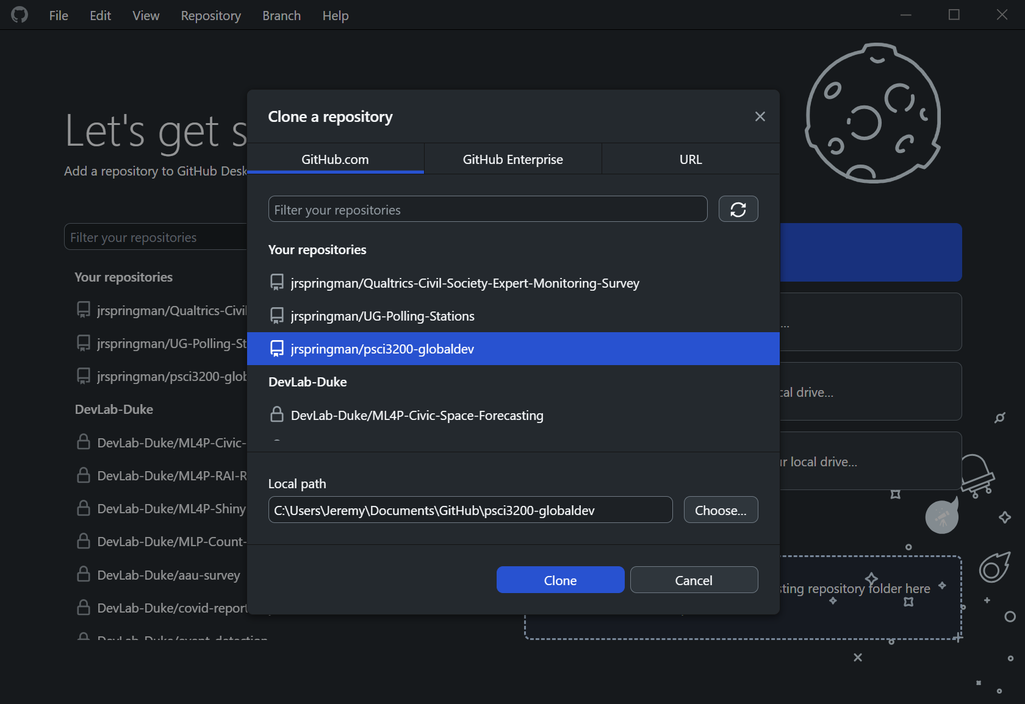
Clone your repo

Slide 20
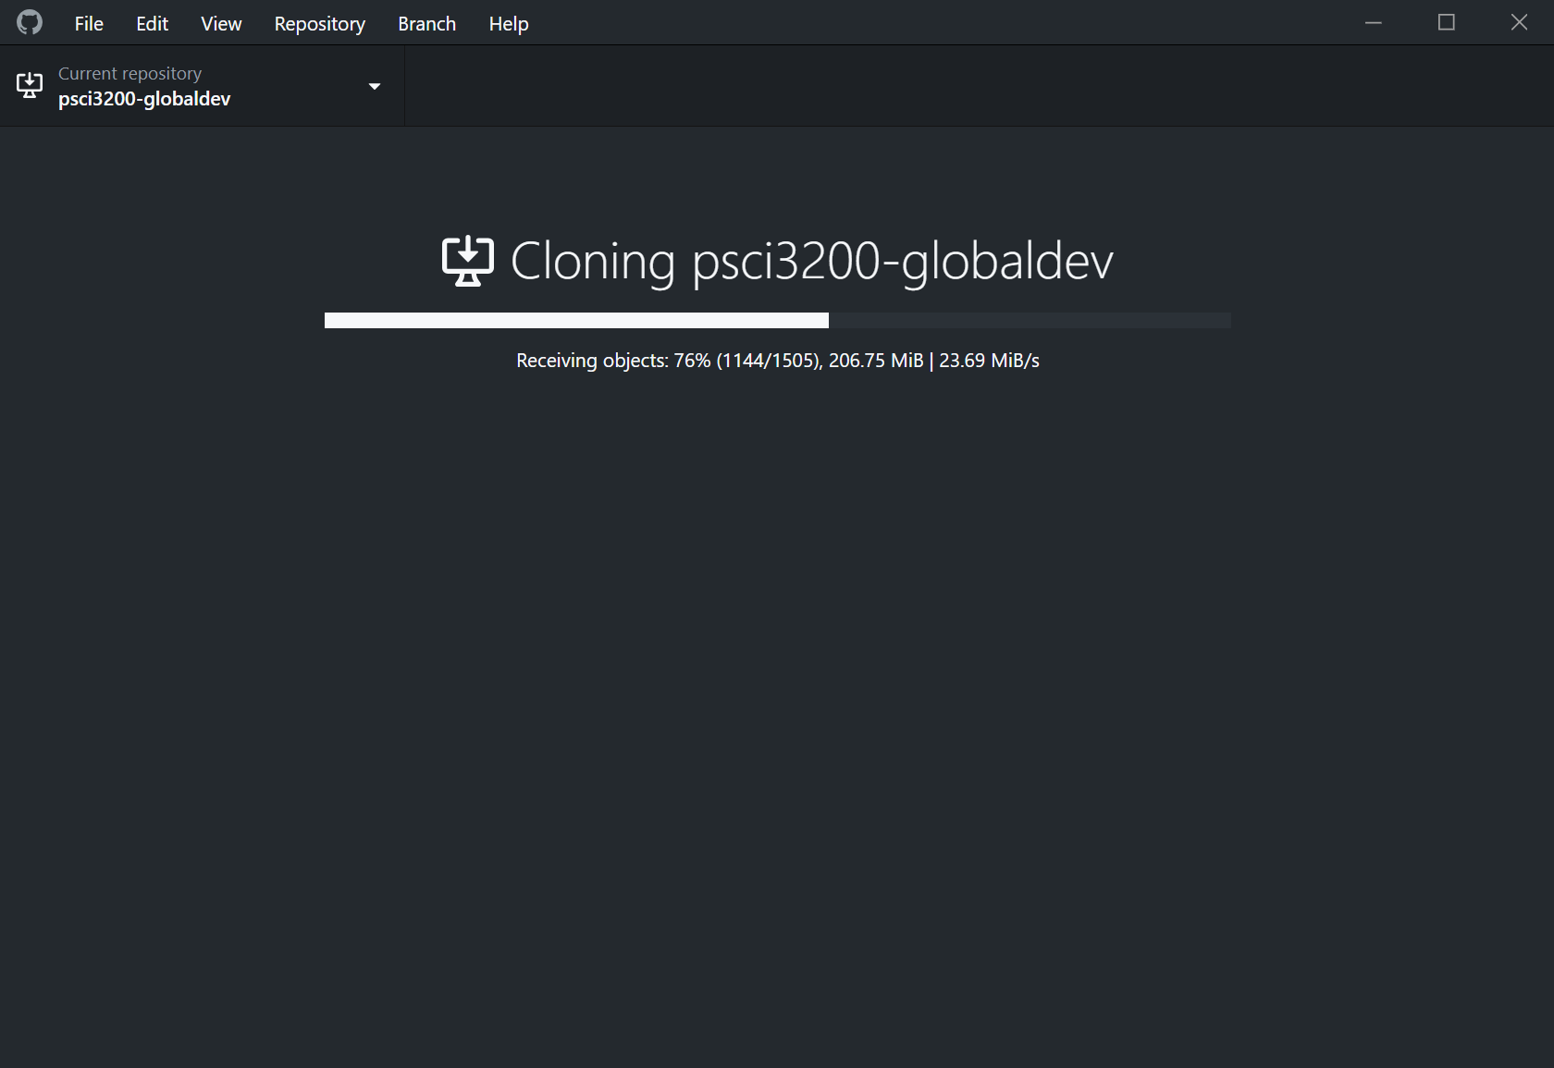
Clone your repo

Slide 21
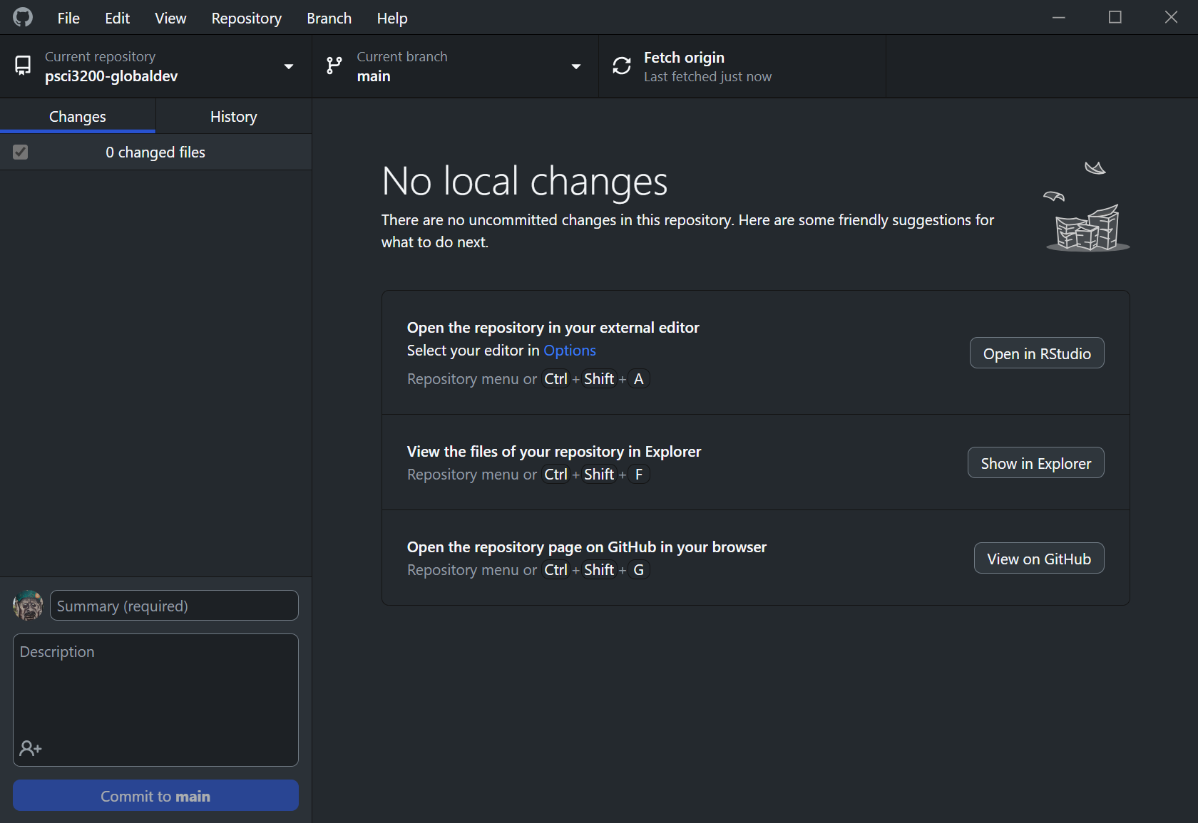
Clone your repo

Slide 22
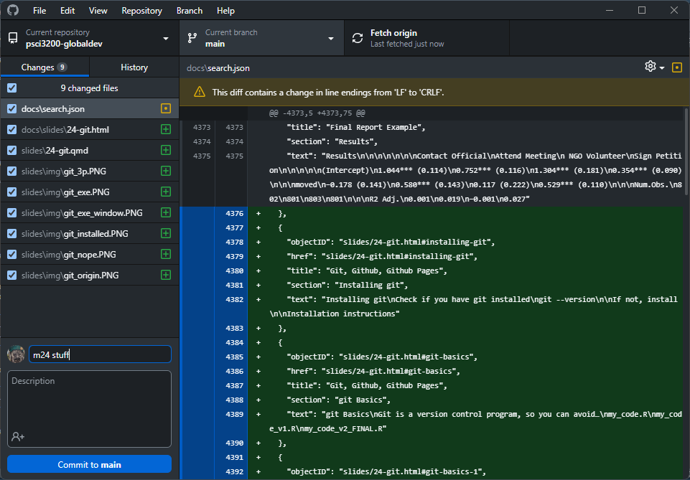
Commit changes

Slide 23
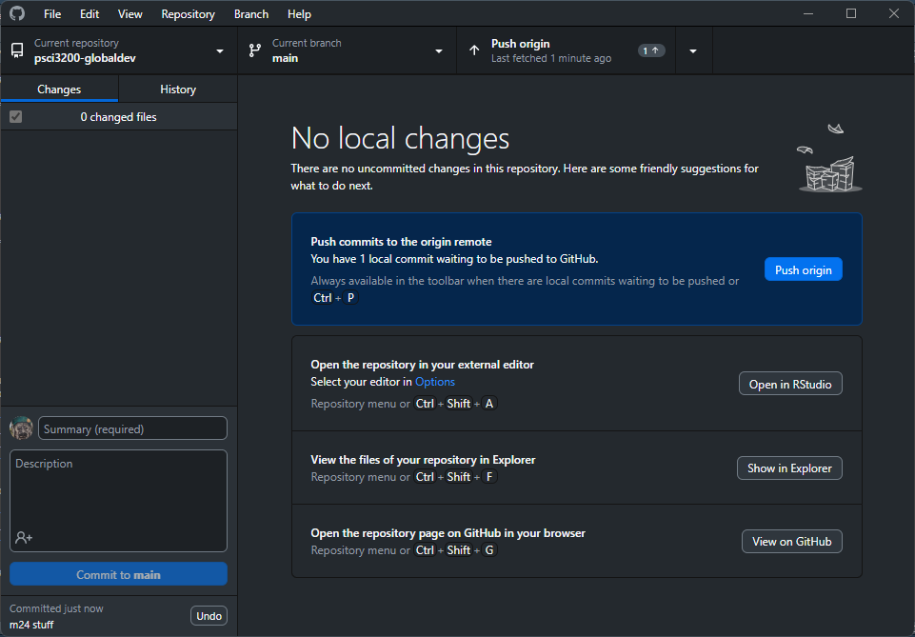
Push to your repo

Slide 24
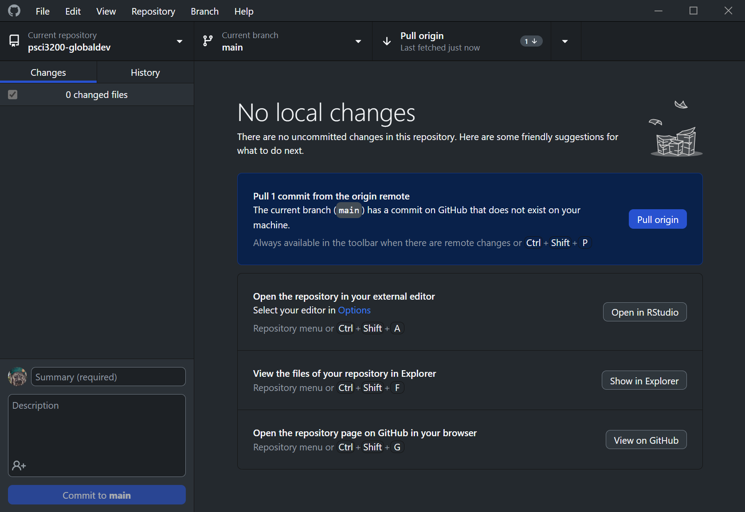
Pull from your repo

Slide 25
Github Pages

Slide 26
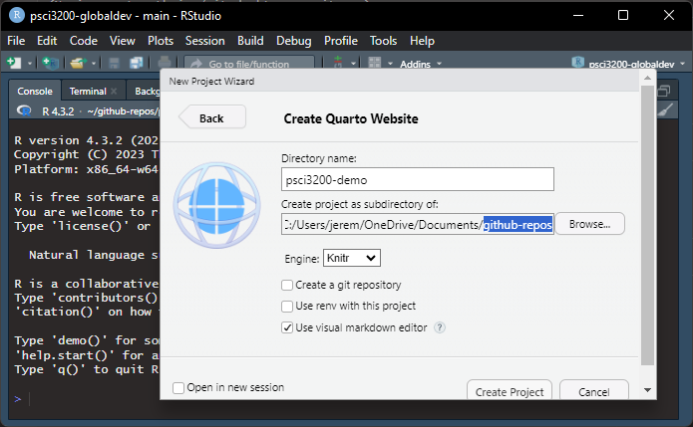
Create a website
Moving to RStudio
File $→$ New Project $→$ New Directory $→$ Quarto Website

Slide 27
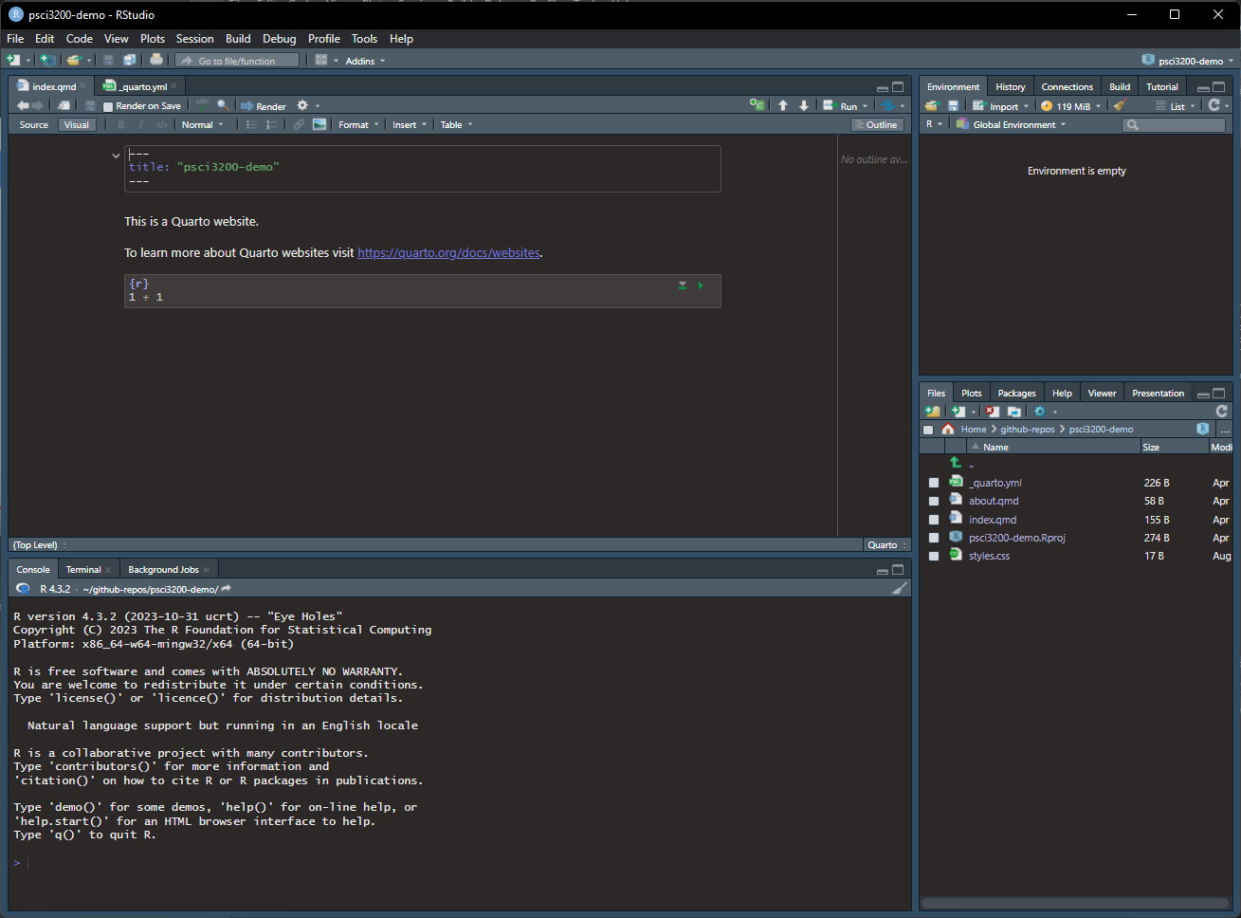
Create a website

Slide 28
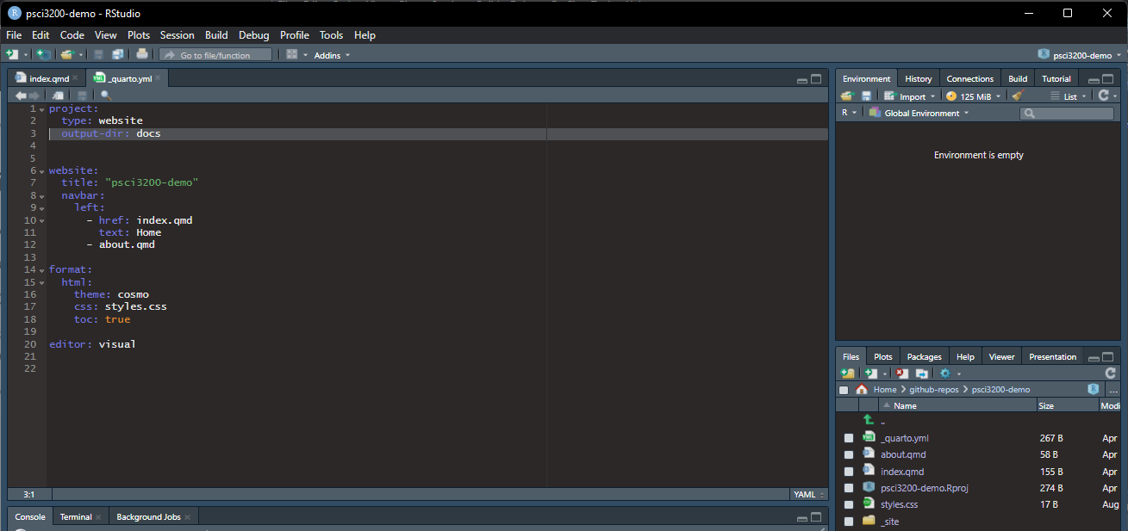
Create a website
Change output director to docs

Slide 29
Publish to Github pages
Keep a repository of your website
Push changes to your website via Github
See changes almost instantly

Slide 30
Publish to Github pages
Where we left off
Publish local git repo to github.com
Uncheck ‘Keep this code private’
Open repo on github.com
Settings $→$ Pages (left-sidebar)

Slide 31
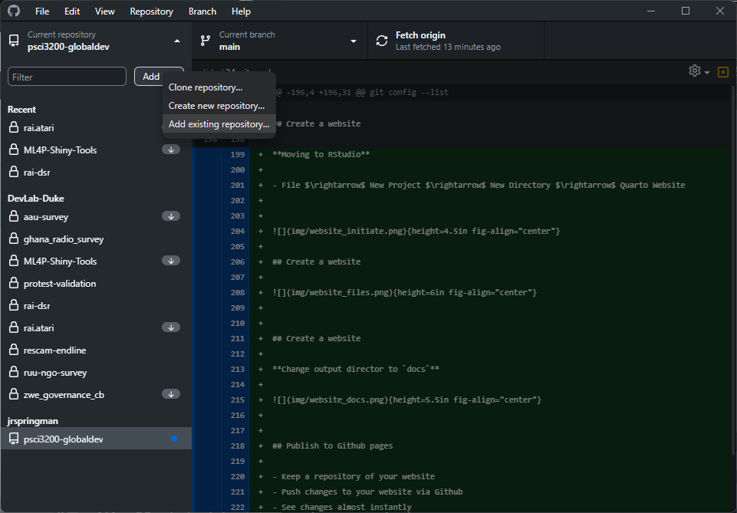
Publish to Github pages

Slide 32
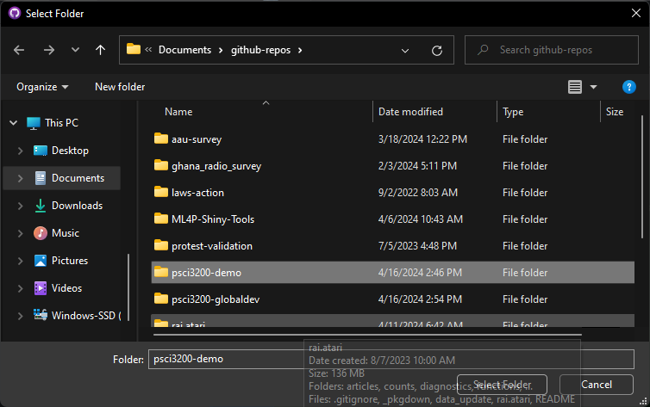
Publish to Github pages

Slide 33
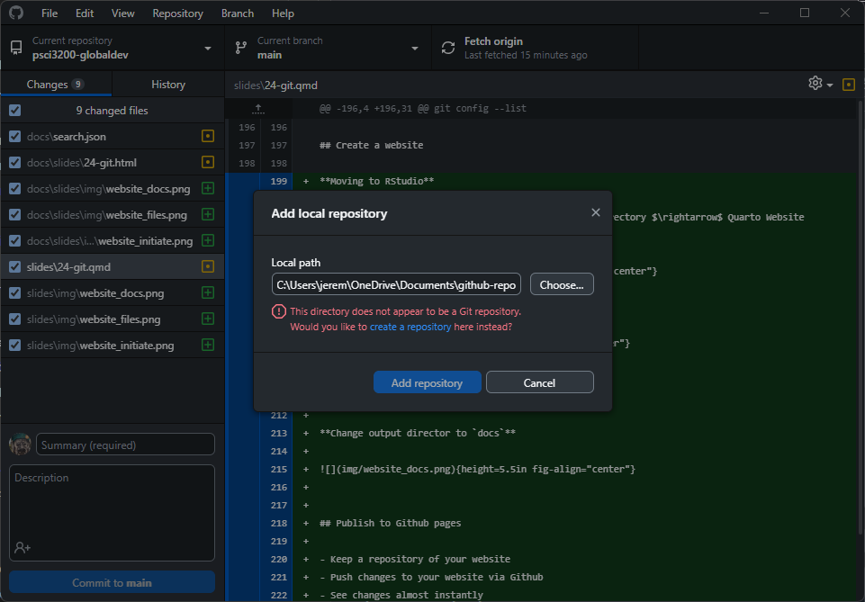
Publish to Github pages

Slide 34
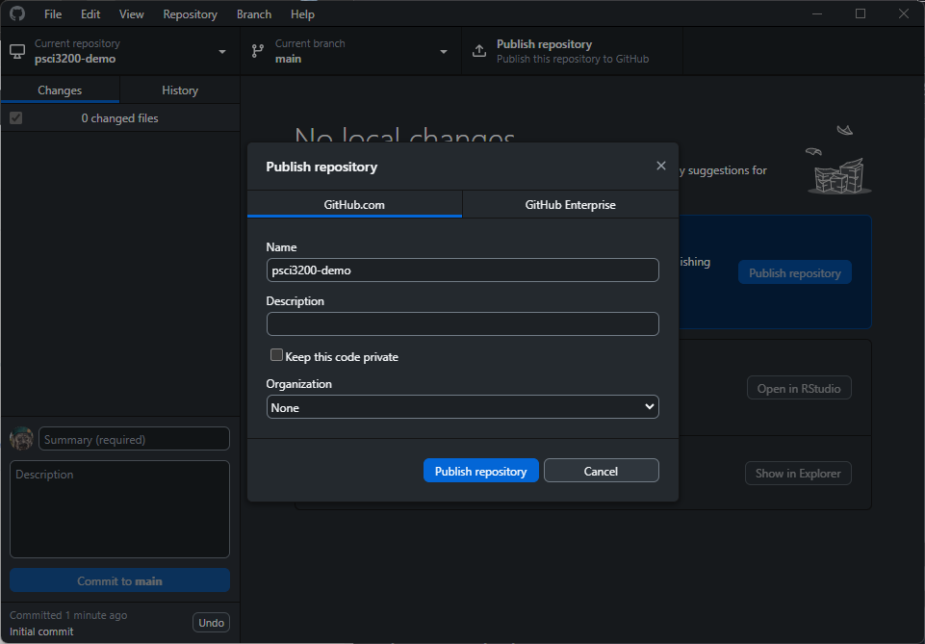
Publish to Github pages

Slide 35
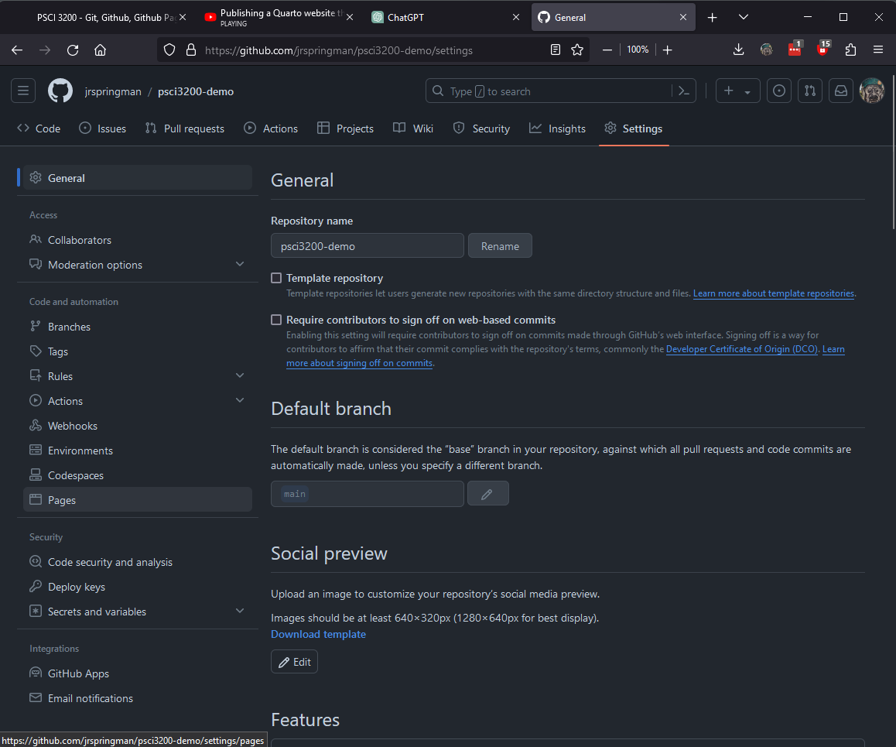
Publish to Github pages

Slide 36
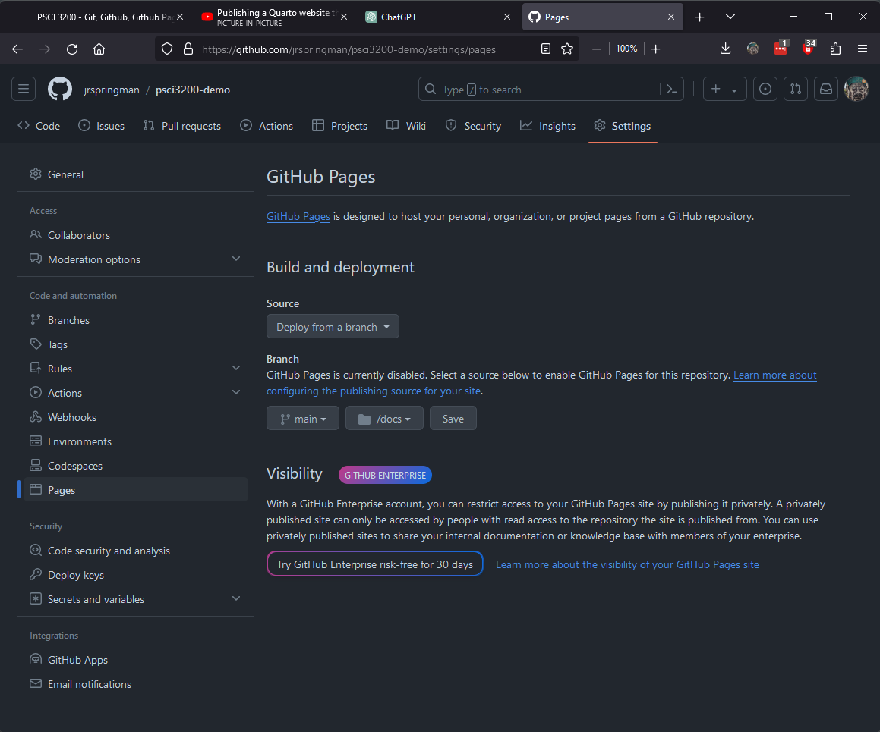
Publish to Github pages

Slide 37
Host Your Final Project
Delete _site folder (now its using docs)
Create data folder to store your dataset
Add final project .qmd file to your repo (or drop it into index.qmd)
Use _quarto.yml to add new pages to navigation bar
Render index.qmd; confirm that other pages have been rendered
Push commit and check that the website updated

