Slide 1
Graphcut Textures: Image and Video Synthesis Using Graph Cuts
Paper by: Vivek Kwatra, Arno Schodl, Irfan Essa, Greg Turk, and Aaron Bobick
Presentation by: Joaquín Ruales

Slide 2
The Problem: Texture synthesis
Notes:
what is the problem?
why is this a meaningful problem?
what is the technical contribution of this paper? what new methods/theory does it propose?
any limitations/problems that cannot be addressed.

Slide 3
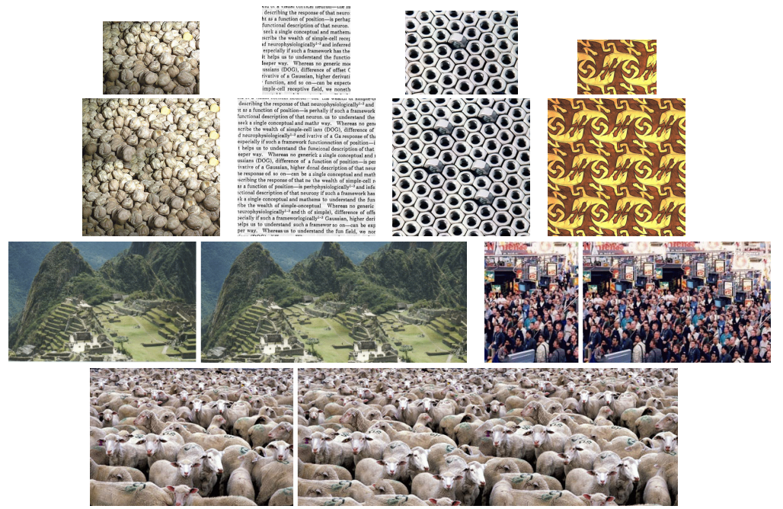

Slide 4
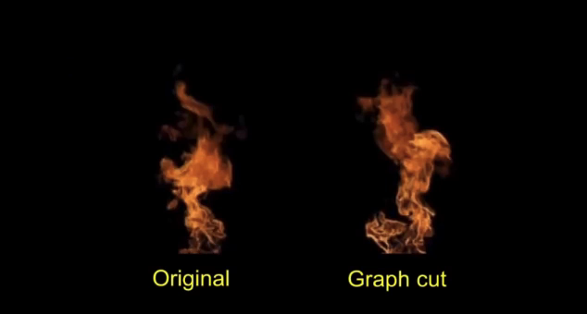
[Video]

Slide 5
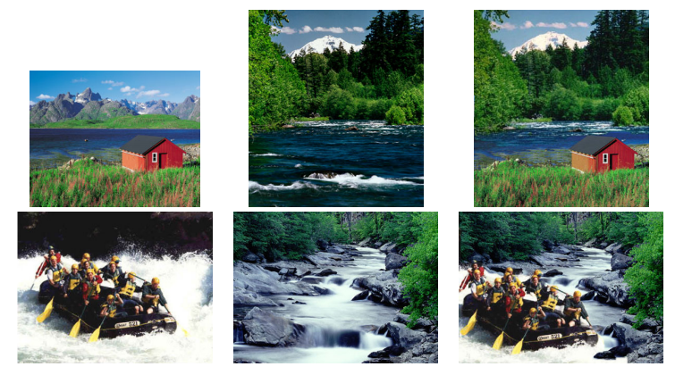

Slide 6
Graphcut texture Algorithm

Slide 7
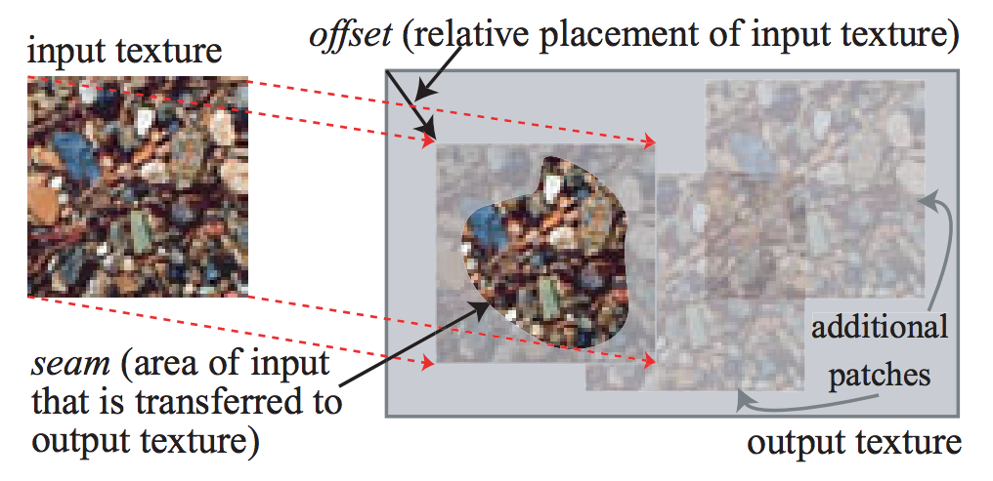
“Offset” and “Seam”

Slide 8
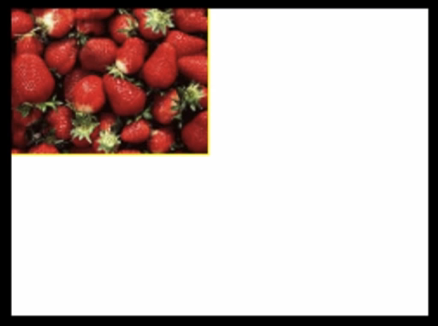
Initialization Stage
[Video]
Notes:
Initialization Stage:
Output image not yet fully covered

Slide 9
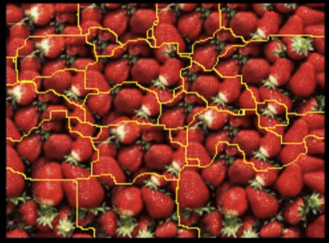
Refinement Stage
[Video]
Notes:
Refinement Stage
Focus on seam improvement

Slide 10
Patch Placement
(Selecting an offset)

Slide 11
Patch Placement
3 options:
  Random placement
  Entire patch matching
  Sub-patch matching

Slide 12
Patch Placement:
Entire patch matching
Choose position t with probability
Where
(C(t) can be computed efficiently in O(nlogn) time thanks to summed area tables and FFT!)
Notes:
C(t) can be computed in O(nlogn) time vs the naive O(n²) timethanks to summed area tables and FFT
Where n is the number of pixels in the image or video

Slide 13
Patch Placement:
Video Textures
Similar procedure
Can choose temporal (1D) or spatio-temporal (3D) offset

Slide 14
Computing the seam

Slide 15
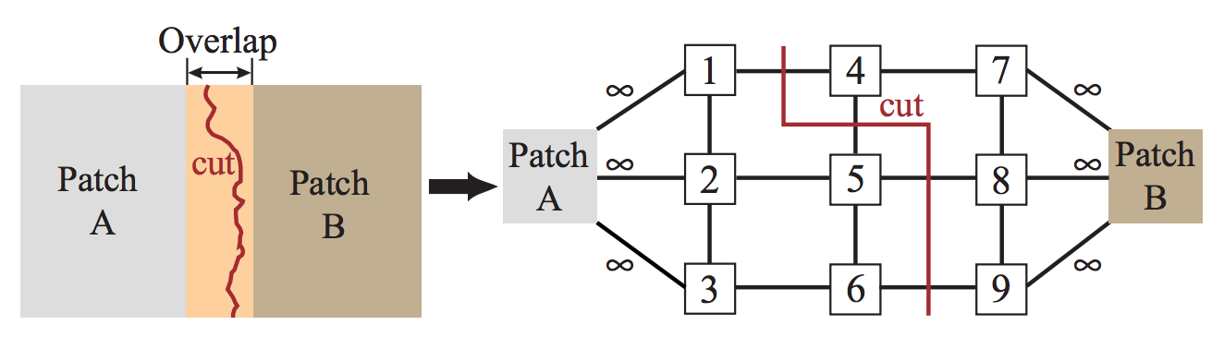
Computing the seam
(Initialization Stage)

Slide 16
Computing the seam
(Initialization Stage)
M(3,6, A, B)
Edge weights given by Matching Quality Cost Function. E.g.:
Weight of represents a pixel constraint.

Slide 17
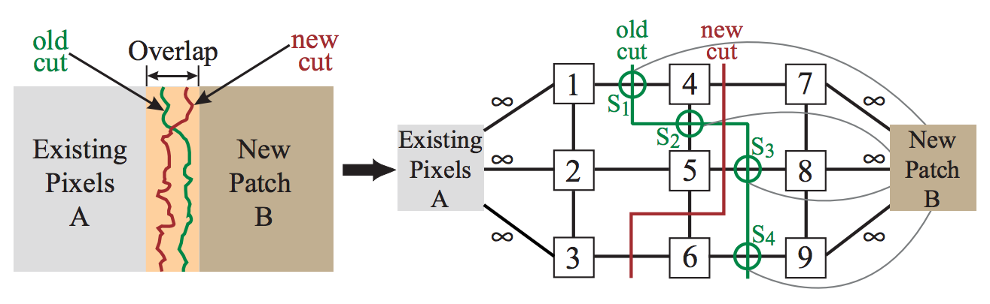
Computing the Seam
(Refinement Stage)
S₁, S₂, S₃, S₄: “Seam nodes”

Slide 18
Technical Contributions to the state of the art

Slide 19
Technical Contributions to the State of the Art
No restrictions on the shape of the created seam between combined images
Consideration of old seam costs (unavailable in Dynamic Programming approaches)
Easy generalization to higher dimensions (N=2: images, N=3: video, N=4, 5, …)
A simple method for adding constraints

Slide 20
Problems and limitations

Slide 21
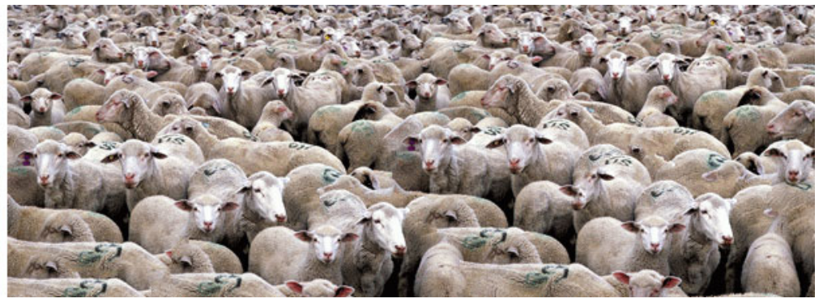
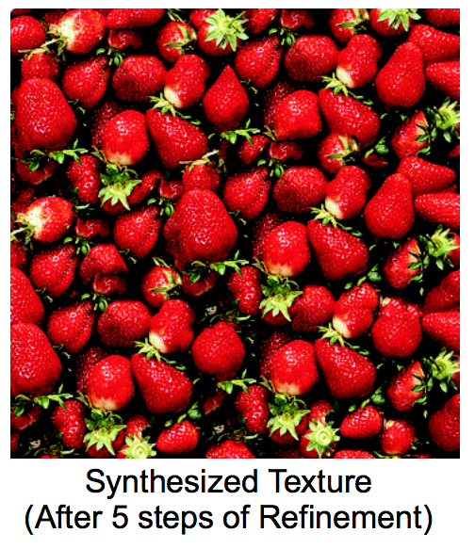
Problems and limitations
Artifacts. (although less apparent than in previous work)

Slide 22
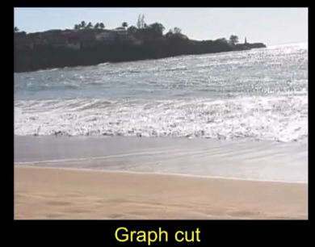
[Video]

