Slide 1
Digital Portfolio
STUDENT NAME: Rubika J
REGISTER NO AND NMID: 2428B0341 AND 68F7986499F4304B75E4B345169FE8BC
DEPARTMENT: BSc Computer Science With Data Analytics
COLLEGE: KPR College Arts Science And Research / Bharathiyar University

Slide 2
Empowering Peers: A Digital Portfolio of Leadership Experiences

Slide 3


AGENDA
Problem Statement
Project Overview
End Users
Tools and Technologies
Portfolio design and Layout
Features and Functionality
Results and Screenshots
Conclusion
Github Link
3/21/2024 Annual Review

Slide 4

PROBLEM STATEMENT
In today’s academic and professional environments, peer leadership is often overlooked despite its importance in fostering collaboration, mentorship, and personal growth. Students and professionals require a structured way to showcase their leadership experiences beyond resumes and certificates. Traditional documentation fails to highlight interactive, engaging, and verifiable aspects of peer leadership. Hence, there is a need for a digital portfolio that represents peer leadership roles, achievements, and skills in an appealing and accessible format.

Slide 5

PROJECT OVERVIEW
This project focuses on building a digital portfolio for Peer Leadership Experience using HTML, CSS, and JavaScript. The portfolio showcases different leadership roles, responsibilities, and outcomes in a modern, interactive interface. It highlights mentorship, teamwork, event organization, and academic guidance through structured sections and visual elements. The design emphasizes simplicity, responsiveness, and ease of navigation to make leadership experiences presentable for both academic and professional opportunities.

Slide 6

END USERS Students – who want to showcase their peer leadership and mentoring experience. Educators & Recruiters – to evaluate leadership qualities and extracurricular contributions. Peers & Juniors – to get inspired and guided by leadership experiences. Organizations – for reviewing leadership skills during internships, placements, or academic applications.

Slide 7

TOOLS AND TECHNIQUES
HTML5 – Structure and content of the portfolio.
CSS3 – Styling, layout, and responsive design.
JavaScript – Interactive features (animations, scroll-to-top, dynamic behavior).
GitHub Pages – Deployment and version control

Slide 8
POTFOLIO DESIGN AND LAYOUT
Header Section – Title and short description of leadership experience.
Experience Cards/Grid – Showcasing different roles (Mentor, Peer Tutor, Event Coordinator, Class Representative).
Interactive Elements – Hover effects, animations, and scroll-to-top button.
Footer Section – Credits and links.
Responsive Design – Works on desktop, tablet, and mobile screens.6. Features and Functionality
8

Slide 9
FEATURES AND FUNCTIONALITY
Responsive design for multi-device compatibility.
Interactive hover effects on leadership role cards.
Scroll-to-top button with smooth animation.
Organized layout with role-specific descriptions.
Easily customizable structure for adding new experiences.
Clean and modern UI to enhance readability

Slide 10
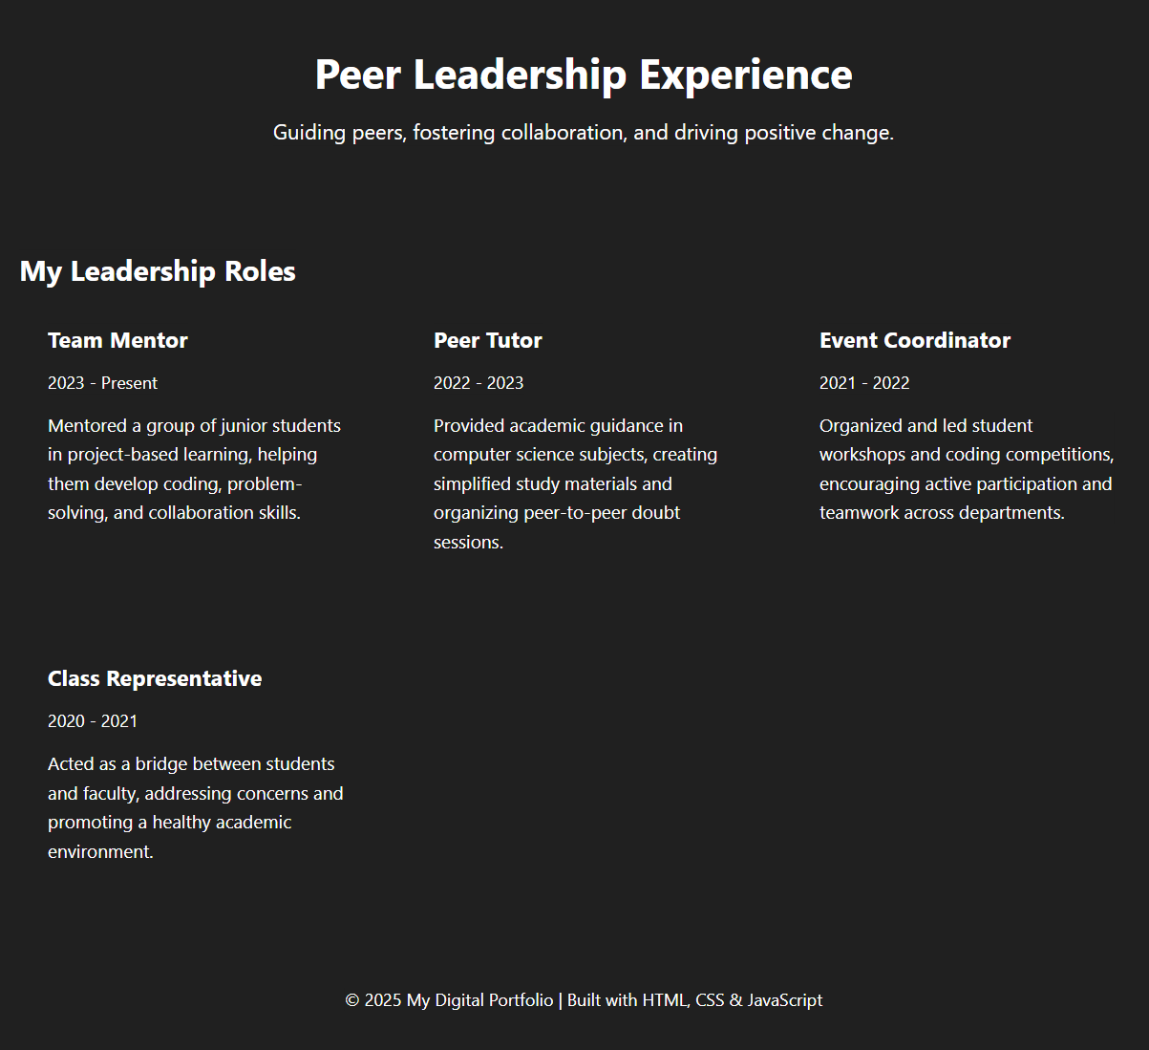

RESULTS AND SCREENSHOTS
Successfully developed a fully functional digital portfolio that presents leadership experiences in an interactive and engaging way.Improved visual representation compared to plain resumes or documents.Provides users with an accessible platform to present peer leadership experiences.(Screenshots can be captured from the running HTML portfolio and attached here.)
3/21/2024 Annual Review
10

Slide 11
CONCLUSION
The Peer Leadership Digital Portfolio effectively highlights the significance of mentorship, guidance, and teamwork in academic and personal growth. By creating a structured, interactive, and responsive platform, the project ensures that leadership experiences are showcased in a way that is both visually appealing and professionally useful. This portfolio can serve as a model for students and professionals to represent soft skills alongside technical skills.
11

Slide 12
Github Link
https://jrubika1006.github.io/Rubika/

