Slide 1

Digital Humanities
&
Literary Studies
Python Natural Language Processing for Literary Text Analysis

Slide 2
Disclaimer
Situating Computational Text Analysis
Within the Digital Humanities

Slide 3
Digital Literary Studies within Digital Humanities
Digital literary studies ≠ digital humanities
Humanities Computation ≠ Digital Literary Studies
Notes:
The approach taken in this presentation is just one small part of Digital Humanities. Although computational approaches to literary texts are kind of a paradigmatic example of DH, and often shall we say the stereotypical approach, DH is an extremely diverse field with numerous different lineages and approaches. In addition to literary studies, many fields such as history, anthropology, classics, and modern languages use DH techniques. Within literary studies, there are also numerous different approaches aside from the one rooted in humanities computing.

Slide 4
Examples
Some Examples of Digital Humanities
Outside of Literary Analysis

Slide 5
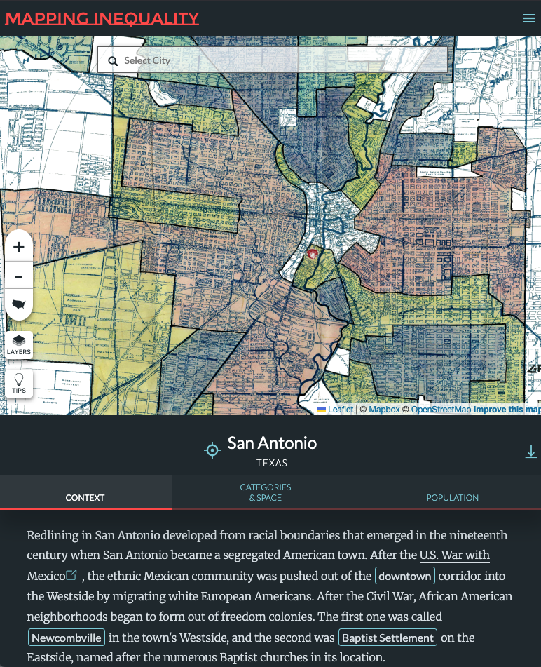
History DH:
Mapping inequality
The project “Mapping Inequality: Redlining in New Deal America is an example of using digital mapping techniques to bring complex historical data to a public audience.
Mapping Inequality

Slide 6
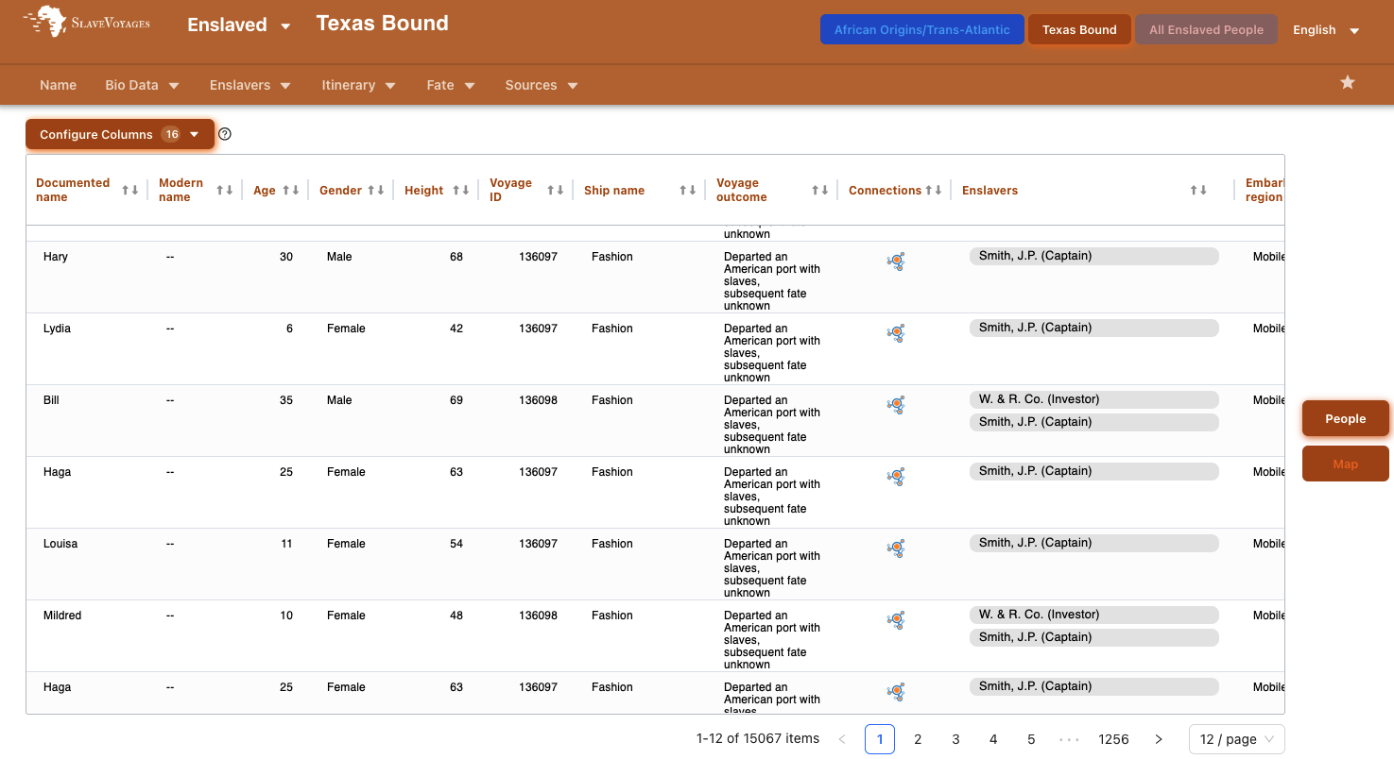
History DH:
the transatlantic slave trade database
https://www.slavevoyages.org/

Slide 7
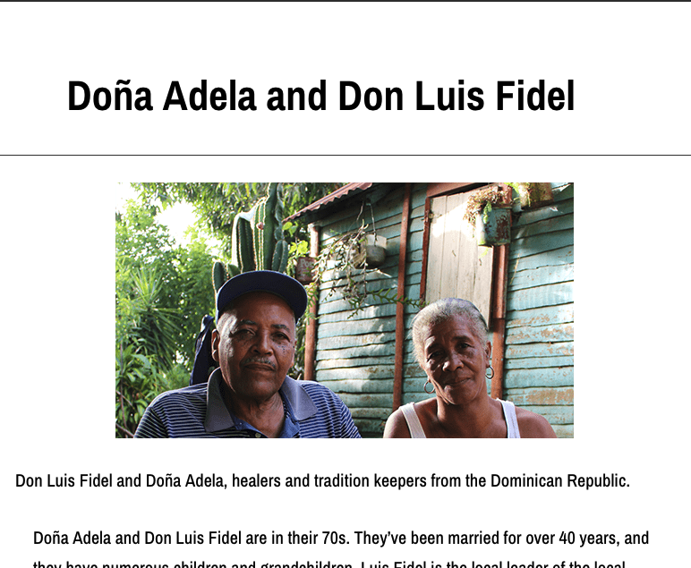
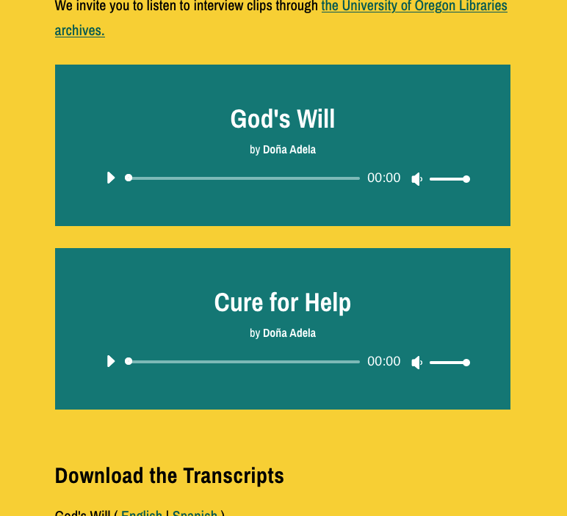
Anthropology DH:
the healers project
The Healers Project is a multimodal digital artifact foregrounding the extensive knowledge, experience, and community leadership of Afro-Indigenous, Indigenous, and Afro-descendant women healers in the Caribbean and Caribbean immigrant communities.
https://healers.uoregon.edu/

Slide 8
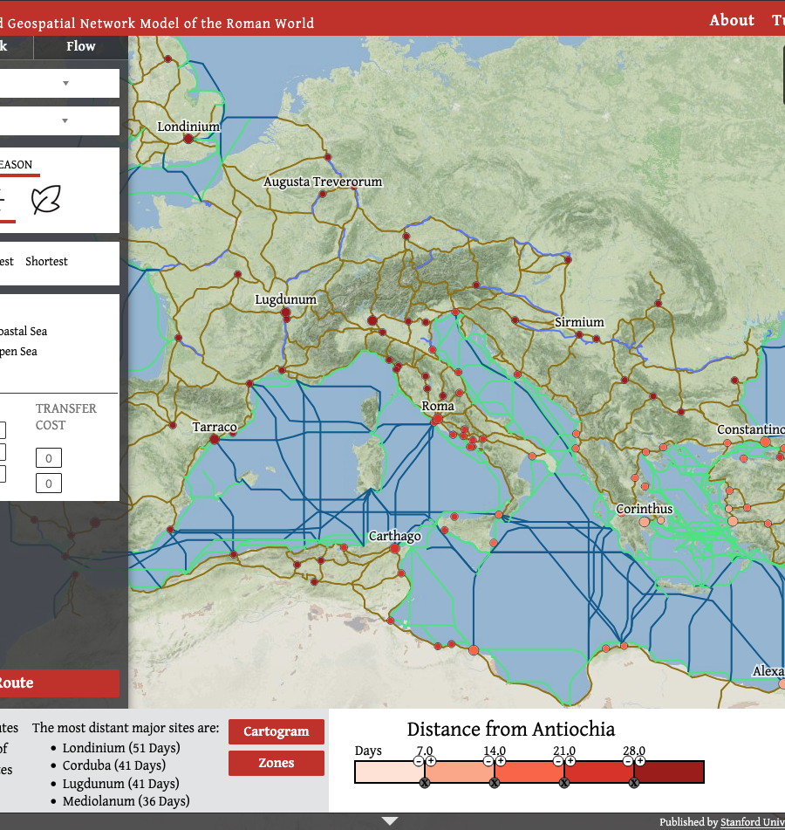
Classics DH:
The Stanford Geospatial Network Model of the Roman World is an interactive map of the Roman Empire that allows users to find out travel times between ancient Roman places.
https://orbis.stanford.edu/

Slide 9
Styles of Digital Literature Studies
Approaches to Literary Studies Within Digital Humanities

Slide 10
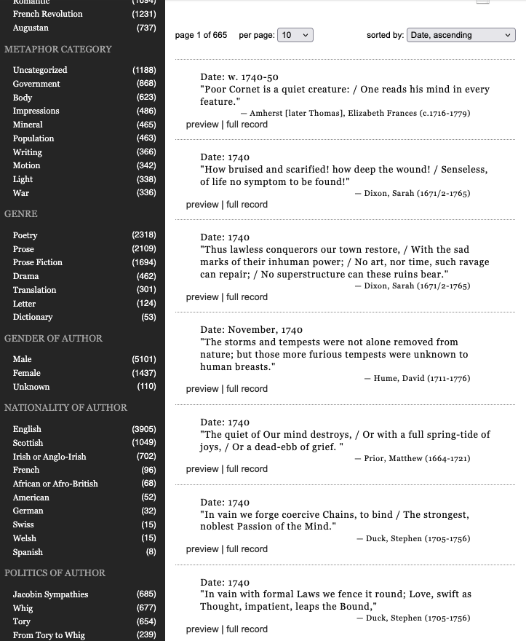
DH Literature Studies:
the mind is a metaphor
”The Mind is a Metaphor” is a database of metaphors compiled by Brad Pasanek (University of Virginia) by using keyword searches in public domain digital texts.
The Mind is a Metaphor: Wayback Machine

Slide 11
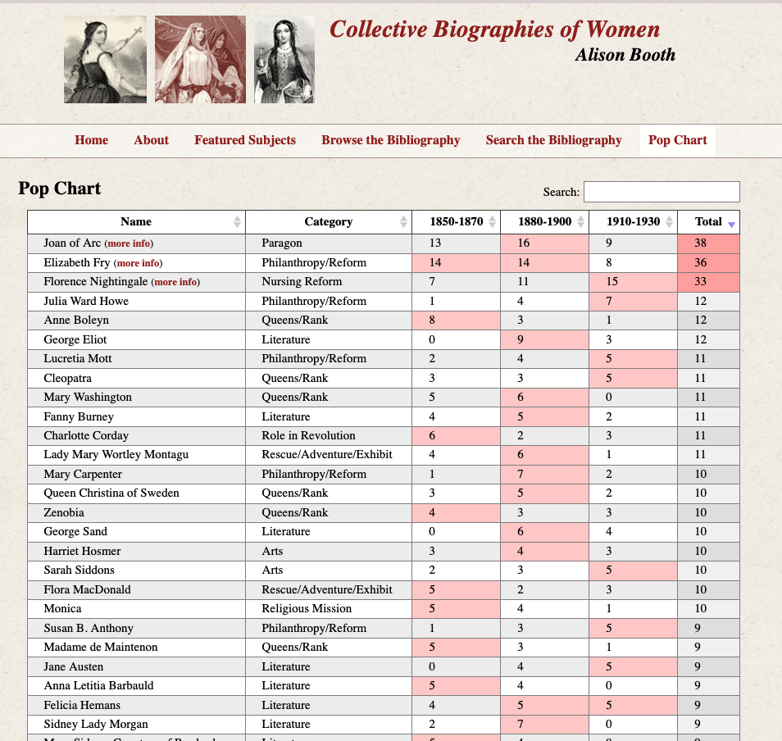
DH Literary Studies:
collective biographies of women
The Collective Biographies of Women site is an analysis of the women covered in collections of women’s biographies in the 19th century.
https://womensbios.lib.virginia.edu/index.html

Slide 12
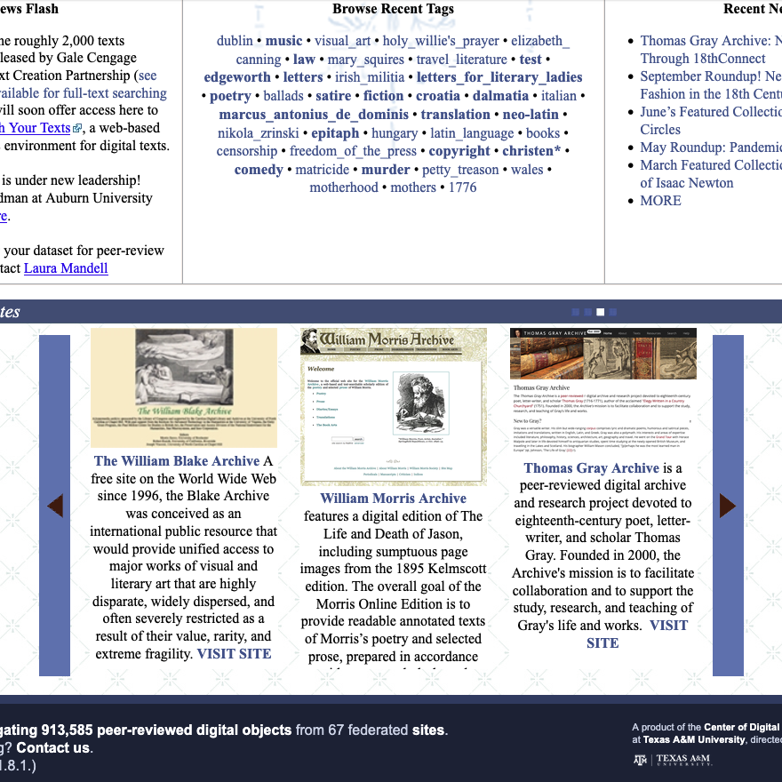
DH Literary Studies:
18th connect
18th connect is a website produced by the center for DH research at Texas A&M. It aggregates digital objects from 67 federated sites focused on the 18th century UK. Importantly, it also peer-reviews digital products, permitting them to be submitted to meet promotion and tenure requirements.
18th connect web archive

Slide 13
”Humanities Computing” DH:
A specific lineage of digital literary studies

Slide 14
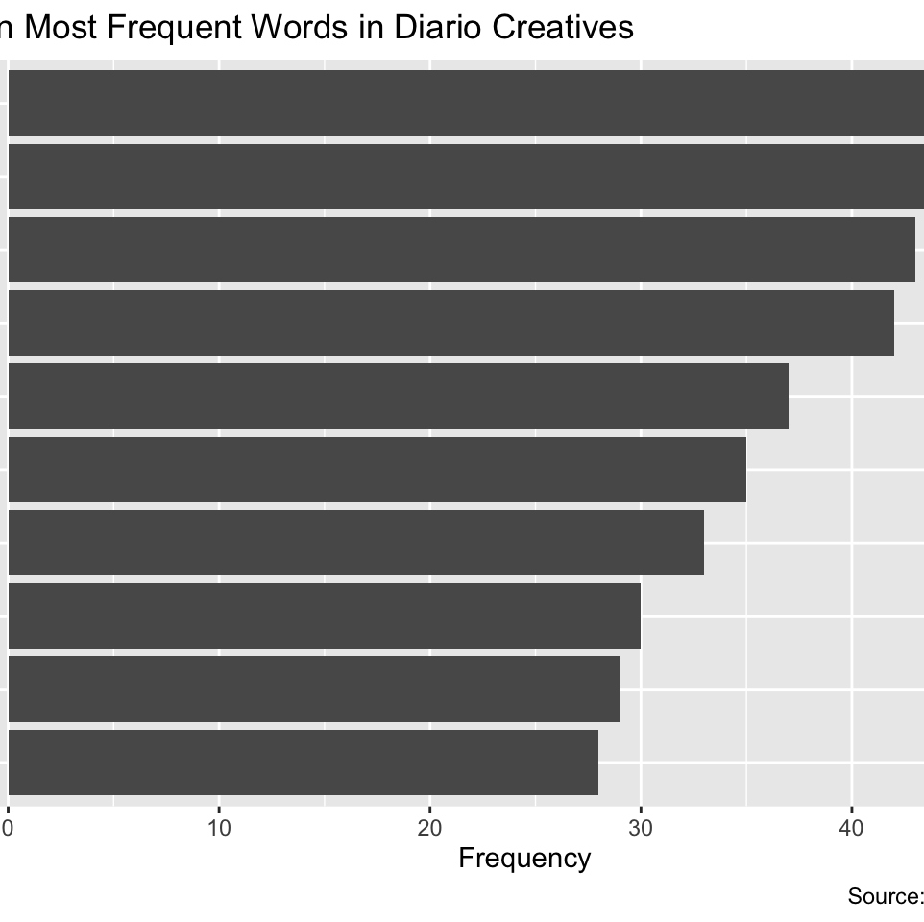
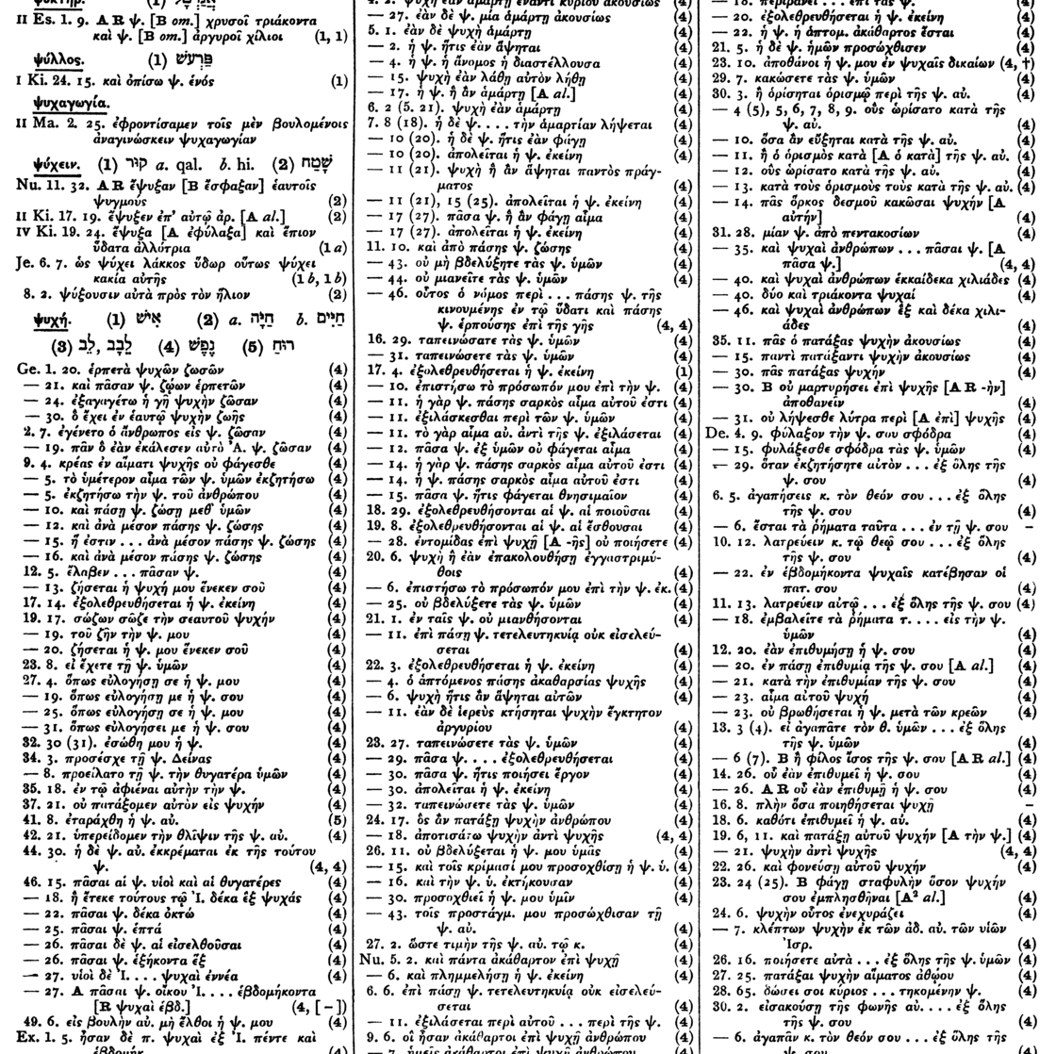
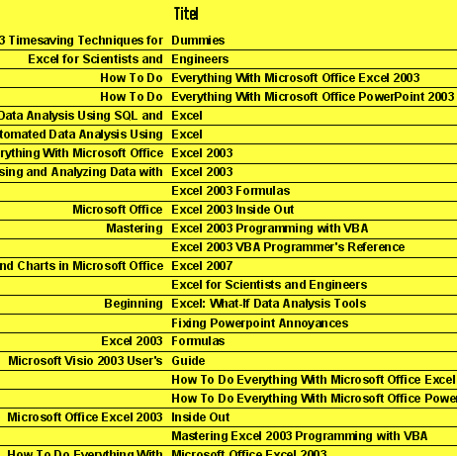
Origins of Humanities Computing
Post world war II
Effort to use computers to solve problems:
Word Frequency
Concordance
KWIC
Identify the frequency of words in a text
An alphabetical list of the principal words in a text
Keyword in Context format for concordance
Illustrations: Word Frequency, Eichmann-Kalwara and Ranganath 2022; Concordance: Hatch and Redpath 1897, https://en.wikipedia.org/wiki/Bible_concordance#/media/File:HatchRedpath2-23psi-1486.png; KWIC: public domain, https://commons.wikimedia.org/wiki/File:KWIC.png
Notes:
Humanities computing evolved after world war II as computers developed and some humanities scholars aimed to use the new technology to solve problems that were once very time-consuming, such as finding all examples of a particular word in a text and printing these out in their context or calculating the frequency of words in a text.

Slide 15
Humanities Computing History
1960-2000
1963: Center for Literary and Linguistic Computing, Cambridge
1964: IBM organizes Literary Data Processing Conference
1966: Computers and the Humanities journal founded
1970: First meeting of later Association for Literary and Linguistic Computing / Association for Computers and the Humanities (ALLC/ACH) conference
1986: Literary and Linguistic Computing journal founded
1987: Humanist email listserv founded
1994: Guidelines for Electronic Text Encoding and Interchange published (TEI)
Notes:
As computers became more accessible in academic settings, centers for humanities computing emerged along with journals and conferences. The focus was on computation as an analytic tool for solving problems. Thus, humanities computing became a highly technical and statistical field without a lot of reflection on digital worlds themselves.

Slide 16
Humanities Computing becomes Digital Humanities
2000-2010
2004: Blackwell’s Companion to Digital Humanities published
2005: Alliance of Digital Humanities Organizations (ADHO) founded
2005: Computers and the Humanities journal renamed, and LLC becomes main humanities computing journal
2007 Digital Humanities Quarterly begins publication
2009: Svensson argues “renaming of humanities computing as digital humanities carries with it a set of epistemic commitments that are not necessarily compatible with a broad and inclusive notion of the digital humanities.”
Notes:
By 2010 the wide spread of the web, social media, and personal computers, and increasingly smart phones, were transforming digital humanities. No longer was it only the use of computers as analytic tools, but also the use of web technology to display and visualize information; the use of digital archives, digital libraries, and digital collections; the use of digital maps; and the practice of critical reflection on digital cultures and the praxis of digital creativity.

Slide 17
Example:
The Stanford Literary Lab and David McClure
Notes:
That said, here I do want to focus on DH text analysis, and specifically on literary text analysis. One of the main examples of this approach to literary analysis has been the Stanford Literary Lab, which evolved out of the lineage of humanities computing in DH.

Slide 18
Stanford Literary Lab
Founded 2010
2011: Pamphlets of the Stanford Literary Lab begin publication
2013: Matthew Jockers publishes Macroanalysis: Digital Methods and Literary History
2014: Matthew Jockers publishes Text Analysis with R for Students of Literature
2015: David McClure shares code for textplot
2019: Data-Sitters Club series begins publication
Stanford Literary Lab

Slide 19
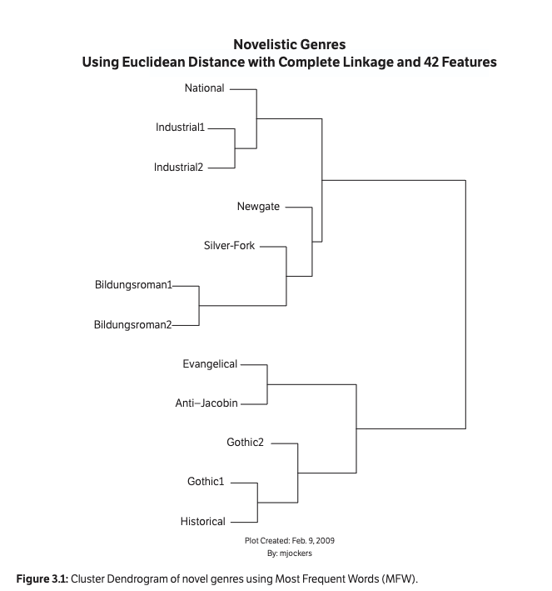
DH Literary History
history of literary genres
Distant reading and computational tools used to classify texts into genres.
Stanford Literary Lab Pamphlet No. 1

Slide 20
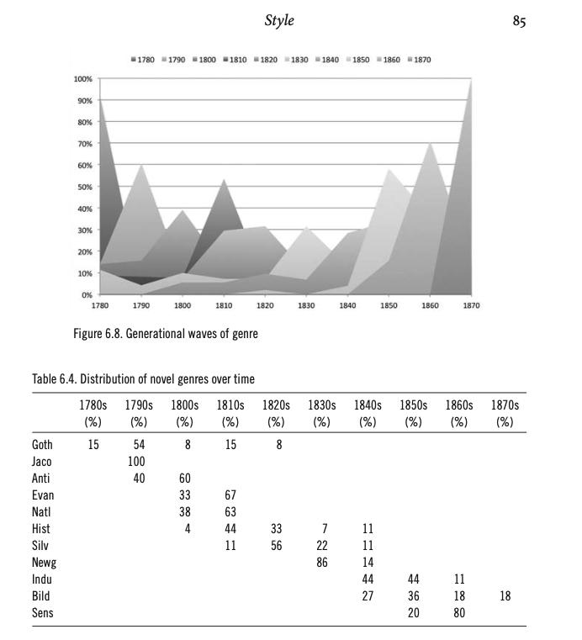
Macroanalysis
Matthew Jockers followed this up in his 2013 book Macroanalysis, in which he applied the concept of “distant reading” to analyze a large corpus of text. This graph shows his work on finding a quantitative basis for understanding the evolution of genres in British literature.

Slide 21
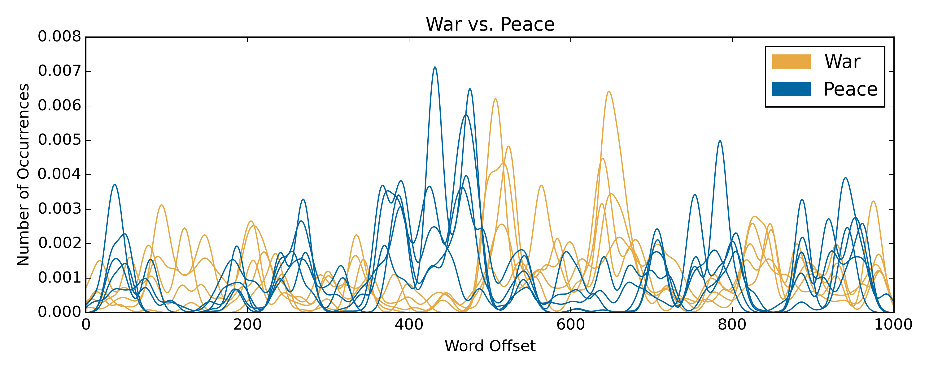
Exploratory Digital Literary Analysis
David McClure’s textplot
David McClure exemplified a less formal, more playful and exploratory approach to computational literary analysis with his analysis of War and Peace.

Slide 22
Example:
Tanya Clement

Slide 23
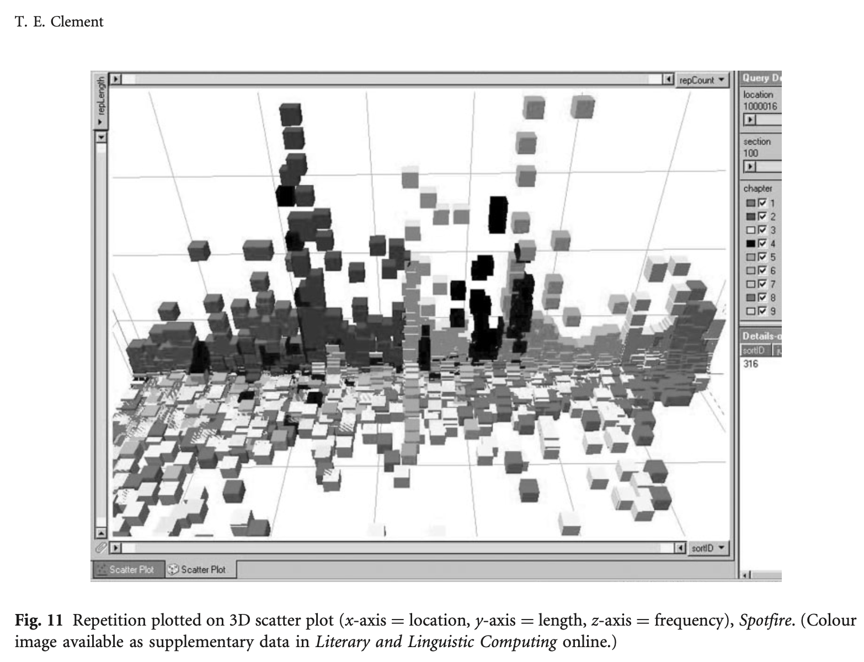
Visualizing Repetition:
clement on gertrude stein
Tanya Clement used a tool called MONK to identify sequences of words that repeat in Stein’s The Making of Americans and then to identify patterns and gaps in those repetitions, arguing this is a purposeful element of structure in the novel that was not previously understood.

Slide 24
Meanwhile ...
Natural Language Processing evolves

Slide 25
The transformation of NLP
Neural networks + machine learning
From the 2010s onward, code libraries for Natural Language Processing became increasingly effective and accessible, facilitating tasks including:
Speech recognition
Sentiment analysis
Machine translation
Topic modeling
Toxicity classification

Slide 26
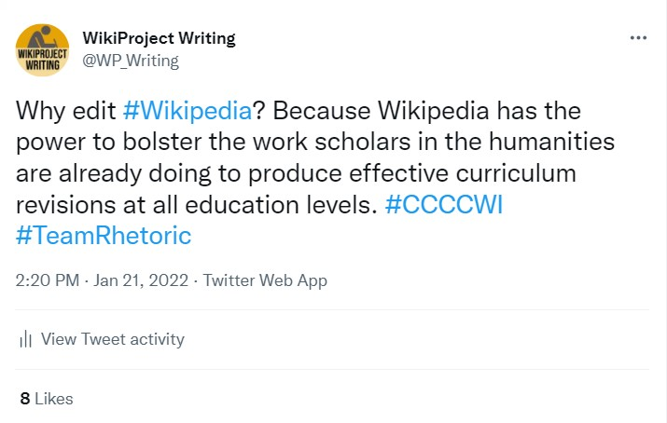
Problem!!!
NLP was designed for social media and web
NLP evolved primarily to analyze large quantities of data-mined web and social media text. Using it for literary analysis often requires
A critical and reflexive attitude
Adaptability
Creativity
Ability to evaluate results

Slide 27
Allison, Sarah, Ryan Heuser, Matthew Jockers, Franco Moretti, and Michael Whitmore. 2011. “Qualitative Formalism: an Experiment.” Stanford Literary Lab Pamphlets 1.
Clement, Tanya. 2008. “’A think not beginning and not ending’: using digital tools to distant-read Gertrude Stein’s The Making of Americans.” Literary and Linguistic Computing 23, no. 3.
Eichmann-Kalwara, Nickoal, and Aditya Ranganath. 2022. A Gentle Introduction to Text Analysis in R. https://aranganath24.github.io/gentle_text_analysis/
Gaede, Franny, Ana-Maurine Lara, Alaí Reyes-Santos, and Kate Thornhill. 2022. “Afro-Indigenous Women Healers in the Caribbean and Its Diasporas: A Decolonial Digital Humanities Project.” Digital Humanities Quarterly 16, no. 3. https://doi.org/10.63744/39s8a7adwhyb.

Slide 28
Hockey, Susan. 2004. “The History of Humanities Computing.” In A Companion to Digital Humanities, edited by Susan Schreibman, Ray Siemens, and John Unsworth (Oxford: Blackwell).
Jockers, Matthew. 2013. Macroanalysis: Digital Methods and Literary History (Urbana: University of Illinois Press).
Jockers, Matthew, and Rosamond Thalken. 2020. Text Analysis with R For Students of Literature, Second Edition (Cham, Switzerland: Springer).
Risam, Roopika. 2019. New Digital Worlds: Postcolonial Digital Humanities in Theory, Praxis, and Pedagogy (Evanston, Illinois: Northwestern University Press).
Svensson, Patrik. 2009. “Humanities Computing as Digital Humanities.” Digital Humanities Quarterly 3, no. 3. https://doi.org/10.63744/ejvcpnbazkgk.

Slide 29
Booth, Alison. “Collective Biographies of Women.” https://womensbios.lib.virginia.edu/about.html
The Healers Project. 2024. The Healers Project: Decolonizing Knowledge Within Afro-Indigenous Traditions. https://healers.uoregon.edu
Nelson, Robert K., LaDale Winling, et al. "Mapping Inequality: Redlining in New Deal America." Edited by Robert K. Nelson. American Panorama: An Atlas of United States History, 2023. https://dsl.richmond.edu/panorama/redlining.
Pasanek, Brad. “The Mind is a Metaphor Database.” https://metaphors.lib.virginia.edu/metaphors
Scheidel, Walter, and Elijah Meeks. “ORBIS: The Stanford Geospatial Network Model of the Roman World.” https://orbis.stanford.edu/.

Slide 30
Booth, Alison. “Collective Biographies of Women.” https://womensbios.lib.virginia.edu/about.html
The Healers Project. 2024. The Healers Project: Decolonizing Knowledge Within Afro-Indigenous Traditions. https://healers.uoregon.edu
Nelson, Robert K., LaDale Winling, et al. "Mapping Inequality: Redlining in New Deal America." Edited by Robert K. Nelson. American Panorama: An Atlas of United States History, 2023. https://dsl.richmond.edu/panorama/redlining.
Pasanek, Brad. “The Mind is a Metaphor Database.” https://metaphors.lib.virginia.edu/metaphors
Scheidel, Walter, and Elijah Meeks. “ORBIS: The Stanford Geospatial Network Model of the Roman World.” https://orbis.stanford.edu/.
The Trans-Atlantic Slave Trade Database. 2019. SlaveVoyages. https://www.slavevoyages.org

