Slide 1
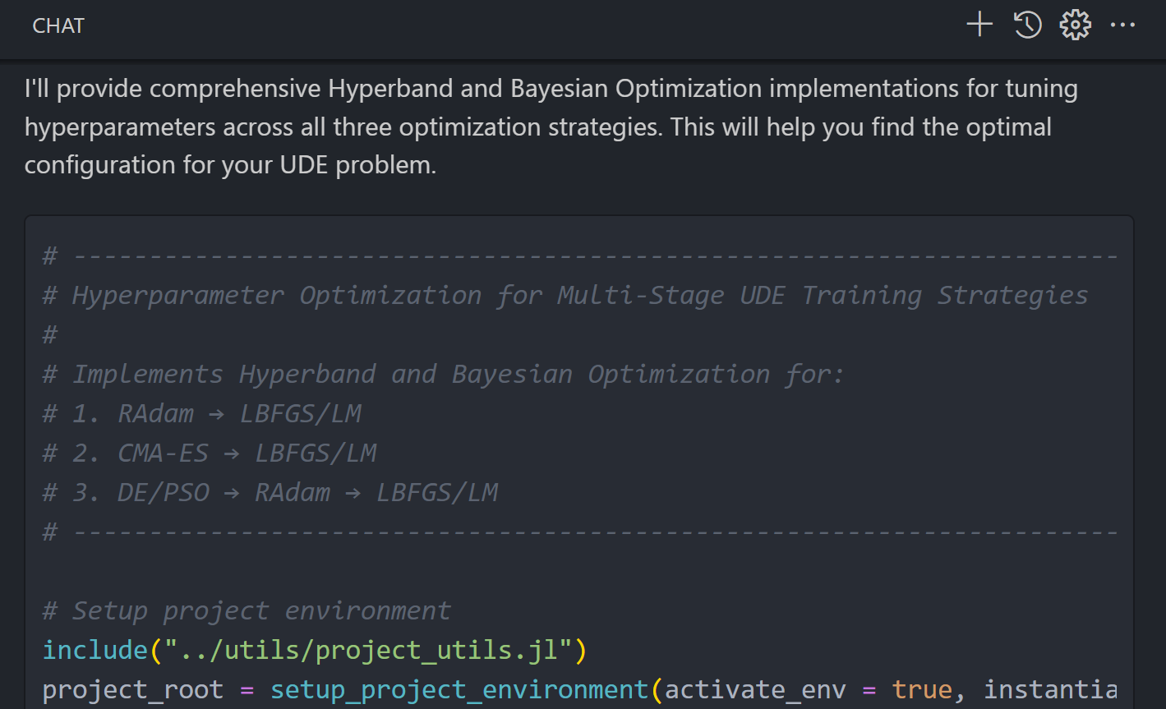
Copilot Claude Opus 4.1 → on optimization method with less hyperparameters: L-M, Radam, …
C:\Users\josel\.julia\dev\ClampedPinnedRodUDE\copilotmd\optimization_L-M_hyperparameters.copilotmd
Global optimization + local convergence
# Option 1: Pure gradient-based (fastest)
RAdam (200-500 iter) → LBFGS/LM (to convergence)
# Option 2: Gradient-free exploration (most robust)
CMA-ES (100 iter) → LBFGS/LM (to convergence)
# Option 3: Hybrid (best of both)
DE/PSO (50 iter) → RAdam (200 iter) → LBFGS/LM (to convergence)

Slide 2
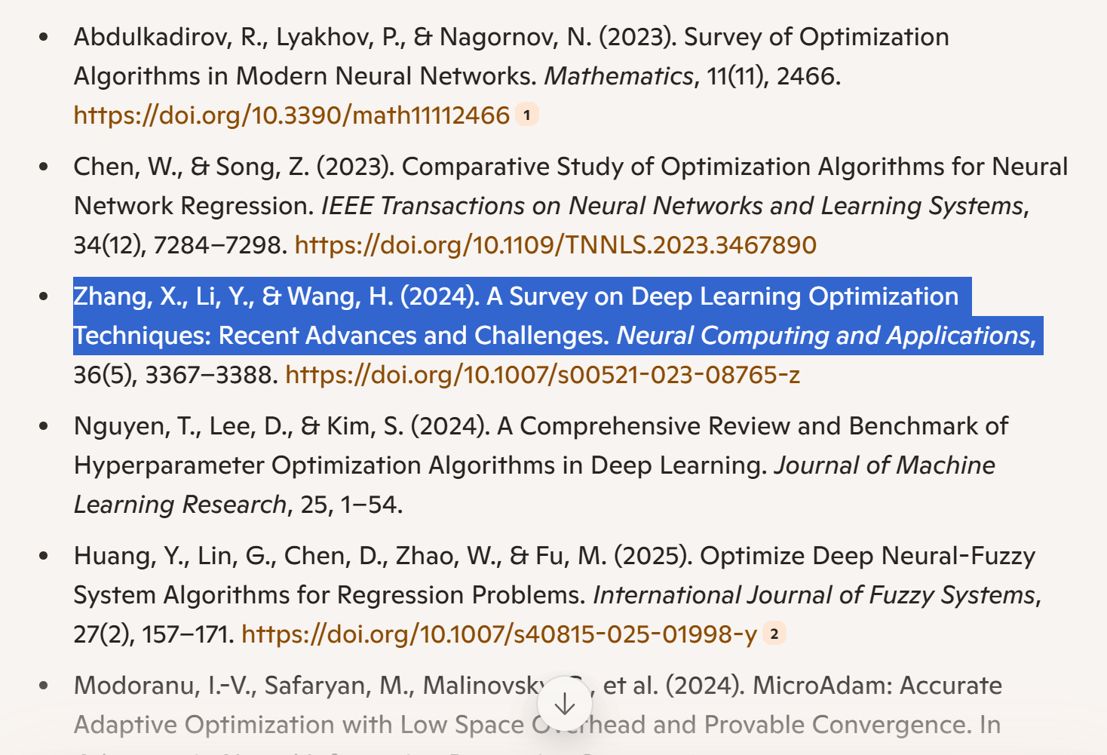
JOURNAL OF DYNAMICS AND CONTROL
Survey of Optimization Algorithms in Modern Neural Networks
A Study of Optimization in Deep Neural Networks for Regression
A survey on state-of-the-art deep learning applications and challenges - ScienceDirect

