Slide 1
Arduino Touchscreen
Learning the GUI library

Slide 2
Objectives
Use cases
Learn How to use a Touschscreen in your Arduino Project.
Develop a Graphical User Interface (GUI)
Understand the Limitations of Touchscreens

Slide 3
Requirements
Arduino Uno compatible board
Touchscreen v2.0 from Seeedstudio
Library: TOUCHSCREEN _ GUI

Slide 4
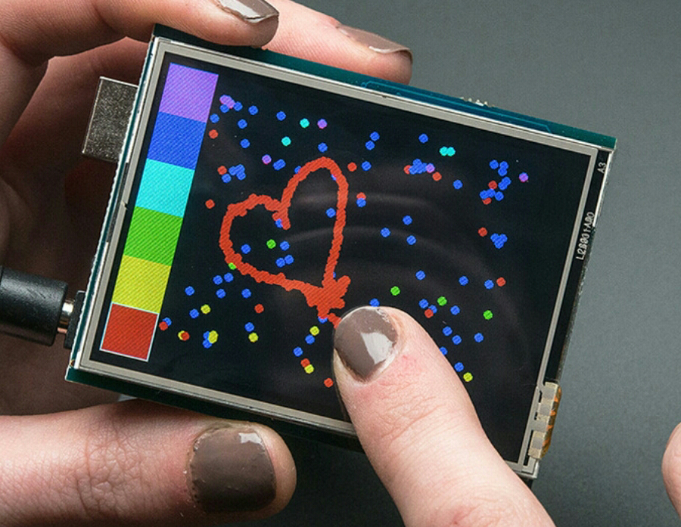
Color Display + User Inputs
240 x 320 pixels
65,535 colors
Backlight
Resistive touchscreen
SPI communication

Slide 5
GUI Library
Canvas
Widgets
Display
Gauge
Dial
Button

Slide 6
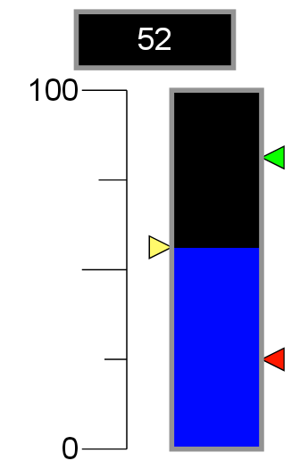
Gauge
A gauge widget represents a numeric value in relation to a scale.
Example:
Tank level

Slide 7
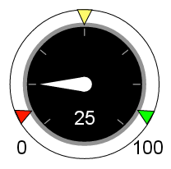
Dial
A dial widget represents a numeric value in relation to a scale.
Example:
Speed

Slide 8
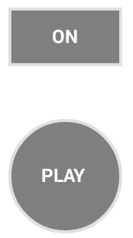
Button
A button widget is used to receive a signal from the user.
A button can also be used to display short text and numbers.
A button can be rectangular or round.
Example:
Start/Stop, On/Off, Play, etc..

Slide 9
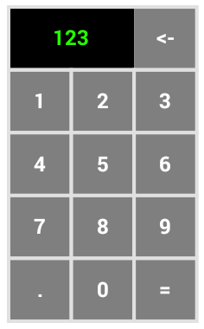
Numeric keypad
A numkey widget is used to enter a precise value.
The numkey widget blocks any other touch events. This is useful to implement a pop-up value entry.

Slide 10
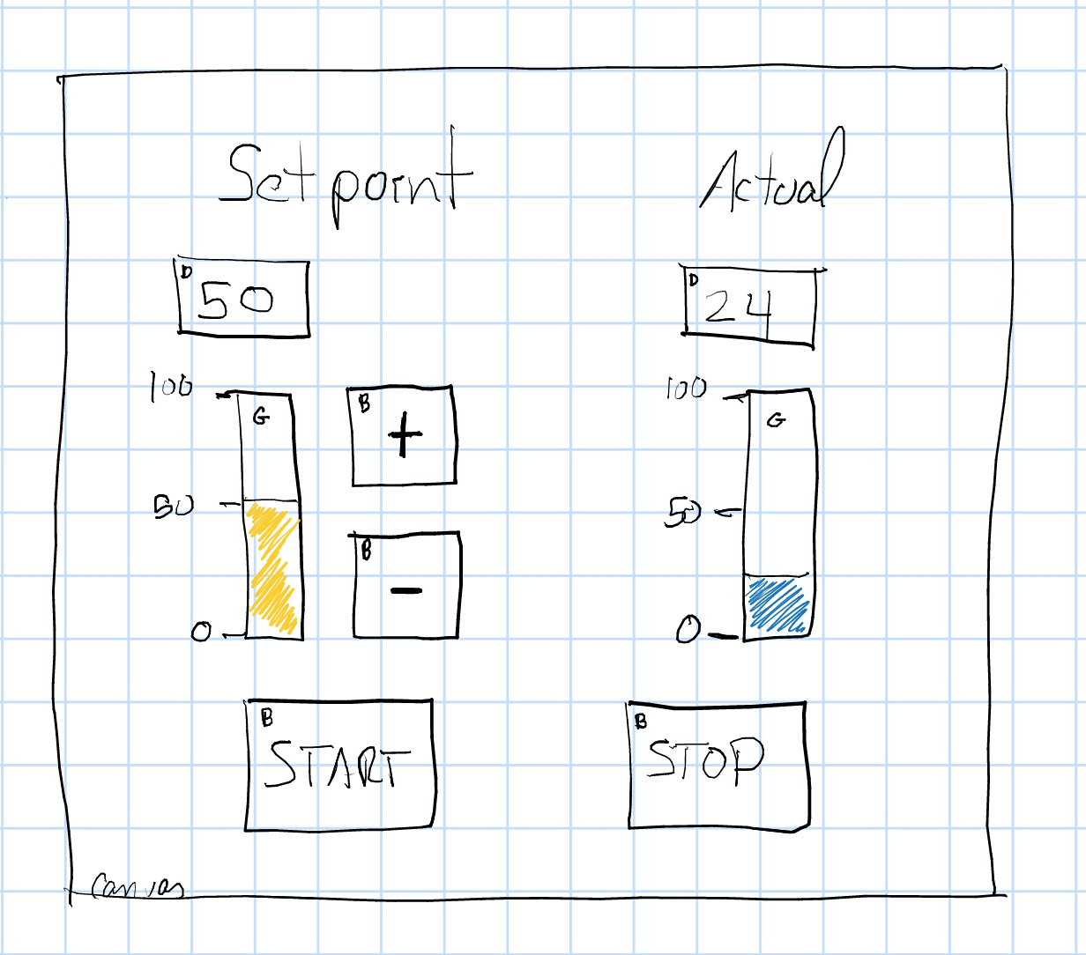
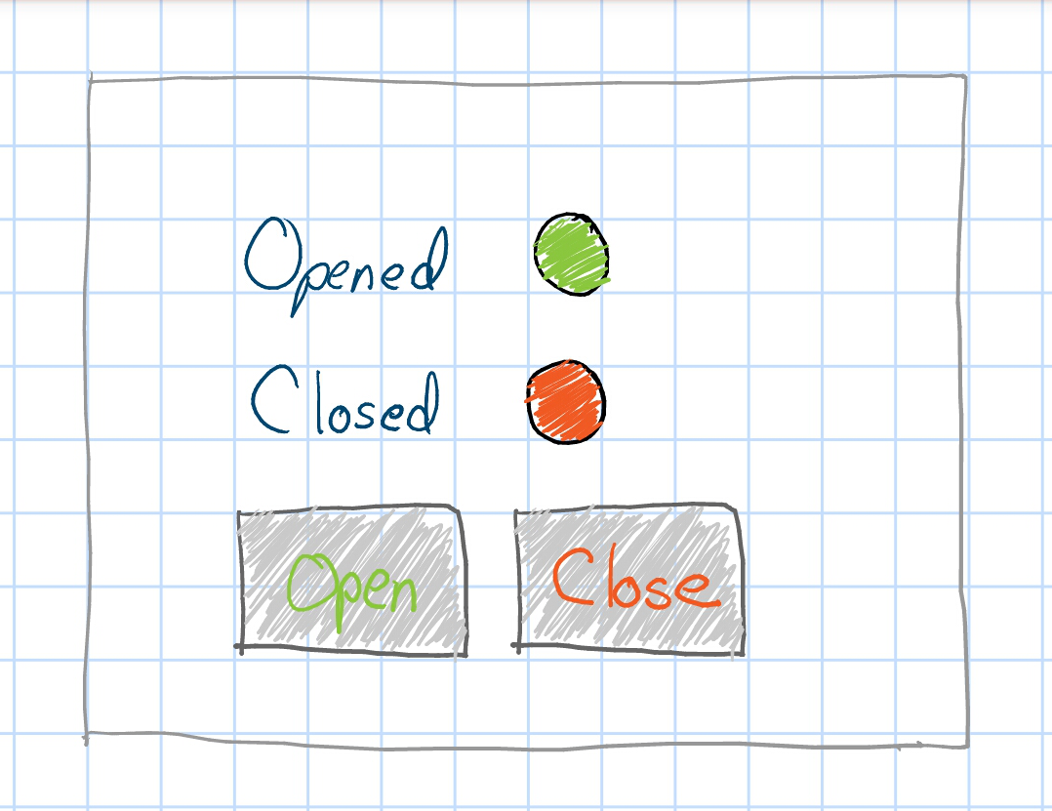
Uses

Slide 11
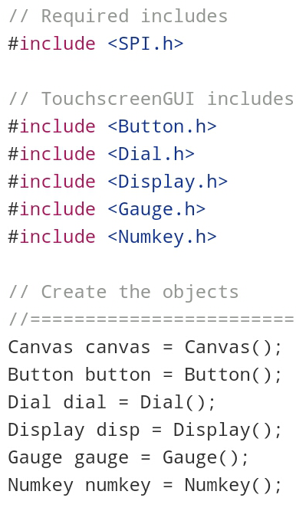
Process
Install library
Open your sketch
Add required includes
Add library includes
Create the objects to use

Slide 12
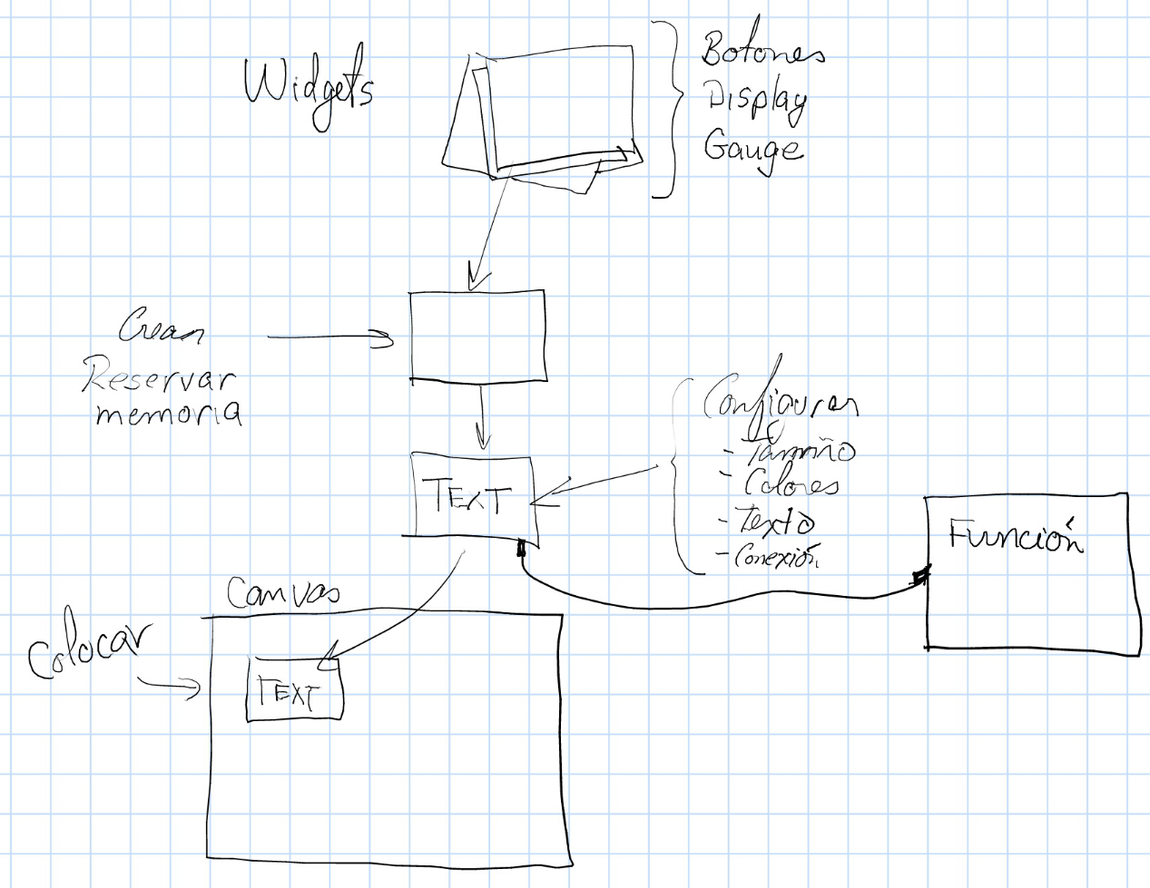
In a nutshell...

Slide 13
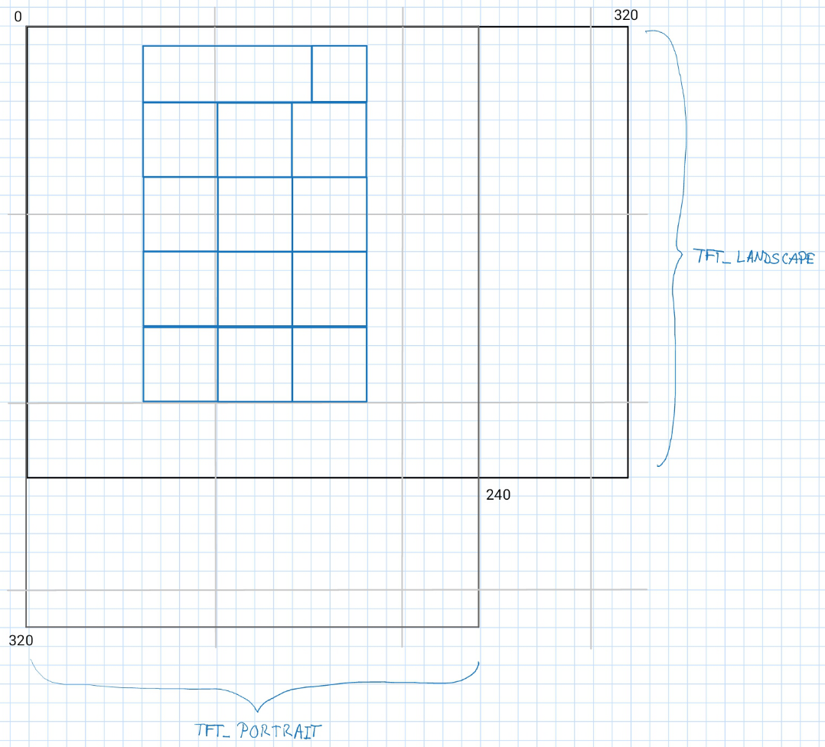
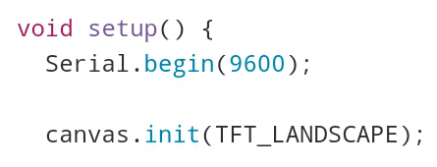
Canvas
A canvas is required to use the widgets
Select portrait or landscape mode

Slide 14
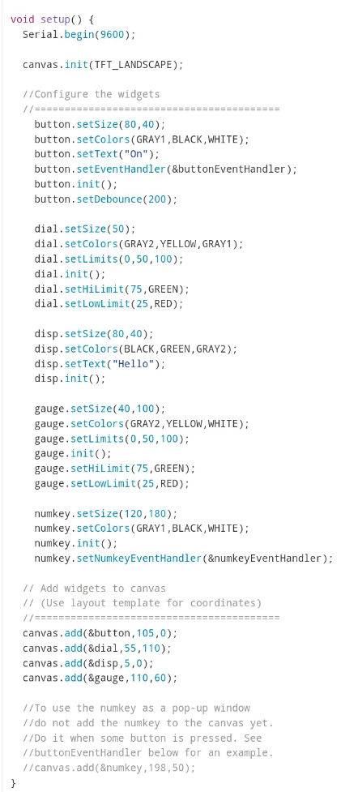
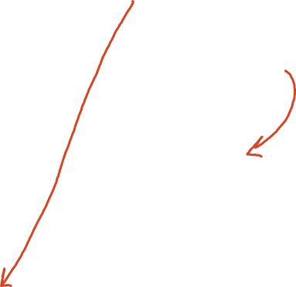
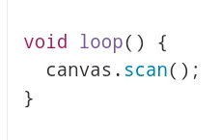
Canvas cont…
Add objects to canvas
Scan for Touch events in no-blocking mode

Slide 15
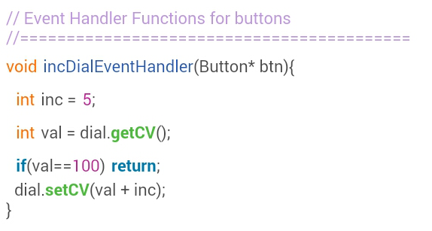
Button
Buttons are input widgets
To do something when pressed, must set an event handler function

Slide 16
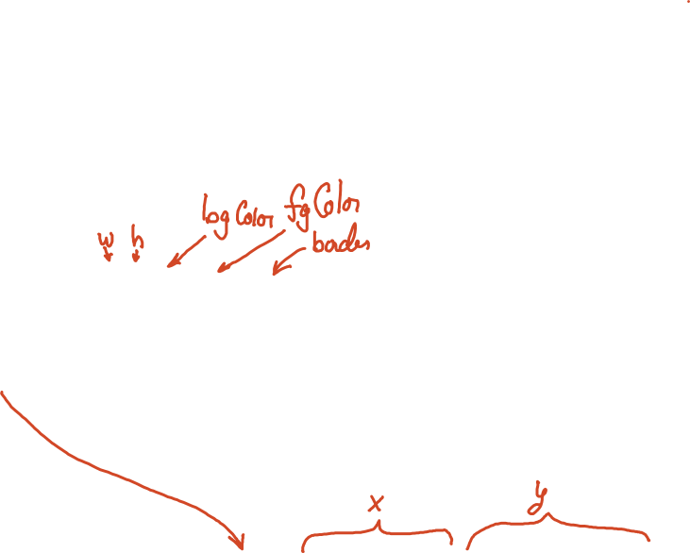
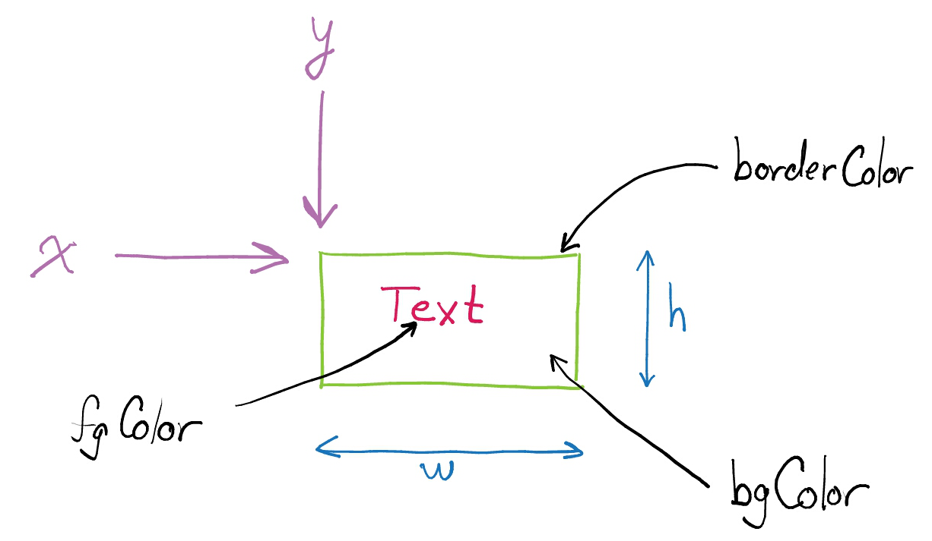
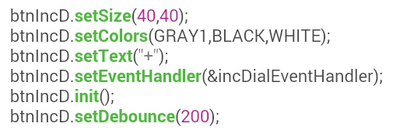
Button configuration

Slide 17
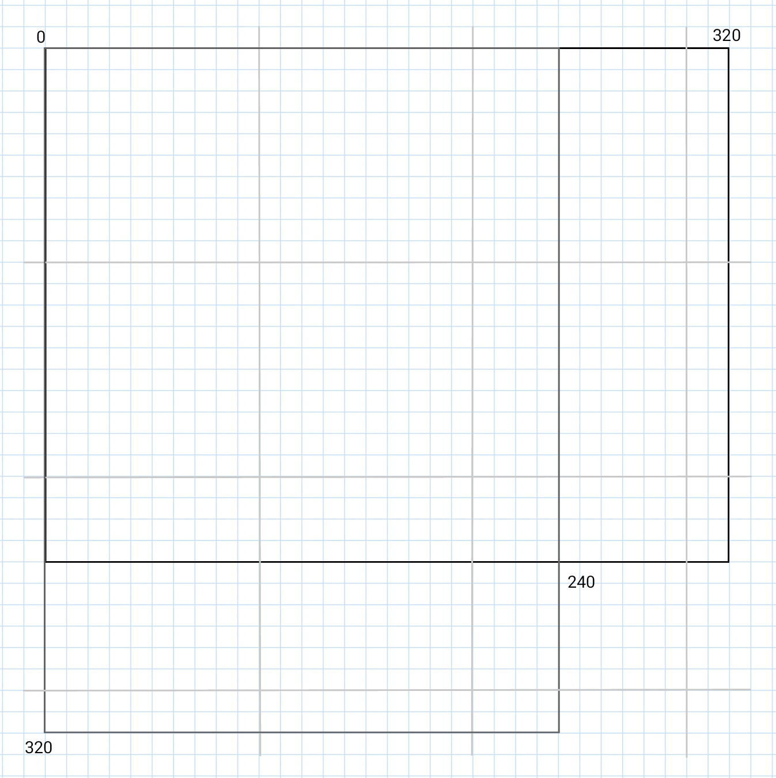
Layout Template

