Slide 1
Disappointment
Team: Josh Rumbut and Eric Muelhberg
Our goal: see if danceability of music is linked to stock valuations.

Slide 2


Probably should have paid attention to this...

Slide 3

Results

Slide 4
fin.

Slide 5
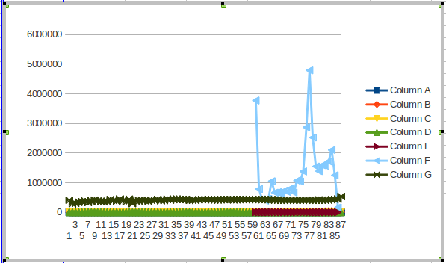
Oh wait we figured it out

