Slide 1
Geographic Analysis of Craft Breweries in the United States
Jon Paugh
Jason Rupp
DDS 6306

Slide 2
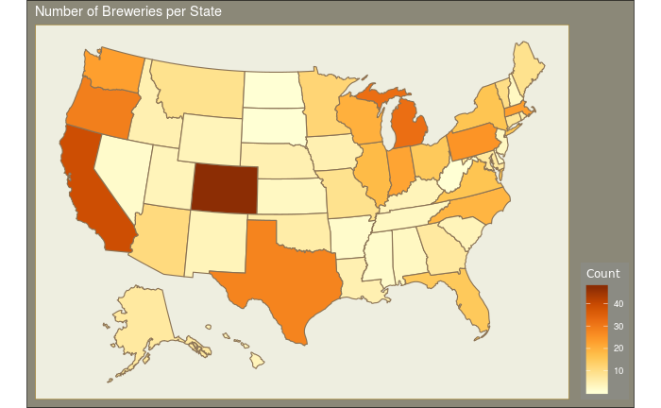
How Many Breweries per State?
Top 3 States = CO, CA, MI
Bottom 3 States = DC, ND, SD

Slide 3
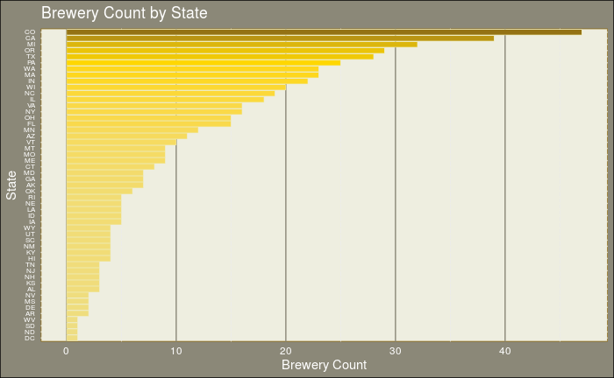
Brewery Count by State
Top 3 States = CO, CA, MI
Bottom 3 States = DC, ND, SD

Slide 4
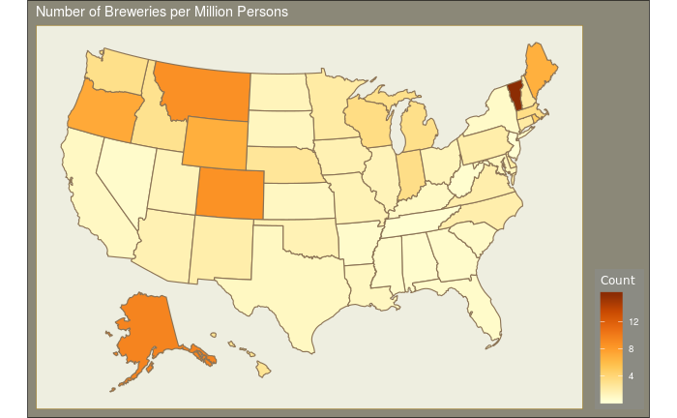
Breweries per Million Population by State
Top 3 State = VT, AK, MT
Bottom 3 States = WV, TN, NJ

Slide 5
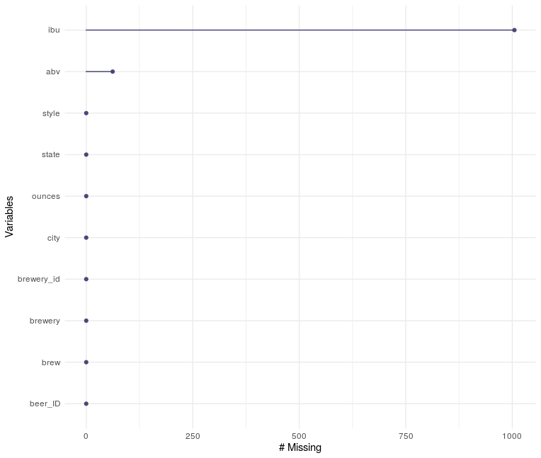
Notes:
Fix this graph

Slide 6
Missing Values
Beer Judges Certification Program Style Guidelines: https://www.bjcp.org/stylecenter.php
Parsed XML document
Found ranges of for missing values (ibu/abv)
Computed and imputed mean by class

Slide 7


Slide 8
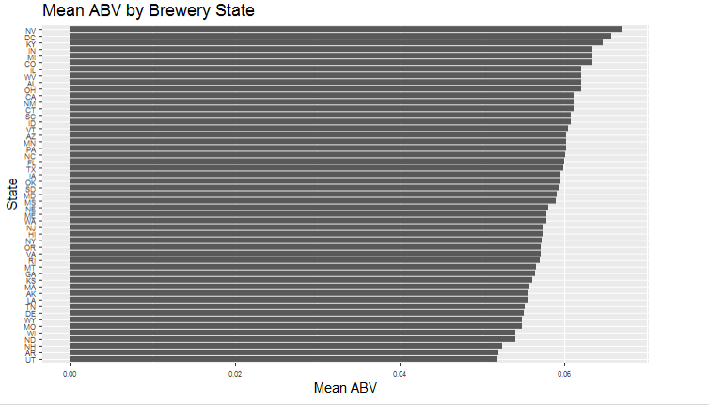
Mean ABV by Brewery State

Slide 9
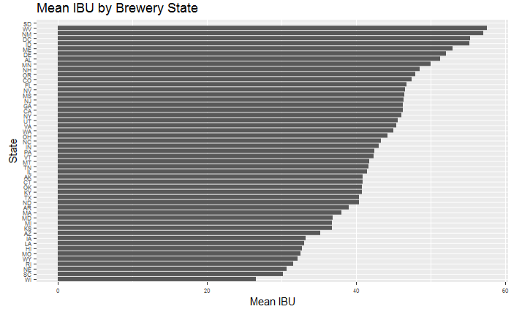
Mean IBU by Brewery State

Slide 10
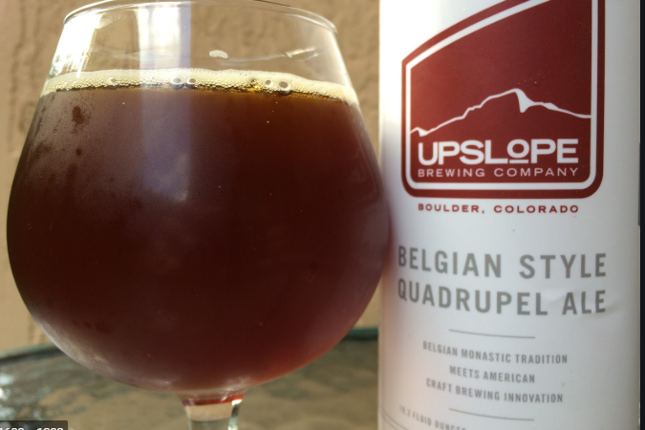
State with Maximum Alcoholic Beer
0.128 ABV!
Upslope Brewing Company
Boulder,CO
Lee Hill Series Vol. 5 - Belgian Style Quadrupel Ale

Slide 11


State with Most Bitter Beer
IBU = 138

Slide 12
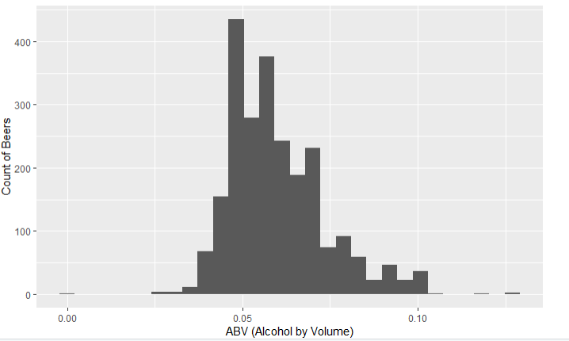
Summary Statistics of ABV
Mean ABV = 0.60. Standard Dev = 0.014.
ABV appears to be a normal distribution but right skewed. Most Beer ABV is below 0.10, with only a few outliers.

Slide 13
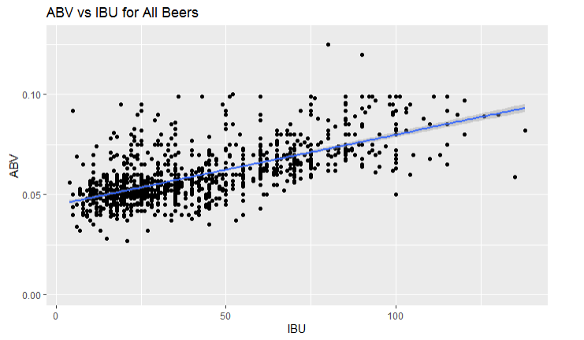
ABV v. IBU
As IBU increases, so does ABV.
Notes:
IBU is a measure of bitterness of the beer (based on the amount of hops added, but not necessarily taste). ABV, or alcohol by volume, measures the strength of the alcohol in the beer. Hops do not directly contribute to higher ABV. So this appears to be more a style choice by the brewer.

Slide 14
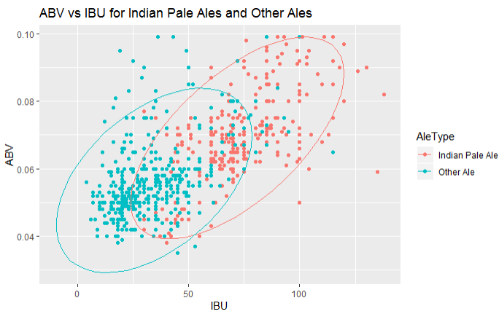
ABV and IBU for IPA vs. All Other Ales

Slide 15
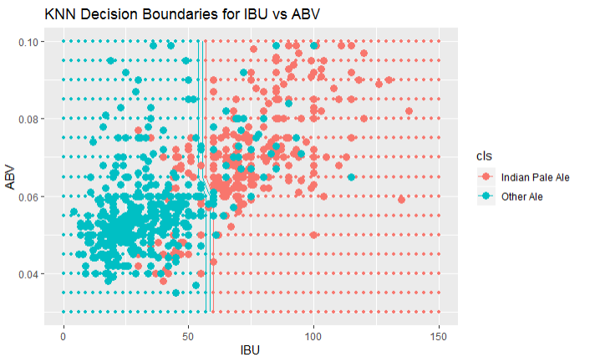
Use K Nearest Neighbor Algorithm to Distinguish IPA vs All Other Ales
Basically KNN is checking where IBU > 58 as a decision boundary, for IPA vs Other Ales
Accuracy is 84%

Slide 16
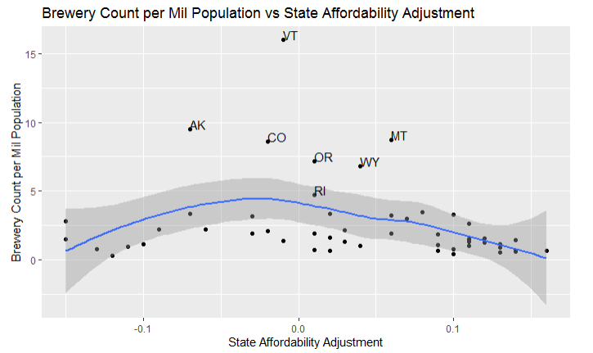
Highest Number of Breweries per Population in States with Average State Affordability
https://taxfoundation.org/new-state-level-price-data-shows-smaller-state-real-income-differences/

Slide 17
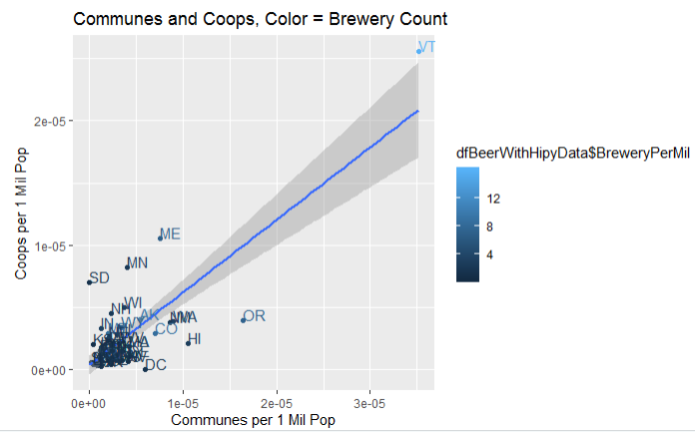
Communes and Coops related to Craft Breweries !?!

Slide 18
Use Cost of Living, Coops, and Communes to Find Next Market for Craft Brews
Abbr | Name | Cost Adjustment | Communes per 1 Million Pop | Coops per 1 Million Pop | Breweries per 1 Million Pop
HI | Hawaii | -0.15 | 1.05E-05 | 2.10E-06 | 2.79407
MN | Minnesota | 0.03 | 4.01E-06 | 8.20E-06 | 2.18595
NM | New Mexico | 0.06 | 8.63E-06 | 3.84E-06 | 1.91837
WA | Washington | -0.03 | 8.93E-06 | 3.90E-06 | 3.20765

