Slide 1
R programming
José R. Valverde
jrvalverde@cnb.csic.es
CNB/CSIC
Classification and
Machine Learning
2024
In God we trust. All others must bring data.
Robert Hayden, Plymouth State College

Slide 2
Introduction to Deep Learning

Slide 3
library(caret)
If I have seen farther than others, it is because I was standing on the shoulder of giants.
-- Isaac Newton
If I have not seen as far as others, it is because giants were standing on my shoulders.
-- Hal Abelson
In computer science, we stand on each other's feet.
-- Brian K. Reid

Slide 4
Getting started
Collect the data that you will use to train the computer
Classify the data yourself first
This should give you a set of well known, well classified data points to use in training
data(iris)
head(iris)
str(iris) # show structure of iris

Slide 5
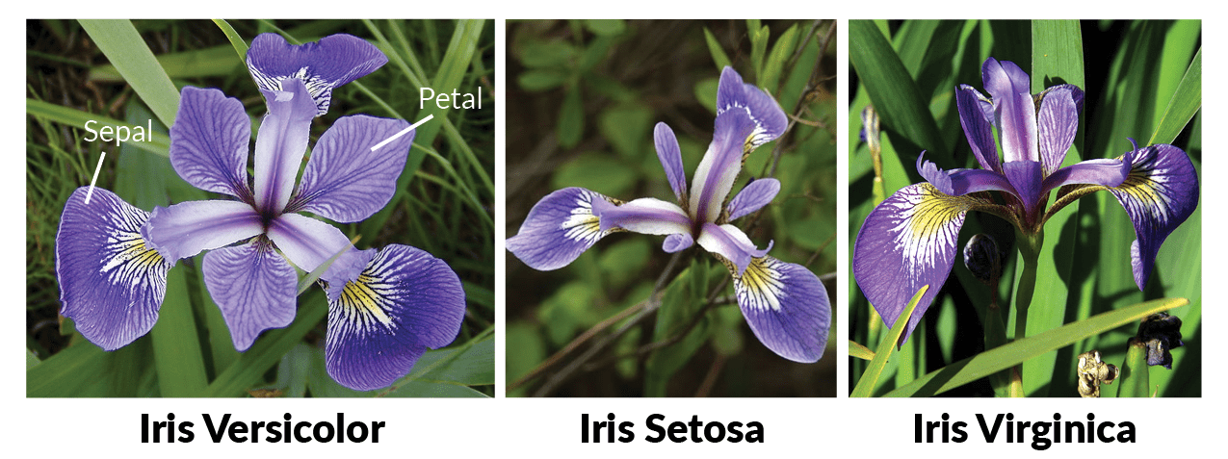

Slide 6
Inspect the data
See if you can spot correlations between measures and groups
pairs(iris)
Don’t believe me, just watch!
# Overall correlation
print( cor(iris[ ,1:4]) )
# get 'iris' levels
species_names <- levels(iris$Species)
measures <- 1:4 # columns with measues
specie <- 5 # column with species

Slide 7
Search for correlations
# explore species correlations (e.g.)
print(species_names[1])
print( cor(iris[iris$Species==species_names[1],
measures]) )

Slide 8
Search for correlations
# explore species correlations (e.g.)
print(species_names)
print( cor(iris[iris$Species=="setosa",
measures]) )
Compute the correlations for each species using function 'cor'

Slide 9
Search for correlations
# explore species correlations (e.g.)
print(species_names)
print( cor(iris[iris$Species=="setosa",
measures]) )
Compute the correlations for each species
for (i in species_names)
print(cor(
iris[ iris$Species == i, measures] ))

Slide 10
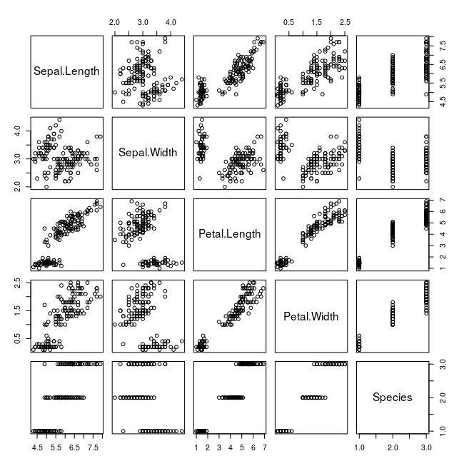
Draw a scatterplot matrix
plot(iris)

Slide 11
Inspect the data
# visualize the 'iris' data
print(featurePlot(x=iris[ , measures], # 1:4
y=iris[ , specie], # 5
plot="ellipse"))
# try using “box” or “density” instead of “ellipse”
# in feaurePlot
With good correlations we could resort to linear models
Here, when we combine all three species, the correlation is somewhat better than when we look at each species sparately.
We would get better results if we analyze all of them simultaneously

Slide 12
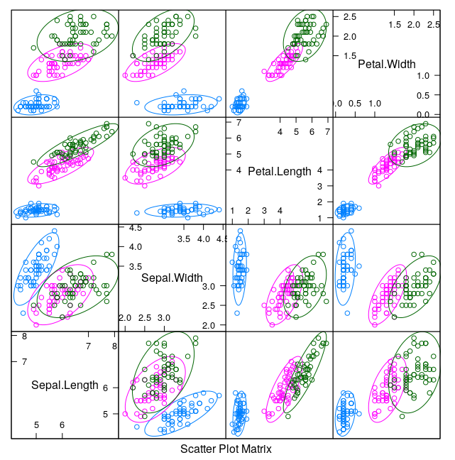

Slide 13
Prepare your data
Reverse psychology:
If you have huge and tiny observables…
Which ones would draw your attention?
We deal with it normalizing the data
Consists in adjusting the values within each group to fall between the range [0,1]

Slide 14
Data normalization
Although we do not really need it, we'll still see how to do it:
  You can make a "normalize()" function and then apply it to all values in a column:
we will get a single columns (and use it as a one-dimensional vector), say 'x'
first we need to "shift to zero" all values:
find the minimum with function min(): e.g. min(x)
subtract the minimum from all the values : e.g. x - min(x)
(you can make a function to do this)
then we need to find the range of values (maximum - minimum)
we can use "max(x) - min(x)"
or we can find the maximum of the "zero-shifted" values
(you may define also a function range() to find the range of a vector)
finally, we divide the zero-shifted values by the range.
normalized value = ( shifted to zero values) /
range of all original values

Slide 15
a possible solution
shift.to.zero <- function(x)
x - min(x)
range <- function(x)
max(x) - min(x)
normalize <- function(x)
shift.to.zero(x) / range(x)

Slide 16
apply it to your data
We can use "apply()" and save the result in a new dataset
  by.column <- 2
  iris_norm <- apply(iris[ ,measures],
  by.column, normalize)
  summary(iris_norm)

Slide 17
Repeat the plots
Repeat the three previous plots with iris and with iris_norm
We plotted "ellipse", "box" and "density"
  types <- c("ellipse", "box", "density")
  par(mfrow=c(2,3))
  make two for loops, one to plot iris and one for iris_norm

Slide 18
example
types <- c("ellipse", "box", "density")
par(mfrow=c(2,3))
for (i in types)
print(featurePlot(x=iris[ , measures],
y=iris[ , specie],
plot=i))
for (i in types)
print(featurePlot(x=iris_norm[ , measures],
y=iris[ , specie],
plot=i))
par(mfrow=c(1,1))

Slide 19
Data normalization
Although we do not really need it, we'll still see how to do it:
  You can make a "normalize()" function and then pass it to "apply()" to apply it to all values in a column:
  normalize <- function(x) {
    num <- x - min(x)
    denom <- max(x) - min(x)
    return (num/denom)
  }
  # Normalize the 'iris' data
  by.column <- 2
  iris_norm <- as.data.frame(
  apply(iris[ , measures], by.column, normalize)
)
print( summary(iris_norm) )

Slide 20
Data normalization
Whether we need it or not, we'll still see how to do it:
  You can make a "normalize()" function and then pass it to "lapply()" to apply it to all values in a column:
  normalize <- function(x) {
    num <- x - min(x)
    denom <- max(x) - min(x)
    return (num/denom)
  }
# Normalize the 'iris' data
iris_norm <- as.data.frame(
lapply(iris[ , measures], normalize))
summary(iris_norm)

Slide 21
Getting ready
Don’t put all your eggs on the same basket
If you use up all the classified data you have to train the computer
  How are you going to see if it has learnt to classify?
  Classifying data that you don’t know?
We will use a large part to train
And keep a smaller part to check if it has learnt

Slide 22
Know your data
Species is a categorical variable that can take a limited number of values
table(iris$Species)
# prop.table here will give x/sum(x) (proportions);
# by multiplying by 100 we get percentages;
# then, we round them to 1 decimal digit
prop.table( table( iris$Species ) )
round( prop.table(table(iris$Species)) * 100,
digits=1 )
The data is evenly distributed among species
  50-50-50 or 0.33-0.33-0.33 or 33.3-33.3-33.3

Slide 23
Splitting
We will typically use ⅔ of the data to train
And keep ⅓ to test
If we use the first ⅔ of ‘iris’
  We’d choose for training two species
  And leave the other for testing
How will the computer learn to recognise (classify) the third species if it has never seen it?

Slide 24
Splitting the data with 'caret'
We'll use a 3/4:1/4 ratio this time:
# Create an index to split based on it
chosen <- createDataPartition(
iris$Species, p=0.75, list=FALSE)
print(chosen)
# Subset training set with the index
iris.training <- iris[chosen,]
# Subset test set with -chosen
iris.test <- iris[-chosen,]

Slide 25
The training process
We will use some observations together with their correct classifications for training
  iris[, measures] and iris[ ,specie]
Which, after selecting 75%, will become
  iris.training[, measures] and iris.training[ , specie]
Afterwards, we give only the observations (iris.test[ , measures]) to the computer and ask for their classification, but not their solutions
And contrast the computed results with the actual classification (iris.test[ ,specie] which we kept hidden)

Slide 26
Build an AI model
# Overview of algorithms supported by caret
names( getModelInfo() )
Make a decision (we'll use KNN) and...
# Train a model
knn.model <- train(
iris.training[, measures],
iris.training[, specie],
method='knn')

Slide 27
k-NN
k-Nearest-Neighbours is a classification system
(much like clustering) based on previously stored,
labeled data
You take some data that has been previously
collected and classified (labeled)
You use this data to “train” the computer
And then you ask the computer to classify new data.

Slide 28
How does it work
Use the training (reference) labels to see how similar are data points belonging to the same group
  And how different from those in other groups
For new data, find its distance (similarity) to known points
  And assign it to the closest known group

Slide 29
Use the model
We can now use our new model to make predictions on new data
# Predict the labels of the test set
predicted.specie <- predict(object=knn.model,
iris.test[, measures])
# Evaluate the predictions
table(predicted.specie)
# Compare with known correct results
print(confusionMatrix(predicted.specie,
iris.test[, specie]))

Slide 30
Valverde's minimum
If you can do it, it can be improved
Si puedes hacerlo, es mejorable
Jose R. Valverde

Slide 31
Preprocess the data
# Train the model with preprocessing (scaling and
# centering)
knn.model <- train(iris.training[, measures],
iris.training[, specie], method='knn',
preProcess=c("center", "scale"))
# Predict values
predictions <- predict(object=knn.model,
iris.test[, measures], type="raw")
# Confusion matrix
print(confusionMatrix(predictions,iris.test[,specie]))

Slide 32
Máxima de Calleja
In case of doubt, expect the worst
En caso de duda, ponte en lo peor
M. Calleja

Slide 33
NEVER trust yourself...
or the computer!
Learning depends on both exposure to good data and use of good systematics
How can we be sure it did work?
  Really
  Not by chance
R is a statistical package. We are using R. We proud ourselves on our statistics
R is a programming language. We can introduce variations ad nauseam.

Slide 34
Repeat many times and check
There are many ways, most depend on the learning method.
# repeat 10 times 10 rounds of cross-validation (not much, but...)
cv.control <- trainControl( method="repeatedcv",
repeats=10, number=10) # you can try 100 and 100 (or more)
metric <- "Accuracy" # use accuracy as a metric for automatic
# evaluation of each model's learning
# Now do the training again, but this time repeating many times,
# evaluating all the mnodels produced for accuracy and selecting
# the best one
knn.model <- train(Species ~ ., data=iris.training,
method="knn", metric=metric, tuneLength=50,
trControl=cv.control )
knn.pred <- predict(knn.model,
iris.test[ , measures], type="raw")
print(confusionMatrix(knn.pred, iris.test[ , specie]))

Slide 35
A short disgression
Save your script
Try variants of the next two slides until you feel that you understand and are comfortable with them.
Then procceed to the subsequent exercise

Slide 36
A gentle reminder
# group some words into a vector
w <- c('January', 'February, 'March', 'April', 'May', 'June')
# group values {1..10} in a vector
n <- 1:10
# group commands as if they were one
{ print(w) ; print(n) }
# make 'i' sucessively take all the values in the vector 'n',
# from 1 to 10, and print 'i' each time
for (i in n) print(i)
# make 'name' sucessively take all the values in the vector 'w',
# and put them one after the other separated by tabulators ('\t')
for (name in w) {
cat(name, '\t') # cat() is like print+paste, without 'end of line'
}
cat('\n') # '\n' means 'end-of-line' (i.e. start a new line)

Slide 37
...more reminiscences
# arrange values 1..12 in a 3x4 matrix
m <- matrix(data=1:12, nrow=3, ncol=4)
m[3,4] # get value at row 3 and column 4
# make a data frame with four named columns
d <- data.frame(tom=1:3, dick=4:6, harry=7:9, joe=10:12)
d$joe # get the contents of column named column 'joe'
d$joe[3] # get the value at position 3 of column 'joe'
# make a list with three elements
l <- list(words=v, numbers=n, matrix=m)
l[[2]] # see 2nd element
l$words # see element named 'words'
l[['data']] <- d # add a new element called 'data'
l$data # see that we can access its contents

Slide 38
Common A/I models
# a) linear algorithms
"lda" # Linear Discriminant Analysis
# b) nonlinear alorithms
"rpart" # Classification And Regression Trees
"knn" # k-Nearest Neighbors
# c) advanced algorithms
"svmRadial" # Support Vector Machines
"rf" # Random Forest

Slide 39
Was KNN good enough?
You may want to try different learning methods: define a vector with the methods' names
methods <- c('knn', 'lda', 'rf’,
‘rpart', 'svmRadial')
Try to repeat the last analysis with each of these methods
  - see next slide for some hints

Slide 40
Some tips
  Use a ‘for’ loop with a variable called 'meth' that will take all the values in the vector of methods' names
  Enclose the last training we did within { }
  Substitute the name of the training method in train() ('knn') with meth
  In each pass of the loop you create a new trained model, to keep it, you will need to save it in a list so we can use it later
    start with an empty list before the for loop: models <- list()
    after running train, add the model to the list
  You may need other packages:
    lattice, MASS, rpart, kernlab, e1071, ranger, randomForest...
    don't worry, you will find out as you try and get errors.

Slide 41
cv.control <- trainControl( method="repeatedcv",
repeats=10, number=10)
metric <- "Accuracy"
methods <- c('knn', 'lda', 'rpart', 'rf', 'svmRadial')
models <- list() # start with an empty list of trained models
for (meth in methods) {
print(meth)
model <- train(Species ~ ., data=iris.training,
method=meth, metric=metric, tuneLength=50,
trControl=cv.control )
pred <- predict(model, iris.test[ ,1:4], type="raw")
print( confusionMatrix(pred, iris.test[ ,5]) )
models[[meth]] <- model
}

Slide 42
methods <- c('knn', 'lda', 'rpart', 'rf', 'svmRadial')
models <- list()
for (n in 1:length(methods)) {
meth <- methods[n] ; print(meth)
cv.control <- trainControl( method="repeatedcv",
repeats=10, number=10)
metric <- "Accuracy"
model <- train(Species ~ ., data=iris.training,
method=met, metric=metric, tuneLength=50,
trControl=cv.control )
pred <- predict(model, iris.test[ ,1:4], type="raw")
print( confusionMatrix(pred, iris.test[ ,5]) )
models[[n]] <- model
names(models)[n] <- meth
}

Slide 43
Select the best model
Summarize accuracy of the models
  We need a list with the models
# summarize accuracy of models
results <- resamples(models)
summary(results)
dotplot(results)
bwplot(results)
κ takes into account the expected error rate

Slide 44
Save all your work
It is time we learn the main ways to save our work
  sink(filename) will save the screen output to a file
  write.table() will save 2D data into a file (useful for data exchange and publication
  saveRDS() will save one object into an RDS (R specific) data file
  save() will save anything into an RData (R specific) file

Slide 45
sink()
sink(filename)
  will redirect all output from your screen to a file named as indicated (you do not see anything on the screen anymore until you close the sink)
    sink('myfile.txt')
sink(filename, split=TRUE)
  does the same but splits output: you save all output but you also see it in the terminal at the same time
    sink('myfile.txt', split=TRUE)
sink()
  closes the last sink file opened (if you opened more than one, the others continue working and copying the output)

Slide 46
write.table()
write.table(x, file='', append=F, sep=' ',
row.names=T, col.names=T, etc...)
  write table will try to save 'x' as a table, use it with vectors, a matrix or a data frame
  x: the data to be saved
  file: the name of the text file where the table will be saved (please, choose an extension (.xxx) that matches the separator (.tab, .csv, .txt))
  append: T/F, whether you want to add the data in 'x' at the end of the contents of the file (useful to add new data to an existing table)
  sep: how do you want to separate the values: commas ',', tabulators '\t', spaces ' ', etc...
  row.names, col.names: T/F, whether you want to also save the row and/or column names in the file (note that row names can be problematic)
some.variable <- read.table(file,...)
  will read the table into some.variable

Slide 47
saveRDS()
saveRDS(object, file, etc...)
  saves a single R object (variable, vector, matrix, data.frame, list, whatever..., but only one) into a file.
  object: the object to save
  file: the name of the file to save it into (please, end the file name with the extension '.rds')
  help(saveRDS) for more details
some.variable <- readRDS(file)
  will read the variable contained in the named file and save it into 'variable'

Slide 48
save()
save(..., file, ascii=F, etc...)
save() can save one or more objects in an external file of RData type
  first list all the objects you want to save
  file is the name of the file where you want to save the objects (please, use '.RData' as the final part or extension of the file name)
  see help(save) for more details
load(file) will read all the contents of an RData file and create all the variables contained in it in your workspace.

Slide 49
Save your work
You will need what you did for later reference:
  the training and testing subsets are tables (in this case): you can save them with write.table()
  we saved all the training models in a list, we can save them all together with saveRDS()
write.table(iris.training,
'2023-02-24-iris_training.txt')
write.table(iris.test,
'2023-02-24-iris_test.txt')
saveRDS(results,
'2023-02-24-list_of_models.rds')

Slide 50
Appendix
One-off encoding
  Used for categorical variables
  Consists in a matrix with as many columns as the original data and as many rows as levels
  Each column has a 1 in the row corresponding to its value and 0 elsewhere
  E.g. sequences like ‘ATGCATGC’
 | A | T | G | C | A | T | G | C
A | 1 | 0 | 0 | 0 | 1 | 0 | 0 | 0
C | 0 | 0 | 0 | 1 | 0 | 0 | 0 | 1
G | 0 | 0 | 1 | 0 | 0 | 0 | 1 | 0
T | 0 | 1 | 0 | 0 | 0 | 1 | 0 | 0

Slide 51
One-off encoding example
nt <- c('A', 'C', 'G', 'T') # possible nucleotides
seq <- 'ATGCATGC' # the sequence
seqlen <- nchar(seq) # length of the sequence
seq_as_vector <- c() # seq as an empty vector
for (i in 1:seqlen) {
letter <- substring(seq, i, i) # get nt at position i
seq_as_vector <- c(seq_as_vector, letter) # and add it
}
# create a one-off-encoded matrix filled with zeroes
ooe_seq <- matrix(nrow=length(nt), ncol=seqlen,
data=rep(0, length(nt)*seqlen))
rownames(ooe_seq) <- nt # use nt as row names (for indexing)
for (i in 1:seqlen) { # for all the nt in the sequence
letter <- seq_as_vector[i] # this is the nt at position i
ooe_seq[ letter, i] <- 1 # set the cell at column i that
} # corresponds to the letter to 1
colnames(ooe_seq) <- seq_as_vector

Slide 52
and so on...
Welcome to the wonderful world of Artificial Intelligence and Machine Learning.
You are now ready to delve into Deep Learning methods in more detail.
But remember...
There is no use in Artificial Intellidence
in Natural's absence
J. R. Valverde
De nada sirve la Inteligencia Artificial
cuando falta la Natural

Slide 53
Thank you
Questions?
To learn more:
https://tanthiamhuat.files.wordpress.com/2018/04/deeplearningwithr.pdf

