Slide 1
R programming
José R. Valverde
jrvalverde@cnb.csic.es
CNB/CSIC
Command line practical session
2024
- Did you hear the joke about statisticians?
- Probably...

Slide 2
Contents
Data analysis
Read and write data
Data manipulation
Graphics

Slide 3
Model formulae

Slide 4
Modeling
One of the most common tasks we will use R for is to build and test statistical models
A “model' is a hypothetical relationship between a response variable and one or more explanatory variables.
For instance:
  The incidence of malaria depends on the previous incidence, the amount of mosquitoes, the use of anti-mosquito devices, the use of prophylactic anti-malaria drugs, sex, age and rock-and-roll.
  We want to assert the strength of these relationships.

Slide 5
Expressing a model
We express a model using a model formula:
  o ~ e1 + e2 +e3
This means that the outcome variable (“o') depends (“~') on the explanatory variables “e1', “e2' and “e3'.
There may be several kinds of relationship. Here, “+' does not mean “add', it is only a way to express the type of dependence relation.

Slide 6
Basic syntax for model formulae
O ~ F the outcome is modeled using formula F
O ~ F₁ + F₂ both F₁ and F₂ should participate in
explaining O
O ~ F₁ – F₂ O is explained by all of F₁ except for F₂
O ~ F₁ : F₂ Consider the interaction between F₁ and F₂
O ~ F₁ * F₂ Consider all, F₁, F₂, and the interaction
between F₁ and F₂, i.e.: F₁ + F₂ + (F₁ : F₂)
O ~ F ^ n Use all terms in F crossed to order n

Slide 7
Example formulas
O ~ (E1 + E2 + E3) ^2
  That means: explain the outcome by using all the pairwise interactions of three explanatory variables
log(O) ~ E1 * E2 - 1
  That means: the logarithm of O is explained using the main effects of E1 and E2, as well as their interactions, but no intercept

Slide 8
Math formulas in models
As we have seen, +, -, *, ^ and : have a special meaning when used in a formula
If we want to use actual mathematics expressions, we cannot directly use them
  they would be interpreted as interactions, not as mathematical operations
We can use function I( ) to do a calculation, and then use this calculation as the factor in the formula

Slide 9
Math formulas in models
O ~ I( E1 + E2) + E3
  That means:
  I(E1 + E2): Add E1 and E2 (calculate the sum)
  use the sum of E1 and E2 as one of the explanatory factors
  Use also E3 as the other explanatory variable
  In other words
  O is explained by two variables, onf of them is the sum of E1+E2 and the other is E3

Slide 10
Contrasts in models
A contrast is a linear combination of variables whose coefficients add up to zero allowing comparison of different treatments
Contrasts can be set for all the session with “options( )' or for a given formula with “C( )'
O ~ C(sex, treatment) + age
The syntax is C(factor, contrast), hence this line means: explain O using variables age and the contrast of variables sex and treatment

Slide 11
Get pre-existing data
data(iris)
help(iris)
R comes with some datasets already installed. Moreover, most packages (collections of functions provided by others) also come with their own additional datasets
We can load these datasets using function “data( )' by providing the name of the dataset.
If the dataset belongs to a specific “package', we'll need to indicate the “package' name as well. More on this later.

Slide 12
Basic descriptives
iris
  This will show the dataset; if it is too large we may not be able to see it entirely
summary(iris)
  This is more useful: it gives us summary information on all the variables of the dataset
iris$Sepal.Width
iris$Petal.Length
  This will show the values in the correspondingly named columns of the dataset
table( iris$Species )

Slide 13
Hypothesis testing
shapiro.test(iris$Sepal.Length)
bartlett.test(iris$Sepal.Length ~
iris$Species) # ~ means'by'
t.test(iris$Sepal.Length[1:50],
iris$Sepal.Length[51:100])
wilcox.test(iris$Sepal.Length[1:50],
iris$Sepal.Length[51:100])
a <- aov(iris$Sepal.Length ~
iris$Species)
TukeyHSD(a)

Slide 14
Question
Can you tell what each of the previous functions was intended to do?

Slide 15
Basic graphics
hist( iris$Sepal.Length )
hist( iris$Sepal.Width )
hist( iris$Petal.Length )
hist( iris$Petal.Width )
boxplot( iris$Sepal.Length )
  Repeat all graphics with boxplot( ... )
plot( iris$Sepal.Length,
iris$Petal.Length )
  Repeat for all combinations
  Can you identify any relationships?

Slide 16
Modifying data, the “visual” way
edit(iris)
What this does:
  It will open a new window, where the contents of the selected variable (iris in this case) can be modified.
  The 'edit' function will create new contents, with the modified values, and return them.
  We can assign the values produced by edit(iris), our modification of the “iris” dataset, to a new variable:
new_iris <- edit(iris)

Slide 17
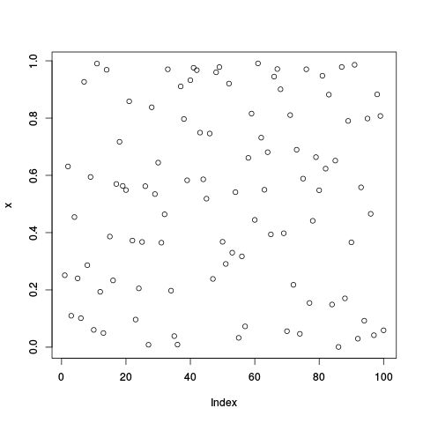
Uniformly distributed random data
We can generate a uniformly distributed set of values using a pseudo-random number generator such as “runif()”
x <- runif(100)
plot(x)
Since they are random, your results can be different.

Slide 18
Random numbers
Random numbers are normally generated with a pseudo-random number generation (PRNG) function.
This function normally generates new values from the previous ones.
  If we start from the same original value we get the same numbers
  If we want to obtain different numbers, we need to start from different “seeds”

Slide 19
Random numbers (2)
Using a specific seed allows us to always obtain the same values (good for repeatability).
  y <- runif(100)
  plot(x, y)
  set.seed(2023)
  x <- runif(100)
  set.seed(2023)
  y <- runif(100)
  plot(x, y)
You should use a seed if you want your results to be repeatable.
  Be conscientiously careful when using seeds.
  Good for repatable science: use seeds and report them.

Slide 20
Generating normal data
We can generate a set of random data following a specific distribution:
help(rnorm)
set.seed(1234)
x <- rnorm(100, 0, 1)
hist(x)
boxplot(x)
y <- 5 + 2 * x + rnorm(100, 0, 1)
plot(x, y)
Notice we make lots of plots. It is a good idea to make sure your supposedly random data does indeed look random (or at least, shows no obvious non-uniformities)

Slide 21
Generating normal data explained
We started by setting a “seed' for the pseudo-random number generator
We then generate 100 values picked at random from a normal distribution with mean 0 and standard deviation 1
  rnorm(100, mean=0, sd=1)
And do some plots to see if it looks convincing (notice that when few data is generated it may strongly deviate from the expected distribution and still be valid).
Next we generate a new set of values y from x, where y = 5 + 2 · x + some random noise
And plot them

Slide 22
Customizing graphics
You can add elements to a graphic, for instance, abline(x, y) adds a line with intercept x and slope y.
In the previous example we computed y as a line y = 5 + 2 · x + some random gaussian noise. The command:
abline(5,2)
Will add the corresponding reference line

Slide 23
Additional graphic customization
points(x, y)
  Add points at coordinates x, y
text(x, y, text)
  Add some text placed at the x,y coordinates
lines(x, y)
  Add lines connecting the points given in the vectors x and y
segments(x1, y1, x2, y2)
  Add segments from (x1, y1) to (x2, y2)
Take note of these commands and the ones in the next slide, for you will want to use them frequently.

Slide 24
Additional graphic customization (2)
arrows(x1, y1, x2, y2)
  Add arrows from (x1, y1) to (x2, y2)
abline(a, b)
  Add a baseline with intercept a and slope b
legend(x, y, text)
  Add a legend at the specified (x, y) position
title(“title', “subtitle')
  Add a title and a subtitle

Slide 25
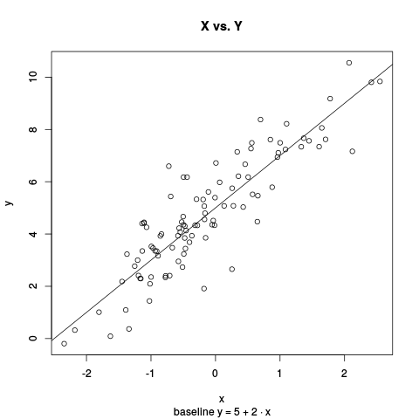
Exercise
Try to generate this plot

Slide 26
Did it look like this?
x <- rnorm(100, 0, 1)
y <- 5 + 2 * x + rnorm(100, 0, 1)
plot(x, y)
abline(5,2)
title("X vs. Y", "baseline y = 5 + 2 * x")

Slide 27
Now try to repeat it
If you didn't use a seed, you can't.

Slide 28
Copying graphics to a file
We can save any graphics that we have generated.
R provides various graphics “devices'. By default it will draw to our screen.
Some "devices" can be attached to files
We can copy a graphic to a file by sending it to the correct "device". Here we copy the current graphic to a file named 'plot.png':
dev.copy(png, file='plot.png')
dev.off()
If you can't find it, getwd() will show youin which directory/folder you are working now.

Slide 29
Copying graphics explained
dev.copy(png, file='plot.png')
dev.off()
That means: make a copy of the current graphic (the one we see on the screen) into a new device (dev.copy)
The device chosen is a device that makes a PNG graphic, and will save it on file “plot.png'
After writing the file, we "turn it off". If we do not, the PNG “device' will remain open, and subsequent plots will overwrite the previous one (both in screen and in the file)!
We cannot see the file contents until the PNG device is turned off (they are not saved until it is turned off, since there may be additional plots)

Slide 30
Copying graphics (2)
hist(x)
dev.copy(png, "plot.png")
  Try to see the contents of “plot.png”
boxplot(x)
  Try to see the contents of “plot.png”
plot(x, y)
dev.off()
  Can you tell what does “plot.png” contain before looking at it yourself?
  The histogram, the boxplot or the x-y scatterplot?

Slide 31
Saving graphics
# This will not show the graphic on
# the screen
png("plot.png")
hist(x)
We can specify the output device: the png() command tells R to use a PNG file instead of the screen.
dev.off()
This will close the last open device (png) and now graphics will go back to the screen again.

Slide 32
Graphic parameters
Did you find these plots boring?
You can further customize the appearance of the graphics display by specifying a number of parameters.
Display parameters allow you to control how things are drawn on the selected graphics device (by default, your screen).
You define these parameters with par( )
help(par)

Slide 33
Changing graphics parameters
We change the display properties using function par( ).
Since each device may use different parameters, we need to modify them explicitly by name
par(mfrow = c(1, 2))
  mfrow allows us to plot several graphics on the same device (a screen window or a file...).
  This example splits the device in one row and two columns (remember, matricial data is arranged by rows first)
hist(x)
boxplot(x)

Slide 34
3 in 1
x <- rnorm(50, 0, 1)
y <- 5 + 2 * x + rnorm(50, 0, 1.3)
z <- 5 + x + 2 * x ^ 2 + rnorm(50,0,1)
par( mfrow = c(3, 1))
plot(x, y, xlab='X', ylab='Y')
plot(x, z, xlab='X', ylab='Z', pch=2)
plot(z, y, xlab='Z', ylab='Y', type='n')
text(z, y, labels= as.character(1:50),
col='red',
pos=rep(1, 50), offset=0.6)

Slide 35
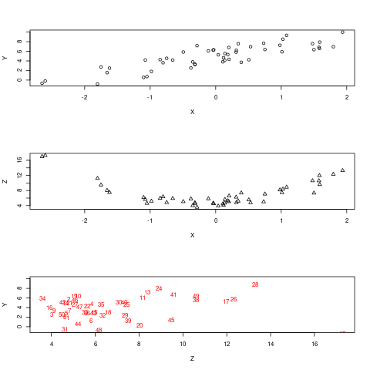

Slide 36
3 in 1 explained
We define a plot area composed of 3 rows and 1 column
The first plot shows x vs. y
The second plot shows y vs. z using a different plotting character (pch)
The third plot shows z vs y but draws no values (type=”n”)
Then we add to the last plot (the third) text labels for the z,y values using as label the corresponding number
“col” specifies the colour, “pos” is the position, and “offset” the displacement in the direction indicated by “pos”

Slide 37
Exercise
Set the display layout back to one single plot
Plot x vs. y as dots
Add labels, using different values for “pos” (from 1 to 4) to see which direction corresponds to each “pos” value.
Redraw the plot each time to see clearly the four directions
Repeat with a different value for “offset”

Slide 38
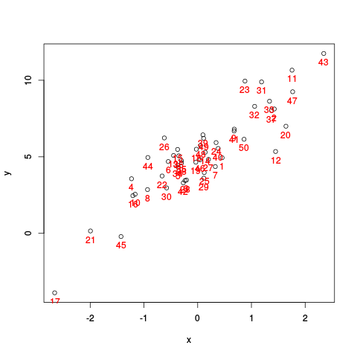

Slide 39
Explore associations
Let's go back to the “iris” data
Visualize scatterplots of each of the continuous variables against each other
  Sepal.Length
  Petal.Length
  Sepal.Width
  Petal.Width
plot(iris$Sepal.Length,
iris$Sepal.Width)

Slide 40
Exercise
Try to draw a trellis graphic of the plots.
Trellis graphics are simply a panel showing all comparisons tabulated in two dimensions:
We have four groups, two sepal and two petal.
Let's plot the Sepal groups against each other.
Define a drawing panel of 2 x 2 graphics
Plot all 4 comparisons in order
SL/SL SL/SW
SW/SL SW/SW
where
SL:Sepal.Length
SW:Sepal.Width

Slide 41
Exercise
Try to draw a trellis graphic of the plots.
Trellis graphics are simply a panel showing all comparisons tabulated in two dimensions:
We have four variables to compare against each other
Define a drawing panel of 4 x 4 graphics
Plot all 16 comparisons in order
AA AB AC AD
BA BB BC BD
CA CB CC CD
DA DB DC DD

Slide 42
Fixing display limits
Everytime you draw a plot, it may happen that its optimal size (as computed by R) exceeds the size of the window or device you want to draw it in. You'll get:
  Error in plot.new(): figure margins too large
To fix it, find out the values of parameter "mar"
  par("mar")
Then set all values to 1. Let us assume it has 16 values, then we should use
  par(mar=rep(1, 16))

Slide 43
Visualize factor effects
Looking at the SL/SW plots, it seems as if there are various parallel linear correlations. This may happen when we have a mixture of subgroups (e.g. age vs height in a mixture of men and women).
Species is a factorial variable. We can try to see the association of each continuous variable to this factor:
par(mfrow=c(1,1))
car::Boxplot(iris$Sepal.Length ~
iris$Species)
This plots Sepal.Length using separate plots for each value of iris$Species (the ~ means "by")
Notice the function name: we need to use car::Boxplot( ), not “boxplot()” this time. More on this later

Slide 44
Feeling sleepy?
Load the “sleep” dataset
data(sleep)
help(sleep)
sleep
summary(sleep)
car::Boxplot(sleep$extra ~ sleep$group)
attach(sleep)
car::Boxplot(extra ~ group)
Do you think that the difference between groups is significant?

Slide 45
Statistics!
t.test(extra ~ group,
alternative="two.sided",
conf.level=.95,
var.equal=TRUE)
  Means: test the model “extra varies depending on the treatment group”
  The null hypothesis is that there is no difference.
  The alternative hypothesis is that there is a difference between groups (be it positive or negative, i.e. two-sided)
  The confidence level is set to 0.95
  Variances are assumed to be equal
Can you confirm a difference?

Slide 46
More t-tests
Try to use different alternative hypotheses:
  “greater”
  “less”
Try assuming non-equal variances (var.equal=FALSE)
Can you confirm a difference now?
Can you believe it?

Slide 47
Data manipulation
The problem here – help(sleep) – is that we took measures on the same 10 patients using two different drugs.
Data is, therefore, paired.
R is assuming we are working with two different and independent experiments because we gave the values all stacked in one column – sleep –
We need to rearrange the data into two paired columns so R knows they are paired observations and uses the paired-samples t-test

Slide 48
Un"stack"ing data
pairsleep <- unstack(sleep,
extra ~ group)
pairsleep
attach(pairsleep)
t.test(X1, X2,
alternate="two.sided",
conf.level=0.95,
paired=TRUE)
How does it look now?

Slide 49
Testing assumptions
In parametric tests we often assume normality and homocedasticity. We should always check our assumptions:
Quantile-quantile plot for normality:
  qqline(iris$Petal.Length)
  with(iris, qqnorm(Petal.Length,
  ylab="Petal length"))
Shapiro-Wilk test for normality:
  shapiro.test(iris$Petal.Length)
Variance homogeneity
  bartlett.test(Petal.Length ~ Species, data=iris)
Note that we have used various “simplifying tricks” here. Try them and see if you understand what they are doing.

Slide 50
Exercice
Generate values from a random normal distribution and test if the random values selected are representatively normal
  Try with 10, 50, 100, 500 and 1000 values
  Check using a Q-Q plot and the Shapiro-Wilk test
Generate two sets of values with the same variance (specified through the standard deviation as parameter “sd=” to rnorm( )) and a third set with a different variance
  Test for homogeneity of variances using Barlett's test.

Slide 51
Exercice
Install R Commander
  install.packages("Rcmdr",
  dependencies=TRUE)
Launch R Commander
  library(Rcmdr)
Generate random samples from different continuous distributions
Study how Rcommander does it
Can you explain what is going on?

Slide 52
What do you think Rcommander is doing?

Slide 53
Explanation
NormalSamples <- as.data.frame(matrix(rnorm(1000*1, mean=0, sd=1), ncol=1))
rnorm(1000*1, mean=0, sd=0) generates 1000 values (1000 rows by 1 column) drawn from a normal distribution using mean 0 and sd 0
matrix( …, ncol=1) uses these values to generate a matrix with only one column (and 1000 rows)
as.data.frame( ) converts the matrix to a data frame for future convenience in subsequent analyses

Slide 54
Explanation (2)
colnames(NormalSamples) <- "obs"
  Gives the single column we have the name “obs”
rownames(tSamples) <- paste("sample", 1:1000, sep="")
  Adds a name to each random sample generated.
  We have 1000 rows, so we need a vector of 1000 names
  We generate this vector with function “paste( )”
  paste( ) will “paste” the text “sample” and the values 1 to 1000, without any separation, generating a collection of 1000 names “sample1”, “sample2”, … , “sample1000”.

Slide 55
Coming up next
Writing scripts
No more boring repetitions
Automating your work...

Slide 56
Thank you
Questions?

