Slide 1
A very short introduction to
Machine Learning
And
Artificial Intelligence
and, by the way,
Data Science
José R. Valverde
CNB-CSIC
Feb 2024
CC-BY-NC-SA

Slide 2
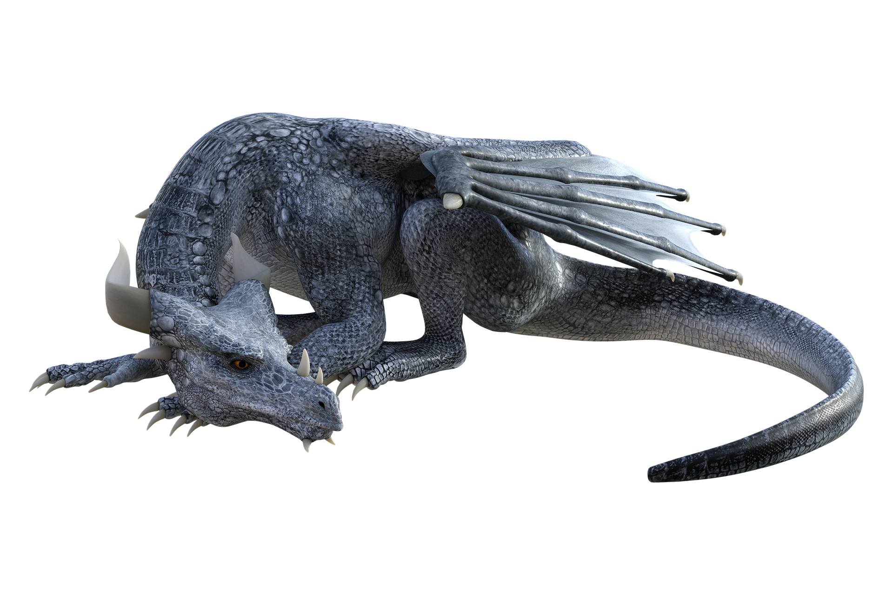
Relax
Image by pendleburyannette from Pixabay
There is no reason to fret

Slide 3
What this is all about
Often both terms (ML/AI) are used interchangeably
(you have been warned!)
We start from Big data (large/huge datasets)
Data mining explores and searches for useful associations in big data.
Machine learning is a subset of AI that allows machines to learn from data without human help.
Artificial Intelligence is a broader concept, includes ML but also human-assisted learning and all processes that make machines look “intelligent” (spoiler: they aren’t).
Data Science tries to make sense of data (find out associations, build models, use them..).

Slide 4
Learning
Supervised
  A human trains the computer
  More efficient and powerful
  Cumbersome to set up
Unsupervised
  The computer “learns” by itself
  Less efficient and powerful
  Does not require human supervision

Slide 5
Unsupervised learning
We use the machine to carry out complex “intelligence” tasks, such as…
  Identifying relevant variables
  Identifying variable importance for an outcome
  Identifying associations and relations
  Classifying and grouping data, etc…
Sounds familiar?
  Regression, statistical models, clustering, factor analysis, PCA, CCA, DeepCCA, EFA, etc...

Slide 6
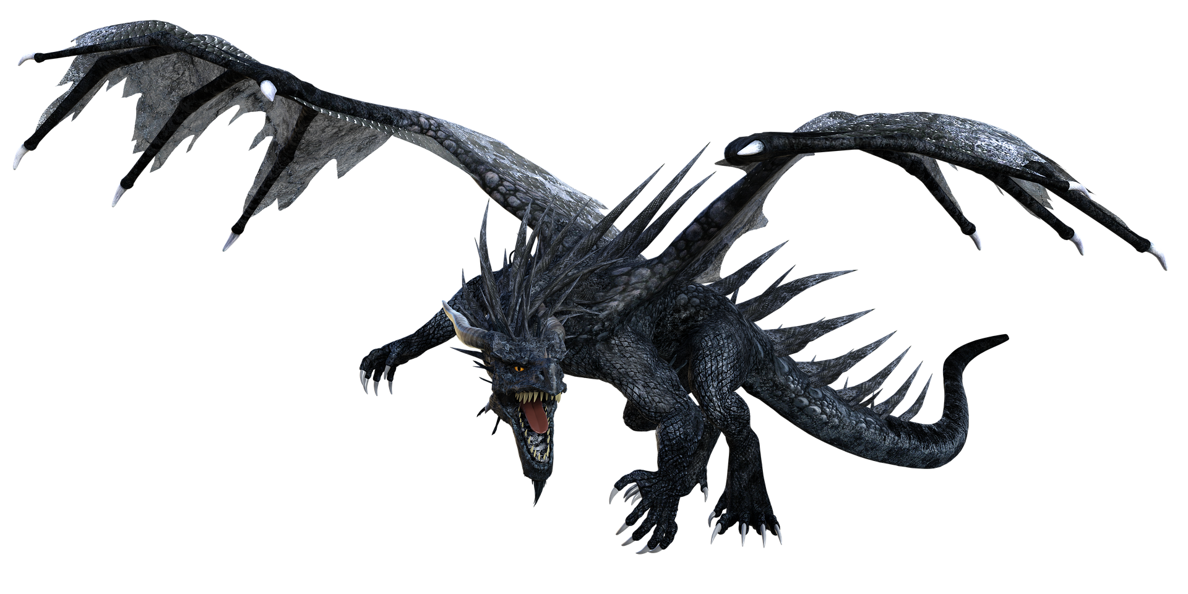
Caution! Here be dragons!
Image by pendleburyannette from Pixabay

Slide 7
Blind!
Unsupervised learning does not require any human intervention
Computers do not “understand” what they do
Only associations are considered, not causality
There is no underlying reasoning.
Choices may be wrong by pure chance
At the end you should look at the associations yourself and decide if they do make sound scientific sense
Hint: it is all a matter of interpretation!

Slide 8
Interpretation
In unsupervised machine learning, everything depends on how we, humans, interpret the associations automatically discovered by the computer.
  If we fail to interpret correctly the associations discovered by the computer, all the process will be faulty (it does not think for us).

Slide 9
Supervised learning
Learning data is “labelled” with the solution.
  Humans must ensure labels are correct before training the computer
The computer can use these labels to identify which associations are meaningful
Learning is faster and has less errors
It’s not that we do not need to, but that often we just cannot supervise the decisions that the computer has done afterwards.

Slide 10
Interpretation again
The success of supervised learning depends on how we (humans) interpret reality before training: we will automate our interpretation using the computer.
  If our interpretation of reality is faulty or prejudiced, so will be anything the computer does (it will just reproduce our mistakes).

Slide 11
The decision process
We want to ensure that we can trust the computer.
  With unsupervised learning we have to see if the predictions make sense and verify them experimentally
  With supervised learning we can check how well the computer matches the labels provided to verify it has actually learnt (does reproduce our pre-hoc model faithfully).

Slide 12
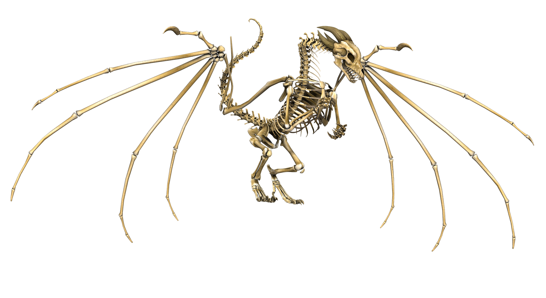
Artificial Intelligence skeleton
Image by JL G from Pixabay

Slide 13
The unsupervised learning process
Collect the data
Feed the data to the computer
Collect the results
Think about and interpret them
Easy, isn’t it? Except for the thinking bit!

Slide 14
The supervised training process
Works like a school:
  We explain the computer what associations we are interested in:
    We provide a set of problem data and the correct solutions
    We repeat it many times so the computer has a chance to learn
  At key times, we interrupt the process and require the computer to pass a test
    We give it problem data and hide the answers
    Then check its answers and grade the exam
  If it has learned then we can proceed

Slide 15
Corollaries
Before starting supervised learning we need to have a data set large enough with problem data, already correctly solved by trusted humans.
To avoid cheating we cannot show all the problems and solutions to the computer
  We typically show ~2/3 or ¾
  The rest are hidden and set aside for testing
  During learning we provide problems and answers
  During testing we provide problems and hide the right answers
  Afterwards we use the answers withheld to grade the computer performance.

Slide 16
Here be dragons!
Modern computers are fast and have a lot of memory
  Too much
Sometimes the computer does not “learn”, it just “memorizes” the answers
  Will be able to answer correctly known questions
  Will have a higher likelihood of failure with unseen problems

Slide 17
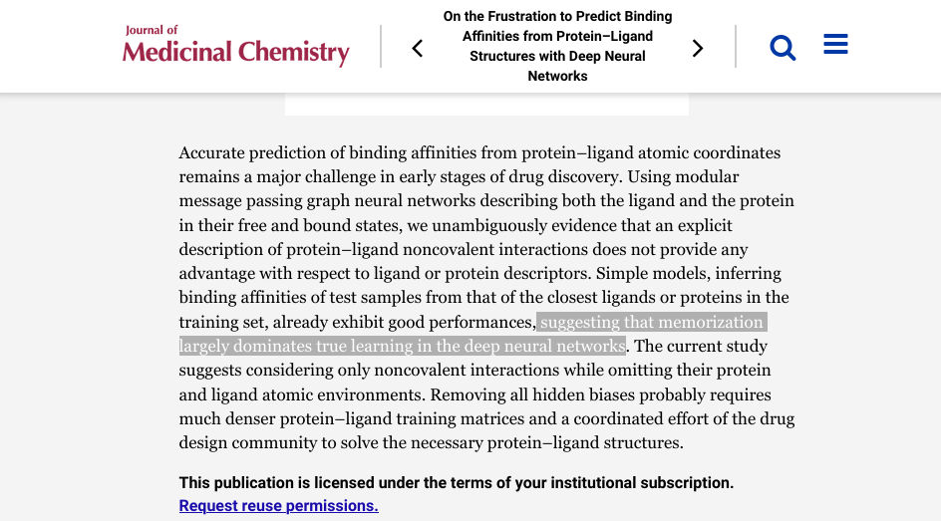
J. Med. Chem. 2022, 65, 11, 7946–7958

Slide 18
Avoiding over-training
The problem arises when we
  over-dimension the learning tool and
  give too few training problems
Bottom line: never trust the computer!
How do we deal with uncertainty?
  Statistics!

Slide 19
Monitoring over-training
Repeat the training process many times, randomizing the problems each time
Each time we will get a different learning model
Compare them
Select the best
Repeat many times
After grading, use the best one.

Slide 20
Grading
Take the labeled problems that we set aside at the beginning, hide the answers and give only the problem data to the computer
  Collect the answers
  Compare them with the hidden labels/answers
  Compute statistics
    Confusion matrix
    Sensitivity
    Specificity
    AUC, ROC, Etc...

Slide 21
The final? test
Once you have a model that makes satisfactory predictions
  Verify them experimentally
Once you have experimental proof that it works
  Use the system

Slide 22
The golden rule
There is no sense in Artificial Intelligence
when Natural is absent.
José R. Valverde
A model will be only as good as the method used and the knowledge employed to train.
WE CAN NEVER BE SURE OF ANYTHING WE THINK WE KNOW
  Neither model, nor data.

Slide 23
Closing the circle
Remember the Bayesian motto?
  The posterior of today is the prior of tomorrow
Ergo, remember to repeat experimental validation of AI models periodically to
  Revise if the original assumptions used in training are still valid
  Revise if the answers produced by the model are still valid
    There is always a non-null chance that the first tests were passed by a random lucky draw of chance.
    New data may invalidate prior assumptions (but you will only notice if you didn't trust the AI model)

Slide 24
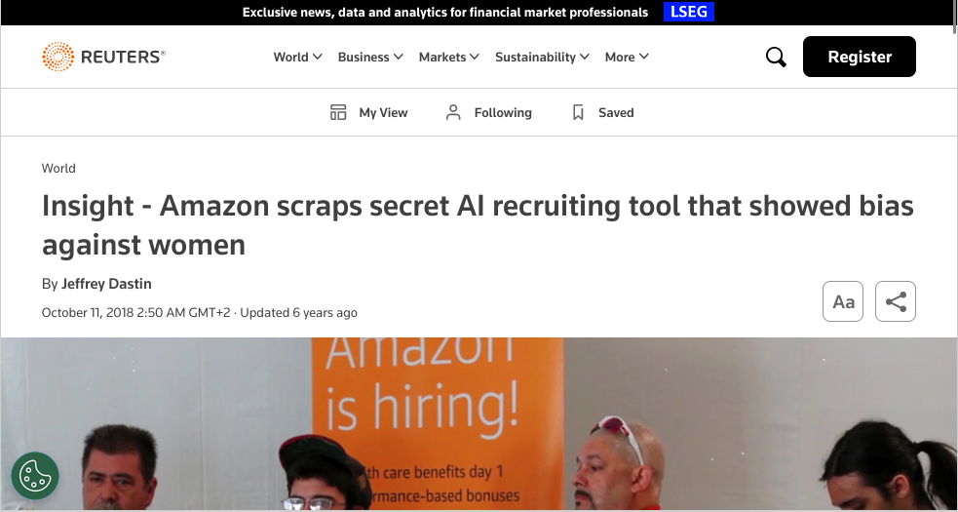

Slide 25
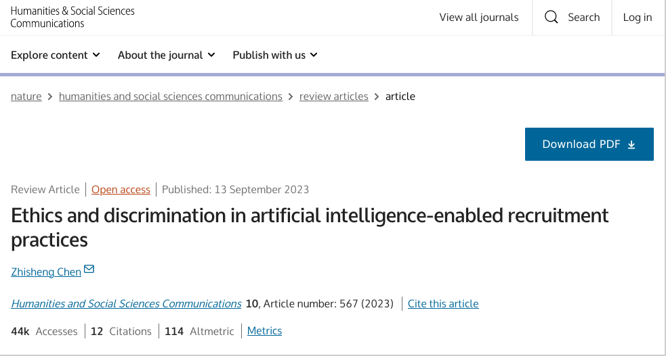

Slide 26
Supervised AI summary
Prepare a well curated large set of training data
Split it into a training and a testing data set
Hand over the training data set to the computer and let it learn
  Repeat the learning process many times
Hand over the unlabeled test data to the computer and check the answers with the known correct labels.

Slide 27
... and remember
Never, ever, trust anyone or anything,
not even yourself, not even the "facts*", much less a computer.
* "facts" (note the quotes) can indeed be misleading or biased: they can be carefully chosen to mislead you (even by you yourself due to unfounded expectations), or your observations be incomplete (limited devices, experience,...). Anybody said "paranoia"? Well, yes! It is your and your descendants' life what is at stake.

Slide 28
...and certainly, do not trust me!
Minority Report?
https://www.propublica.org/article/machine-bias-risk-assessments-in-criminal-sentencing
Racist AI?
https://www.science.org/doi/10.1126/science.aax2342
Biased selection?
https://www.bbc.com/news/education-53787203
Accurate predictions?
https://www.science.org/doi/10.1126/science.1248506

Slide 29
Practical decisions
There are literally thousand of learning methods.
Which one should I use?
  The right answer: study and understand them, study and understand your problem and make an educated decision
  The pragmatic answer: read the literature about your problem, look for comparative reviews and use the method reported to be best according to experience.

Slide 30
Discovering associations

Slide 31
Well, we already know something
Correlation/regression
Multiple regression models
  Linear, nonlinear, MARS, etc...
PCA
EFA
CCA
Neural Networks
etc...

Slide 32
Finding structure
Cluster analysis
  Group individuals according to their scoring on different variables
  Various methods are very popular:
    Hierarchical clustering
    K-means
    Fuzzy C-means
    Neighborhood based
    Random Forest
    DB-cluster
    Neural Networks
    etc...

Slide 33
Telling groups apart
We want to discriminate subjects and separate (classify) them into groups
  K-Nearest Neighbors
  Linear Discriminant analysis
  Decision Tree
  Random Forest
  Neural Networks
  Support Vector Machines (SVMs)

Slide 34
Regression
Measure degrees of association
  K-Nearest Neighbors
  Neural Network
  Support Vector Machine (SVM)
  Decision tree
  Random Forest
  Regularized linear regression
  MARS (EARTH)
  Neural Networks
  ...

Slide 35
Prediction/forecasting
Usually used as an extension of longitudinal analyses/time series
  Linear models
  Non-linear models
  ARIMA models
  MARS (EARTH) models
  Neural Networks
  K-nearest neighbors
  -etc...

Slide 36
Translating "languages"
Translate any language (not just human, e.g. the "languages of life")
LLM (Large Language Models)
  AlphaFold and derivatives
  LLαMA 2
  Falcon
  Flor
  BERT
  GPT, GPT-NeoX, GPT-J etc...

Slide 37
Simplification
Most methods allow us to discover the importance of each variable
  How much it contributes to explaining the feature sought
This can be used to identify the most relevant contributors
  To simplify a model
  To select the main contributors / explainers / determinants of a phenomenon

Slide 38
Sounds familiar?
This is what we have been doing all along the course
  Find associations and correlations
  Identify strength of association (importance)
  Rank variables, group them
  Choose models...
That is why Statistics and ML/AI are also called Data Science

Slide 39

Questions?

