Slide 1
R programming
José R. Valverde
jrvalverde@cnb.csic.es
CNB/CSIC
Scripting
2024
Statistical facts
Natality rate is double the mortality rate. Therefore one out
of every two persons is imnmortal.

Slide 2
Summary
What is a script?
How do I write scripts?
CCA example
Proteomics exampleeta²genomics example

Slide 3
May the “source” be with you
Instead of writing all the commands each time, we can save them to a file.
Remember
  source( ) tells R to read commands from the specified file
  The reason is that files with commands are called “source files” (they are the “source” of the “stream” of commands for the computer)
  R source files usually have a name ending in “.R”, but that is only a non-compulsory mnemotecnical aid.

Slide 4
Feeding a stream of instructions to the computer
Source files contain commands expressed in a special language that we humans can learn easily
  The computer only understands series of 0s and 1s
Thus, command files may come in one of three flavours:
  Computer executables (series of 0s and 1s)
  Instructions understood by humans (source code) that need to be translated into an executable file (from human readable to 0s and 1s) once. Afterwards you can use the translated code (the 0s and 1s executable file) to do the work.
  Instructions to be translated on the fly (line by line) each time, or scripts (the script is human-redable and thus needs to be translated each and every time). Since translation takes time, using them is slower.

Slide 5
Scripts
A script is a series of commands written by a human, in a language that is easy for a human to understand (i.e. it is a source file)
But, instead of translating them into a “compilation” of instructions expressed as 0s and 1s, scripts are translated on the fly
  The computer reads commands one by one
  As it reads one command, it translates into 0s and 1s
  It executes the instructions expressed as 0s and 1s
  Then it forgets the command and reads the next command

Slide 6
Executable vs. interpreted
An executable file will
  Run very fast because commands are executed directly by the computer
  Be specific of the computer, because each computer architecture interprets 0s and 1s differently
A script will
  Run slower because commands need to be translated one-by-one, each time
  Be general because we can use a translator for each computer architecture

Slide 7
R is an interpreter
Some languages have been designed to create executable files using “compilers”
Some languages have been designed to work one command at a time by “interpreters”
Compiled programs are fast and specific
Interpreted programs are slower but general

Slide 8
Using R comfortably
As we start to do more complex tasks, we will need to issue a longer series of commands
Re-typing all the commands each time is burdensome
We can, instead, write all the commands in a source file and ask R to read and interpret the commands in that file
It MUST be a text file with valid R commands.

Slide 9
Writing R scripts
R scripts MUST be text-only files
You need to use a text-editor for that
  NOT a word-processor!
Some text editors can “understand” various computer languages and
  Highlight/colorize differently different computer language elements
  Some may even, interpert (or run the interpreter) too

Slide 10
Some recommendations
Ask St. Google!
  R highlighting text editor for (your system name here)
Use a well-known IDE
  An IDE is an integrated-development-environment
  It contains a text editor with language highlighting
  And can call upon R to execute the commands you are writing

Slide 11
Some recommendations
This time for real
Rcommander (Rcmdr)
  install.packages("Rcmdr",
  dependencies=T)
  library(Rcmdr)
Jaguar (JGR)
  install.packages("Deducer", dependencies=T)
  library(Deducer)
  JGR()
Rstudio
and many more...

Slide 12
Some recommendations
This time for real (2)
SciViews
Tinn-R
R-gtk

Slide 13
Recommendations explained
We can expand R functionality to add new capacities
  And share our expansions!
There is a shared library of such extensions written and shared by fellow humans: CRAN.
install.packages( ... )
  Contacts CRAN and downloads and installs such an expansion
library( ... )
  Tells R to use this expansion (and thus extend its functionality, the list of commands that it knows)

Slide 14
Avoiding scripts
We can expand R functionality to add new capacities
  And share our expansions!
There is a shared repository of such extensions written and shared by fellow humans: CRAN.
install.packages( ... )
  Contacts CRAN and downloads and installs such an expansion
library( ... )
  Tells R to use this expansion (and thus extend its functionality, the list of commands that it knows)

Slide 15
Handling data

Slide 16
Preparation
Download the archive with the R exercises data files
exercises/R_exercises_datafiles.zip
Create a directory for it
Extract the contents in said directory
Make the directory your working directory
  Launch R
Or launch R and make that directory your working directory
  using setwd('..how to go there..')

Slide 17
Opening an external file
The safest way is to convert any file to CSV (or TAB) format
  This allows you to inspect the file contents with a text editor
Open cherry.xlsx in Excel or OOCalc
Save the data as a CSV file with Save as...
cherry <- read.csv(file.choose(),
dec='.', sep=';')
cherry
Choose the relevant file

Slide 18
Opening an Excel file
library(xlsx)
cherry <- read.xlsx(file.choose(), sheetIndex=1)
This will open the chosen Excel (.xlsx) file and load the first spreadsheet in the file as “cherry”
Inspect the contents
head(cherry)
cherry
plot(cherry)
summary(cherry)
NOTE: if you do not have an R extension you can add it with
install.packages("name"), for instance: install.packages("xlsx", dependencies=TRUE)
)

Slide 19
Accessing named data
Data in a dataset or frame can be labelled with names (e.g. column and row names)
We refer to data by name using the “$” sign
  cherry$Girth
  mean(cherry$Girth)
  hist(cherry$Girth)

Slide 20
Working with named data (2)
with(cherry, hist(Height))
with(cherry, mean(Height))
attach(cherry)
Girth # now you see me
hist(Girth)
plot(Height, Volume)
detach(cherry)
Girth # now you don't

Slide 21
Transforming variables
Let us construct a new dataset with all data log-transformed
cherry1 <- transform(cherry,
logVolume=log(Volume),
logGirth=log(Girth))
cherry1
head(cherry1)
hist(cherry1$logVolume)
log( ) gives the natural logarithm, you can also use log2( ) or log10( ) instead.
If your data contains zeros, you can use log1p() which computes log(x+1)

Slide 22
Selecting subsets
cherry[3,] # third row
cherry[3:5,] # rows 3 to 5
cherry[-c(2,4),] # all rows except
# rows 2 and 4
Now try the following and see if you can understand what you get after each call.
We are not assigning the result to a variable, but you certainly can, if you want to use the subset afterwards

Slide 23
Subsets
subset(cherry, Height>70)
subset(cherry, Height>=70)
subset(cherry, Height==80)
subset(cherry, Height==80,
select=c(Girth,Volume))
subset(cherry, Height>80 & Girth>15)
subset(cherry, Height>80 | Girth>15)

Slide 24
Merging data
Sometimes data comes from different sources and we need to merge it into a new dataset to facilitate analysis. Try the following and see what happens
newData <- data.frame(Girth=c(11.5, 17.0),
Height=c(71, 75),
Volume=c(22, 40))
newData
allData <- rbind(cherry, newData)
allData
What does each command do?

Slide 25
Merging data from various sources
Let us assume we have data from other source (we'll simply make it up this time)
precipitation <- rnorm(n=31, mean=50, sd=10)
precipitation
allData2 <- cbind(cherry, precipitation)
allData2
Obviously, variables should have the same order in both data sets.

Slide 26
The attack of the killing tomatoes

Slide 27
tomatoes.xlsx
An experiment has been conducted using three different varieties of tomatoes and four different seed densities, with three replications for each of the 12 combinations.
The yeld in each of the 36 experimental field plots have been measured and saved in an Excel file “tomatoes.xlsx”

Slide 28
Your task
Create a dataset called 'tomatoes' and inspect the data with “plot( )” and “summary( )”
Make a histogram of the “yield” variable
Compute the mean, median and standard deviation of “yield” (sum, mean, median, var, sd)
Make a dataset with two new variables, one with the square root of the yield and one with the logarithm of yield values

Slide 29
Graphs

Slide 30
Scatterplots
attach(cherry)
plot(cherry)
plot(Girth, Volume)
plot(log(Girth), log(Volume))
plot(Height)
What do you see?

Slide 31
Histograms, boxplots, barplots
hist(Volume)
boxplot(Volume)
# plot monthly average temperature
# from May to September in NYC (°F)
temp <- c(65.5, 79.1, 83.9, 84.0, 76.9)
barplot(temp, names=5:9)

Slide 32
NYC temperatures
We have the NYC temperature data in files ny-temp.xlsx and ny-temp.csv
Variables are Month, Day and Temp (ºF)
Read the data into NYTemp
Make two sub-datasets, july and august with the corresponding data

Slide 33
Personalized plots
attach(july)
plot(Day, Temp)
plot(Day, Temp, pch=16)
plot(Day, Temp, pch=2)
plot(Day, Temp, type="l") # that's an ell
plot(Day, Temp, type="b")
plot(Day, Temp, type="l", lty=2)
plot(Day, Temp, type="l", lwd=2)
plot(Day, Temp, type="l", col="blue")
plot(Day, Temp, type="l", xlab="Day in month", ylab="Temperature (F)",
main="Temperature in New York")
plot(Day, Temp, type="l", cex.lab=1.3)
plot(Day, Temp, type="l", cex.axis=1.3)
plot(Day, Temp, type="l", xlim=c(0,40), ylim=c(50,100))
detach(july)

Slide 34
Superimposing data
range(july$Temp)
range(august$Temp)
plot(july$Day, july$Temp, type="l", ylim=c(70,100))
points(august$Day, august$Temp, col="red")
plot(july$Day, july$Temp, type="l", ylim=c(70,120))
lines(august$Day, august$Temp, col="green")

Slide 35
Sugar candy
legend(5,120, c("July", "August"), text.col=c("Black","Green"))
plot(july$Day, july$Temp, type="l", ylim=c(70,100))
abline(h=73, col="red")
abline(v=14, col="blue")
abline(84.652, -0.0468)

Slide 36
Saving a plot
plot(july$Day, july$Temp)
dev.print(file="plotfile1.pdf", device=pdf)
pdf("plotfile2.pdf")
plot(july$Day, july$Temp, col="blue")
dev.off()
Find the files and open them

Slide 37
Linear Regression

Slide 38
Linear regression
Use the cherry dataset
plot(cherry$Girth, cherry$Volume)
lm(cherry$Volume ~ cherry$Girth)
lm(Volume ~ Girth, data=cherry)
  Remember '~' means 'depending on', or 'by'
This gives you the estimated intercept and slope. If we specify the dataset with data=, then variables will be sought in the dataset, if not, then we would have to use cherry$....

Slide 39
Using a linear model
It is usually convenient to save the regression results for further analysis
linreg1 <- lm(Volume ~ Girth,
data=cherry)
linreg1
abline(linreg1)
summary(linreg1)
confint(linreg1) # confidence
# intervals

Slide 40
LR explained
The Coefficients part is the most interesting one
It has one line for each parameter in the model with four columns
  Estimate: the estimated value
  Std. Error: the associated standard deviation
  T value: the t-test statistic for the hypothesis that the value is zero
  Pr(>|t|): p-value for the hypothesis that the parameter has no effect on the outcome

Slide 41
Model validation
We can extract the fitted values, raw residuals and standardized residuals with functions fitted(), residuals() and rstandard() and use them to validate the model
plot(fitted(linreg1),
residuals(linreg1))
plot(fitted(linreg1),
rstandard(linreg1))
qqnorm(rstandard(linreg1))
abline(0,1)

Slide 42
Exercise
Fit a new model where you use log(Volume) as the response variable and log(Girth) as covariate.
Call the model linreg2
Check the model.

Slide 43
Multiple Linear Regression
Try to fit using two explanatory variables instead of one
linreg3 <- lm(log(Volume) ~ log(Girth) +
log(Height), data=cherry)
  Here ‘+’ does not mean ‘add’ but ‘and’: this would read as log(Volume) depends on log(Girth) and on long(Height)
Check the model
Compare the last two models with ANOVA
anova(linreg3, linreg2)
We use ANOVA because we compare several coefficients

Slide 44
Example:
Canonical Correspondence Analysis

Slide 45
CCA
We collect data from a number of observables under a number of experimental conditions and look for associations
  E.g. a collection of control samples, a collection of samples with different treatments, etc... vs. observed species
CCA looks for “linear combinations” of observations that associate with “linear combinations” of conditions.
For instance: the association may be between a group of combined environmental variables (weather, soil, nutrients, latitude, i.e. a geographical region) and another group of combined variables (phalaenopsis, pahiopedilum, cattleya... i.e. orchids)

Slide 46
The “canonical” example
We measure plant growth for different plants
Under combinations of conditions (pH, N, P, K, Temperature, Rain, etc.)
We want to know if some combinations of conditions harbor certain combinations of plants
I.e. how different environments associate with different biomes (many plants associate with a given environment, where an environment is defined by many conditions)

Slide 47
Biotechnology
Let’s say we want to make a tropical garden in Atocha’s station
We could try to reproduce all tropical conditions (even artficial latitude?)
Or we could seek which are the main conditions required for the growth of the main tropical plants.
It is not a 1:1 correlation but a many:many one

Slide 48

Sorry, I couldn’t resist...
Ice-skating pink flamingos on a frozen stream in (not-named) zoological garden.
And no, it’s not funny.

Slide 49

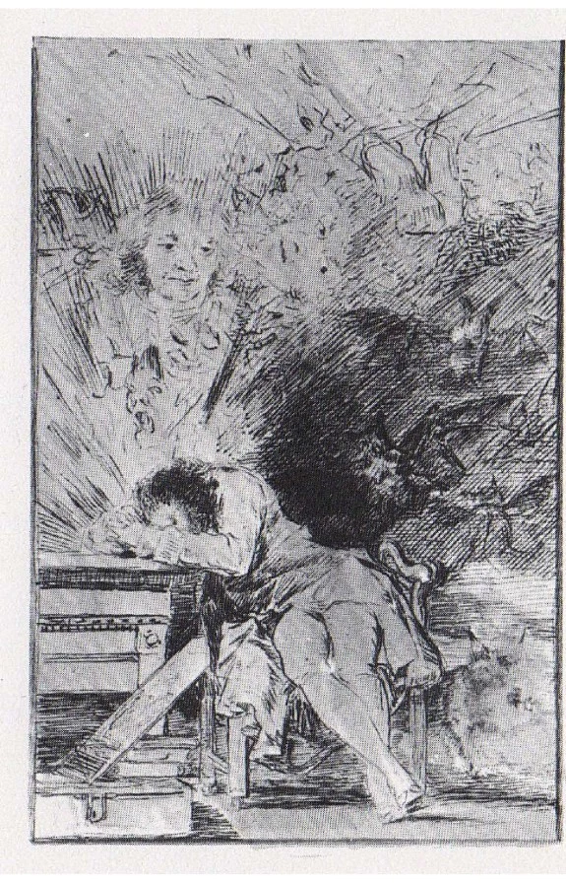
And yes...
Francisco de Goya (1746-1828).
“El Sueño de la Razón Produce Monstruos” (The Sleep of Reason Produces Monsters), 1797
Plate 43 of series “Los Caprichos”
Author's comment:
“Imagination abandoned by reason generates improbable monsters; but added to it, it becomes mother to the arts and the fountain of every marvel.”
Francisco de Goya
The Sleep of Reason Produces Monsters
(design for the Caprices, plate 43)
Sepia pen and ink drawing. 1797-1798

Slide 50
Getting ready
CCA is used to identify associations between two sets of variables (usually sets of observed variables and combinations of experimental conditions)
We will need several R extensions to do this:
require(ggplot2)
require(GGally)
require(CCA)
Remember, use install.packages( ) if missing

Slide 51
The data
We have measured three psychological variables, four academic variables and gender for 600 people. Are there any associations?
mm <- read.csv(
"https://stats.idre.ucla.edu/stat/data/mmreg.csv")
head(mm)
# embellish column names
colnames (mm) <- c ("Control.Of.Ones.Life",
"Self.Concept", "Motivation",
"Read", "Write", "Math",
"Science", "Sex")
summary (mm)

Slide 52
Visualize the data
xtabs (~Sex, data = mm)
psych <- mm[, 1:3]
acad <- mm[, 4:8]
ggpairs (psych)
ggpairs (acad)
matcor (psych, acad)
This shows how our data is distributed.
We can now do multiple regression, multiple linear regressions, …
  one by one, for all combinations...
or we can do all at once with CCA

Slide 53
CCA
cancor <- cc(psych, acad)
# display canonical correlations
# between canonical variates
cancor$cor
# display canonical coefficients
cancor[3:4]
These are like regression coefficients:
  for ”read”, a 1 point increase leads to 0.0446 decrease in the first canonical variable of the academic set and
  being female leads to a 0.63 decrease in dimension 1 for the academic set
when all other variables are held constant

Slide 54
Plots
plot(cancor$cor, type='b')
plt.cc(cancor)
# Get canonical covariates X and Y: 1st
CC1_X <- as.matrix(psych) %*% cancor$xcoef[ , 1]
CC1_Y <- as.matrix(acad) %*% cancor$ycoef[ , 1]
cor(CC1_X, CC1_Y) ; cancor$cor # we check to see that they match
# Get canonical covariates X and Y, 2nd
CC2_X <- as.matrix(psych) %*% cancor$xcoef[ , 2]
CC2_Y <- as.matrix(acad) %*% cancor$ycoef[ , 2]
# plot data along covariates and color by, say, Sex
library(tidyverse); library(dplyr)
cca.df <- mm %>% mutate(CC1_X=CC1_X, CC1_Y=CC1_Y,
CC2_X=CC2_X, CC2_Y=CC2_Y)
ggplot(data=cca.df, aes(x=CC1_X,y=CC1_Y))+ geom_point()
cca.df %>% ggplot(aes(x=CC1_X,y=CC1_Y, color=Sex))+ geom_point()
cca.df %>% ggplot(aes(x=CC2_X,y=CC2_Y, color=Sex))+ geom_point()

Slide 55
Explanation
tidyverse is a series of R packages for data analysis that use a special approach
%>% (pipe) means pass whatever is on the left to whatever is on the right as an argument
  head(iris)
  iris %>% head()
ggplot2 provides nice graphics using tidy phylosophy: we create an empty frame for the data with 'ggplot()' and add layers with '+'
  aes() constructs aesthetic mappings
  geom_point() adds the colored values as points

Slide 56
CCA (2)
# compute canonical loadings
canlod <- comput(psych, acad, cancor)
# display canonical loadings
canlod[3:6]
These are correlations between variables and canonical dimensions. Looking at the first dimension, the negative values indicate (— × — = +) that there is a positive correlation between reading and academic variables (as a linear combination of them, i.e. with different impact on different variables).
See more on
http://www.ats.ucla.edu/stat/r/dae/canonical-correlation-analysis/

Slide 57
CCA(3)
We have three canonical dimensions of which only the first two are significant
# tests of canonical dimensions
ev <- (1 - cancor$cor^2)
n <- dim(psych)[1] # number of dimensions
p <- length(psych) # length of first set
q <- length(acad) # length of second set
k <- min(p, q) # the shortest of the two
m <- n - 3/2 - (p + q)/2 # number of permutations
w <- rev(cumprod(rev(ev))) # rev. cumulative product

Slide 58
CCA(4)
# initialize to a vector of “k” zeros
d1 <- d2 <- f <- vector("numeric", k)
for (i in 1:k) {
s <- sqrt((p^2 * q^2 - 4)/(p^2 + q^2 - 5))
si <- 1/s
d1[i] <- p * q
d2[i] <- m * s - p * q/2 + 1
r <- (1 - w[i]^si)/w[i]^si
f[i] <- r * d2[i]/d1[i]
p <- p - 1
q <- q - 1
}
pv <- pf(f, d1, d2, lower.tail = FALSE)
(dmat <- cbind(WilksL = w, F = f, df1 = d1, df2 = d2, p = pv))

Slide 59
An easy approach: vegan
library(vegan)
library(labdsv)
# psyco.cca <- cca(acad, psych)
psycho.cca <- cca(acad ~ Control.Of.Ones.Life+Self.Concept+Motivation,
data=psych) # this is the preferred way in 'vegan'
plot(psyco.cca)
anova(psyco.cca, by='term') # try by='mar', by='axis'
data(varespec) # different species
data(varechem) # different chemical soil properties
vare.cca <- cca(varespec ~
Baresoil+Humdepth+pH+N+P+K+Ca+Mg+S+Al+Fe,
data=varechem)
vare.cca
plot(vare.cca)
summary(vare.cca)
anova(vare.cca, by='term') # try by='mar', by='axis'

Slide 60
An easy approach: vegan
install.packages('vegan')
library(vegan)
library(labdsv)
data(varespec) # different species
data(varechem) # different chemical soil properties
vare.cca <- cca(varespec ~
Baresoil+Humdepth+pH+N+P+K+Ca+Mg+S+Al+Fe,
data=varechem)
vare.cca
plot(vare.cca)
summary(vare.cca)
anova(vare.cca, by='term') # try by='mar', by='axis'

Slide 61
Example
Proteomic analysis

Slide 62
Proteomics
Each protein has a different sequence
We can split proteins at specific patterns
Which will give us different sub-sequences (fragments) in each protein
We can separate these fragments and identify their properties
Many of these fragments are specific
This allows us to identify which proteins are present and in which amount

Slide 63
A typical analysis
Will split proteins
Will separate them and measure properties
Will identify specific fragments by looking up their properties in a database
Will result in a listing of all the proteins identified in each sample together with the amount of fragments seen (which is expected to correlate with the protein abundance).

Slide 64
Beyond the analysis
If we have a number of samples, we may wonder if they are different or not, and which differences are relevant.
We can compare protein frequencies in different groups using... which test?
  If they are normally distributed, a parametric test
  Otherwise a non-parametric test

Slide 65
The data
Open the file proteomics.tab, see its layout
Read in the file proteomics.tab
  It is tab-separated
  It contains column AND row names
  Proteins are sorted from greater to lower frequency
Test for normality

Slide 66
The dataset
data <- read.table("proteomics.tab",
header=T, na.strings=NA, dec=".",
sep="\t", strip.white=T,
row.names=1)
data
names(data)
Contains 10 control samples, two samples for mutant.1 (A and B) and one sample for mutants 2 and 3.

Slide 67
Test for normality with Shapiro-Wilk
We have 312 proteinsand need to check each of them
Mutants might have a diferent distribution from controls: we'll test only on controls
We need proteins to be in columns
tdata <- t(data)
# for protein p1
tdata[1:10,1]
shapiro.test(tdata[1:10,1])

Slide 68
Exercise
Repeat for all 312 proteins

Slide 69
A solution
for ( i in 1:312 ) {
print(
shapiro.test( tdata[1:10, i] )
)
}

Slide 70
Comparing distributions
Are mutant 2 and 3 alike?
library(Deducer)
likelihood.test(data$mutant.2,
data$mutant.3)
likelihood.test(data[, 13], data[, 14])
But not all proteins are equally significant. The proteins less expressed may be absent in many samples
data[300:313, ]

Slide 71
Exercice
Repeat the analysis considering only the first 10, 50, 100, 150, 200, 250 and 300 proteins)
You may also consider computing the χ² Goodness-Of-Fit test.

Slide 72
Solution
for ( i in c(10, 50, 100, 150,
200, 250, 300) ) {
print(paste('Similarity with', i,
'proteins') )
print(
likelihood.test(
data[1:i, 13],
data[1:i, 14] )
)
}

Slide 73
Exercise
Print proteins for which the P of both, the likelihood-based G-test and the χ² Goodness-of-fit test is greater than 0.05

Slide 74
Solution
We can get the p-value of a test as property “p.value”, using the shorthand “$p.value”
for ( i in c(10, 50, 100, 150,
200, 250, 300) ) {
pl <- likelihood.test(data[1:i, 13],
data[1:i, 14] )$p.value
px <- chisq.test(data[1:i, 13],
data[1:i, 14] )$p.value
if ( (pl > 0.05) & (px > 0.05) )
print(paste('P',i, sep=''))
}

Slide 75
Explanation
A table, list or frame can have headers and row names.
We can refer to rows or columns by number or name
  e.g. data[,1] or data$control.1, data[1,] or data$p1
A test returns “a kind of table/list/frame” as well
hence, we can refer to values by number or name as well
  likelihood.test(data$mutant.1,
  data$mutant.2 )$p.value
  result <- likelihood.test(data$mutant.1,
  data$mutant.2 )
  result$p.value

Slide 76
Suggestions
Compute the average of all control measures
Compare the control average to each mutant sample
Consider each protein separately
  Are the differences between the control and each mutant significant?
  Ensure you apply a correction for multiple comparison

Slide 77
Example:
Analysing meta²genomic data

Slide 78
What is metagenomics?
99% of the bacteria cannot be cultivated
  I.e. they cannot be raised in the laboratory under controlled conditions to study them
  I.e. they are unknown
Non-cultivable bacteria can only be studied in situ.
  Genomic analysis of DNA data collected in situ is called metagenomics
  Needs not be just bacteria!

Slide 79
Studying communities
An in situ sample will contain a variety of organisms: a community
  If it only contained one species, we could use that environment to raise and study it
We can collect DNA from a community and study it
  Identify species
  Identify genes
  Identify “thingies”

Slide 80
A typical experiment
We collect data subject to different conditions and choose one of the datasets as “control”
We compare “thingies” between datasets obtained under different conditions
  Taxonomy
  Genetic signatures (OTUs)
  Hierarchical classification of samples based on global similarity, etc...
To detect similarities and differences

Slide 81
The analysis
We'll look for differences between the control and each treatment
  Genes / Species / whatever
We'll decide if the differences are significant ot not
  With a multiple-comparison correction because there are so many “thingies”
We'll test if there is an association between traits and treatments

Slide 82
The analysis (2)
Requires a lot of preparatory work and is usually carried out with ad hoc tools that give us
  Composition
  Relevance of factors / treatments
  Community similarity and clustering

Slide 83
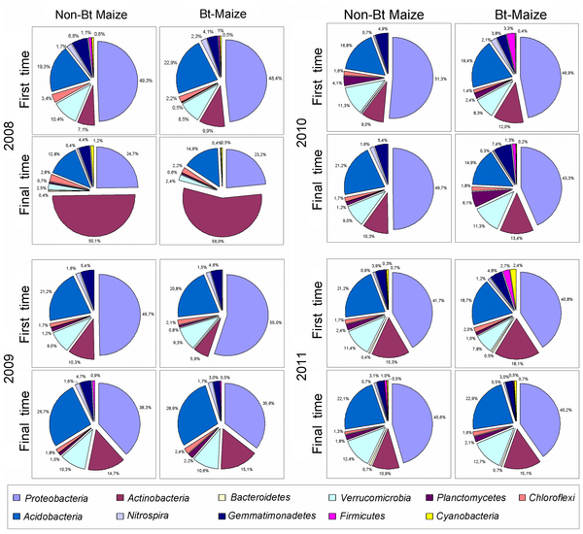

Slide 84
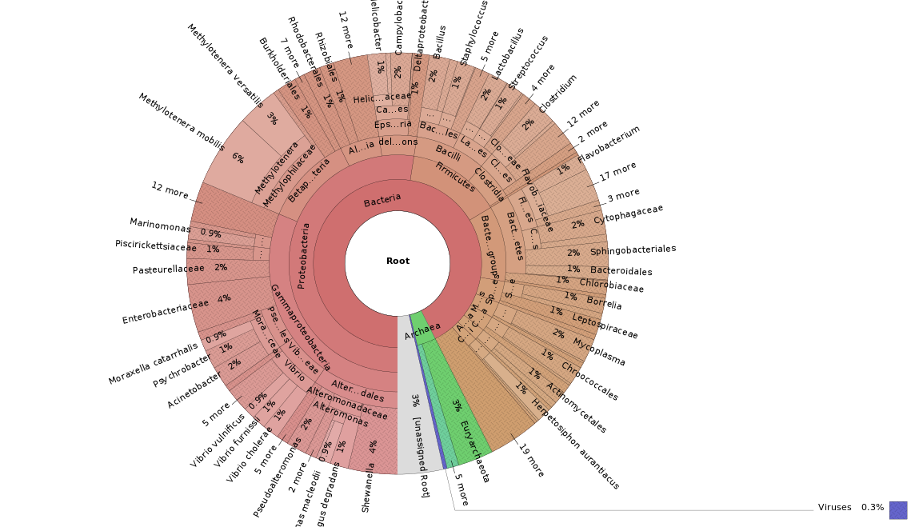
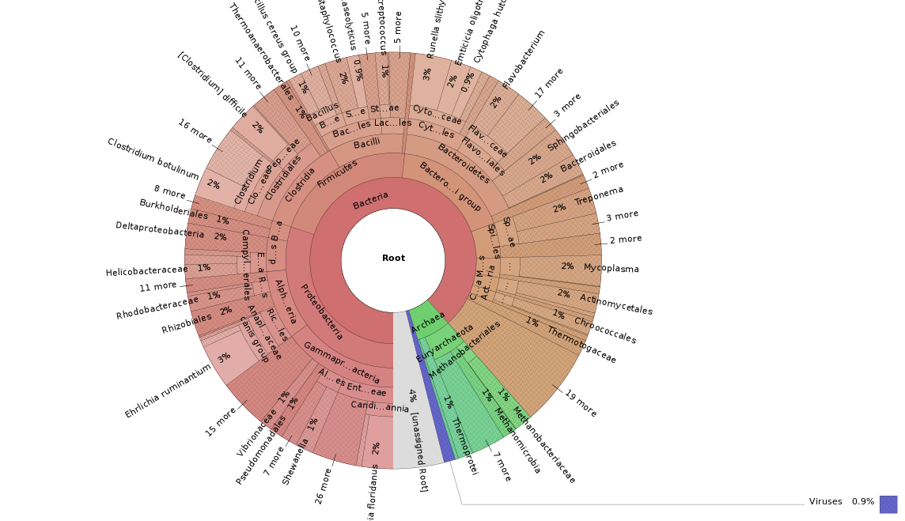
Species distribution (mud T₀, T₁)

Slide 85
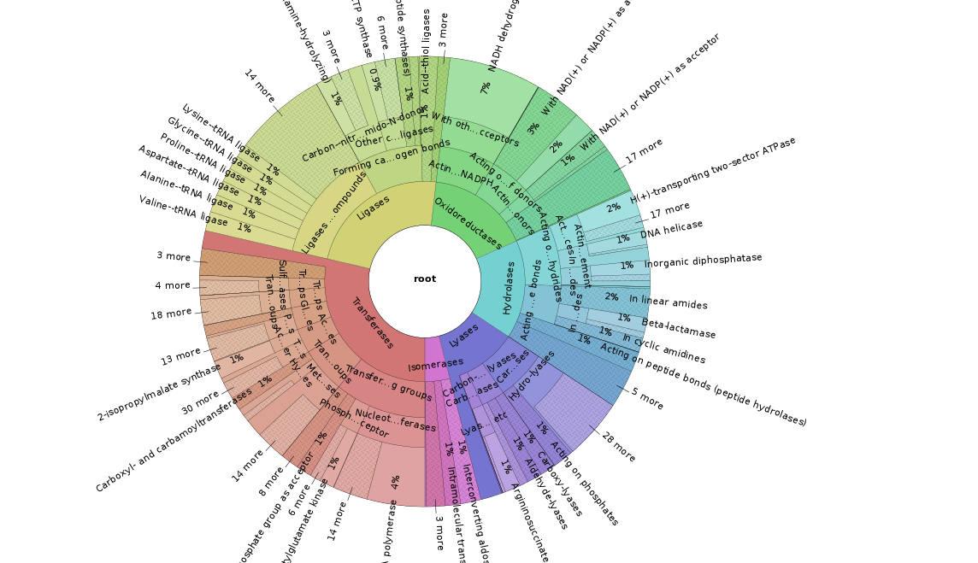
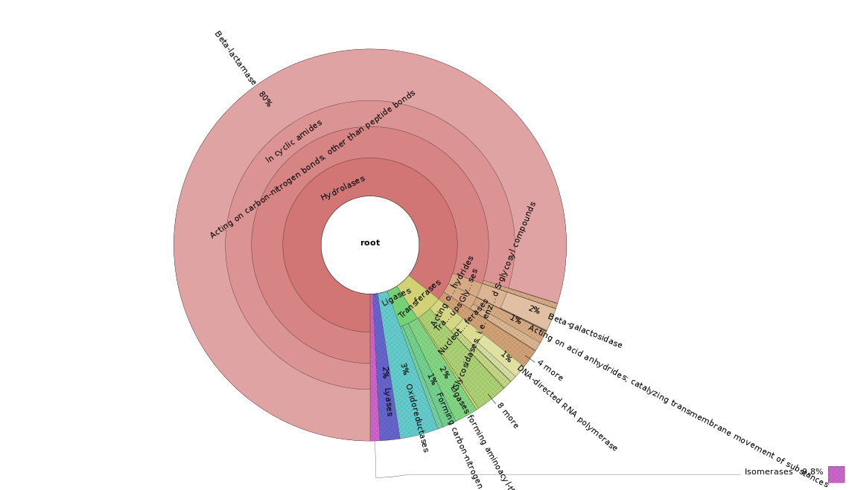
Functional distribution (T₀, T₁)

Slide 86
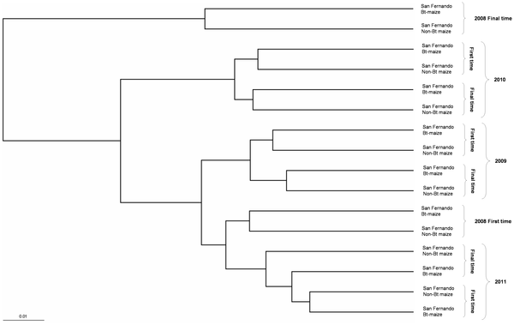
Classify communities

Slide 87
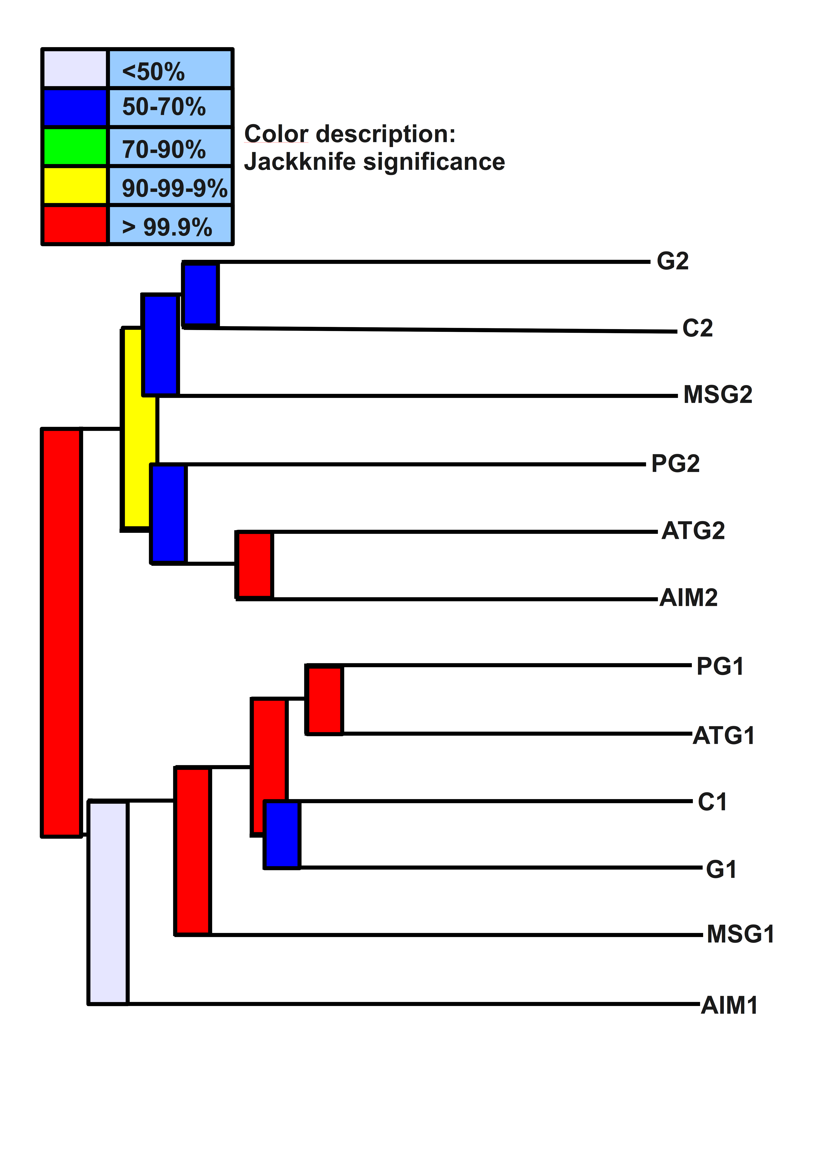
Grouping
The phylogenetic trees of each sample were built and compared for common / absent nodes and for proportions.
The computed UniFrac distances were used to cluster (group) samples by similarity.
Jackknifing of the tree provides statistical significance for each grouping (branching).
1: first sampling time
2: last sampling time

Slide 88
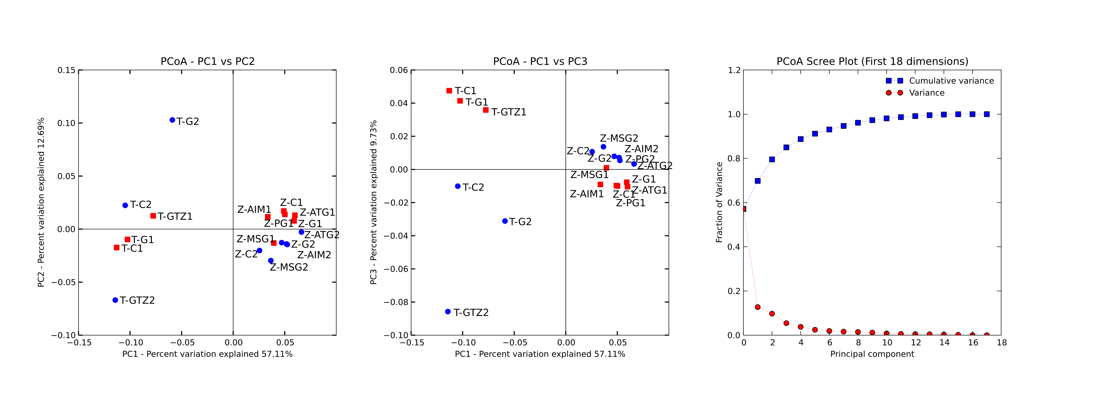
Principal Components Analysis: Which factors are important?
T: Toledo 1: first sampling time
Z: Zaragoza 2: second sampling time
PC1: Location?
PC2: Treatment / Time?
PC3: Sampling time?

Slide 89
Meta²genomics
There is a problem with usual metagenomic data
  It is not exhaustive!
  “Thingies” (species, genes, rRNAs...) are not distributed uniformly
  Some are easier to detect than others
But as the number of experiments grows, we have more data to compare
  From different locations and treatments
We enter a new, unchartered realm.

Slide 90
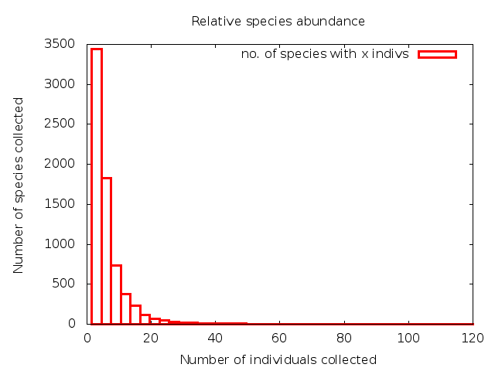
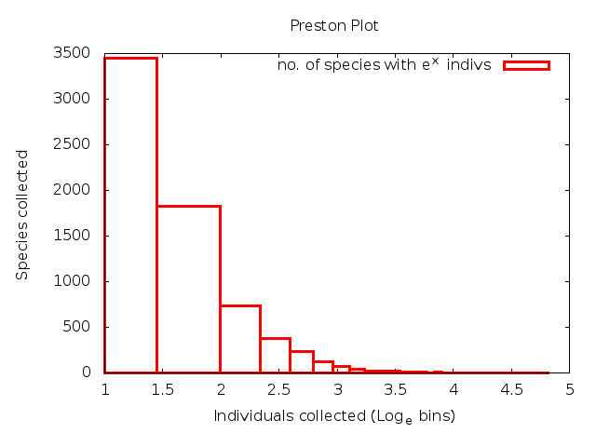
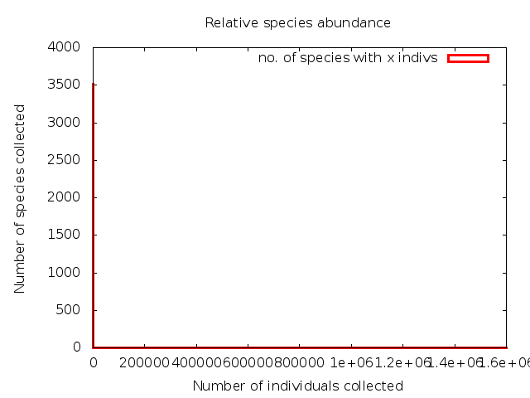
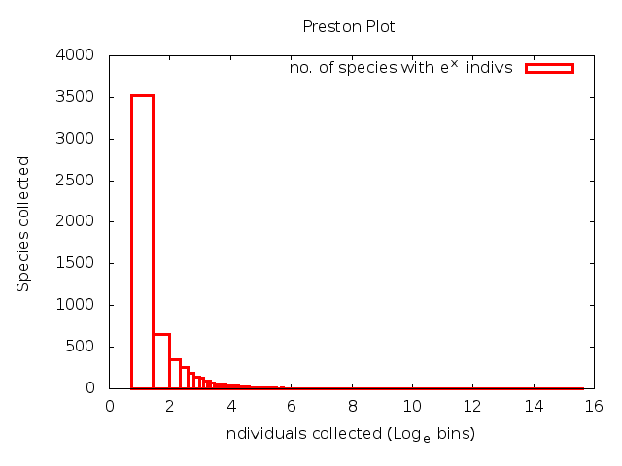

Slide 91
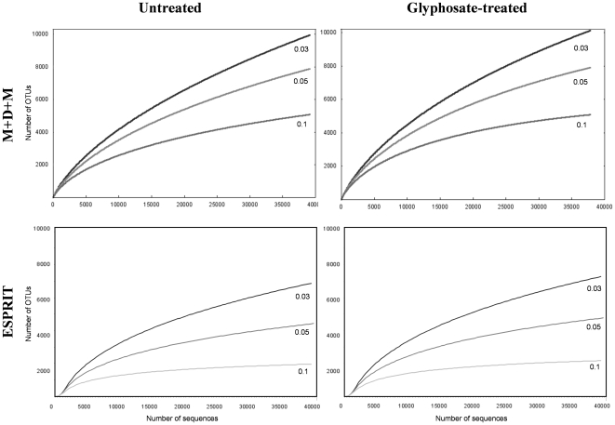

Slide 92
Comparing many experiments
In each experiment we compare a control with a treatment under an specific environment
We can try to consider many experiments to increase our “coverage” of “thingies”
And now we can ask for associations
That is called Canonical Correspondence Analysis or CCA.

Slide 93
CCA
We collect data from a number of observables under a number of experimental conditions and look for associations
  E.g. a collection of control samples, a collection of samples with different treatments, etc... vs. observed species
The method looks for “linear combinations” of observations that associate with “linear combinations” of conditions.
I.e. it is like a “multiple PCA” which is like multiple linear regression...

Slide 94
taxonomy vs treatments
We'll analyze associations between taxonomic groups and treatments using CCA from “vegan”)
library(vegan)
tt <- read.table("S3_cum_tax_megan_tt.csv", header=T, sep=",", dec=".")
p <- read.table("S3_cum_tax_megan_phylum%.csv", header=T, sep=",", dec=",")
tP <- as.table(t(P))

Slide 95
Taxonomy vs. Treatments (2)
Pcca <- cca(tP, tt)
plot(Pcca)
summary(Pcca)
ccaP <- cca(tt, tP)
ccaP
plot(ccaP)
summary(ccaP)

Slide 96
Exercice
Repeat for Class, Order, Family, Genus and Species

Slide 97
A possible solution
Copy/paste the code
Substitute “phylum” by the appropriate level
Run
This will work OK for a reduced number of levels: we simply replace by hand the name of the file and repeat the analysis (by hand)

Slide 98
Alternative solution
tt <- read.table("S3_cum_tax_megan_tt.csv", header=T, sep=",", dec=".")
for ( level in c(“phylum”, “class”,
“order”, etc...) ) {
file <- paste(“S3_cum_tax_megan_”,
level, “%.csv”
P <- read.table(file, header=T, sep=",",
dec=",")
tP <- as.table(t(P))
etc...
}

Slide 99
Suggestions
At each taxonomic level, try to identify which taxonomic groups have significant differences between groups of experiments
You need to know how to group experiments
This info is not provided here
Thus...
Do not do it now.

Slide 100
Thank you
Questions?

