Slide 1
R programming
José R. Valverde
jrvalverde@cnb.csic.es
CNB/CSIC
Exercises
2024
Statistics means never having to say you’re certain.

Slide 2
Functions

Slide 3
Defining your own functions
There are many functions already available
But sometimes we'll want to define our own ones:
f <- function(x) return(2*x^2 -
0.9*x - 1)
f(0)
f(1.5)

Slide 4
Functions are also variables
You can use a function as you would use a variable, e.g. when calling another function.
  If your function produces a value, it is the same as a variable that contains a value
plot(f)
plot(f, from=-1, to=2)

Slide 5
Exercise
Define the function
And plot it with
plot(g, from=-1, to=2, add=T,
col="red")

Slide 6
Minima and maxima
We can see that f(x) has a minimum around 0.25 and g(x) a maximum around 0
We can find the minimum with
optimize(f, interval=c(-1,2))
Exercise:
  Find the maximum of g(x) using optimize

Slide 7
Minima and maxima
We can see that f(x) has a minimum around 0.25 and g(x) a maximum around 0
We can find the minimum with
  optimize(f, interval=c(-1,2))
Exercise:
  Find the maximum of g(x) using optimize
  Which function has a minimum at the same point where g(x) has a maximum?
    DEFINE AND CHECK IT
    HINT: you can even use a lambda function

Slide 8
Roots
f(x) is 0 around -0.5 and 1
We can use uniroot to obtain the exact values:
uniroot(f, interval=c(-1,2))
# that gave an error
uniroot(f, interval=c(-2,0))
Find the root close to 1
Find the roots of g(x)

Slide 9
Exercise
Find the values for which f(x) = g(x)

Slide 10
Exercise
Find the values for which f(x) = g(x)
Which function is zero if and only if f(x) = g(x)?

Slide 11
Exercise
Find the values for which f(x) = g(x)
Which function is zero if and only if f(x) = g(x)?
Define a function h(x) that is either f(x) - g(x) or g(x) - f(x)
Plot it
Use optimize and uniroot to find the roots.

Slide 12
Functions with several arguments
We can define it in several ways
  As a function taking two argumens (x₁ and x₂)
  As a function taking one argument, which is a vector with two components (x = (x₁, x₂))
    val = c(x1, x1) ---> val[1] = x1, val[2] = x2
  As a function taking one argument: a list with two components (x = x1, x2))
    val = list(x1, x1) --> val[[1]] = val$x1 = x1, val[[2]] = val$x2 = x2
Try it

Slide 13
Solution
f1 <- function(x1,x2) return(
-5 - 3*x1 + 4*x2 + x1^2 - x1*x2 + x2^2)
f1(0,0)
f1(1,2)
f2 <- function(x) return(
-5 - 3*x[1] + 4*x[2] + x[1]^2 - x[1]*x[2] +
x[2]^2)
f2(c(0,0))
f2(c(1,2))

Slide 14
Contour plot
For functions of one argument we plot a line, for two arguments (dimensions) it is convenient to draw a contour plot.
  The axis are X1 and X2
  We draw lines/curves corresponding to different values of the function
    All values of x1, x2 in a line give the same result for the function

Slide 15
Contour plot (2)
x1 <- seq(0,2,length=51)
x1
x2 <- seq(-3,1, length=51)
x2
fVals <- outer(x1,x2,f1)
dim(fVals)
contour(x1,x2,fVals)

Slide 16
Contour plot (3)
We want a plot with 50 grid points in X1 and X2
  So we need 51 points, from 0 to 50
Function outer( ) will compute the function in all grid points
And then we use function contour( ) to draw the plot.

Slide 17
Another dimension
Define a function 'fun' that calculates (x² + y²)
now try:
x <- seq(-10, 10, length= 30)
y <- x
z <- outer(x, y, fun)# calculate h for all x,y points
z[is.na(z)] <- 1 # set to 1 all NAs in the result
op <- par(bg = "white") # set a white background
persp(x, y, z, # plot values of h in the x,y plane
theta = 30, phi = 30, # help(persp)
expand = 0.5,
col = "lightblue")

Slide 18
And yet another one
Using the former 'h' function, color by height:
library(lattice)
wireframe(z, drape=T,
col.regions=rainbow(100))
Indeed, there are many ways to skin a cat!

Slide 19
Minimum
Function optim( ) can be used for finding the minimum and maximum of a function.
It is a general-purpose function with many options
optim(par=c(0,0), fn=f2)

Slide 20
Optimization (2)
Note that optim( ) requires that we use a function taking one argument, which is why we need to use the second implementation of the function
  The one that takes a vector of two values (x₁,x₂)
We needed to provide a point where we'll start the search
In general, multidimensional optimization is a difficult task and will require additional arguments to optim( ) for fine tuning.
nlsminb( ) is a slower but more reliable alternative

Slide 21
Enzyme Kinetics

Slide 22
Enzyme kinetics
Enzyme activity has been measured in various different concentrations of the substrate and the inhibitor. Activity is measured as reaction rate.
We have measures of the reaction rate (R) with (I) no inhibitor, 50 μM and 100 μM, and for each series, we have measured 6 different substrate concentrations (S) from 10 μM to 600 μM
There are two replicas of the experiment
Data is in inhib.xlsx and inhib.csv

Slide 23
Inspect the data
Read the data into variable 'inhib'
Make a scatterplot with substrate concentration (S) on the x-axis and reaction rate ( R ) on the y-axis.
Can you spot any problem?

Slide 24
Inspect the data
Read the data into variable 'inhib'
Make a scatterplot with substrate concentration (S) on the x-axis and reaction rate ( R ) on the y-axis.
Can you spot any problem?
  look into 'inhib.csv'
inhib <- read.table("inhib.csv",
sep=";",
header=T)
with(inhib, plot(S, R))

Slide 25
Inspect the data
Read the data into variable 'inhib'
Make a scatterplot with substrate concentration (S) on the x-axis and reaction rate ( R ) on the y-axis.
Can you spot any problem?
  Can you tell apart the reactions with different inhibitor concentrations?

Slide 26
Inspect the data (2)
Our problem is that the data is in columnar form. Each inhibitor concentration follows the former ones in the same column.
  We could convert to horizontal format, but we can also play a neat trick
  We know that we have 12 observations for each inhibitor concentration, so you can try
  attach(inhib)
  grp <- c(rep(1,times=12),
  rep(2,times=12),
  rep(3,times=12))
  plot(S, R, col=grp)
  plot(S, R, pch=grp)
  plot(S, R, col=grp, pch=grp)

Slide 27
Inspect the data (3)
We have created a vector with 12 ones, 12 twos and 12 threes.
Then we simply use this vector to indicate the color (or marker) for each value in S/R.
  The first 12 observations will use color/marker #1
  The second 12 obervations, color/marker #2
  The third 12 observations, colot/marker #3

Slide 28
Normal reaction rate
In the absence of inhibitors, the reaction rate follows what is called a Michaelis-Menten relation:
Where V_{max} and K need to be estimated from the data (typically using least-squares fitting)

Slide 29
Estimating V_{max} and K
We can use nls( ) (non-linear-least-squares) to do the fitting, but we need starting values
  First, select the first 12 rows (the data subset with no inhibitor (I = 0)
  Call this selection e.g. 'dat0'
  dat.i0 <- inhib[1:12, ]
  Make the NLS model
mm.i0 <- nls(R ~ Vmax * S / (K + S),
start = list(Vmax=3, K=100),
data=dat.i0)
summary(mm.i0)

Slide 30
Validation
We can analyze the raw residuals to check if they (the error in the measure) do indeed follow a normal distribution.
plot(fitted(mm.i0),
residuals(mm.i0))
What do you think?

Slide 31
Validation (2)
Make a scatterplot for the data and add the line corresponding to the fitted function.
  You will need to define a function to calculate the Michaelis-Menten curve, using the values for Vmax and K estimated previously.
  Then plot the data for dat0
  Then plot your function from 0 to max(dat0) and add it to the previous plot (with argument add=T)

Slide 32
Validation (2)
Make a scatterplot for the data and add the line corresponding to the fitted function.
plot(dat.i0$S, dat.i0$R)
mi.men.i0 <- function(S) 2.9811 * S /
(35.853 + S)
plot(mi.men.i0, from=0,
to=max(dat.i0), add=T)

Slide 33
Modelling inhibitor effect
The association between inhibitor, substrate and reaction rate may be modeled as
Here, we need to estimate V_{max}, K₁ and K₂ from the data.

Slide 34
Do it
Fit the model with nls( ).
  You may try starting with V_{max} = 3, K₁ = 100 and K₂ = 25 as an initial guess.
Make the scatterplot of all the observations using colors for each inhibitor concentration
Add three different fitted curves, one for each inhibitor concentration using the same color for each concentration as for the datapoints

Slide 35
Solution
mmi <- nls(R ~ Vmax * S / (K1 * (1 + (I/K2)) + S),
start=list(Vmax=3, K1=100, K2=25), data=inhib)
summary(mmi)
plot(S, R, col=grp) # we already have grp
# for [ I ] = 0
fm <- function(S) 2.93828 * S /
(33.99345 * (1 + 0 / 34.84463 ) + S)
plot(fm, from=0, to=620, add=T, col=1)
fm <- function(S) 2.93828 * S /
(33.99345 * (1 + 50 / 34.84463 ) + S)
plot(fm, from=0, to=620, add=T, col=2)
fm <- function(S) 2.93828 * S /
(33.99345 * (1 + 100 / 34.84463 ) + S)
plot(fm, from=0, to=620, add=T, col=3)

Slide 36
Compare with initial fit
Add the line corresponding to the model of the reaction obtained considering only the observed reaction rates in the absence of the inhibitor
plot(mi.me.i0, from=0, to=620,
add=T,
col=1, lty=2)

Slide 37
Getting the coefficients
We can get them with summary()
When we "print" it, we see it "nice"
But it is actually a list, with among others, an element called coefficients... if we assign them names (variables) we can get
  sum.mmi <- summary(mmi)
  coef <- sum.mmi$coefficients
  Vmax <- coef['Vmax', 'Estimate']
  K1 <- coef['K1', 'Estimate']
  K2 <- coef['K2', 'Estimate']

Slide 38
Use variables whenever possible
Compare this new version
  m <- function(I, S) Vmax * S /
  (K1 * (1 + I / K2 ) + S)
and using a for loop we can do all inhibitor concentrations at once
  for (I in c(0, 50, 100))
  plot(function(S) m(I, S), from=0,
  to=620)
but, since m takes two arguments, and plot uses a function with one, we make a new lambda function that takes only one argument to pass the inhibitor concentration at each iteration of the loop
this is incomplete: we need some additional steps to also add colors and symbols, but you get the idea.

Slide 39
Make separate models for [ I ]
We can use separate models for each Michaelis Menten fit for each inhibitor concentration [ I ], that is, use the initial MM equation for each.
They can be done all at once, indeed!
mm3 <- nls(R ~ Vmax[grp] * S /
(K[grp] + S),
start = list(Vmax=c(3,3,3),
K=c(100,100,100)),
data=inhib)

Slide 40
Explanation
We provide the whole dataset, and say that we have three groups of data, for which we give three starting values of V_{max} and K.
To identify which data is to be used for each of the three fits, we use the same “grp” vector that we used to color the plots
  grp contans 12 ones, 12 twos and 12 threes, hence indicating which data are to be used in the first, second and third model

Slide 41
Compare the models
We have
  mm0 (model with no inhibitor, [ I ] = 0)
  mmi (model with all the inhibitor concentrations)
  mm3 (three models, one for each inhibitor concentration
We can compare models using anova, e.g.
  anova(mmi, mm3)
  Are they the significantly different?

Slide 42
Yonder and beyond
There is a lot more to curve fitting, specially when we talk about enzyme reactions
You may have more than one substrate, more than one inhibitor and various error (residual) distributions. This may demand
  Various logistic regression, Generalized Least Squares, ARIMA or mixed-effects modeling methods
  Fitting to sigmoidal, third-degree polynomials or other types of curves
  Repeated measures analyses
  Time series analyses...

Slide 43
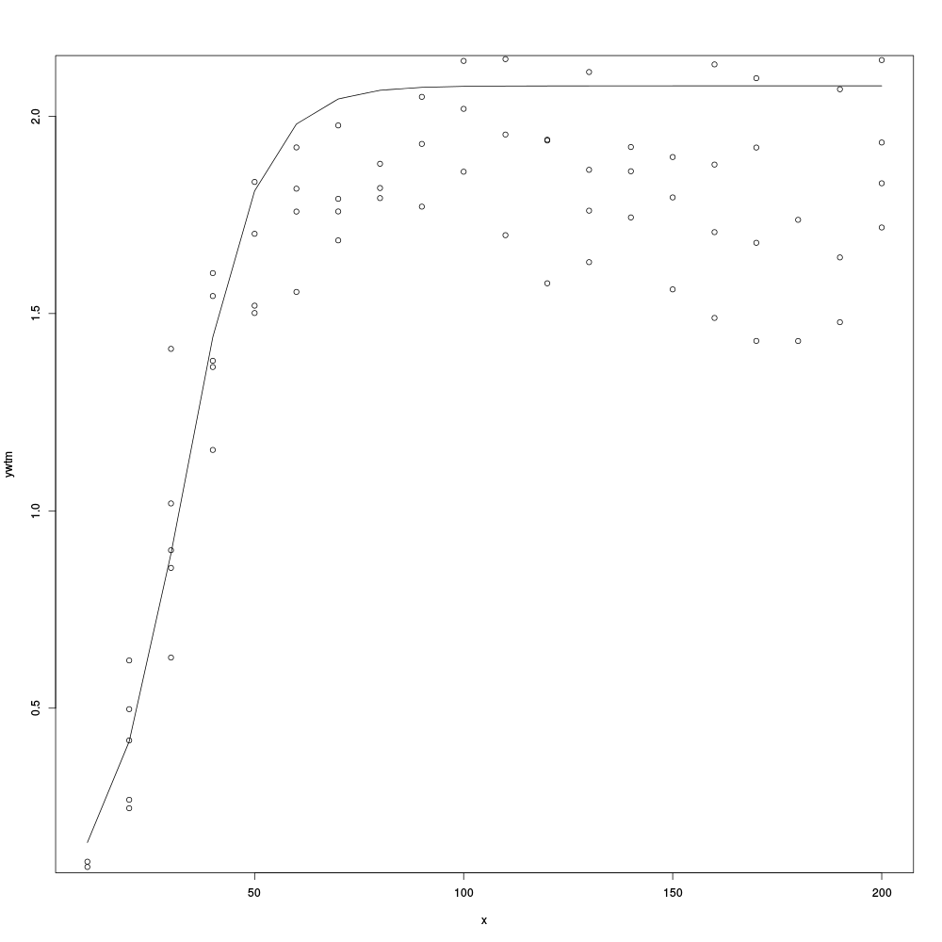
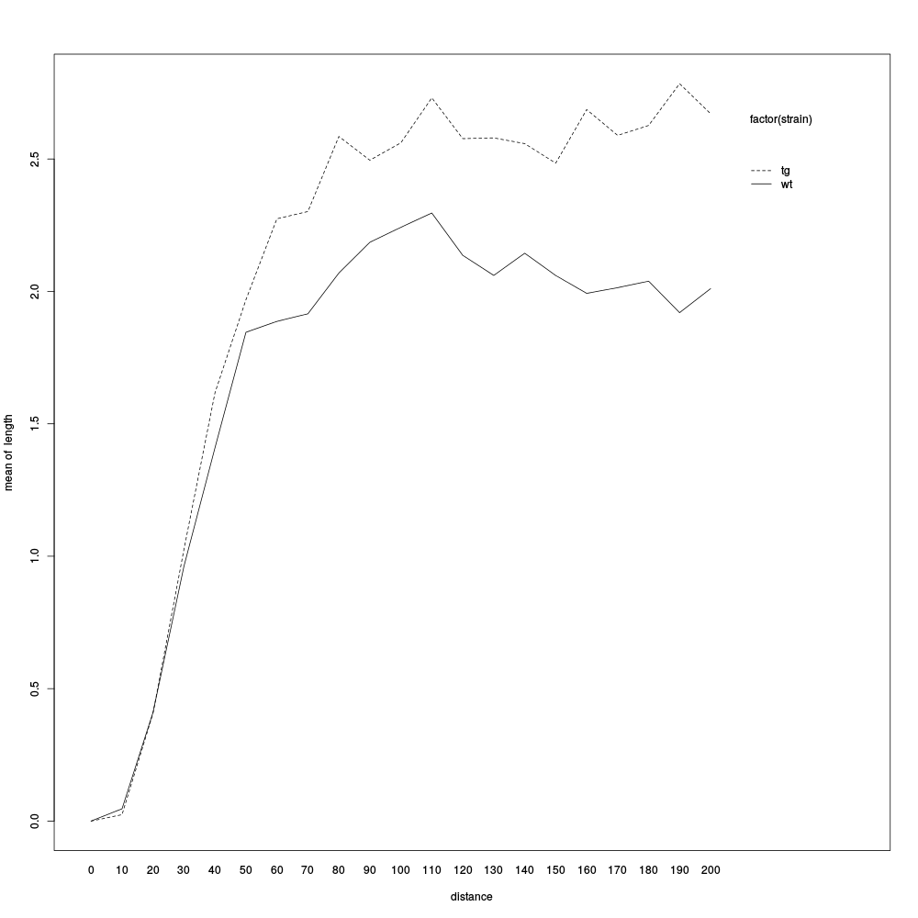
This is real world data:
Data from the wt strain (left) is not well fitted by a usual MM curve: it shows a decrease in the reaction rate after the peak, indicating presence of a triggered inhibitor
Comparison with the mutant (right) shows differences in the curves: the mutant does not produce the inhibitor and fits a MM curve. The wt, starts to inhibit the reaction once a trigger concentration of the product is reached.

Slide 44
Principal Components Analysis

Slide 45
The experiment
Data is available from the MASS package as dataset “crabs”
100 blue and 100 orange crabs were measured (50 male and 50 female each) for
  Caparace length (CL)
  Caparace width (CW)
  Frontal lobe length (FL)
  Rear width (RW)
  Body depth (BD)
Can we tell color from (any, some, or all of) the other variables?

Slide 46
Data input and transformation
library(MASS) # load package MASS
head(crabs) # look at the data
# compute a dataset with log values
logcrabs <- log(crabs[,4:8])
head(logcrabs)
# Group variable
group <- crabs$sex : crabs$sp
group
plot(logcrabs, col=group)

Slide 47
Question
Does the raw data show a clear asociation between the four groups and the variables measured?
  Blue / Female
  Orange / Female
  Orange / Male
  Blue / Male

Slide 48
PCA
pca <- princomp(logcrabs, cor=T)
pca
summary(pca)
plot(pca)
loadings(pca)
pca$scores

Slide 49
Explanation
We carry out Principal Components Analysis with function princomp( )
We can use the covariance function (default) or the correlation matrix (which we have selected here with cor=T) to cause a scaling of the variables.
The first component explains the greatest amount of variance in our observations.

Slide 50
Investigating PCA
scorData <- data.frame(pca$scores)
plot(scorData)
plot(scorData, col=group)
plot(scorData[,1:3], col=group)
plot(logcrabs[,1], scorData[,1],
col=group)
Is there any association between components and groups (remember the color association)?

Slide 51
More Info
You can obtain more examples, details and information in
Introduction to R: Exercises
Helle Sørensen, 2015
U. Of Copenhagen
Which it so happens is the source upon which some parts of this presentation are based.

Slide 52
Thank you
Questions?

