Slide 1
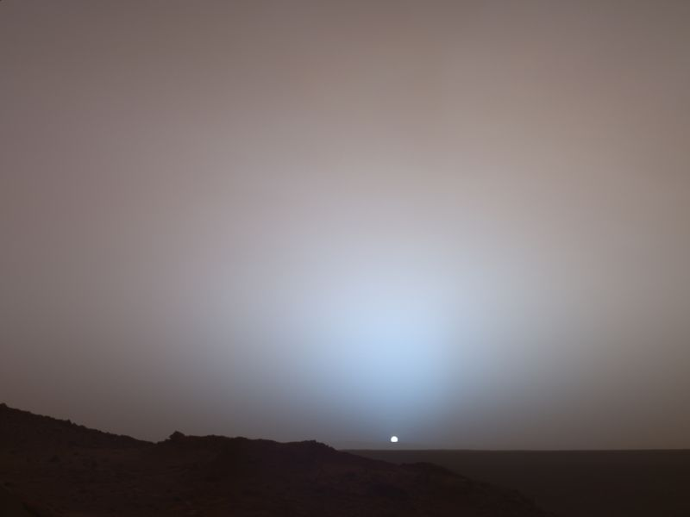
TINKER simulations

Slide 2
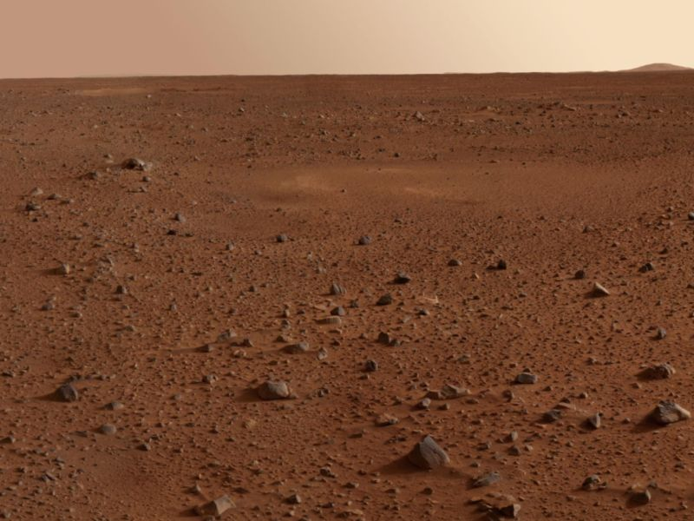

Lecture Outline
TINKER introduction
Protein simulations in vacuo
Protein simulations in implicit solvent model
Solvent simulations with periodic boundary conditions
Protein simulations in explicit, all-atoms solvent model

Slide 3
TINKER MD
  TINKER introduction

Slide 4

TINKER
Developed at Jay Ponder’s lab
  http://dasher.wustl.edu/tinker/
Professional quality
Main goal is development of algorithms
Less extensive than other programs (e. g. CHARMM)‏
Wider support for force fields
  AMBERxx, AMOEBAxx, CHARMMxx, Dang, Dudek, Hoch, MMxx, OPLSxx, SMOOTHxx...
Focus on ease of use
Command line interface
Free, with source code
Integrated with GAMESS-US QM software (SIMOMM)‏

Slide 5

Running TINKER
Coordinates (XYZ)‏
  Convert from/to PDB (pdbxyz, xyzpdb)‏
Parameter file
  .key file
    tinker.key (always valid)‏
    filename.key (filename is same as in filename.xyz)‏
  keyword value
    parameters /opt/structure/tinker/params/amber.prm
Other files
  Parameter files (potential energy functions/force fields)‏
  Restart, output, trajectories
Interactive command line
  Easy: just answer
  Answers may be given in the command line

Slide 6
Worth noting
Filename extension is not entered (tinker assumes it)‏
Tinker asks for options not given in the command line
Tinker outputs progress report to console
  Worth saving for inspection/analysis
    command model | tee model-command.log
    command model > model-command.log &
filename.key takes precedence over tinker.key
  Use tinker.key for common options
  User filename.key for model-specific options
Existing output files are not overwritten
  A sequential suffix is added (e. g. model.xyz_2)‏

Slide 7
TINKER MD
  Protein model in vacuo

Slide 8

Initial setup
Create a subdirectory and move to it
  Copy PDB coordinate file to your directory
    e. g. 2ech.pdb
  Look into tinker installation directory, folder ‘params’
    e. g. ls /opt/structure/tinker/params/
  Select a force field and put it into tinker.key
    e. g. parameters /opt/structure/tinker/params/charmm27.prm
  Convert PDB coordinates to XYZ coordinates
    e. g. pdbxyz 2ech
    Correct any discrepancies in atom names
      PDB files tend to use atom names corresponding to the force field used during refinement
      Not all force fields use the same atom names
  Have an initial look with analyze

Slide 9
Initial structure optimization
Tinker offers various methods
  minimize
  optimize
  newton
  PSS
  sniffer
Minimization progresses until a target RMSD is reached
  Use target RMSD of 1.0
  Use chosen program interactively or in batch mode
    minimize 2ech 1.0 | tee 2ech-minimize.log
    newton 2ech A A 1.0 > 2ech-newton.log &
Speed up using cutoffs in tinker.key
  cutoff 15.0

Slide 10
Heating
Tune computation in tinker.key
  cutoff 15.0
  lights
Reduce output clutter in tinker.key
  archive
Run ANNEAL to heat progressively the system to desired temperature
  Heat from 1 to 298 K
  Do not perform previous equilibration (0 steps)‏
  Apply heat linearly
  Use a 1.0 fs timestep and save data every 0.1 ps
  Keep atomic weights
  Run in batch mode
    anneal 2ech 1 298 0 2000 L 1.0 0.1 0.0 > 2ech-anneal.log &

Slide 11
Equilibration
Keep the system at target temperature until equilibrium is reached
Run DYNAMIC to simulate 3ps at 298K and monitor energies
  Continue using same parameters
  Run in batch mode
    dynamic 2ech 3000 1.0 0.1 298 > 2ech-equil.out &
  After completion check system evolution
    grep ‘Temperature’ 2ech-equil.out > temperature.data
    grep ‘Total Energy’ 2ech-equil.out >totalenergy.data
    ...
    Import into a graphical program and plot fluctuations
  Visualize the trajectory
    e. g. with gopenmol

Slide 12
Production
Gather thermodinamical statistics and trajectory
Start from equilibrated structure
Run DYNAMIC to simulate 5 ps at 298 K
  Timestep: 1fs
  Number of steps: 5000
  Take snapshots every 100 steps (100 fs = 0.1 ps)‏
  Run in batch mode
    dynamic 2ech 5000 1.0 0.1 298 > 2ech-prod.log &
Monitor progress
  Visualize trajectory
  Watch out for strong energy fluctuations

Slide 13
Analysis
Visualize trajectory
Extract relevant data
  grep ‘Total Energy’ 2ech-prod.log > te.out
  cat te.out | sed -e ‘s/ Total Energy//g’ > te.1
  cat te.1 | sed -e ‘s/K.*//g’ > te.2
  cat te.2 | sed -e ‘s/ //g’ > te.dat
Plot data
  Import into plotting program
Perform distance geometry calculations
  DISTGEOM
Compute time dependent correlations
  CORRELATE

Slide 14
TINKER MD
  Protein in implicit solvent model

Slide 15
Define implicit solvent model
Select an implicit solvation model
  ASP / SASA / ONION / STILL / HCT / ACE / GBSA
  Add it to tinker.key
    solvate still
  State solvent dielectric constant
    dielectric 80.0
  State polarization effects
    polarization direct
Perform the whole simulation process using the new parameters (tip: use a separate directory)‏
  Start from initial PDB
  Minimize
  Equilibrate
  Production run
  Analyze

Slide 16
Easy, wasn’t it?

Slide 17
TINKER MD
  Water in
  Periodic Boundary Conditions

Slide 18
Initialization
Use a fresh directory
Start with the coordinates for one molecule of water
  water.xyz
Choose a model for water (e. g. TIP3P)‏
  CHARMM contains a TIP3P model
  You can build your own
  Check atom name discrepancies
    e. g. for CHARMM you get O → OT (101), H → HT (88)‏
Generate a water box using XYZEDIT
  xyzedit water
  Place 27 molecules in a cubic box of 9.3125 Å side

Slide 19
Heating
Define periodic boundary conditions in tinker.key (or in water.key):
  Box size
    a-axis 9.3125
  Cutoff distance (less than ½ the box size)‏
    cutoff 4.0
Fine tune computation (TIP3P is a rigid model)‏
    integrate RIGIDBODY
    group-molecule
    neutral-groups
Heat the system during 6 ps at NVT.
    dynamic waterbox 6000 1.0 0.1 2 298
    anneal waterbox 1 298 0 6000 L 1.0 0.1 0.0

Slide 20
Equilibration
After we have heated the system, we let it equilibrate for another 6ps at 298K (NVT)‏
  dynamic waterbox 6000 1.0 0.1 2 298
Analyze system evolution for equilibration
    grep ‘Temperature’ water-equil.out > temperature.data
    grep ‘Total Energy’ water-equil.out >totalenergy.data
    ...
    Import into a graphical program and plot fluctuations
  Visualize the trajectory
    e. g. with gopenmol

Slide 21
Production
Gather thermodinamical statistics and trajectory
Start from equilibrated structure
Run DYNAMIC to simulate 5 ps in the NVE ensemble
  Timestep: 1fs
  Number of steps: 5000
  Take snapshots every 100 steps (100 fs = 0.1 ps)‏
  Run in batch mode
    dynamic waterbox 5000 1.0 0.1 1 > production.log &
Monitor progress
  Visualize trajectory
  Watch out for strong energy fluctuations
Analyze results.

Slide 22
TINKER MD
  Protein in explicit solvent model

Slide 23
Introduction
Explicit solvent models are very expensive
  Approximations and shortcuts have dramatic effects
  Boundary Conditions are required to keep the solvent confined
    Periodic Boundary Conditions (spherical)‏
    Stochastic Boundary Conditions (Brownian motion)‏
  Cutoffs and cell sizes reduce computation area
    Reaction region
    Bufer (Langevin motion) region
    Reservoid (fixed) region

Slide 24
Process
Preparation
  Generate biomolecule coordinates input file
  Compute energy
  Minimize Energy
Generate solvation sphere
  Generate solvent cube
  Soak biomolecule in solvent
  Minimize water around biomolecule
  Equilibrate water around biomolecule
Heat-Equilibration-Production of entire system
Analyze results.

Slide 25
Preparation
Same as we do for in vacuo simulations:
  Grab PDB file
  Convert to XYZ
  Analyze structure
  Minimize structure energy
You can start from saved minimized coordinates from a previous in vacuo run.

Slide 26
Adding water
Create a box of water
  Get hold of a water molecule
  Select force field (e. g. CHARMM27)‏
  Fix atom name and definition discrepancies
    e.g. O : OHT, type 101, H : HT, type 88
  Run XYZEDIT
    Number of molecules: 1600
    Box size: 36.342
  Translate box to center of mass using XYZEDIT
Solvate biomolecule
  Open with XYZEDIT
  Translate to center of mass
  Soak in water
  No need to remove water outside the sphere
    TINKER will ignore it once defined.

Slide 27
Equilibration of water around fixed protein
Open original biomolecule file
  Note down molecule size (713 atoms)‏
Define computation conditions in tinker.key
  Use spherical boundary conditions
    The system is centered around origin 0.0.0
    The system size is ~32 A
      sphere 0.0 0.0 0.0 18.0
      wall
  Exclude biomolecule by defining active region
    Range from first (714) to last (5372) solvent atoms
      active -714 5372
  Stir the bottle to remove strong Van der Waals interactions
      rattle
Minimize energy and equilibrate as usual.

Slide 28
MD simulation
Once the solvent has adapted to the biomolecule’s environment we can run the simulation:
  Remove restriction on the active region
  Select a faster integration method
    integrate verlet
Heat to 298K
  dynamic 2ech 1000 1.0 0.1 298
  anneal 2ech 1 298 0 L 1000 1.0 0.1 0.0
Equilibrate at 298K
  dynamic 2ech 1000 1.0 0.1 298
Production run at 298K
  dynamic 2ech 5000 1.0 0.1 298
Analyze

