Slide 1
2010-CNB-IMS
Introduction
José R. Valverde
EMBnet/CNB

Slide 2
Summary
Target description
Goals
Introduce molecular simulations

Slide 3
Target
References:
  http://en.wikipedia.org/wiki/Tuberculosis
  http://en.wikipedia.org/wiki/Multi-drug-resistant_tuberculosis
The suspect
  TBC is a major neglected disease
  Prevalence is raising
  MDR-TB becoming more frequent

Slide 4
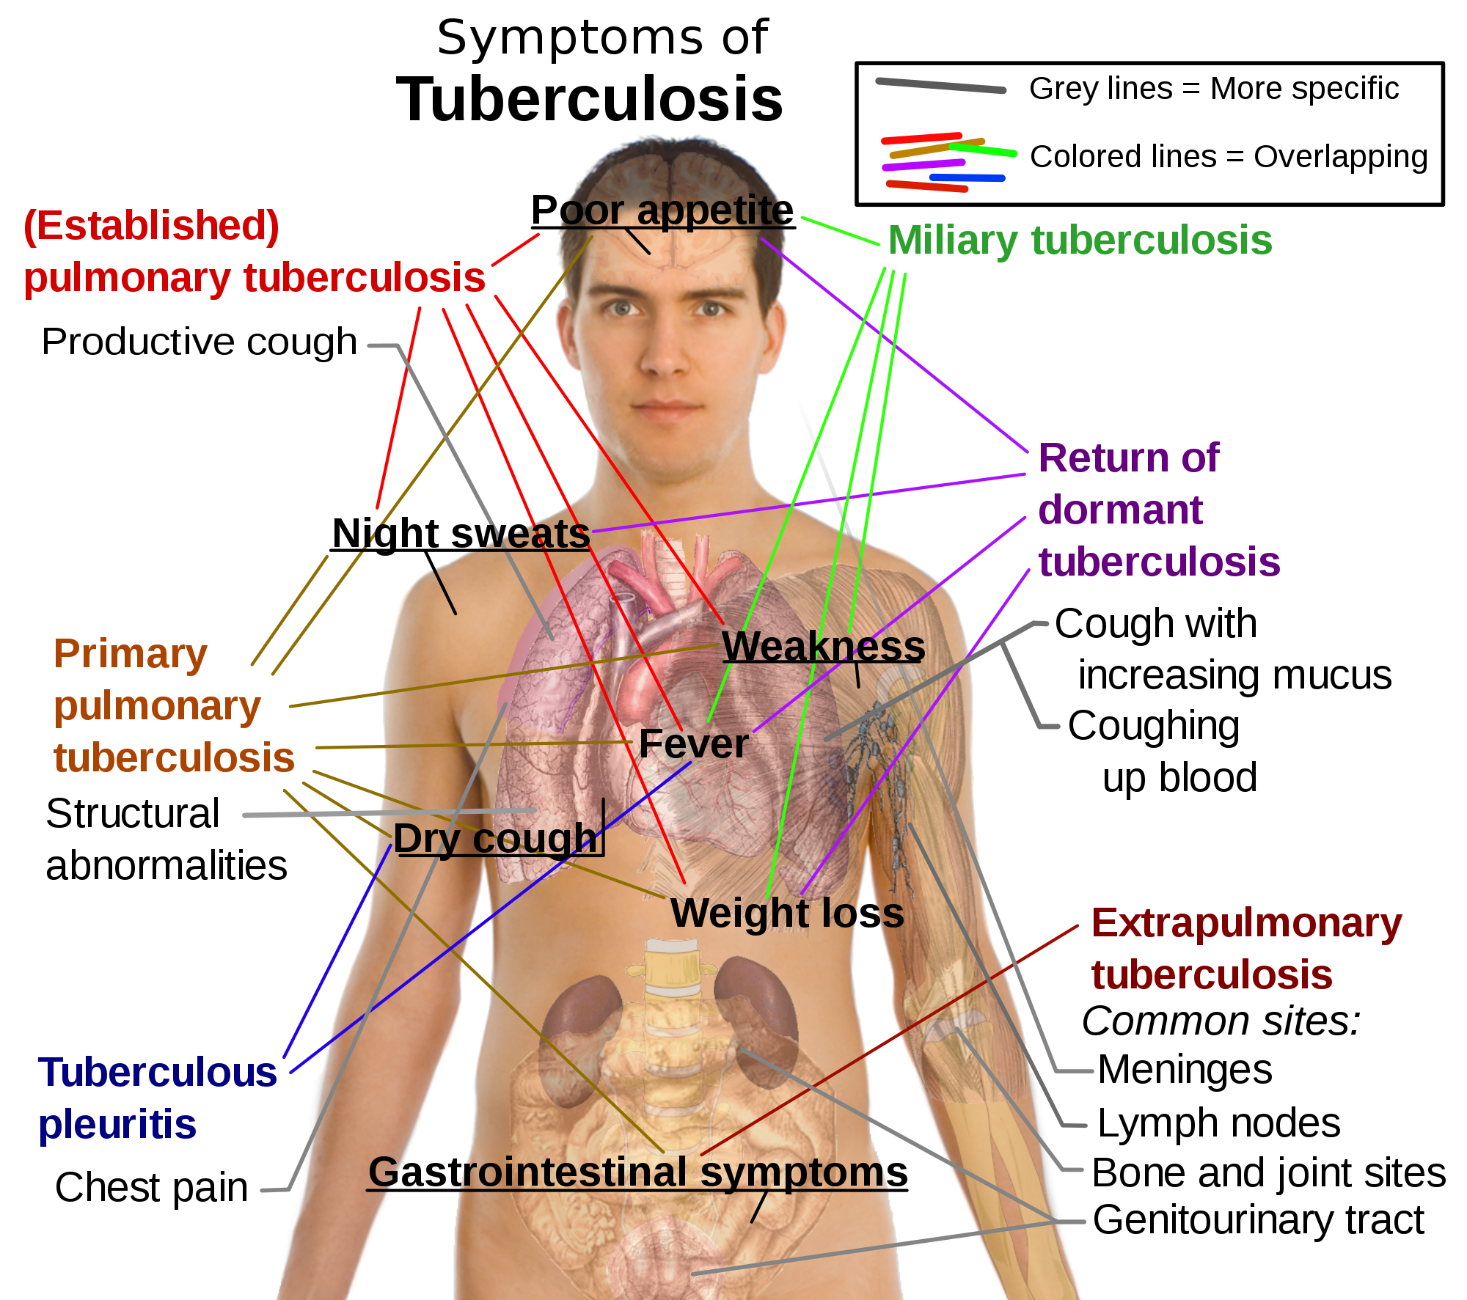
Effects
TBC is a systemic disease
Can simulate many other diseases
Often misdiagnosed
Deadly in late stages

Slide 5
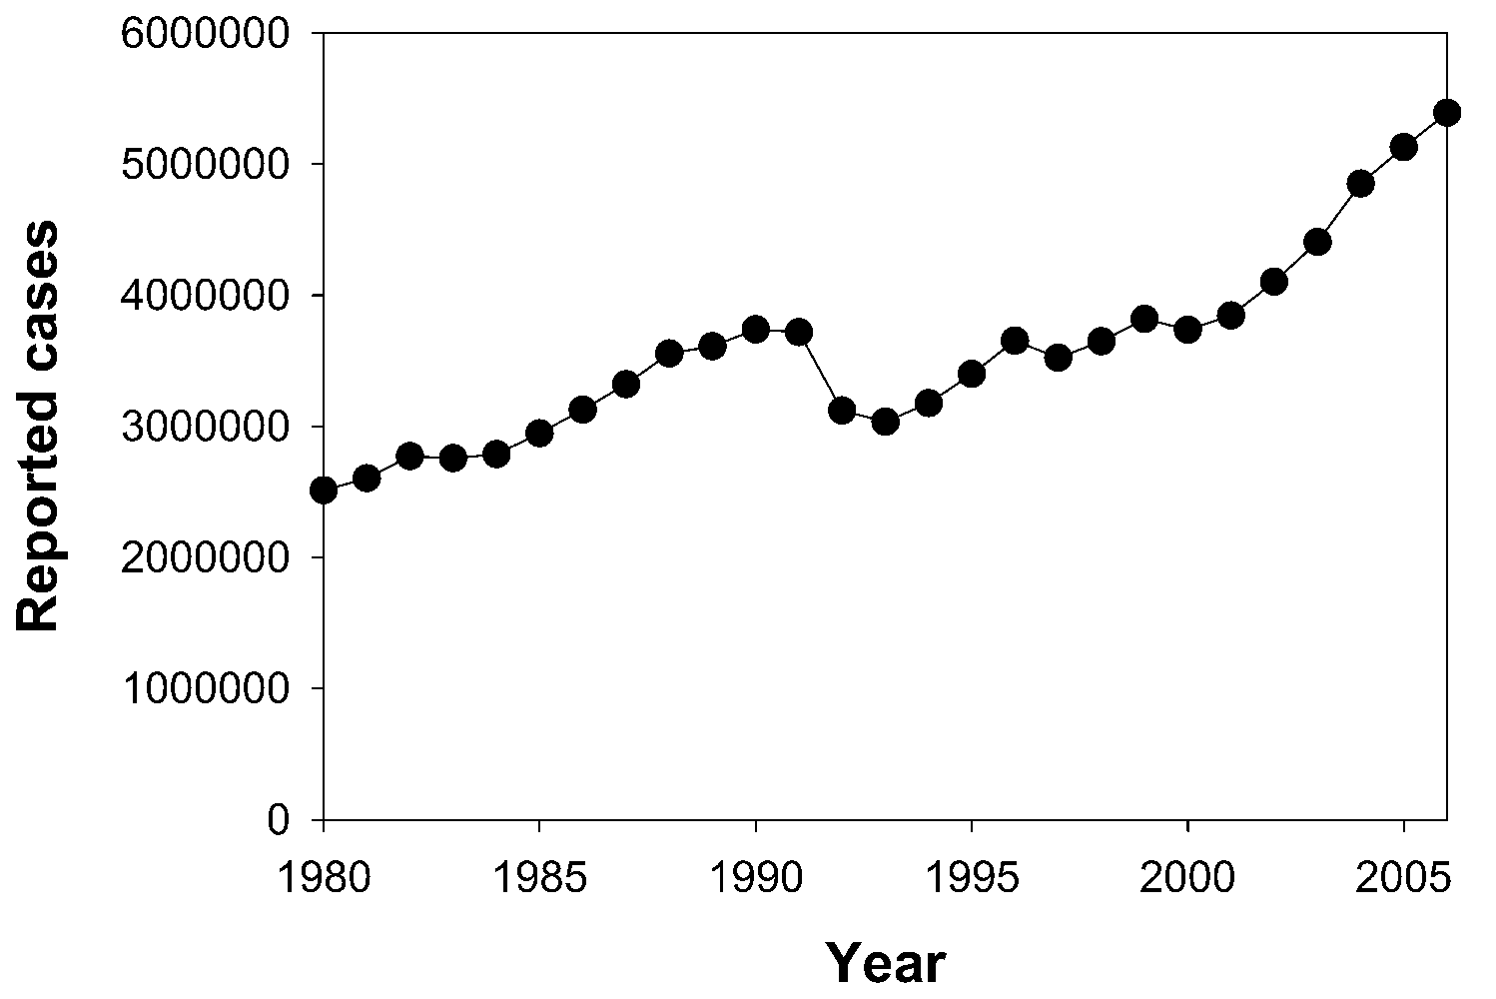
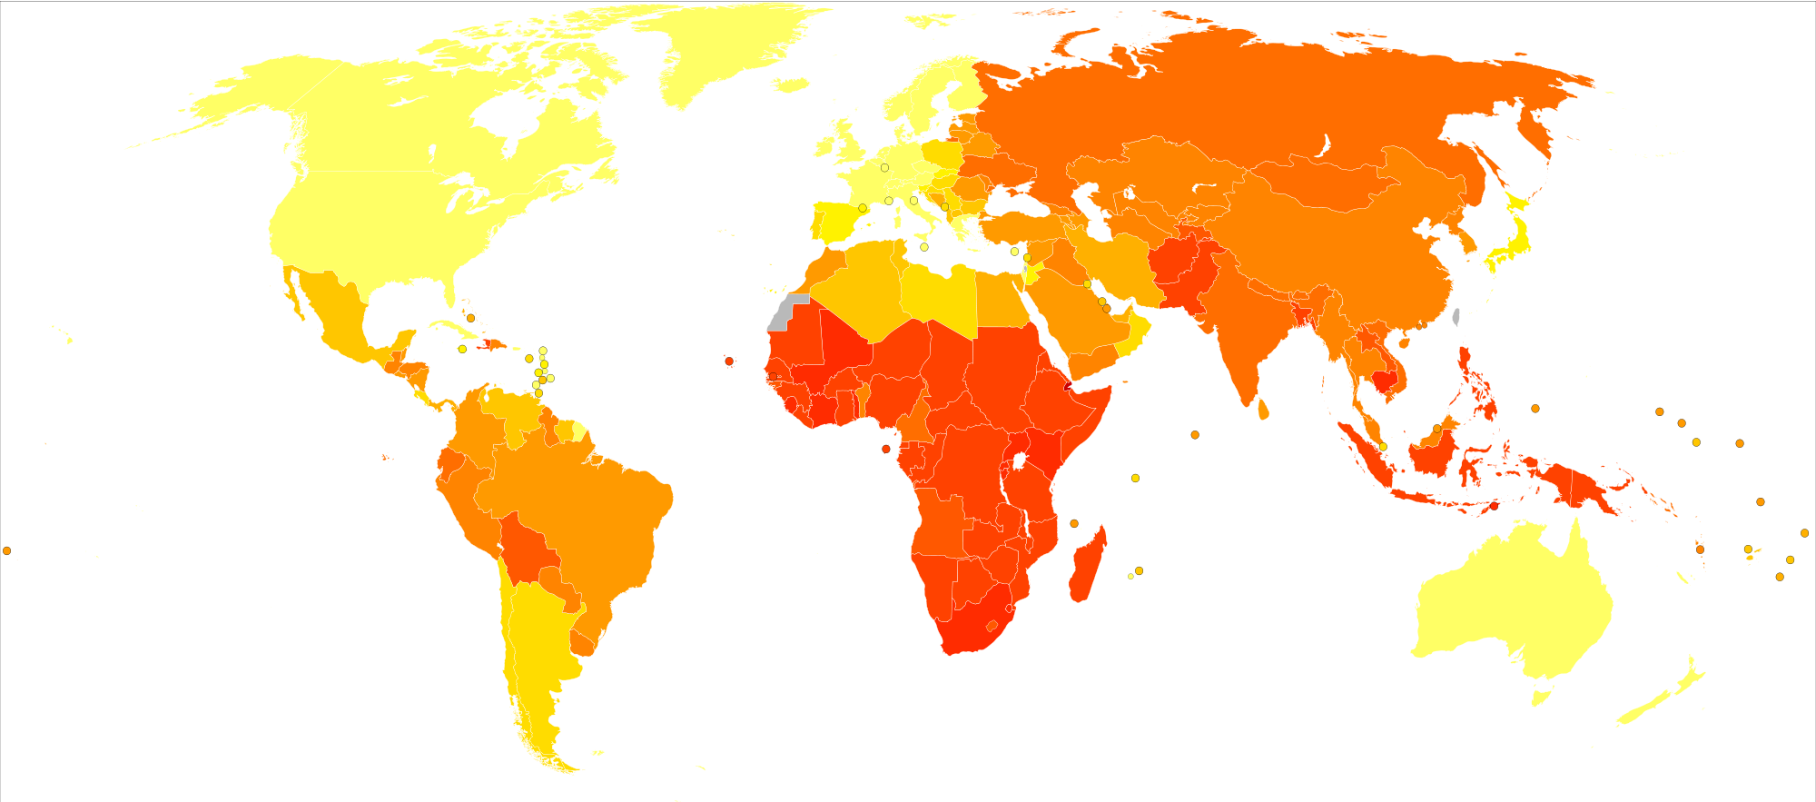
Epidemiology
~1/3 of the world population has been infected
1 new infection per second
Resurgence
MDR-TB emergence
Age-standardized death from tuberculosis per 100,000 inhabitants in 2004

Slide 6
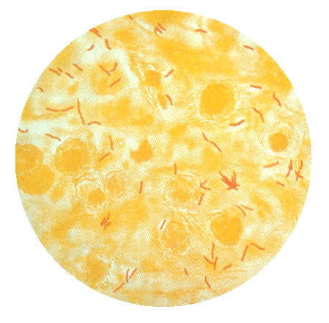
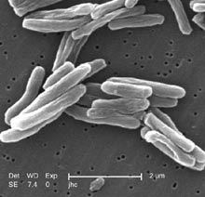
The culprit
Mycobacterium tuberculosis
  Aerobic bacillum
  Slow growth
  Genetically diverse
  Undigestible by macrophages

Slide 7
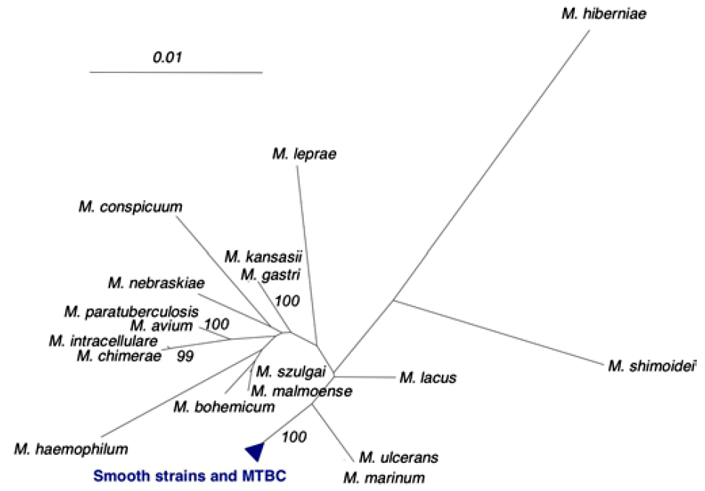
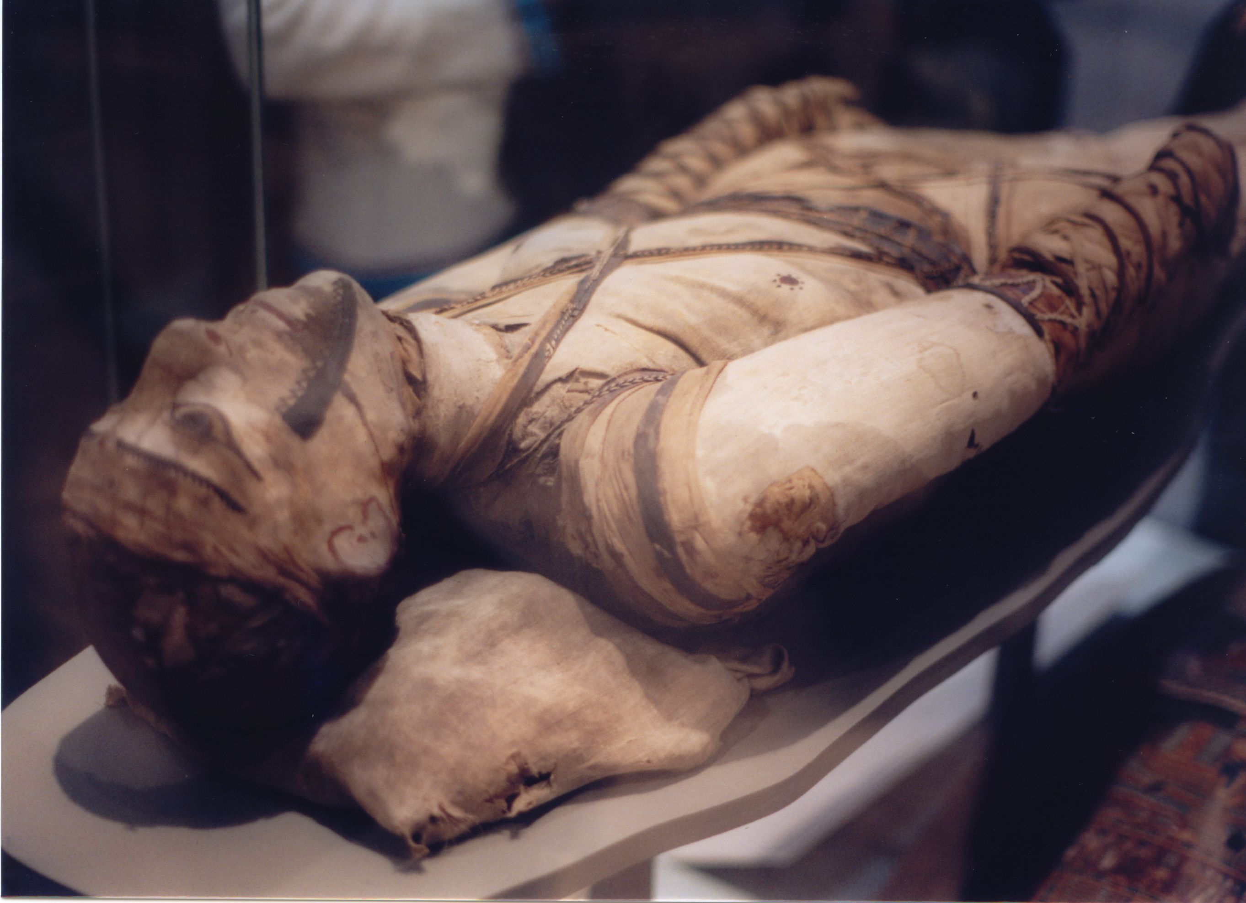
The convict's family
Genome of H37Rv
  Bison 18K years BC
  Neolithic men (7K BC)
  Mummies (3K BC)
  Not descended from M. bovis

Slide 8
MDR-TB / XDR-TB
First line therapy
    Ethambutol (EMB, E), Isoniazid (INH, H), Pyrazinamide (PZA, Z), Rifampicin (RMP, R), Streptomycin (STM, S)
    2HREZ/4HR3 (2 months HREZ daily, followed by 4 months HR three times a week)
Multi-drug resistant tuberculosis
    Develops in the course of treatment
    Less fit, less transmissible
    SHREZ+MXF(Moxyfloxacin)+Cycloserine

Slide 9
KatG
Responsible for resistance to INH
Well known
Most mutations are found between codons 138 and 328
with the most commonly observed gene alteration being
at codon 315 of the katG gene (Slayden and Barry, III,
2000). The Ser315Thr substitution is estimated to occur
in 30–60% of INH resistant isolates (Ramaswamy and
Musser, 1998; Musser et al., 1996; Slayden and Barry, III,
2000). The katG 463 (CGG-CTG) (Arg-Leu) amino acid
substitution is the most common polymorphism found in
the katG gene and is not associated with INH resistance.

Slide 10
KatG S94A
Build mutant
  From wild type
  InsightII Biopolymer
Molecular docking
  Refine INH using MOPAC
  AutoDock/AutoGrid
Molecular Dynamics simulation
  Amber8 using AMBER2003 FF

Slide 11
KatG S315T
Build mutant
  MODELLER
Dock INH
  Autodock/AutoGrid
MD
  TINKER, GROMACS
QM
  MOPAC

