Slide 1

Theory of Molecular Dynamics Simulations

Slide 2
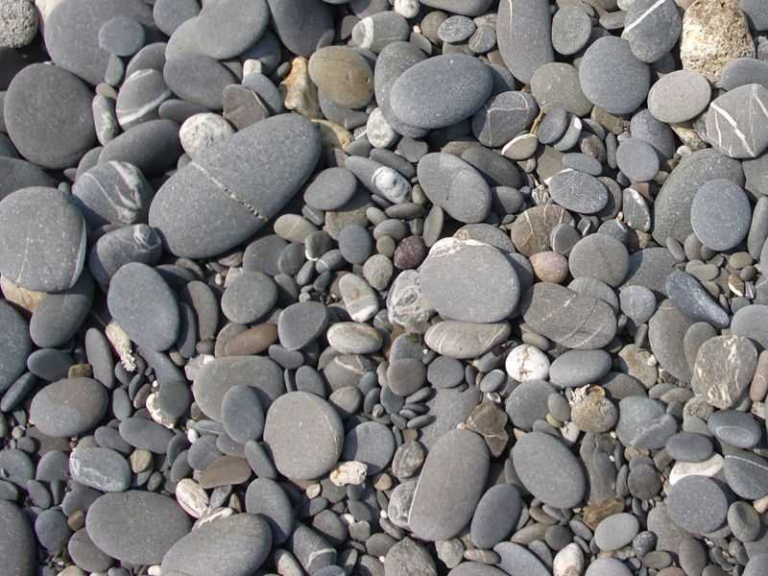


Lecture Outline
Molecular Dynamics
  History
Reason for Molecular Dynamics
  Statistical Mechanics
  Ensembles
Basic Molecular Dynamics
  Classical Mechanics
  Integration algorithms
Practical Molecular Dynamics
  Potential energy functions
  Special treatments (non-bonded, solvation, PBC)‏
Running a simulation
  The heat-stabilize-measure-analyze cycle

Slide 3
Molecular Dynamics
History

Slide 4
Molecular Dynamics
Theoretical study of molecular behavior
  Fluids
  Solids
  Biological macromolecules
Focus on Dynamic behavior
  Stability
  Conformational changes
  Protein folding
  Molecular interactions
  Molecular transport
  Drug design
  Macromolecular ensembles
  X-ray and NMR refinement...

Slide 5
History
Originally introduced in late 1950’s to study atomic interactions as hard spheres.
Study fluid dynamics
Development of realistic models (soft spheres)‏
Development of realistic potentials (interactions)‏
Development of protein potentials
Today, MD is used for anything from structure refinement to macromolecular simulations.

Slide 6
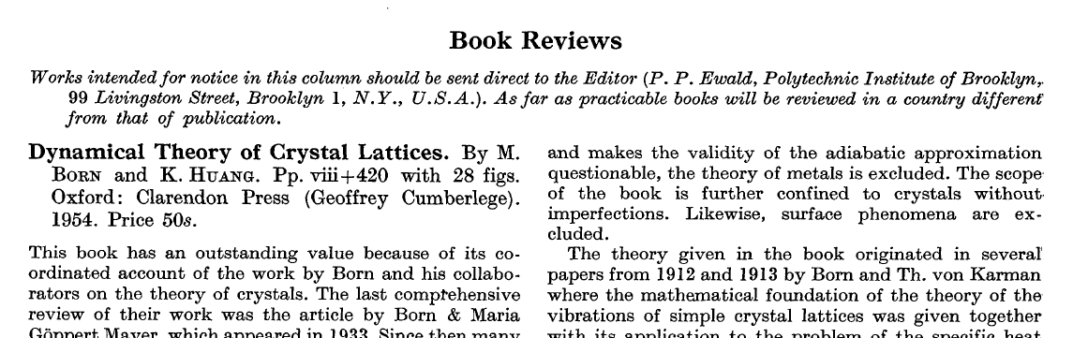
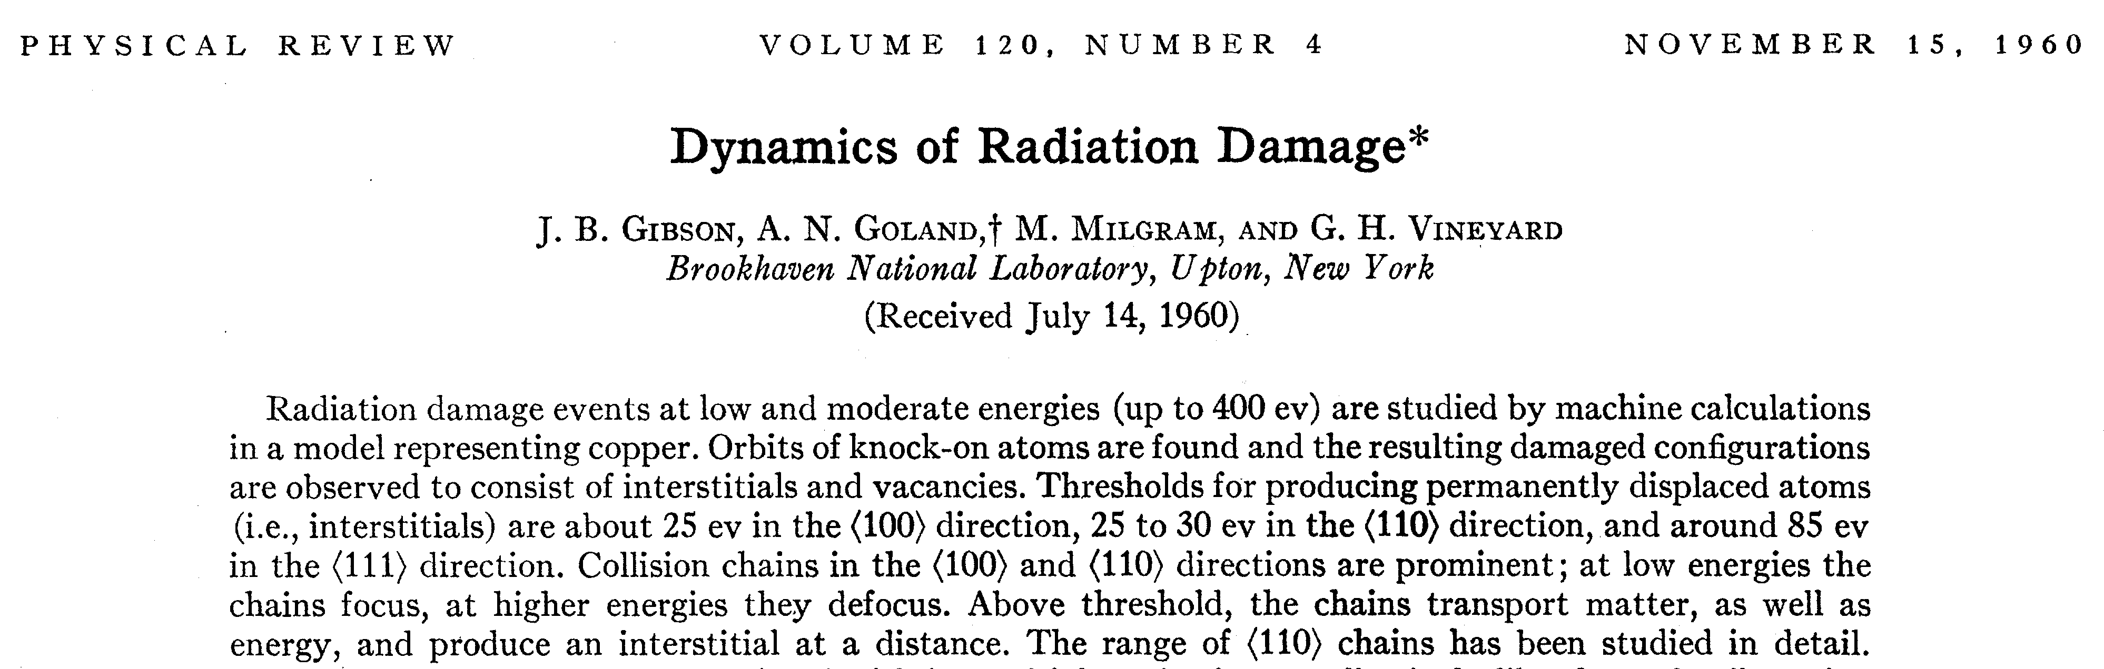

Slide 7
Molecular Dynamics
The basics: Statistical Mechanics

Slide 8
Statistical Mechanics
One experiment does not make science.
  One random experiment much less
  Molecules exhibit brownian motion
  We can induce a givenmotion pattern... over the brownian motion
  One experiment does not make science
In order to translate molecular data to macroscopic observables we need an statistical approach
Statistical mechanics studies macroscopic processes from a molecular point of view.
  Provides rigorous mathematical treatment
  Works from time-independent statistical averages

Slide 9

Statistical Mechanics: definitions
Thermodynamic state of a system
  Defines system state through thermodynamic parameters:
    Temperature (T)‏
    Volume (V)‏
    Pressure (P)‏
    Number of molecules (N)‏
    E, U, µ, etc...
Mechanical or microscopic state
  Defined by atomic positions (q) and momenta (p)‏
    Coordinates in phase space
    A system with N particles has 6N coordinates
    A point G in phase space defines an state of the system
Ensemble
  A collection of points in phase space satisfying a given thermodynamic state.

Slide 10
Ensembles
An ensemble is a time independent collection of configurations with the same thermodynamic properties (e. g. generated by Monte Carlo)‏
  NVE (microcanonical ensemble)‏
  NVT (canonical ensemble)‏
  NPT (isobaric-isothermal ensemble)‏
  mVT (grand canonical ensemble: fixed chemical potential m (μ), volume and temperature).
    μ = ∂U / ∂N
    N and U (internal energy) may change as long as μ is constant

Slide 11
Computing observables
Statistical mechanics collects data from an ensemble to compute averages and deduce macroscopic properties
  <A> (average of A) where
    A(p^{N}, r^{N}) is the observable as a function of particle positions and momenta
    A depends on the partition function (how configurations are distributed in the ensemble)‏
    The partition function depends on all possible states
    MC goal is to generate enough conformations
The ergodic hypothesis
  <A>_{ensemble} = <A>_{time}
    Allows us to evaluate <A> from configurations generated over time using MD
    MD tries to generate enough configurations to satisfy this equality

Slide 12
Molecular Dynamics
The method

Slide 13
Molecular Dynamics
Generate conformations in an ensemble using time dependence:
  Consider atoms and molecules as a classical system
  Use classical dynamics to compute movement (µ) and positions (r)‏
  Newton’s laws:
    F_{i} = m_{i}·a_{i}
    F_{i} = -½ ∇_{i}V (where V is the potential energy of the system)‏
    a = dv /dt = - (1/m) (dE / dr)‏
    v = a·t + v₀= dr / dt
    r = v·t + r₀ = a·t² + v₀·t + r₀
  Therefore we need
    Initial positions (r₀) and velocities (v₀)‏
    A way to compute potential energy changes (∇V)‏

Slide 14
Performing a simulation
Start from initial positions and velocities
  Assign initial positions (e. g. randomly for a fluid)‏
  Assign initial velocities (e. g. randomly from a Maxwell-Boltzmann or Gaussian distribution) at a given temperature
  Select a suitable potential energy function (to compute the gradient of V)‏
  Set the daemons loose...
Evaluate the potential energy and update positions and velocities (momenta)‏
  V depends on positions of all particles
  Too complex to evaluate analytically
  Needs numerical integration

Slide 15
Verlet algorithm
Does not use velocities
At each step ∂t:
  Compute accelerations at time t (a_{t})‏
  Use a_{t} and positions at time t and time t-∂t to compute new positions (for time t+∂t)‏
    r_{t+∂t} = 2r_{t} – r_{t-∂t} + a_{t} ∂t²
  Note that v = (r_{t} – r_{t-∂t}) / ∂t
Advantages:
  Easy to implement
  Moderate requirements
Disadvantages
  Moderate precision

Slide 16
Leapfrog
Compute velocities at time t + ½ ∂t
Use these to compute positions at t + ∂t
  r_{t+∂t} = r_{t} + v_{t + ½ ∂t} ∂t
  Velocities and positions leap (jump) ever each other like a frog
Advantages
  Velocities are calculated explicitly
  But not at the same time as positions

Slide 17
Velocity Verlet
Uses positions, velocities and accelerations at time t
There is no compromise on precision
Requires more computation
  r_{t+∂t} = r_{t} + v_{t}·∂t + ½ a_{t}·∂t²

Slide 18
Beeman
Closely related to Verlet
  r_{t+∂t} = r_{t} + v_{t}·∂t + (2/3) · a_{t}·∂t² – (1/6) ·a_{t-∂t}·∂t²
Advantages
  More accurate velocities
  Better energy conservation
Disadvantages
  More complex
  More expensive

Slide 19
Molecular Dynamics
The force field
(Potential Energy function)‏

Slide 20
The force field
An analytical potential function is unfeasible
  Depends on all particles
  Depends on interactions among them
A numerical approximation is used instead
  Integrated using a suitable method
  Parameterized for a specific problem
    Experimental results
    Quantum mechanical computations
    Tested against experiment
No changes in electronic structure are allowed
  Non bond-breaking/making allowed
Atoms in molecules (do they exist??) and interactions are modeled as classical particles and forces.

Slide 21
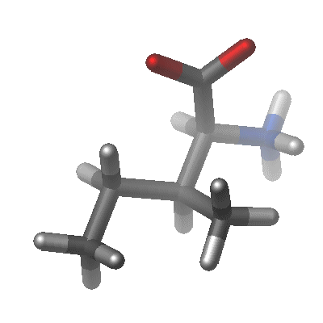
A general potential force field
Potential energy is a function of atomic positions
  V = E_{bonded} + E_{non-bonded}
  E_{bonded} = E_{bond-stretch} + E_{bond-bend} + E_{bond-rotation}

Slide 22
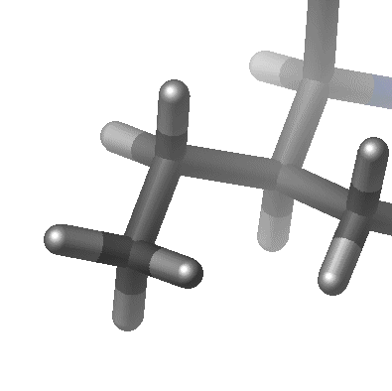
Bond stretch
Modeled as an harmonic potential
Energy among two atoms joined by a covalent bond
  Change in Energy as bond lengths deviates from ideal
    K_{b} (b – b₀)²
  Must be summed for all bonds
  Both K_{b} and b₀ are bond specific and must be tabulated for each bond type
    Depends on bond order and
    atoms bonded

Slide 23
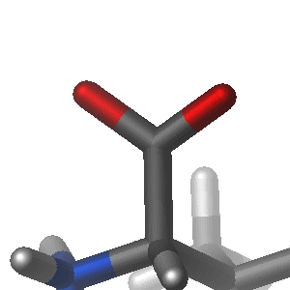
Bond bending
Depends on changes in the angle between two bonds
  Involves angle between three atoms
  Computed as an harmonic potential depending on the ideal bond angle
  E = K_{θ} (θ – θ₀)²
  Must be computed for all bond angles
  K_{θ} and θ₀ depend on bond orders and chemical types of the atoms involved
  Must be tabulated for all combinations

Slide 24
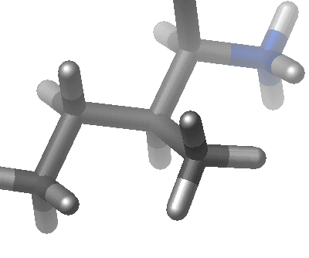

Bond torsion
Involves the effect of torsion around a bond
  Reflects steric effects between atoms separated by three covalent bonds
  Described by a dihedral angle and a coefficient of symmetry
  Modeled as a sine function series
Some force fields (e. g. CHARMM) add
  Urey-Bradley term
    atoms separated by two bonds
  Improper dihedrals
    used to maintain
      Planarity
      Chirality

Slide 25
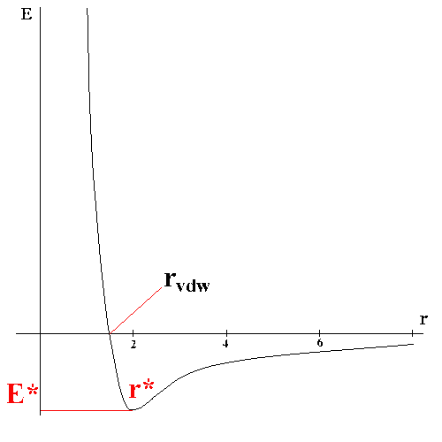
Non-bonded interactions
Sum of all inter-atomic interactions
  Van der Waals
  Electrostatic
  Hydrogen bonding (optional)‏
  Must be computed for each atom against all others (N²)
  Van der Waals
    Computed as a Lennard-Jones potential
  Electrostatic
    Computed as classical interaction

Slide 26
Considerations
Potential energy is differentiable against atomic coordinates
  Gives the value of the force acting on each atom
An empirical function has limitations in accuracy
  Fixed set of atom types
    Same atom acts differently on different environments
    Definition of extra atom types
  Speedup approximations
    Additive approximation
      Interaction of atom with system computed as sum of one atom to one-atom interactions
      Ignores polarization effects
  Entropic effects not included in single calculations
    Minimum E need not correspond to equilibrium E
    Entropic effects are included in MD simulations

Slide 27
Treatment of non-bonded terms
They are the most expensive element in the evaluation of the potential energy function
Require N² evaluations (all atoms against all others)‏
Can be reduced by using a cutoff
  Truncation
    Large energy fluctuations
    Rarely used
  SHIFT (modify entire surface)‏
    Slight decrease in equlibrium distances)‏
  SWITCH (two cutoffs and progressive change)‏
    Strong fluctuation in switch regions
    Avoid for small cutoff regions

Slide 28
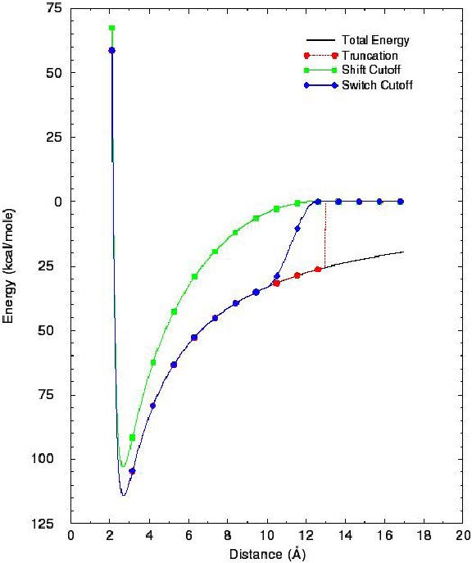
Cutoffs

Slide 29

Long range electrostatic interactions
Important in many system
Increasing cutoff raises computational cost
Approximations have been developed
  Proteins or enzymes in crystalline state
    Ewald summation
    Particle-mesh Ewald method
  Non periodic systems (e. g. enzyme in solution)‏
    Multipole expansion
      Short range component evaluated pairwise
      Long range component substituted by a multipole
        Extended electrostatic model
        Fast Multipole Method

Slide 30
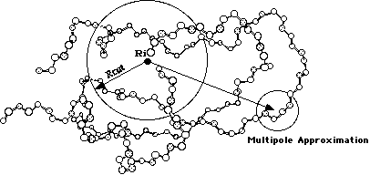
Extended Electrostatics model

Slide 31
The solvent
Has a strong influence
Involves a potentially large amount of additional molecules (and interactions)‏
Approaches
  Implicit solvent models
    Substitute solvent by an approximation
      Effective dielectric constant (e. g. 80 for water)‏
      Distance-dependent dielectric coefficient
      Continuum electrostatic theory
  Explicit solvent models
    Include the solvent as an explicit element of the calculation
      Dielectric constant should be set to 1
      Requires boundary conditions to avoid leakages

Slide 32
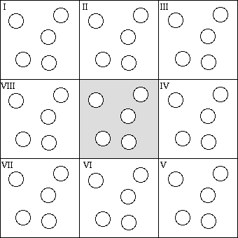
Periodic Boundary Conditions
Reduce simulation cost by “replicating” a unit cell many times
  Replication is virtual
  Particles exiting the cell on one side re-enter it on the opposite side
  Interactions are computed considering adjacent cells (modulo cell size)‏
    Cutoffs must be used
    shorter than cell size
    to avoid a particle seeing
    its own image in replica cells

Slide 33
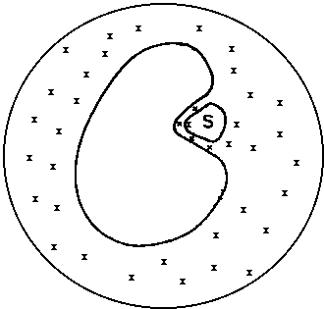
Solvation shells
Avoid using periodic boundary conditions
Allows inclusion of explicit solvent molecules
  Build a droplet engulfing the system
  Use spheric boundary potentials to confine water inside the shell
  Requires less molecules than periodic boundary conditions
    Still, a significant amount

Slide 34
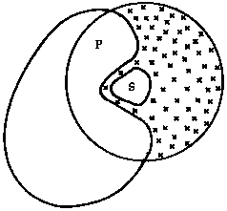
Active site solvation
We can further reduce solvation to the active site
  When we have a large structure
  But are interested in only one section
  Partition the enzyme in two regions
    Active site/Reaction zone
      Solvated
      Allowed to move during the simulation
    Reservoir zone
      Unsolvated
      Movement restricted
        Harmonically
        Fixed
Dramatically reduces cost
  If we are only interested in one region

Slide 35
Molecular Dynamics
Running a simulation

Slide 36
What’s in a run?
Start from initial coordinates and momenta
Using classical physics and a potential energy function generate a time series of conformations
  A trajectory (the path followed by each atom according to classical mechanics)‏
  Usually in the microcanonical ensemble (NVE)‏
  Recently isothermal-isobaric (NTP)‏
Analyze the conformations (trajectory)‏
Requires a suitable starting point

Slide 37
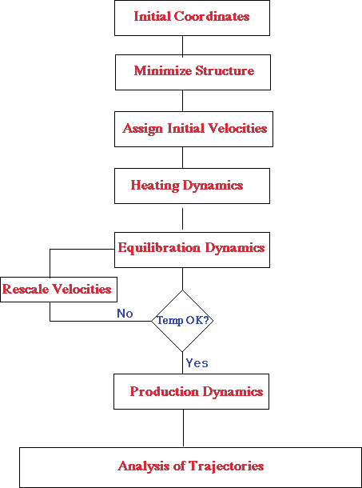
Flowchart

Slide 38
Initialization
Select a 3D coordinate dataset
  E. g. a conformation from a PDB file
  Simulation will be very sensitive to initial configuration
  Should be close to the state we want to model
  Complete the structure if needed
    Many structures lack H or H bonds
  It is often (not always, THINK!) advisable to optimize the structure
    Energy minimization/relaxation by molecular mechanics
      Remove strong Van der Waals (steric) effects
    Simulated annealing cycles
      Skip local minima (heat, cook, cool cycles)‏
  Add explicit solvent molecules (if needed)‏
    Use a minimized box of solvent
    Minimize solute-solvent complex

Slide 39
Heating the system
A minimized structure is (supposedly) the most stable structure
  0 ºK
Assign initial velocities at a low temperature
Start the simulation
At periodic times, velocities are adjusted to a slightly higher temperature
Until we reach the simulation temperature
  Take off the freezer and thaw
Solvated case:
  If solvent is present, allow solvent to equilibrate first
  Then equilibrate the complex solvent+solute

Slide 40
Equilibration
Once the desired temperature is reached
Keep the system at the desired temperature
Until the system equilibrates
  If temperature changes readjust velocities
    Nosé-Hoover thermostat
    Berenden velocity scaling
    Andersen stochastic collisions
    Langevin piston
  Monitor variables
  Check property stabilization with respect to time
Goal is to ensure our initial configuration (coordinates, momenta) is as close as possible to the system we want to simulate.

Slide 41
Production
We are now ready to formerly conduct the simulation
Continue simulation for the time length desired
Keep system on desired thermodynamic conditions
  Ensemble
Collect parameters of interest
  Save trajectory (coordinates, velocities)‏
Monitor progress
  Simulation proceeds by finite steps
  Energy might not be conserved
    Cutoff
    Time step
    Rounding errors due to finite precison
    etc...
  Monitor energy conservation and stability during the time series.

Slide 42
Analysis
The final step to our goal
Start from trajectory of the system
  Graphical visualization
    Animations
      Useful to understand conformational changes
    Time series graphs
      Energy
      RMSD and fluctuations
      Radius of gyration
      Correlation functions, etc...
  Compute averages
    Structural properties
    Thermodynamical parameters
    Chemical-physical properties
    Etc...
  Transform into macroscopic observables

