Slide 1

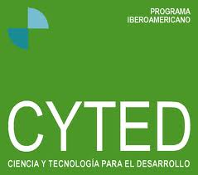
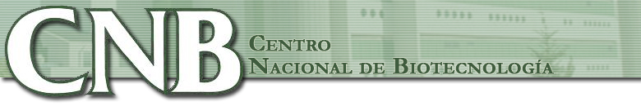

Hunting PP
CNB/CSIC
José R. Valverde
Britt Mellström
José R. Naranjo
FreeBIT/CYTED

Slide 2
Outline
Hunting Protein-Protein interactions in 13 steps (novel DREAM dimerization)
Step 0: Read bibliography
Step 1: Search for homologs
Step 2: Multiple Alignment
Step 3: Coevolution Analysis
Step 4: Predict interating proteins
Step 5: Predict interacting a. a.
Step 6: Homology modeling
Step 7: ab initio modeling
Step 8: Build ionic models
Step 9: Molecular refinement
Step 10: Protein-Protein docking
Step 11: Dimer analysis
Step 12: Dimer refinement
Step 13: Region analysis

Slide 3
0: Read Bibliography
Should be the initial step in all cases
Should have been already done
Likely to be neglected
  It is funnier to play from the start
Guides all subsequent analysis and experiment
Allows taking a decision
  Is it worth the trouble?

Slide 4
Step 0: What was known
From bibliography, Calsenilin:
  Has four EF hands, two of them bind Ca⁺⁺
  Full-length protein is 100% insoluble (expose hydrophobic domain)
  Ca⁺⁺ dimerizes the protein (L155+L159 ↔ L251) and increases 7% alpha helix (likely covering hydrophobic domain)
  Co-expressed with PSEN2 moves to membrane, alone to cytosol
  N-term unstable random coil (NMR), cleaved by Caspase3 (DXXD)
  L155XXLL involved in vitamin D interaction (surface)
  Mg⁺⁺ binds EF-II and is involved in DNA interaction
  Solvent exposed groove with F₁₀₀, F₁₁₄, I₁₁₇, Y₁₁₈, F₁₂₁, F₁₂₂, Y₁₅₁ and L₁₅₅ implicated in target DNA recognition

Slide 5
Step 0: what wasn't written
From experiment we learn that
  C₄₆C₄₇ -> S₄₆S₄₇ increases DNA binding strength
  In presence of Mg⁺⁺ W₅₀ interacts with Y₂₀₃ in region between EF-III and EF-IV
  With Mg⁺⁺ it dimerizes in a different way from the known Ca⁺⁺ dependent one (insoluble)
Which are the key interacting amino acids in presence of Mg⁺⁺?

Slide 6
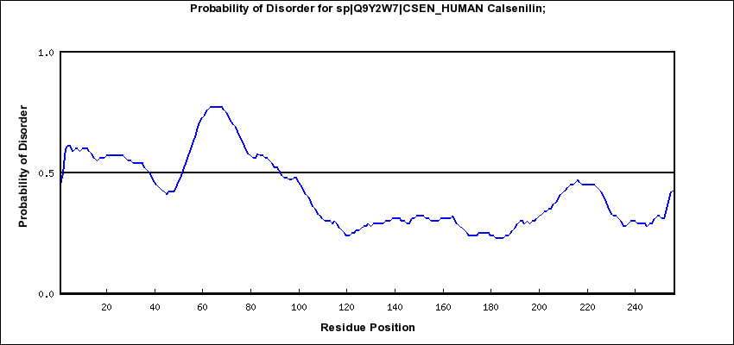
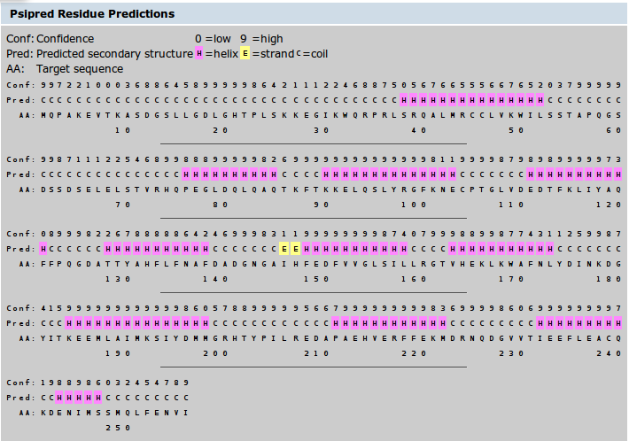
Step 0: preliminary analysis
Non disordered region around W₅₀
likely in alpha-helix conformation.

Slide 7
Step 1: Search for homologs
Protein
  Human
  Bovin
  Rat
  Mouse
PDB
  Human (EF 3-4)
  Mouse (EF1-4)
Nucleic Acids
+ Crab-eating macaque
+ Chicken
+ Beetle (Cowpea bruchid)
+ Fish (Gold, Zebra,Sable...)
+ Coral (Acropora millepora)
+ Ascaris suum
+ Trichinella, Schistosoma

Slide 8
Step 1: same family
KChIP-1/KCNIP-1: Kv channel-interacting protein 1 (recoverin family)
KChIP-2/KCNIP-2: Kv channel-interacting protein 2 (recoverin family)
KChIP 3/KCNIP-3: Calsenilin, DREAM (neuronal calcium sensor family)
KChIP 4/KCNIP-4: Kv channel-interacting protein 4 (recoverin family)

Slide 9
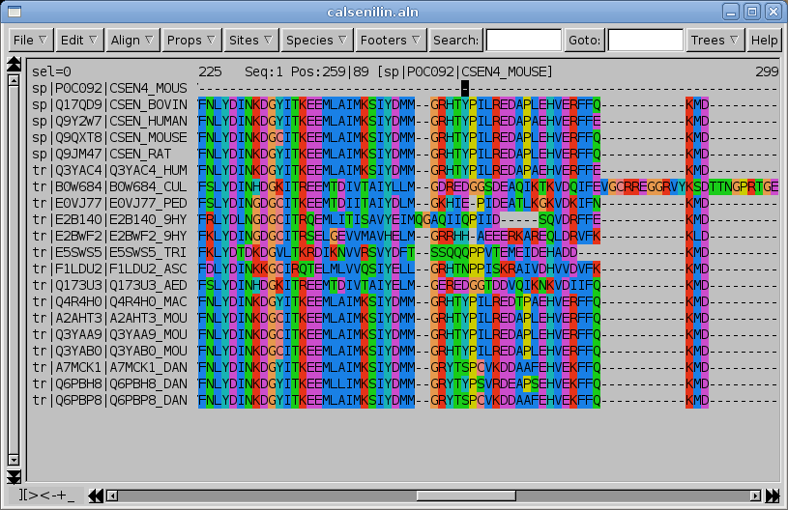
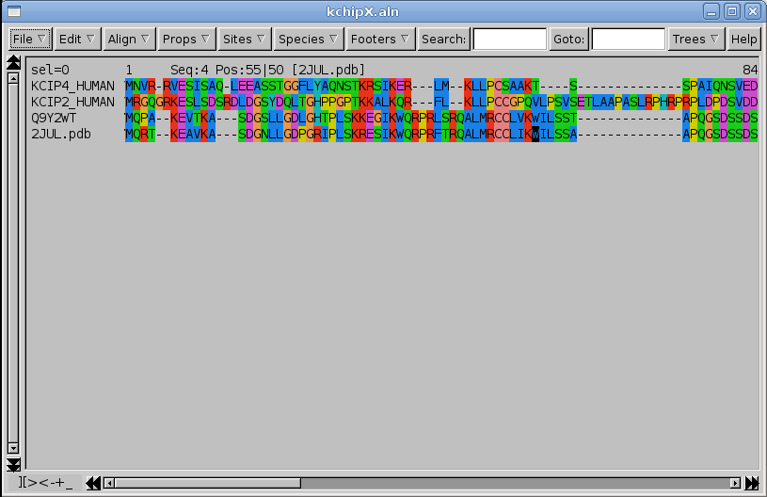
Step 2: Multiple Alignment
Homologue proteins
  Too high conservation
Same family
  Too little conservation

Slide 10
Step 3: coevolution analysis
CAPS results (protein family)
  Unable to find coevolution traces before aa 68 or around Y₂₀₂
    N-term function is privative of DREAM
    Any role is likely due to conformational freedom

Slide 11
Step 4: Predict interacting proteins
PIPs
  Lists 7 interactions for DREAM. It is possible that some of them share common amino acids, so they may be investigated by docking or else
PRISM
  Lists several other putative interactions, which are worth saving for further analysis

Slide 12
Step 5: Predict interacting a. a.
All report a patch in the region of interest covering 8-9 consecutive a. a. but cannot resolve most relevant ones
  ConsPPISP
  MetaPPISP
  Polyview
  PPI-Pred
  ProMate
  ConSurf
  3d_Partner
K A 192 0.265 N
S A 193 0.855 P
I A 194 0.989 P
Y A 195 0.884 P
D A 196 0.980 P
M A 197 0.994 P
M A 198 0.991 P
G A 199 0.977 P
R A 200 0.996 P
H A 201 0.984 P
T A 202 0.993 P
Y A 203 0.992 P
P A 204 0.208 N
I A 205 0.989 P
L A 206 0.926 P

Slide 13
Step 6: Homology modeling
In order to proceed we need a 3D structure
  Homology modeling
    Likely to fail with the N-term as we know it holds no great similarity with known sequences
  Threading
    We may be lucky and find some small patch in the N-term that can be assigned
  There are many servers available
    Which one should we use?

Slide 14
Step 6: Try everything!
Servers
CPHmodels
HHpred
LOOPP (adds heuristics)
MUSTER
Phyre and Phyre2
(ps)²
PsiPred
I-Tasser
Metaservers
GeneSilico: blastp, compass, ffas, fugue, HHsearch, jmbrank, pcons5, pdbblast, phyre, PRC, sparks
LoMets: PSIpred, MUSTER, hhsearch, SAM-T02, Sparks-2, SP3, PROSPECT2, PPA-I, FUGUE
PMP: SwissModel, M4T, ModWeb
27 servers 5-10 models per server

Slide 15
Homology model samples

Slide 16
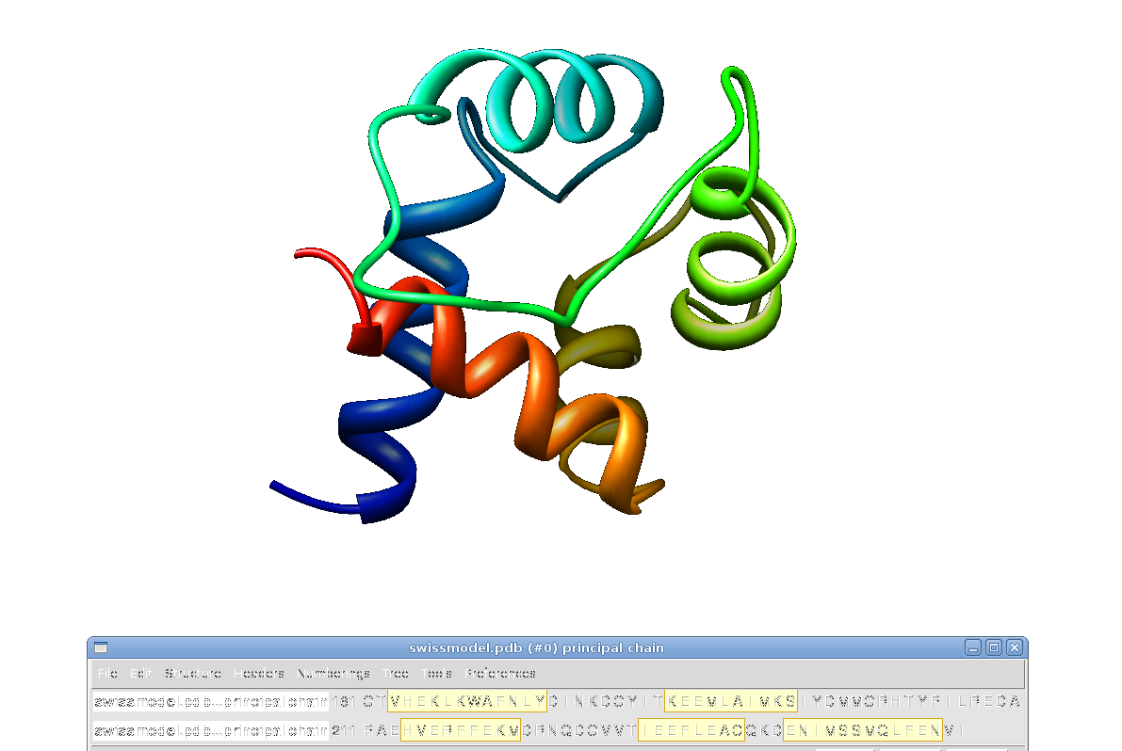
SwissModel

Slide 17
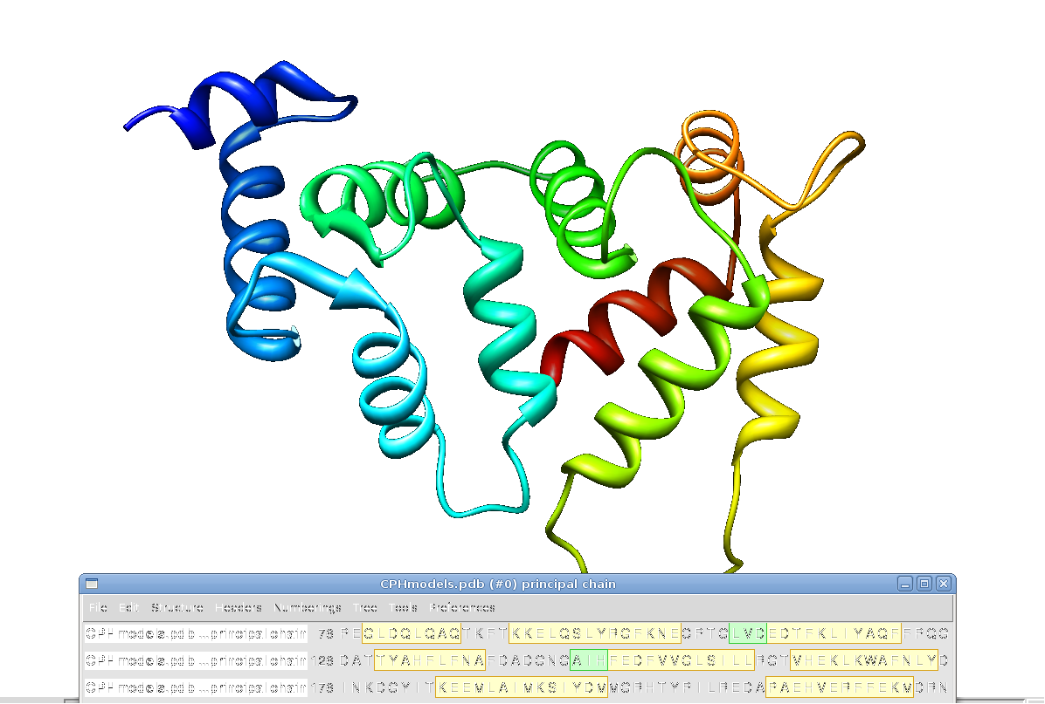
CPHmodels

Slide 18
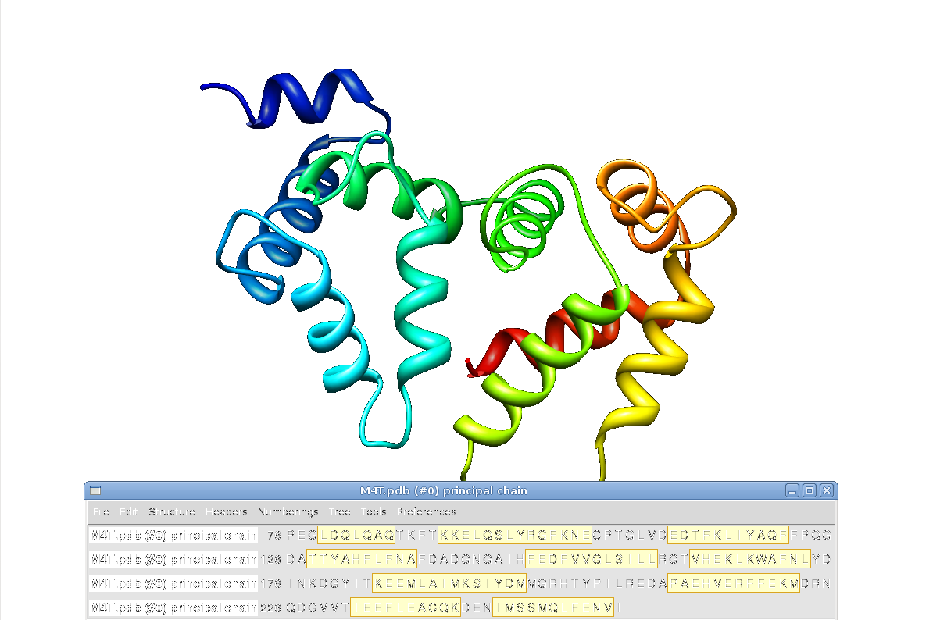
M4T

Slide 19
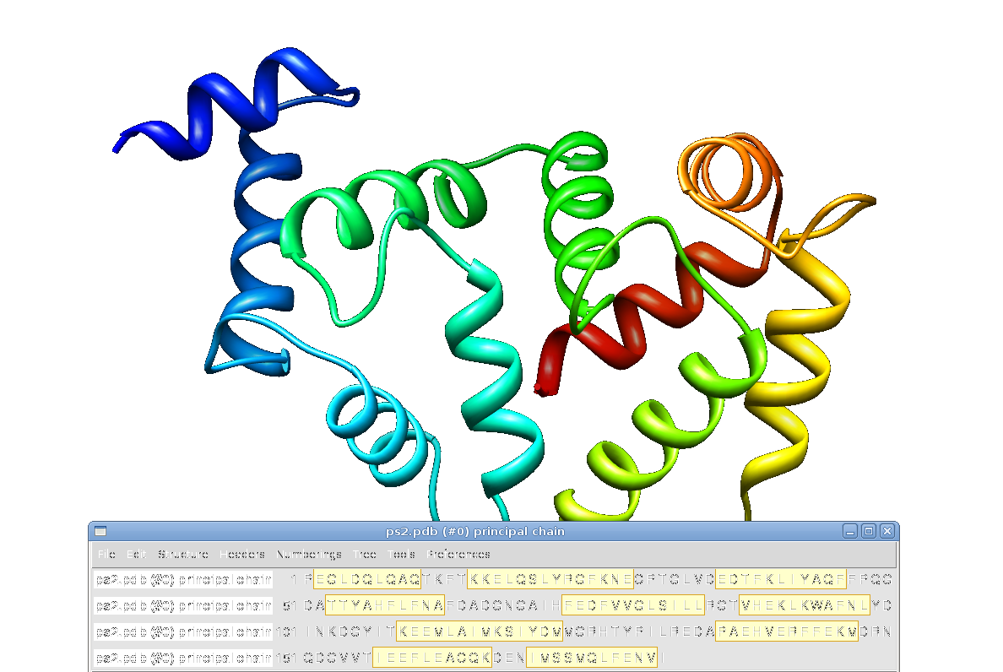
(ps)²

Slide 20
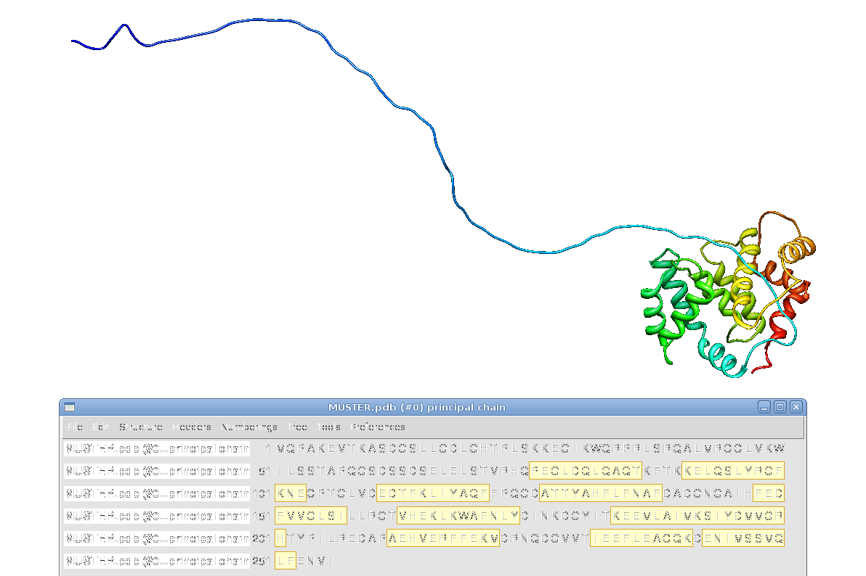
MUSTER

Slide 21
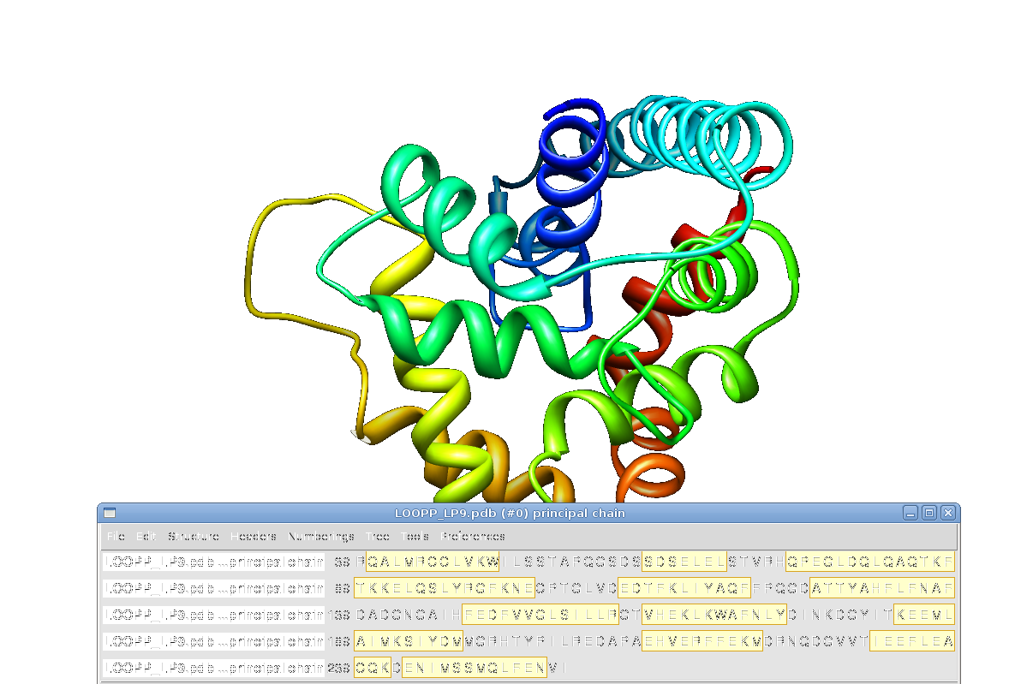
LOOPP LP9

Slide 22
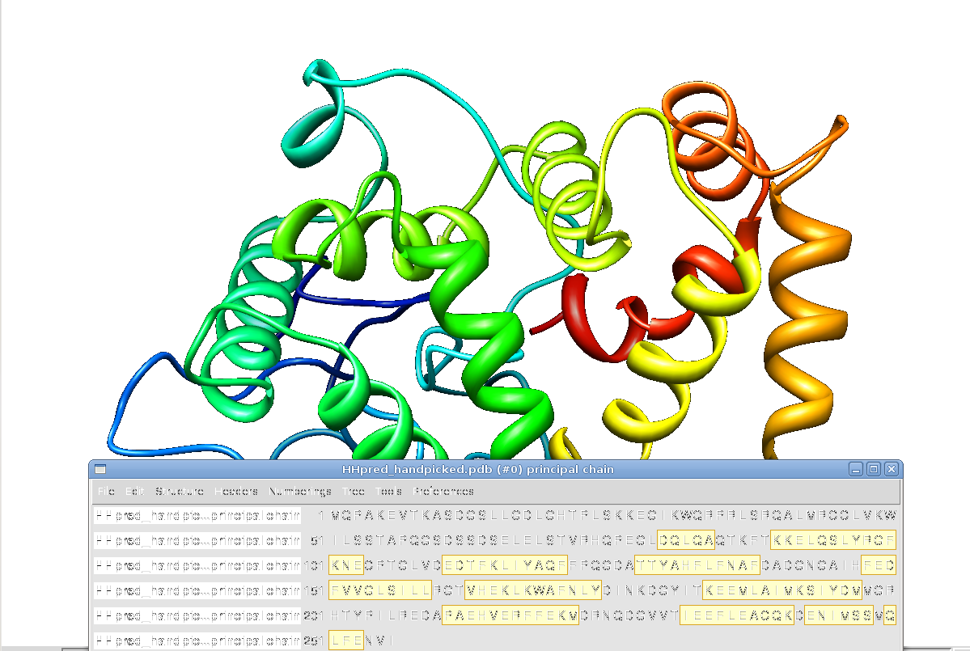
HHpred (handpicked templates)

Slide 23
Step 7: ab initio modeling
Phyre2 (fast/slow)
QUARK (I-Tasser)
Rosetta (Robetta)
Works well for “short” sequences (up to 150-200 aa)
Combine with homology modeling

Slide 24
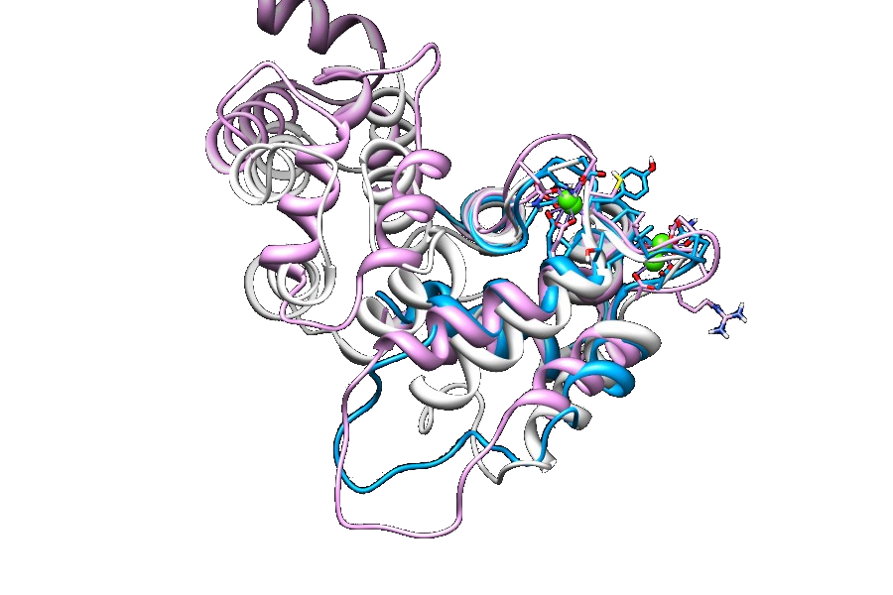
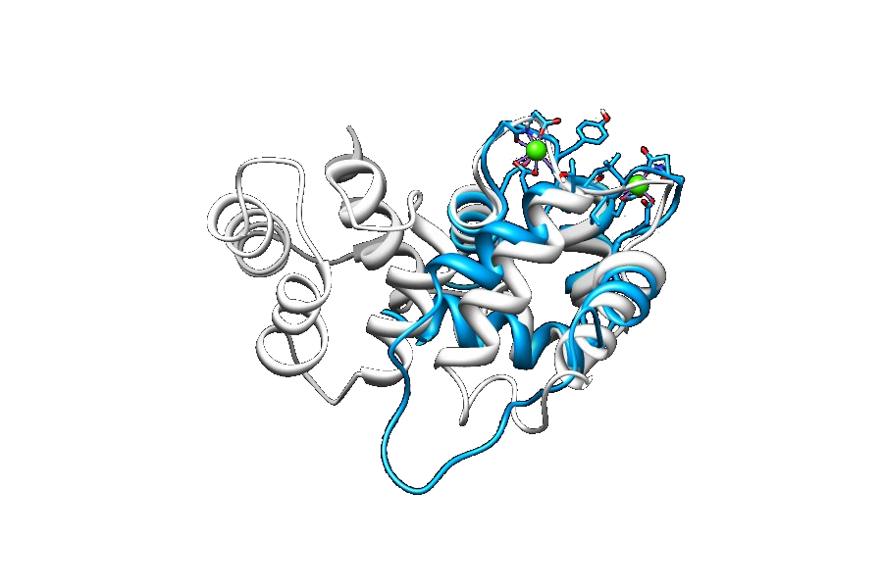
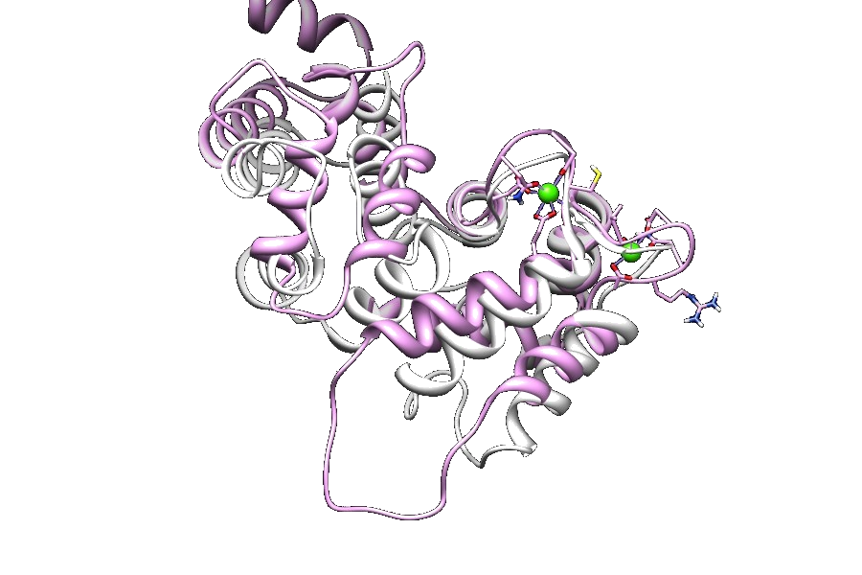
Step 7: ab initio validation
Build models for N-term and C-term
Compare C-term against known structure
  Good prediction quality
N-term mostly alpha helix

Slide 25
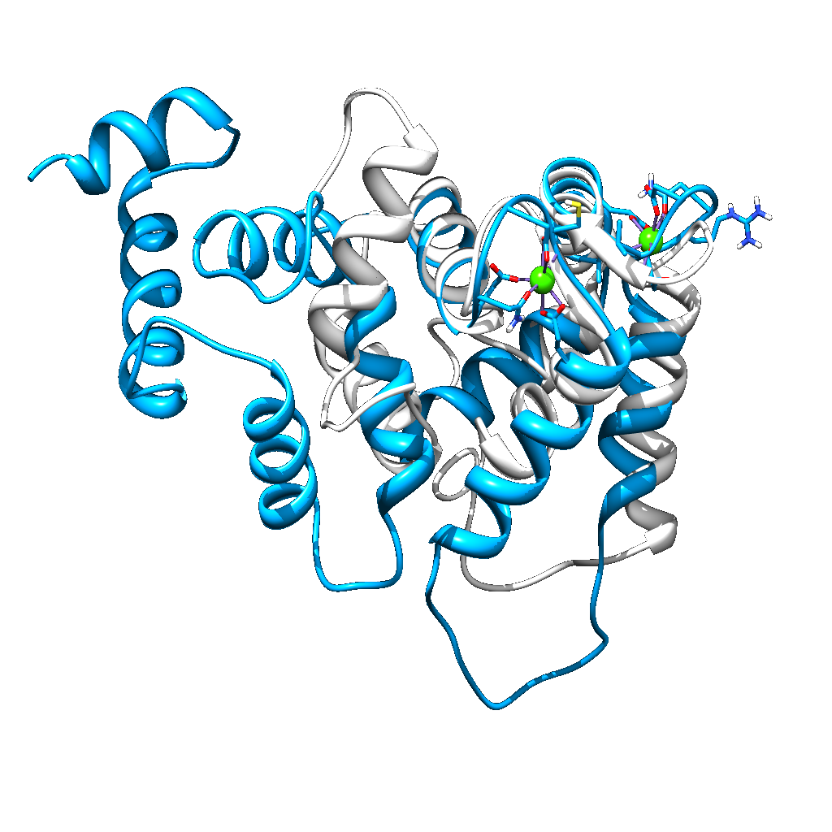
Quark ab initio 1 vs 2jul-A
Structures aligned with UCSF Chimera
and rendered with POV-ray

Slide 26
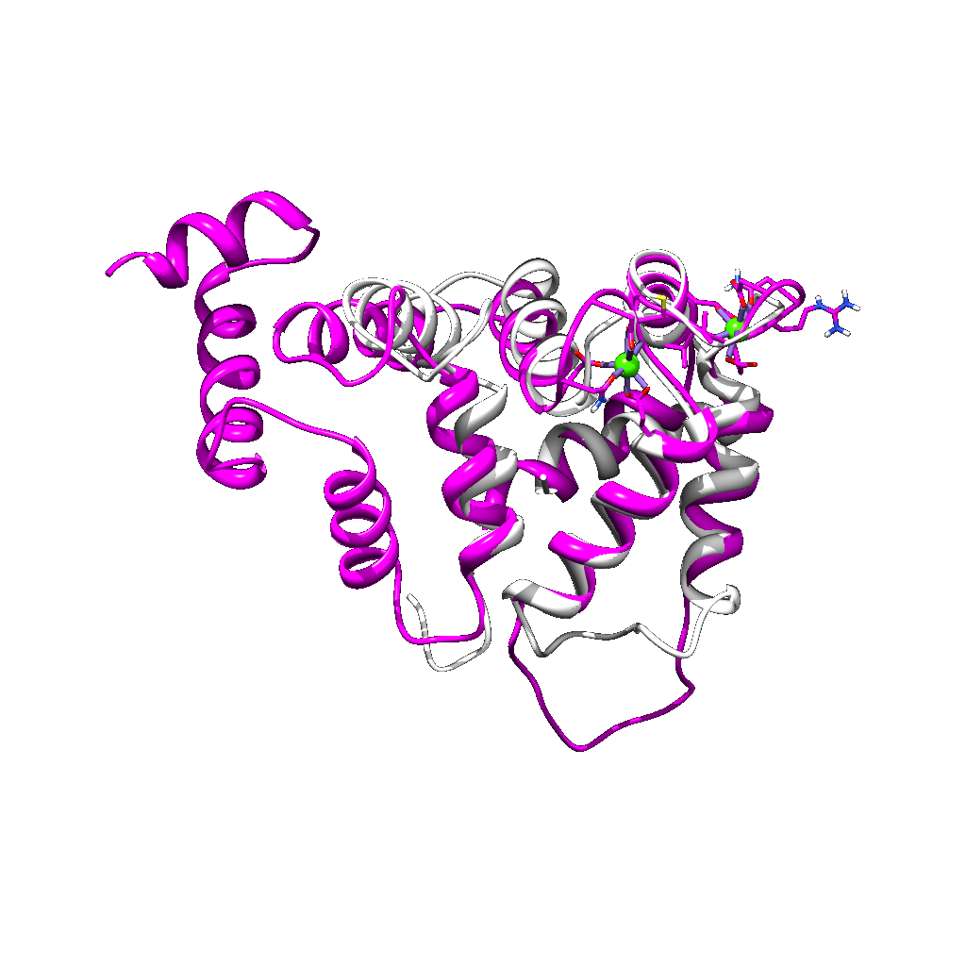
Rosetta ab initio 1 vs 2jul-A
Structures aligned with UCSF Chimera
and rendered with POV-ray

Slide 27
Ab initio + homology model samples

Slide 28
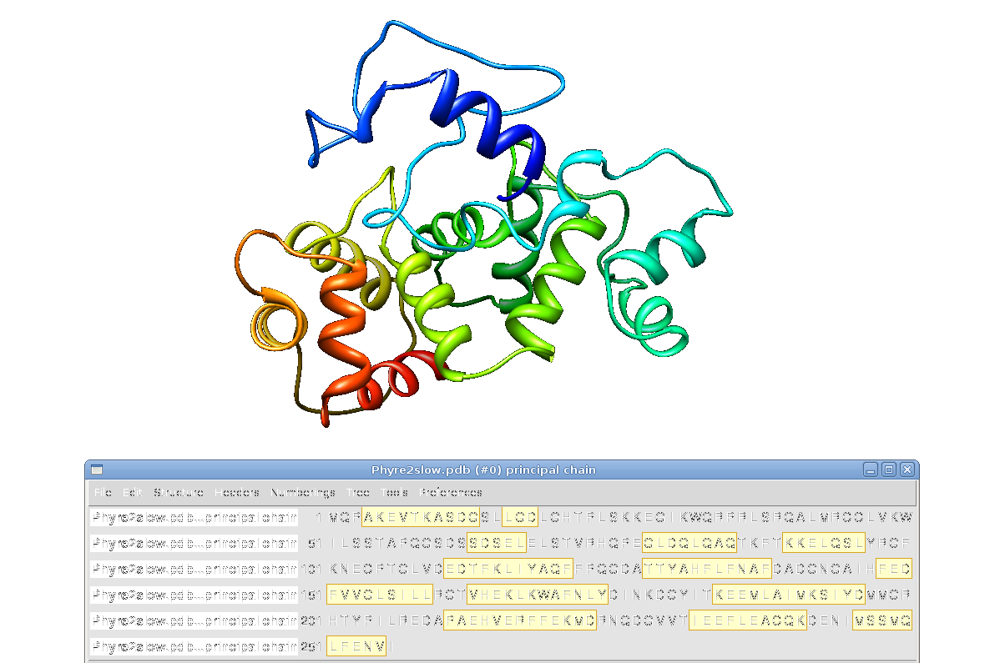
Phyre2 (slow)

Slide 29
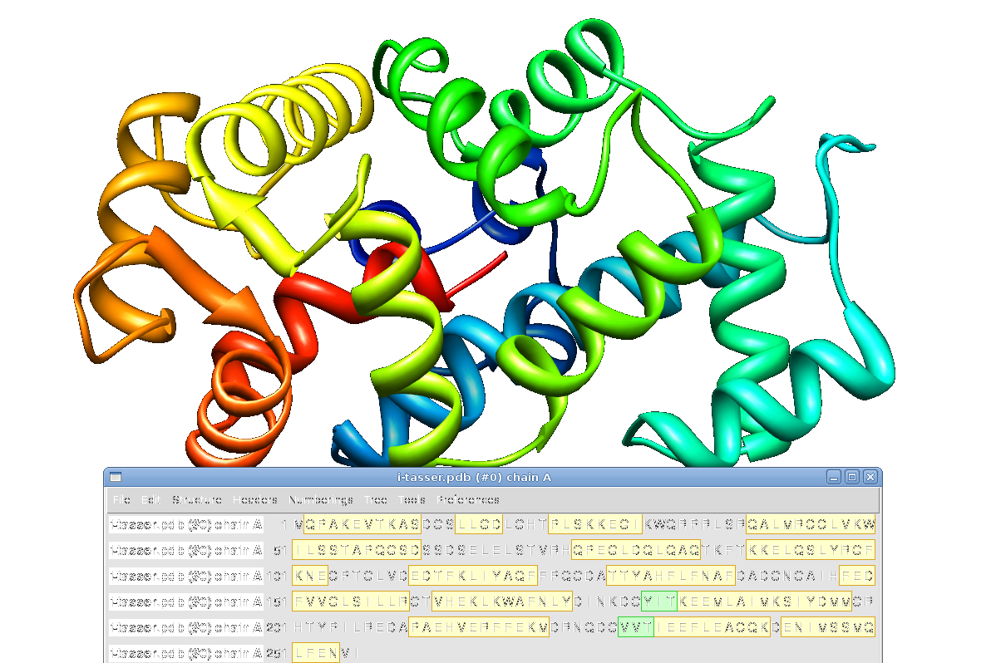
i-tasser (quark)

Slide 30
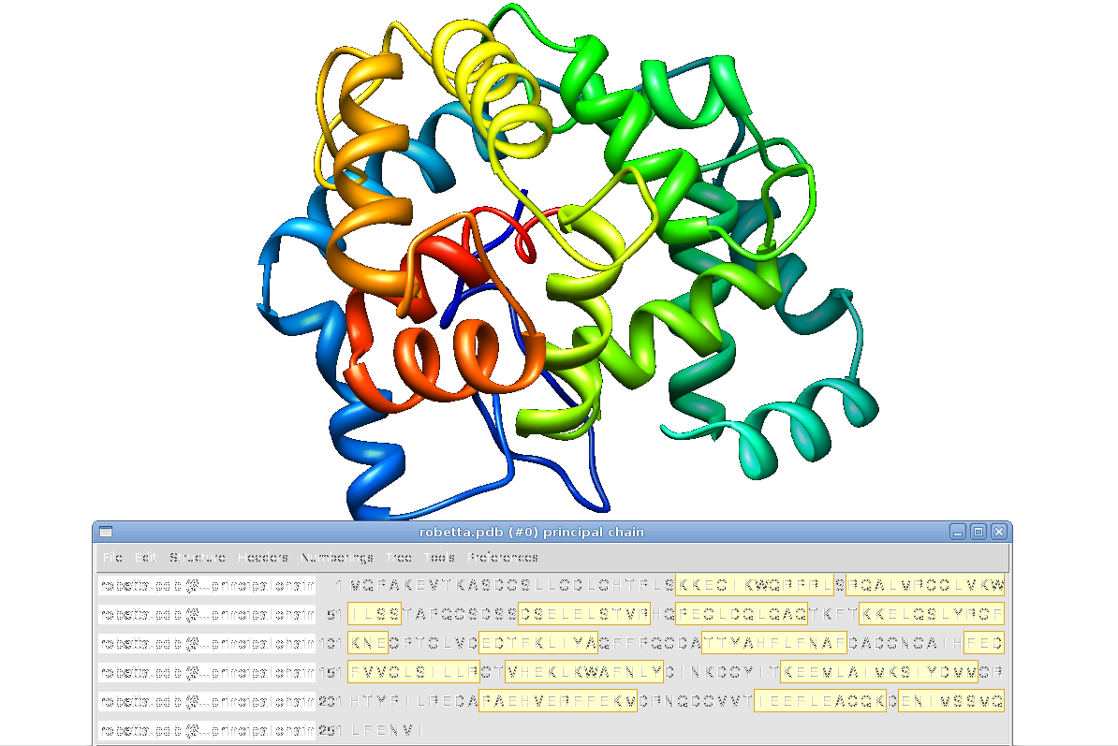
Robetta (rosetta)

Slide 31
Step 7: Model selection
~200-400 models generated
As expected neither homology nor threading models include a structured N-term with W₅₀
Homology + ab initio produce complete models but no N-term common structure (barring W₅₀ alpha helix)
  HHpred (auto and hand-selected templates): 1
  I-Tasser (also predicts Ca⁺⁺ binding sites): 5
  Loopp (heuristics L9 +/- redconf): 1
  Phyre-2 (slow and fast): 2
  Robetta: 5

Slide 32
Step 8: build ionic models
Use 2JUL (mouse) to add Ca⁺⁺ ions to models in EF-hand 3 and 4
Add Mg⁺⁺ to EF-Hand 2
No ions
2 Ca⁺⁺
1 Mg⁺⁺ 2 Ca⁺⁺
1 Mg⁺⁺
14 models x 4 conformations

Slide 33
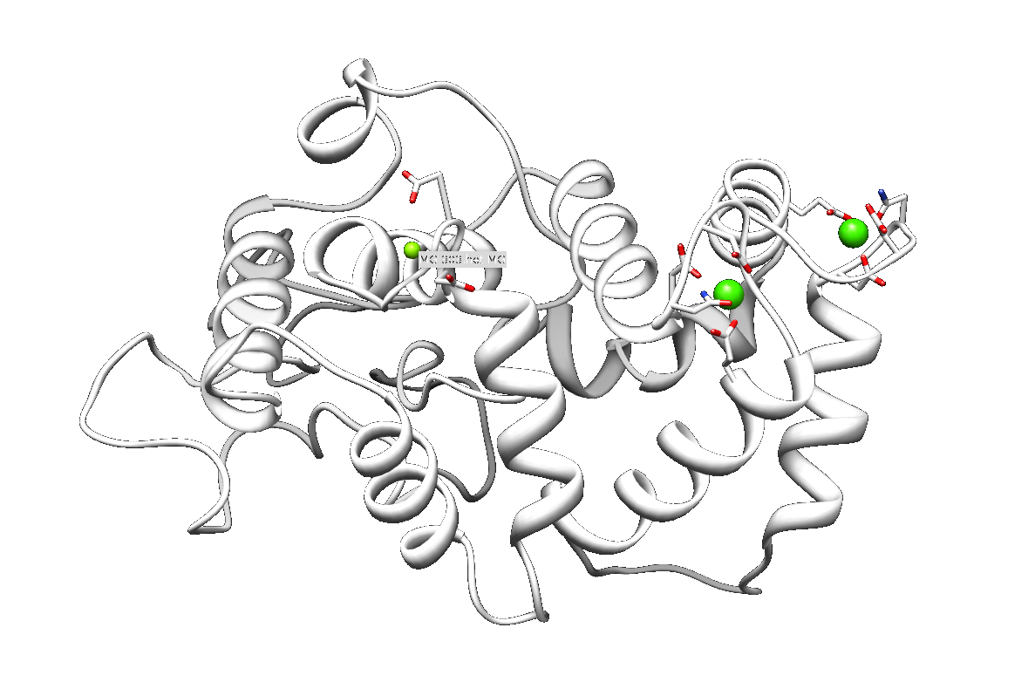
HHpred (handpicked) 1 Mg⁺⁺ 2 Ca⁺⁺

Slide 34
Step 9: Molecular simulation
Minimize/Optimize structure
  GROMACS + gromos53a6 force field
Full MD runs in vacuo and in intracellular physiologic saline solution
  SPC/E water
  intracellular ionic strength 215 mM (Mouat & Manchester (1998) Comp Hematol Int, 8:56)
  Equilibration NVT, NPT (300ºK, 100ps in 2fs steps)
  Production NPT (300ºK, 10ns in 2fs steps)

Slide 35
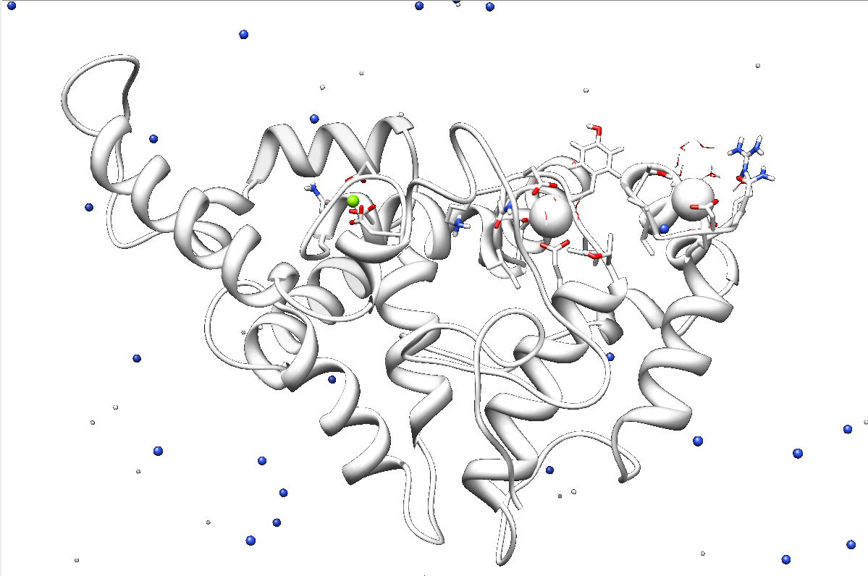
Robetta3 1Mg⁺⁺ 2Ca⁺⁺ MD in solution

Slide 36
Step 9: validate model dynamics
Verify final models agree with known data
  Check for known differences between conformations
  Verify final structure agrees with experiment
Analyze dynamic behaviour
  Understand flexibility of different regions

Slide 37
Step 10: Docking
GRAMM
HEX
ZDOCK
PatchDock/FireDock
  No assumptions / Hint L / Hint W
SymmDock
  No assumptions / Hint L / Hint W
14 models x 4 conformations x 5 dockings

Slide 38
Step 11: Dimer refinement
Some dimers may enhance if relaxed
Simulate each dimer in vacuo and in physiologic intracellular solution (GROMACS with gromos53a6 and spc/e water)
Analyze interactions (H-bonding, H2O H-bond networks) using UCSF Chimera for visualization.
Generate mutants for identified amino acids and review dimerization changes (TRITON + Modeller + Gromacs + docking)

Slide 39
Step 12: Dimer analysis
2 Ca⁺⁺
  Dimerize around L₁₅₅, L₁₅₉, L₂₅₁
  itasser3 - phyre2fast,slow - robetta3,4
1 Mg⁺⁺ 2 Ca⁺⁺
  Dimer involving W₅₀ ↔ Y₂₀₃
  Hhpred-hand - itasser1- phyre2fast,slow, robetta1,3,4
Functional site accessibility
  L₁₅₅XXLL, D₆₁XXD₆₄, differential solubility...
14 models x 4 conformations x 5 dockings x 10-20 dimers

Slide 40
A dimer sampler

Slide 41
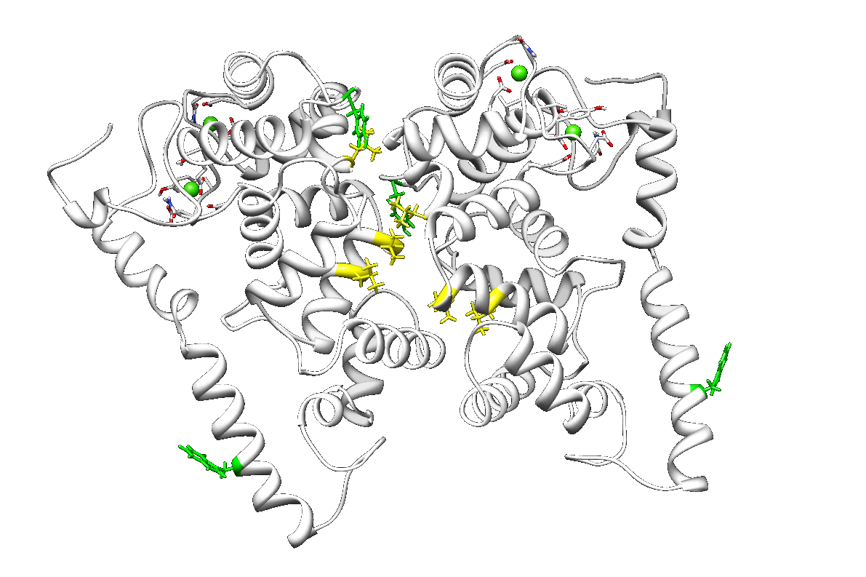
2Ca⁺⁺ with W₅₀ favored
W₅₀!

Slide 42
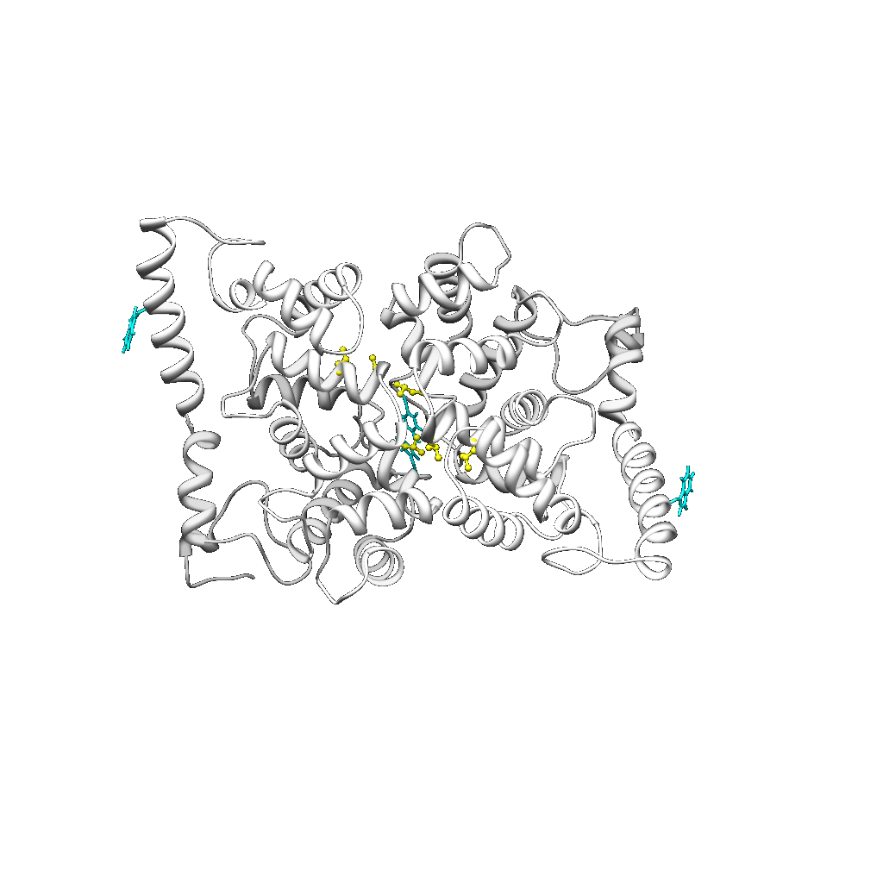
2Ca⁺⁺ with W₅₀ favoured (min)
W₅₀!

Slide 43
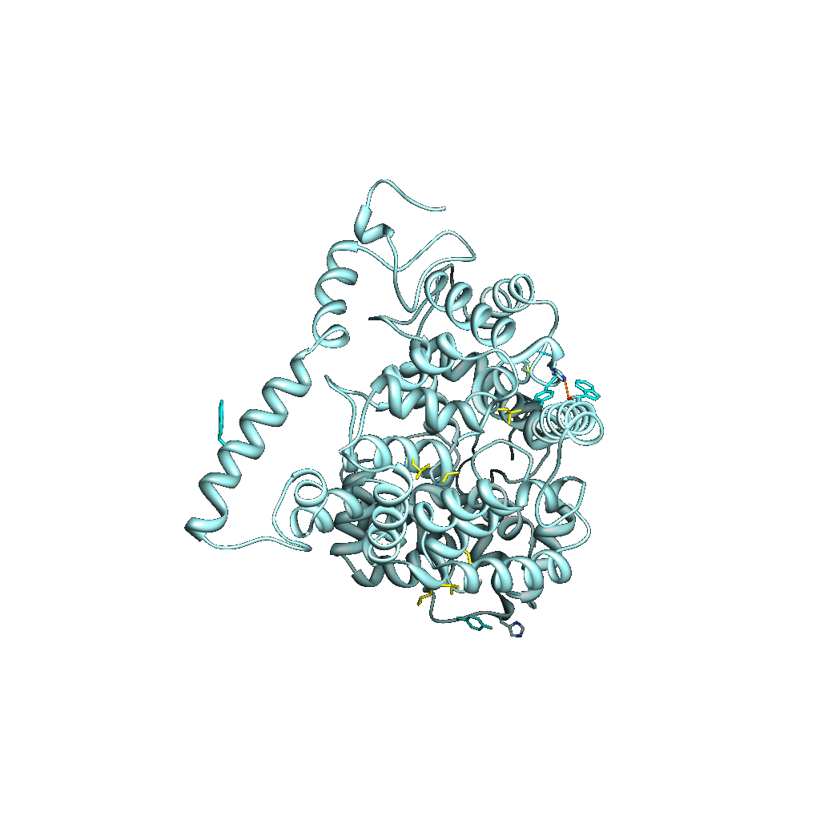
1Mg++ 2Ca++
W₅₀ Y₂₀₃

Slide 44
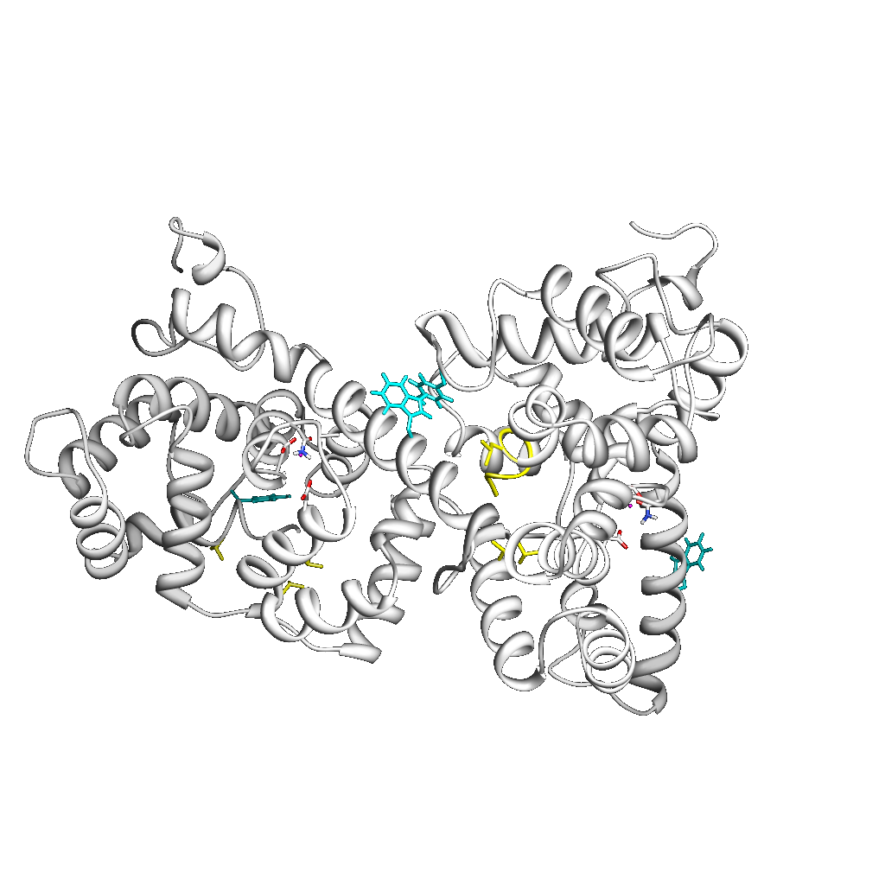
1Mg++ 2Ca++ (min)

Slide 45
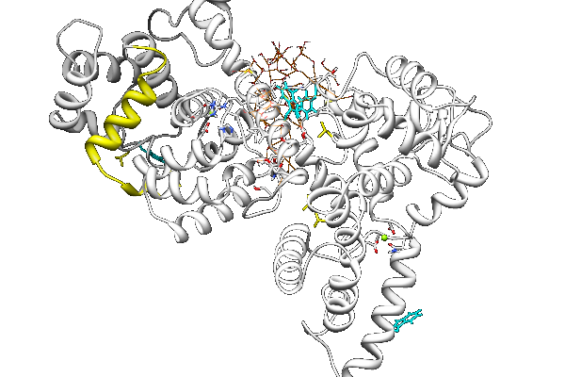
1Mg++ 2Ca++ in solution

Slide 46
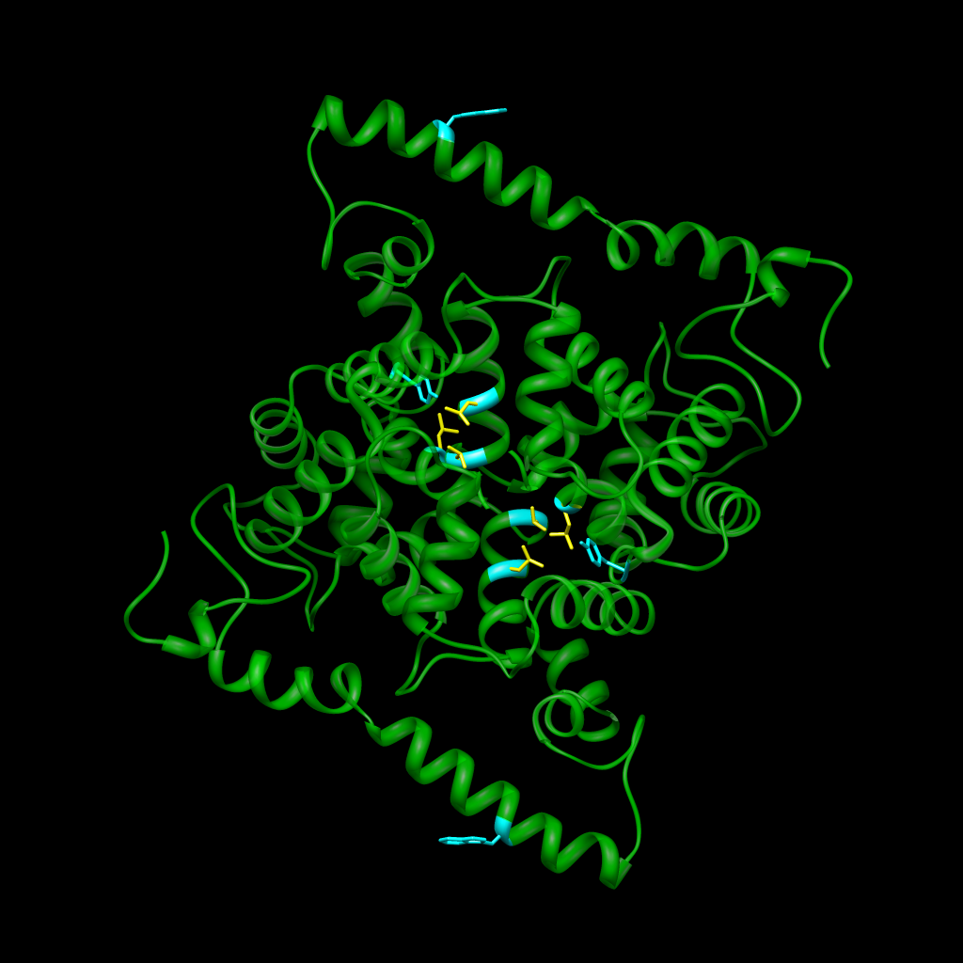
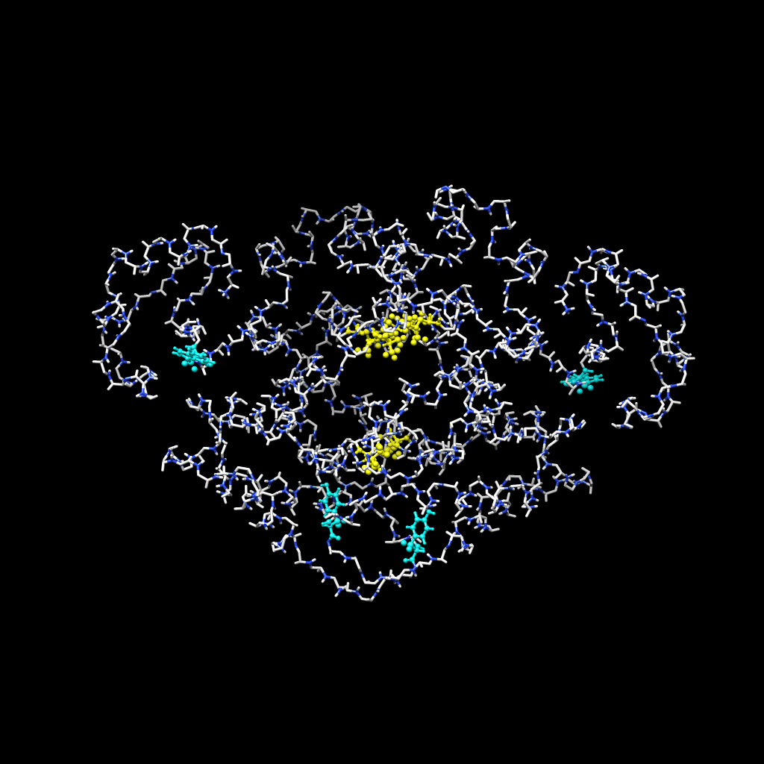
Site-directed mutants
R₂₀₀A
T₂₀₂A

Slide 47
Step 13: Region analysis
Concentrate on interface region and analyze in detail
  W₅₀ is likely in an alpha helix
  Y₂₀₃ is in extended/loop conformation
  Take best generated interfaces and relax using MD
  Analyze interactions
  1SCF/DFT Quantum analysis of electron density distribution
    Analyze cost/benefit
    Visualization challenges

Slide 48
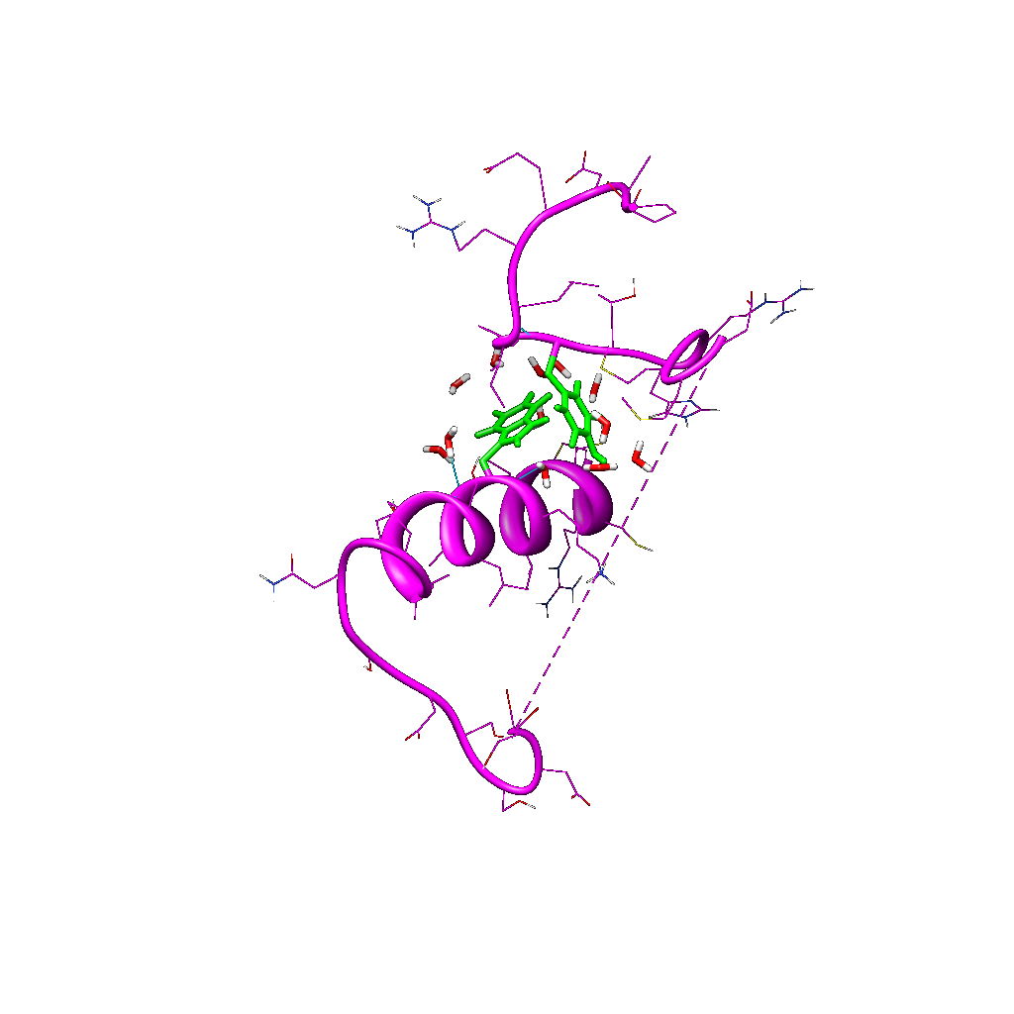
Robetta3 PatchDock08 fragment

Slide 49
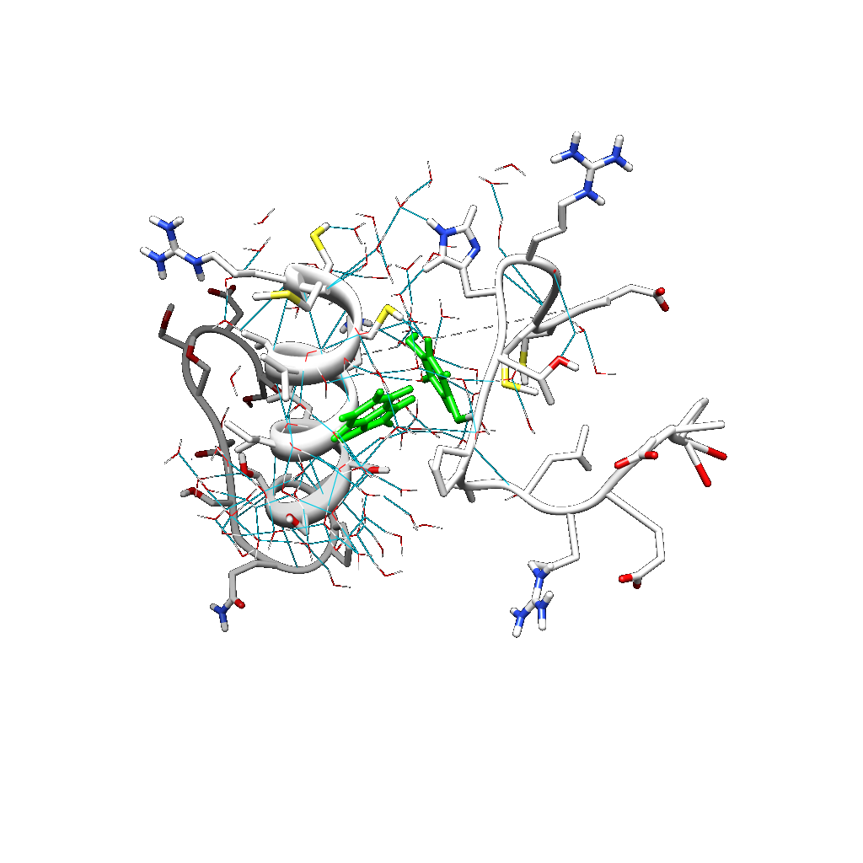
Interaction network in solution

Slide 50
Conclusion
We have an extensive toolset to predict macromolecular interactions
  Interaction prediction may be as easy as reading the bibliography or doing an MSA
  Difficulty increases with lack of knowledge
  Yet we can proceed a long way forward
Predictions need experimental validation
  Site-directed mutagenesis is being carried out at J. R. Naranjo's lab by B. Mellström

Slide 51
Short description
“Given the low sequence conservation of the N-terminal region, we generated in silico models of native and mutant DREAM 3D structures, predicted likely dimer conformations and analyzed in detail the candidate interactions of W₅₀ in presence and absence of Mg⁺⁺; the results of these computer simulations were used to guide subsequent site-directed mutagenesis in the vicinity of Y₂₀₃.”

Slide 52
Thanks
Medline, EMBL, SwissProt, PDB, EBI, NCBI
RONN, PsiPred, Jpred, CDM, YASPIN
Mafft, ClustalW, SeaView
CAPS, PIPs, PRISM
ConsPPISP, MetaPPISP, Polyview, PPI-Pred, ProMate, ConSurf, 3d_Partner
CPHmodels, HHPred, LOOPP, MUSTER, Phyre, Phyre², (ps)², PsiPred, I-tasser, GeneSilico, blastp, compass, ffas, FUGUE, HHsearch, jmbrank, pcons5
PDBblast, PRC, sparksLoMets, SAM-T02, Sparks-2, SP3, PROSPECT2, PPA-I, PMP, SwissModel, M4T, ModWeb
QUARK, Rosetta, Robetta
UCSF Chimera, PyMol
Gramm, Hex, Zdock, PatchDock/FireDock, SymmDock
Gromacs, Triton, Modeller, MOPAC2009

Slide 53
More thanks
To Britt Mellström and José R. Naranjo
To CYTED and FreeBIT
To CSIC for “trueno”
To CESGA for “finisterrae”
To all of you for coming

