Slide 1



Developing Free Software
Help your project succeed
Jose R Valverde
CNB/CSIC
FreeBIT/CYTED
CC-BY-SA

Slide 2
Outline
Setting the tone
Managing your project
Funding your project
Marketing
Defending your project

Slide 3
Setting the tone
maintain a warm, cozy environment
  avoid private discussions
  nurture respectful conducts
fight trolls (and other not-so-mytic beasts)
  avoid geeting dragged to fruitless pursuits
  filter spam, viruses, etc
  protect contributor privacy
define acceptable behaviour

Slide 4
The Cathedral and the Bazaar
Steering the project:
  The benevolent dictator
  The consensus democracy
Learn to delegate
  by designation
  by volunteering
Keep ecuanimity
Software development it's all about people

Slide 5
Quality and Spirits
Everybody wants to feel part of a group
  A group they can be proud of!
Maintain quality:
  frequent code reviews over the net
  do periodic builds and crash-test parties
  do periodic brainstorms
  release frequently
Arrange for personal meetings
Keep the news flowing

Slide 6
Educate users and developers
Of course, you want to deliver documentation and training
Educate developers on Free Software culture
  knowledge sharing (beware of eager PhDs and ambitous programmers)
  openness (no reason for shame)
  pride on response, not on results
Lead by example

Slide 7
Foster communications
No question is too small (or too big)
Document common questions
Document design decisions
  and the decision making process
Any interesting bit should be in the open
  when discussed to avoid errors
  when decided to avoid mistakes
  to protect yourself

Slide 8
Money!
Money is a good thing
  it means your project is useful
Be honest!
  when dealing with money, make sure your interests are clear from the start
  define carefully the limits
    who controls what?
    what does money buy?
    how is money spent?

Slide 9
Giving money
Evberybody bewares of bullies
The perceived goal is common good
  You give money for the common good to benefit from the common good
You may pay for features you need
You may contribute with programmers
  Your programmers will be your front face
You may contribute with funds

Slide 10
Getting money
Save on licenses
Software as a service
  sell maintenance, customization and development
Advertising in your product, site, etc..
Meet with users and developers
Teach users and developers
Promote your company

Slide 11
Milk the community
Donnations
Online courses
Meetings
Merchandising
  print on demand
  books
  quick guides
  t-shirts, hats, mouse pads...

Slide 12
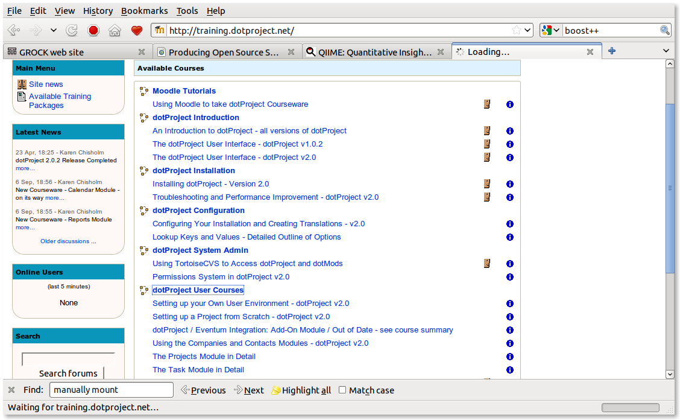

Slide 13
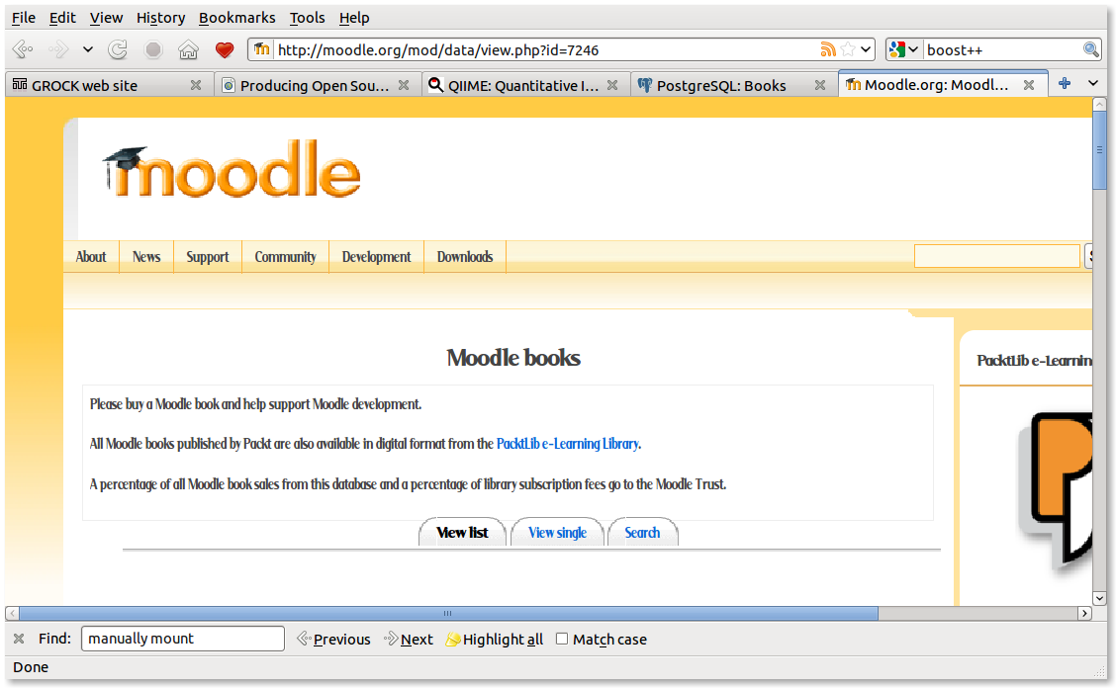

Slide 14
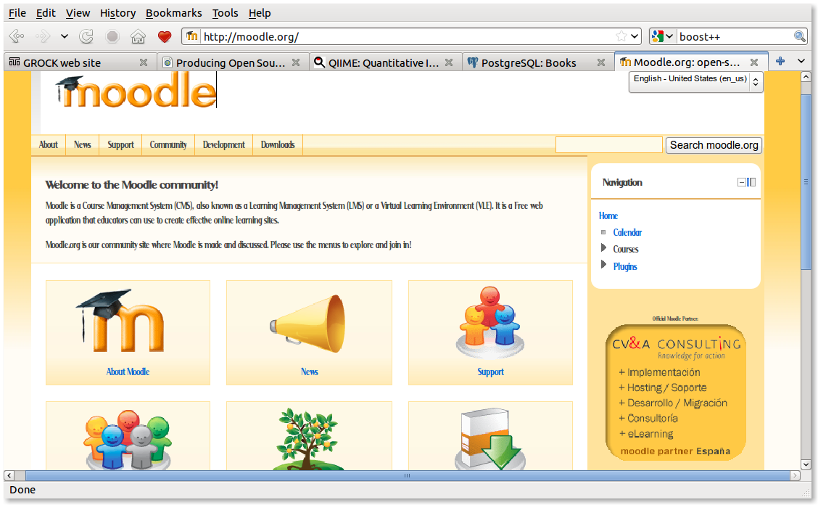

Slide 15
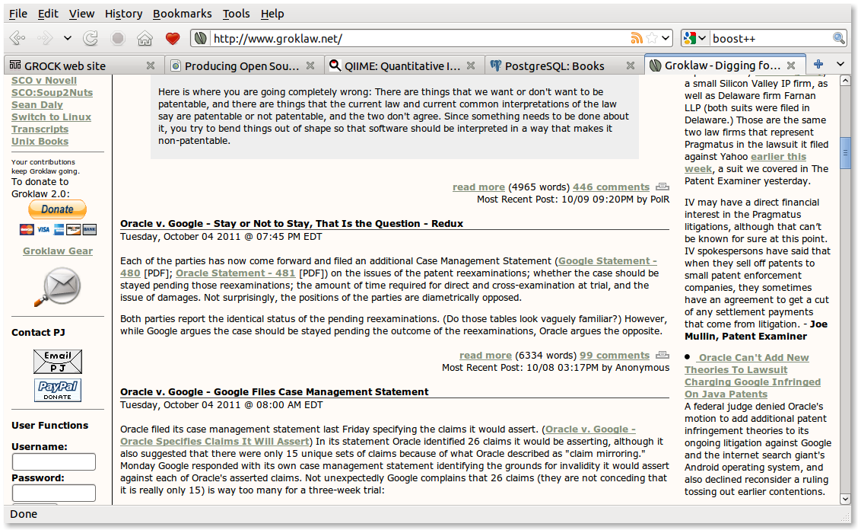

Slide 16
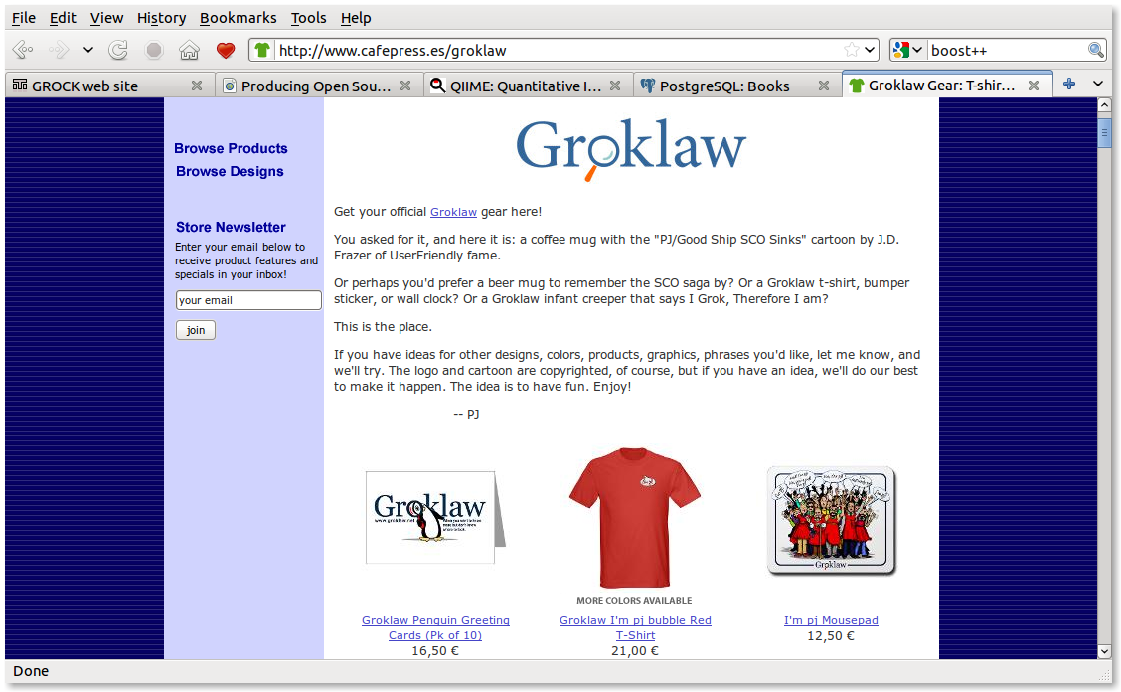

Slide 17
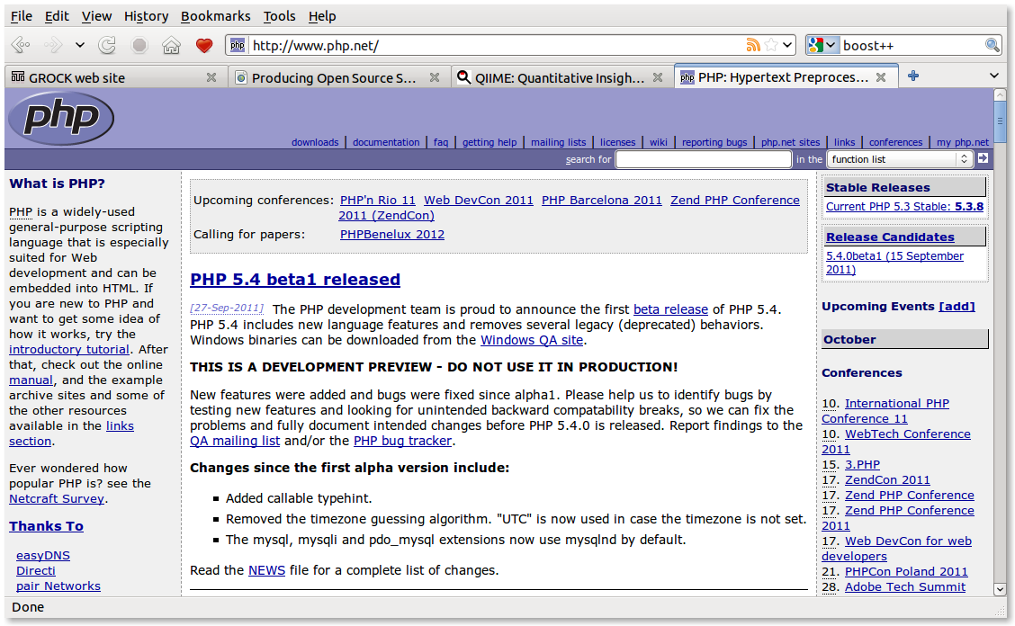

Slide 18
Marketing
Do not rely just on web presence
Promote your site in search/ad engines
Find a niche, hit the blogs
Give away small tools for free
Promote your tools in user forums: Careful with that axe, Eugene!
Promote your tools in app. forums: Apple, Google, Freshmeat, Bioinformatics.org, etc...
Keep in contact with users (tell about updates)
Creative social network marketing

Slide 19
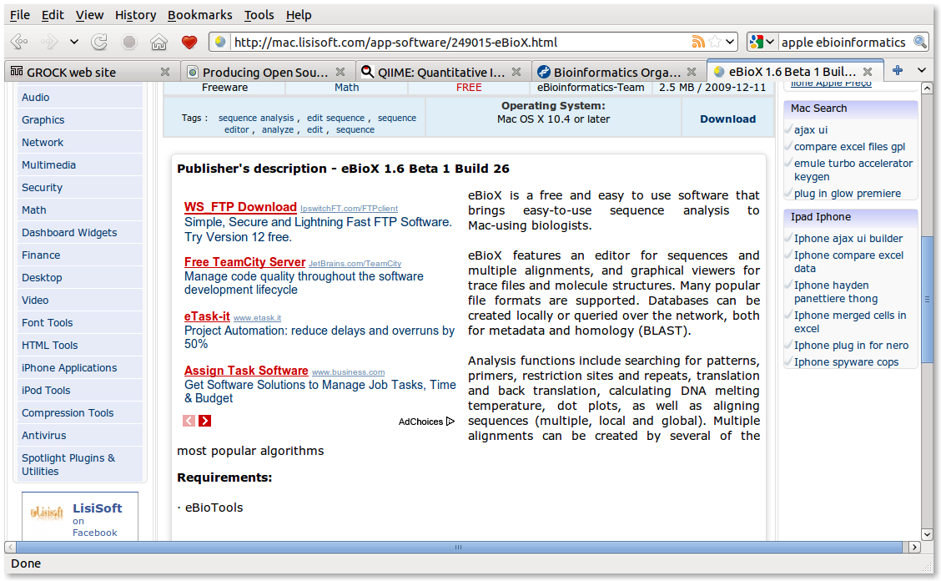

Slide 20
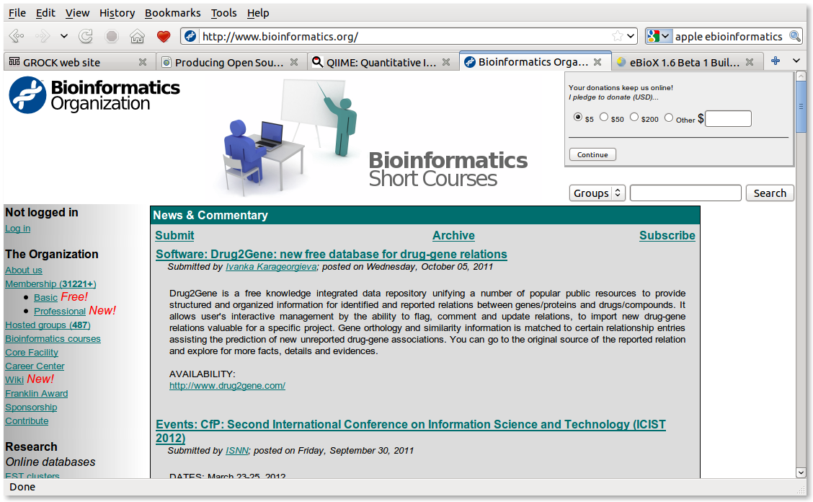

Slide 21
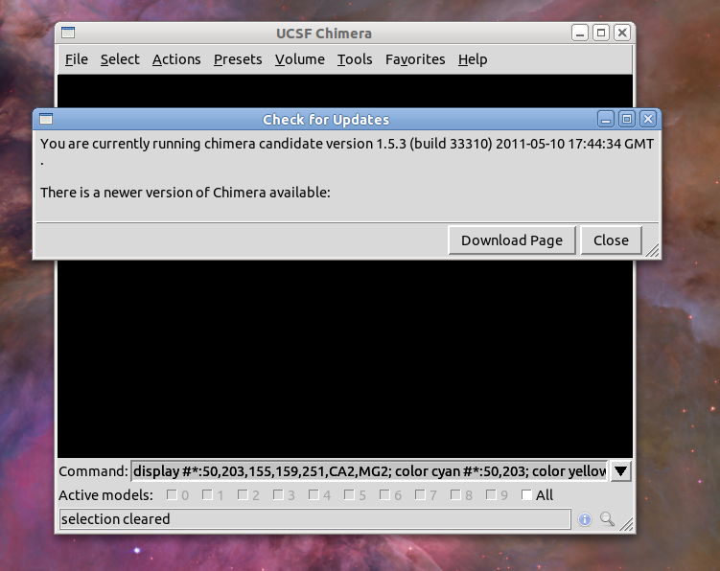

Slide 22
Marketing yourself
Learn to use FLOSS in your CV
  https://wiki.mozilla.org/FreeSoftwareOnResumes:Writing
Learn to protect your work
  Read the small print in any contribution license
  Do not assume anybody (specially big corporations) is nice just because they say so.
  When in doubt, ask the experts

Slide 23
Defending your project
Fight against Software patents
  Look for local partners in USA
Join the Electronic Frontier Foundation
  http://www.eff.org
Join the Free Software Foundation
  http://www.fsf.org
Join the Open Invention Network
  http://www.openinventionnetwork.com
Follow GrokLaw.net

Slide 24
Welcome
To the wonderful world of
Free and Libre
Open Source
Software

