Slide 1
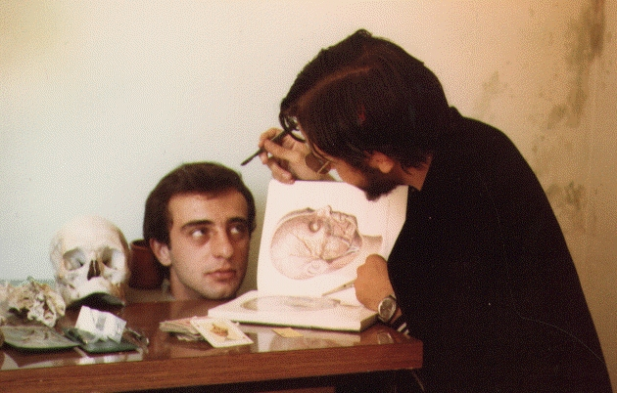
Protein Function
How to dissect a protein's function
(and survive to tell it).
José R. Valverde (jr@es.embnet.org)
EMBnet/CNB (www.es.embnet.org)
CC-BY-SA

Slide 2
Introduction
Using theoretical predictions may save experimental work
  analysis of all possible interactions
Ideally we want
  an efficient experimental function analysis method (and cheap!)
  or a theoretical one that never fails (or almost)

Slide 3
Long term goal
Efficiently get useful predictions on a protein function
  save time and money in experiments
    Guide new experiments
  high throughput analysis (*omics)
  detect targets and substrates
  enhance our quality of life

Slide 4
Current status:
Experiments
Unknown protein: explore all its possible interactions
  proteins (1K-100K optimistic, zillions possible)
  nucleic acids
  polisaccarides, fats, etc...
  drugs, compounds, atoms (zillions)
Known protein:
  Does it have unknown roles?

Slide 5
Current status:
Theory
Prediction from sequence
  relies on functional dictionaries
Prediction from structure
  relatively few structures available
  relative reliability of structure prediction
  analysis of interactions
    quick but low precision
    slow but high precision

Slide 6
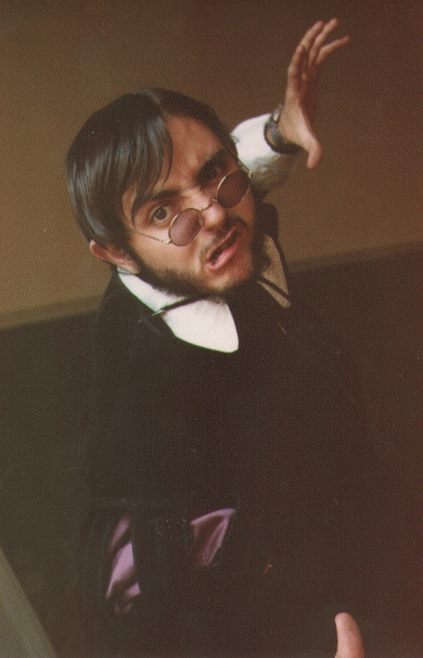
Who's afraid...
of function prediction?
But it's so easy!

Slide 7
Developments to date
Sequence comparison
  motives
  domains
  matrices
Include context
Structural analysis
  conservation
  interactions

Slide 8
Starting point
Organisms evolve stepwise
Sequence determines structure determines function
Function controls structure controls sequence
But...
  context is very important

Slide 9
What did we learn?
Similar functions share similar sequences
Similar functions share similar structures
Similar sequences have similar structures
Similar structures have similar functions

Slide 10
Rules are meant to be broken
  Similar functions have similar sequences
Not always (e.g. convergent evolution)
  Similar functions have similar structures
Not always (ut supra)
  Similar sequences have similar functions
Not always (e.g. deletereal mutations)
  Similar structures have similar functions
Not always (ut supra)

Slide 11
Available options
Compare sequences
Build motive dictionaries
Build “grammar” rules
Analyze structure
Analyze interactions
Analyze context

Slide 12
Comparison: example
Once upon a time, on a place far away
Once upon a time, on a kingdom far away
Once there was a princess
There was once in a kingdom far, far away...
How does a tale start?

Slide 13
Comparing sequences
Build multiple alignments and look for similarities/differences
  Direct and intuitive
  Expensive work
  Highly precise
  Too low or high a conservation makes work difficult
  Polisemy, synonimy

Slide 14
Build motifs
Identifify and use only relevant residues
  Define allowed variability (e.g. A-[IVL]-X-D)
  Initially costly, very efficient
  Requires enough sequences (positives and negatives) to estimate reliability
  Sometimes variability is too high:
    position specific score matrices

Slide 15
Motives: example
I am
I'm
You are
You're
He is
He's
How do we conjugate 'to be'?

Slide 16
Motives: counter example
How does a tale end?
  And they lived happily ever after
  And ever since then that is the way it has been
  And so the story goes
  And that is the story as I was told it
Where would a motif or a matrix take us?
  Several matrices?

Slide 17
Positional dependencies
Analyzed using HMMs and NNs
  Capture dependencies and relations not inmediately evident
  More precise and automatizables
  Require more space and time
  Conceptually intuitive but very difficult to understand (except by practice).

Slide 18
HMM: example
A rose is a rose is a rose
Two roses are two roses are two roses
Can you give me an apple?
Can you give me many apples?
Can you give me some water?

Slide 19
Structural comparisons
Originally done by hand are now automatic
  identify “3D templates”
Relatively reliable
  May get around important differences in sequence
Relatively few structures available
Structure may change substantially depending on the environment

Slide 20
If there is no structure
Many secondary structure prediction methods (and associated functionality)
  transmembranes, helix-turn-helix...
  Post-Translational Modifications (PTMs)
Homology prediction (credible at high similarities)
Threading (take with a grain of salt).

Slide 21
Molecular interactions
In silico
  Costly
    Use of abstractions (pharmacophores,...)
    coevolution
  Many possibly interesting possibilities
    protein-protein: 1K-100K
    protein-substrate: 10K – zillions
  Forces us to balance reliability vs. efficiency
    Still very useful to guide work

Slide 22
Predicting protein interactions
Search for preserved amino acids in multiple alignments
  Important for interactions
  Clustal, MAFFT, MUSCLE, T-Coffee...
Coevolution analysis
  If there is no clear conservation, maybe changes are counteracted by coevolution
  CAPS

Slide 23
Predict protein-protein interactions
Some servers will tell you which proteins may interact with yours
  PIPs, PRISM
Some servers will tell you which amino acids are likely to be involved in P-P interactions
  ConsPPISP, MetaPPISP, Polyview, PPI-Pred, ProMate, ConSurf, 3d_Partner

Slide 24
Function prediction from structure
Protein Function Prediction Server
  Uses structural data from structure databases
  http://wolf.bms.umist.ac.uk/~mjfikpd2/predict/enon.html
Catalytic Site Atlas
  structural models of active sites
  http://www.ebi.ac.uk/thornton-srv/databases/CSA/

Slide 25
High throughput prediction
Phylogenetic profiles
QSAR screenings
Interaction networks
Analysis of interaction maps in proteomes
A field in active development.

Slide 26
Advice
Start from the sequence:
  ProSite, Blocks, PRINTS, Pfam, InterPro
Try structure
  predict if not available
  2D: PredictProtein, transmembrane, PTMs, etc...
  3D: PFPS, CSA...
Resort to context and interactions
  QSAR...

Slide 27

In any case
Ask you local bioinformatician.
'Cos you have one, don't you?

Slide 28
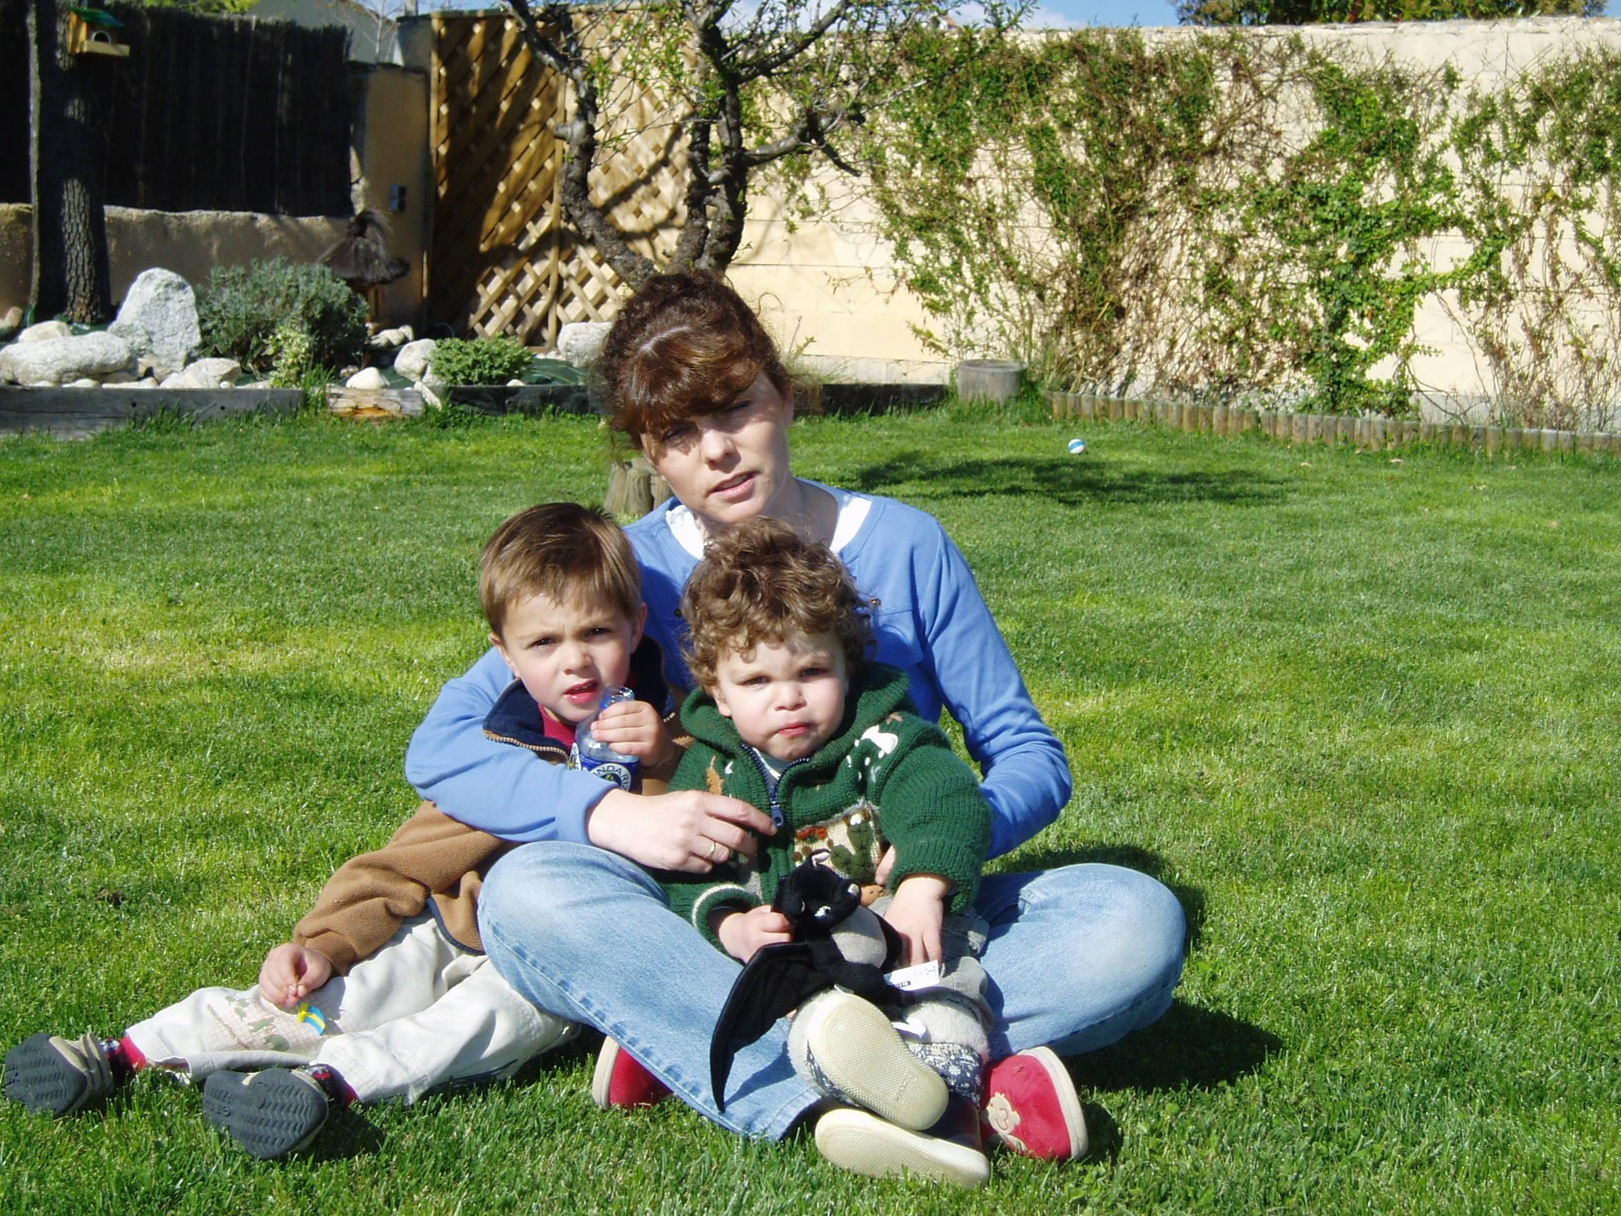
Thanks
To SEPROT
  for remembering this old guy
To you all
  for coming
  and staying
  awake

