Slide 1
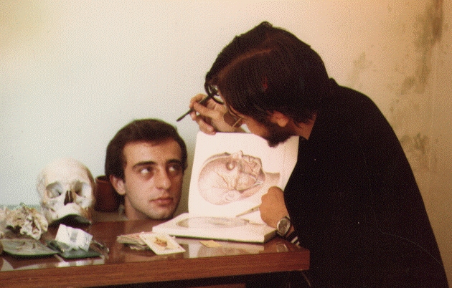
Protein Function
How to dissect a protein's function
(and survive to tell it).
José R. Valverde (jr@es.embnet.org)
EMBnet/CNB (www.es.embnet.org)
CC-BY-SA

Slide 2
Introduction
Using theoretical predictions may save experimental work
  analysis of all possible interactions
Ideally we want
  an efficient experimental function analysis method (and cheap!)
  or a theoretical one that never fails (or almost)

Slide 3
Long term goal
Efficiently get useful predictions on a protein function
  save time and money in experiments
    Guide new experiments
  high throughput analysis (*omics)
  detect targets and substrates
  enhance our quality of life

Slide 4
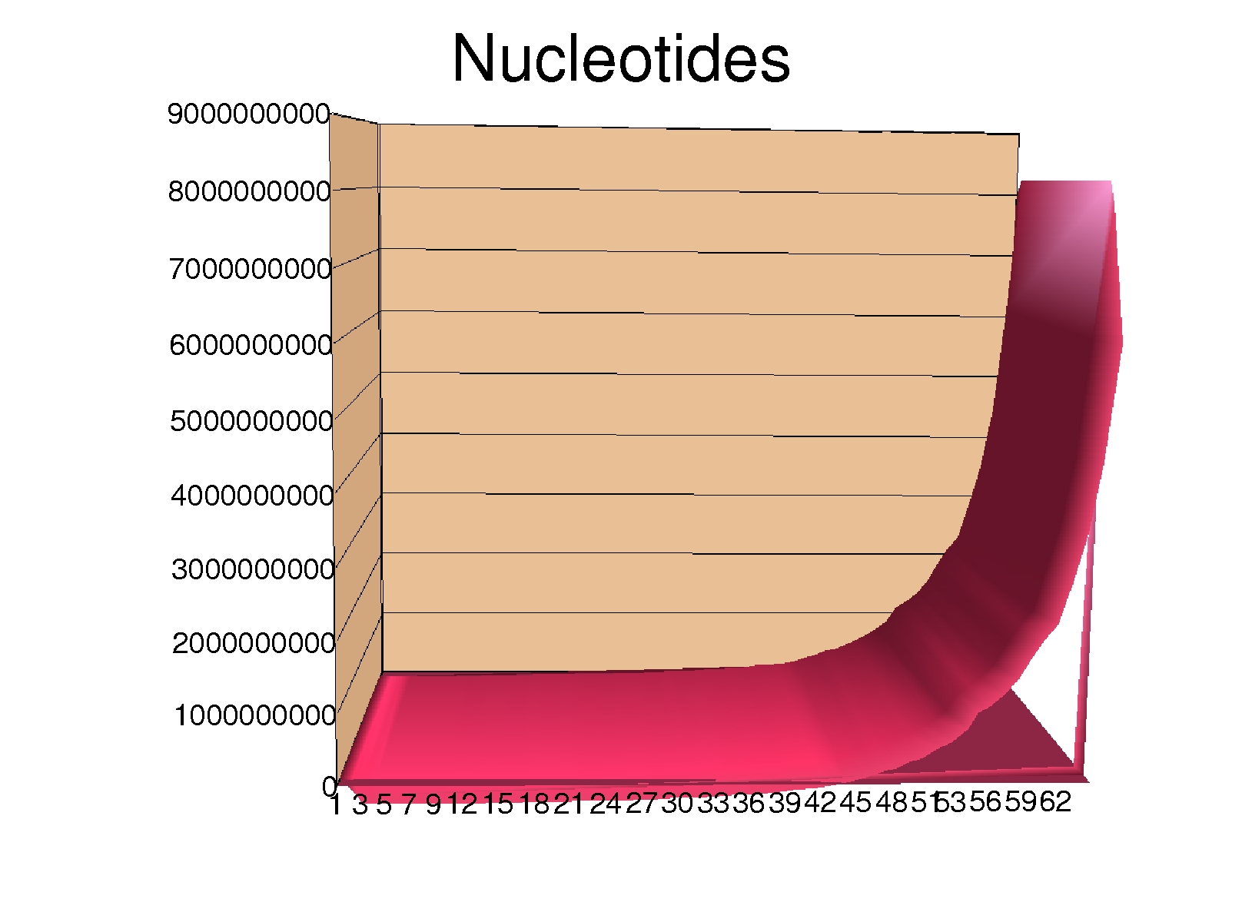
Primary databases
EMBL/GenBank/DDBJ
UniProt
PDB/MSD/RCSB
The last 6 months contain half of all the knowledge gathered in the whole HISTORY of mankind

Slide 5
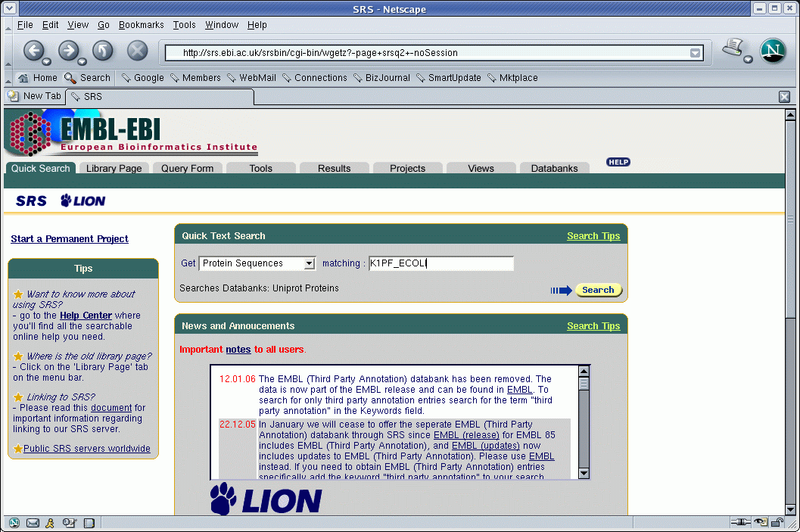
srs.ebi.ac.uk

Slide 6
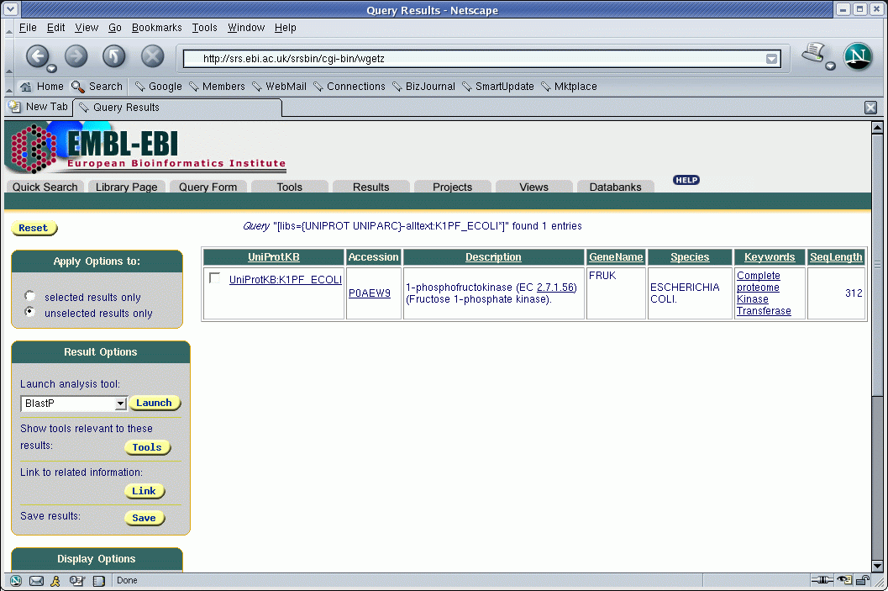
srs.ebi.ac.uk

Slide 7
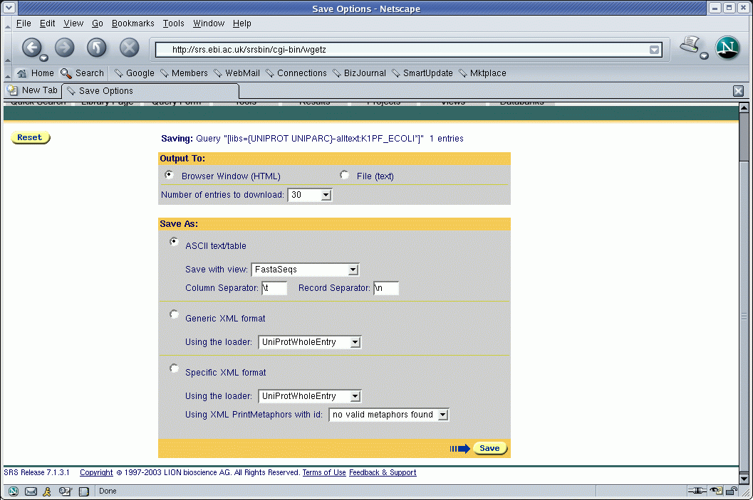
srs.ebi.ac.uk

Slide 8
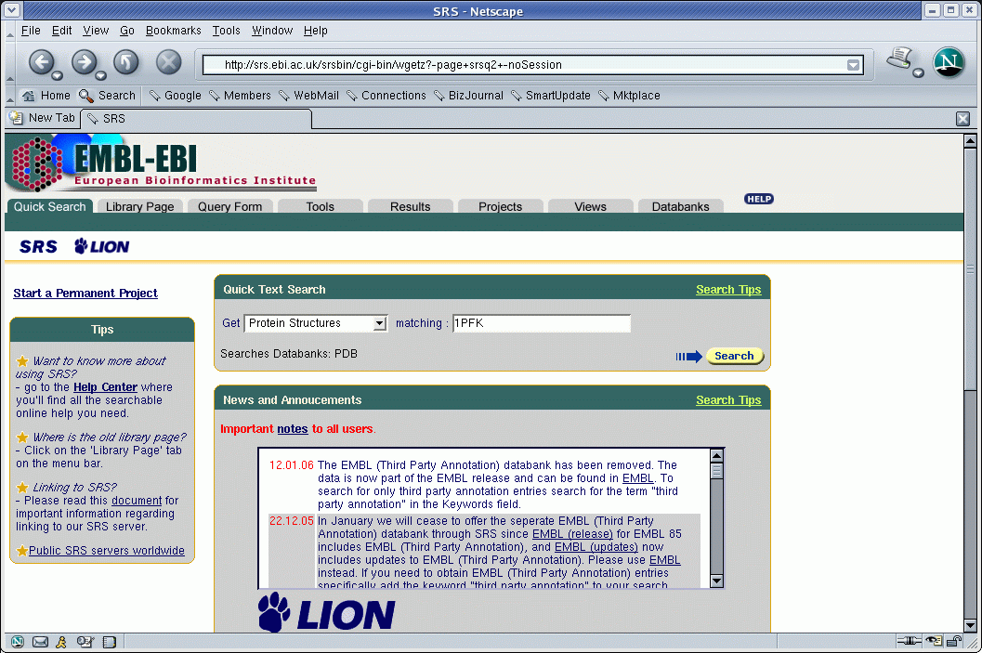
srs.ebi.ac.uk

Slide 9
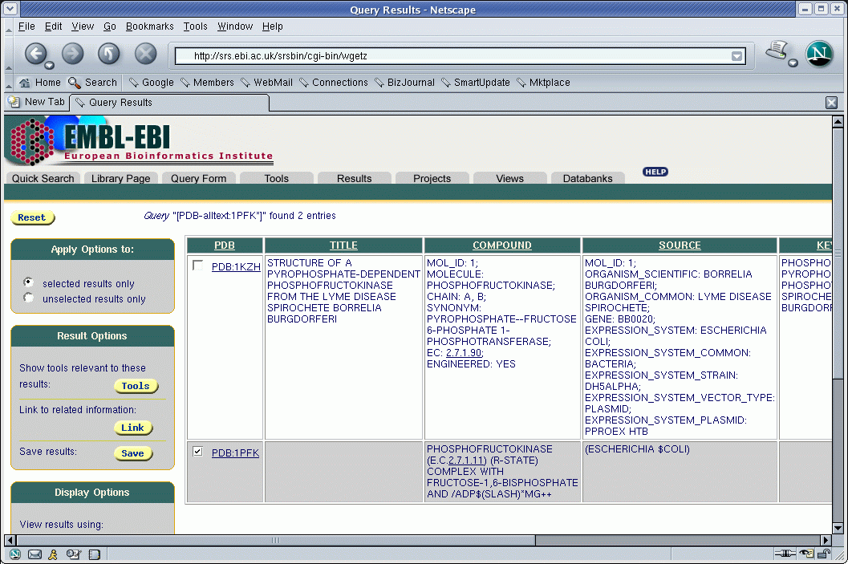
srs.ebi.ac.uk

Slide 10
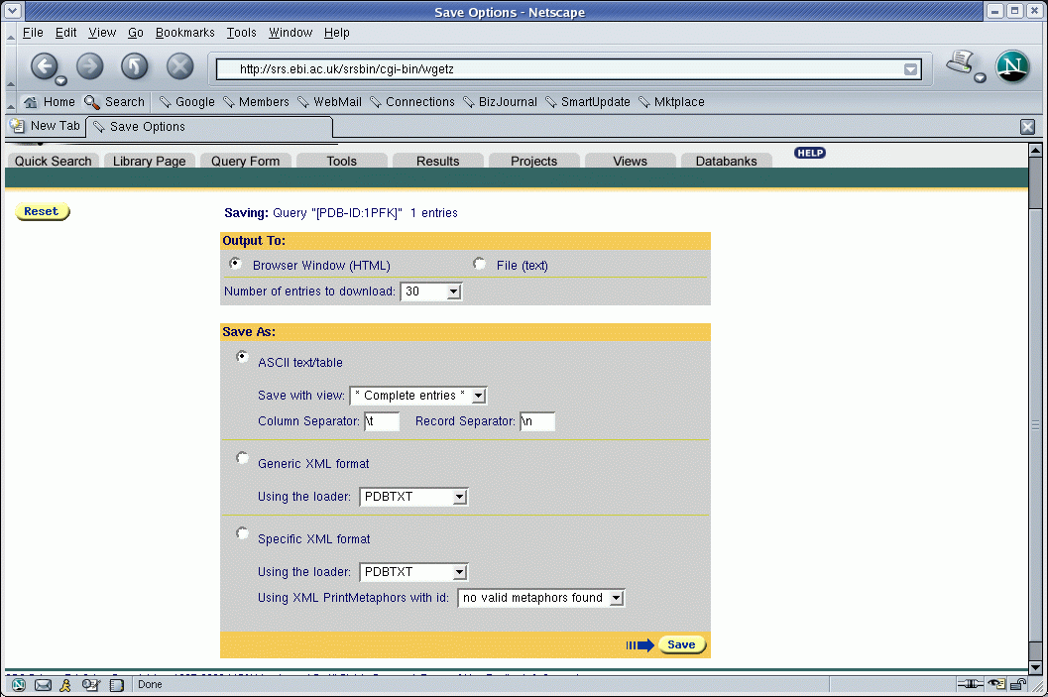
srs.ebi.ac.uk

Slide 11
Sequence dictionaries
Function should be determined by structure
Structure should be determined by sequence
Similar functions and structures should have similar sequences
Thus, it suffices to compare sequences
or not?

Slide 12
PROSITE
Dictionary of conserved sequences (motifs)
  derived by experiment-driven sequence comparison
  with literal variability (patterns)
  with detailed descriptions
  rules and matrices added recently as well

Slide 13
Prosite: example
ID PHOSPHOFRUCTOKINASE; PATTERN.
AC PS00433;
DT NOV-1990 (CREATED); MAY-1991 (DATA UPDATE); JUL-1998 (INFO UPDATE).
DE Phosphofructokinase signature.
PA [RK]-x(4)-G-H-x-Q-[QR]-G-G-x(5)-D-R.
NR /RELEASE=41.16,130569;
NR /TOTAL=105(81); /POSITIVE=105(81); /UNKNOWN=0(0); /FALSE_POS=0(0);
NR /FALSE_NEG=16; /PARTIAL=2;
CC /TAXO-RANGE=??EP?; /MAX-REPEAT=2;
CC /SITE=1,substrate_binding; /SITE=4,substrate_binding;
CC /SITE=7,substrate_binding;
DR Q8YKG3, K6P1_ANASP, T; Q9HGZ1, K6P1_ASPOR, T; Q8A8R5, K6P1_BACTN, T;
DR O94201, K6P1_CANAL, T; P06998, K6P1_ECOLI, T; Q03215, K6P1_KLULA, T;
DR Q92448, K6P1_PICPA, T; O08333, K6P1_STRCO, T; P72830, K6P1_SYNY3, T;
...
...
DR Q9KH71, PFP_DICTH , N;
3D 1MTO; 1PFK; 2PFK; 3PFK; 4PFK; 6PFK;
DO PDOC00336;

Slide 14
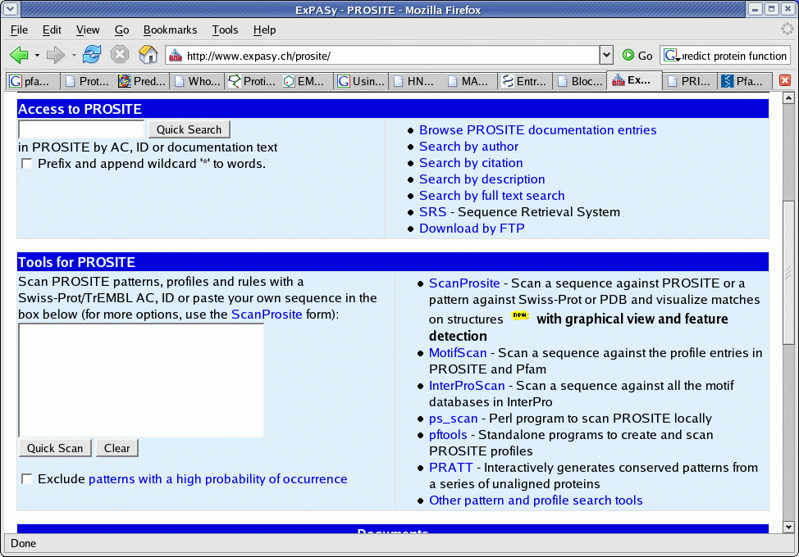
ProSite in practice
Expasy
  www.expasy.ch/prosite/
  Tools for PROSITE
  Paste sequence
  QuickScan
  Exclude Patterns with a high probability of occurrente
  Otras herramientas

Slide 15
ProSiteDoc: example
{PS00433; PHOSPHOFRUCTOKINASE}
{BEGIN}
*********************************
* Phosphofructokinase signature *
*********************************
Phosphofructokinase (EC 2.7.1.11) (PFK) [1,2] is a key regulatory enzyme in
the glycolytic pathway. It catalyzes the phosphorylation by ATP of fructose
6-phosphate to fructose 1,6-bisphosphate. In bacteria PFK is a tetramer of
identical 36 Kd subunits. In mammals it is a tetramer of 80 Kd subunits. Each
80 Kd subunit consist of two homologous domains which are highly related to
the bacterial 36 Kd subunits. In Human there are three, tissue-specific, types
of PFK isozymes: PFKM (muscle), PFKL (liver), and PFKP (platelet). In yeast
PFK is an octamer composed of four 100 Kd alpha chains (gene PFK1) and four
100 Kd beta chains (gene PFK2); like the mammalian 80 Kd subunits, the yeast
100 Kd subunits are composed of two homologous domains.
As a signature pattern for PFK we selected a region that contains three basic
residues involved in fructose-6-phosphate binding.
-Consensus pattern: [RK]-x(4)-G-H-x-Q-[QR]-G-G-x(5)-D-R
[The R/K, the H and the Q/R are involved in fructose-6-P
binding]
-Sequences known to belong to this class detected by the pattern: ALL.
-Other sequence(s) detected in Swiss-Prot: NONE.
-Note: Escherichia coli has two phosphofructokinase isozymes which are encoded
by genes pfkA (major) and pfkB (minor). The pfkB isozyme is not evolutionary
related to other prokaryotic or eukaryotic PFK's (see <PDOC00504>).

Slide 16
BLOCKS
Sometimes sequence is not well preserved
  Instead of distilling sequences store all of them
  http://blocks.fhcrc.org/
ID Pp2A_PR55; BLOCK
AC IPB000009A; distance from previous block=(-8,88)
DE Protein phosphatase 2A regulatory subunit PR55
BL ARF; width=50; seqs=66; 99.5%=2403; strength=1594
2ABA_CANTR|P53031 ( 20) EADIISTVEFDHTGDFLATGDKGGRVVLFERNQSKKKQSCEYKFFTEFQS 39
2ABA_SCHPO|Q12702 ( 28) EADIISAVEFDHTGDYLATGDKGGRVVLFERNHSKKGCEYKFFTEFQSHE 40
2ABA_YEAST|Q00362 ( 24) EADLITAVEFDYTGNYLATGDKGGRVVLFERSNSRHCEYKFLTEFQSHDA 71
2ABA_DROME|P36872 ( 80) DADIISCVEFNHDGELLATGDKGGRVVIFQRDPASKAANPRRGEYNVYST 312ABA_HUMAN|Q00007 ( 27) EADIISTVEFNHSGELLATGDKGGRVVIFQQEQENKIQSHSRGEYNVYST 182ABA_PIG|Q29090 ( 6) EADIISTVEFNHSGELLATGDKGGRVVIFQQEQENKIQSHSRGEYNVYST 182ABA_RAT|P36876 ( 27) EADIISTVEFNHSGELLATGDKGGRVVIFQQEQENKIQSHSRGEYNVYST 18

Slide 17
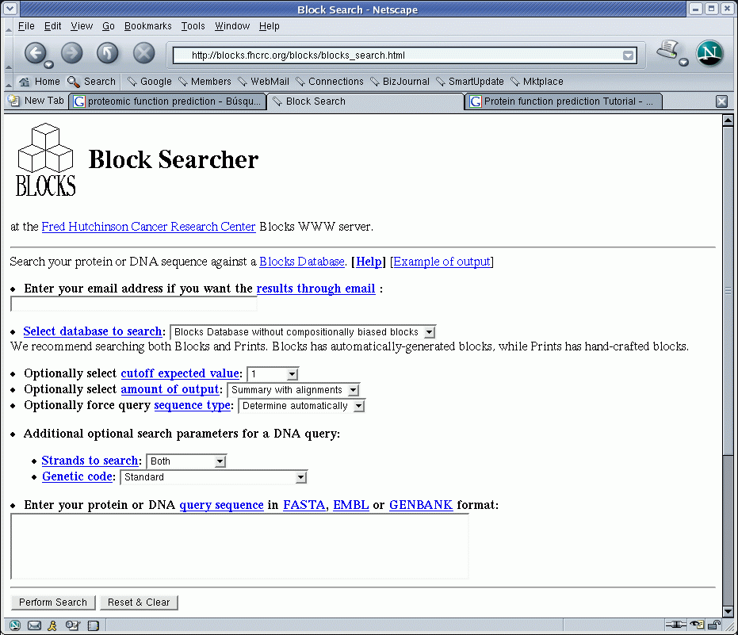
BLOCKS in practice

Slide 18
PRINTS
Compilation of fingerprints (preserved motives in a family)
  Includes context information
  http://umber.sbs.man.ac.uk/dbbrowser/PRINTS/
  Searches are done using fingerPRINTScan
    FPScan
    GRAPHScan
    MULScan

Slide 19
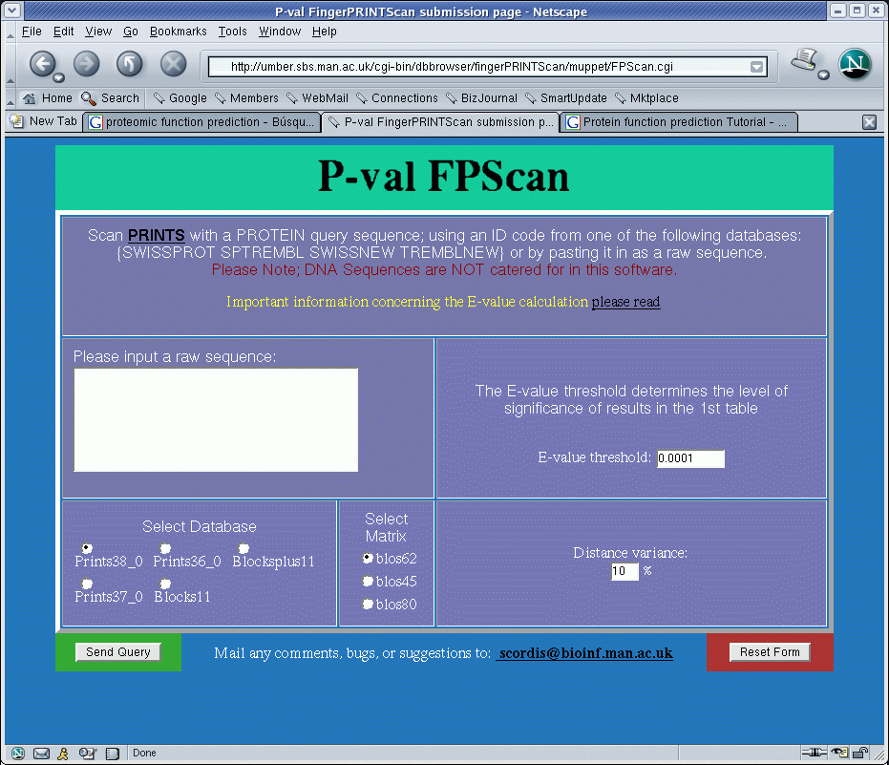
PRINTS in practice

Slide 20
Pfam
Common protein domains and families
  Alignments
  HMMs (Hidden Markov Models)
  Considers context and positional differences
http://sanger.ac.uk/resources/databases/
Search by:
  protein sequence
  DNA sequence...

Slide 21
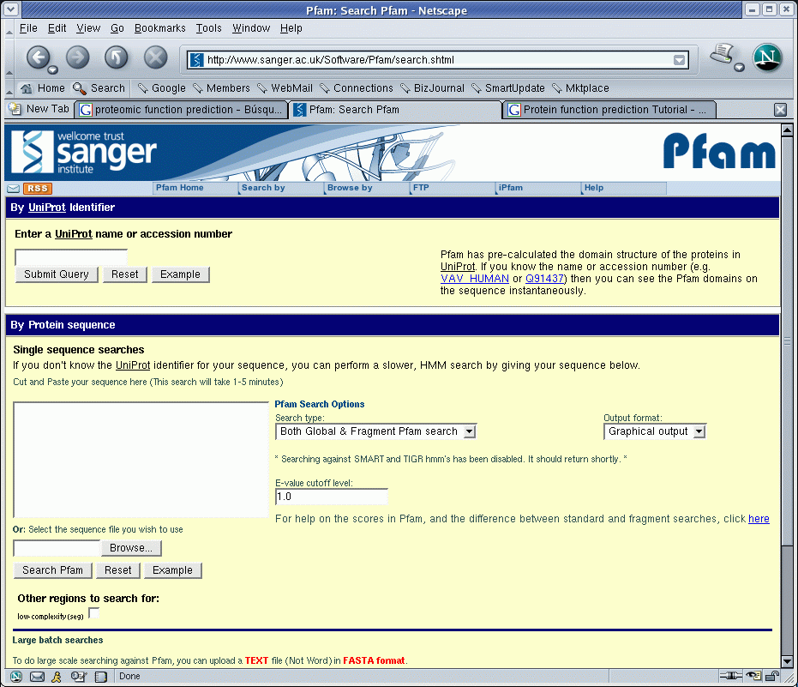
Pfam in practice

Slide 22
ProDom
Exhaustive set of protein family domains generated automatically.
  PSI-Blast
  SCOP (information on 3D domains)
  MultAlin
  CrossReferences to other systems
http://prodom.prabi.fr/

Slide 23
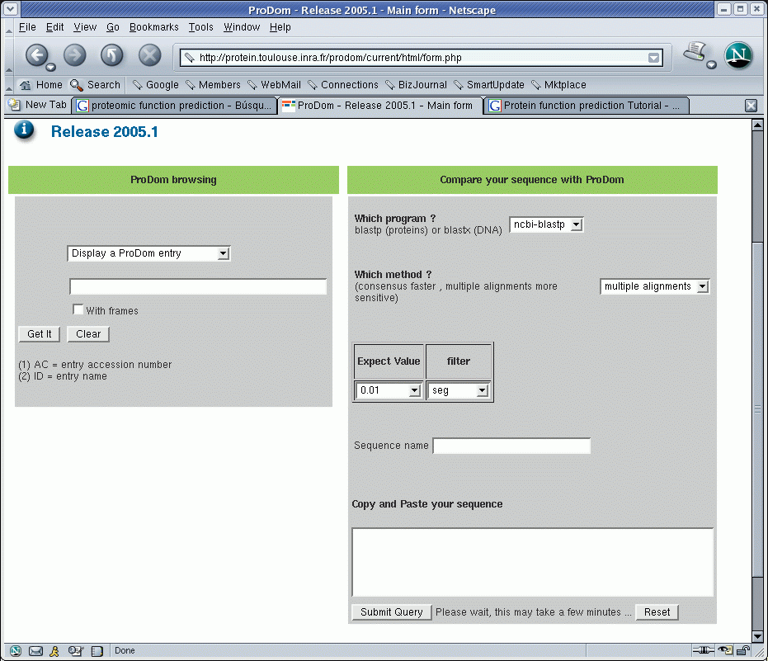
ProDom in practice

Slide 24
Interpro
Database on protein families, domains and functional sites
  Integrates other databases: PROSITE, PRINTS, ProDom, SMART, TIGRFAMs, PIRSF, SUPERFAMILY, PANTHER y Gene3D
  http://www.ebi.ac.uk/interpro/
  InterProScan

Slide 25
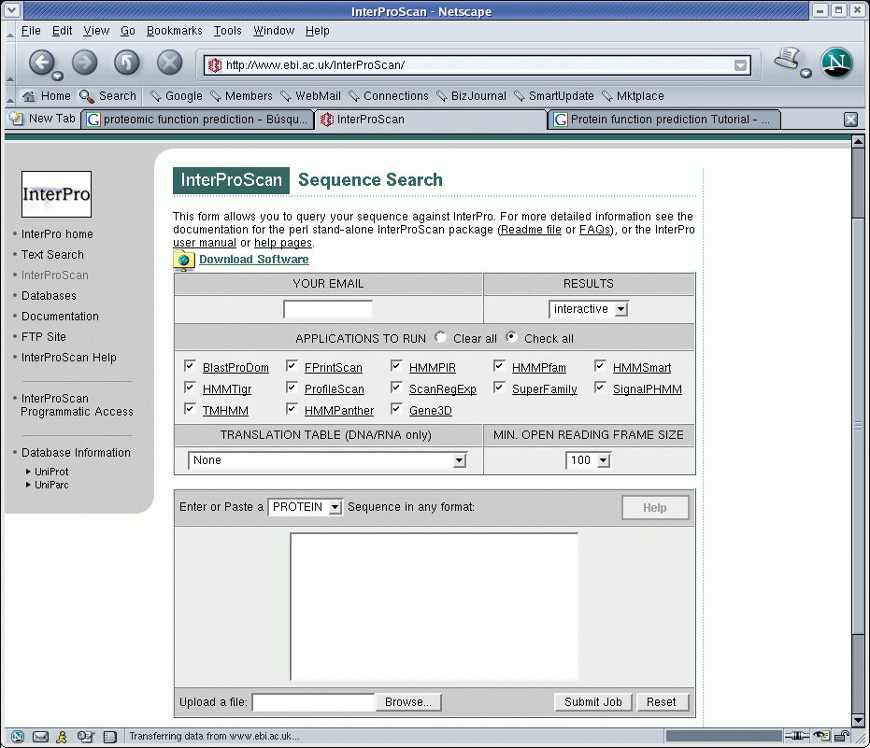
InterProScan

Slide 26
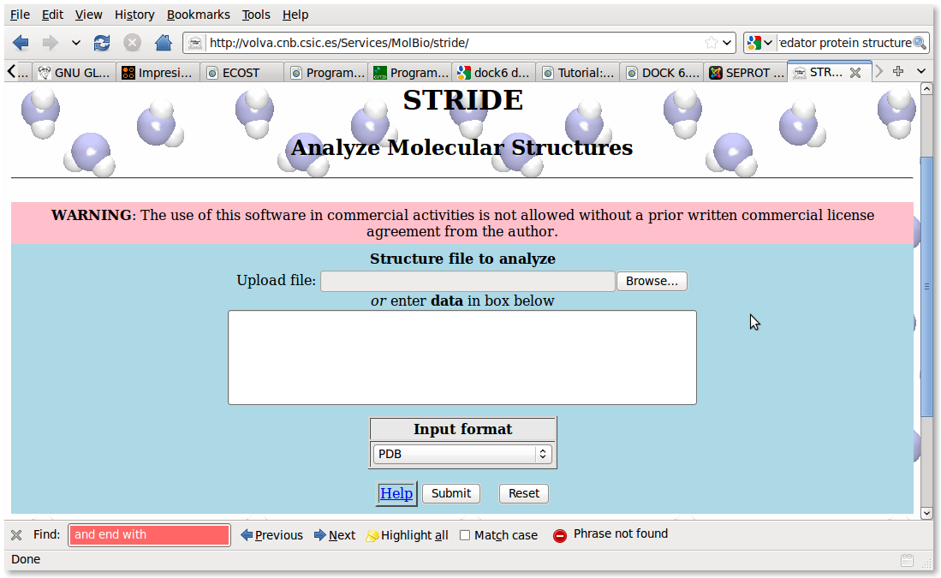
PDBfinder (DSSP/HSSP)
  Known secondary structures can be used for prediction using homology

Slide 27
PredictProtein
Automatic prediction of functional and structural properties of a protein
  Run a battery of tests on the sequence
    similarity
    motives
    structure...
  http://www.predictprotein.org/
  and produces a detailed report of the predictions obtained.

Slide 28
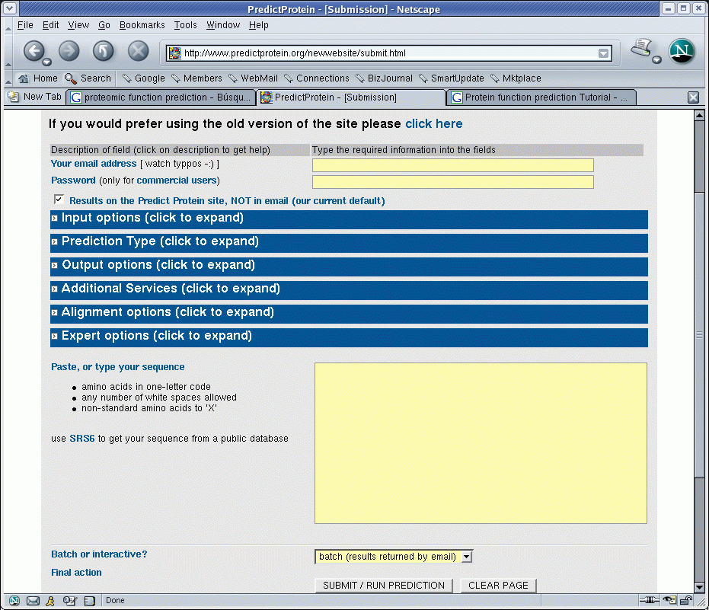
PredictProtein

Slide 29
Function prediction from structure
Protein Function Prediction Server
  Uses structural data from structure databases
  http://wolf.bms.umist.ac.uk/~mjfikpd2/predict/enon.html
Catalytic Site Atlas
  structural models of active sites
  http://www.ebi.ac.uk/thornton-srv/databases/CSA/

Slide 30
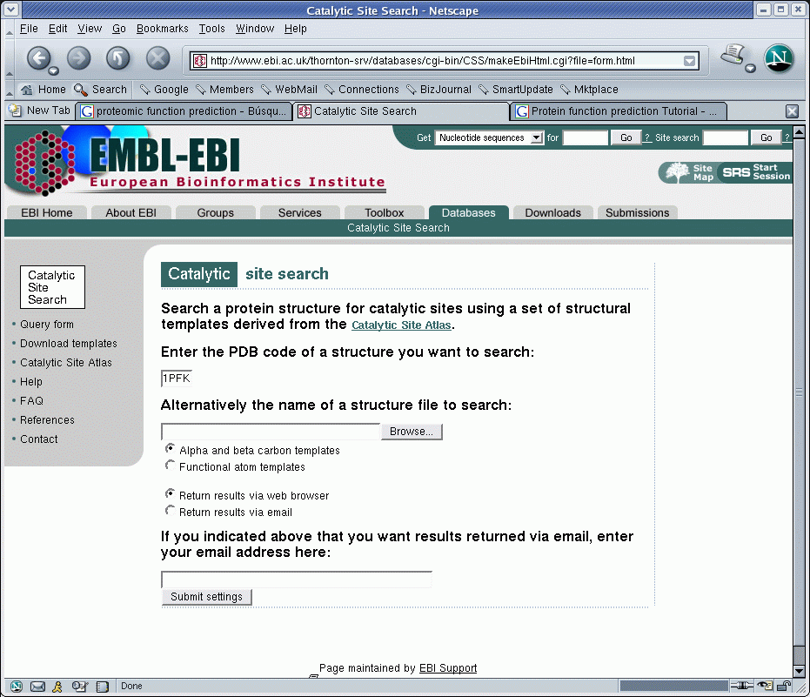
Catalytic Site Atlas

Slide 31

In any case
Ask you local bioinformatician.
'Cos you have one, don't you?

