Slide 1
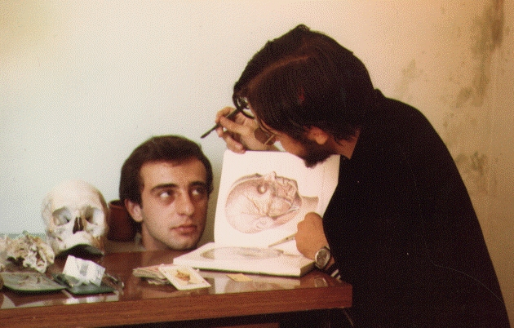
Protein Function
How to dissect a protein's function
(and survive to tell it).
José R. Valverde (jr@es.embnet.org)
EMBnet/CNB (www.es.embnet.org)
CC-BY-SA

Slide 2
Introduction
Using theoretical predictions may save experimental work
  analysis of all possible interactions
Ideally we want
  an efficient experimental function analysis method (and cheap!)
  or a theoretical one that never fails (or almost)

Slide 3
Long term goal
Efficiently get useful predictions on a protein function
  save time and money in experiments
    Guide new experiments
  high throughput analysis (*omics)
  detect targets and substrates
  enhance our quality of life

Slide 4
Current status:
Experiments
Unknown protein: explore all its possible interactions
  proteins (1K-100K optimistic, zillions possible)
  nucleic acids
  polisaccarides, fats, etc...
  drugs, compounds, atoms (zillions)
Known protein:
  Does it have unknown roles?

Slide 5
Current status:
Theory
Prediction from sequence
  relies on functional dictionaries
Prediction from structure
  relatively few structures available
  relative reliability of structure prediction
  analysis of interactions
    quick but low precision
    slow but high precision

Slide 6
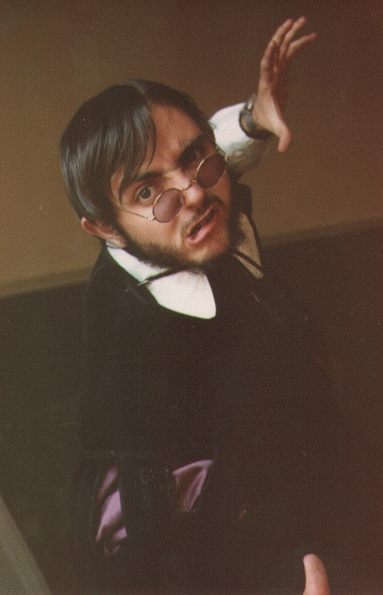
Who's afraid...
of function prediction?
But it's so easy!

Slide 7
Structural comparisons
Originally done by hand are now automatic
  identify “3D templates”
Relatively reliable
  May get around important differences in sequence
Relatively few structures available
Structure may change substantially depending on the environment

Slide 8
If there is no structure
Many secondary structure prediction methods (and associated functionality)
  transmembranes, helix-turn-helix...
  Post-Translational Modifications (PTMs)
Homology prediction (credible at high similarities)
Threading (take with a grain of salt).

Slide 9
Molecular interactions
In silico
  Costly
    Use of abstractions (pharmacophores,...)
    coevolution
  Many possibly interesting possibilities
    protein-protein: 1K-100K
    protein-substrate: 10K – zillions
  Forces us to balance reliability vs. efficiency
    Still very useful to guide work

Slide 10
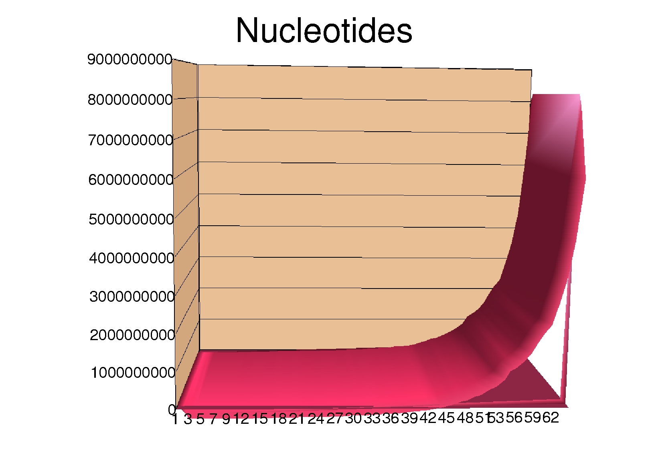
Primary databases
EMBL/GenBank/DDBJ
UniProt
PDB/MSD/RCSB
The last 6 months contain half of all the knowledge gathered in the whole HISTORY of mankind

Slide 11
Homology modelling
Templates with similarity > 40%
Assign to problem the structure of template
Optimize structure (resolve esteric conflicts)
  http://swissmodel.expasy.org/
  http://bmm.cancerresearchuk.org/3djigsaw/
  http://www.cbs.dtu.dk/services/CPHmodels/

Slide 12
Threading
Partial templates, similarities < 30%
  http://www.sbg.bio.ic.ac.uk/~3dpssm/
  http://tardis.nibio.go.jp/fugue/
  http://cbsuapps.tc.cornell.edu/loopp.aspx
  http://supfam.cs.bris.ac.uk/SUPERFAMILY/

Slide 13
Modelling: where do I start?
EVA
  http://www.pdg.cnb.uam.es/eva/
Wizards
  http://www.es.embnet.org/Doc/Guides/molmod/Moldy/
  http://swissmodel.expasy.org/

Slide 14
Why not try everything?
Metaservers
GeneSilico: blastp, compass, ffas, fugue, HHsearch, jmbrank, pcons5, pdbblast, phyre, PRC, sparks
LoMets: PSIpred, MUSTER, hhsearch, SAM-T02, Sparks-2, SP3, PROSPECT2, PPA-I, FUGUE
PMP: SwissModel, M4T, ModWeb
Servers
CPHmodels
HHpred
LOOPP (adds heuristics)
MUSTER
Phyre and Phyre2
(ps)²
PsiPred
I-Tasser

Slide 15
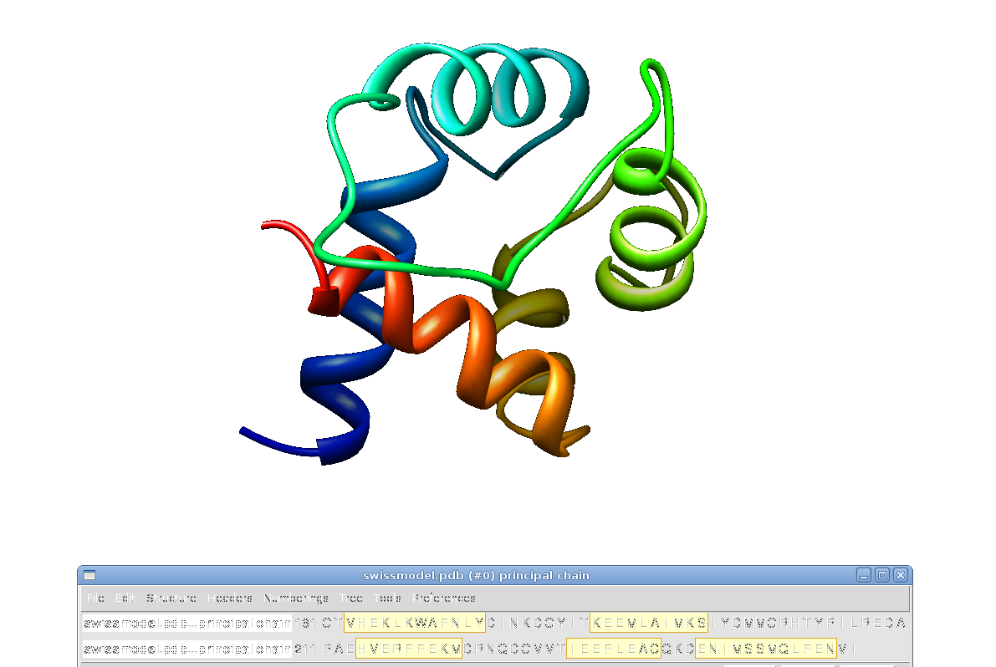
SwissModel
May give a model
that is too short if
it cannot find a
suitable homologue

Slide 16
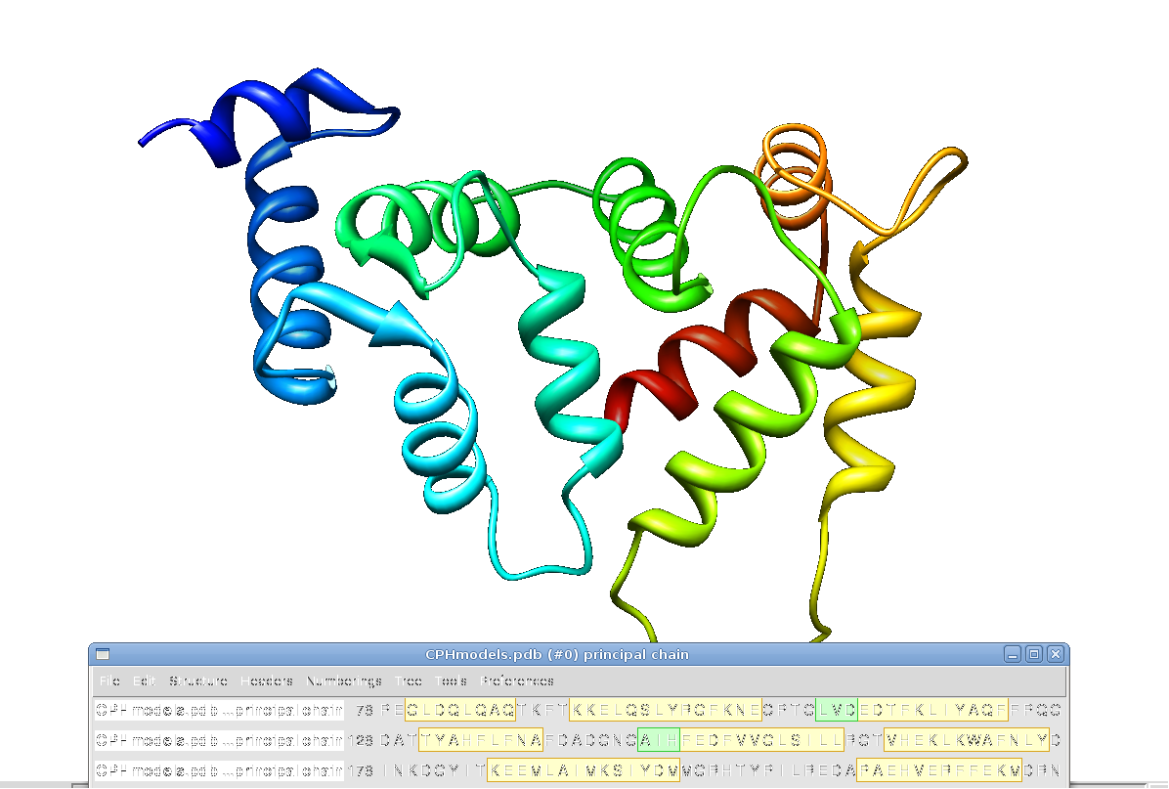
CPHmodels
Combining
several templates
gives longer
models but may
still be too short

Slide 17
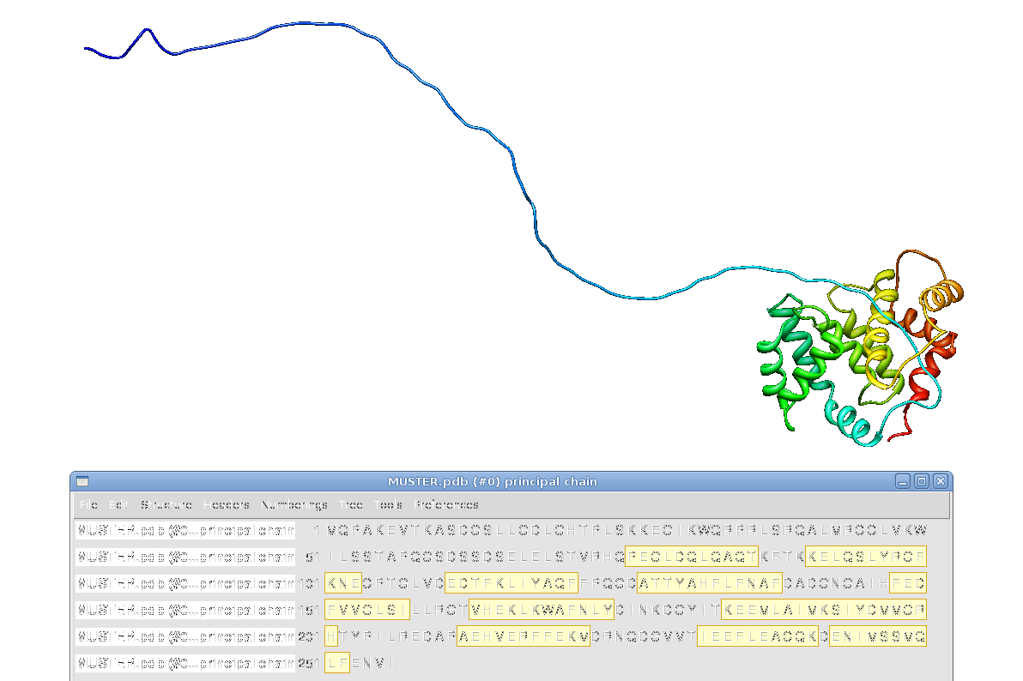
MUSTER
Note that some servers will
provide a “full” structure but
nonassignable amino acids
will be in an extended
conformation (not useful)

Slide 18
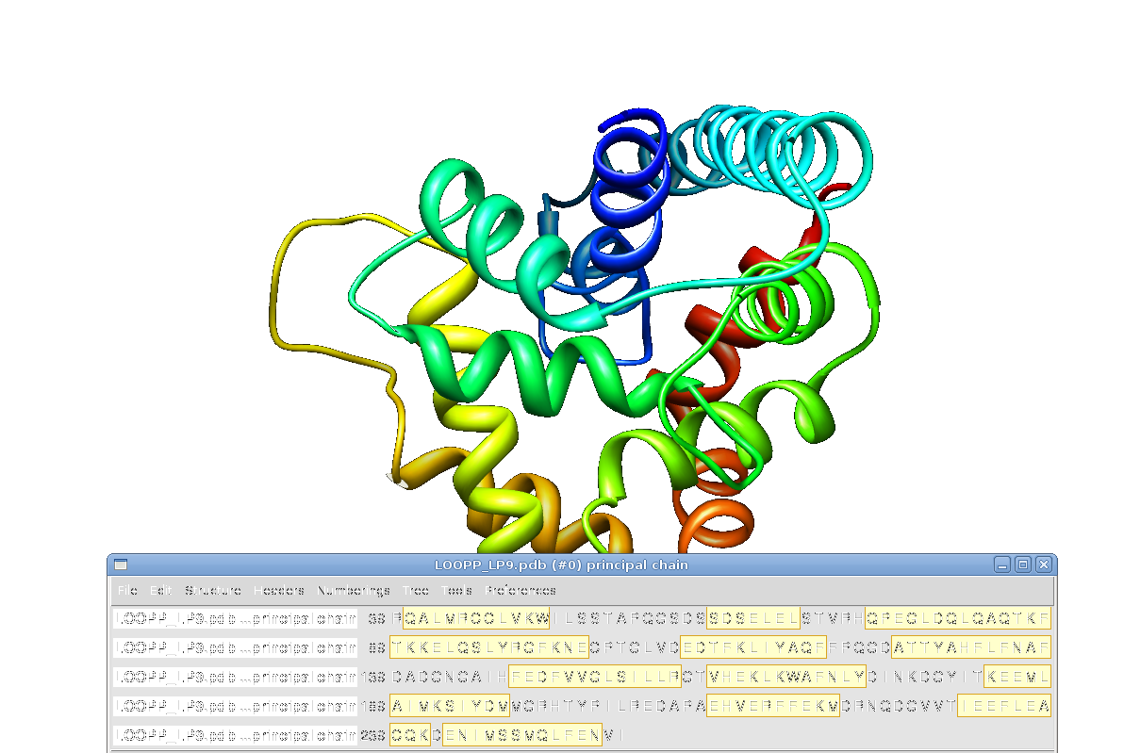
LOOPP LP9
Some servers may
use heuristics to
complete the
full model.
As any heuristic,
these should be
taken with care.

Slide 19
ab initio modeling
Phyre2 (fast/slow)
QUARK (I-Tasser)
Rosetta (Robetta)
Does not make any assumptions (e. g. similarity)
Works well for “short” sequences (up to 150-200 aa)
  Combine with homology modeling

Slide 20
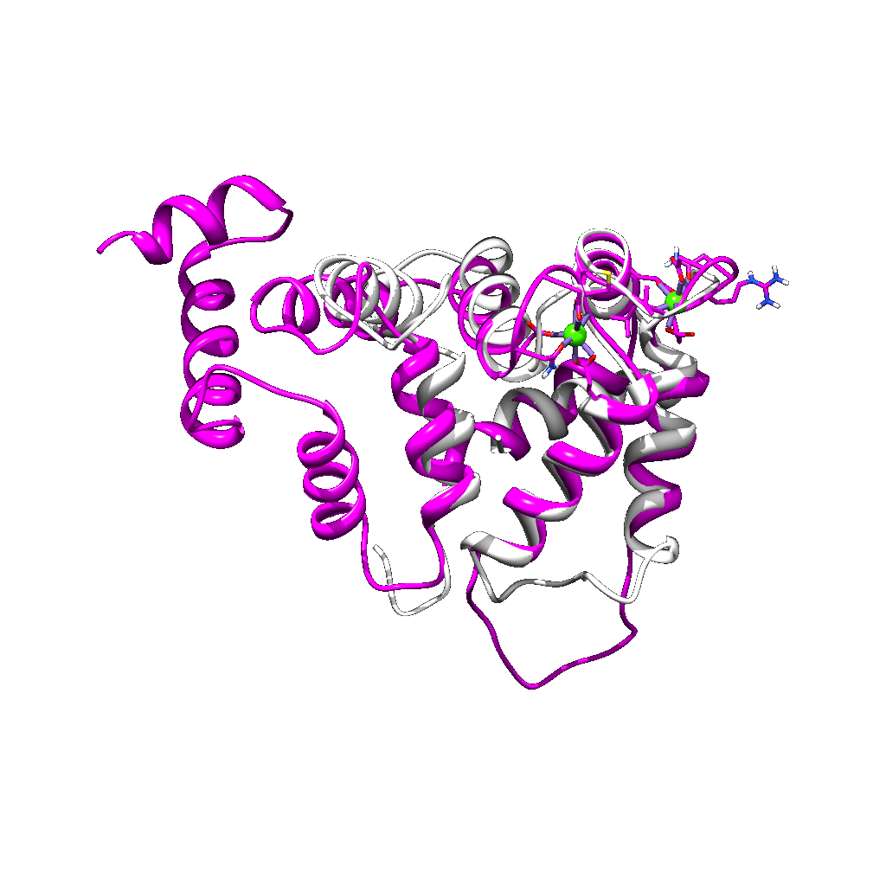
Rosetta ab initio vs known PDB
In this case we
predicted from
scratch a model
for which partial
structure was available
in order to check the
accuracy of the prediction.
It was quite good!
Structures aligned with UCSF Chimera
and rendered with POV-ray

Slide 21
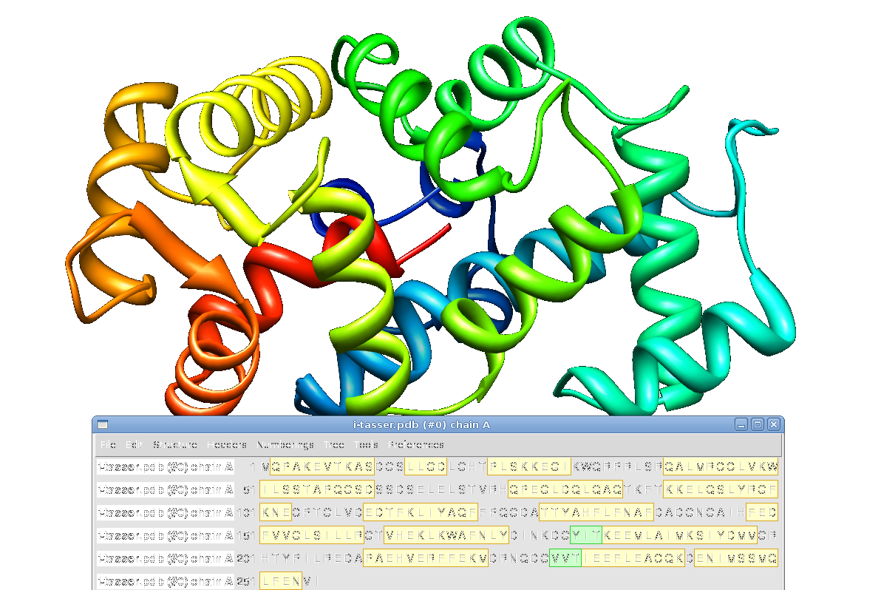
i-tasser (quark)
Combining ab initio with
homology...

Slide 22
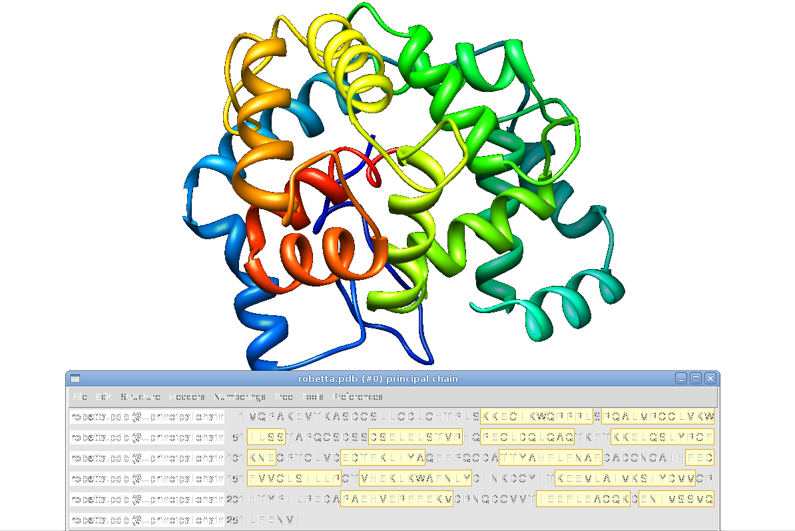
Robetta (rosetta)
... needs not always work
and give consistent results
(in this case the unknown
region was known to be
very flexible)
Use with cuation!

Slide 23
Protein-protein Docking
Predict protein-protein interactions
  GRAMM
  HEX
    Allows manual tuning
  ZDOCK
  PatchDock/SymmDock
    Allows specifying interface amino acids as hint
  And many, many more...

Slide 24
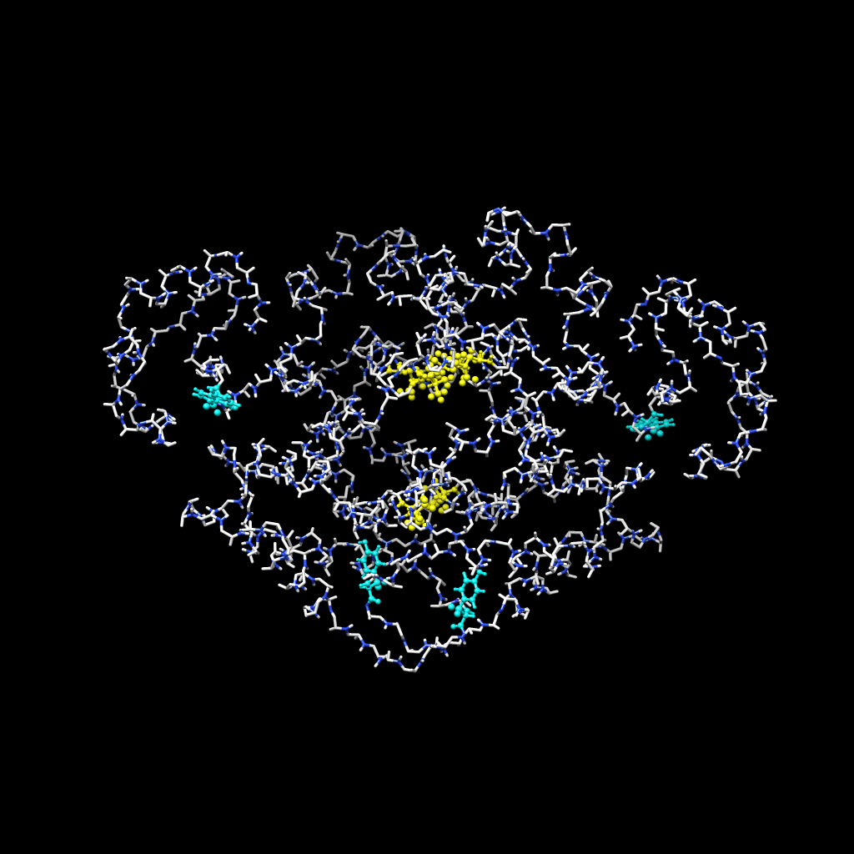
Docking refinement
Docking programs
  assume rigid mols.
  generate many alternatives
It may help using MD for refinement
  allows for flexibility
Review & pick by hand

Slide 25
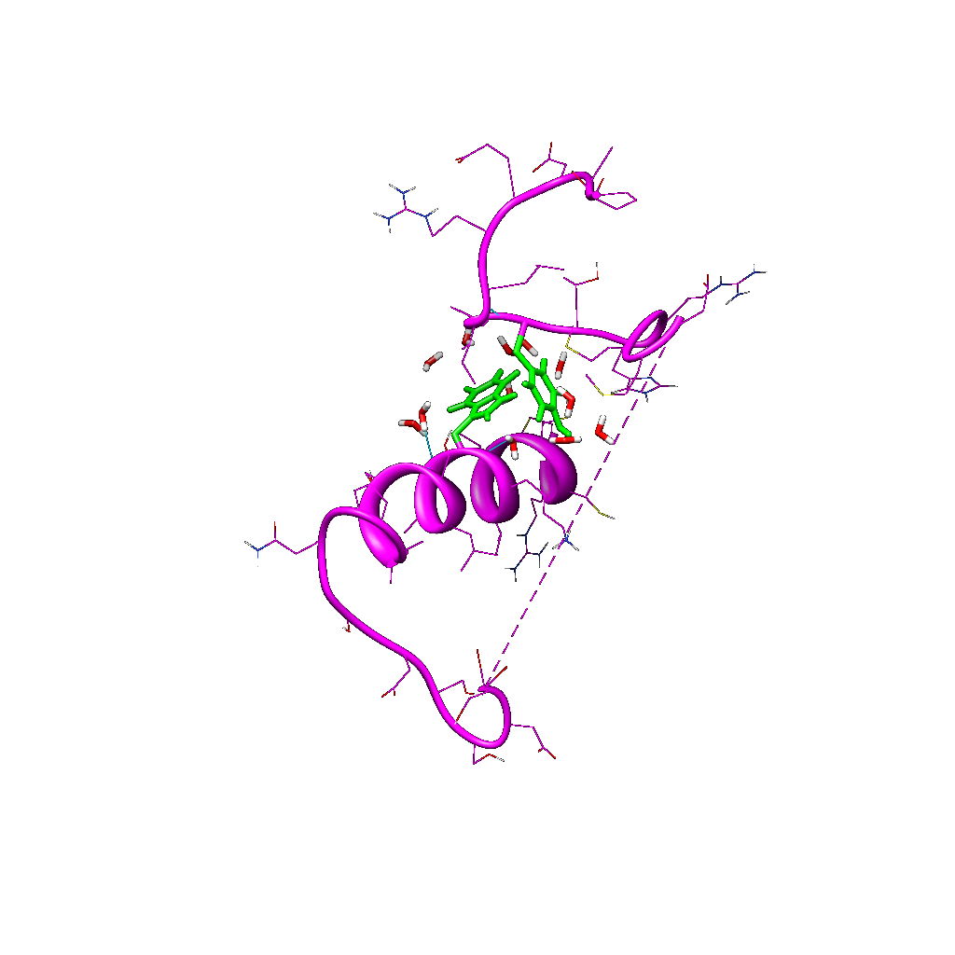
If you cannot get a full structure
You can always try to model only the region of interest.

Slide 26
QSAR
Quantitative Structure Activity Relationship
  A body of techniques
  Aim is activity prediction of small compounds
  An alternative to S. James Black method
    Modify substrates in search of analogues
    Test experimentally
  Not a substitute:
    Experimental testing still needed
    But for a smaller set

Slide 27
QSAR
Similar molecules have similar functions and similar structures
  Similar structures should have similar functions
  Wouldn't it be nice if we could say...
    what will be the effects of a substance?
    what is the actual activity / reactivity of different species?
    etc...
Look at structural similarities and try to predict.
  Any similarity in any property is worth using for our guess

Slide 28
3D-QSAR
Traditional QSAR models used any structural property
  Generally simplifications to speed up computation
With bigger computers we can now consider the 3D structure
  We may go all the way to full models
    Rigid
    Flexible...

Slide 29
Ligand-receptor binding
Once the properties of ligands and binding site are known we can explore the binding process
  Experiment (e. g. X-ray)
  Grid maps
    Define a grid around the protein
    use functional sites as probes (e. g. H₂O for -OH)
    Place probes on grid and look for putative interaction sites
  Multiple copy minimization
    Build a cloud of copies of the probe around the receptor
    Minimize each of them independently
    Model approximation of probe to receptor
    Refine

Slide 30
Docking explained
Predict the structure of the interaction complex of two or more molecules
  Requires a scoring method to evaluate
Involves many degrees of freedom
  Six degrees for translation and rotation of one molecule around the other
Expensive in computational time
The hands-on approach
  Use computer graphics and do it by hand
  May be very efficient if we have an idea of where the active site is
  Needs caution: similar substrates may adopt very different conformations

Slide 31
Docking algorithms
How many degrees of freedom are ignored?
  Treat both molecules as rigid bodies and use only the six basic movements (DOCK, GRAMM):
    DOCK (Kuntz) derive a negative image of the binding site as superposing spheres
  Flexible docking: include conformational degrees of freedom.
    Allow only ligand flexbility (e.g. MonteCarlo with Simulated Annealing, umbrella sampling)
    Allow ligand and receptor flexibility (MD)
  Genetic algorithms
  Others...

Slide 32
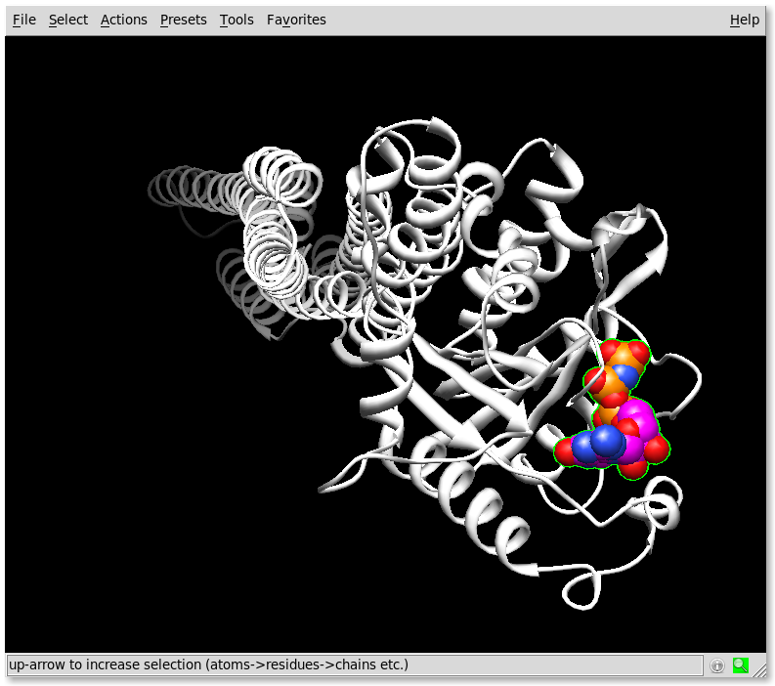
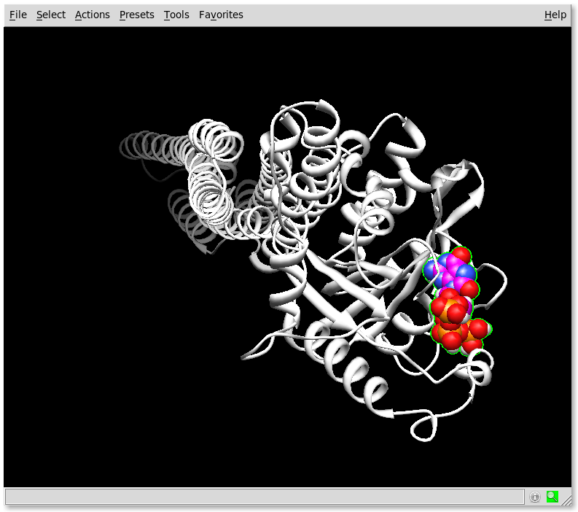
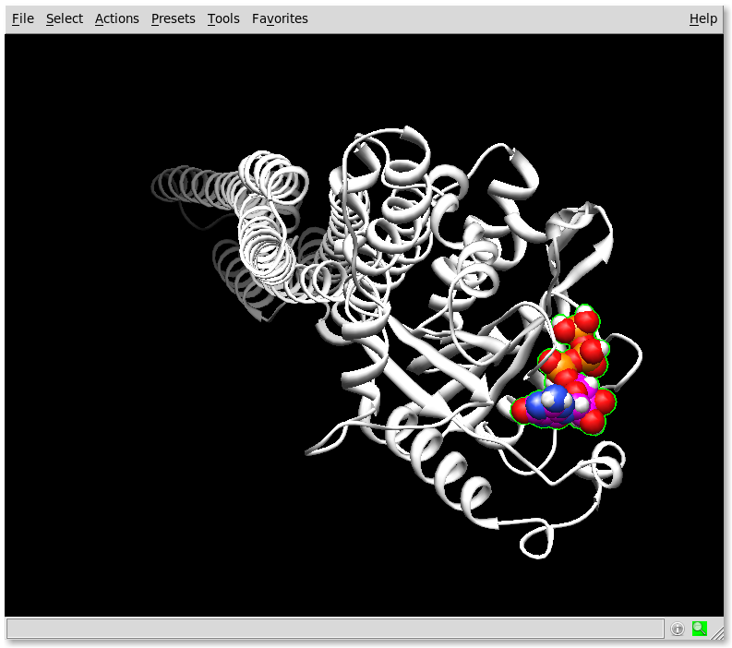
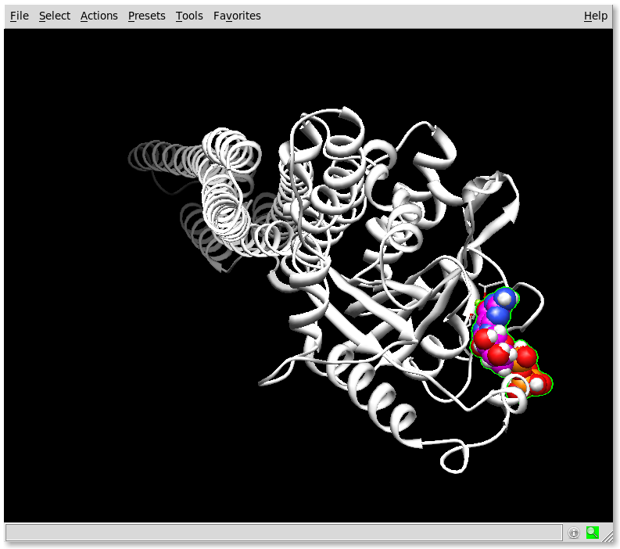
Docking scores example
There are many
free programs:
Autodock
Dock6
3D-Dock
Gramm
etc...
1f5n + 8oxoGTP (max E)
1f5n + GTP
In this case, the
model with max.
H bonds gave a
prediction of
8OGTP binding
closer to known
GTP binding
1f5n + 8oxoGTP (max H)
1f5n + 8oxoGTP (max Grid)

Slide 33
Searching
Once the active site is known we can look for other target drugs
  Match them in the active site
  Convert chemical formulas to structures
Search databases
  Commercial
  CORINA (gives isolated structures and synthesis info)
  HIC-UP (PDB ligands)
  NCI (antitumour drugss)
  ZINC (the database: millions of compounds)

Slide 34
Predicting interactions
ZINC contains over 13 million purchasable compounds in ready-to-dock, 3D formats
  http://zinc.docking.org/
Many more:
    http://dtp.nci.nih.gov/docs/3d_database/dis3d.html
    http://pubchem.ncbi.nlm.nih.gov/
    http://bioinformatics.charite.de/superdrug/
    And more...

Slide 35
High throughput prediction
Phylogenetic profiles
QSAR screenings
Interaction networks
Analysis of interaction maps in proteomes
A field in active development.

Slide 36
Advice
Start from the sequence:
  ProSite, Blocks, PRINTS, Pfam, InterPro
Try structure
  predict if not available
  2D: PredictProtein, transmembrane, PTMs, etc...
  3D: PFPS, CSA...
Resort to context and interactions
  QSAR...

Slide 37

In any case
Ask you local bioinformatician.
'Cos you have one, don't you?

