Slide 1
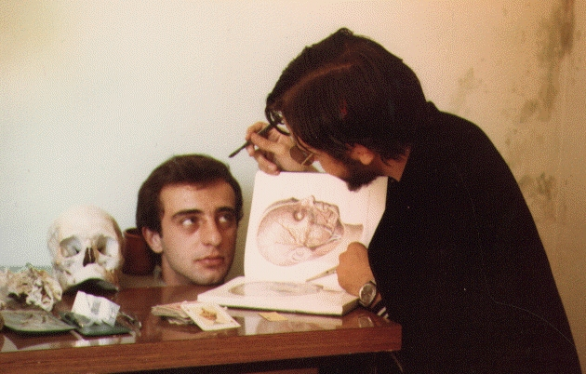
Protein Function
How to dissect a protein's function
(and survive to tell it).
José R. Valverde (jr@es.embnet.org)
EMBnet/CNB (www.es.embnet.org)
CC-BY-SA

Slide 2
Introduction
Using theoretical predictions may save experimental work
  analysis of all possible interactions
Ideally we want
  an efficient experimental function analysis method (and cheap!)
  or a theoretical one that never fails (or almost)

Slide 3
Long term goal
Efficiently get useful predictions on a protein function
  save time and money in experiments
    Guide new experiments
  high throughput analysis (*omics)
  detect targets and substrates
  enhance our quality of life

Slide 4
Current status:
Experiments
Unknown protein: explore all its possible interactions
  proteins (1K-100K optimistic, zillions possible)
  nucleic acids
  polisaccarides, fats, etc...
  drugs, compounds, atoms (zillions)
Known protein:
  Does it have unknown roles?

Slide 5
Current status:
Theory
Prediction from sequence
  relies on functional dictionaries
Prediction from structure
  relatively few structures available
  relative reliability of structure prediction
  analysis of interactions
    quick but low precision
    slow but high precision

Slide 6
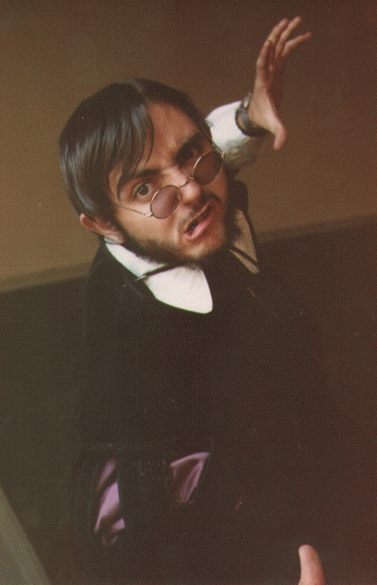
Who's afraid...
of function prediction?
But it's so easy!

Slide 7
Developments to date
Sequence comparison
  motives
  domains
  matrices
Include context
Structural analysis
  conservation
  interactions

Slide 8
Starting point
Organisms evolve stepwise
Sequence determines structure determines function
Function controls structure controls sequence
But...
  context is very important

Slide 9
What did we learn?
Similar functions share similar sequences
Similar functions share similar structures
Similar sequences have similar structures
Similar structures have similar functions

Slide 10
Rules are meant to be broken
  Similar functions have similar sequences
Not always (e.g. convergent evolution)
  Similar functions have similar structures
Not always (ut supra)
  Similar sequences have similar functions
Not always (e.g. deletereal mutations)
  Similar structures have similar functions
Not always (ut supra)

Slide 11
Available options
Compare sequences
Build motive dictionaries
Build “grammar” rules
Analyze structure
Analyze interactions
Analyze context

Slide 12
Comparison: example
Once upon a time, on a place far away
Once upon a time, on a kingdom far away
Once there was a princess
There was once in a kingdom far, far away...
How does a tale start?

Slide 13
Comparing sequences
Build multiple alignments and look for similarities/differences
  Direct and intuitive
  Expensive work
  Highly precise
  Too low or high a conservation makes work difficult
  Polisemy, synonimy

Slide 14
Build motifs
Identifify and use only relevant residues
  Define allowed variability (e.g. A-[IVL]-X-D)
  Initially costly, very efficient
  Requires enough sequences (positives and negatives) to estimate reliability
  Sometimes variability is too high:
    position specific score matrices

Slide 15
Motives: example
I am
I'm
You are
You're
He is
He's
How do we conjugate 'to be'?

Slide 16
Motives: counter example
How does a tale end?
  And they lived happily ever after
  And ever since then that is the way it has been
  And so the story goes
  And that is the story as I was told it
Where would a motif or a matrix take us?
  Several matrices?

Slide 17
Positional dependencies
Analyzed using HMMs and NNs
  Capture dependencies and relations not inmediately evident
  More precise and automatizables
  Require more space and time
  Conceptually intuitive but very difficult to understand (except by practice).

Slide 18
HMM: example
A rose is a rose is a rose
Two roses are two roses are two roses
Can you give me an apple?
Can you give me many apples?
Can you give me some water?

Slide 19
Structural comparisons
Originally done by hand are now automatic
  identify “3D templates”
Relatively reliable
  May get around important differences in sequence
Relatively few structures available
Structure may change substantially depending on the environment

Slide 20
If there is no structure
Many secondary structure prediction methods (and associated functionality)
  transmembranes, helix-turn-helix...
  Post-Translational Modifications (PTMs)
Homology prediction (credible at high similarities)
Threading (take with a grain of salt).

Slide 21
Molecular interactions
In silico
  Costly
    Use of abstractions (pharmacophores,...)
    coevolution
  Many possibly interesting possibilities
    protein-protein: 1K-100K
    protein-substrate: 10K – zillions
  Forces us to balance reliability vs. efficiency
    Still very useful to guide work

Slide 22
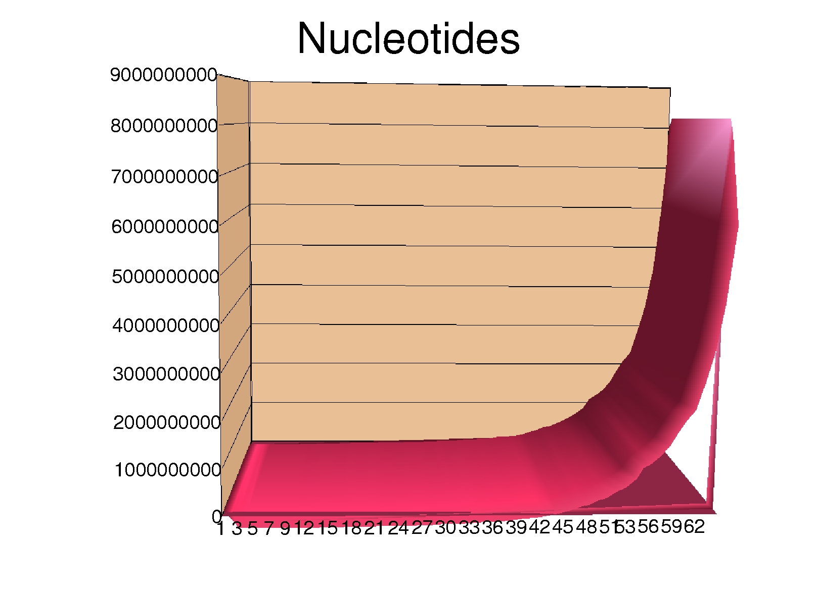
Primary databases
EMBL/GenBank/DDBJ
UniProt
PDB/MSD/RCSB
The last 6 months contain half of all the knowledge gathered in the whole HISTORY of mankind

Slide 23
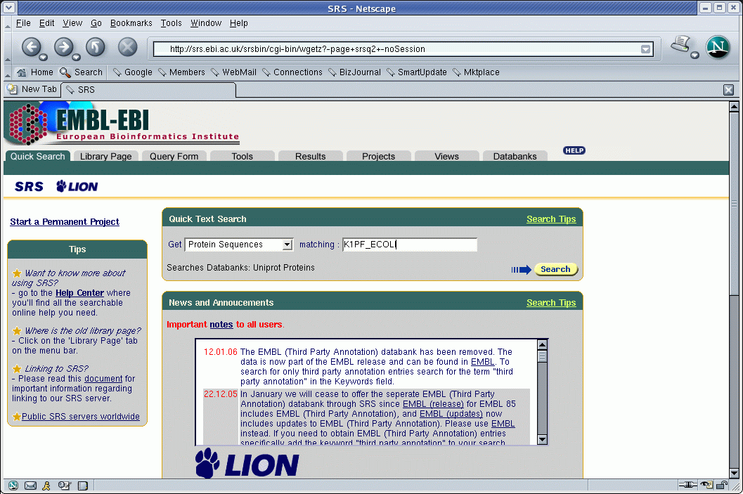
srs.ebi.ac.uk

Slide 24
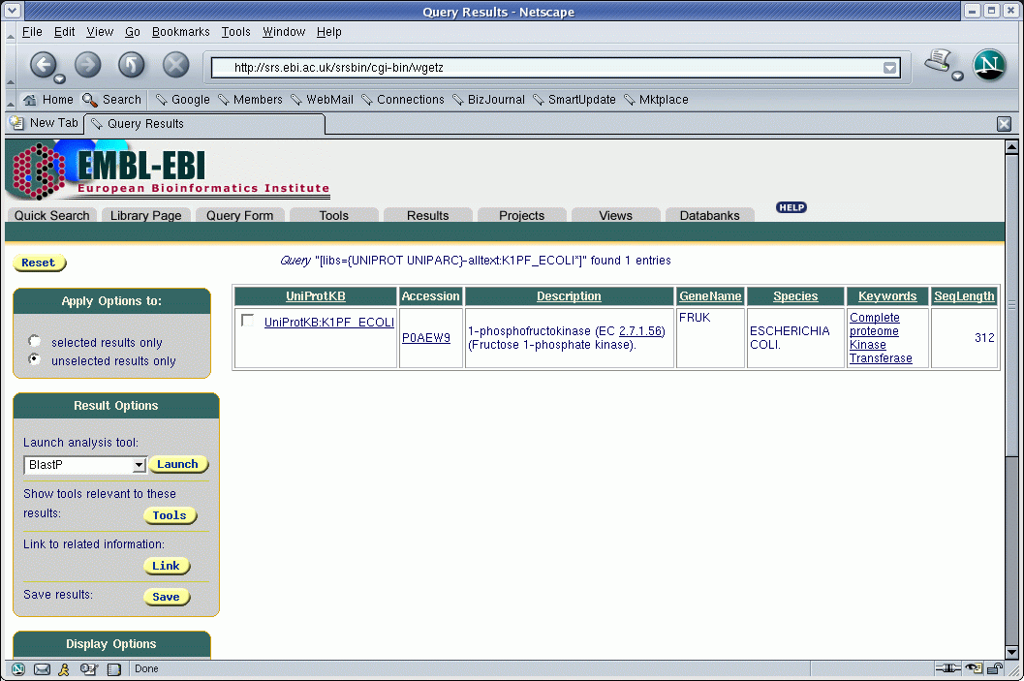
srs.ebi.ac.uk

Slide 25
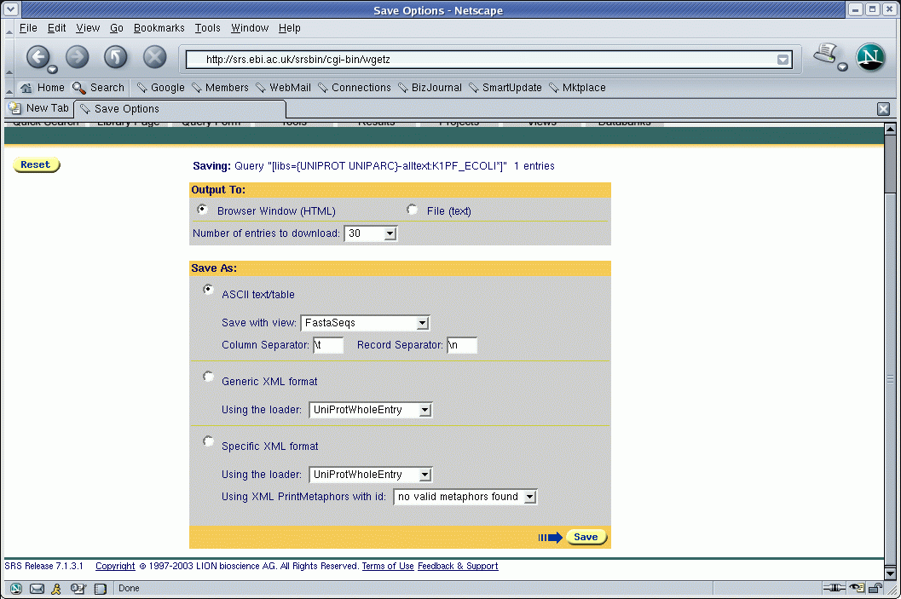
srs.ebi.ac.uk

Slide 26
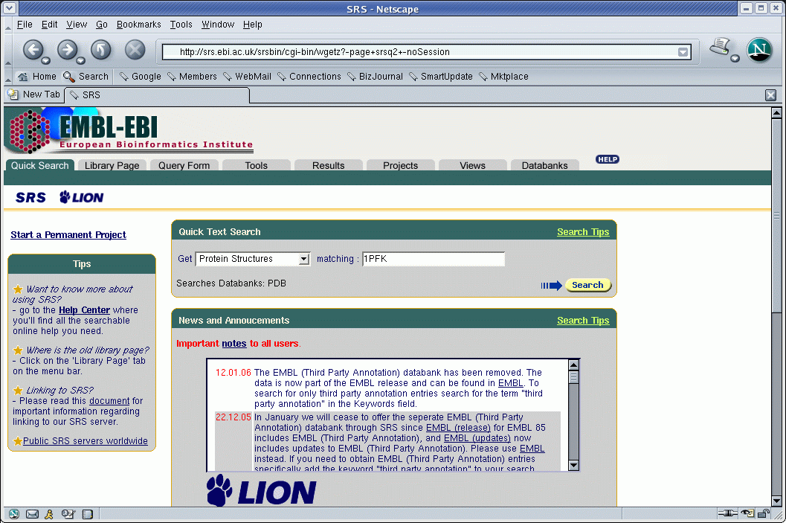
srs.ebi.ac.uk

Slide 27
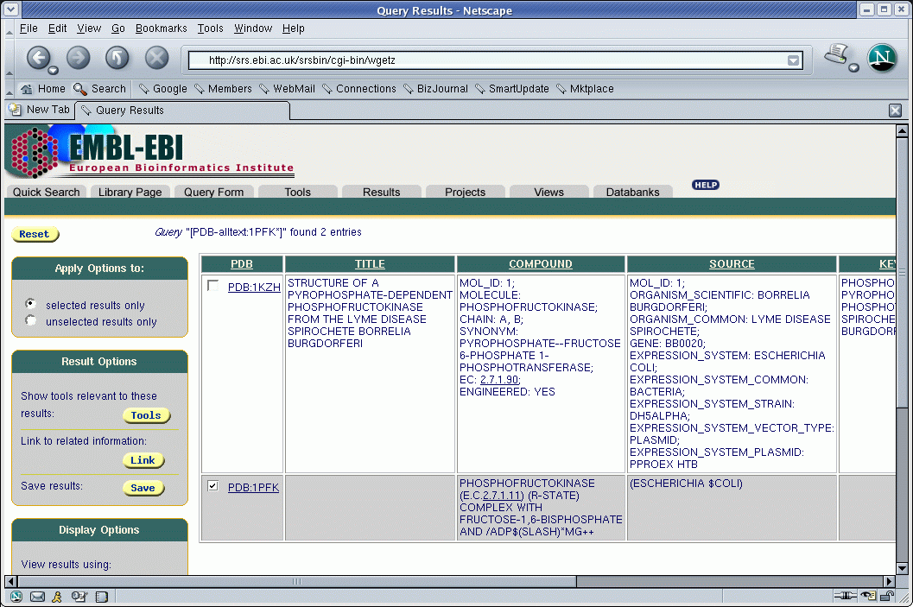
srs.ebi.ac.uk

Slide 28
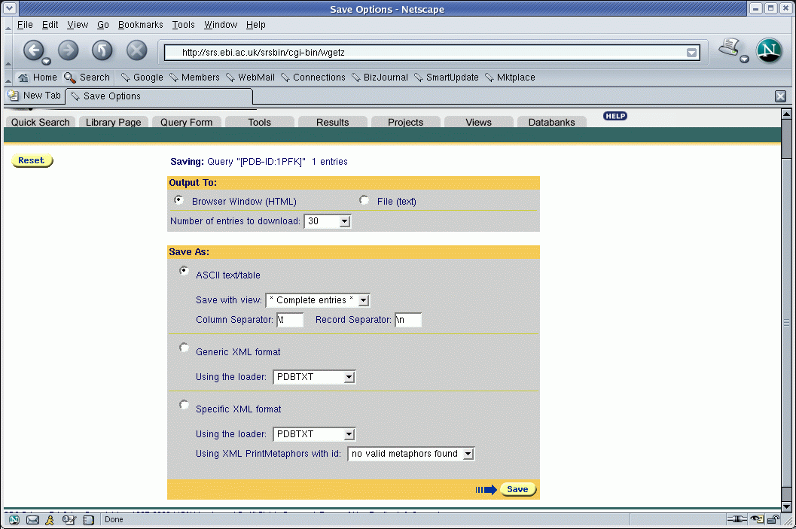
srs.ebi.ac.uk

Slide 29
Sequence dictionaries
Function should be determined by structure
Structure should be determined by sequence
Similar functions and structures should have similar sequences
Thus, it suffices to compare sequences
or not?

Slide 30
PROSITE
Dictionary of conserved sequences (motifs)
  derived by experiment-driven sequence comparison
  with literal variability (patterns)
  with detailed descriptions
  rules and matrices added recently as well

Slide 31
Prosite: example
ID PHOSPHOFRUCTOKINASE; PATTERN.
AC PS00433;
DT NOV-1990 (CREATED); MAY-1991 (DATA UPDATE); JUL-1998 (INFO UPDATE).
DE Phosphofructokinase signature.
PA [RK]-x(4)-G-H-x-Q-[QR]-G-G-x(5)-D-R.
NR /RELEASE=41.16,130569;
NR /TOTAL=105(81); /POSITIVE=105(81); /UNKNOWN=0(0); /FALSE_POS=0(0);
NR /FALSE_NEG=16; /PARTIAL=2;
CC /TAXO-RANGE=??EP?; /MAX-REPEAT=2;
CC /SITE=1,substrate_binding; /SITE=4,substrate_binding;
CC /SITE=7,substrate_binding;
DR Q8YKG3, K6P1_ANASP, T; Q9HGZ1, K6P1_ASPOR, T; Q8A8R5, K6P1_BACTN, T;
DR O94201, K6P1_CANAL, T; P06998, K6P1_ECOLI, T; Q03215, K6P1_KLULA, T;
DR Q92448, K6P1_PICPA, T; O08333, K6P1_STRCO, T; P72830, K6P1_SYNY3, T;
...
...
DR Q9KH71, PFP_DICTH , N;
3D 1MTO; 1PFK; 2PFK; 3PFK; 4PFK; 6PFK;
DO PDOC00336;

Slide 32
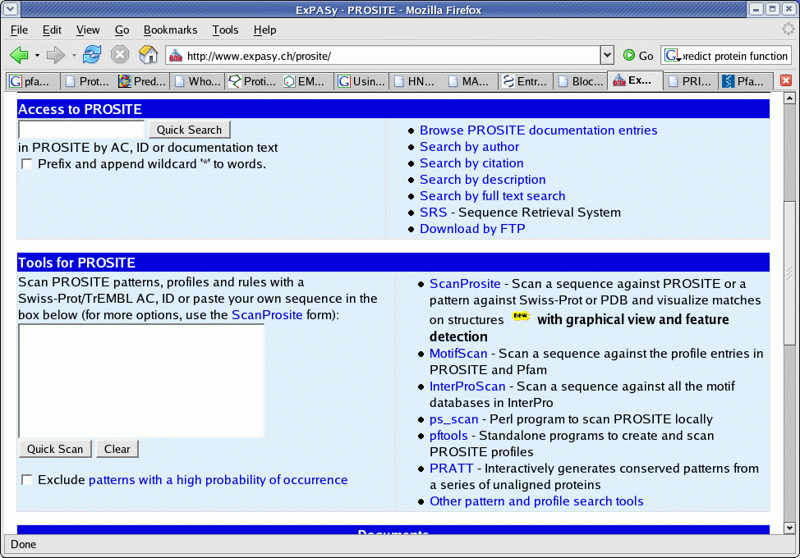
ProSite in practice
Expasy
  www.expasy.ch/prosite/
  Tools for PROSITE
  Paste sequence
  QuickScan
  Exclude Patterns with a high probability of occurrente
  Otras herramientas

Slide 33
ProSiteDoc: example
{PS00433; PHOSPHOFRUCTOKINASE}
{BEGIN}
*********************************
* Phosphofructokinase signature *
*********************************
Phosphofructokinase (EC 2.7.1.11) (PFK) [1,2] is a key regulatory enzyme in
the glycolytic pathway. It catalyzes the phosphorylation by ATP of fructose
6-phosphate to fructose 1,6-bisphosphate. In bacteria PFK is a tetramer of
identical 36 Kd subunits. In mammals it is a tetramer of 80 Kd subunits. Each
80 Kd subunit consist of two homologous domains which are highly related to
the bacterial 36 Kd subunits. In Human there are three, tissue-specific, types
of PFK isozymes: PFKM (muscle), PFKL (liver), and PFKP (platelet). In yeast
PFK is an octamer composed of four 100 Kd alpha chains (gene PFK1) and four
100 Kd beta chains (gene PFK2); like the mammalian 80 Kd subunits, the yeast
100 Kd subunits are composed of two homologous domains.
As a signature pattern for PFK we selected a region that contains three basic
residues involved in fructose-6-phosphate binding.
-Consensus pattern: [RK]-x(4)-G-H-x-Q-[QR]-G-G-x(5)-D-R
[The R/K, the H and the Q/R are involved in fructose-6-P
binding]
-Sequences known to belong to this class detected by the pattern: ALL.
-Other sequence(s) detected in Swiss-Prot: NONE.
-Note: Escherichia coli has two phosphofructokinase isozymes which are encoded
by genes pfkA (major) and pfkB (minor). The pfkB isozyme is not evolutionary
related to other prokaryotic or eukaryotic PFK's (see <PDOC00504>).

Slide 34
BLOCKS
Sometimes sequence is not well preserved
  Instead of distilling sequences store all of them
  http://blocks.fhcrc.org/
ID Pp2A_PR55; BLOCK
AC IPB000009A; distance from previous block=(-8,88)
DE Protein phosphatase 2A regulatory subunit PR55
BL ARF; width=50; seqs=66; 99.5%=2403; strength=1594
2ABA_CANTR|P53031 ( 20) EADIISTVEFDHTGDFLATGDKGGRVVLFERNQSKKKQSCEYKFFTEFQS 39
2ABA_SCHPO|Q12702 ( 28) EADIISAVEFDHTGDYLATGDKGGRVVLFERNHSKKGCEYKFFTEFQSHE 40
2ABA_YEAST|Q00362 ( 24) EADLITAVEFDYTGNYLATGDKGGRVVLFERSNSRHCEYKFLTEFQSHDA 71
2ABA_DROME|P36872 ( 80) DADIISCVEFNHDGELLATGDKGGRVVIFQRDPASKAANPRRGEYNVYST 312ABA_HUMAN|Q00007 ( 27) EADIISTVEFNHSGELLATGDKGGRVVIFQQEQENKIQSHSRGEYNVYST 182ABA_PIG|Q29090 ( 6) EADIISTVEFNHSGELLATGDKGGRVVIFQQEQENKIQSHSRGEYNVYST 182ABA_RAT|P36876 ( 27) EADIISTVEFNHSGELLATGDKGGRVVIFQQEQENKIQSHSRGEYNVYST 18

Slide 35
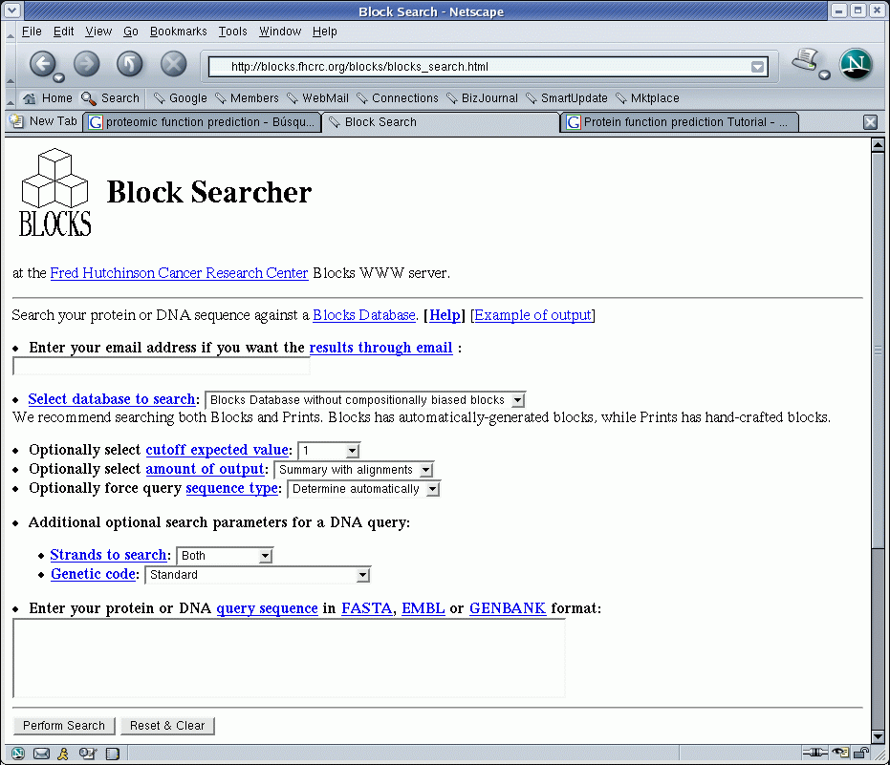
BLOCKS in practice

Slide 36
PRINTS
Compilation of fingerprints (preserved motives in a family)
  Includes context information
  http://umber.sbs.man.ac.uk/dbbrowser/PRINTS/
  Searches are done using fingerPRINTScan
    FPScan
    GRAPHScan
    MULScan

Slide 37
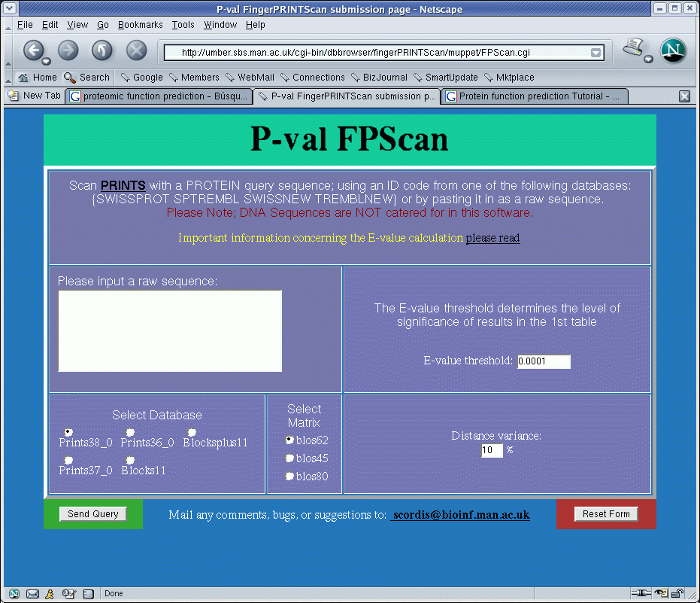
PRINTS in practice

Slide 38
Pfam
Common protein domains and families
  Alignments
  HMMs (Hidden Markov Models)
  Considers context and positional differences
http://sanger.ac.uk/resources/databases/
Search by:
  protein sequence
  DNA sequence...

Slide 39
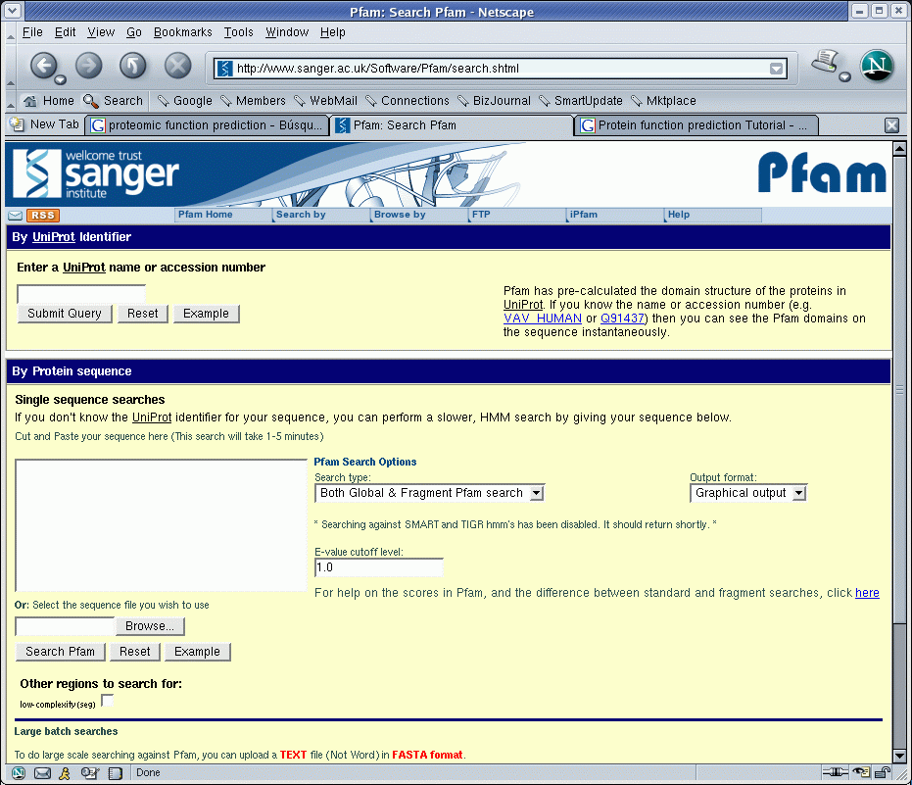
Pfam in practice

Slide 40
ProDom
Exhaustive set of protein family domains generated automatically.
  PSI-Blast
  SCOP (information on 3D domains)
  MultAlin
  CrossReferences to other systems
http://prodom.prabi.fr/

Slide 41
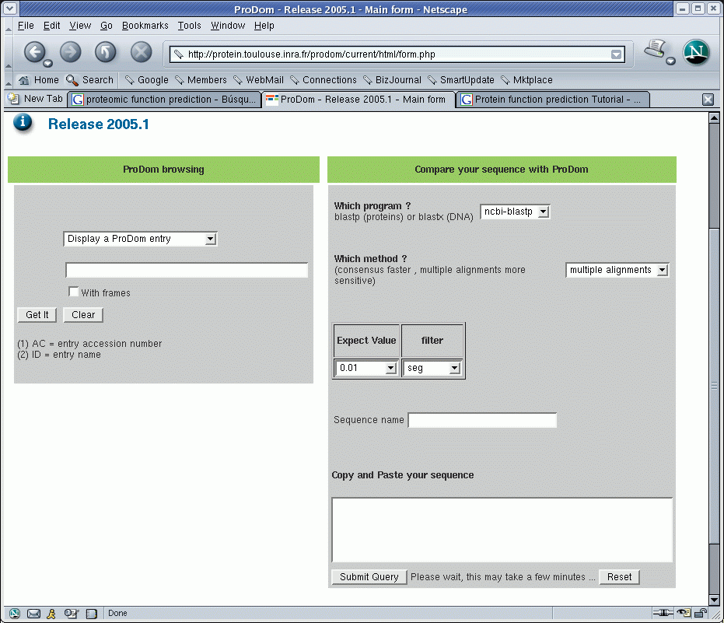
ProDom in practice

Slide 42
Interpro
Database on protein families, domains and functional sites
  Integrates other databases: PROSITE, PRINTS, ProDom, SMART, TIGRFAMs, PIRSF, SUPERFAMILY, PANTHER y Gene3D
  http://www.ebi.ac.uk/interpro/
  InterProScan

Slide 43
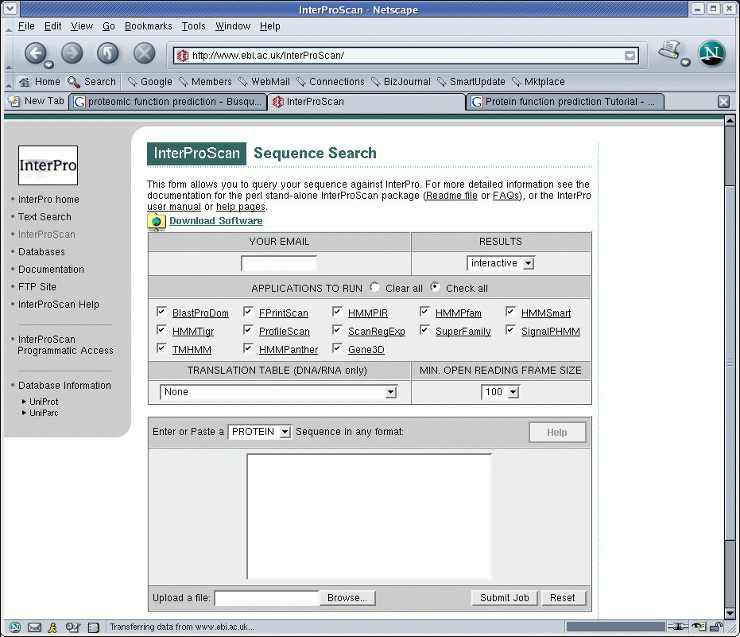
InterProScan

Slide 44
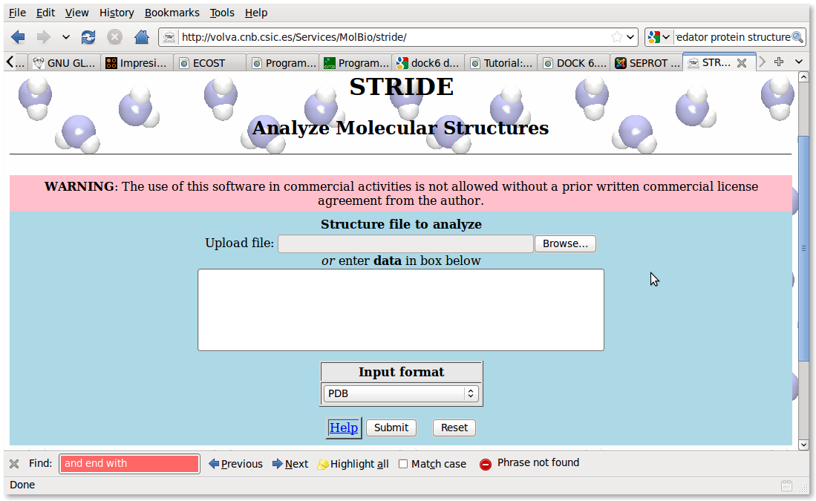
PDBfinder (DSSP/HSSP)
  Known secondary structures can be used for prediction using homology

Slide 45
PredictProtein
Automatic prediction of functional and structural properties of a protein
  Run a battery of tests on the sequence
    similarity
    motives
    structure...
  http://www.predictprotein.org/
  and produces a detailed report of the predictions obtained.

Slide 46
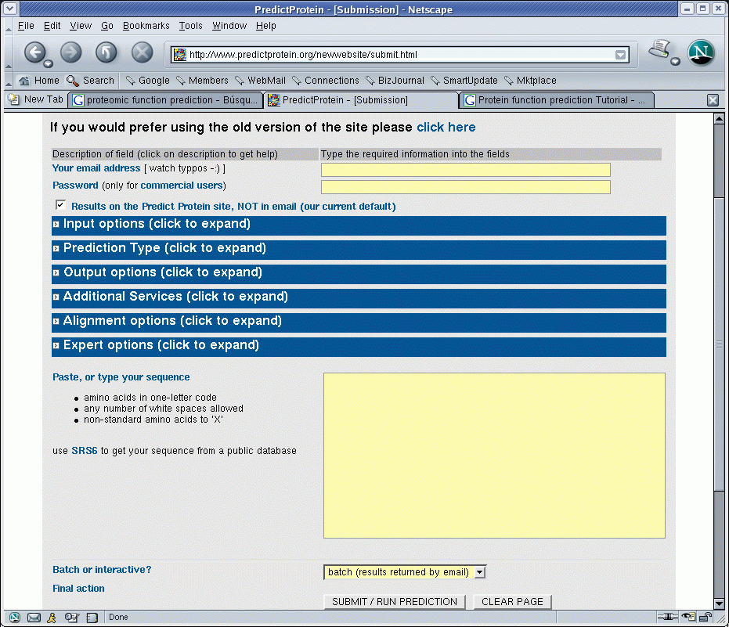
PredictProtein

Slide 47
Homology modelling
Templates with similarity > 40%
Assign to problem the structure of template
Optimize structure (resolve esteric conflicts)
  http://swissmodel.expasy.org/
  http://bmm.cancerresearchuk.org/3djigsaw/
  http://www.cbs.dtu.dk/services/CPHmodels/

Slide 48
Threading
Partial templates, similarities < 30%
  http://www.sbg.bio.ic.ac.uk/~3dpssm/
  http://tardis.nibio.go.jp/fugue/
  http://cbsuapps.tc.cornell.edu/loopp.aspx
  http://supfam.cs.bris.ac.uk/SUPERFAMILY/

Slide 49
Modelling: where do I start?
EVA
  http://www.pdg.cnb.uam.es/eva/
Wizards
  http://www.es.embnet.org/Doc/Guides/molmod/Moldy/
  http://swissmodel.expasy.org/

Slide 50
Function prediction from structure
Protein Function Prediction Server
  Uses structural data from structure databases
  http://wolf.bms.umist.ac.uk/~mjfikpd2/predict/enon.html
Catalytic Site Atlas
  structural models of active sites
  http://www.ebi.ac.uk/thornton-srv/databases/CSA/

Slide 51
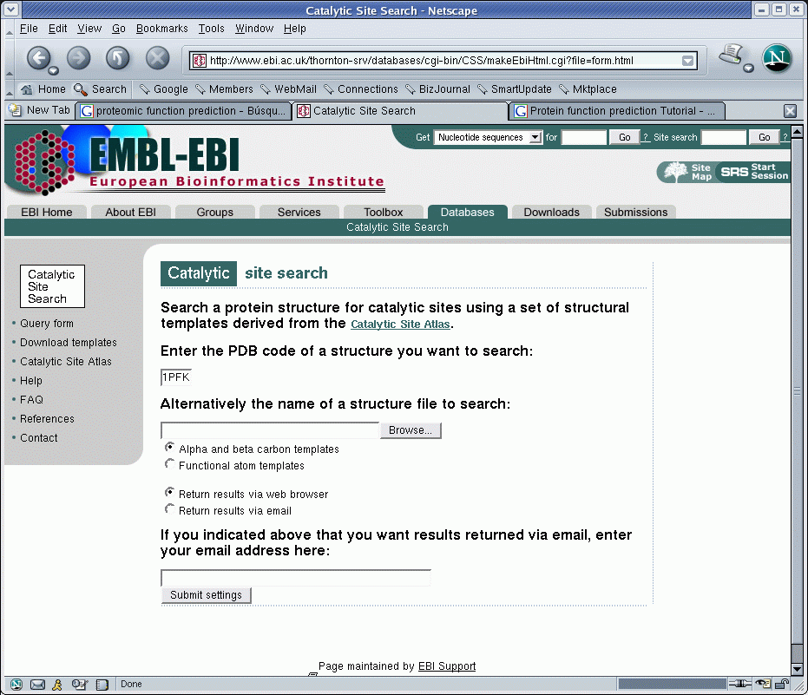
Catalytic Site Atlas

Slide 52
Predicting interactions
ZINC contains over 13 million purchasable compounds in ready-to-dock, 3D formats
  http://zinc.docking.org/
Many more:
    http://dtp.nci.nih.gov/docs/3d_database/dis3d.html
    http://pubchem.ncbi.nlm.nih.gov/
    http://bioinformatics.charite.de/superdrug/
    And more...

Slide 53
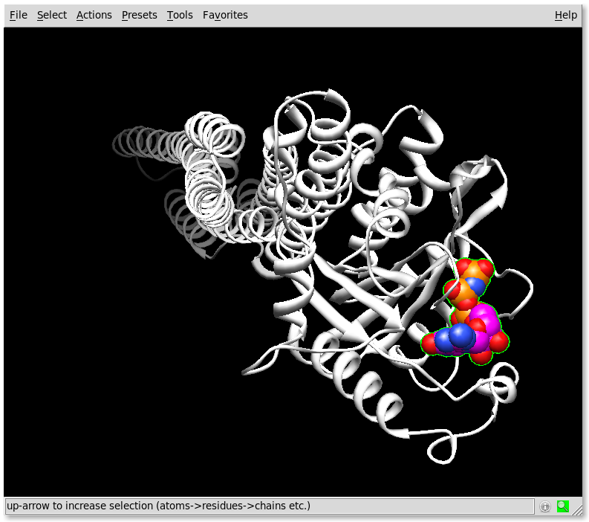
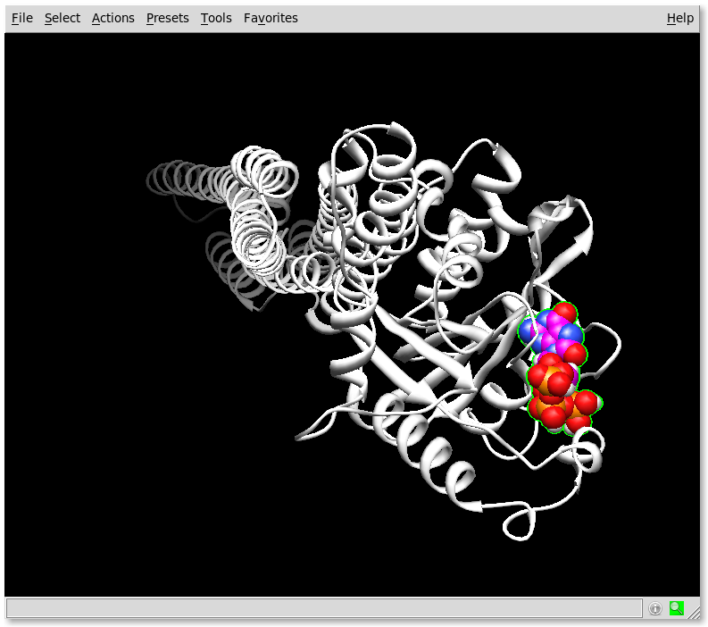
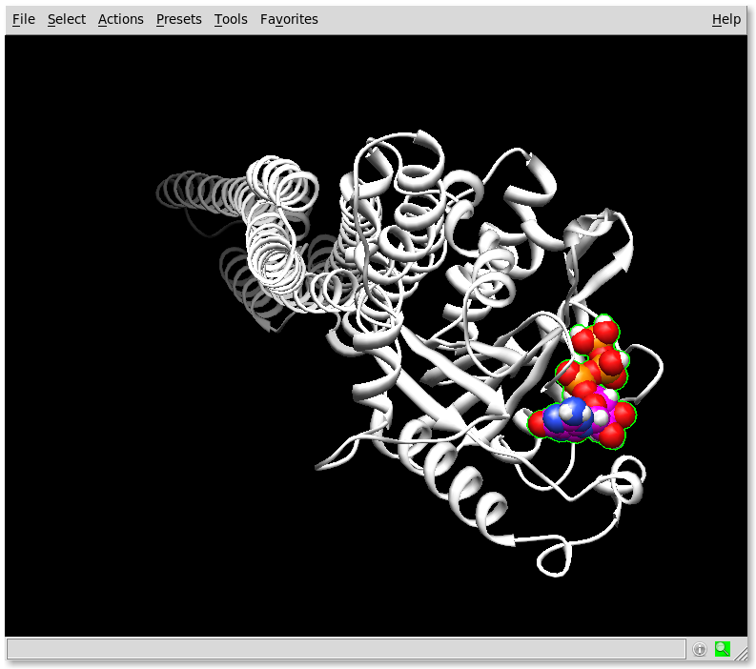
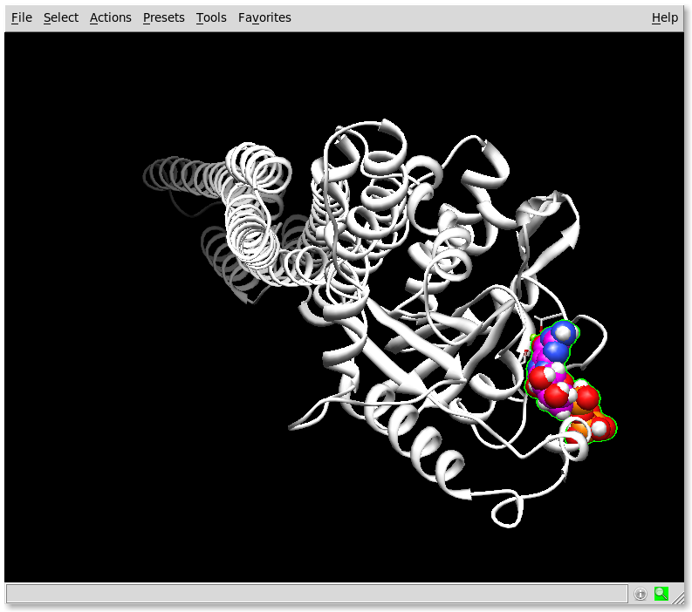
Docking example
Autodock
Dock6
3D-Dock
Gramm
etc...
1f5n + 8oxoGTP (max E)
1f5n + GTP
1f5n + 8oxoGTP (max H)
1f5n + 8oxoGTP (max Grid)

Slide 54
High throughput prediction
Phylogenetic profiles
QSAR screenings
Interaction networks
Analysis of interaction maps in proteomes
A field in active development.

Slide 55
Advice
Start from the sequence:
  ProSite, Blocks, PRINTS, Pfam, InterPro
Try structure
  predict if not available
  2D: PredictProtein, transmembrane, PTMs, etc...
  3D: PFPS, CSA...
Resort to context and interactions
  QSAR...

Slide 56
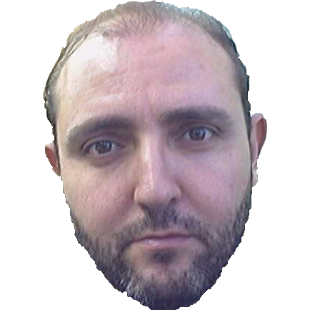
In any case
Ask you local bioinformatician.
'Cos you have one, don't you?

Slide 57
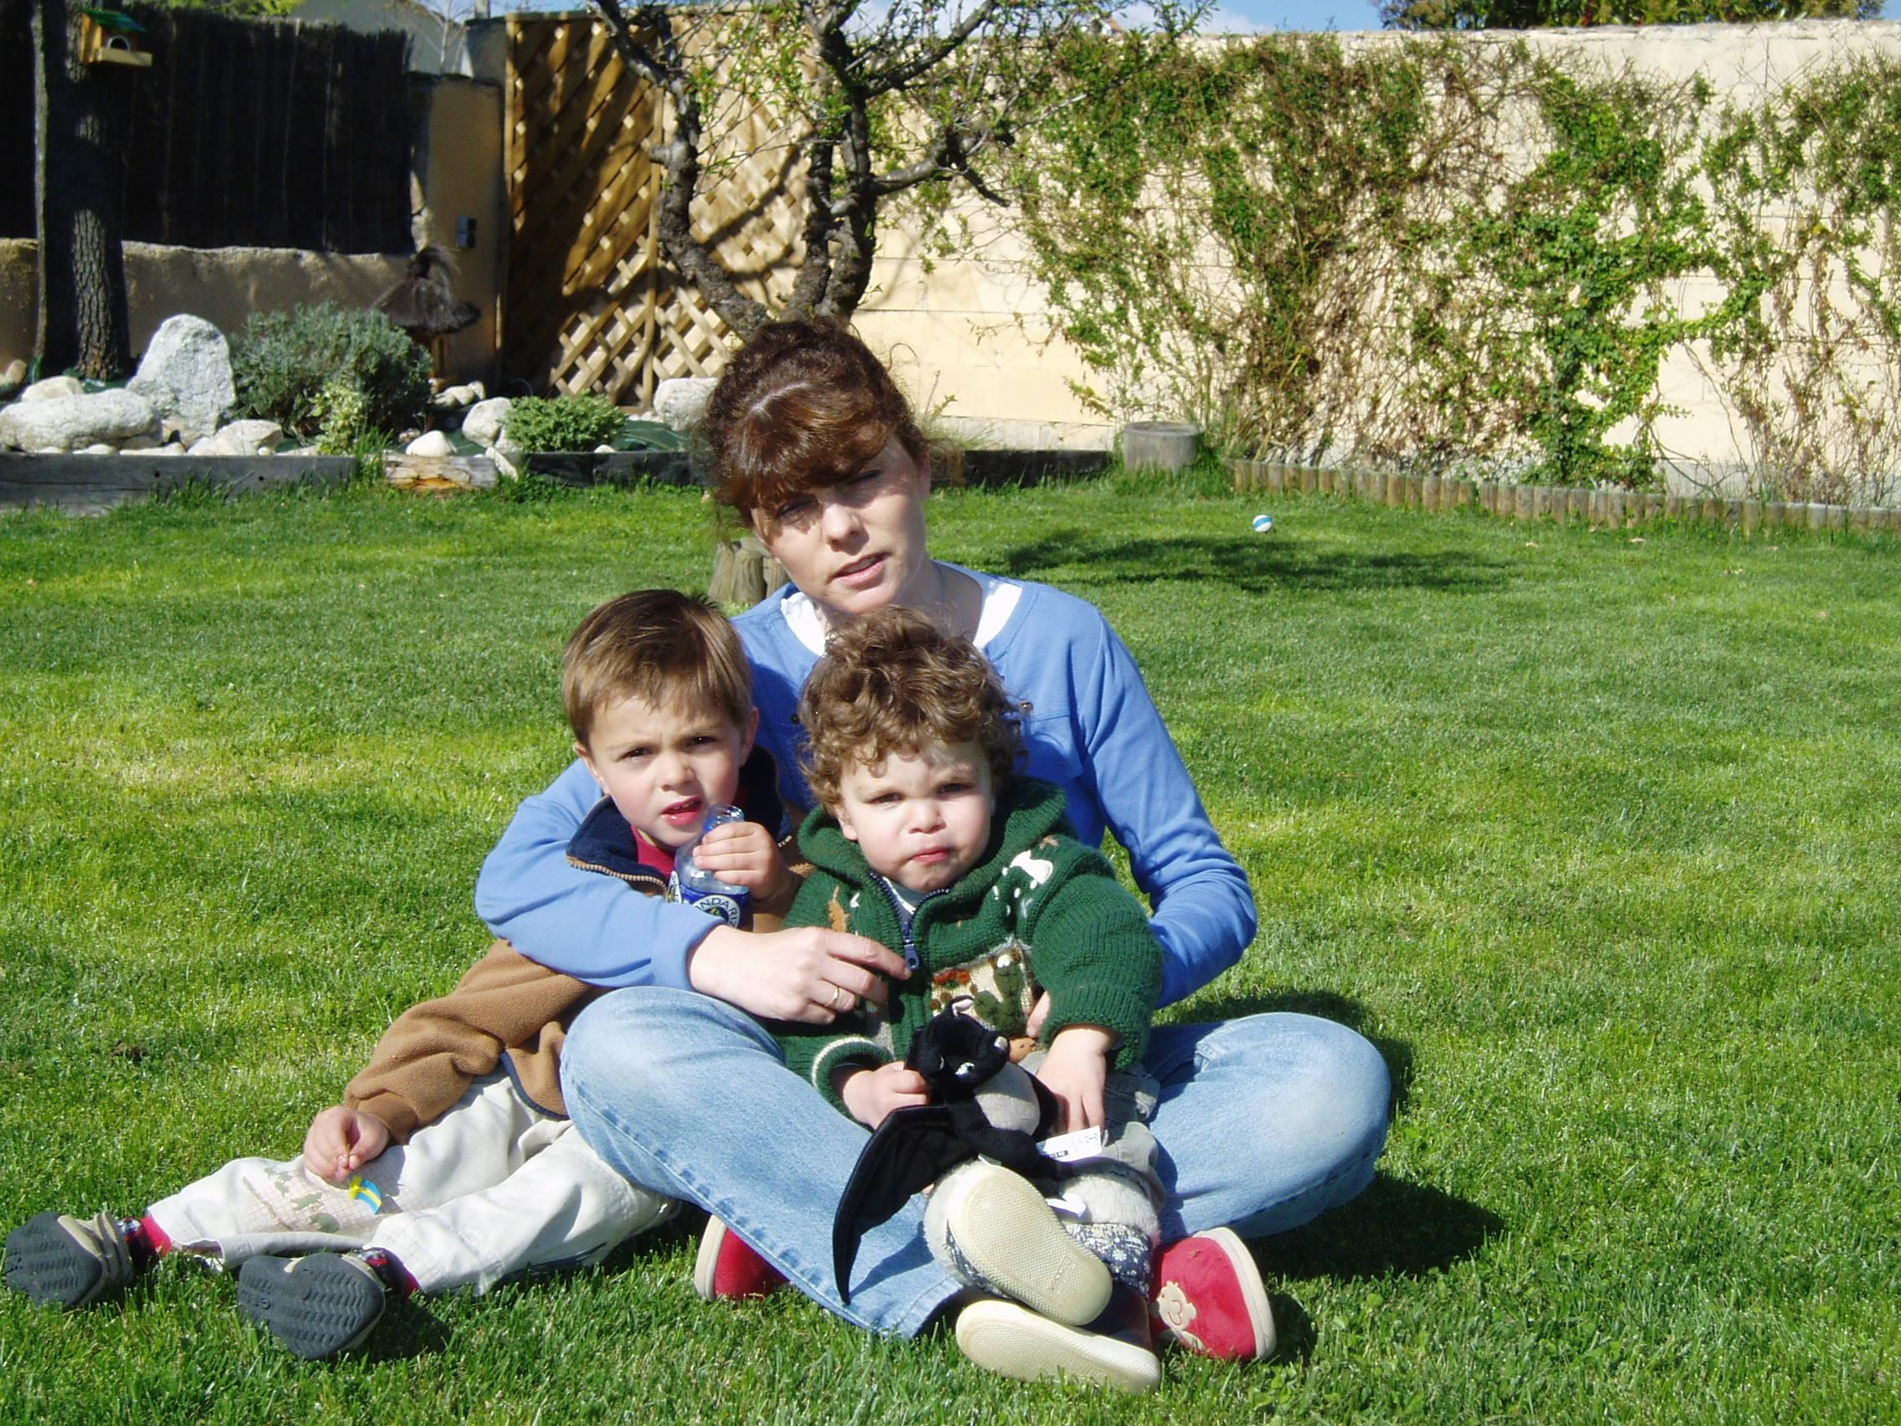
Thanks
To SEPROT
  for remembering this old guy
To you all
  for coming
  and staying
  awake

