Slide 1
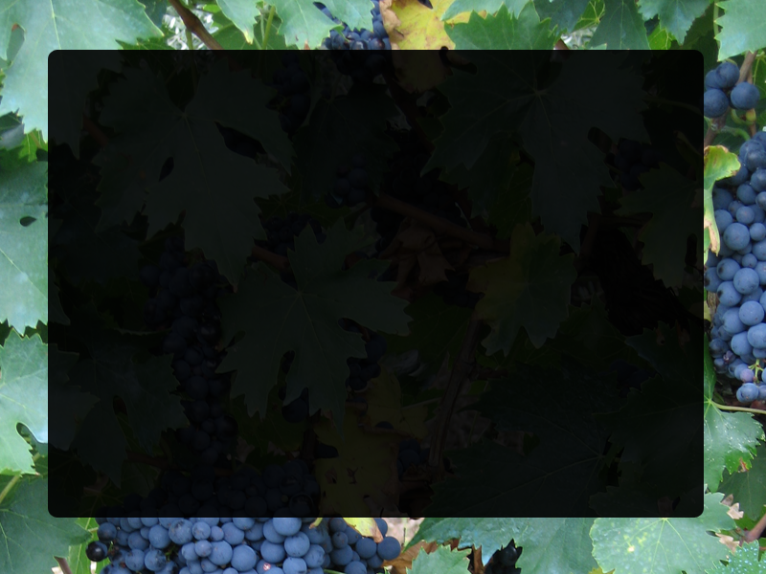
Solid Rock
José R. Valverde
Scientific Computing
CNB/CSIC
jrvalverde@cnb.csic.es
CC-BY-NC-SA

Slide 2
Making Movies: Chimera
Basic commands
Spin/rock
Center
Increase quality
Creating animations
Volume rendering
Morphing

Slide 3
Making it simple
Open chimera
  Load molecule(s)
  Tools → Utilities → Movie recorder
    Record
    Move molecule
    Stop
    Make movie

Slide 5
Automatic movement
Favorites → Command Line
  turn y 3 120
Tools → Utilities → Movie recorder
  Record
  Press enter on command line
  When done press Stop and Make Movie

Slide 7
Basic commands
You can use several commands separated by a ';'
  movie record
  movie stop
  movie encode
General form: movie action options
  movie record directory dir1/dir2/. supersample 3 size w,h raytrace true
  movie encode mformat mp4 output mymv

Slide 8
Automatic recording
The problem lies in hand switching
Let us use the command line:
  movie record ; turn y 3 120 ; wait; movie stop
  movie encode output mymovie

Slide 10
Controlling movement
You can use any visualization command between movie commands
Remember to wait for a long command to finish before issuing the next
Try rocking instead of spinning
  movie record; rock y 3 68; wait; rock x 3 68; wait; movie stop; movie encode output mymovie.mov

Slide 12
Control animation
You can use any visualization command
  On the menu
  On the command line
Better if you define layout first
  Change window size
  Presets → Interactive 1
  Select → residue
  Actions → set pivot...

Slide 14
Control animation (2)
windowsize 640 480
preset apply interactive 1
cofr :GLN
movie record ; rock y 3 68 ; wait ; rock x 3 68; wait ; movie stop ; movie encode output mymovie.mov
You can put everything in a script file .cmd and load it with File → open

Slide 15
Notes:
# You can add comments starting lines with a #
# set window size
windowsize 640 480
preset apply interactive 1
cofr :GLN
movie record
rock y 3 68
wait
rock x 3 68
wait
movie stop
movie encode output 06-script.mov

Slide 16
Improving quality
  Record with supersampling (e.g. 3): draw at a bigger size and resize down
    movie record supersample 3
  Record at desired size
    movie record size 640,480
  Increase output bit rate for a given window size, 640x480: 200 (low), 1000 (medium), 6000 (high)
    movie encode bitrate 10000
  Use appropriate encoding (e.g. mov, mp4)
  Add fill frames

Slide 17
Notes:
# set chimera window size
windowsize 640 480
# select preset colored ribbons display
preset apply interactive 1
# set GNP as center of frame rotation
cofr :GNP
# do movie
movie record supersample 3
# start with 10 fill frames
wait 10
rock y 3 68
wait
rock x 3 68
wait
# end with 10 fill frames
wait 10
movie stop
#movie encode bitrate 10000 output 07-quality.mov

Slide 18
Raytracing
Very slow, may hang GUI for > ~200 frames
Produces a POVray file for each frame and renders it using POVray
windowsize 640 480
~ribbon
show :GLN
repr sphere
color byelement
reset
set bg_color black
movie record supersample 3 raytrace true
wait 10 ;rock y 3 68; wait; rock x 3 68; wait; wait 10
movie stop
movie encode mformat mp4 bitrate 10000 output 08-raytrace.mp4

Slide 19
Notes:
open 1f5n.mol2
open 1f5n-L.mol2
# set window size
windowsize 640 480
# remove ribbons display
~ribbon
# remove remaining receptor atoms/bonds
~show #0
# select ligand
show :GNP
# center and resize
reset
# make ligand ball-and-stick
repr bs
# add surface
surface :GNP
# color by element
color byelement
# add transparency to surface
surftransparency 30 :GNP
# set background color
set bg_color black
movie record supersample 3 raytrace true
wait 10
rock y 3 60
wait
rock x 4 30
wait
turn y 3 120
wait
wait 10
movie stop
movie encode bitrate 10000 output 08-raytrace.mov

Slide 20
Animation
Start by marking all needed positions:
  savepos start
  center :GLN; savepos centered
  ~select 0; move x 30; move y 40; turn x 90; select 0; savepos unbound
Chimera moves among positions with reset. If more than one frame is requested, linear interpolation will be used.

Slide 21
Prepare world
Select initial position
Select conformation/display
Add labels:
  2dlabel create title “XX” xpos 0.3 ypos 0.9 color white
Select background color
  set bg_color gray
etc...

Slide 22
You can do anything...
While recording:
  Add/remove surfaces
  Fade in/out objects
  Identify Hydrogen bonds
  Color by any criteria
  Change display modes (CPK, surface..)
  Anything!

Slide 23
Getting it done
Work on a script
  Prepare positions
  Set up initial scene
  Comment out (#) movie record
  Keep on adding commands until OK
  Add movie stop; movie encode
  Uncomment movie record
Load script

Slide 24
Notes:
# set window size
windowsize 640 480
# open receptor (#0) and ligand (#1)
open 1f5n.mol2
open 1f5n-L.mol2
# set receptor to look nice
preset apply interactive 1
# set ligand in ball and stick
repr bs :GNP
# increase subdivision quality for smoother ribbons
set subdivision 5
# name this position
savepos closer
center :GNP
savepos centered
reset closer
# zoom out, move molecule to corner, name position
scale 0.7
move x -20
move y -10
savepos corner
# unselect receptor, move and rotate ligand, reselect
~select 0
move x 30
move y 40
turn z 90
turn x 90
select 0
savepos unbound
# write label
#set bg_color gray
2dlabel create title text "1F5N bound to GTP" xpos 0.3 ypos 0.92 color white
# start recording
movie record
# move from unbound to corner position along 50 frames using linear interpolation
reset corner 50
wait
# get closer over 25 frames with interpolation
reset closer 25
wait
# center around GNP
reset centered 25
wait
# hide label using 25 frames
2dlabel change title visibility hide frames 25
# show hydrogen bonds
scale 1.03 25
wait
hbond intermodel true intramodel false color yellow linewidth 5
roll y 0.5 50
wait
roll y -0.5 50
wait
roll x 0.5 50
wait
roll x -0.5 50
wait
# show receptor surface highlighting aromatic rings
surface #0 ; color white #0; surftransparency 100 #0
# reorient
turn z 3 30
wait
# Fade in surface (make it visible)
surftransparency 0 #0 20
# now that the surface is visible we can color the aromatic rings
color blue aromatic ring
# return and zoom out
rock y 3 150
wait
rock x 3 150
wait
scale 0.98 50
wait
# wait an extra second
wait 25
# done
movie stop
movie encode mformat mp4 output 10-binding.mp4 bitrate 6000

Slide 25
Volume rendering
You can also animate volumetric data
  e.g. from EMSD:1321
    open #0 emdbID:1321
    volume #0 level 127
    volume #0 color yellow
    movie record
    rock x 3 68; rock y 3 68
    roll 1,1,0 3 68
    movie stop; movie encode

Slide 26
Notes:
#
# Make a movie viewing a volume
# two orthogonal axes are shown.
# Fetch Herpes virus map from EMDB.
open #0 emdbID:1321
# Save local copy of map.
volume #0 save emdb_1321.mrc
# Set nice looking threshold level.
volume #0 level 127
# Make volume color yellow
volume #0 color yellow
# Make background color gray
set bg_color dimgray
# zoom out a bit
scale 0.7
# Set window size in pixels
windowsize 512 512
# Start recording movie
movie record supersample 3
wait 10
rock x 3 68
wait
rock y 3 68
wait
roll 1,1,0 3 68
wait 10
movie stop
# Encode movie
movie encode output emdb_1321.mov bitrate 6000

Slide 27
Morphing
You can morph among different structures too:
  morph start #0.1
  morph interpolate #0.2
  …
  morph interpolate #0.10
  morph movie
  movie record
  coordset #1 1, ; wait; movie stop; ...

Slide 28
Notes:
open 1m5l.pdb
morph start #0.1
morph interpolate #0.2
morph interpolate #0.3
morph interpolate #0.4
morph interpolate #0.5
morph interpolate #0.6
morph interpolate #0.7
morph interpolate #0.8
morph interpolate #0.9
morph interpolate #0.10
morph interpolate #0.11
morph interpolate #0.12
morph interpolate #0.13
morph interpolate #0.14
morph interpolate #0.15
morph interpolate #0.1
morph movie
~show #0
color byelement
ribbon #1
ribrepr round #1
windowsize 384 512
scale 2
movie record
coordset #1 1,301
wait 310
movie stop
movie encode output ~/Desktop/1m5l.mov bitrate 6000

Slide 29
Morphing example
Fetch by ID: PDB:1az6
Tools → Structure comparison → Morph conformations
Add → Add all variants, then add again variant #1
Action on create → Hide conformations
Create
Play

Slide 32
That's all, folks!
Questions?

