Slide 1

Quantum Mechanics
José R. Valverde
EMBnet/CNB

Slide 2


Introduction
A molecule is not a string/network of atoms
  It is a cloud of electrons in a field of nuclei
  Molecular orbitals
QM deals with electrons and nuclei
  May account for bond-breaking / formation
  Explore the fine structure of species
  Explores electronic behaviour (excited states)
Quantum Dynamics may explore system evolution in time

Slide 3
The wave equation
A particle is a wave is a particle is a wave is...
The core of QM is Schroedinger's equation
HΨ = EΨ
Ψ is a continuous natural function (3D [+ time]) in all the space
In practice we have a system of equations with many Ψ for many E levels
Given Ψ we can compute observables
  Observable = ∫ Ψ* Operator Ψ dτ / ∫ Ψ* Ψ dτ

Slide 4
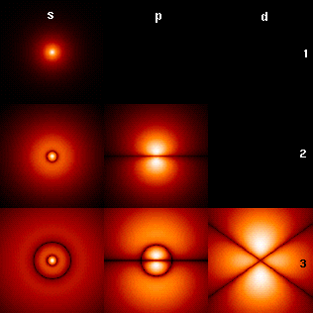

Atomic orbitals: H
Schroedinger equation can be solved for H (1s¹)
  Electrons are in orbitals
  Orbitals are probabilistic electron density clouds
    Higher probability regions have a higher charge density

Slide 5

Atomic orbitals: polielectronic
We consider each electron separately:
  With its own wave function Χ_{i}
  The total wave function is Ψ = Χ_{i} Χ₂ ··· Χ_{n}
  Electrons have spin (½ -½, α β)
    He: 1s² = 1s^{α} 1s^{β} → Ψ = Χ^{α} Χ^{β}
    Pauli's exclusion principle: if we exchange two electrons the function must change sign
      Rewrite the equation as a determinant to account for all combinations and normalize with 1/√n!
      Simplify notation as Ψ = Χ1 Χ2 ... Χn

Slide 6
Solving the equation
Assign a value to orbitals (e. g. STO functions defined by Hartree and simplified by Slater)
Apply the variational principle:
  As the function gets better, the energy will be lower
Orbitals should be ortonormal
    ∫ ΧiΧj dτ = 0 if i ≠ j
  But as we use approximations we must account for overlap integrals:
    ∫ ΧiΧj dτ = Sij

Slide 7
Molecular orbitals
The total wave function for the molecule will be again the product of individual electron wave functions
Ψ = Φ1Φ2...Φn
Invidual orbital wave functions are computed from atomic orbitals Χ_{k} as a LCAO
Φ_{i} = ∑_{k} c_{ik}Χ_{k}
We know Χ_{k} so we need to find c_{ik}
  Use variational principle

Slide 8
Computing Ψ
We have
  Ψ = Φ₁Φ₂...Φ_{n} (a normalized determinant) where Φ_{i} = ∑_{k} c_{ik}Χ_{k}, with Χ_{i} known and the only unknowns are c_{ik}.
  Can be written as a system of equations
    In matrix form
    We can solve the system of equations to find c_{ik}
  Born-Oppenheimer approximation
    Nuclear movement is too slow w.r.t. Electrons
    Nuclear movement effects can be ignored.

Slide 9
The Self Consistent Field
We can exploit the variational principle:
    Start we a guess for c_{ik}
    Substitute guessed values into the set of equations
    Compute energy
    Use this energy to define a new set of values for c_{ik}
    Continue until the set of values stabilizes (becomes self-consistent)
Problems
    There are factors we haven't considered
    We start from approximations to atomic orbitals

Slide 10
Relativity
In general we ignore it
  Its effects are negligible for most biological atoms/molecules
Relevant for heavy atoms
  External electrons repel internal electrons towards the nucleus
  Inner electrons speed increases and becomes relativistic
  Cr, Fe, Zn... owe relevant properties to relativity

Slide 11
Basis sets
LCAO: MOs as a linear combination of AOs
  Φ_{i} = ∑_{k} c_{ik}Χ_{k}
Χ_{k} are represented by approximate functions:
  Basis functions/basis set
STO: spherical harmonics
  Good for diatomics and semiempirical methods
GTO: Gaussian curves
  Bad close and far from nucleus
  Can be enhanced by sums of gaussians

Slide 12
Common Basis sets
STO-3G
  Minimal basis set
3-21G:
  core is a contraction of 3 PGTOs, valence is divided in two parts, one uses 2 PGTOs and the other 1 GTO
  Similar to STO-3G but uses double PGTOs in the valence section
6-31G
  Similar to 3-21G but higher precision

Slide 13
Common basis sets
6-311G
  Splits valence in three levels, with 3 PGTOs for inner valence orbital and two levels for variation
6-311++G(3d,2p)
  6 PGTOs for contracted (compute once) core
  3 GTOs for inner valence
  2 additional valence levels
  2 diffusion functions (++)
  3 polarization functions for d orbitals and 2 for p orbitals

Slide 14
Ab initio methods

Slide 15
Hartree-Fock
SCF or HF uses the variational principle as described. N⁴
RHF: use same orbitals irrespective of spin
  Good for full occupancy (singlet)
UHF: different orbitals for different spins
  Good for unpaired electrons (doublet..)
  Spin contamination
ROHF: compute spins separately by force same orbitals
Recovers 99% of the energy

Slide 16
Electron correlation
Electron clouds do not consider correlation
Picture a single voxel:
  There is a probability that two electrons will be there simultaneously at any time
  But it is unlikely as they repel each other
  Electron movement is correlated
Including correlation increases precision
  But takes more time

Slide 17
Localized methods
As we have seen we move in N⁵-N⁸
Most interactions are mainly local
  Consider only local contributions of atomic orbitals to MOs
  Used for MP and CC
  May scale linearly

Slide 18
Semiempirical methods

Slide 19
Semiempirical methods
Based on valence bond
  Substitute known values to speed up calculus
    From experimental data (includes correlation)
    From previous ab initio calculations
  Hückel
    Very simple, imprecise, good start guess
  NDO: neglect of differential overlap
    CNDO (complete neglect of differential overlap)
    MNDO (modified neglect)
    AM1 (Austin Model 1)
    PM1, PM2, PM3... PM6 (Parameter model n)

Slide 20
As a rule
CNDO < MNDO < AM1 < PM3 < PM6

Slide 21
Density Functional Theory

Slide 22
The basics
Energy may be computed from electron density (Hoenburg and Kohn) using a functional
  A function that takes functions as arguments
Density may be computed as a linear combination of orbitals (Kohn and Sham)
We need to identify the function of density that is to be feeded the functional to compute the energy

Slide 23
Applications

Slide 24
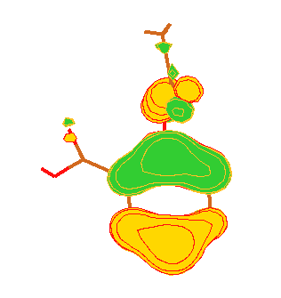
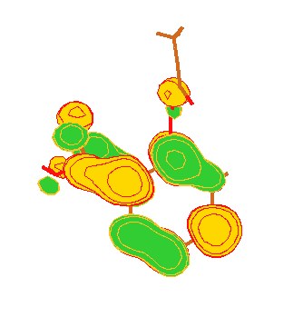
Electronic structure
Orbitals
HOMO (highest occupied)
  nucleophiles
LUMO (lowest unoccupied)
  electrophiles
Frontier orbital theory

Slide 25
Population analysis
Charge distribution in space
Assignment to nuclei (atoms)
  Theory of atoms in molecules
  Partial charges
  Bond order
Mulliken
Lowdin
NBO

Slide 26
Charge distribution
Simplifications:
  Dipoles
  Multipoles
  Used in QSAR
Electrostatic field
  Map over VdW surface
  ESP
ChelpG method

Slide 27
Other properties
Structure
Molecular size and dimensions
Energy and tensions
  Vibration states (phonons)
  Forces for MD simulations
Electroaffinity
Additive properties (to build molecules)...

Slide 28
Reactions
Saddle point calculations
Transition state calculations
IRC (Internal reaction coordinates)
Reaction coordinate path

Slide 29
QM/MM QM/MD QD
QM/MM
  Minimize complex structures
QM/MD
  Model dynamical behavior of complex structures
    Interest region modeled by QM
    Rest modeled by MD
    Border region needs special treatment (ghost atoms)
    ONIOM, Carr-Parrinello
QD
  Full quantum dynamical modeling

Slide 30
In practice
Select a basis set approximation to AOs
Select a method to compute MOs
  Ab initio
  Semiempirical
Build model
Launch program
Wait...

