Slide 1

Molecular Modeling with
Ghemical
José R. Valverde
EMBnet/CNB
Nov. 2011

Slide 2
What is/are Ghemical?
A molecular modeling tool with a GUI that allows Molecular Mechanics and Quantum Mechanics simulations
http://bioinformatics.org/ghemical/
  Molecular Mechanics/Dynamics (Tripos FF)
  Semi-empirical QC (Mopac): mopac7.sf.net
  Ab initio QC (MPQC) www.mpqc.org
Windows version with GAMESS-US support
  www.uiowa.edu/~ghemical/

Slide 3
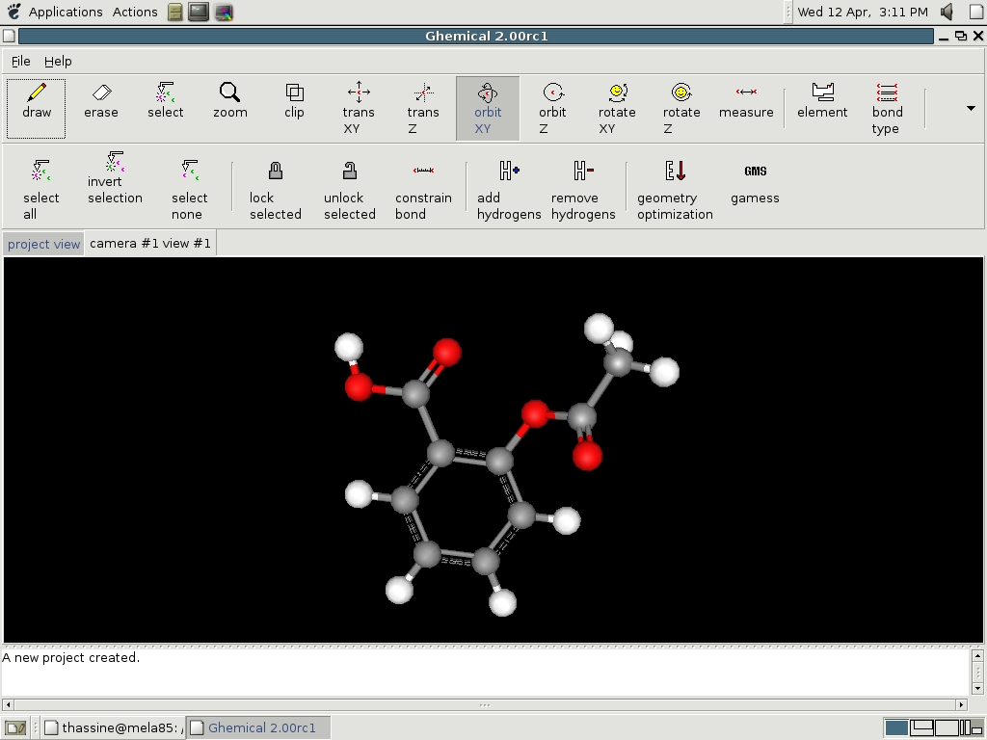
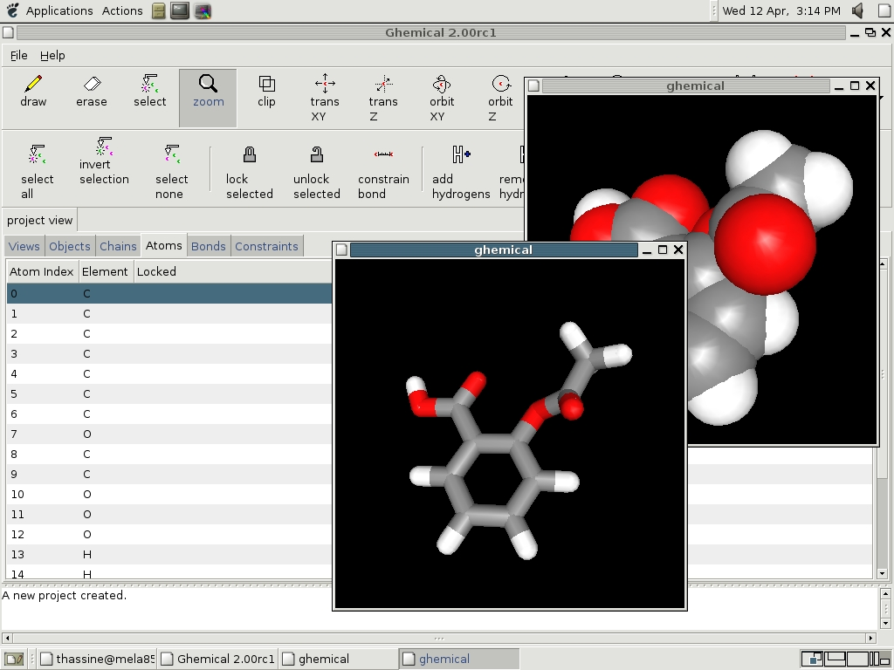
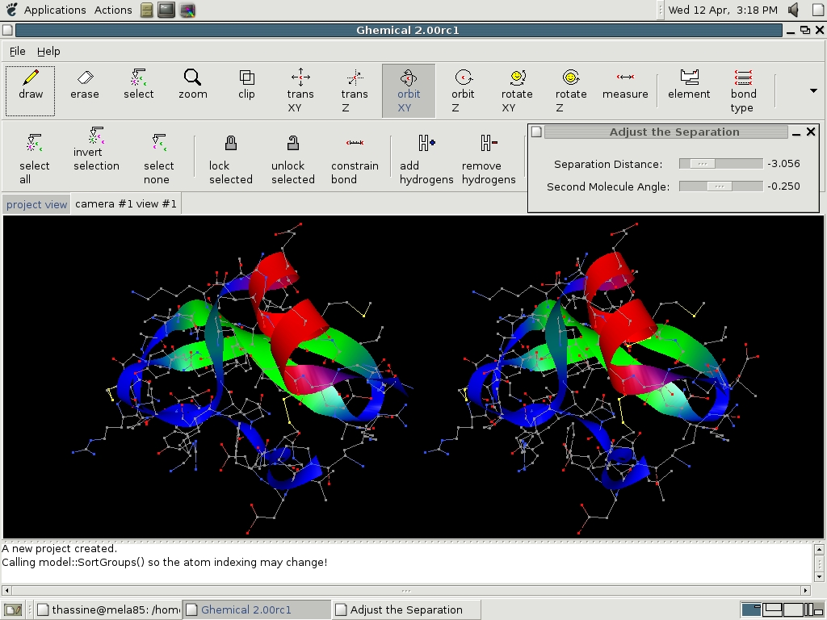
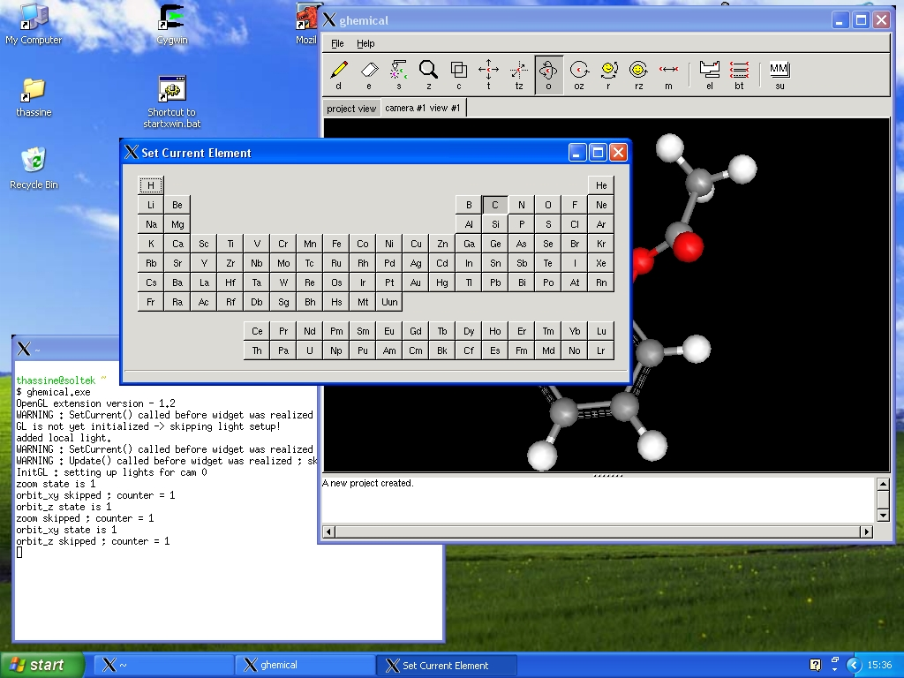

Slide 4
Avogadro
Avogadro.openmolecules.net
A derivative of Ghemical
  Cross-platform
  Fast
  Extensible
  Support for other QM packages as plugins

Slide 5
Overview
Perform MD simulations using built-in engine
Perform semi-empirical calculations
  Dinucleotide
  Tetraloop
  Unfold alpha helix
Perform ab initio calculations
  aspirin
Visualize results

Slide 6
Dinucleotide
Launch Ghemical
With right mouse button bring pop-up menu
  File → Import
    Open is only for ghemical files!
  Open adenlyladenylate.pdb
Run Molecular Dynamics simulation
  Right mouse button → context menu → Compute → Molecular Dynamics

Slide 7
MD simulation
Default simulation covers all standard steps:
  Heating (5000 steps)
  Equilibration (5000 steps)
  Simulation (18000 steps)
  Cooling (2000 steps)
Default time step is 0.5 femtoseconds
Default T is 300 K
Default P is 1 bar
Choice of Constant-T, P or both
Only explicit solvent (Build → Solvate Box/Sphere)

Slide 8
Tretaloop Hairpin
Open gcaa.pdb
  Right mouse button → Build → Zap all
  Right mouse button → File → Import
Run a molecular dynamics simulation
  How long does it take?
Cancel when you are tired of waiting
For large simulations it is better to use specialized tools
  GROMACS

Slide 9
Unfold alpha helix
Open polyala10helix.pdb
  Right mouse button → Build → Zap all
  Right mouse button → File → Import
Run simulation at 1000 C
Reload molecule and run simulation at 300 K
Reload molecule and run simulation at 6000K
  Did you see anything abnormal? No?
  The default time step of 0.5fs is good enough for most simulations.

Slide 10
A saucerful of secrets
Set the controls for the heart of the sun (Pink Floyd, 1968)
Molecular dynamics does not handle bond-breaking or forming. I. e. it does not handle Chemistry.
To deal with Chemistry we need a Quantum Mechanics approach
  Analyze electronic structure
  Analyze dynamical behaviour

Slide 11
Aspirin
Load Wikipedia:aspirin in your browser
Load aspirin.pdb
  Right mouse button → Build → Zap all
  Right mouse button → File → Import
Set up computation method
  Right mouse button → Compute → Setup...
  All QM...
    Mopac MP3

Slide 12
As a rule
CNDO < MNDO < AM1 < PM3 < PM6

Slide 13
Optimize Geometry
Select Geometry Optimization
  Right mouse button → Compute → Geometry Optimization...
Watch as energy decreases and structure is refined
Compute molecule energy
  Right mouse button → Compute → Energy
Display Electron Density
  Right mouse button → Objects → Volume rendered ESP

Slide 14
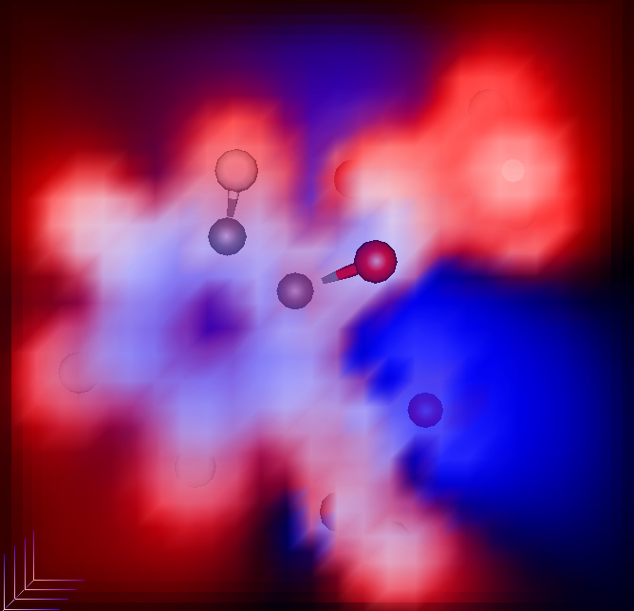

Slide 15
Predicting reactivity
Electrostatic potential planes can be used predict the location of an electrophilic attack. An electrophile will typically attack in areas near an electrostatic potential minimum, which are colored blue.
Does it match what you'd expect?
HOMO/LUMO theory
HOMO can give electrons
LUMO can take electrons

Slide 16
HOMO/LUMO
Orbital count in Ghemical starts at zero
HOMO is orbital 33
  Right mouse button → Objects → Delete current object
  Right mouse button → Set current orbital
    Change X to 33
  Right mouse button → Objects → Molecular orbital volume / MO density volume
LUMO is orbital 34
  Same as above but change X to 34

Slide 17
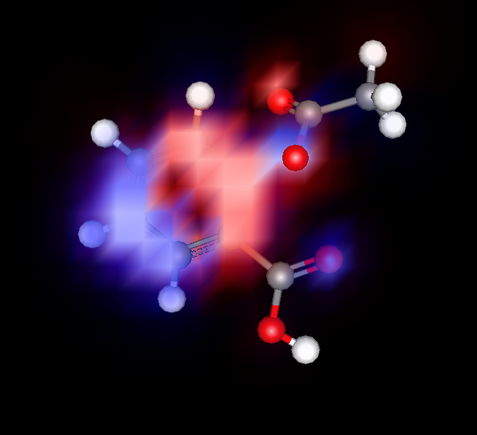
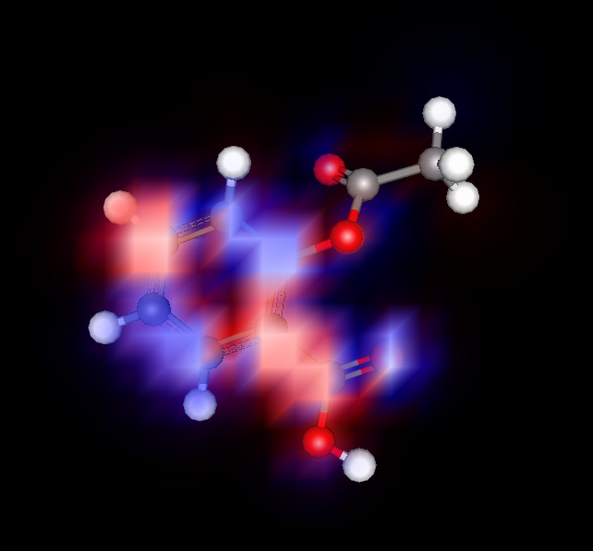
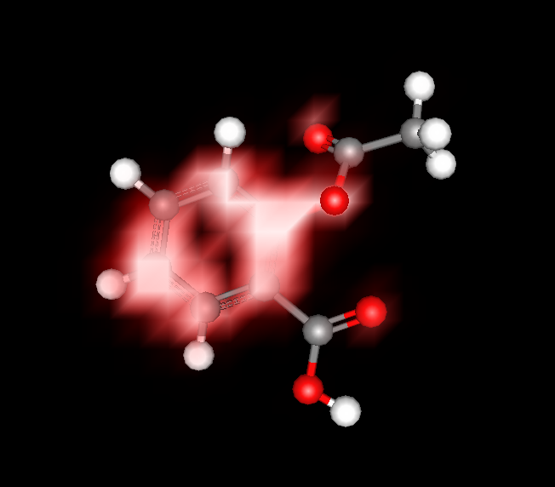
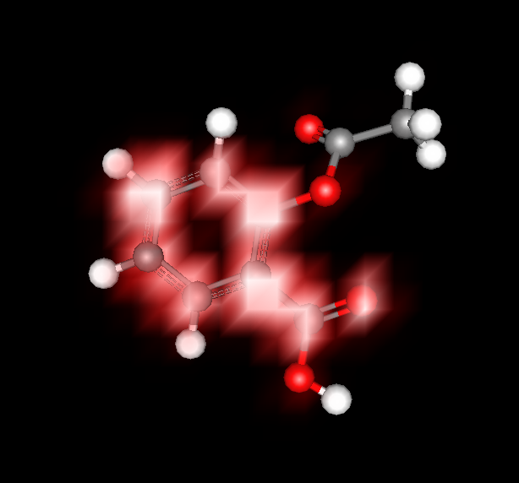

HOMO
LUMO

Slide 18
Increasing precision
Semi-empirical calculations often result in “approximate results”
Semi-empirical calculations cannot work with non-parametrized atoms
For increased accuracy use full ab-initio methods
  STO-3G: minimal basis set
  6-311G**: standard basis set
  Corrections for e-e interactions (MP2, CI, CC,...)

Slide 19
As a general rule
HF << MP2 < CISD < MP4(SDQ) ~ CCSD < MP4 < CCSD(T) < CCSDT

Slide 20
Comparing results
Reference ground state
  Ab initio: all electrons and nuclei separated by infinite distance
  Semi-empirical: consider only valence shell electrons, separate atoms an infinite distance
    Should yield heat of formation
    Equivalent to semi-empirical minus a contant
Differential results can be compared
Direct results cannot be directly compared

Slide 21
Simulating reactions
Find transition state
Work out transition state, reactants and products
  Intrinsic Reaction Coodinate (IRC)
    Transition State Search
    Follow IRC forward and backward
  Dynamic Reaction Coordinate
    Molecular Dynamics with energy conservation
Build energy landscape
Carr-Parrinello Molecular Dynamics

Slide 22
Method Time
Molecular Mechanics N²
Molecular Dynamics N²
Hartree-Fock (HF) N² - N⁴ (depending on symmetry and cutoff use)
MP2 N⁵
MP3, MP4 N⁶
MP5 N⁸
CC2 N⁵
CCSD N⁶
CISD N⁶
CASSF A! (depends on the number of orbitals)
CI complete N!
Semiempirical methods N² (for small systems)
Semiempirical methods N³ (for large systems)
DFT N³
DFT with linear scaling algorithms N
Note: adapted from Computational Chemistry: A Practical Guide for applying Techniques to Real-World Problems. David C. Young. Wiley & Sons. 2001.

Slide 23
Increasing speed
Use Semi-empirical methods
Use DFT
Use parallel programs on clusters
  MPQC
  NWchem
Use modern methods
  MOPAC/MOZYME
  Siesta
Combine QM/MM
  NWchem, Gromacs, Ego VIII, etc...

Slide 24
The magic recipe
Quantum Chemistry is computationally intensive
Be careful when preparing data
Pay attention to detail
Document everything minutely
Be patient
Be patient
Be patient

Slide 25
Questions?

